Slide 1
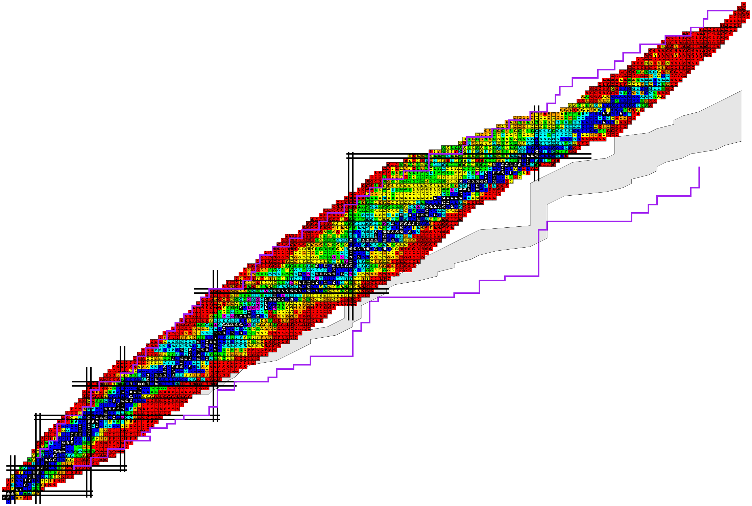

A novel way to study nuclear giant resonances with vortex gamma photons
Workshop on “Vortex states in nuclear and particle physics”,
Zhuhai, Guangdong, April 24th-28th, 2024
Yifei Niu
MOE Frontiers Science Center for Rare Isotopes
School of Nuclear Science and Technology
Lanzhou University

Slide 2
Outline
Introduction
Nuclear Giant Resonances studied by QPVC approach
Nuclear Giant Resonances excited by vortex photon
Summary and Perspective

Slide 3
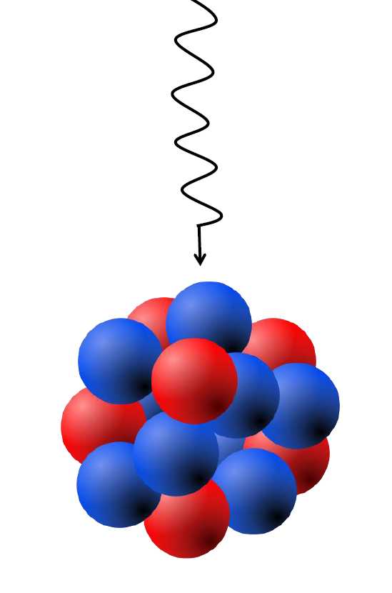
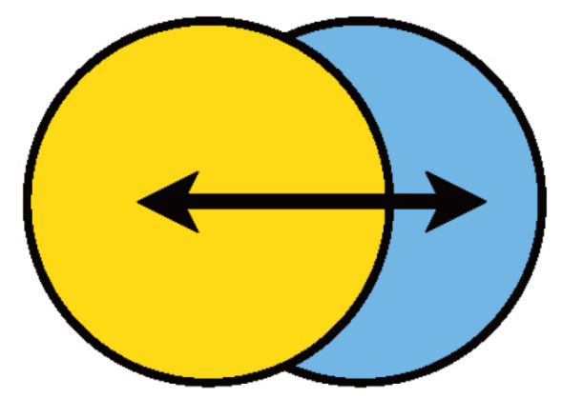
Nuclear Giant Resonances
Giant Dipole Resonance in ¹⁶O
γ
R. Bramblett, Phys. Rev. 133, B869 (1964)
Characteristics
Broad resonance width ~ 5 MeV
Larger transition probabilities than s.p.
Excitation energy varies slowly and smoothly with mass number

Slide 4
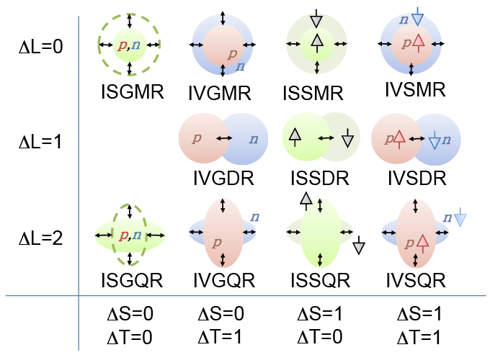
Different modes of giant resonances
IS = Iso-Scalar
IV = Iso-Vector
S = Spin
G = Giant
M = Monopole
D = Dipole
Q = Quadrupole
reactions:
(α, α’ ), (p,p’) …
(γ, γ’),
(γ, n) ,
(e, e’) …
L : orbital angular momentum S: spin T: isospin

Slide 5
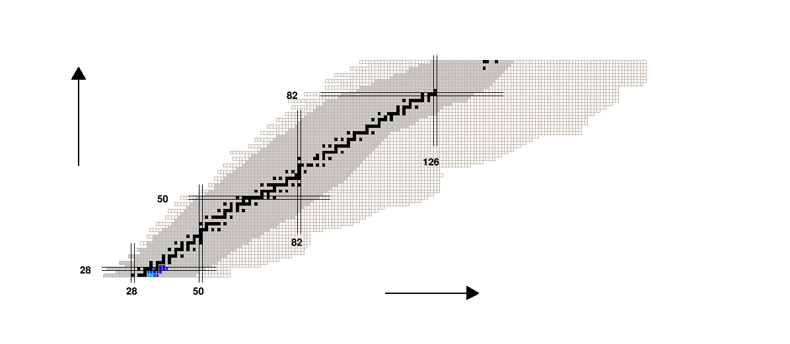
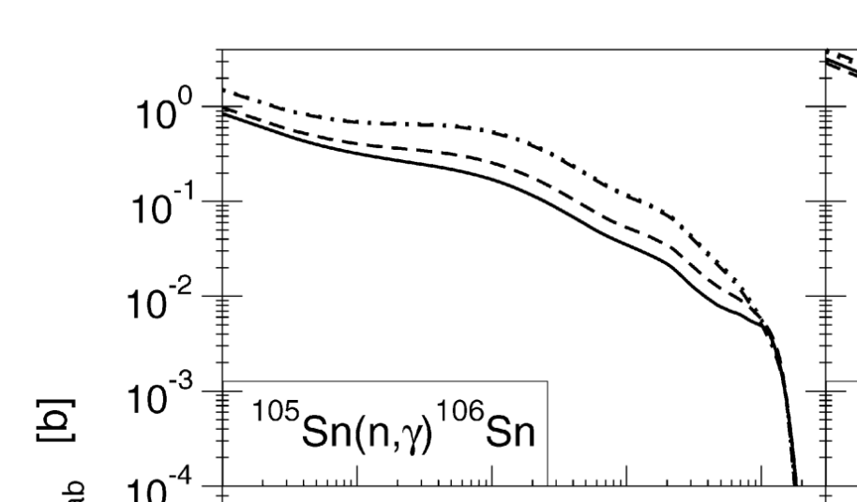
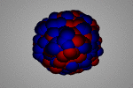
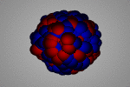
Giant Resonances Provide Insight to
How were the heavy elements from iron to uranium made?
r-process
A. C. Larsen et al., Prog. Part. Nucl. Phys. 107, 69 (2019)
β decay
Neutron capture
E. Litvinova et al., NPA 823, 26 (2009)
What is the equation of state (EOS) of nuclear matter?
Giant monople resonance (GMR)
Giant dipole resonance (GDR)
Nuclear incompressbility K
Symmetry energy slope L
Garg and Colo, PPNP 101, 55 (2018)
Roca-Maza and Paar, PPNP 101, 96 (2018)

Slide 6
Schematic picture for collective excitations

Slide 7
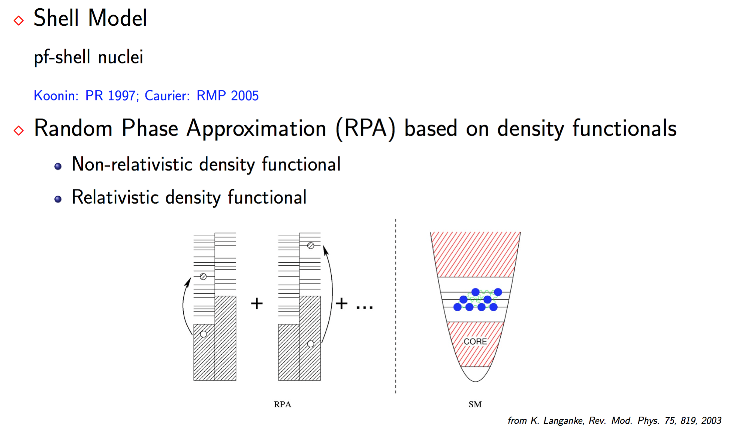
Microscopic theories
Configuration Interaction Shell Model
light nuclei or nuclei near magic number
S. E. Koonin et al., Phys. Rep. 278, 1, 1997
E. Caurier, et al., Rev. Mod. Phys. 77, 427, 2005
Random Phase Approximation (RPA) based on density functionals
Non-relativistic density functional
Relativistic density functional
G. Colo, et al., Comp. Phys. Comm. 184, 142, 2013
N. Paar, et al., Rep. Prog. Phys. 70, 691, 2007
from K. Langanke et al., Rev. Mod. Phys. 75, 819, 2003

Slide 8
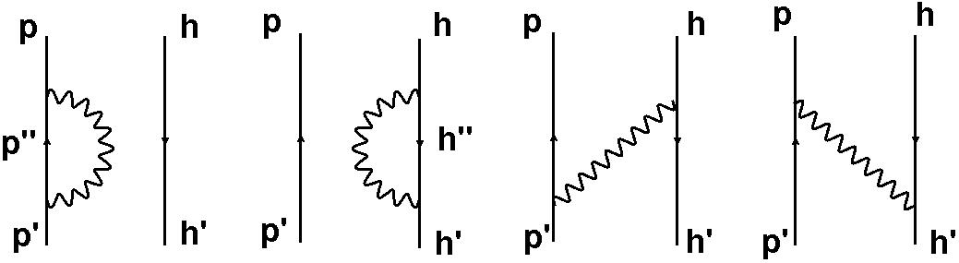
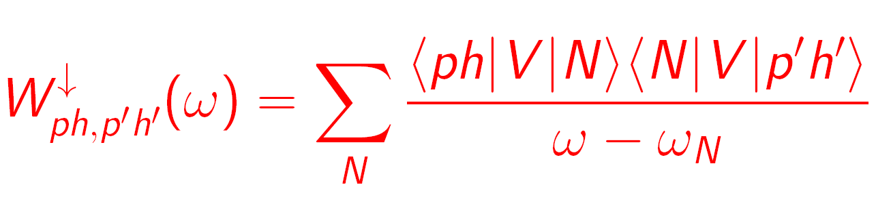
Something in between? --- RPA+PVC model
RPA
Second RPA drozdz et al., PR 197, 1 (1990)
Gambacurta et al., PRC 81, 054312 (2010)
Yang et al., PRC 106, 014319 (2022)
RPA + PVC (particle vibration coupling)
Low-lying vibration phonons |N>
RPA+PVC model based on Skyrme DFT
Colo et al., PRC 50, 1496 (1994); Niu et al., PRC 85, 034314 (2012)
RPA+PVC model based on relativistic DFT Litvinova et al., PRC 75,064308 (2007)

Slide 9
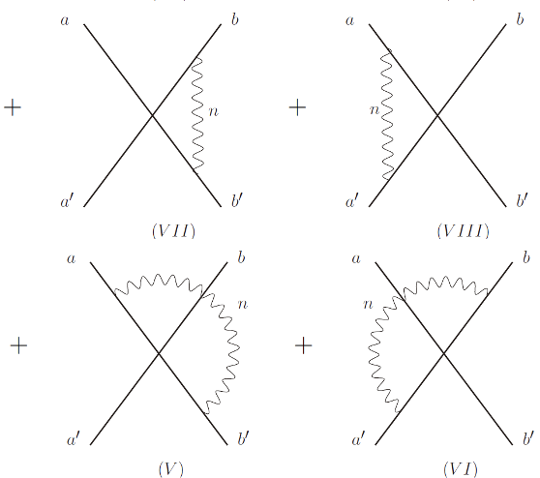
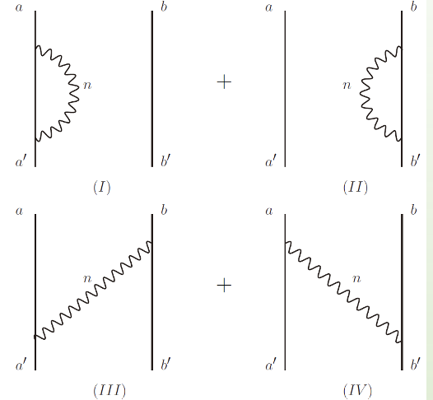
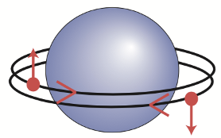
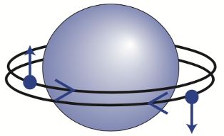

QRPA+QPVC model
To include pairing correlations for open-shell nuclei
Quasiparticle RPA + quasiparticle vibration coupling
(QRPA) + (QPVC)
based on relativistic DFT
based on Skyrme DFT
Litvinova et al., PRC 78,014312 (2008)
QPVC effect
2 qp $⊗$ phonons
2 quasiparticles(qp)
Pairing effect

Slide 10
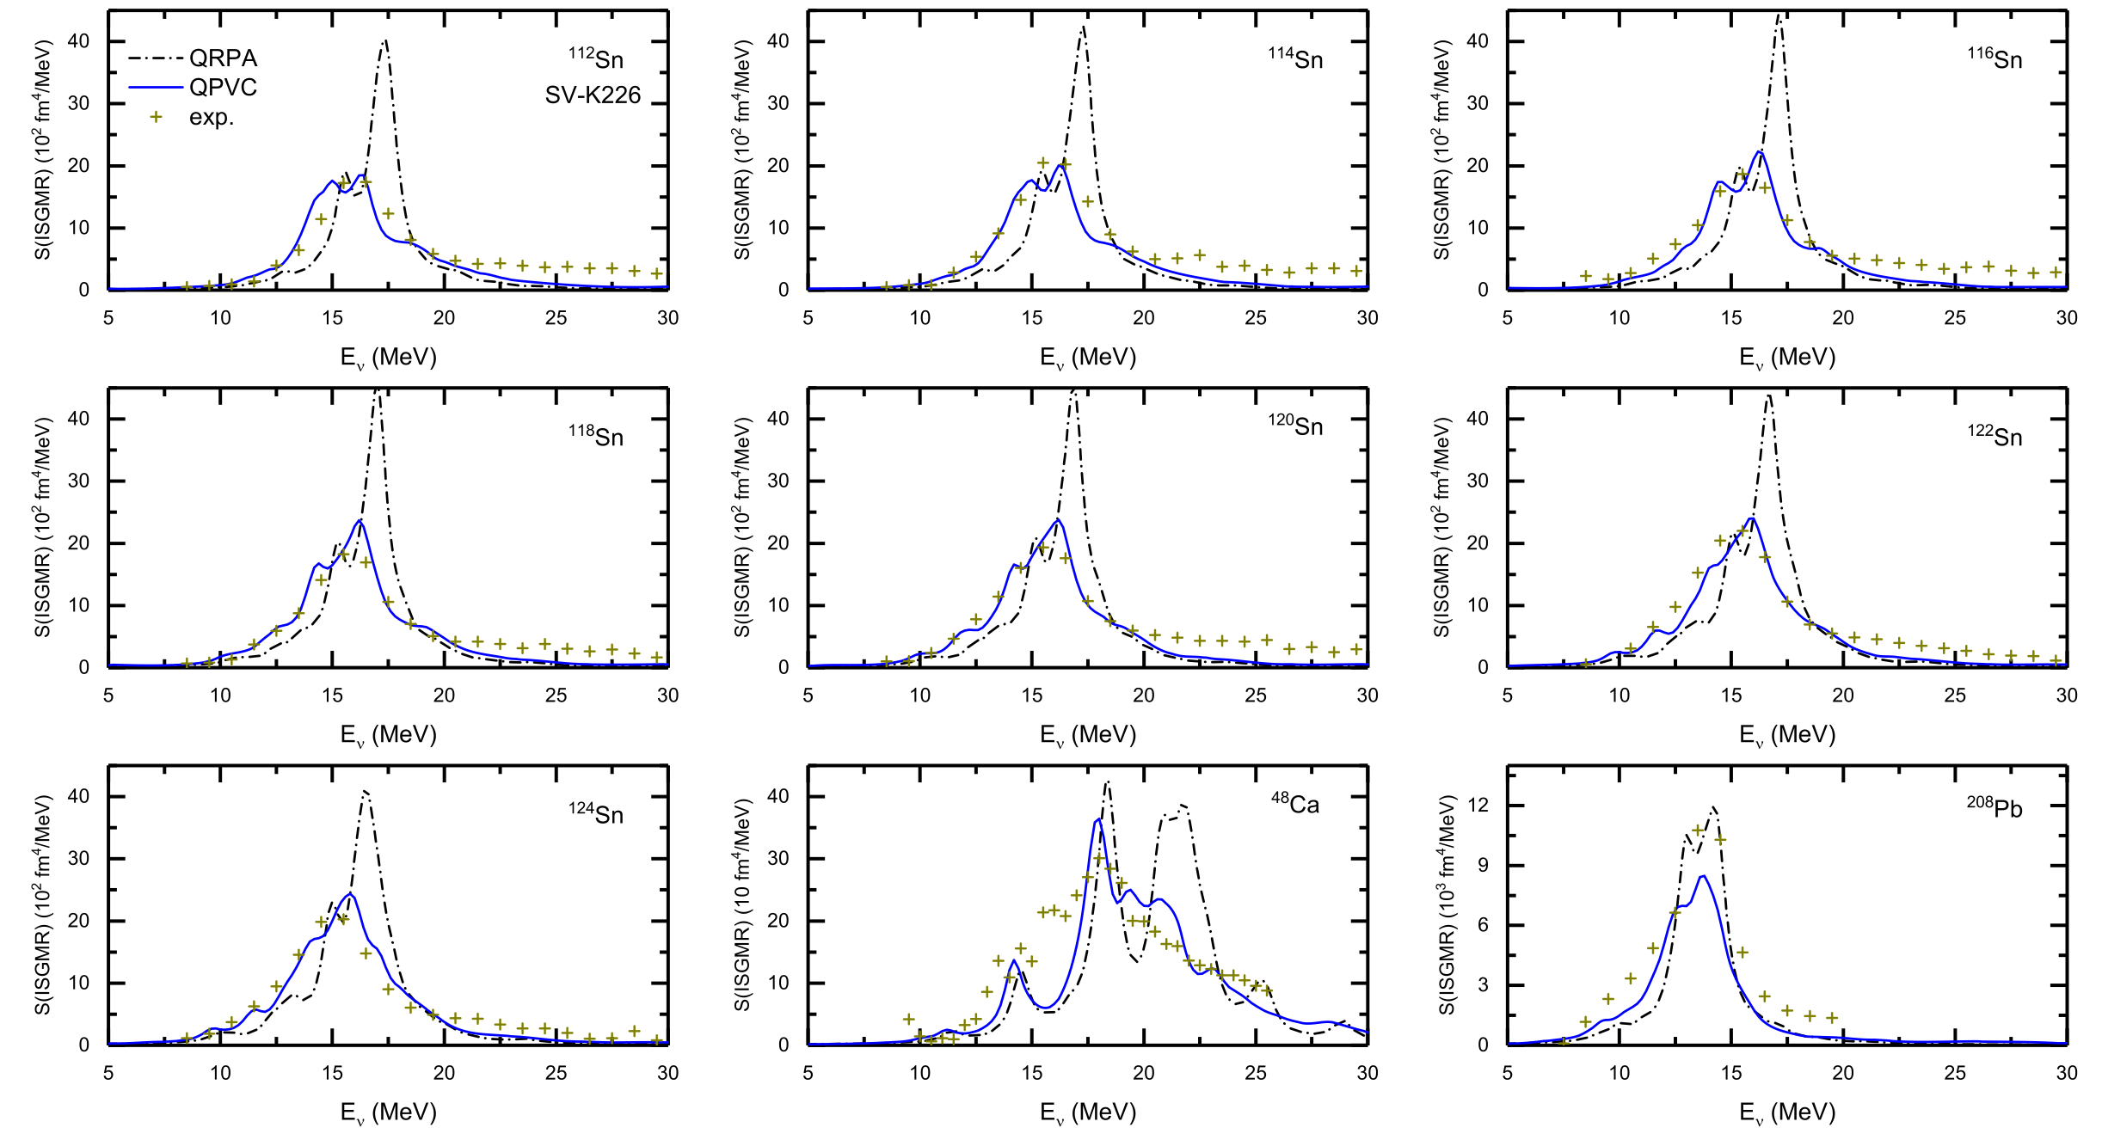
Giant Monopole Resonance studied by QPVC
Achieved a unified description of GMR in Ca, Sn and Pb isotopes
Solved the famous puzzle in nuclear physics “Why are tins so soft? ”
Z.Z. Li, Y.F. Niu and G. Colo, PRL 131, 082501 (2023)

Slide 11
Giant Dipole Resonance studied by QPVC
Photoabsorption cross section is dominated by GDR
  Unified descriptions of GDRs in Ca, Sn and Pb isotopes

Slide 12
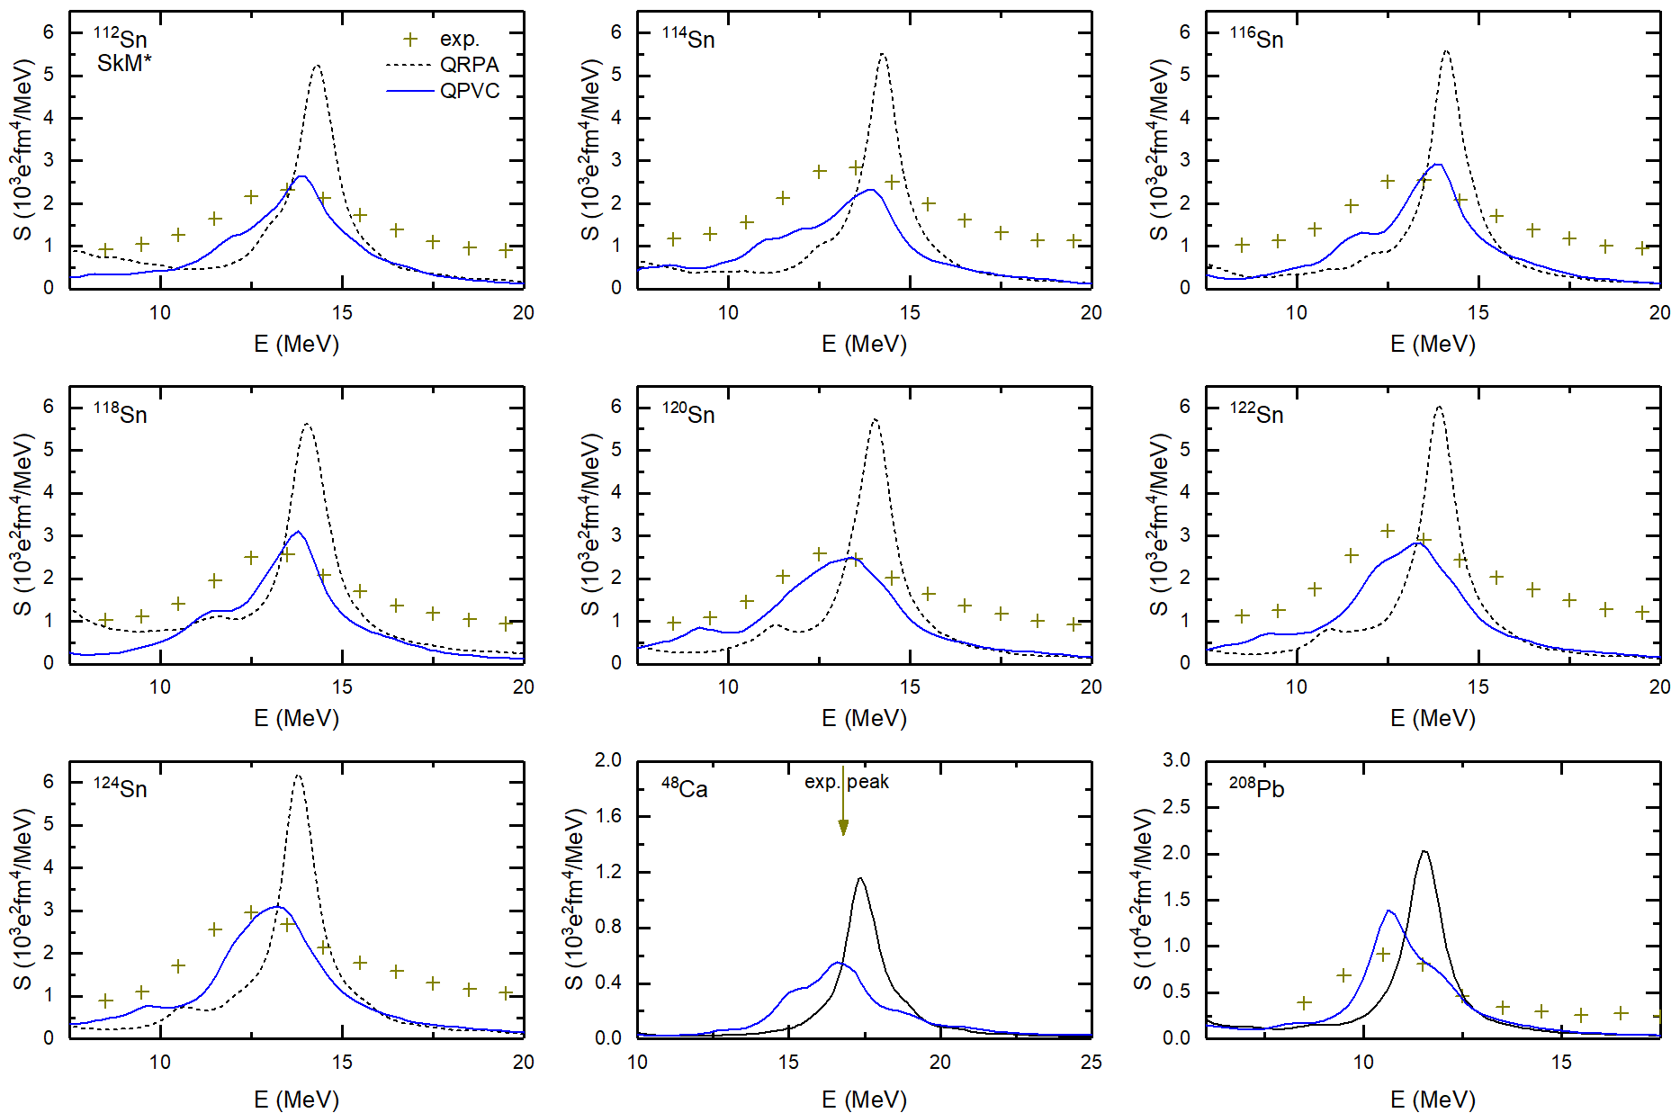
Giant Quadrupole Resonance studied by QPVC
  Unified descriptions of GQRs in Ca, Sn and Pb isotopes

Slide 13
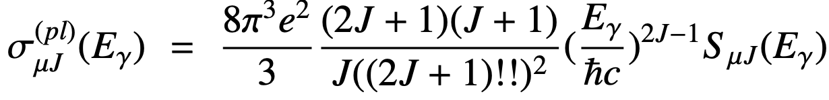
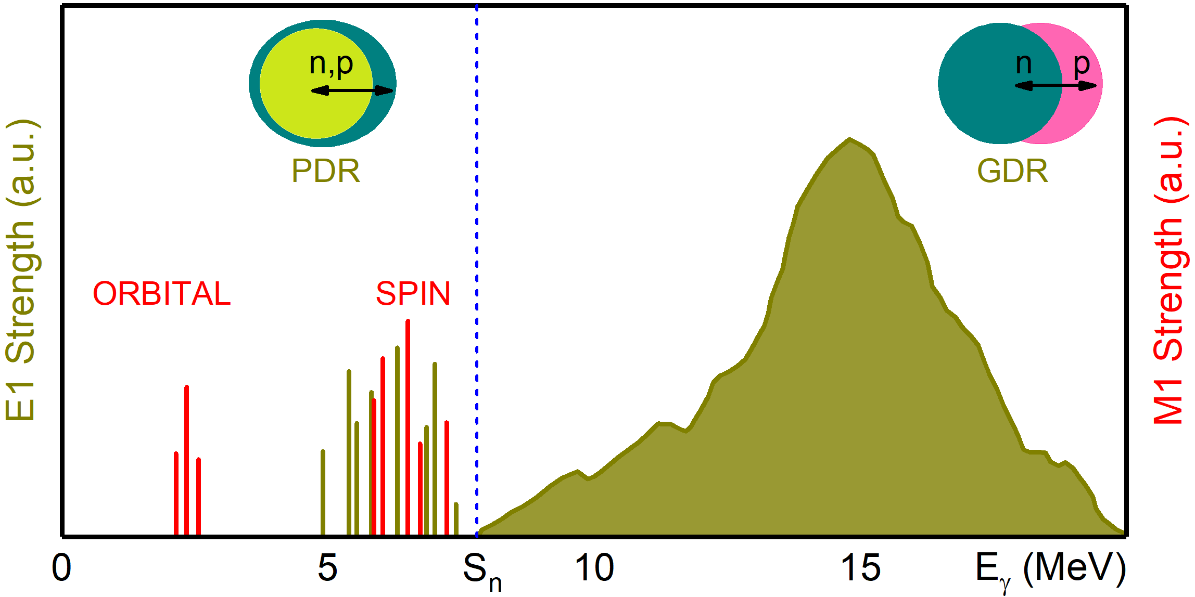
Photo-nuclear reaction
Advantages
The transition strengths can be extracted in a model-independent way due to the well-known electromagnetic force
cross section
transition strengths
Main modes
Giant Dipole Resonance
(GDR)
Pygmy Dipole Resonance
(PDR)
T: transition probability
E: electric
M: magnetic

Slide 14
Different modes of giant resonances
L : orbital angular momentum S: spin T: isospin
IS = Iso-Scalar
IV = Iso-Vector
S = Spin
G = Giant
M = Monopole
D = Dipole
Q = Quadrupole
Is it possible to study giant resonances of higher multipolarity with photons?

Slide 15
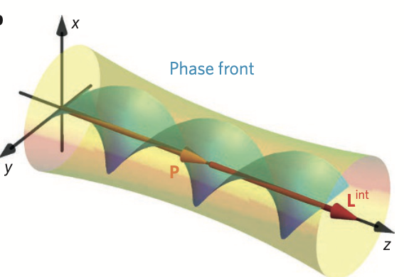
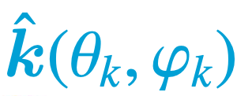
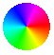
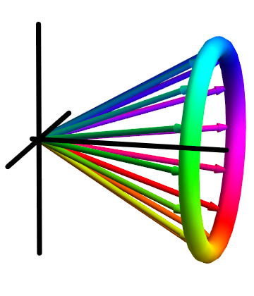

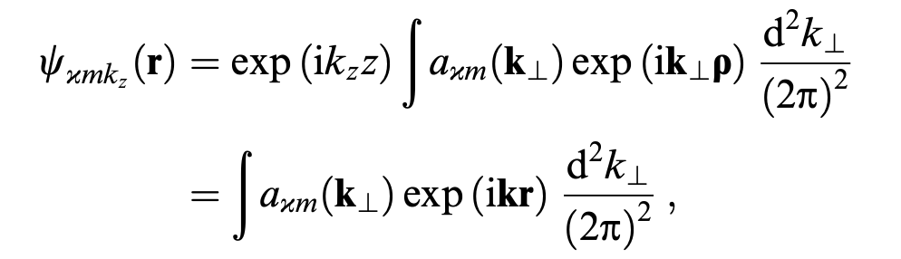
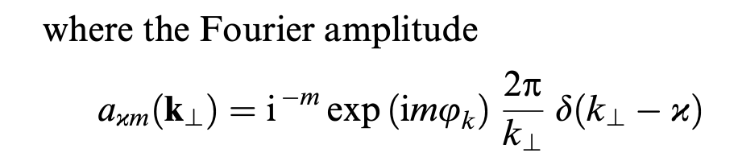


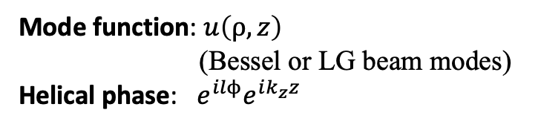

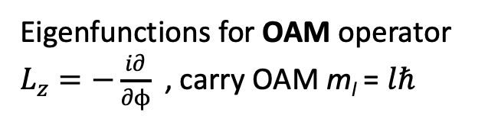

New possibilities: vortex photon
Coordinate space
Momentum space
p_{x}
$$3π/2$$
Bliokh et al., Nature photonics 9, 796(2015)
$$π$$
$$0$$
$$π/2$$
p_{z}
p_{y}
Vortex wavefunction:
Superposition of plane waves
$$Ψ_{l}\left(r,t\right)=u\left(ρ,z\right){e^{ilϕ}e^{ik_{z}z}e}^{−iωt}$$
Eigenfunctions for OAM operator $L_{z}=−\frac{i∂}{∂ϕ}$ , carry OAM m_{l} = $lℏ$
Mode function: $u\left(ρ,z\right)$
(Bessel or LG beam modes)
Helical phase: $e^{ilϕ}e^{ik_{z}z}$
Knyazev and Serbo, Physics uspekhi 61, 449 (2018)

Slide 16
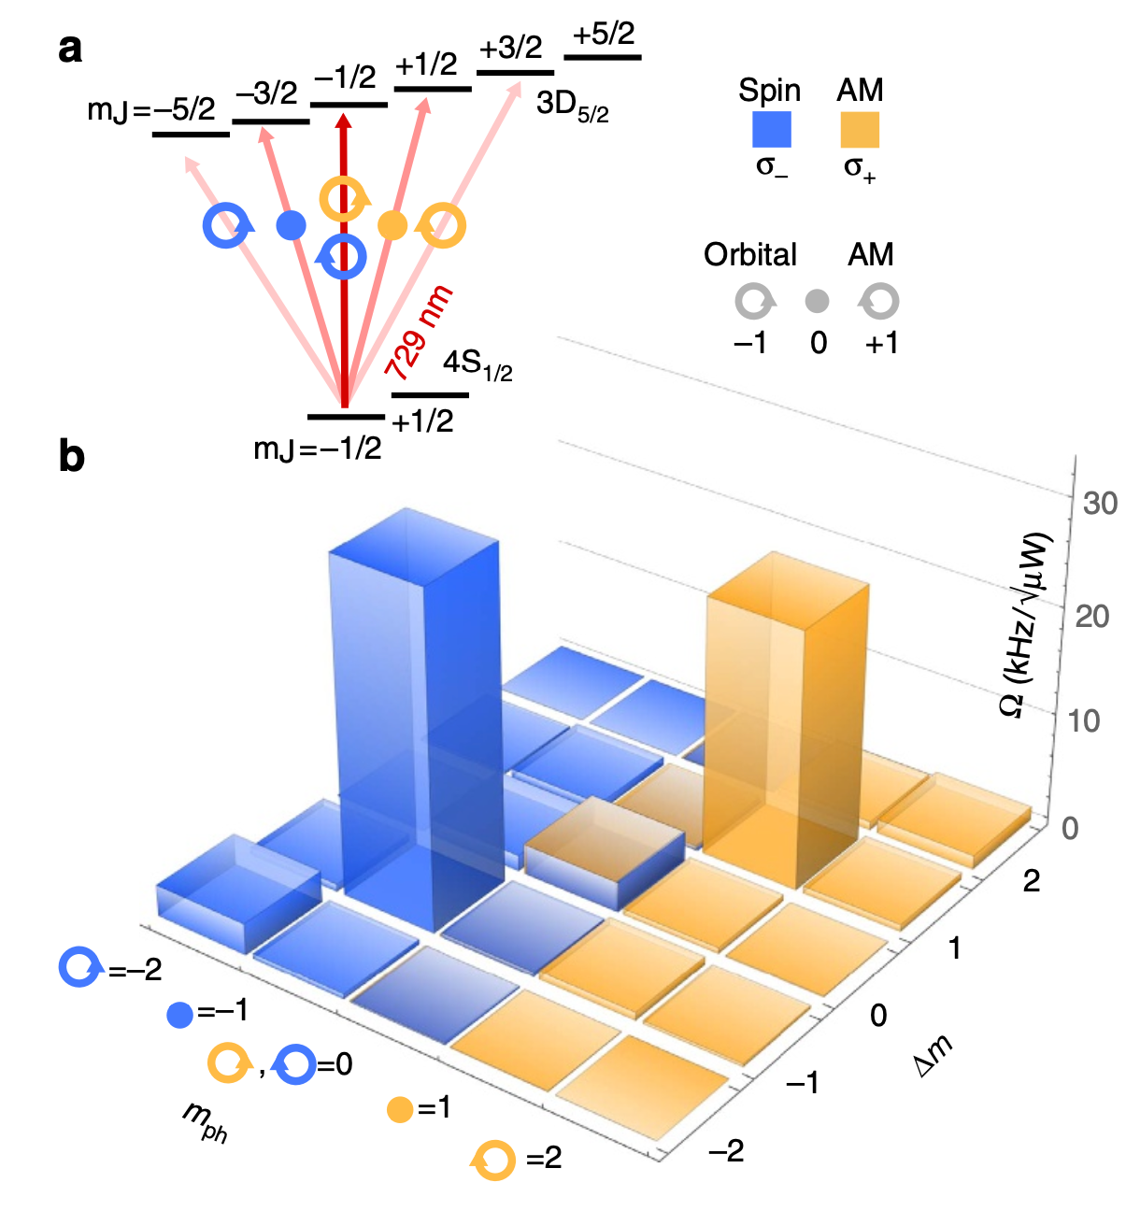
Transfer of optical OAM to a bound electron
Excite an atomic transition (⁴⁰Ca⁺) with a vortex laser beam (Laguerre-Gaussian beam)
demonstrate the transfer of optical orbital angular momentum to the valence electron of a single trapped ion
Modification of transition selection rule
Difference in AMP between initial and final state
Total angular momentum projection (AMP) of photons
Schmiegelow et al., Nature Comm. 7, 12998 (2016)

Slide 17
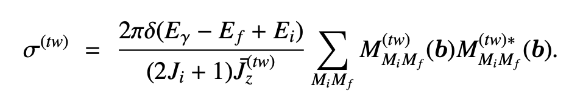
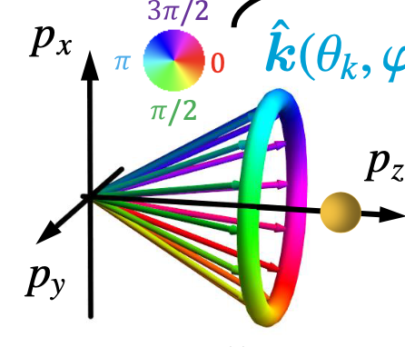
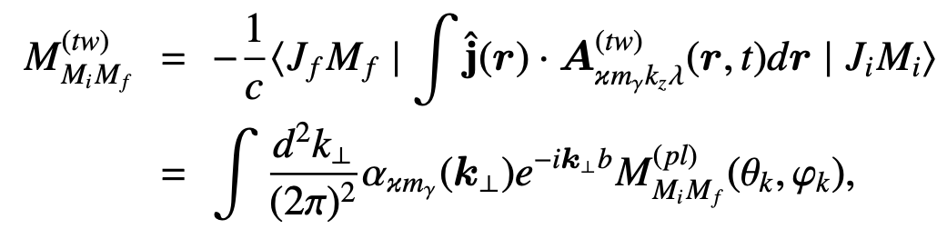
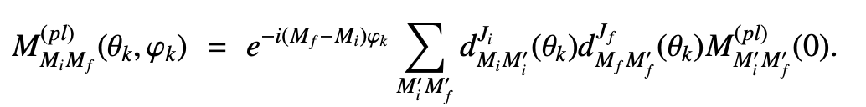
Cross section for vortex photon absorption on nucleus
Nuclear photo-absorption cross section for vortex gamma photon
Transition amplitude
By rotating the nucleus from the propagation axis to the k direction (plane-wave component)
Finally
Average flux density of vortex gamma beam:

Slide 18
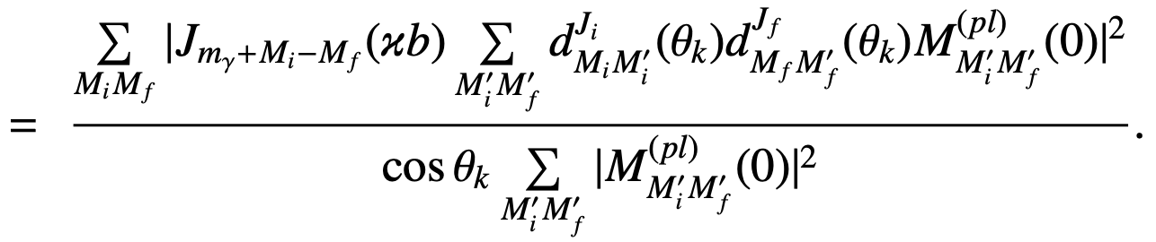

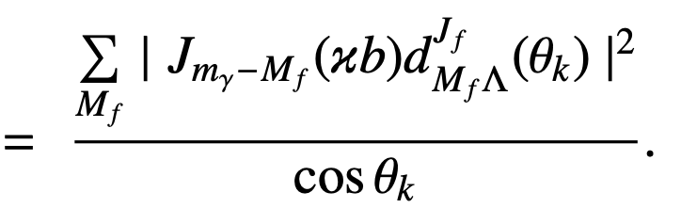

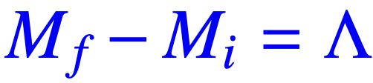

Ratio of the vortex and plane-wave cross section
The ratio of the vortex and plane-wave cross section
even-even nuclei
Impact parameter b=0
The spherical Bessel function gives the selection rule
the projection of total angular momentum on propagation axis
which reflects angular momentum conservation.
For plane wave case, the selection rule is
: helicity

Slide 19
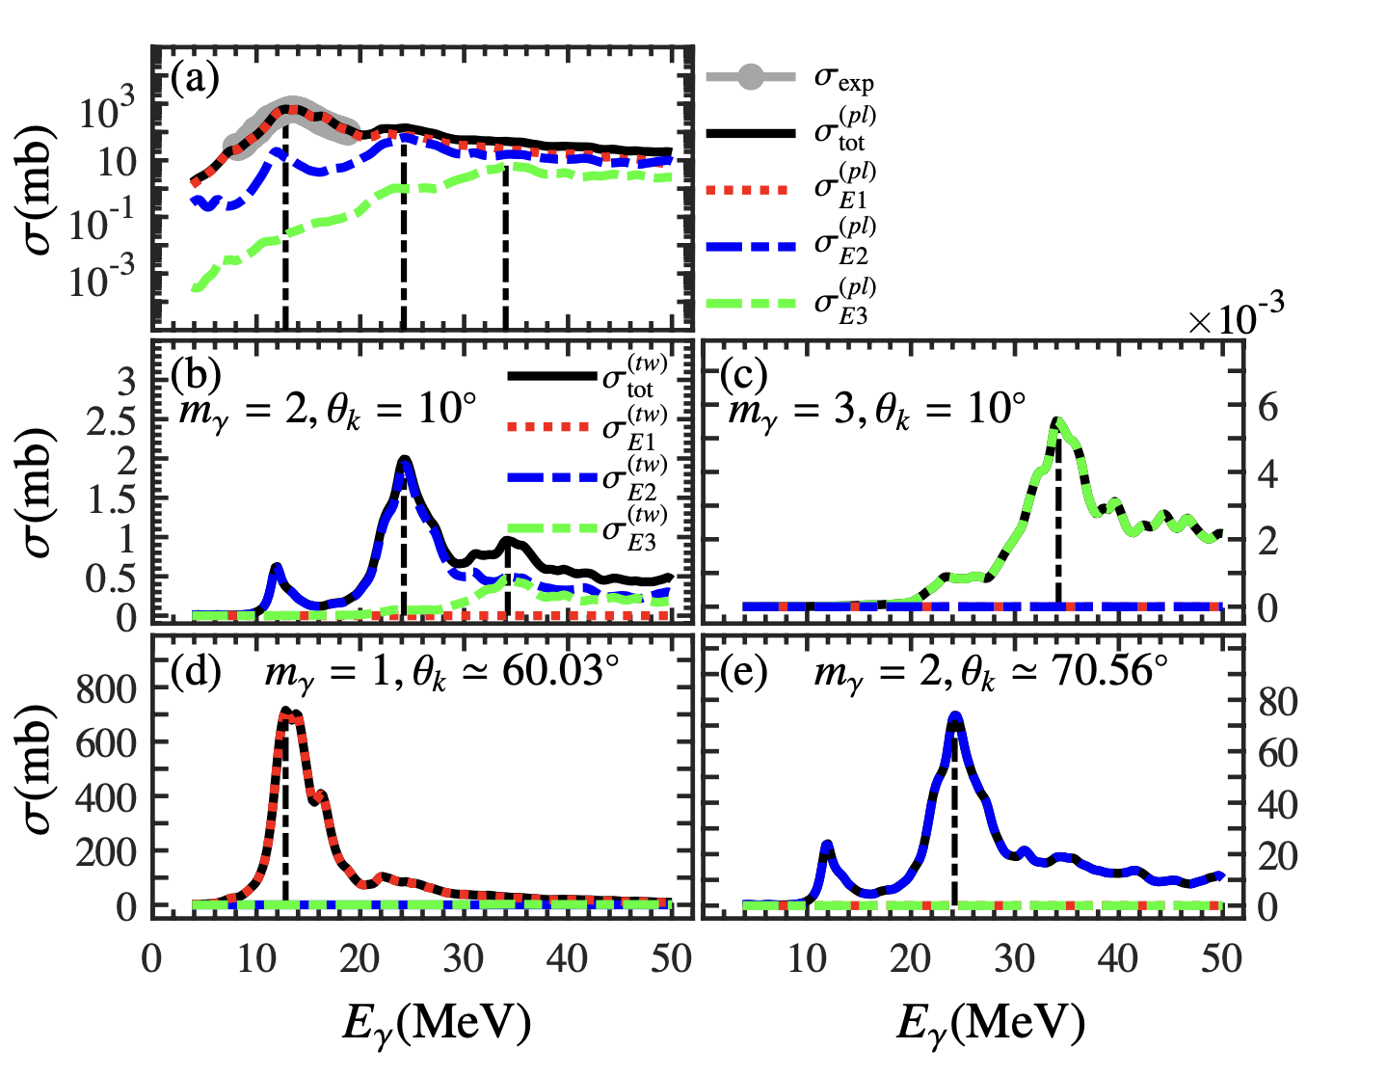

Photo-absorption cross section: plane wave vs. vortex
RPA+PVC calculation SAMi-T
Plane-wave photon case
Vortex photon case
Forbidden of
due to selection rule:
Forbidden of
due to properties of Wigner d-function
which vanishes at specific angle

Slide 20
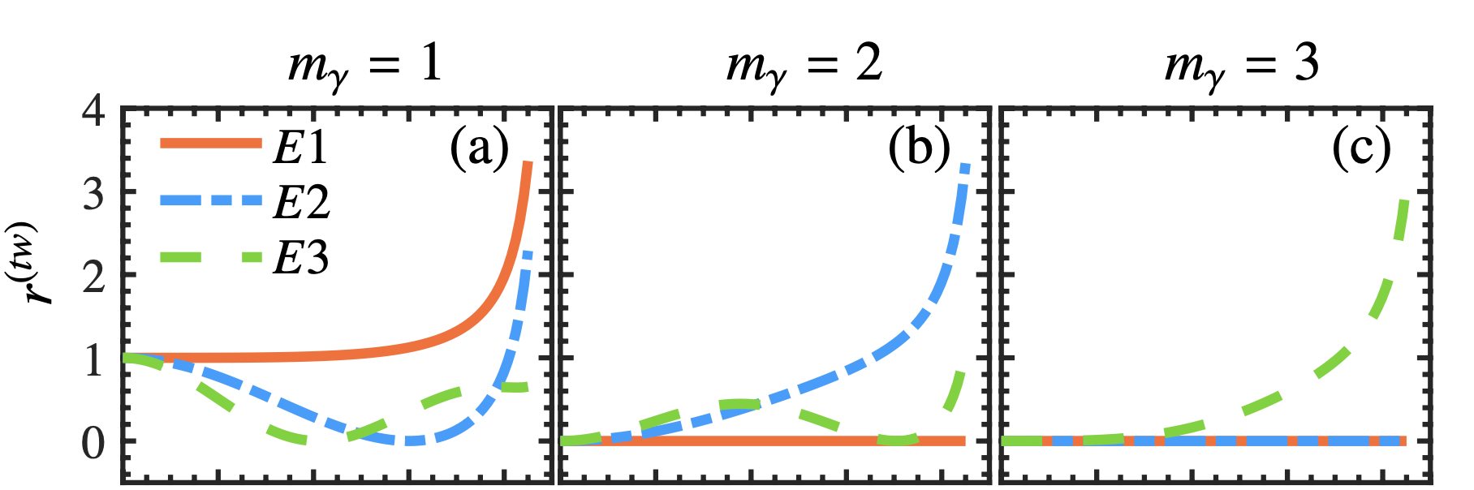
Ratio of the vortex and plane-wave cross section
E3 vanishes
E1 forbidden
E1 E2 forbidden
E2 vanishes
E3 vanishes
: back to the plane-wave case r^{(tw)}=1
dependence on comes from Wigner d-function

Slide 21
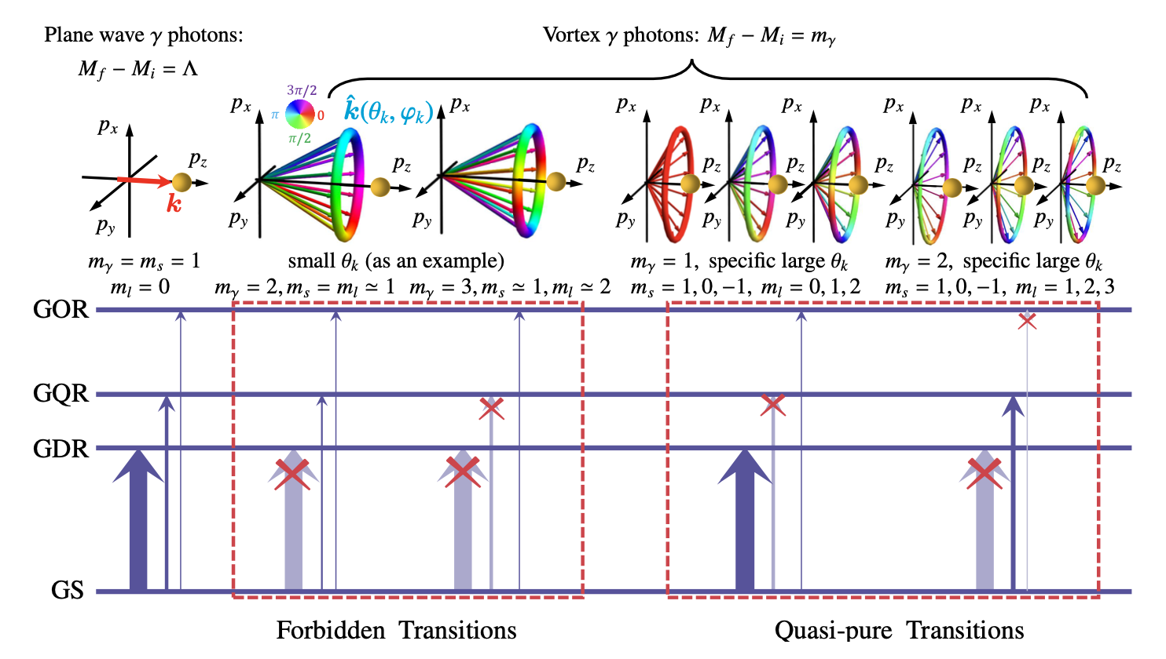
Manipulation of giant resonances via vortex photon
Z. W. Lu, L. Guo, Z. Z. Li, M. Ababekri, F. Q. Chen, C. B. Fu, C. Lv, R. R. Xu, X. J. Kong, Y. F. Niu, and J. X. Li, PRL 131, 202502 (2023)

Slide 22
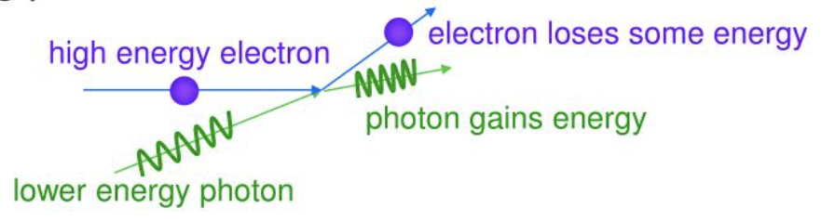
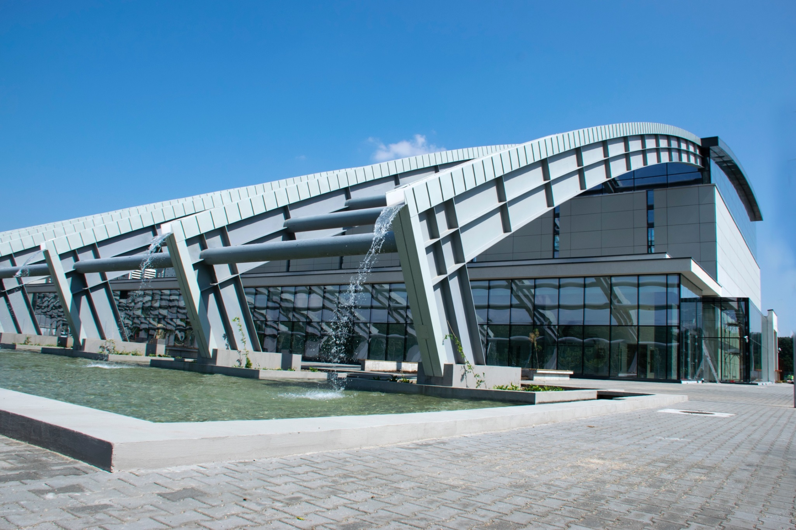
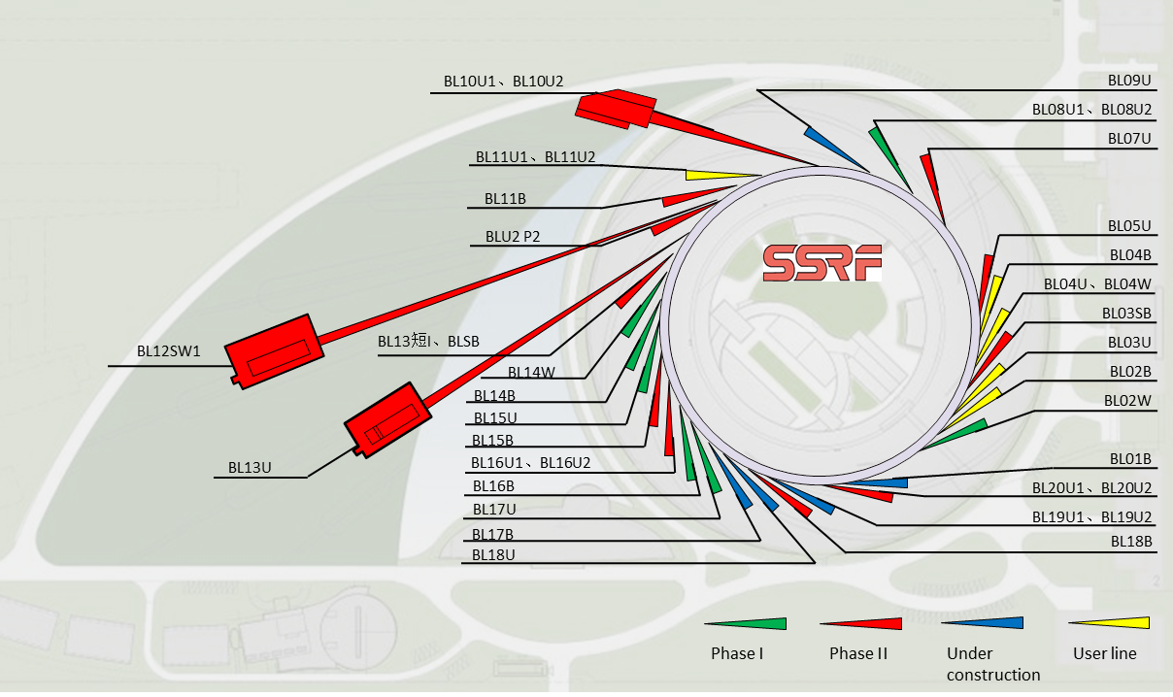
New $γ$ beam facilities
Inverse compton scattering
E_{e}=3.5GeV
E_{L}=0.116eV(CO₂)
γ = 6849
E_{γ} =4γ²E_{L}=21.7MeV
High Intensity γ-ray Source (HIγS)
Extreme Light Infrastructure – Nuclear Physics (ELI-NP)
Shanghai Laser Electron Gamma Source (SLEGS)
H. R. Weller et al., Prog. Part. Nucl. Phys. 62, 257 (2009)
K. A. Tanaka et al., Matter Radiat. Extremes 5, 024402 (2020)
H. W. Wang et al., 原子核物理评论 37, 1 (2020); Nucl. Sci. Tech. 33:87 (2022)
SLEGS BL03SS-ID

Slide 23
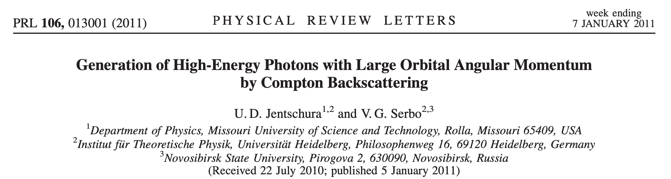
Possibility to produce vortex gamma photon
In this Letter, we show that it is possible to produce high-energy twisted photons by Compton backscattering of twisted laser photons off ultrarelativistic electrons.
Experiments at SLEGS?

Slide 24
Summary and Perspectives
Summary
Fully self-consistent QRPA+QPVC based on Skyrme density functional for non-charge-exchange channel is developed
  Succesfully applied to the study of giant multipole resonances
New possibilites to study nuclear giant resonances with vortex gamma photons are explored
  Forbidden transitions and quasi-pure transitions are found
  Provide a clean probe for the study of IV giant quadrupole resonances
Perspectives
Applications in astrophysics
Vortex electrons interaction with nucleus
Explore how to generate vortex gamma beam
…

Slide 25
Acknowledgement
Collaborators:
LZU: Z. Z. Li L. Guo F. Q. Chen PKU: J. Meng Anhui Uni.: Z. M. Niu
Aizu Univ. and RIKEN: H. Sagawa Milan Univ. : G. Colo, E. Vigezzi
Xian Jiaotong Uni.: Z. W. Lu, M. Ababekri, J. X. Li
CIAE: R. R. Xu, C. Lv Fudan Uni.: C. B. Fu, X. J. Kong
Thank you!

Slide 26
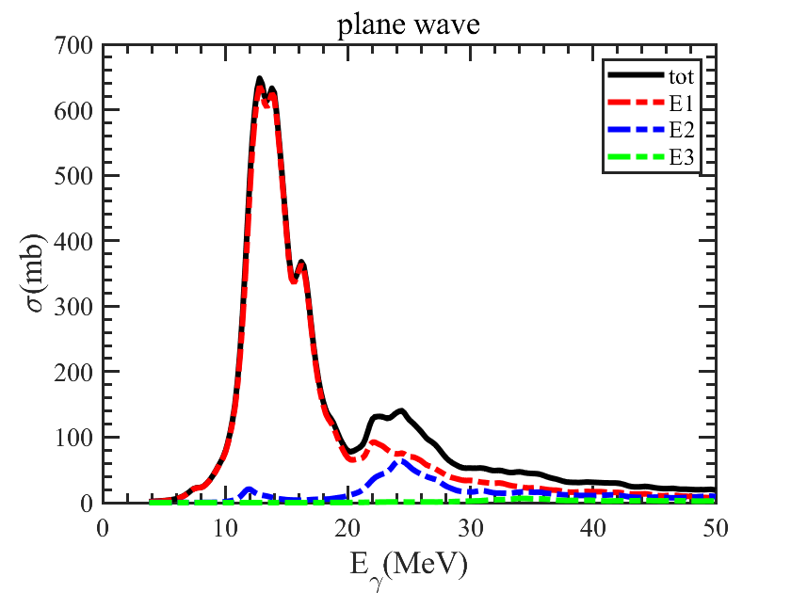
Chanllenges?

Slide 27
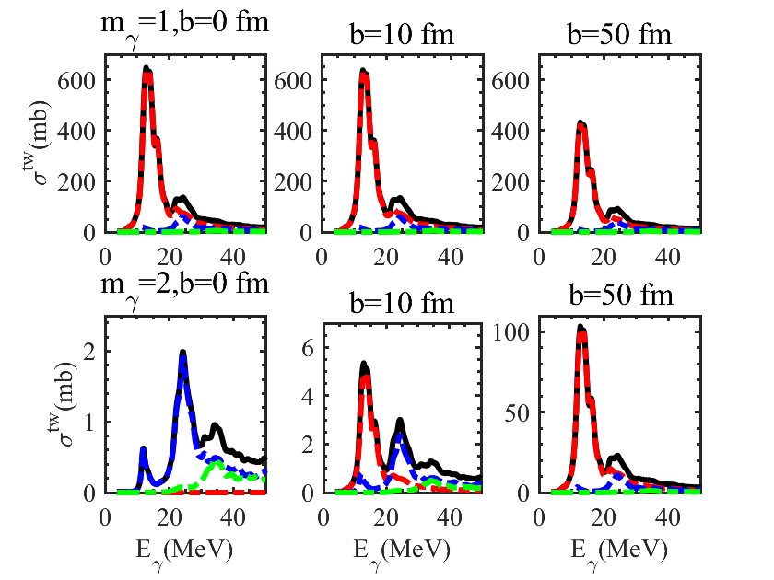
Chanllenges?

Slide 28
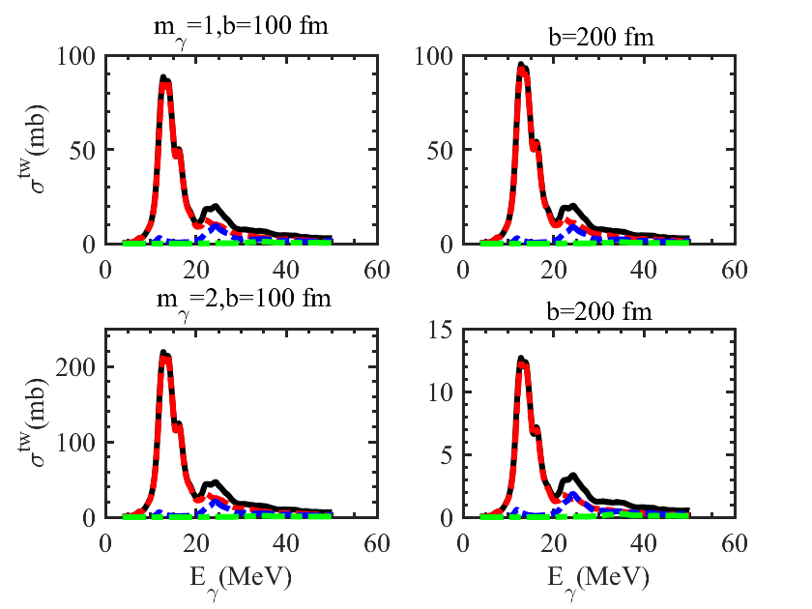
Chanllenges?

Slide 29
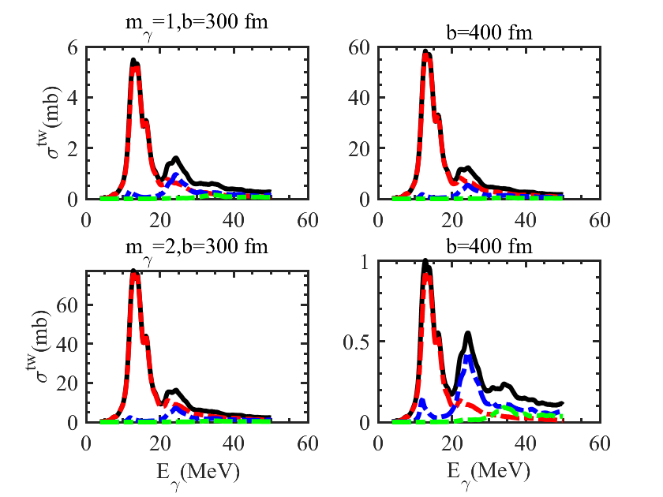
Chanllenges?

Slide 30
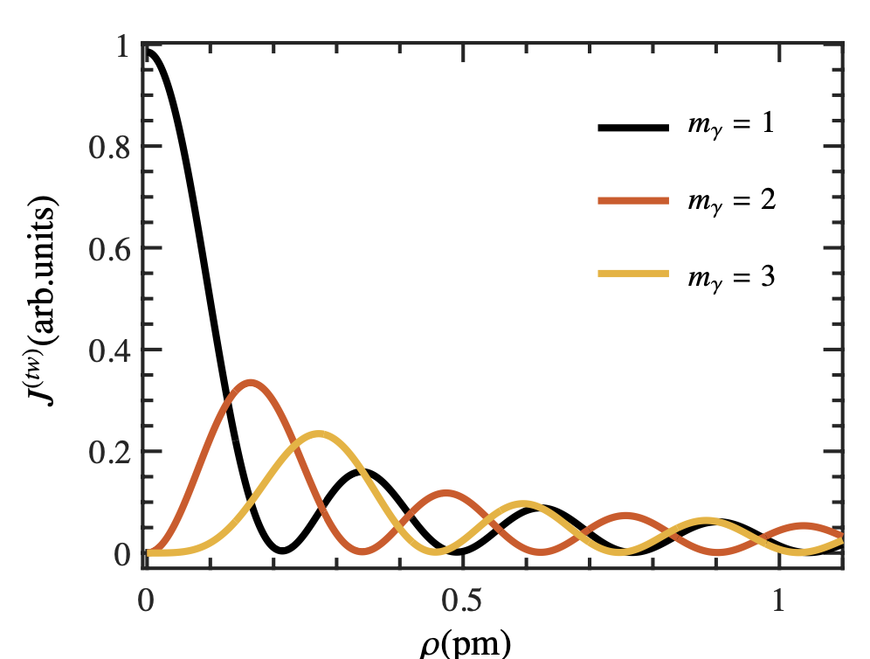

Slide 31
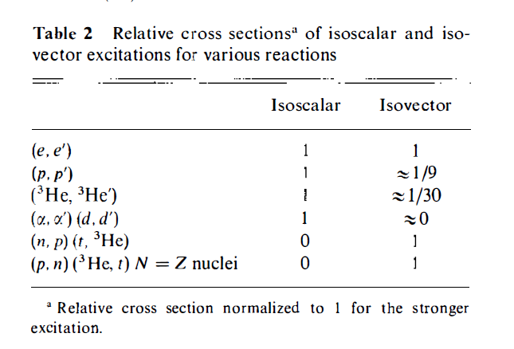
Experimental probes
IS. IV…

