Slide 1
Strong Laser-driven Polarized and Vortex Particles
Jian-Xing Li (栗建兴)
Xi’an Jiaotong University(西安交通大学)
2024.4.25，Vortex states in nuclear and particle physics

Slide 2
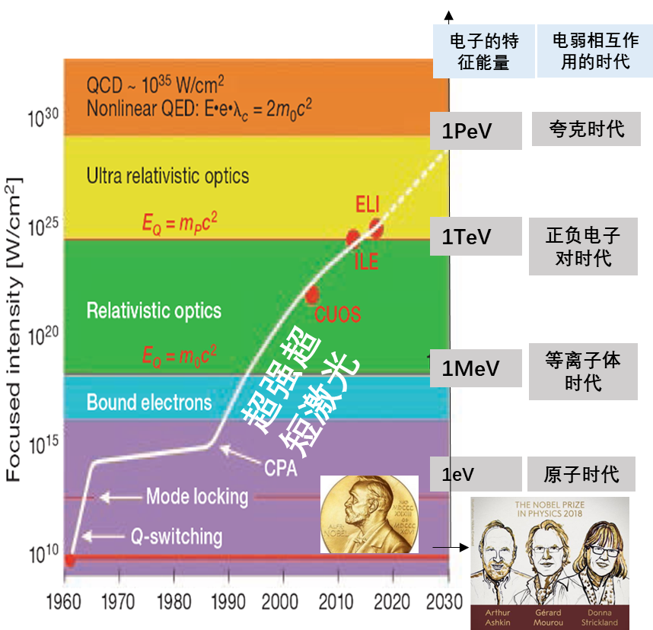
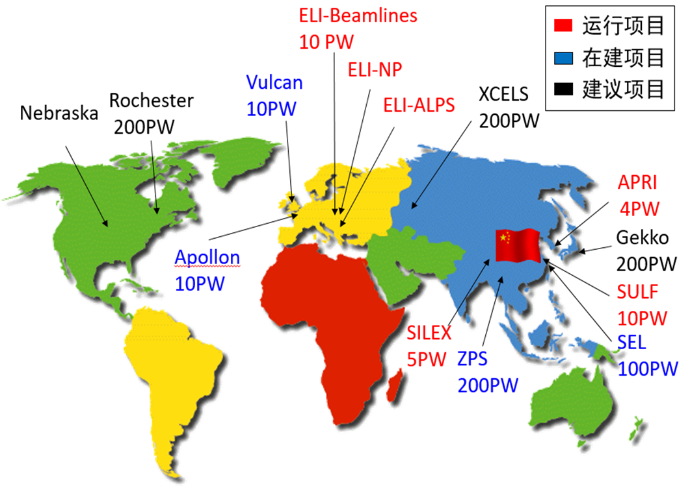
Background
Ultraintense Ultrafast Laser Facilities：~10 PW, ~ , ~fs
强场QED效应
Worldwide Ultraintense Ultrafast Laser Facilities
CPA: 2018 Nobel Prize for Physics

Slide 3
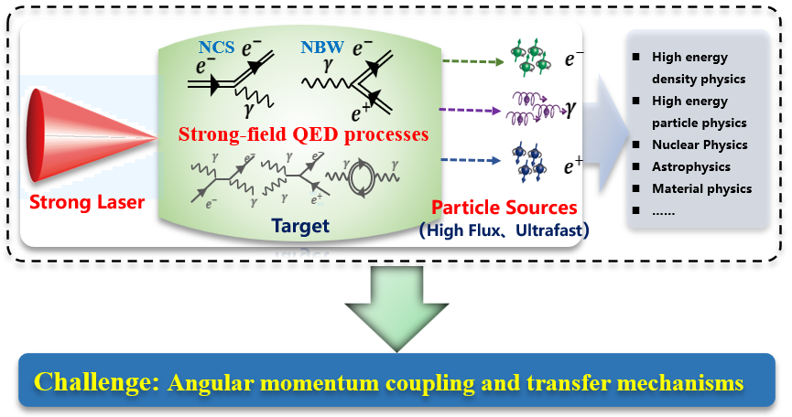
Background

Slide 4
Outline
1
Polarized electron beam
2
Polarized positron beam
3
Vortex Gamma photons
4
Vortex electrons and positrons

Slide 5
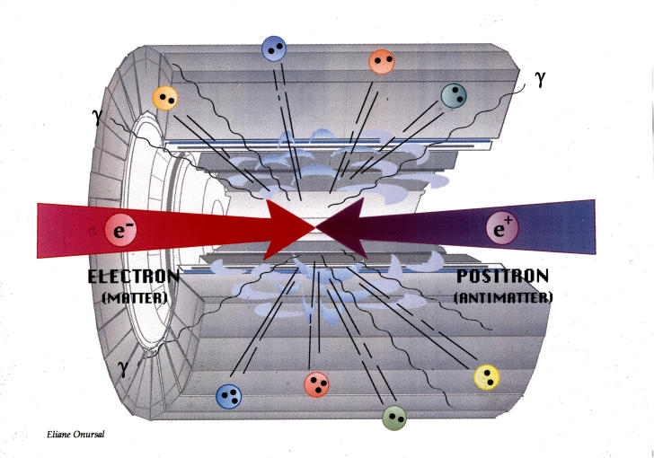
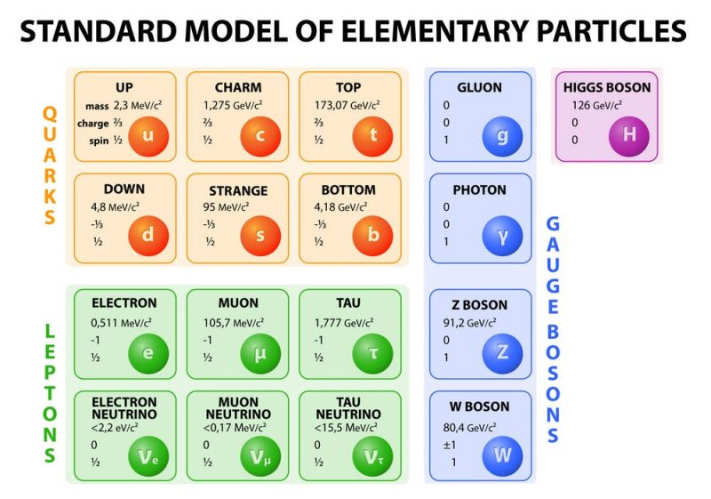
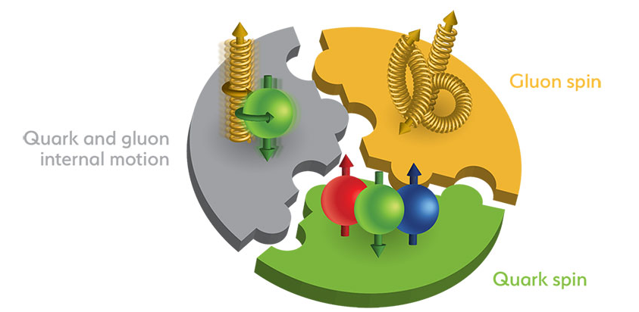
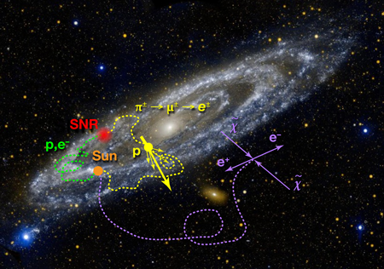
Applications
Widespread applications of polarized positrons
Polarized electron-positron colliders
Test the Standard Model (SM) and searching new physics beyond SM
precisely measuring the effective weak mixing angle
test the electroweak gauge group
probing CP violation
studying supersymmetry particles
searching for gravity in extra dimensions
·······
Polarized positron-ion colliders
Reconstructing the proton spin structure
simulating extreme cosmic environments
in laboratories

Slide 6
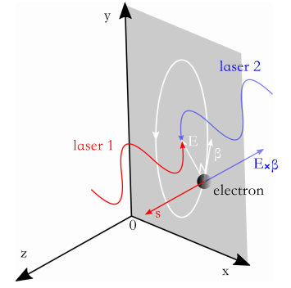
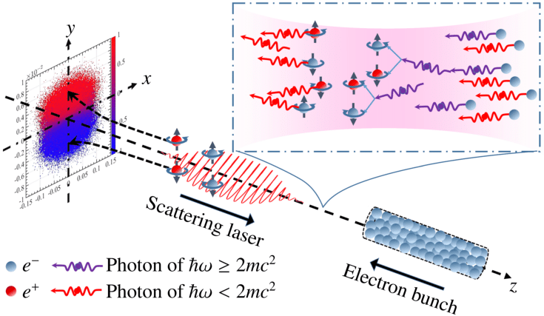
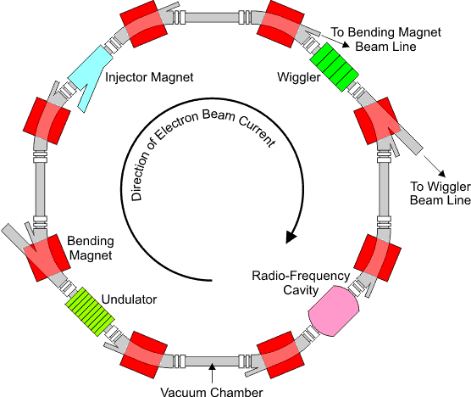
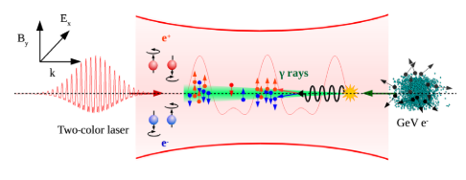
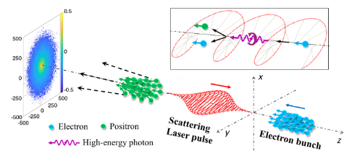
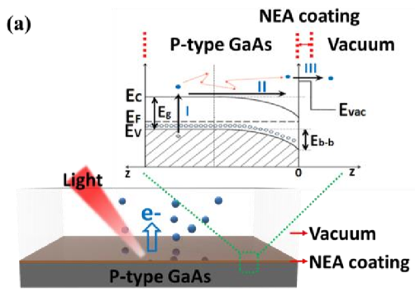
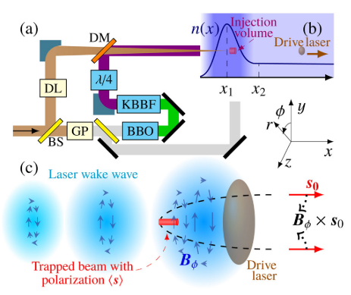
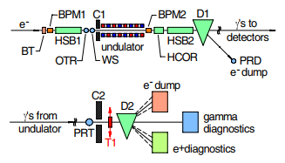
Generation methods
Methods for generating ultrarelativistic polarized positrons
Spontaneous polarization in storage rings
Laser-electron beam collisions
PPCF 60, 064003(2018)
PLB 800, 135120 (2020))
PRL 123, 174801(2019)
PRL 125, 044802(2020)
Interaction of circularly polarized γ photons with high-Z targets via Bethe-Heitler process
Acceleration of pre-polarized positrons
Sensors 20(8),2419 (2020)
PRL 122, 214801(2019)
PRL 96, 114801(2006); PRL 100, 210801(2008); PRL 116, 214801(2016)

Slide 7
Generation methods
Typical positron parameters and limitations of different methods
Method |  | Positron Parameters | Limitation
Spontaneous polarization in storage rings |  | $${\overline{S}}_{+}≥90\%$$ | Take minutes to hours
Interaction of circularly polarized γ photons with high-Z targets |  | $${\overline{S}}_{+}≈30\%\sim 40\%$$ $${10}^{−6} \text{nC}\text{/}\text{shot}$$ | Limited by the low luminosity of $γ$ photon beams
Laser-electron beam collisions | an unpolarized GeV electron beam with an asymmetric laser pulse | $${\overline{S}}_{+}≈30\%\sim 40\%$$ $${10}^{−4} \text{nC}\text{/}\text{shot}$$ | Exact spatiotemporal synchronization between the laser and electron beams | Limited by the construction of asymmetric strong lasers
 | a longitudinally fully polarized GeV electron beam colliding with a circularly polarized laser pulse | $${\overline{S}}_{+}≈40\%\sim 65\%$$ $${10}^{−4} \text{nC}\text{/}\text{shot}$$
 |  |  |  | Limited by the flux and polarization of electron beams
Ultrastrong laser irradiation on solid targets |  | $${\overline{S}}_{+}≈30\%$$ $$\text{10 }\text{nC}\text{/}\text{shot}$$ | Require a laser peak intensity exceeding ${10}^{24}\text{W}\text{/}\text{c}{\text{m}}^{\text{2}}$ ($a_{0}=1500$)
Relevant experiments in ILC, CEPC and JLEIC require positrons with ${\overline{S}}_{+}≥60\%$ and a yield of about $\text{nC}\text{/}\text{shot}$.

Slide 8
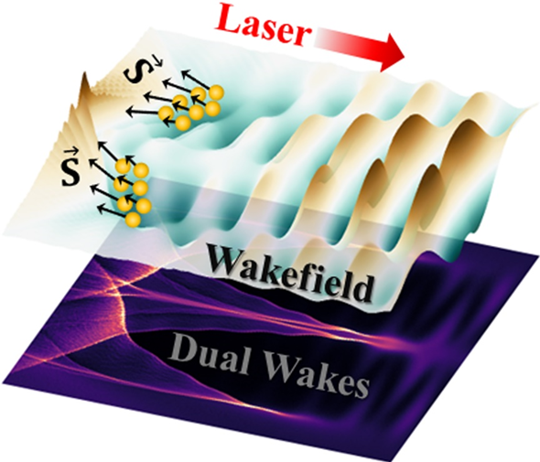
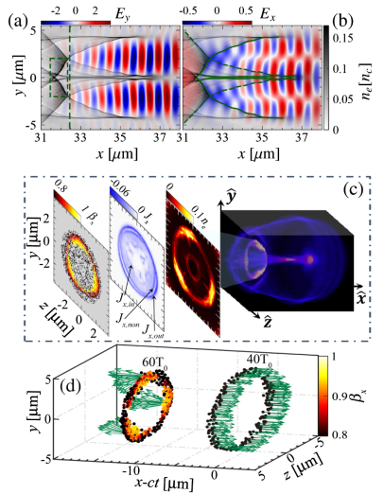
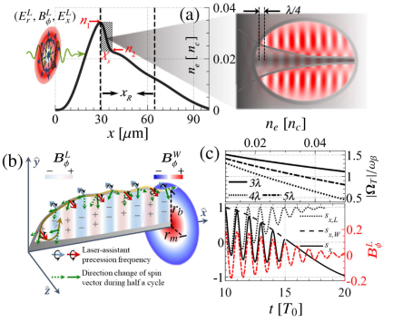
Polarized electron beam
T. Sun et al., Phys. Rev. Lett. 132, 045001 (2024)

Slide 9
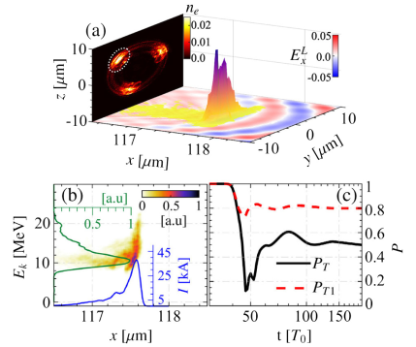
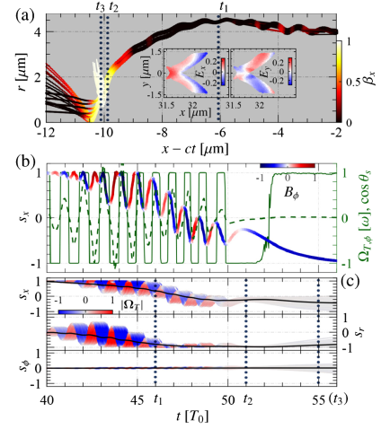
Polarized electron beam
Open question：Vortex electron beam acceleration via wakefield？

Slide 10
Polarized positron beam
A single-shot interaction of a strong laser with a tilted solid foil
Average polarization degree : ${\overline{S}}_{+}≈70\%$
Maximum density : $n_{+}={{10}^{−3}n}_{c}≈{10}^{18} \text{c}{\text{m}}^{\text{−3}}$
Yield : $N_{+}=0.1 \text{nC}\text{/}\text{shot}$
Laser Parameters:
$$a=a_{0}exp\left(−r^{2}/w_{0}^{2}\right)exp(−t^{2}/τ^{2})$$
$$λ_{0}=1μ\text{m}\text{, }a_{0}=500,w_{0}=5λ_{0}, τ=6T_{0}, φ_{L}={45}^{∘}$$
For a peak cone $α=({25}^{∘}<θ<{27}^{∘}, {175}^{∘}<φ<{177}^{∘})$:
$${\overline{S}}_{+}≈72.3\%, N_{+}≈0.2 pC$$
${10}^{20}e_{+}/(s⋅{mm}^{2}⋅{mard}^{2}⋅0.1\%BW)$ for $ε_{+}=300 MeV$
Target Parameters: Carbon foil
$$n_{e}=550n_{c}, θ_{T}={30}^{∘},L_{T}=30μm, d_{T}=2μm$$
$$n_{pre}=n_{e}exp\left(−L/L_{pre}\right), L_{pre}=0.5μm$$
K. Xue et al., Phys. Rev. Lett. 131, 175101 (2023). Editors’ suggestion.

Slide 11
Polarized positron beam
Experimental feasibility analysis

Slide 12
Polarized positron beam
Using a cone target with the same laser pulse
Plasma focusing effect on the laser
Laser trapping and acceleration of electrons
$$n_{+}={10}^{20} \text{c}{\text{m}}^{\text{−3}}$$
$$N_{+}=12. 5 \text{nC}\text{/}\text{shot}$$
The direction of becomes azimuthal
$${\overline{S}}_{+}≈25\%$$
Target Parameters:
$$n_{e}=550n_{c}, r_{1}=7μm, r_{2}=0.5μm, L_{cone}=50μm,n_{NCD}=5n_{c}$$

Slide 13
Polarized positron beam
Open question：More efficient methods？
Other possible physical process
BH process :
$N_{+}^{′}≈1.7×{10}^{6}≈0.1 \text{pC}≪$ the yield of positrons generated via the NBW process $0.1\text{nC}$
Annihilation of electron-positron:
the lifetime of positrons $τ_{+}≈{10}^{−8}s≫$ Time required to pass throuth the target ${10}^{−12} s$
Attenuation of $γ$ photons:
incoherent scatter,
coherent scattering,
photoelectric absorption.
·······

Slide 14
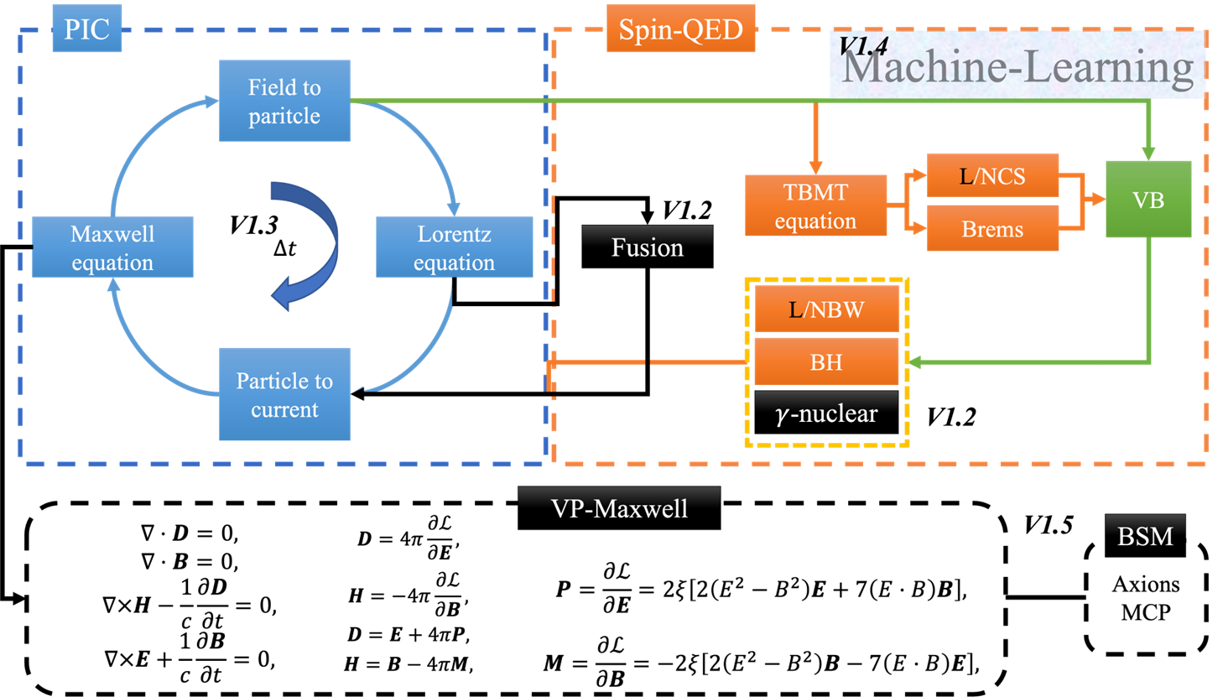
QED-PIC code: SLIPs
Framework of SLIPs
F. Wan et al., Matter Radiat. Extremes 8, 064002 (2023)

Slide 15
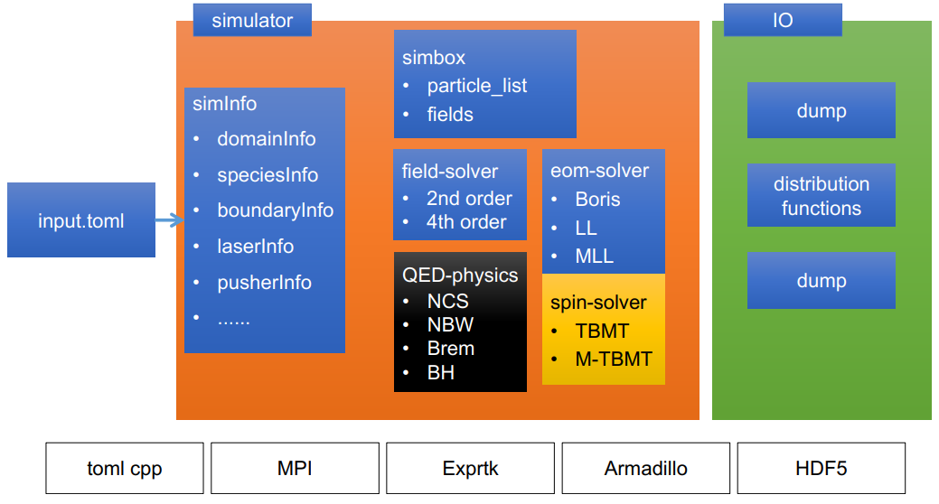
QED-PIC code: SLIPs
Data structure of SLIPs

Slide 16
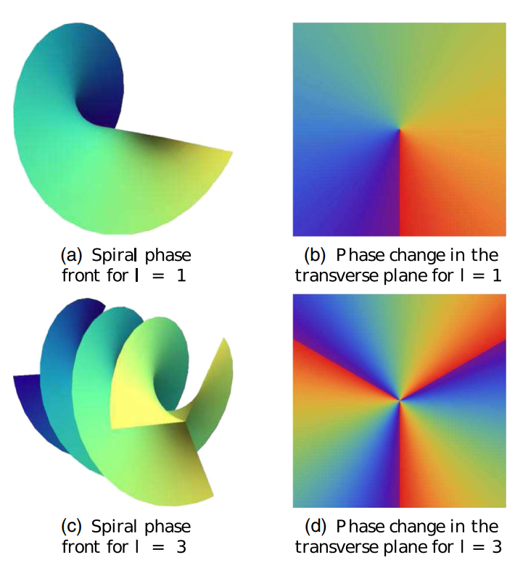
Vortex Gamma photons
Vortex/twisted photons
Vortex wave:
$$Ψ_{l}\left(r,t\right)=u\left(ρ,z\right){e^{ilϕ}e^{ik_{z}z}e}^{−iωt}$$
Mode function: $u\left(ρ,z\right)$ (i.e. Bessel or LG beam modes)
Helical phase: $e^{ilϕ}e^{ik_{z}z}$
Eigenfunctions for OAM operator $L_{z}=−\frac{i∂}{∂ϕ}$, carry OAM $lℏ$
Vortex waves have distinct topological structure such that there is no continuous deformation from plane wave (front) or spherical wave to helical wave, the corresponding topological charge is $l$.
[Phys. Usp. 61, 449 (2018)]
16

Slide 17
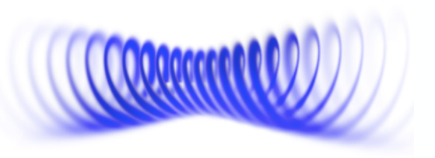
Vortex Gamma photons
Doing nuclear/particle physics with vortex beams
Proton Spin Puzzle
Present: Spin polarized targets & beams have been the only tools in use
1980s
Now
Only ~30% of proton spin is due to quarks spins;
Quest for the remaining ~70% is the major enterprise in New Physics: quark OAM, gluon spin, gluon OAM
Next: Exploring new tools such as vortex beams
Colliding protons with OAM beams:
Deep Inelastic Scattering with vortex electrons? [ JLab 2016 ]
[Eur. Phys. J. A 52, 268 (2016)]
Photo-nuclear physics [Sci. Rep. 7, 5018 (2017)] Photon-induced reaction cross section will be changed due to AM conservation relation
Doing Spin Physics With Unpolarized Particles
[Phys. Rev. Lett. 124, 192001 (2020); Prog. Part. Nucl. Phys. 127, 103987 (2022)]

Slide 18
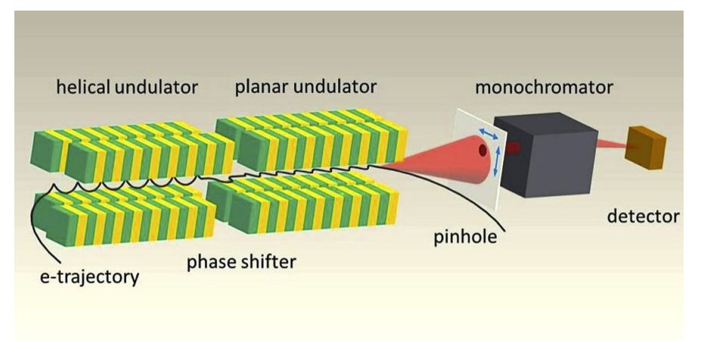
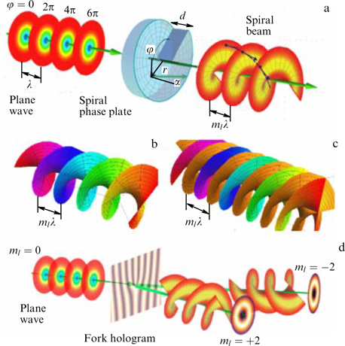
Vortex Gamma photons
Vortex Photon Generation
Photon beams of 99 eV carrying OAM have been observed in the 2nd harmonic off-axis radiation of a helical undulator.
[Phys. Rev. Lett. 111, 034801 (2013)]
Other observations of OAM photon radiation:
[J. Synchrotron Rad. 24, 934, (2017)]
[Phys. Rev. X 7, 031036 (2017)]
18

Slide 19
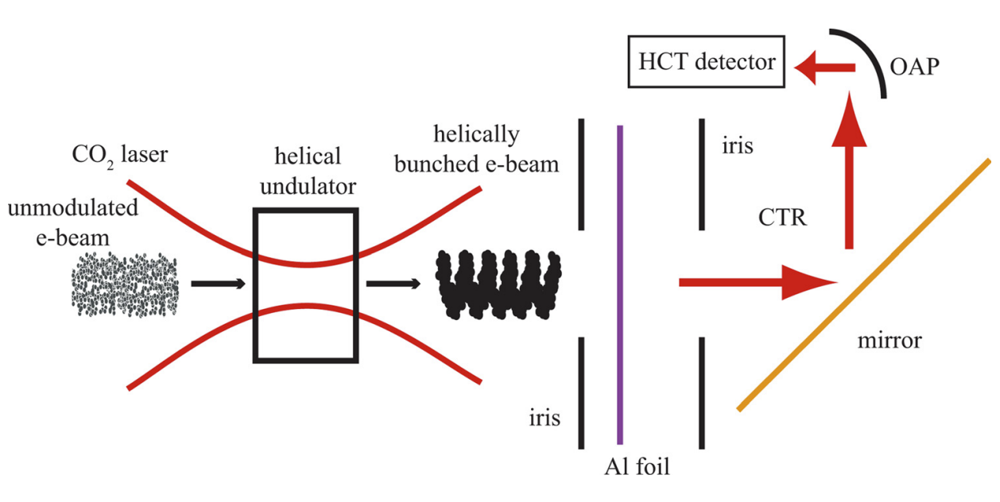
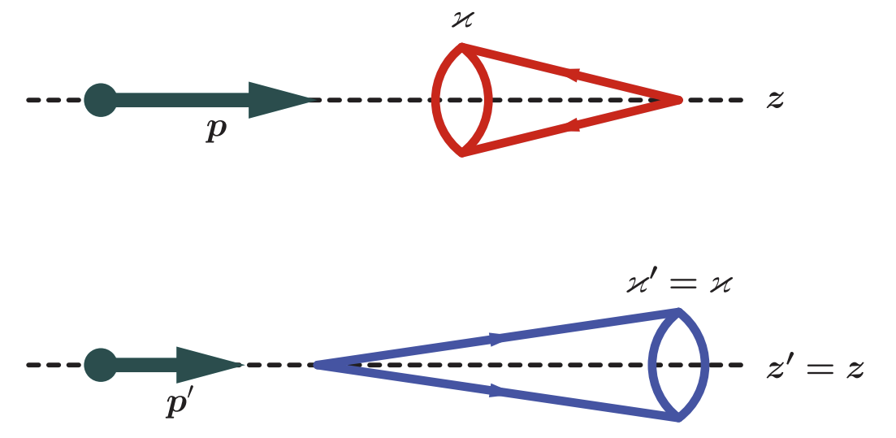
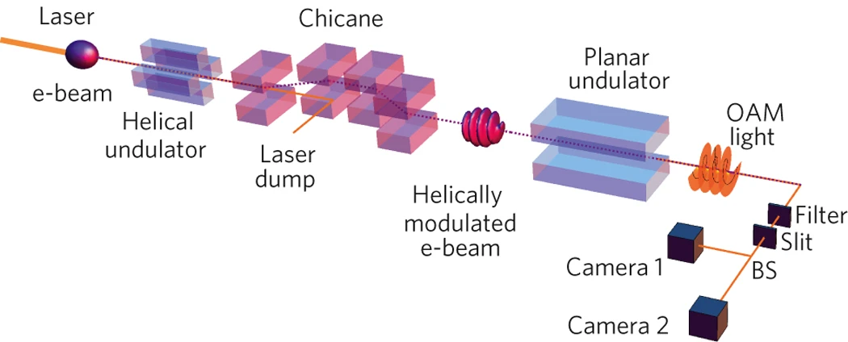
Vortex Gamma photons
Vortex Photon Generation
Vortex light with higher energy is generated via linear Compton back scattering
(low energy vortex photon → high energy vortex photon)
Helical microbunching of a relativistic
electron beam [Appl. Phys. Lett. 100, 091110 (2012)]
[Phys. Rev. Lett. 106, 013001 (2011)]
Vortex light with higher energy is generated via radiation
Coherent optical vortices from relativistic electron beams
[Nature Phys., 9: 549–553 (2013)]
[Phys. Rev. D 99, 116016 (2019)]
19

Slide 20
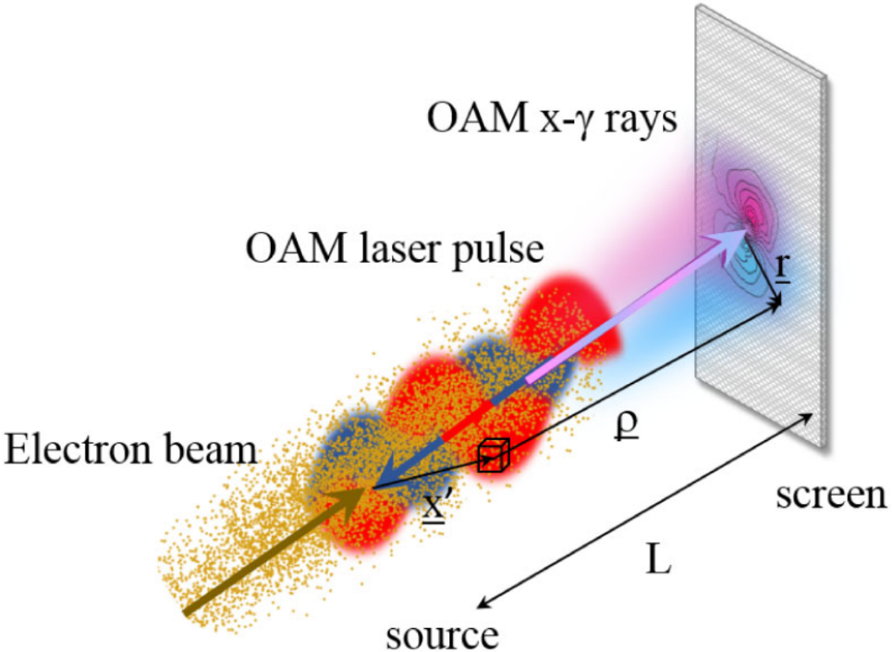
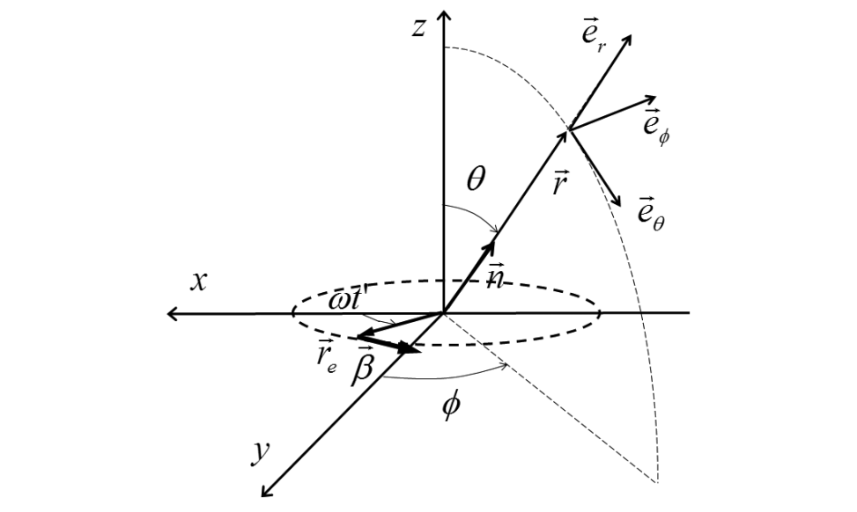
Vortex Gamma photons
Vortex Photon Generation: Classical Radiation
Possibility of producing x-gamma rays with orbital angular momentum by means of the inverse Compton backscattering between a high brightness electron beam and a twisted laser pulse
[Phys. Rev. Lett. 117, 123903 (2016)]
The proposal is based on classical radiation by charged particles in helical motion.
The radiated n-th harmonic carries total AM (TAM) of n$ℏ$.
[Phys. Rev. Lett. 118, 094801 (2017)]
Quantum effects have to considered at higher energies.
20

Slide 21
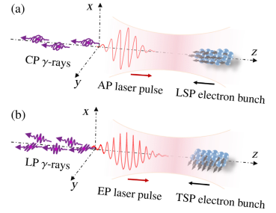
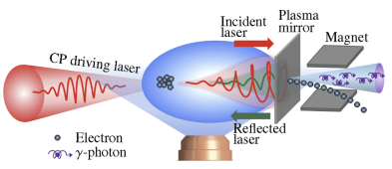
Vortex Gamma photons
Linear Compton scattering
Opt. Lett. 47, 3356 (2022)
Nonlinear Compton scattering
Phys. Rev. Lett. 124, 014801 (2020)
Multi-photon absorption channel: Electron spin
Single-photon absorption channel: Laser polarization
Y. Wang et al., arXiv: 2306.14936 (2023)
Angular Momentum Conservation is not taken into account!
21

Slide 22
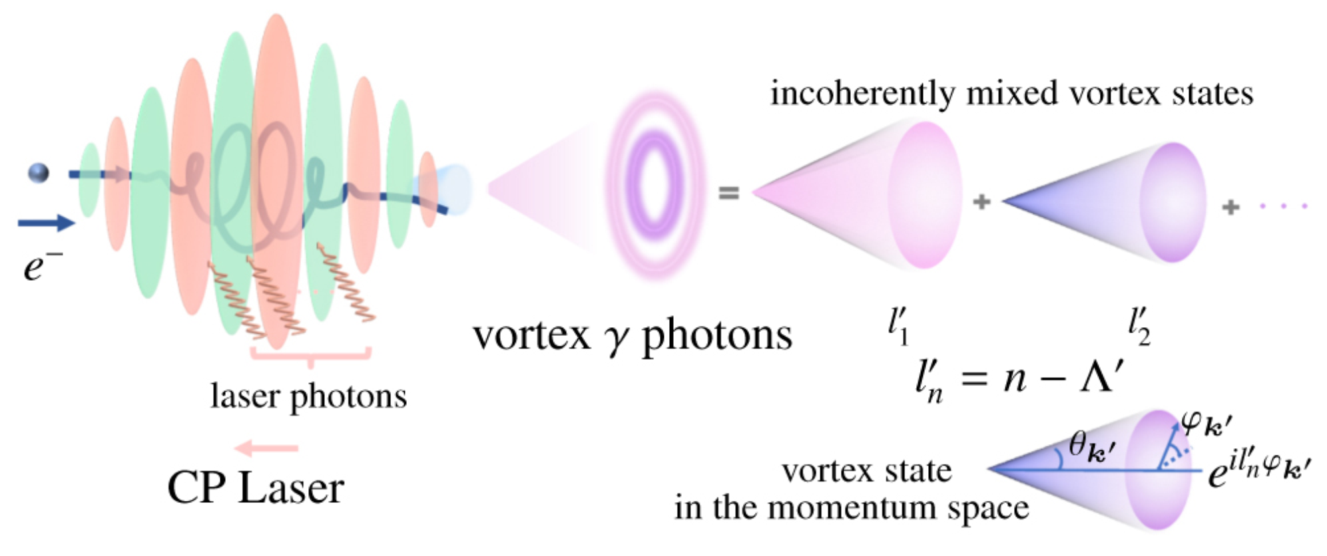
Vortex Gamma photons
Quantum electrodynamics scattering theory:
Multiphoton Absorption, Angular Momentum Conservation
Spin-to-orbital angular momentum transfer
Radiation of γ photons with phase vortices: Mixed states
M. Ababekri et al., Phys. Rev. D 109, 016005 (2024)
22

Slide 23
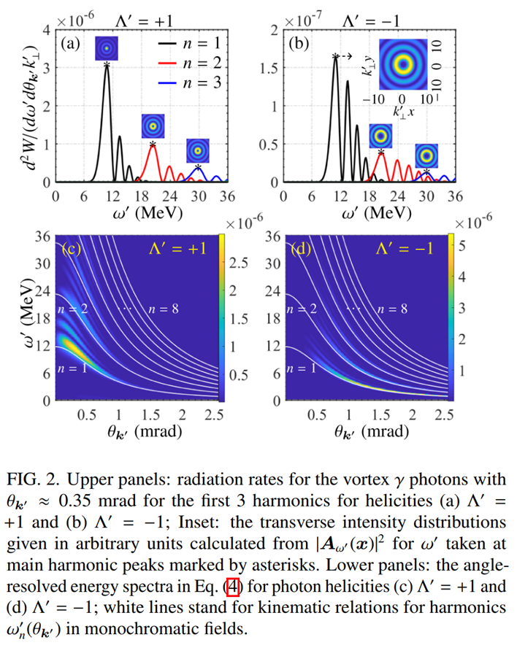
Vortex Gamma photons
23

Slide 24
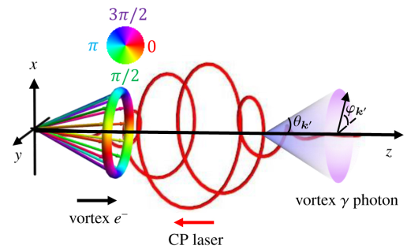
Vortex Gamma photons
Orbital-to-orbital angular momentum transfer
Generation of γ photons with extremely large orbital angular momenta
Open question:
How to generate a pure state of OAM?
LG laser?
Stimulating CS process?
R. Guo et al., arXiv:2310.16306
24

Slide 25
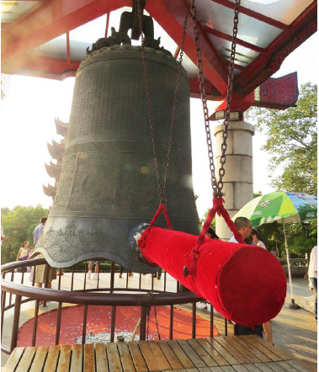
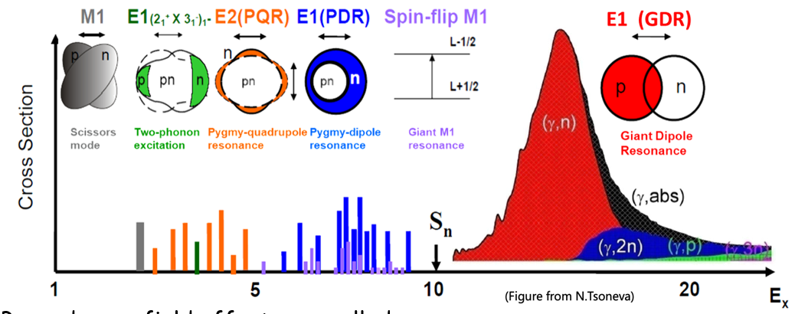
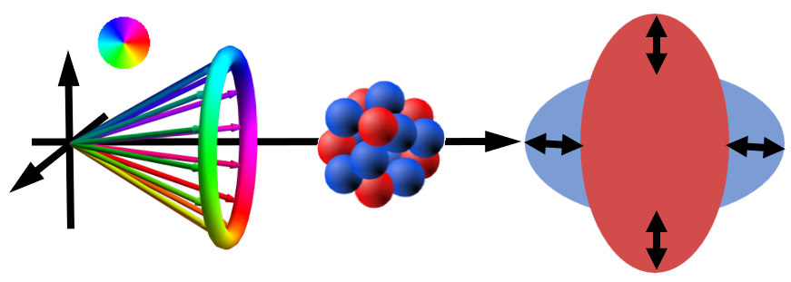
Vortex photonuclear reaction
Nuclear giant resonances
Challenge：
Measurement of isovector giant resonances with higher multipolarities
钟：原子核
锤子：探针（e,γ,α,p,n）
钟声：不同的振动模式
Z.-W. Lu et al., Phys. Rev. Lett. 131, 202502 (2023)

Slide 26
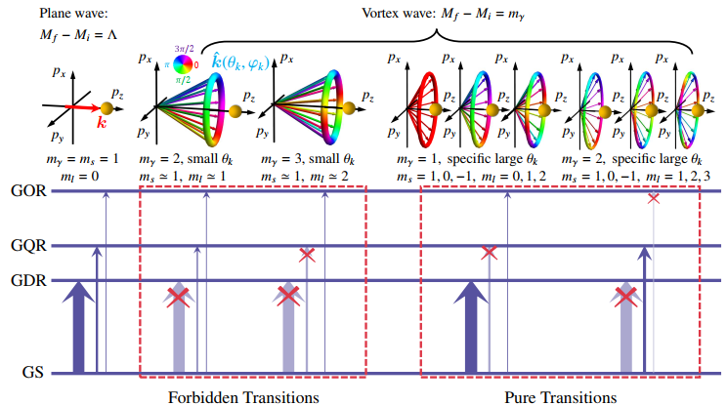
Vortex photonuclear reaction
Collective excitations of different multipole transitions in nuclei
Giant octupole resonance
Giant quadrupole resonance
Giant dipole resonance
Ground State
Simulation: Random-phase approximation plus particle-vibration coupling (RPA+PVC) model
Lu et al., Phys. Rev. Lett. 131, 202502 (2023)

Slide 27
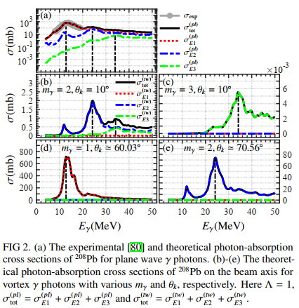
Vortex photonuclear reaction
Detecting the OAM states of vortex γ photon

Slide 28
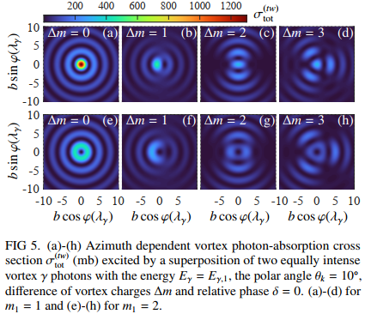
Vortex photonuclear reaction
Detecting the mixed OAM states of vortex γ photon

Slide 29
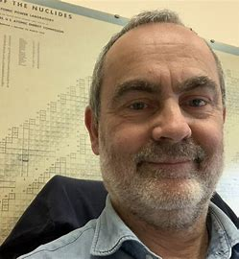
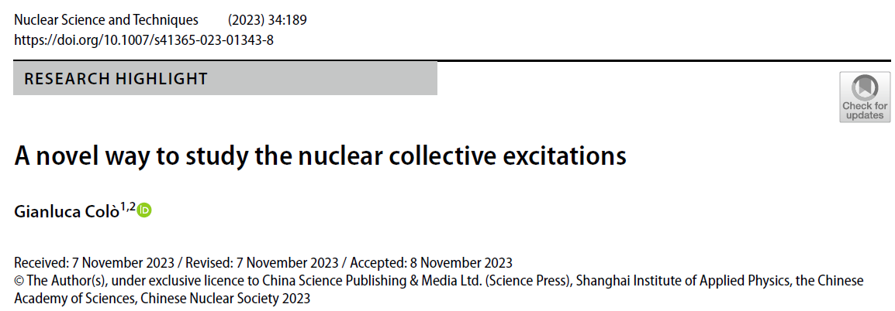
Vortex photonuclear reaction
《Nuclear Science and Techniques》上对该工作进行了专题报道，并评价本工作是核物理的“突破”、“新颖方法”：
“Here comes the breakthrough, as detailed in Ref. [5]... In [5], a novel method has been proposed to excite giant resonances having a given angular momentum, in a controlled way…”
意大利国家核物理研究所、米兰大学物理学院主任 Gianluca Colò教授

Slide 30
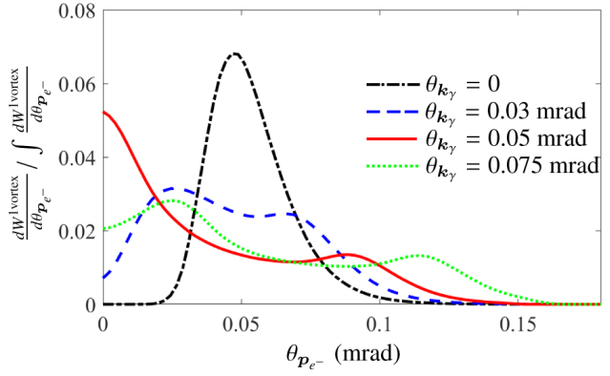
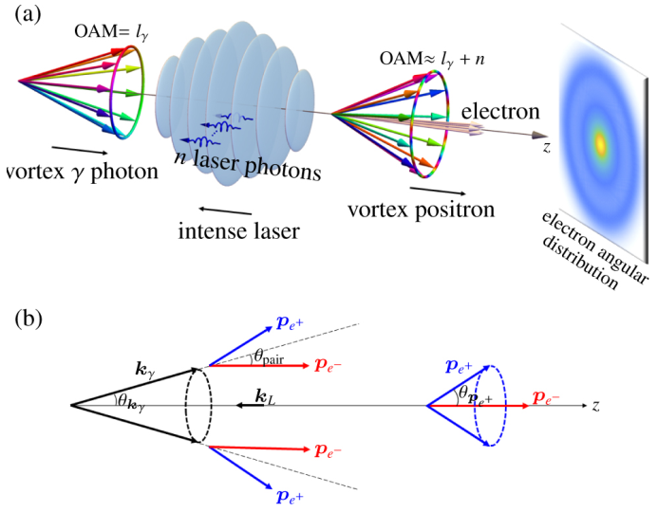
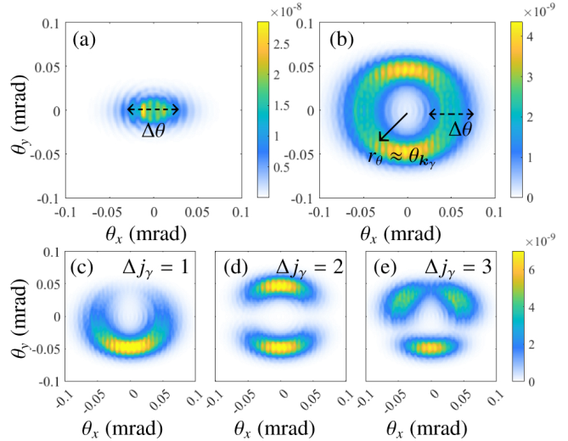
Vortex electrons and positrons
Full angular-momentum-resolved quantum scattering theory of NBW process
Orbital-to-orbital angular momentum transfer in NBW
Generation of photons with extremely large orbital angular momenta
M. Ababekri et al., arXiv:2404.11952 (2024)
30

Slide 31
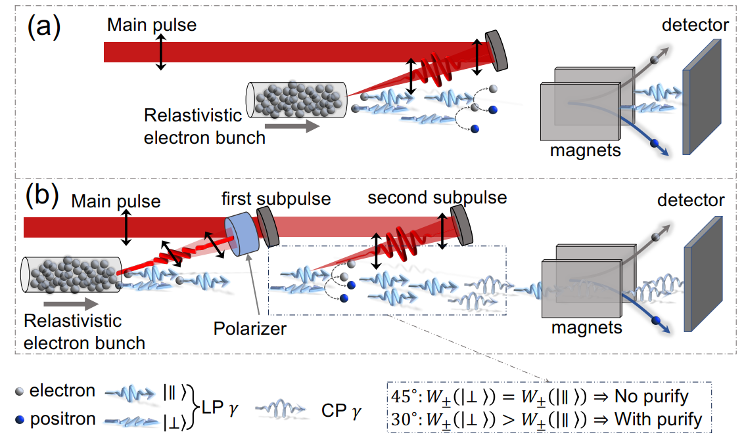
利用VD辅助的VB效应产生圆偏振伽马光源
C. Lv et al., arXiv: 2401.14075 (2024)

Slide 32
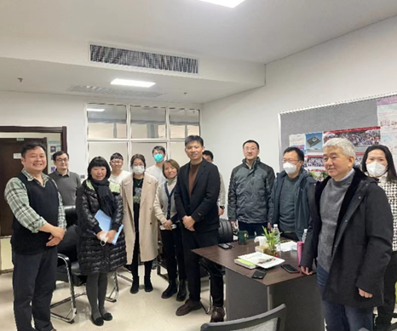
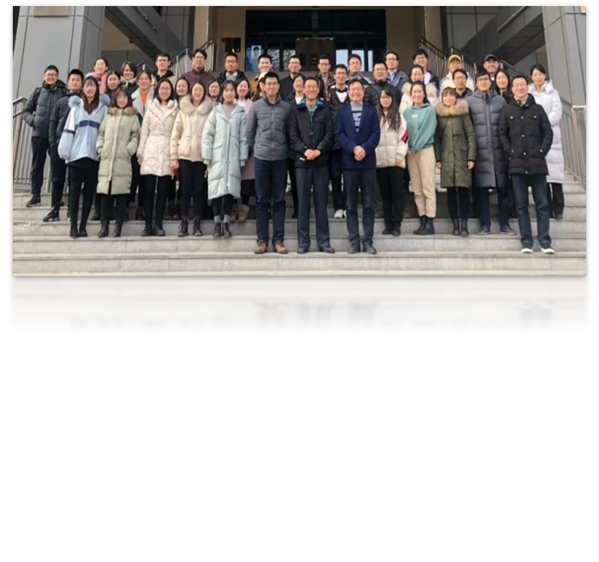
Acknowledgment
32/10
China Institute of Atomic Energy：Bing Guo, Chong Lv, Ruirui Xu
Peking University：Bin Qiao
Research center of laser fusion, China academy of engineering physics：
Zongqing Zhao, Yuqiu Gu, Weimin Zhou, Bo Zhang, Jiaxing Wen……
Lanzhou University: Yifei Niu, Fangqi Chen……
Fudan University: Changbo Fu, Xiangjin Kong
Hunan University: JinQing Yu
Sun Yat-Sen University: YongSheng Huang
Northwest Institute of Nuclear Technology: Xiu-Feng Weng
……

Slide 33
Thanks for your
attention!

