Slide 1
Generating Neutrons with OAM for Fundamental Physics Experiments

Slide 2
Outline
-An introduction to structured waves
-Why structured waves?
-Coherent averaging
-Orbital angular momentum (OAM)
-The Austrian NRSE Interferometer CANISIUS
-Instrument overview
-Modes and applications
-Some fundamental physics cases for neutron OAM
-Do absorption cross sections depend on wave structure?
-Structured waves in non-inertial frames. The Sagnac effect (OAM-Rotation coupling)

Slide 3

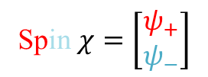


Thermal Neutrons: An Overview
Behold: The Neutron!
-Unique “quantum” probe structures and dynamics over vast length and energy scales
→Diffraction to USANS up to radiography
-Beams can be modulated in space (mm-cm) and time (Hz-MHz)
-Cross sections make neutrons useful for detecting light nuclei and in some cases contrast enhancement
-Fundamental physics questions
→Quantum Information, Contextuality, Equivalence Principle
Spin-Rotation Coupling!
Longitudinal Coherence Length $σ_{∥}$
Wavelength $λ$
Spin $χ=\left[\begin{matrix}ψ_{+} \\ ψ_{−}\end{matrix}\right]$
Transverse Coherence Length $σ_{⊥}$
For us: $λ=1.9 A E=25 meV θ=0.1°−1° \left|μ\right|=60 neV/T$
$σ_{⊥}=0.01 µm −10 µm σ_{∥}=10 nm φ=1−{10}^{11} cm^{−2}s^{−1}$
Notes:
Structure of the spatial wavefunction is fully determined by the momentum distribution

Slide 4

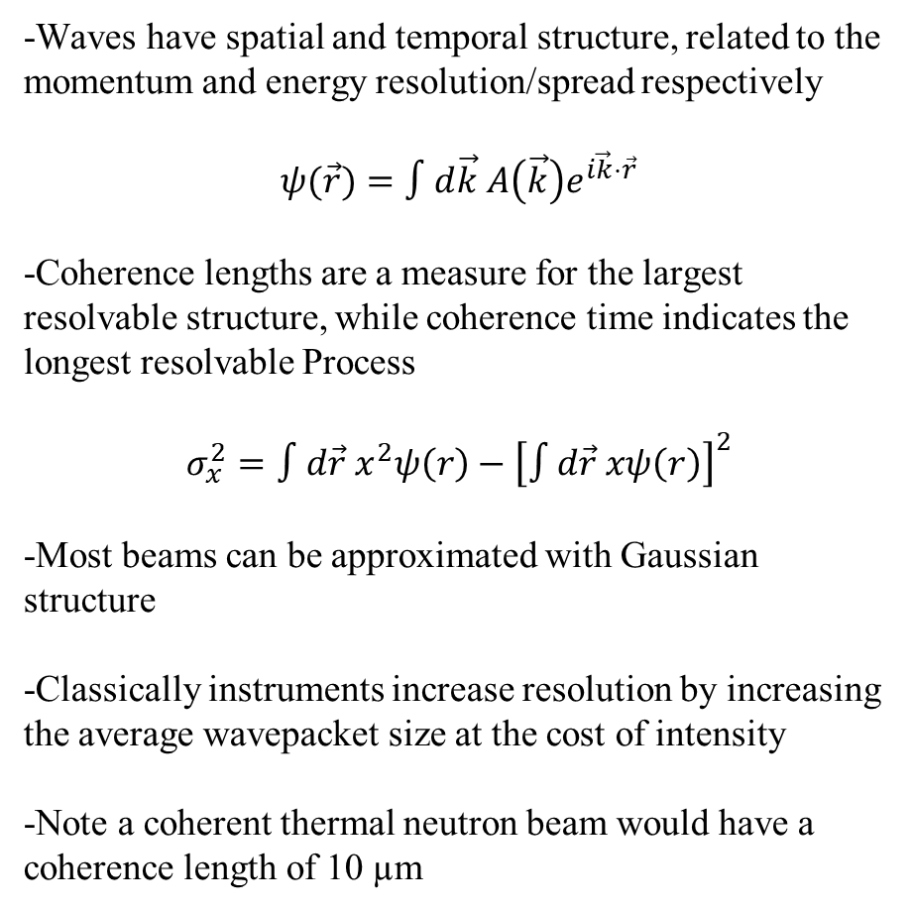


Structured Waves
-Waves have spatial and temporal structure, related to the momentum and energy resolution/spread respectively
$$ψ(\vec{r})=∫d\vec{k} A\left(\vec{k}\right)e^{i\vec{k}⋅\vec{r}}$$
-Coherence lengths are a measure for the largest resolvable structure, while coherence time indicates the longest resolvable Process
$$σ_{x}^{2}=∫d\vec{r} x^{2}ψ\left(r\right)−{\left[∫d\vec{r} xψ\left(r\right)\right]}^{2}$$
-Most beams can be approximated with Gaussian structure
-Classically instruments increase resolution by increasing the average wavepacket size at the cost of intensity
-Note a coherent thermal neutron beam would have a coherence length of 10 µm
Longitudinal Coherence Length $σ_{∥}$
Wavelength $λ$
Transverse Coherence Length $σ_{⊥}$

Slide 5

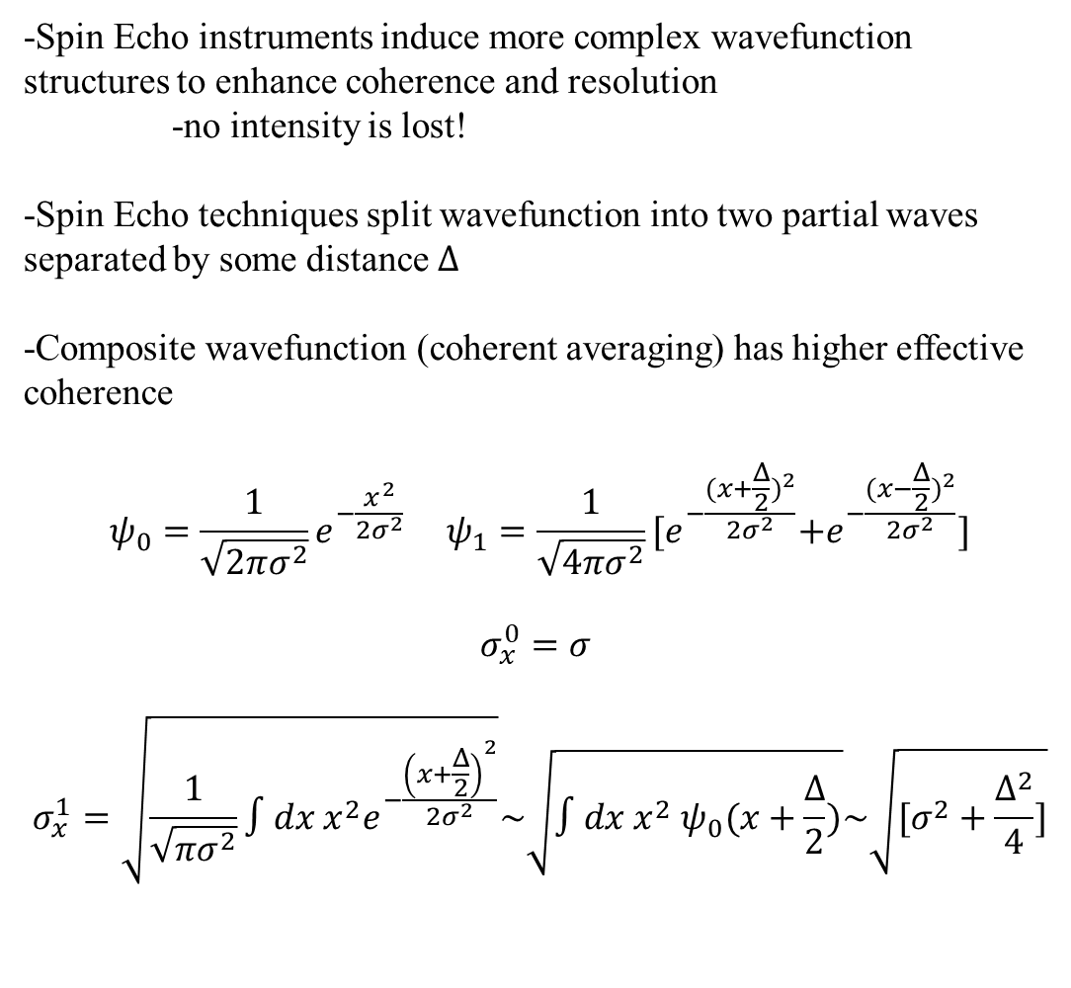
Structured Waves
-Spin Echo instruments induce more complex wavefunction structures to enhance coherence and resolution
-no intensity is lost!
-Spin Echo techniques split wavefunction into two partial waves separated by some distance $Δ$
-Composite wavefunction (coherent averaging) has higher effective coherence
$$ψ_{0}=\frac{1}{\sqrt{2πσ^{2}}}e^{−\frac{x^{2}}{{2σ}^{2}}} ψ_{1}=\frac{1}{\sqrt{4πσ^{2}}}{[e}^{−\frac{{(x+\frac{Δ}{2})}^{2}}{{2σ}^{2}}}+e^{−\frac{{(x−\frac{Δ}{2})}^{2}}{{2σ}^{2}}}]$$
$$σ_{x}^{0}=σ$$
$$σ_{x}^{1}=\sqrt{\frac{1}{\sqrt{πσ^{2}}}∫dx x^{2}e^{−\frac{{\left(x+\frac{Δ}{2}\right)}^{2}}{{2σ}^{2}}}}\sim \sqrt{∫dx x^{2} ψ_{0}(x+\frac{Δ}{2})}\sim \sqrt{[σ^{2}+\frac{Δ^{2}}{4}]}$$
$$Δ$$

Slide 6
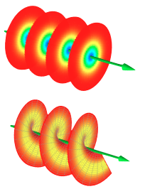
Why Structured Waves?
-Structured waves increase momentum and energy resolution and effective coherence!
-The type of structure (time, space, angular momentum), determines what we are sensitive to
-Information can be encoded in structure
-Some types of structure, such as Orbital Angular Momentum can be used as a quantum DoF

Slide 7
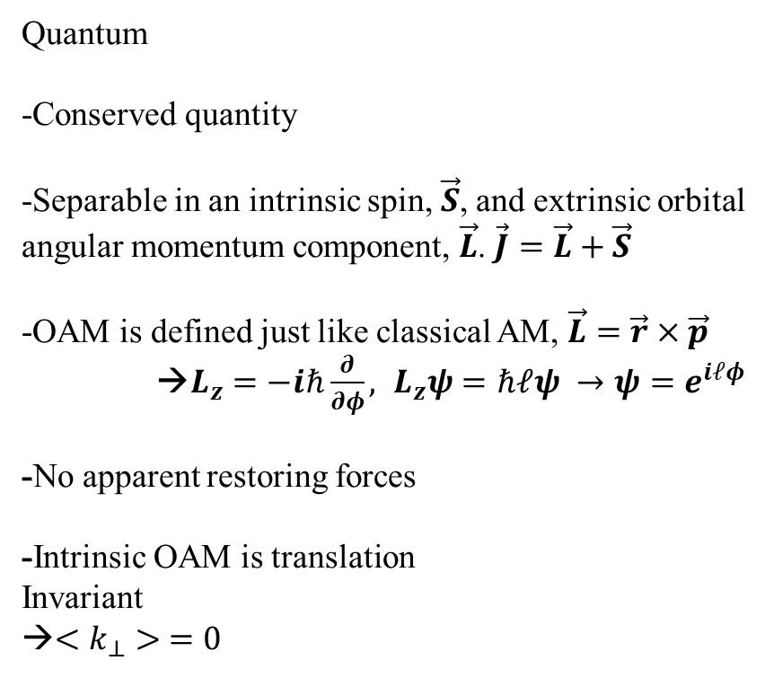

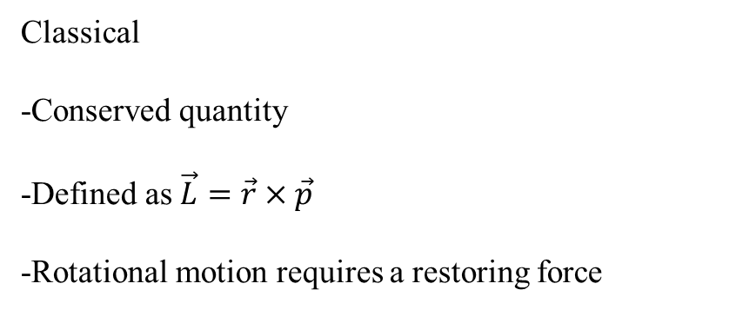



Angular Momentum
Classical
-Conserved quantity
-Defined as $\vec{L}=\vec{r}×\vec{p}$
-Rotational motion requires a restoring force
Quantum
-Conserved quantity
-Separable in an intrinsic spin, $\vec{S}$, and extrinsic orbital angular momentum component, $\vec{L}$. $\vec{J}=\vec{L}+\vec{S}$
-OAM is defined just like classical AM, $\vec{L}=\vec{r}×\vec{p}$
→$L_{z}=−iℏ\frac{∂}{∂φ}, L_{z}ψ=ℏℓψ →ψ=e^{iℓφ}$
-No apparent restoring forces
-Intrinsic OAM is translation
Invariant
→$<k_{⊥}> =0$
$$α$$
$$d$$
$$\vec{L}$$
$$m,\vec{ω}$$

Slide 8
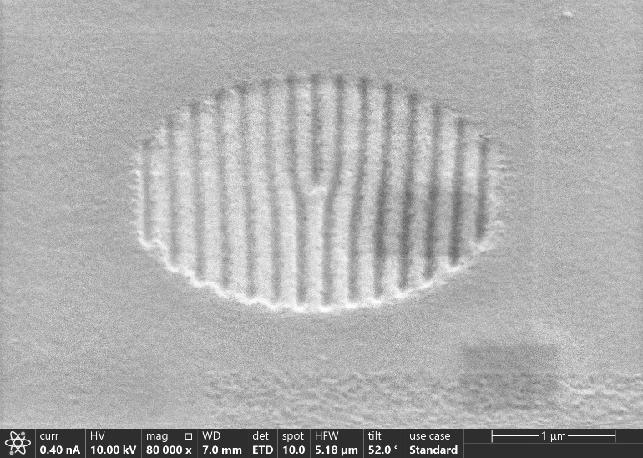
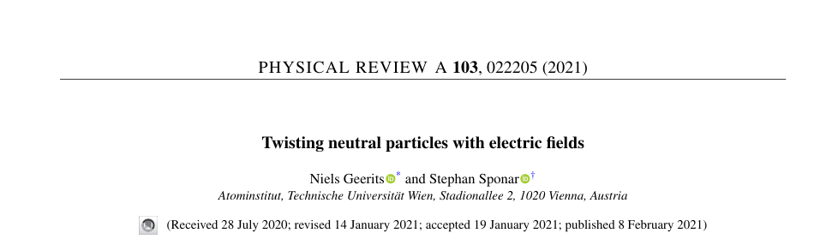
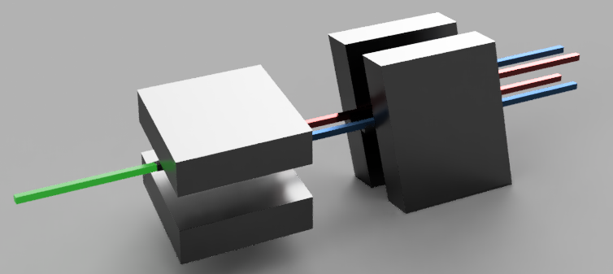
Methods for OAM
-Spiral Phase Plate (Strong Nuclear)
-Fork Gratings (Strong Nuclear)
-Refraction/Coherent Averaging (Strong Nuclear/Magnetic)
-Neutron Nucleus Weak Interaction (Weak Nuclear)
-Static Electic Fields (EM)
-Dynamical Diffraction in non centrosymmetric crystals (Strong Nuclear/EM)

Slide 9
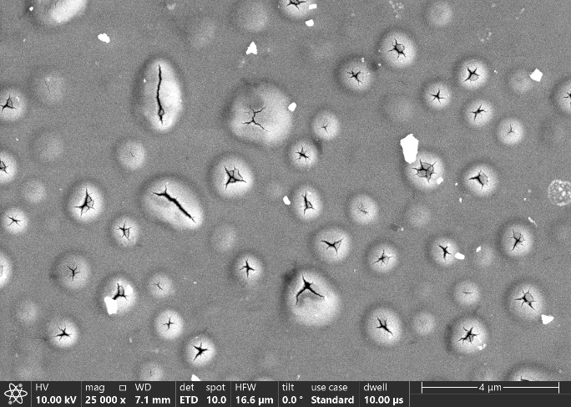
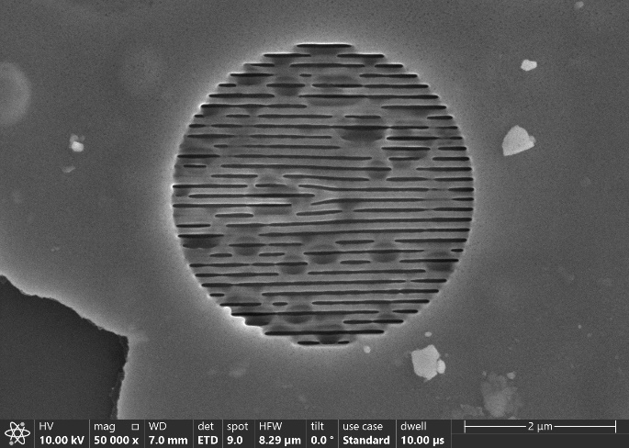
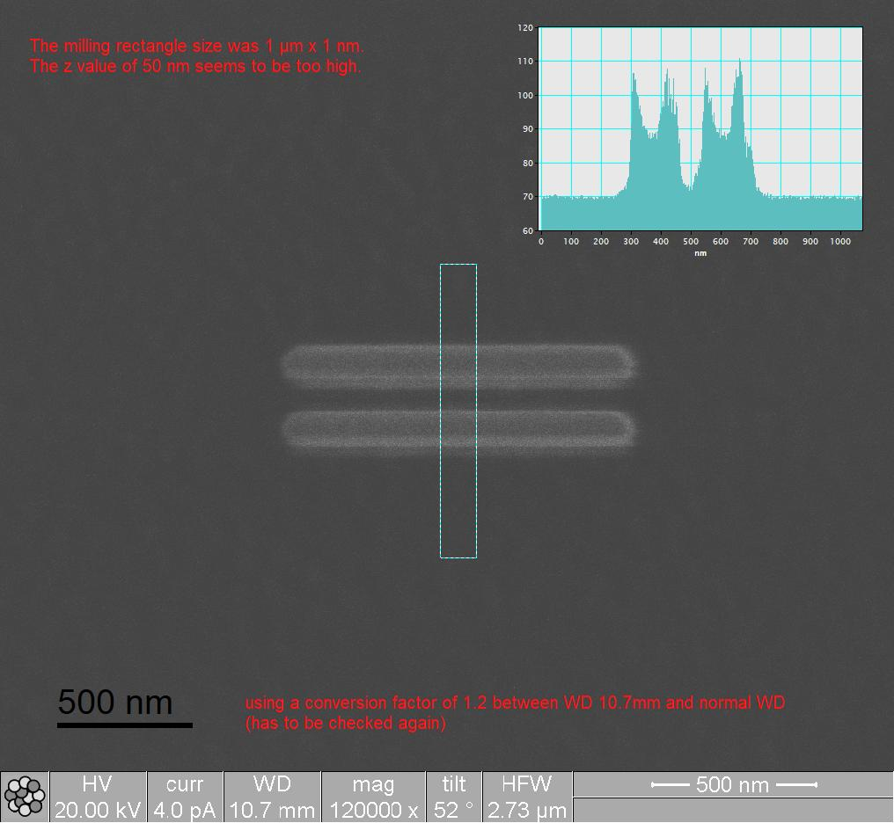
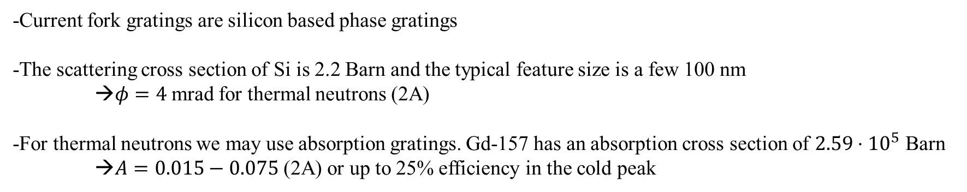
Fork Gratings for Thermal Neutrons
-Current fork gratings are silicon based phase gratings
-The scattering cross section of Si is 2.2 Barn and the typical feature size is a few 100 nm
→$φ=4$mrad for thermal neutrons (2A)
-For thermal neutrons we may use absorption gratings. Gd-157 has an absorption cross section of $2.59⋅{10}^{5}$ Barn
→$A=0.015−0.075$ (2A) or up to 25% efficiency in the cold peak

Slide 10
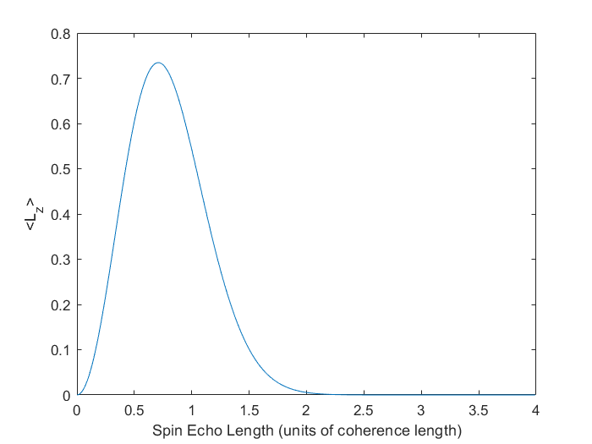
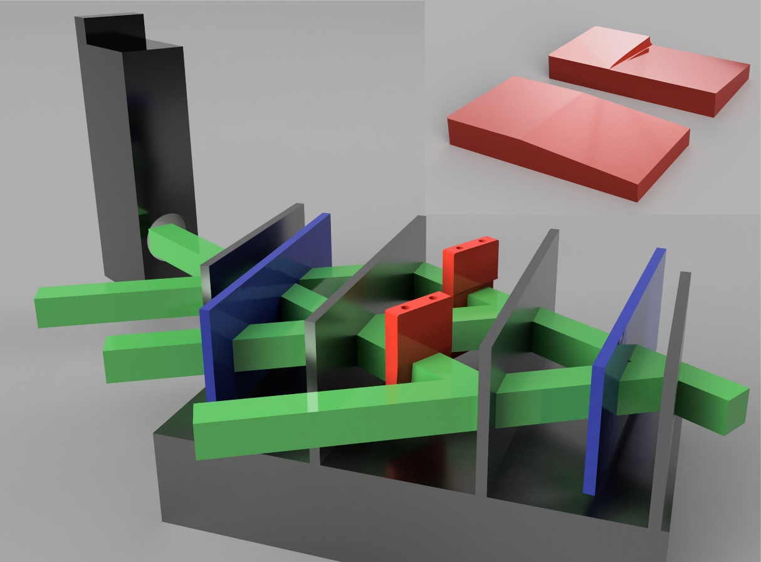
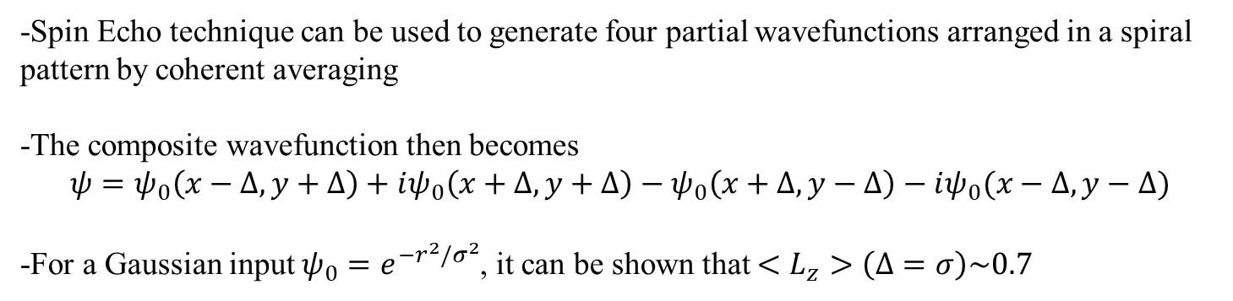
OAM Generation: Coherent Averaging
-Spin Echo technique can be used to generate four partial wavefunctions arranged in a spiral pattern by coherent averaging
-The composite wavefunction then becomes
$$ψ=ψ_{0}\left(x−Δ,y+Δ\right)+iψ_{0}\left(x+Δ,y+Δ\right)−ψ_{0}\left(x+Δ,y−Δ\right)−iψ_{0}(x−Δ,y−Δ)$$
-For a Gaussian input $ψ_{0}=e^{−r^{2}/σ^{2}}$, it can be shown that $<L_{z}>\left(Δ=σ\right)\sim 0.7$

Slide 11
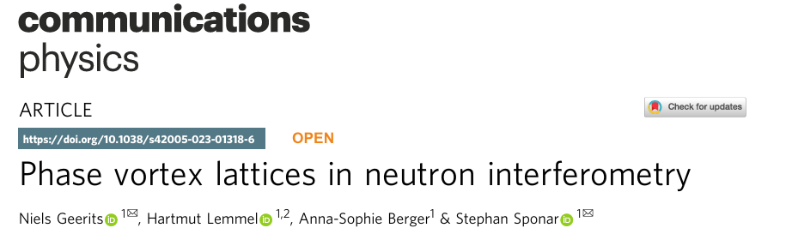
OAM Generation: Coherent Averaging
-Spin Echo technique can be used to generate four partial wavefunctions arranged in a spiral pattern by coherent averaging
-The composite wavefunction then becomes
$$ψ=ψ_{0}\left(x−Δ,y+Δ\right)+iψ_{0}\left(x+Δ,y+Δ\right)−ψ_{0}\left(x+Δ,y−Δ\right)−iψ_{0}(x−Δ,y−Δ)$$
-For a Gaussian input $ψ_{0}=e^{−r^{2}/σ^{2}}$, it can be shown that $<L_{z}>\left(Δ=σ\right)\sim 0.7$

Slide 12
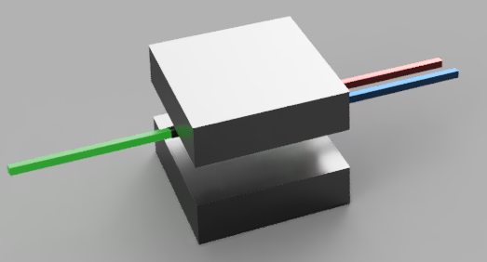
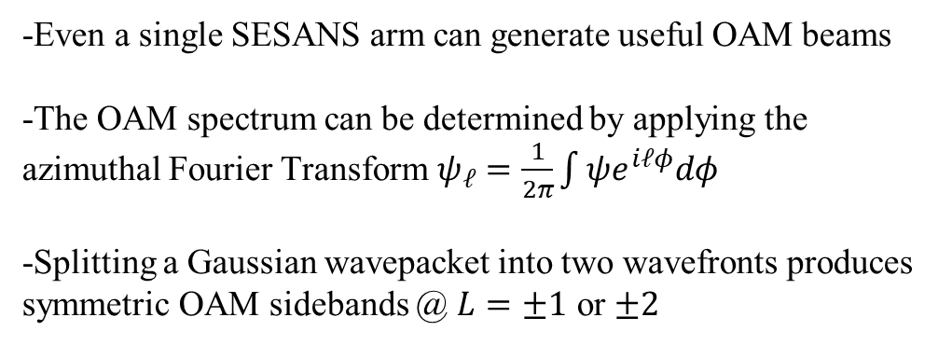
OAM with 1D separation?
-Even a single SESANS arm can generate useful OAM beams
-The OAM spectrum can be determined by applying the azimuthal Fourier Transform $ψ_{ℓ}=\frac{1}{2π}\int{ψe^{iℓφ}dφ}$
-Splitting a Gaussian wavepacket into two wavefronts produces symmetric OAM sidebands @ $L=±1$ or $±2$

Slide 13
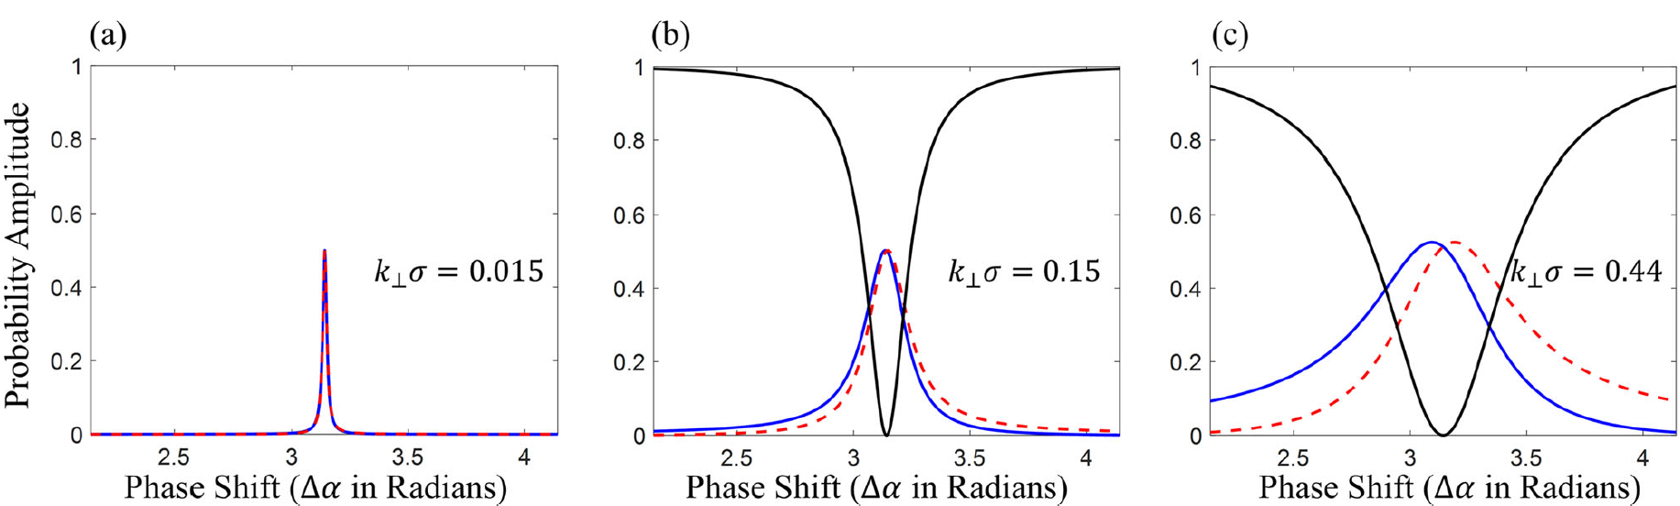
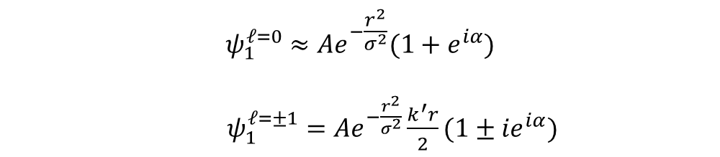
OAM Generators: Coherent Averaging
$$ψ_{1}^{ℓ=0}≈Ae^{−\frac{r^{2}}{σ^{2}}}(1+e^{iα})$$
$ψ_{1}^{ℓ=±1}=$ $Ae^{−\frac{r^{2}}{σ^{2}}}\frac{k^{′}r}{2}(1±{ie}^{iα})$
Note that for OAM generation occurs only in a very narrow range of phase shifter settings if the refraction is much smaller than the coherence!

Slide 14
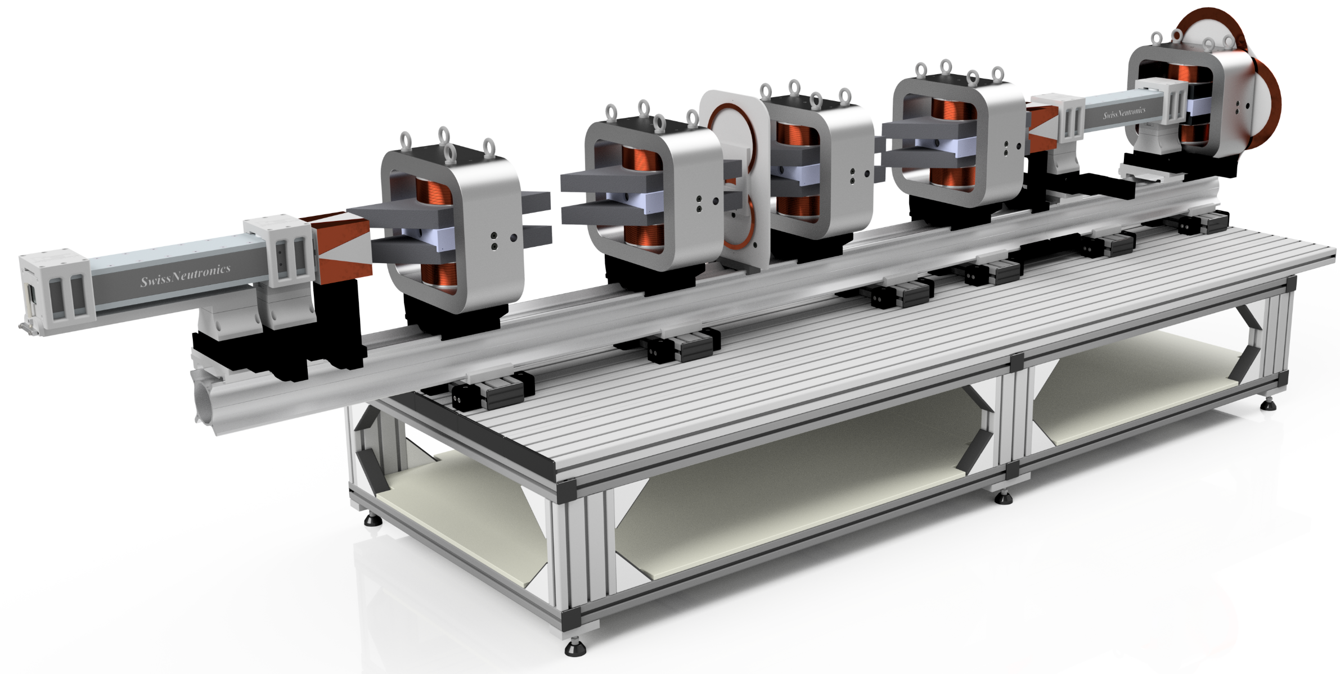
CANISIUS
Cold Austrian Neutron Instrument for Spin-echo Interferometry and fUndamental Science
A broad band NRSE instrument with SESANS/SEMSANS, NRSE and MIEZE capabilities
situated on the white beam of the 250 kW reactor

Slide 15
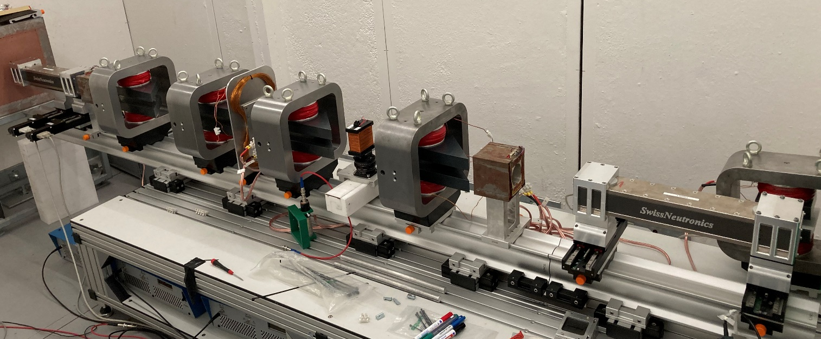
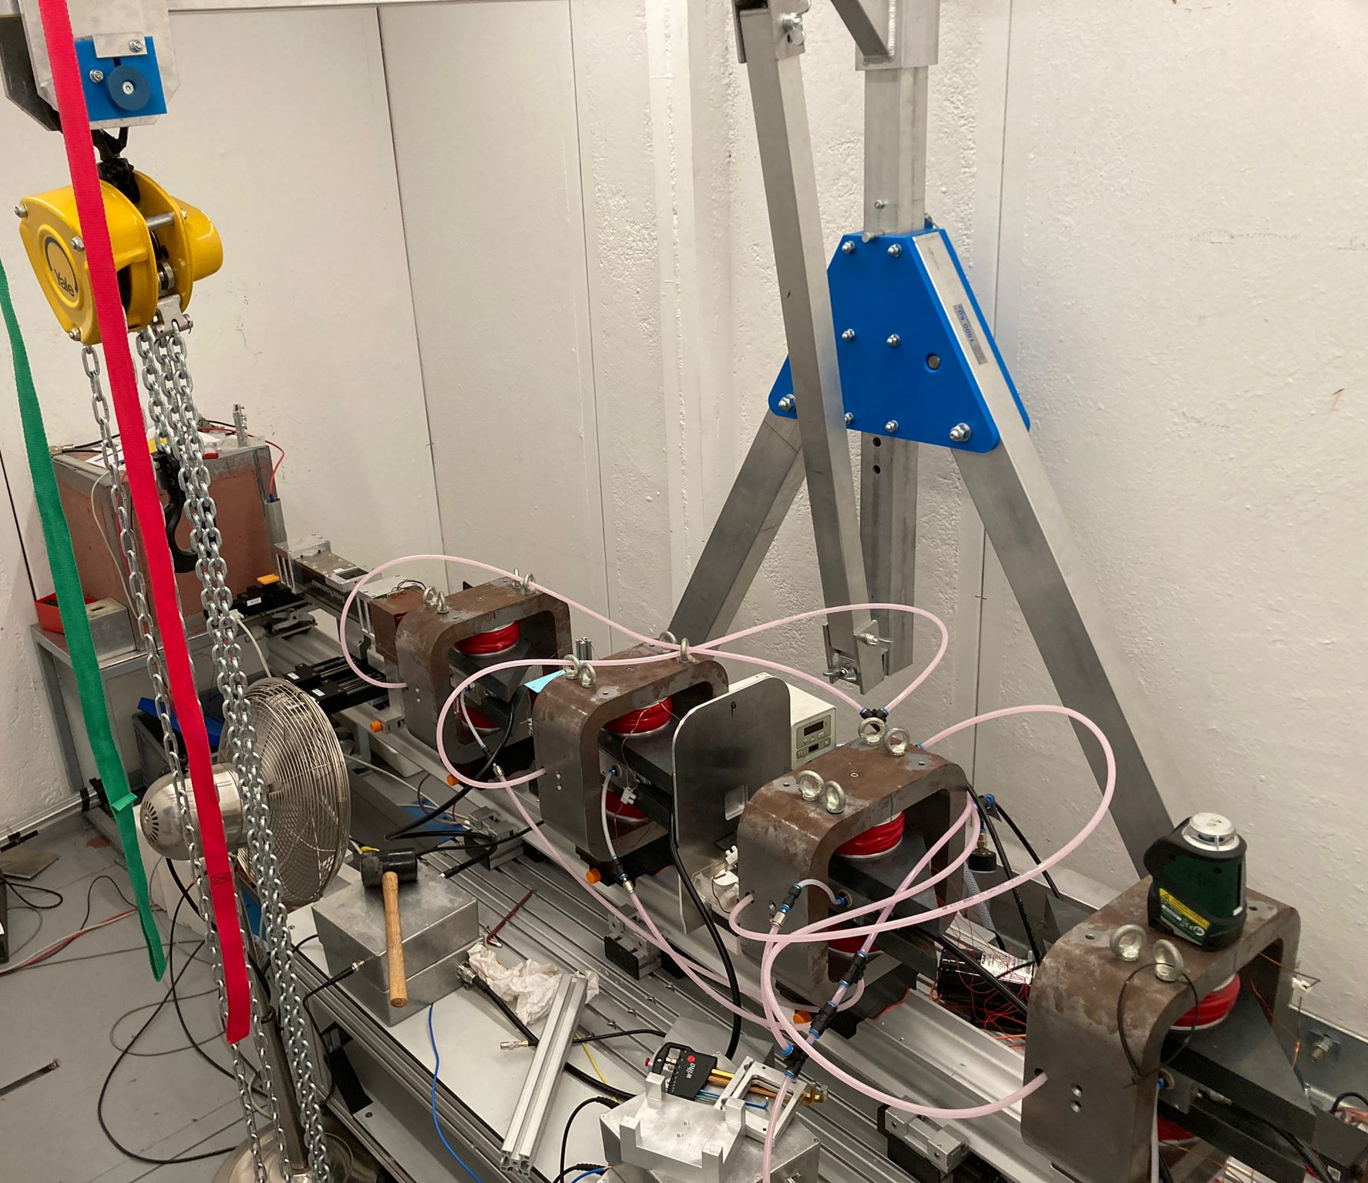
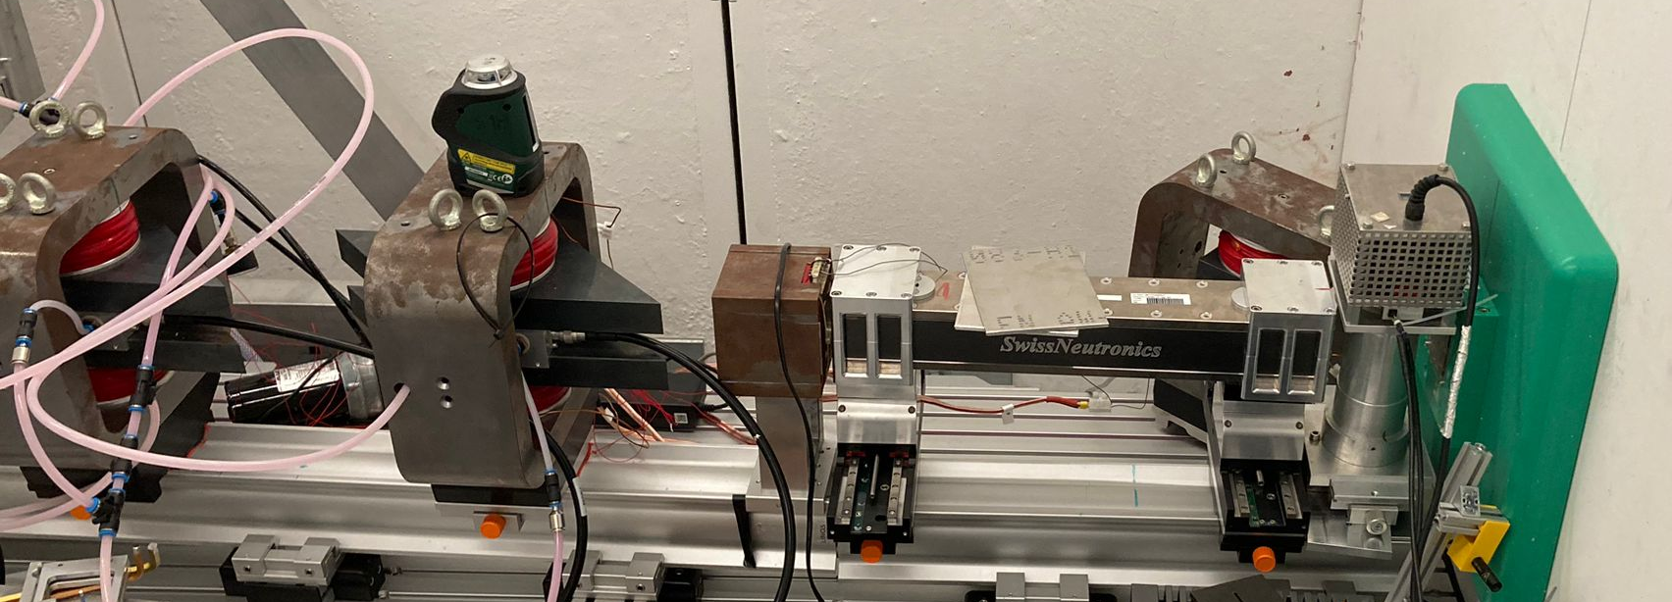
CANISIUS

Slide 16


CANISIUS Design Parameters
Flux: ~ ${10}^{3} s^{−1}cm^{−2}$
Wavelength band 2.5 A to 6 A
RF is currently running @ 1.4 MHz (4 MHz design)
ToF option by spin chopping on the front RF flipper or mechanical
Beam size 3 mm x 30 mm (initial) 7 mm x 10 mm (detector)
Changeable poleshoes for switching between NRSE/MIEZE to SESANS
Poleshoes can be rotated up to 5° to achieve defocused SESANS
SEL: 270 nm @ 3 A
SET: 210 ps @ 3 A

Slide 17
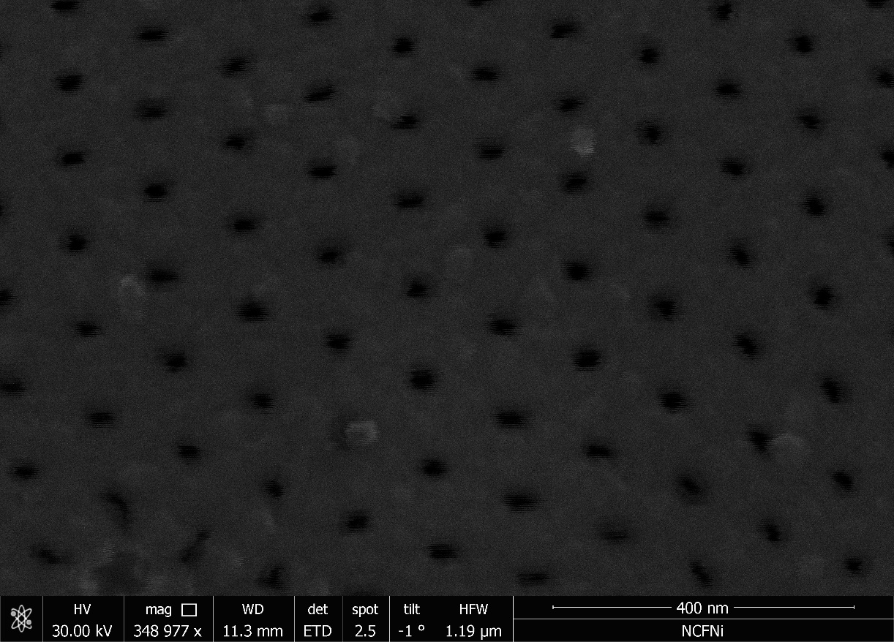
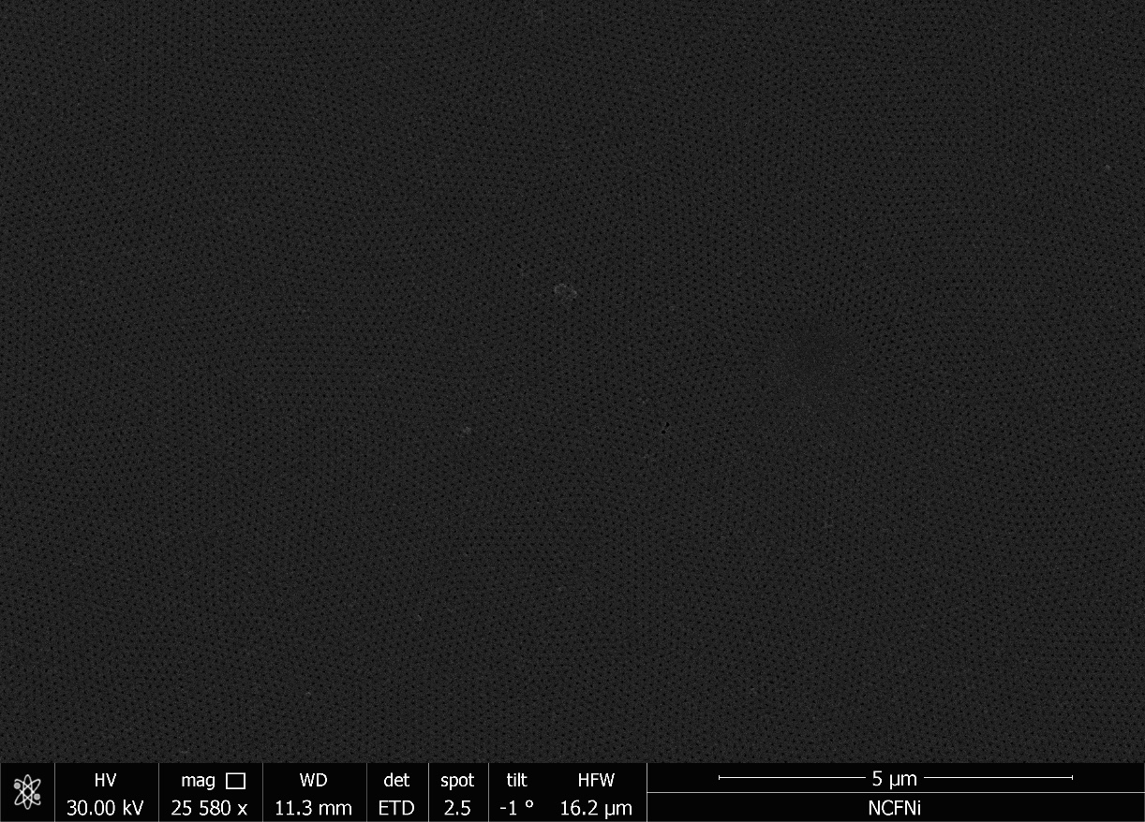
CANISIUS in SESANS

Slide 18
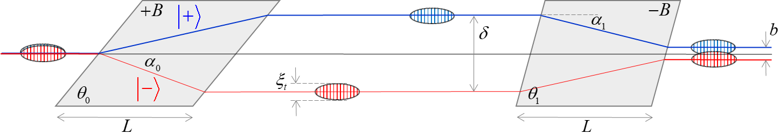
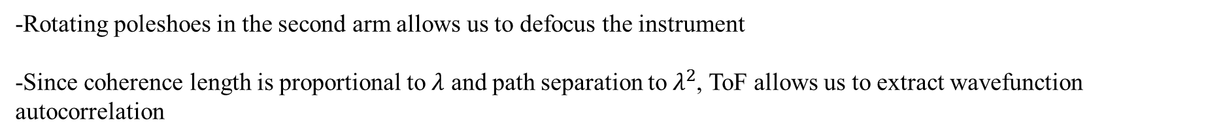

CANISIUS in defocused ToF SESANS
$$Δ$$
-Rotating poleshoes in the second arm allows us to defocus the instrument
-Since coherence length is proportional to $λ$ and path separation to $λ^{2}$, ToF allows us to extract wavefunction autocorrelation

Slide 19
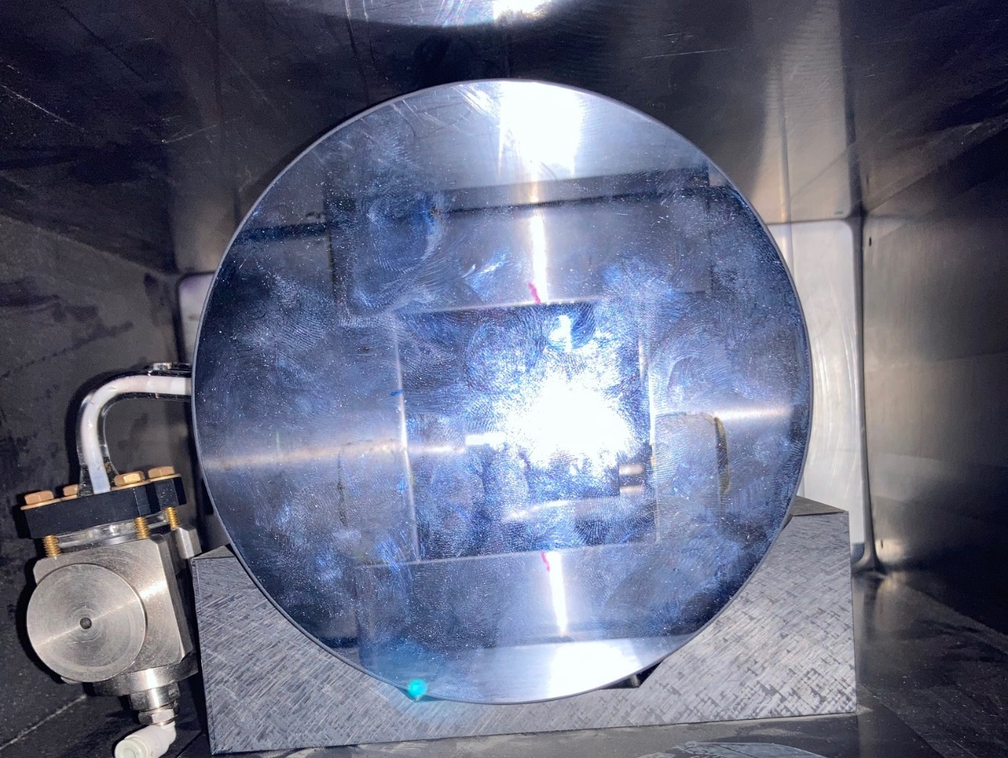
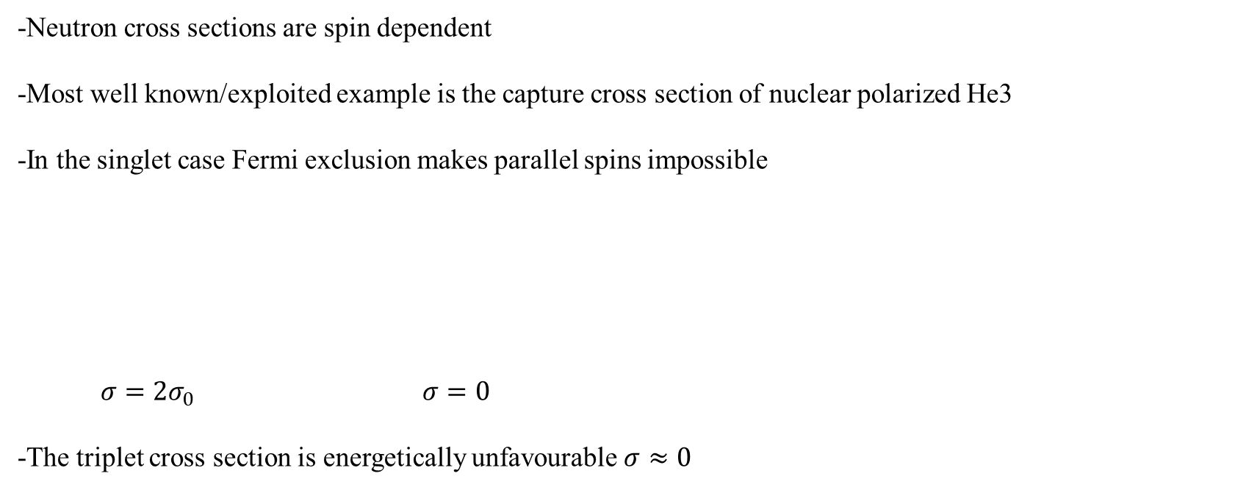
OAM Dependent Cross Sections
-Neutron cross sections are spin dependent
-Most well known/exploited example is the capture cross section of nuclear polarized He3
-In the singlet case Fermi exclusion makes parallel spins impossible
$σ=2σ_{0}$ $σ=0$
-The triplet cross section is energetically unfavourable $σ≈0$

Slide 20
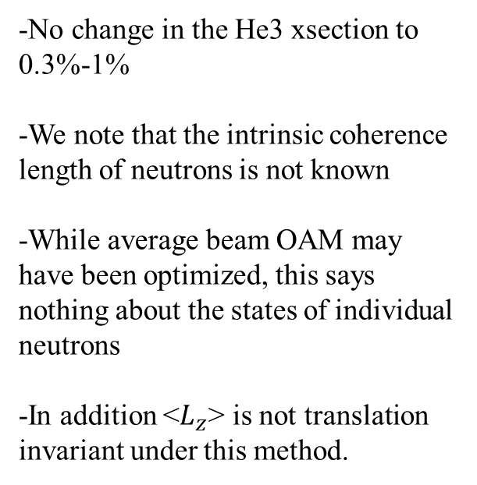
OAM Dependence of Absorption Cross Sections
-Composite nuclei which capture neutrons with OAM have different total angular momentum
-Some total AM are not permitted, in which case the absorption should be non-existent
-According to Jach and Vinson in Phys Rev C 105 L061601 (2022) the x section of polarized He3 is OAM dependent
-Theory incomplete due to disregarding L=0 state
-No change in the He3 xsection to 0.3%-1%
-We note that the intrinsic coherence length of neutrons is not known
-While average beam OAM may have been optimized, this says nothing about the states of individual neutrons
-In addition <$L_{z}$> is not translation invariant under this method.

Slide 21








OAM Dependent Cross Sections
-Standard QM suggests cross sections are dependent on the total AM of the composite nucleus
→Polarized He3 neutron capture cross section should depend on neutron OAM
Recently been tested using a coherent averaging method with four paths:
T. Jach and J. Vinson, Phys. Rev. C 105, L061601 (2022).
$$ψ_{in}$$
$$ψ_{out}$$
$$<L_{z}>$$
$$α=θ_{1}+θ_{2}$$
4 path
Interferometer
$$α=θ_{2}$$
$$α=θ_{1}$$
$$α=θ_{1}−θ_{2}$$
T. Jach and J. Vinson predicted a difference cross section of 40%
$$θ_{2}$$

Slide 22





OAM Dependent Cross Sections
$$<L_{z}>$$
$$<L_{z}>$$
$$θ_{1}$$
$$θ_{2}$$
$$θ_{2}$$
-As coherence increases the areas of maximal OAM become narrower
-Neutron coherence is unknown, though it must be equal to or larger than the beam coherence

Slide 23
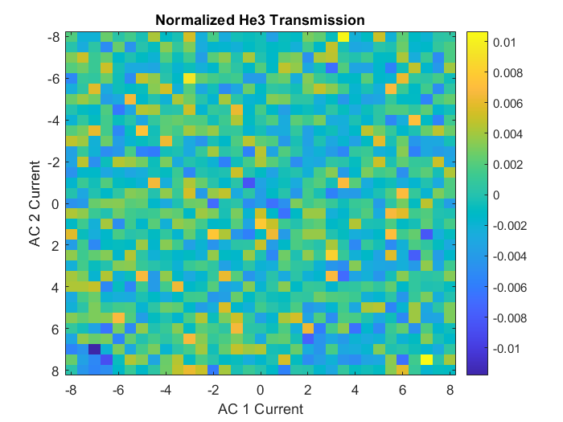
OAM Dependent Cross Sections
-No Structure in the transmission
-FT shows no signal at expected frequency to within 0.3%
-Finer phase scans could reveal something

Slide 24

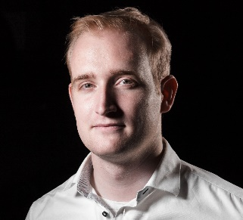
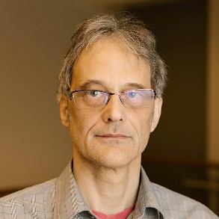
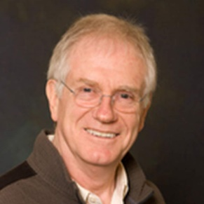


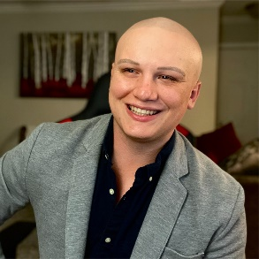
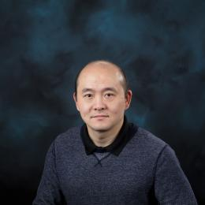
OAM Dependent Cross Sections
Atominstitut TU Wien
Stephan Sponar
Niels Geerits
Indiana University
Mike Snow
Roger Pynn
Sam Mckay
Roger Pynn
Oak Ridge National Lab
Fankang Li
Kaleb Burage
Peter Jiang

Slide 25
Continued Search

Slide 26
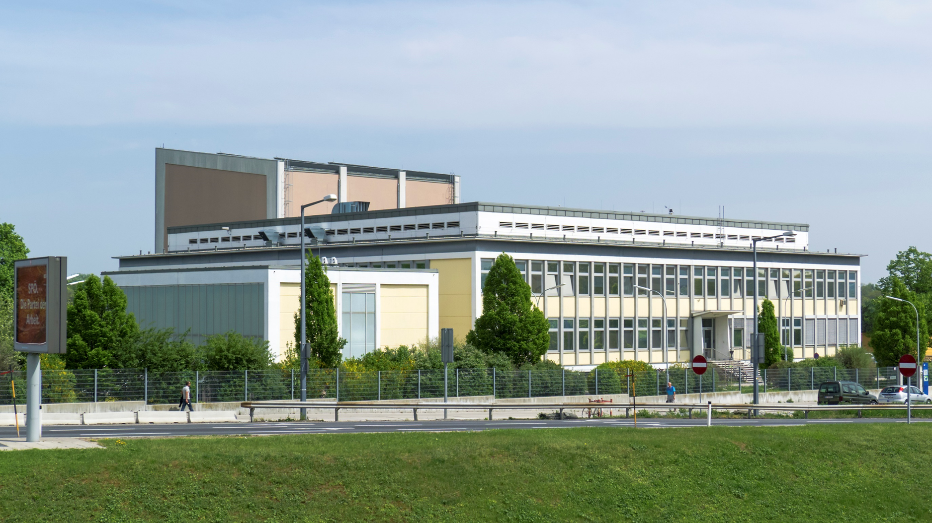
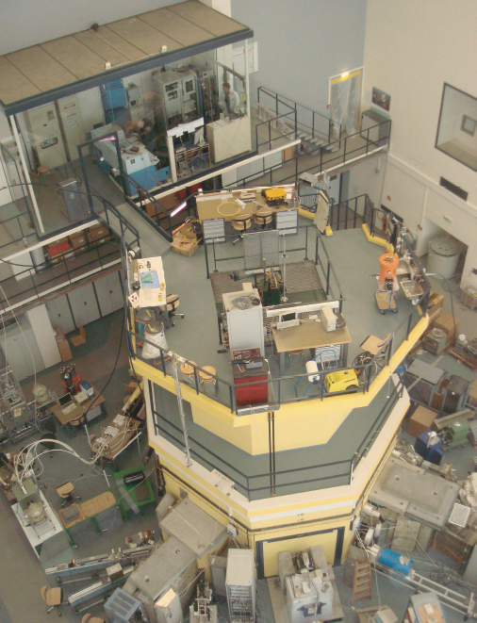


Thank You!
Projects:
P34239 (FWF)
DE-SC0023695 (DOE)

Slide 27
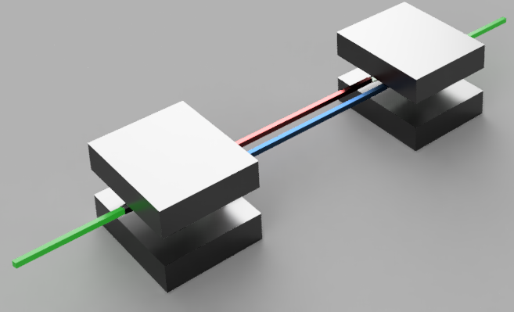
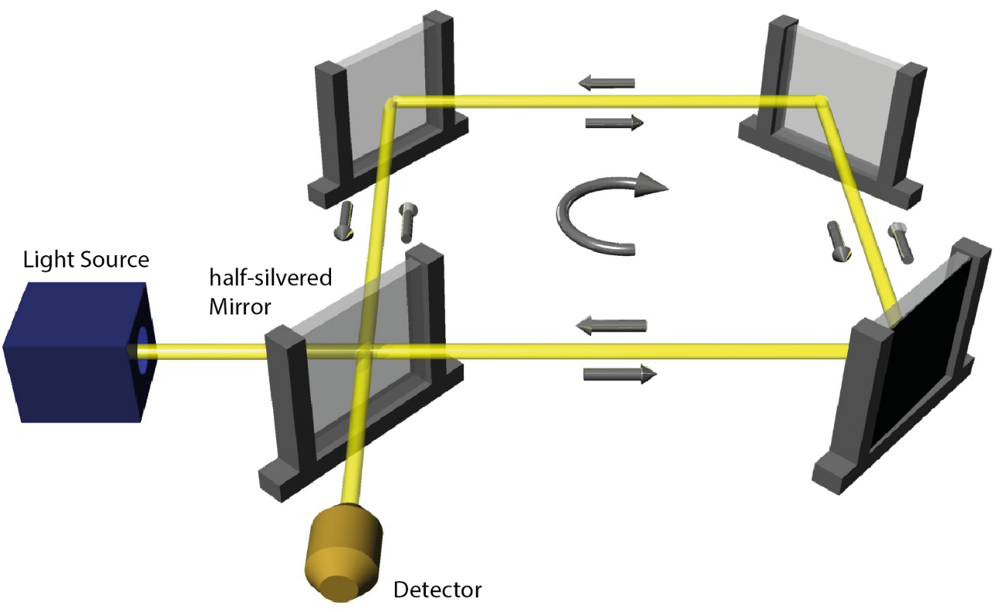
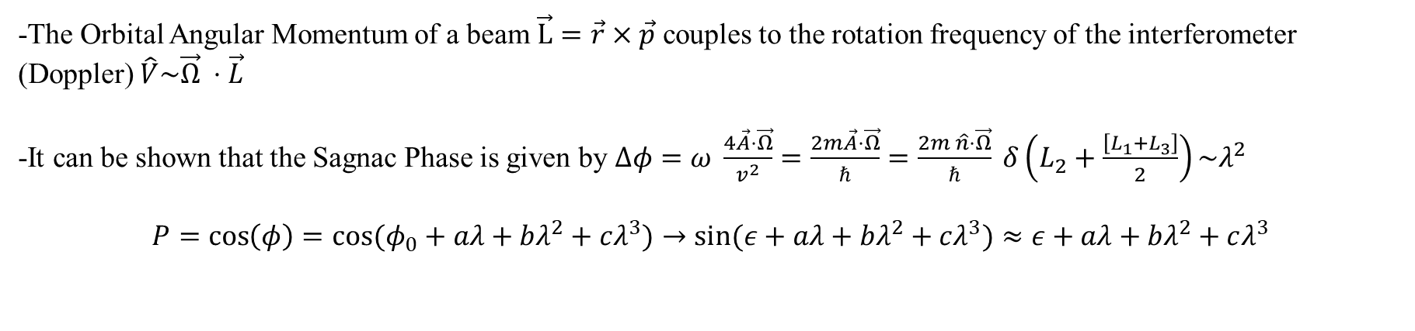
The Sagnac Effect
-The Orbital Angular Momentum of a beam $\vec{L}=\vec{r}×\vec{p}$ couples to the rotation frequency of the interferometer (Doppler) $\hat{V}\sim \vec{Ω} ⋅\vec{L}$
-It can be shown that the Sagnac Phase is given by $Δφ=ω \frac{4\vec{A}⋅\vec{Ω}}{v^{2}}=\frac{2m\vec{A}⋅\vec{Ω}}{ℏ}=\frac{2m \hat{n}⋅\vec{Ω}}{ℏ} δ\left(L_{2}+\frac{\left[L_{1}+L_{3}\right]}{2}\right)\sim λ^{2}$
$$P=\cos\left(φ\right)=cos⁡(φ_{0}+aλ+bλ^{2}+cλ^{3})→\sin{(ε+aλ+bλ^{2}+cλ^{3})}≈ε+aλ+bλ^{2}+cλ^{3}$$

Slide 28
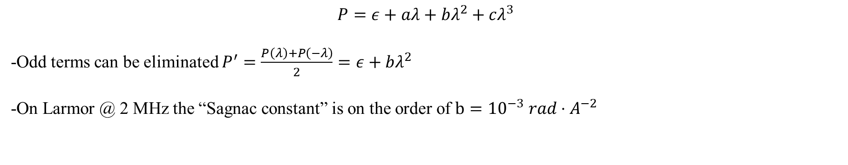
The Sagnac Effect
$$P=ε+aλ+bλ^{2}+cλ^{3}$$
-Odd terms can be eliminated $P^{′}=\frac{P\left(λ\right)+P\left(−λ\right)}{2}=ε+bλ^{2}$
-On Larmor @ 2 MHz the “Sagnac constant” is on the order of $b={10}^{−3} rad⋅A^{−2}$

