Slide 1
Nuclear photoabsorption in ²²⁹Th using twisted light
Tobias Kirschbaum¹, Thorsten Schumm² and Adriana Pálffy¹
¹Julius-Maximilians-Universität Würzburg, Germany
²Technische Universität Wien, Austria
arXiv preprint, arXiv: 2404.13023

Slide 2
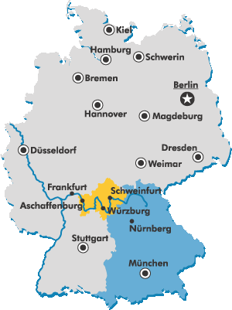
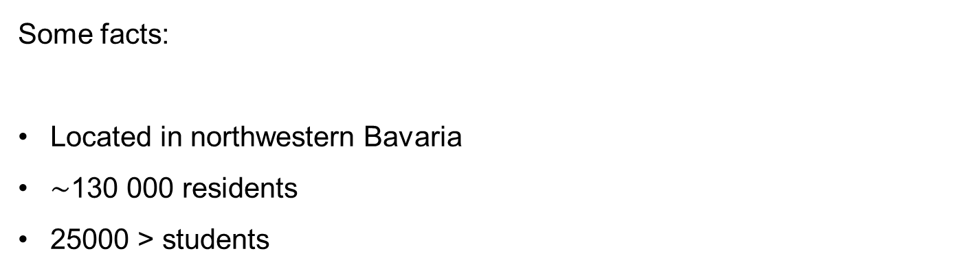
About Würzburg
1
[1]
Some facts:
Located in northwestern Bavaria
$\sim$130 000 residents
25000 > students
[1] www.regierung.unterfranken.bayern.de/regierungsbezirk/index.html

Slide 3
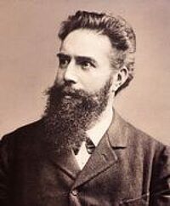
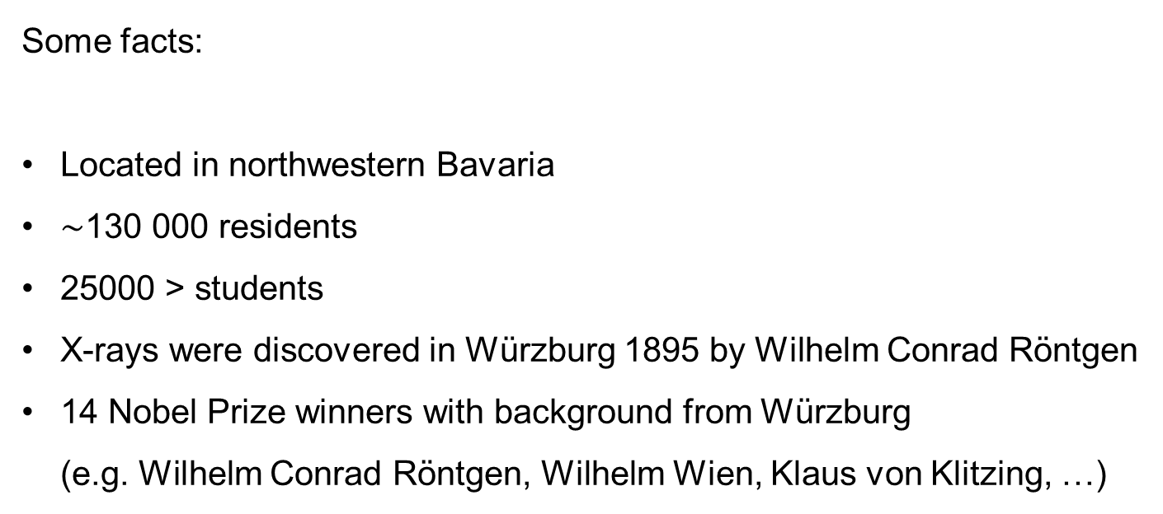
About Würzburg
1
[2]
[1]
Some facts:
Located in northwestern Bavaria
$\sim$130 000 residents
25000 > students
X-rays were discovered in Würzburg 1895 by Wilhelm Conrad Röntgen
14 Nobel Prize winners with background from Würzburg (e.g. Wilhelm Conrad Röntgen, Wilhelm Wien, Klaus von Klitzing, …)
[1] www.regierung.unterfranken.bayern.de/regierungsbezirk/index.html
[2] www.physik.uni-wuerzburg.de/ueber-uns/fakultaetsgeschichte/nobelpreistraeger/wilhelm-conrad-roentgen/

Slide 4
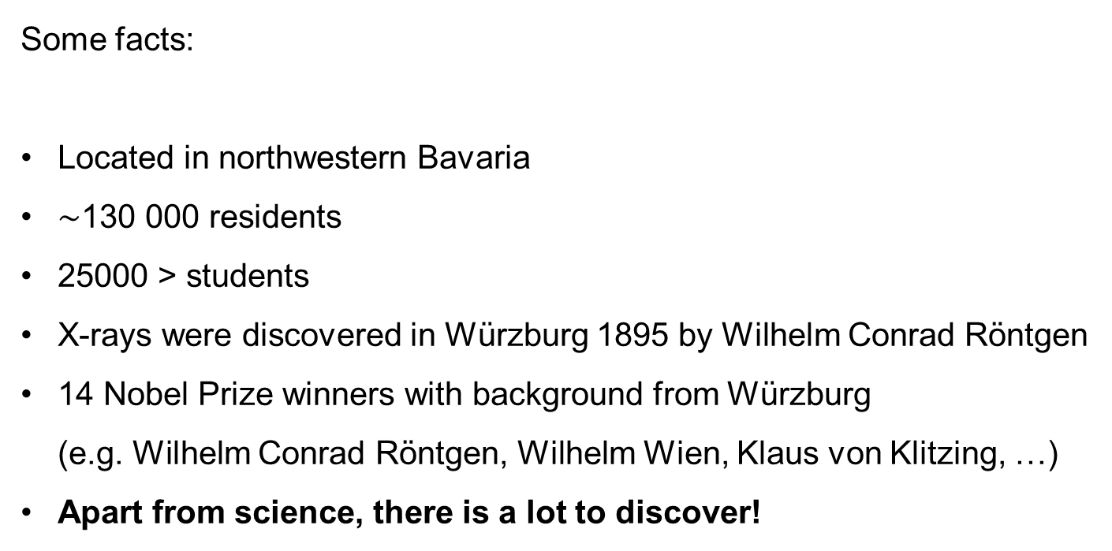
About Würzburg
1
[2]
[1]
Some facts:
Located in northwestern Bavaria
$\sim$130 000 residents
25000 > students
X-rays were discovered in Würzburg 1895 by Wilhelm Conrad Röntgen
14 Nobel Prize winners with background from Würzburg (e.g. Wilhelm Conrad Röntgen, Wilhelm Wien, Klaus von Klitzing, …)
Apart from science, there is a lot to discover!
[1] www.regierung.unterfranken.bayern.de/regierungsbezirk/index.html
[2] www.physik.uni-wuerzburg.de/ueber-uns/fakultaetsgeschichte/nobelpreistraeger/wilhelm-conrad-roentgen/

Slide 5
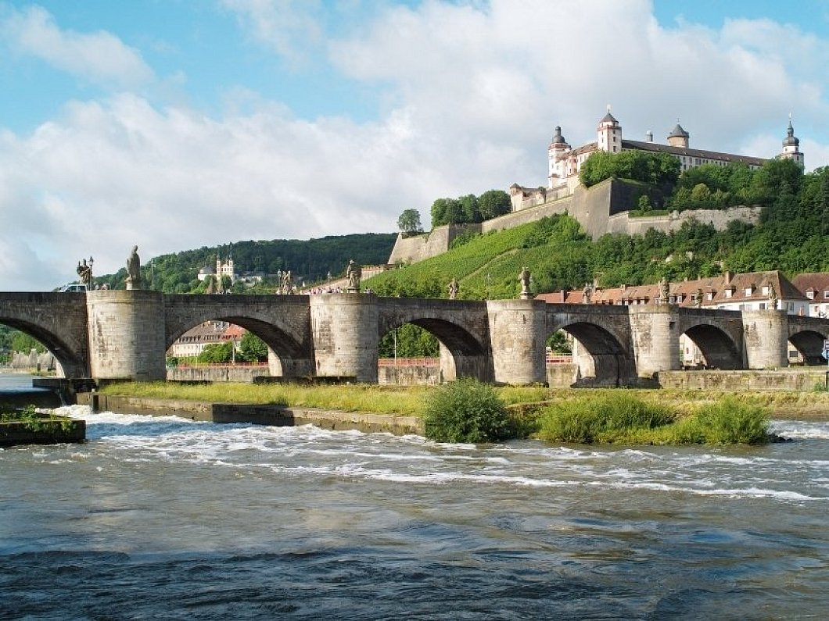
About Würzburg
2
Festung and old main bridge
[3]
[3] www.nw.de/lifestyle/reise/10843191_Wuerzburger-Wahrzeichen.html

Slide 6

About Würzburg
2
Festung and old main bridge
[3]
Residence
[4]
[3] www.nw.de/lifestyle/reise/10843191_Wuerzburger-Wahrzeichen.html
[4] www.welterbetour.de/wuerzburger-residenz

Slide 7
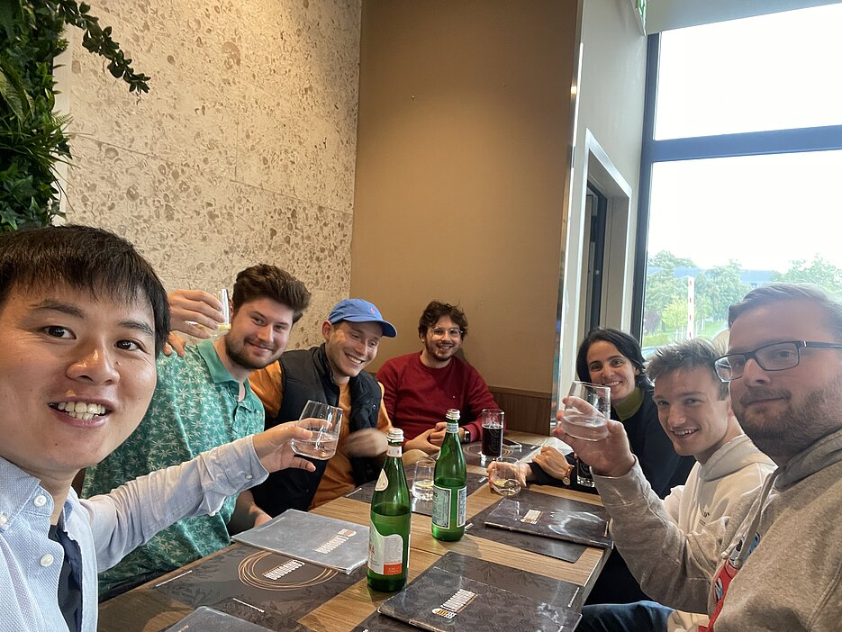
About our group
3
Prof. Dr. Adriana Pálffy (PI)
We work on theoretical quantum optics:
Quantum optics with Mössbauer nuclei and x-rays
Topological quantum optics
Excitation schemes for the nuclear clock candidate ²²⁹Th

Slide 8
About our group
3
Tobias (PhD student)
We work on theoretical quantum optics:
Quantum optics with Mössbauer nuclei and x-rays
Topological quantum optics
Excitation schemes for the nuclear clock candidate ²²⁹Th

Slide 9

²²⁹Th in a nutshell
4
Lowest known nuclear excited state at $\sim$ 8.3 eV (VUV)
²²⁹Th [5, 6]
[5] E. Peik et al., Quantum Sci. Technol. 6, 034002 (2021)
[6] S. Kraemer et al., Nature 617, 706-710 (2023)
Notes:
Mention that 229Th is radioacitve

Slide 10

²²⁹Th in a nutshell
4
Lowest known nuclear excited state at $\sim$ 8.3 eV (VUV)
Long-lived (Isomer) with M1 + E2 multipole mixing
→ $τ_{γ}≈O({10}^{3})$ s [6]
²²⁹Th [5, 6]
[5] E. Peik et al., Quantum Sci. Technol. 6, 034002 (2021)
[6] S. Kraemer et al., Nature 617, 706-710 (2023)

Slide 11
²²⁹Th in a nutshell
4
Lowest known nuclear excited state at $\sim$ 8.3 eV (VUV)
Long-lived (Isomer) with M1 + E2 multipole mixing
→ $τ_{γ}≈O({10}^{3})$ s [6]
²²⁹Th [5, 6]
Ideal candidate for nuclear clock with outstanding properties
[5] E. Peik et al., Quantum Sci. Technol. 6, 034002 (2021)
[6] S. Kraemer et al., Nature 617, 706-710 (2023)

Slide 12
²²⁹Th in a nutshell
4
Lowest known nuclear excited state at $\sim$ 8.3 eV (VUV)
Long-lived (Isomer) with M1 + E2 multipole mixing
→ $τ_{γ}≈O({10}^{3})$ s [6]
Benchmark for testing fundamental physics
²²⁹Th [5, 6]
Ideal candidate for nuclear clock with outstanding properties
[5] E. Peik et al., Quantum Sci. Technol. 6, 034002 (2021)
[6] S. Kraemer et al., Nature 617, 706-710 (2023)

Slide 13
²²⁹Th in a nutshell
4
Lowest known nuclear excited state at $\sim$ 8.3 eV (VUV)
Also: Commercial applications, e.g. improving satellite navigation
Long-lived (Isomer) with M1 + E2 multipole mixing
→ $τ_{γ}≈O({10}^{3})$ s [6]
Benchmark for testing fundamental physics
²²⁹Th [5, 6]
Ideal candidate for nuclear clock with outstanding properties
[5] E. Peik et al., Quantum Sci. Technol. 6, 034002 (2021)
[6] S. Kraemer et al., Nature 617, 706-710 (2023)

Slide 14
²²⁹Th in a nutshell
4
Lowest known nuclear excited state at $\sim$ 8.3 eV (VUV)
Problem: Uncertainty on transition energy, lack of narrowband VUV lasers
Also: Commercial applications, e.g. improving satellite navigation
Long-lived (Isomer) with M1 + E2 multipole mixing
→ $τ_{γ}≈O({10}^{3})$ s [6]
Benchmark for testing fundamental physics
²²⁹Th [5, 6]
Ideal candidate for nuclear clock with outstanding properties
[5] E. Peik et al., Quantum Sci. Technol. 6, 034002 (2021)
[6] S. Kraemer et al., Nature 617, 706-710 (2023)
Notes:
229th is radioacitve

Slide 15
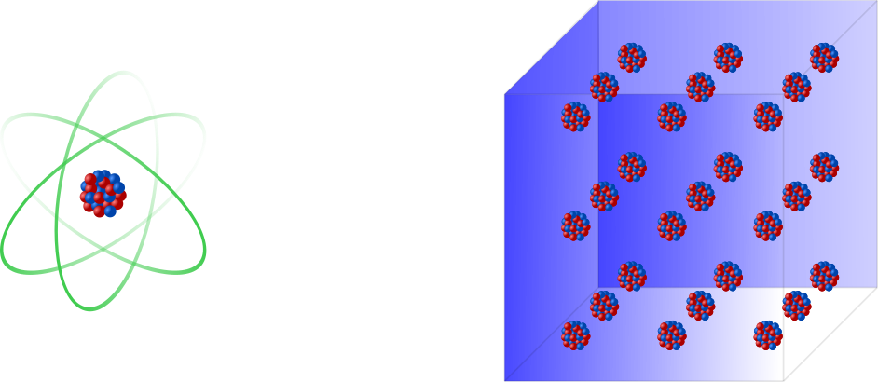
Main approaches for a nuclear clock
5
1.) Single ion nuclear clock [7]
→ Great accuracy, but technically demanding
[7] E. Peik and C. Tamm, EPL 61, 181 (2003)

Slide 16
Main approaches for a nuclear clock
5
1.) Single ion nuclear clock [7]
2.) Solid state nuclear clock [8]
→ Great accuracy, but technically demanding
→ More nuclei can be interrogated, but systematic crystal effects
[7] E. Peik and C. Tamm, EPL 61, 181 (2003)
[8] G. A. Kazakov et al., New J. Phys. 14, 083019 (2012)

Slide 17
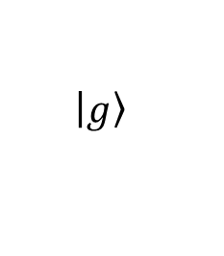

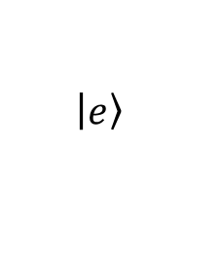
Motivation
6
Just recently: Radiative excitation of ²²⁹Th‘s isomeric state with plane wave beams [9]
$$\left|\left.e\right\rangle \right.$$
$$ℏω$$
$$\left|\left.g\right\rangle \right.$$
[9] J. Tiedau et al., Phys. Rev. Lett., in press (2024)

Slide 18
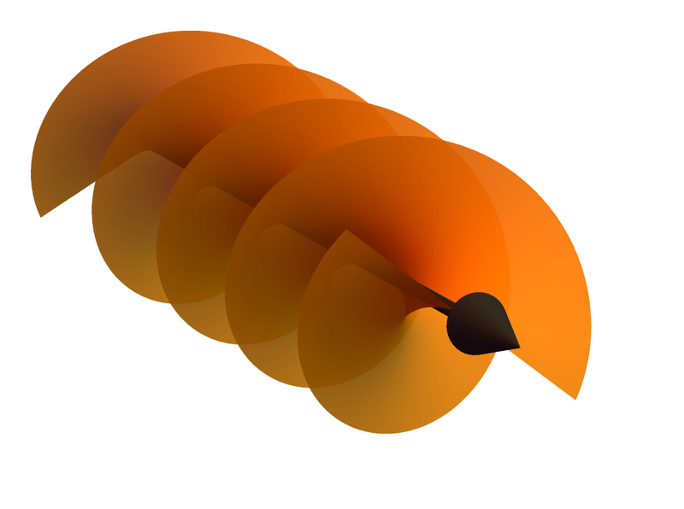
Motivation
6
Just recently: Radiative excitation of ²²⁹Th‘s isomeric state with plane wave beams [9]
Question: Twisted light instead of plane waves?
$$\left|\left.e\right\rangle \right.$$
$$ℏω$$
$$\left|\left.g\right\rangle \right.$$
[9] J. Tiedau et al., Phys. Rev. Lett., in press (2024)

Slide 19
Outline
Based on the two clock approaches, we consider the interaction of twisted light with:

Slide 20
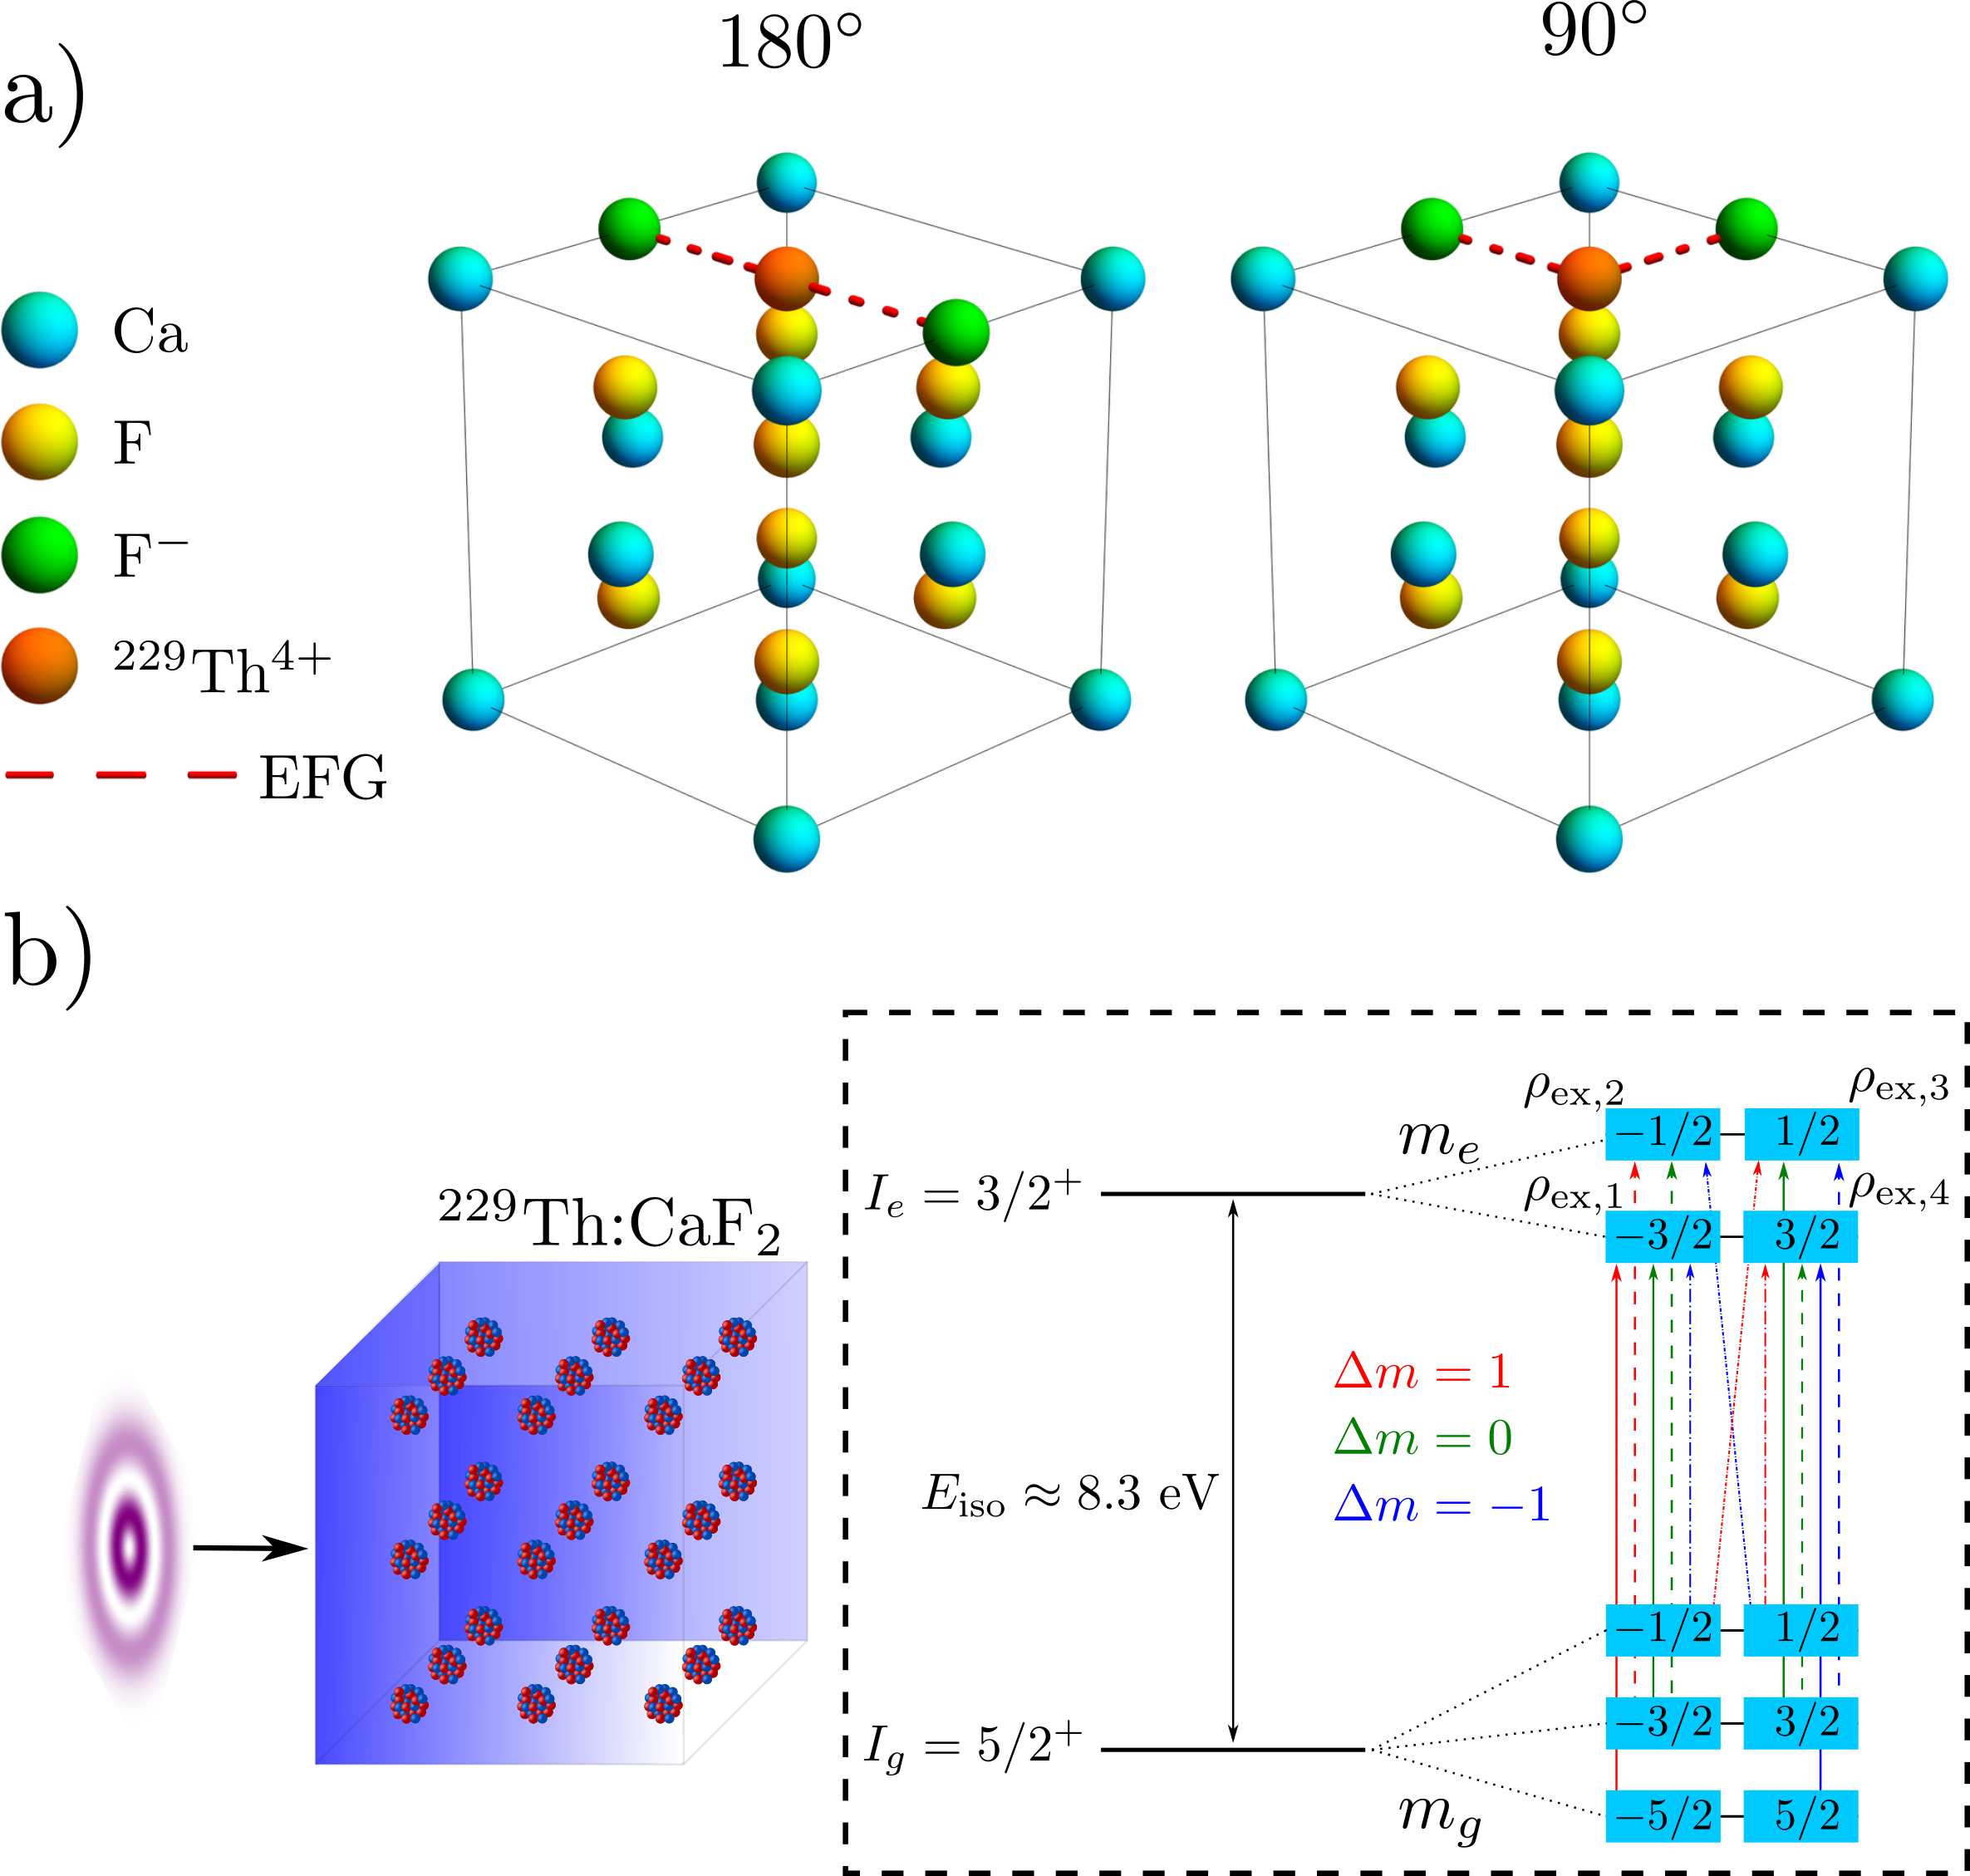
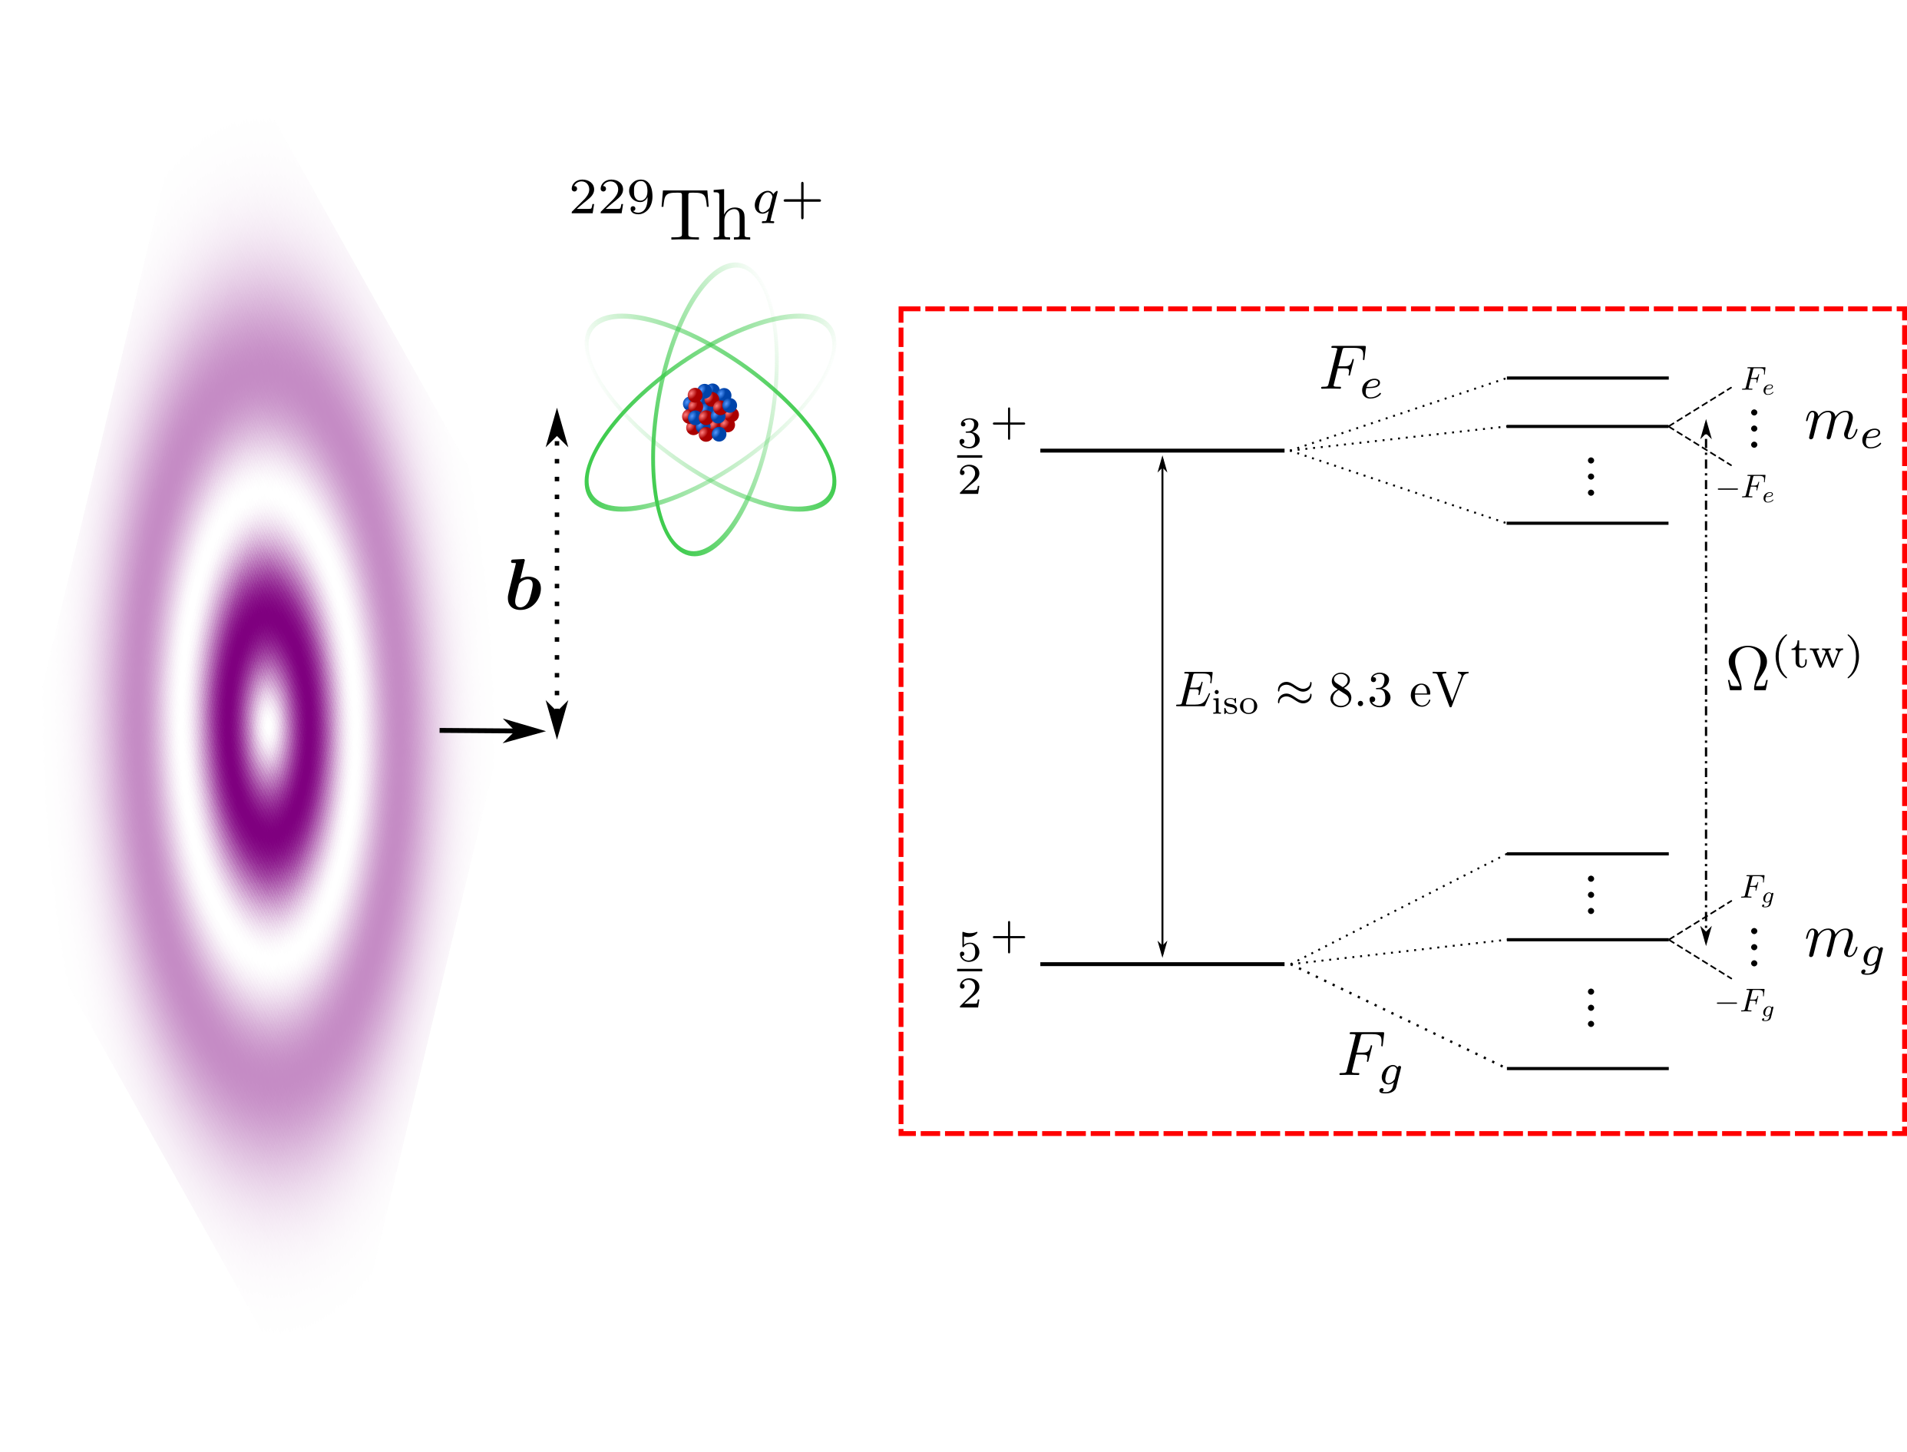
Outline
Based on the two clock approaches, we consider the interaction of twisted light with:
1.) A single ²²⁹Th nucleus
2.) An ensemble of ²²⁹Th nuclei

Slide 21
Outline
1.) A single ²²⁹Th nucleus
2.) An ensemble of ²²⁹Th nuclei

Slide 22


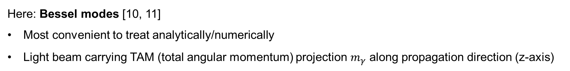


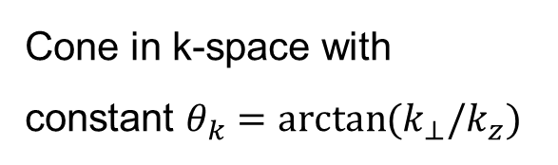

1.) Twisted light in a nutshell
7
Here: Bessel modes [10, 11]
Most convenient to treat analytically/numerically
Light beam carrying TAM (total angular momentum) projection $m_{γ}$ along propagation direction (z-axis)
$$k$$
$$k_{⊥}=k\sin{θ_{k}}$$
$$θ_{k}$$
$$k_{z}=k\cos{θ_{k}}$$
Helical wave front
Annual intensity pattern
Cone in k-space with constant $θ_{k}=\arctan{(k_{⊥}/k_{z})}$
[10] O. Matula et al., J. Phys. B. 46, 205002 (2013)
[11] S. Schulz et al., Phys. Rev. A 100, 043416 (2019)
Notes:
Mention also phase singularity!!!

Slide 23
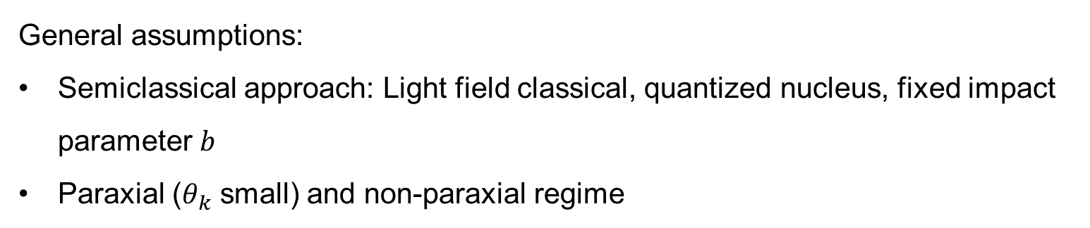
1.) Nuclear twisted light interaction
8
General assumptions:
Semiclassical approach: Light field classical, quantized nucleus, fixed impact parameter $b$
Paraxial ($θ_{k}$ small) and non-paraxial regime

Slide 24

1.) Nuclear twisted light interaction
8
General assumptions:
Semiclassical approach: Light field classical, quantized nucleus, fixed impact parameter $b$
Paraxial ($θ_{k}$ small) and non-paraxial regime
Same structure of matrix element as in atomic photo absorption [12] and GDR [13]
Twisted Rabi frequency for a single nucleus:
$$Ω_{fi}^{(tw)}∝\left|M_{fi}^{(tw)}\right| ∝\left|d_{∆m Λ}^{L}\left(θ_{k}\right) J_{m_{γ}−∆m}\left(ζb\right) \sqrt{I }\sqrt{B\left(μL, \left|\left.i\right\rangle \right.→\left|\left.f\right\rangle \right.\right)}\right|$$
Intensity
Small Wigner d-function
Bessel function first kind
Reduced transition probability
$$ζ=|k_{⊥}|$$
[12] A. Afanasev et al., Phys. Rev. A 97, 023422 (2018)
[13] L. Lu et al., Phys. Rev. Lett. 131, 202502 (2023)

Slide 25
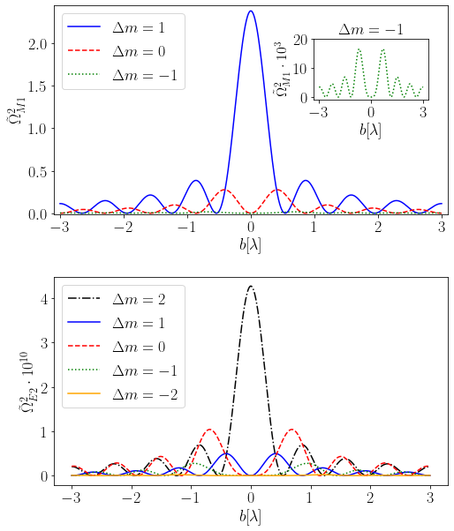
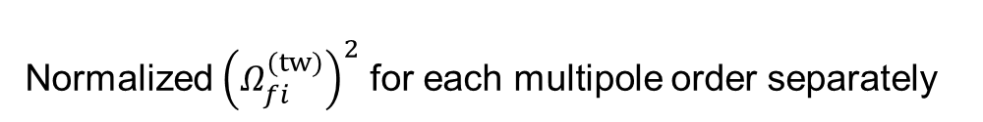




1.) Selection rules for a single ion
9
$$m_{γ}=1$$
$$θ_{k}=45°$$
Normalized ${\left(Ω_{fi}^{(tw)}\right)}^{2}$ for each multipole order separately
$$m_{γ}=2$$
$$θ_{k}=45°$$

Slide 26
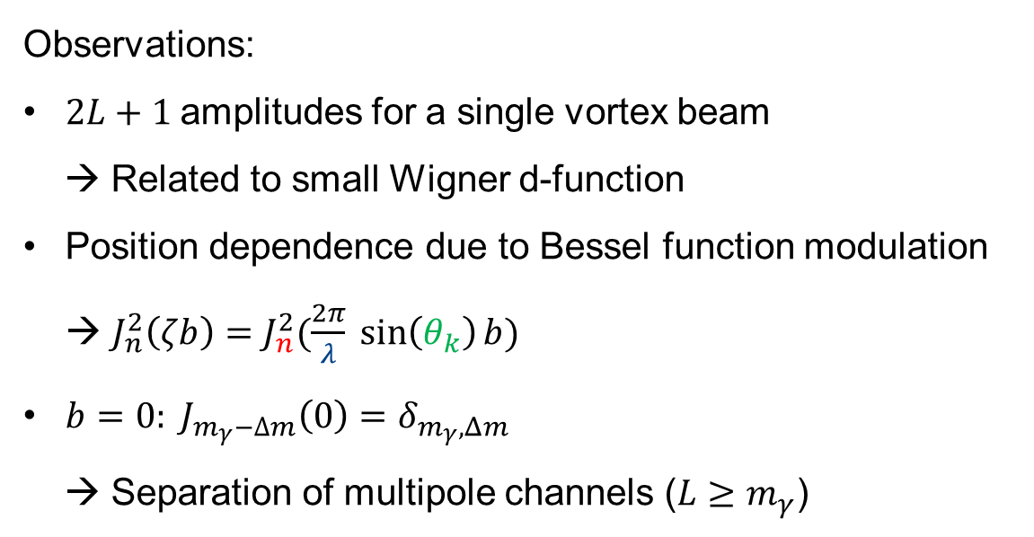
1.) Selection rules for a single ion
9
$$m_{γ}=1$$
$$θ_{k}=45°$$
Normalized ${\left(Ω_{fi}^{(tw)}\right)}^{2}$ for each multipole order separately
Observations:
$2L+1$amplitudes for a single vortex beam
→ Related to small Wigner d-function
Position dependence due to Bessel function modulation → $J_{n}^{2}\left(ζb\right)=J_{n}^{2}(\frac{2π}{λ} \sin\left(θ_{k}\right)b)$
$b=0: J_{m_{γ}−∆m}\left(0\right)=δ_{m_{γ},Δm}$
→ Separation of multipole channels ($L≥m_{γ}$)
$$m_{γ}=2$$
$$θ_{k}=45°$$

Slide 27
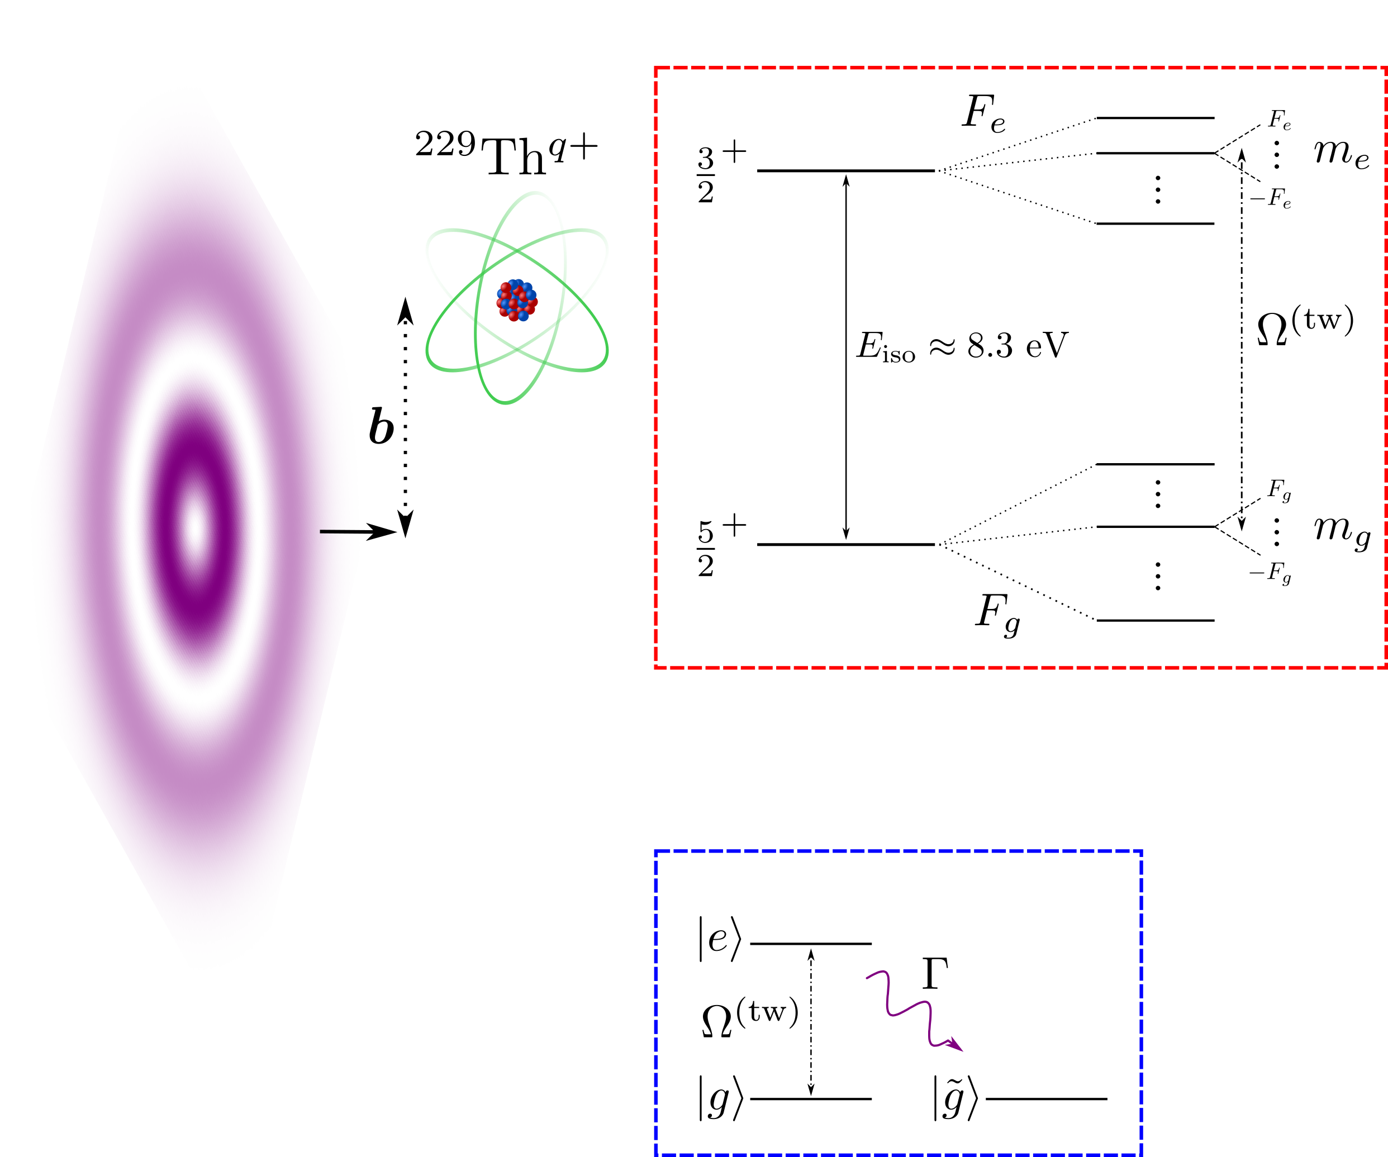
1.) Resonant driving in a single ²²⁹Th ion
10
Assumptions:
Single ion with arbitrary charge state:
→ Hyperfine + Zeemann splitting

Slide 28
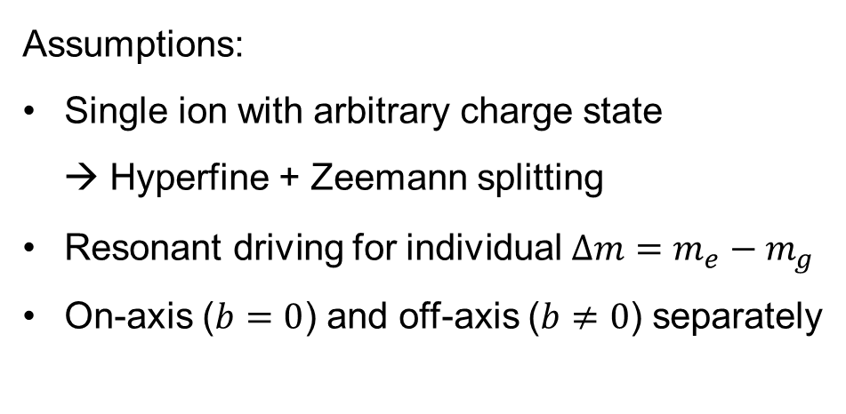
1.) Resonant driving in a single ²²⁹Th ion
10
Assumptions:
Single ion with arbitrary charge state
→ Hyperfine + Zeemann splitting
Resonant driving for individual $∆m=m_{e}−m_{g}$
On-axis ($b=0$) and off-axis ($b≠0$) separately

Slide 29
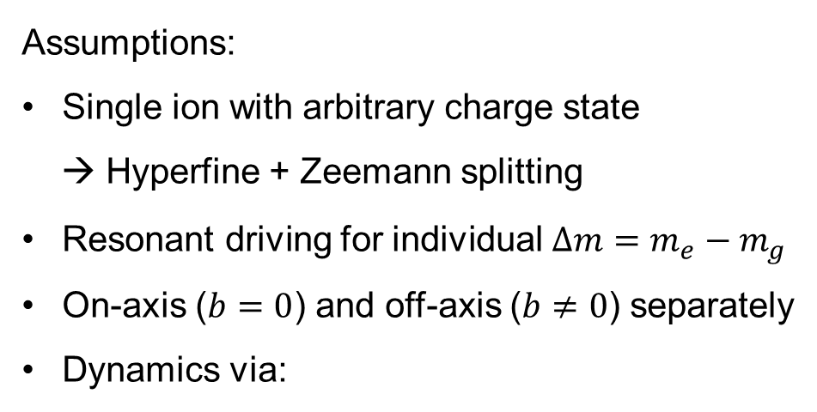

1.) Resonant driving in a single ²²⁹Th ion
10
Assumptions:
Single ion with arbitrary charge state
→ Hyperfine + Zeemann splitting
Resonant driving for individual $∆m=m_{e}−m_{g}$
On-axis ($b=0$) and off-axis ($b≠0$) separately
Dynamics via:
$$∂_{t}ρ=\frac{1}{iℏ}\left[H_{int}^{(tw)},ρ\right]+ℒ$$
Simplification

Slide 30
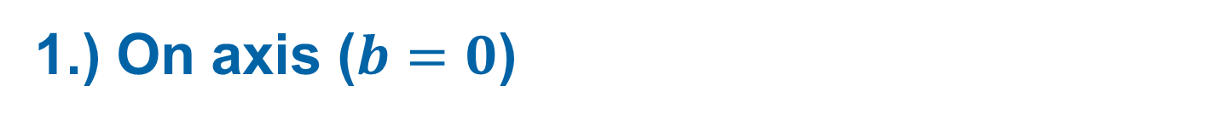
1.) On axis ($b=0$)
11
Probing the E2 transition via $m_{γ}=2 \left(Λ=1\right)$ → Appealing to determine $B(E2)$experimentally

Slide 31
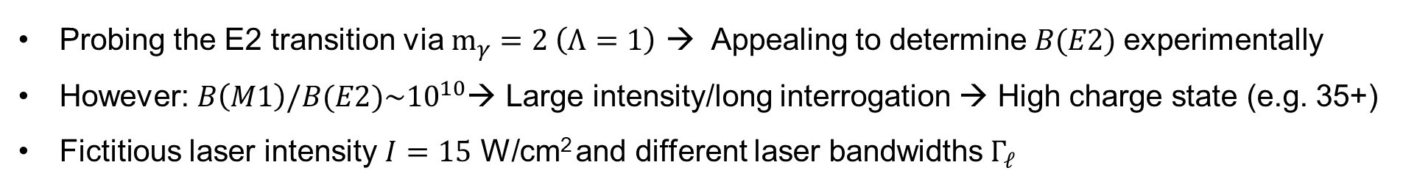
1.) On axis ($b=0$)
11
Probing the E2 transition via $m_{γ}=2 \left(Λ=1\right)$ → Appealing to determine $B(E2)$experimentally
However: $B\left(M1\right)/B(E2)\sim {10}^{10}$→ Large intensity/long interrogation → High charge state (e.g. 35+)
Fictitious laser intensity $I=15$ W/cm² and different laser bandwidths $Γ_{ℓ}$

Slide 32
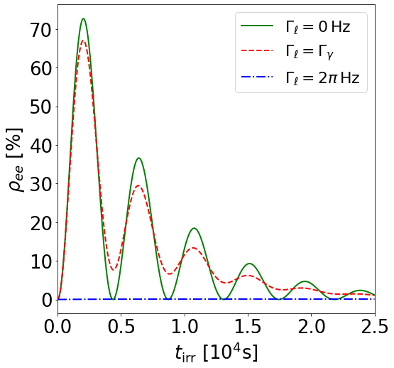
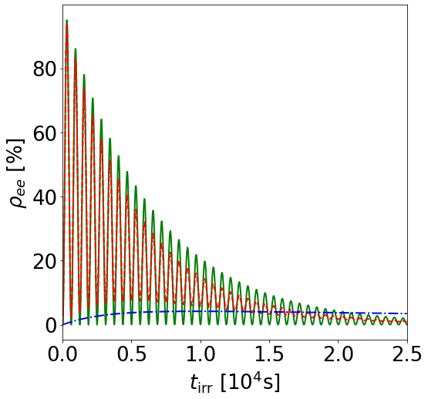


1.) On axis ($b=0$)
11
Probing the E2 transition via $m_{γ}=2 \left(Λ=1\right)$ → Appealing to determine $B(E2)$experimentally
However: $B\left(M1\right)/B(E2)\sim {10}^{10}$→ Large intensity/long interrogation → High charge state (e.g. 35+)
Fictitious laser intensity $I=15$ W/cm² and different laser bandwidths $Γ_{ℓ}$
$$θ_{k}=5°$$
$θ_{k}=45°$
From paraxial to non-paraxial

Slide 33
1.) On axis ($b=0$)
11
Probing the E2 transition via $m_{γ}=2 \left(Λ=1\right)$ → Appealing to determine $B(E2)$experimentally
However: $B\left(M1\right)/B(E2)\sim {10}^{10}$→ Large intensity/long interrogation → High charge state (e.g. 35+)
Fictitious laser intensity $I=15$ W/cm² and different laser bandwidths $Γ_{ℓ}$
$$θ_{k}=5°$$
$θ_{k}=45°$
From paraxial to non-paraxial
In summary: Experimentally not feasible due to laser requirements, particle confinement, …

Slide 34
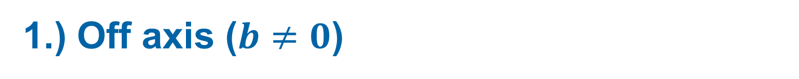
1.) Off axis ($b≠0$)
12
For all calculations${\text{:} m}_{γ}=2, Λ=1, θ_{k}=10°$

Slide 35
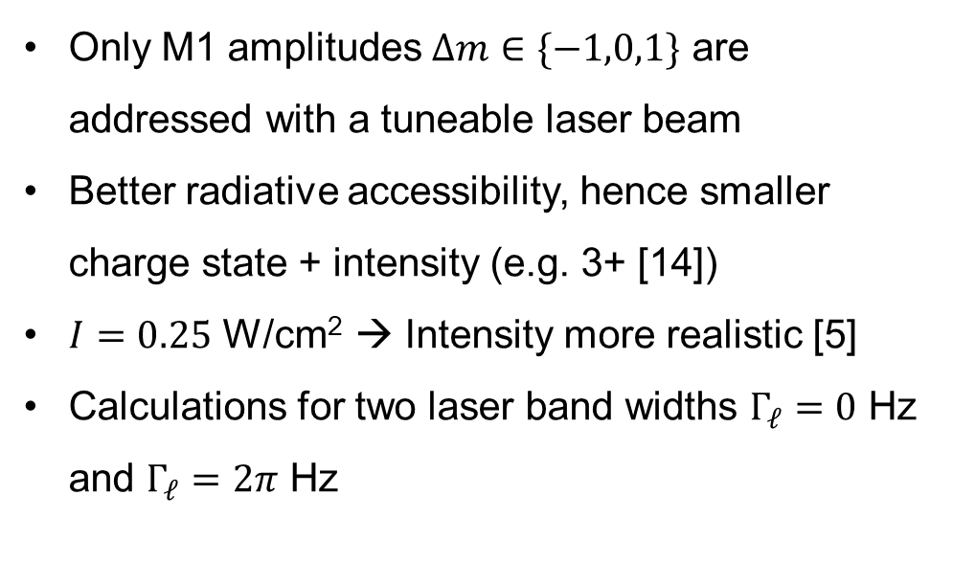
1.) Off axis ($b≠0$)
12
For all calculations${\text{:} m}_{γ}=2, Λ=1, θ_{k}=10°$
Only M1 amplitudes $Δm∈\{−1,0,1\}$ are addressed with a tuneable laser beam
Better radiative accessibility, hence smaller charge state + intensity (e.g. 3+ [14])
$I=0.25$ W/cm² → Intensity more realistic [5]
Calculations for two laser band widths $Γ_{ℓ}=0$ Hz and $Γ_{ℓ}=2π$ Hz
[14] C. J. Campbell et al., Phys. Rev. Lett. 108, 120802 (2012)
[5] E. Peik et al., Quantum Sci. Technol. 6, 034002 (2021)

Slide 36
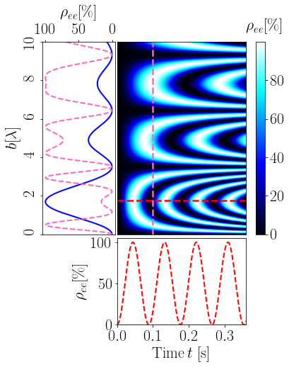
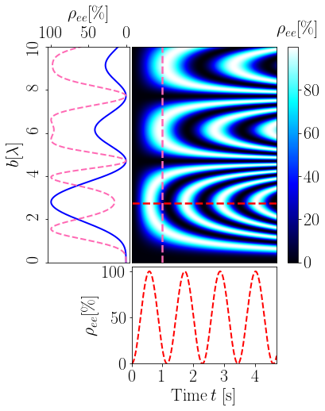
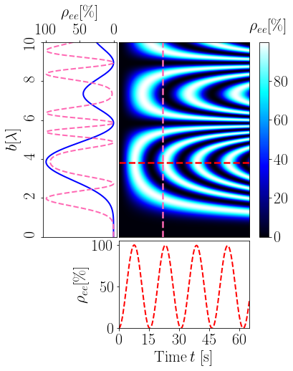

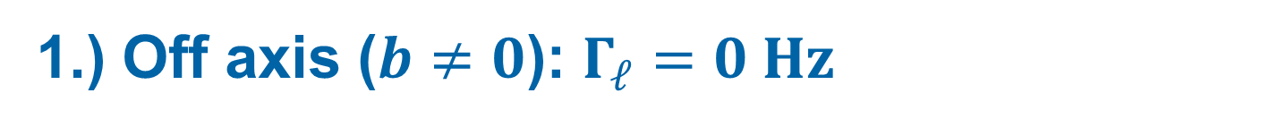


1.) Off axis ($b≠0$): $Γ_{ℓ}=0 Hz$
13
$$Δm=1$$
$$Δm=0$$
$$Δm=−1$$
Spatial modulation of $ρ_{ee}$ via $J_{n}^{2}(ζb)$→ Characteristic $ρ_{ee}(b)$ at fixed time t
Timescale of oscillations mainly dependent on Wigner function $d_{Δm Λ}^{1}(θ_{k})$

Slide 37

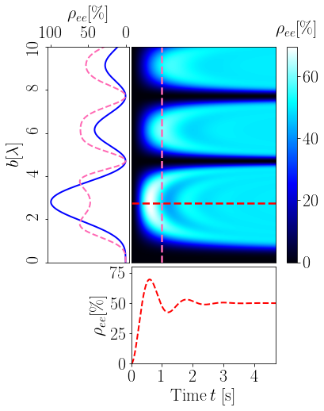
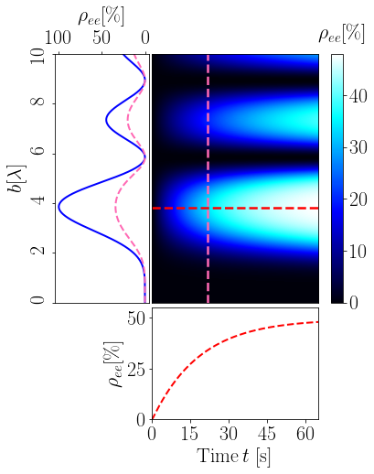
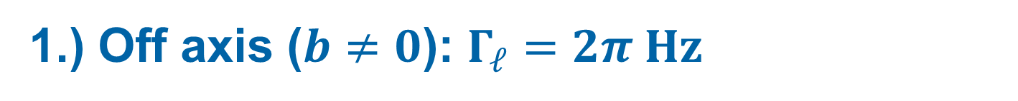
1.) Off axis ($b≠0$): $Γ_{ℓ}=2π Hz$
14
$$Δm=1$$
$$Δm=0$$
$$Δm=−1$$
Temporal dynamics differ → Most pronounced for $Δm=0$ and $Δm=−1$
Spatial modulation remains unchanged

Slide 38
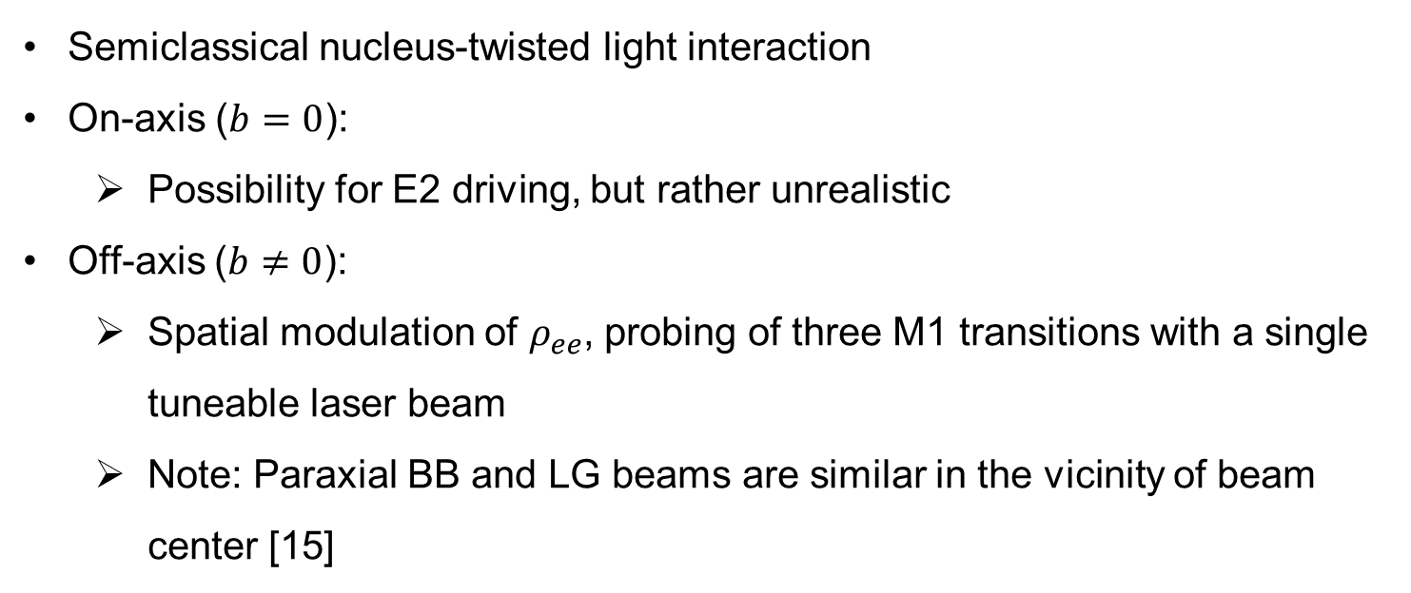
1.) Conclusions
15
Semiclassical nucleus-twisted light interaction
On-axis ($b=0$):
  Possibility for E2 driving, but rather unrealistic
Off-axis ($b≠0$):
  Spatial modulation of $ρ_{ee}$, probing of three M1 transitions with a single tuneable laser beam
  Note: Paraxial BB and LG beams are similar in the vicinity of beam center [15]
[15] A. Afanasev et al., New J. Phys. 20, 023032 (2018)

Slide 39
Outline
1.) A single ²²⁹Th nucleus
2.) An ensemble of ²²⁹Th nuclei

Slide 40
2.) $"$Selection rules$"$ for a macroscopic sample
16
Nuclei homogeneously distributed

Slide 41
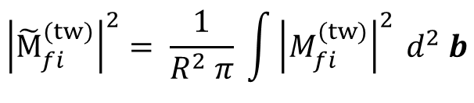

2.) $"$Selection rules$"$ for a macroscopic sample
16
Nuclei homogeneously distributed
Averaging the observable [16]
Average over $b$
$${\left|{\tilde{M}}_{fi}^{(tw)}\right|}^{2}= \frac{1}{R^{2} π} \int{{\left|M_{fi}^{(tw)}\right|}^{2} d^{2} b}$$
[16] H. M. Scholz-Marggraf et al., Phys. Rev. A 90, 013425 (2014)

Slide 42
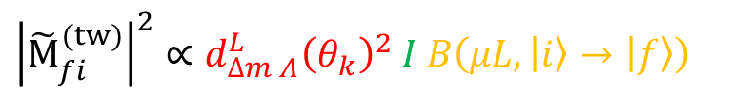
2.) $"$Selection rules$"$ for a macroscopic sample
16
Nuclei homogeneously distributed
Averaging the observable [16]
Average over $b$
$${\left|{\tilde{M}}_{fi}^{(tw)}\right|}^{2}= \frac{1}{R^{2} π} \int{{\left|M_{fi}^{(tw)}\right|}^{2} d^{2} b}$$
$${\left|{\tilde{M}}_{fi}^{(tw)}\right|}^{2}∝d_{∆m Λ}^{L}{\left(θ_{k}\right)}^{2} I B\left(μL, \left|\left.i\right\rangle \right.→\left|\left.f\right\rangle \right.\right)$$
$2L+1$ amplitudes, but position/TAM dependence vanishes
[16] H. M. Scholz-Marggraf et al., Phys. Rev. A 90, 013425 (2014)

Slide 43


2.) ²²⁹Th:CaF₂
17
CaF₂ is ideal inert host for ²²⁹Th [17] → Charge state 4+
$n>{10}^{17}$cm⁻³
Conduction band
$Δ_{g}\sim 12$eV
Valence band
[17] S. Stellmer et al., Phys. Rev. A 97, 062506 (2018)
Notes:
Important: Interaction of nuclear quadrupole moments with EFG generated by the crystal lattice leads to the emergence of a nuclear quadrupole splitting on the order 100MHz

Slide 44
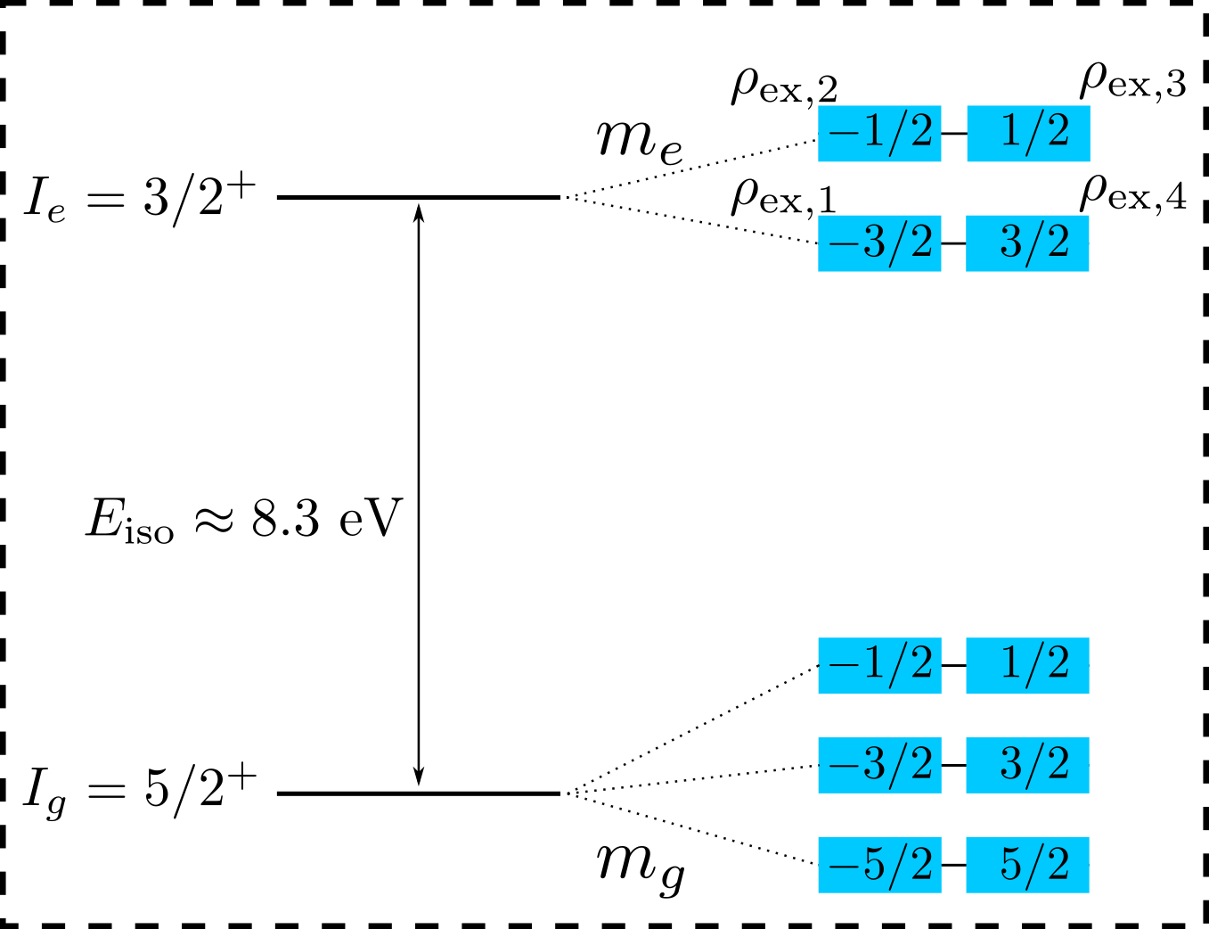
2.) ²²⁹Th:CaF₂
17
CaF₂ is ideal inert host for ²²⁹Th [17] → Charge state 4+
Interaction of nuclear quadrupole moments with Electric Field Gradient
→ Nuclear quadrupole splitting [18]
$n>{10}^{17}$cm⁻³
Conduction band
$Δ_{g}\sim 12$eV
Valence band
[17] S. Stellmer et al., Phys. Rev. A 97, 062506 (2018)
[18] P. Dessovic et al., J. Phys. Condens. Matter 26, 105402 (2014)
Notes:
Important: Interaction of nuclear quadrupole moments with EFG generated by the crystal lattice leads to the emergence of a nuclear quadrupole splitting on the order 100MHz

Slide 45
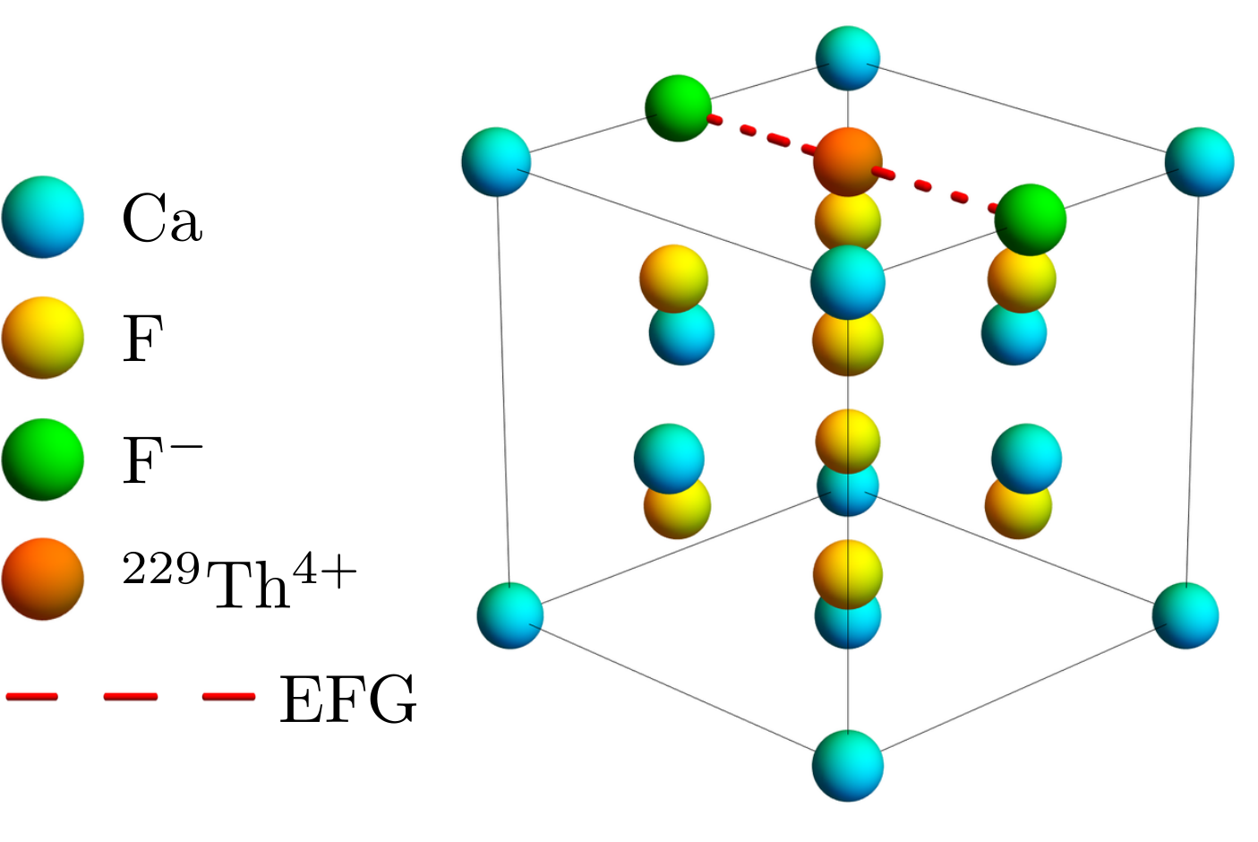
2.) ²²⁹Th:CaF₂
17
CaF₂ is ideal inert host for ²²⁹Th [17] → Charge state 4+
Interaction of nuclear quadrupole moments with Electric Field Gradient
→ Nuclear quadrupole splitting [18]
Quantization axis is determined by orientation of EFG
$n>{10}^{17}$cm⁻³
Conduction band
$Δ_{g}\sim 12$eV
Valence band
[17] S. Stellmer et al., Phys. Rev. A 97, 062506 (2018)
[18] P. Dessovic et al., J. Phys. Condens. Matter 26, 105402 (2014)
Notes:
Important: Interaction of nuclear quadrupole moments with EFG generated by the crystal lattice leads to the emergence of a nuclear quadrupole splitting on the order 100MHz

Slide 46
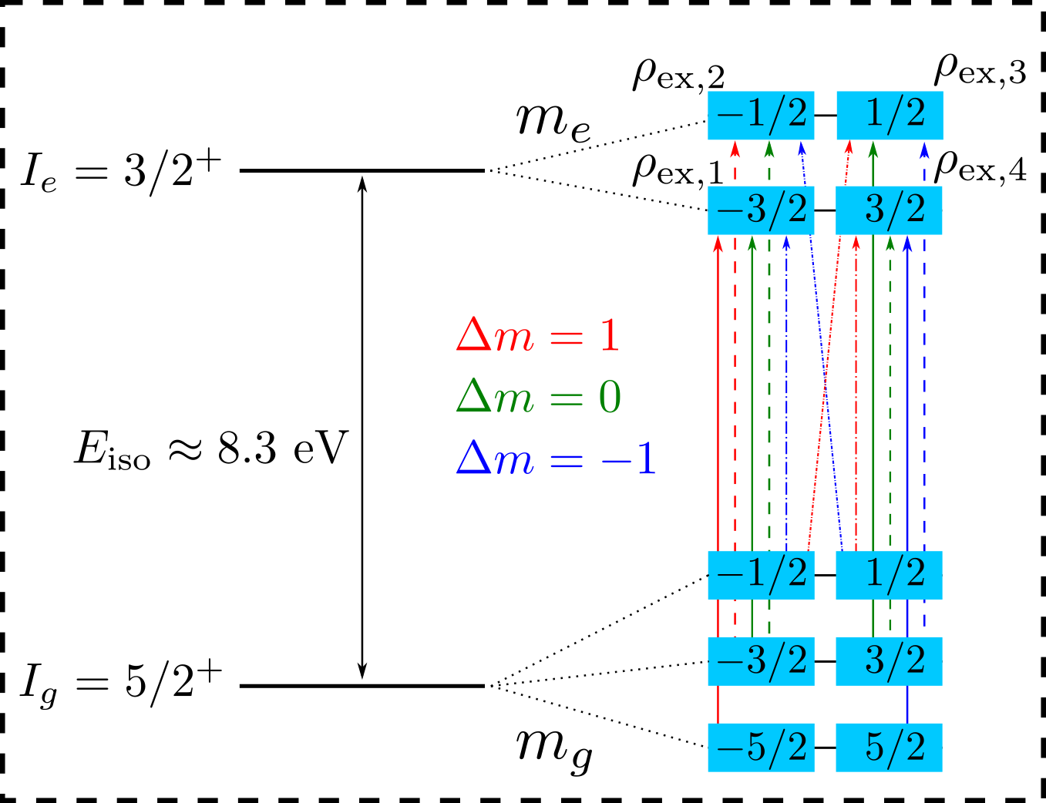
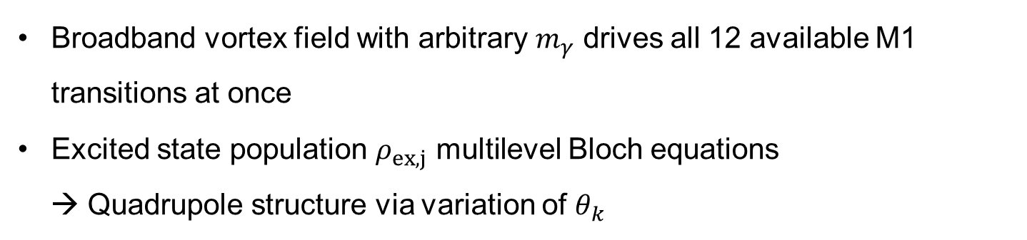
2.) Photoabsorption in ²²⁹Th:CaF₂
18
$n>{10}^{17}$cm⁻³
Broadband vortex field with arbitrary $m_{γ}$ drives all 12 available M1 transitions at once
Excited state population $ρ_{ex,j}$ multilevel Bloch equations
→ Quadrupole structure via variation of $θ_{k}$
Conduction band
$Δ_{g}\sim 12$eV
Valence band
Notes:
Important: Interaction of nuclear quadrupole moments with EFG generated by the crystal lattice leads to the emergence of a nuclear quadrupole splitting on the order 100MHz

Slide 47
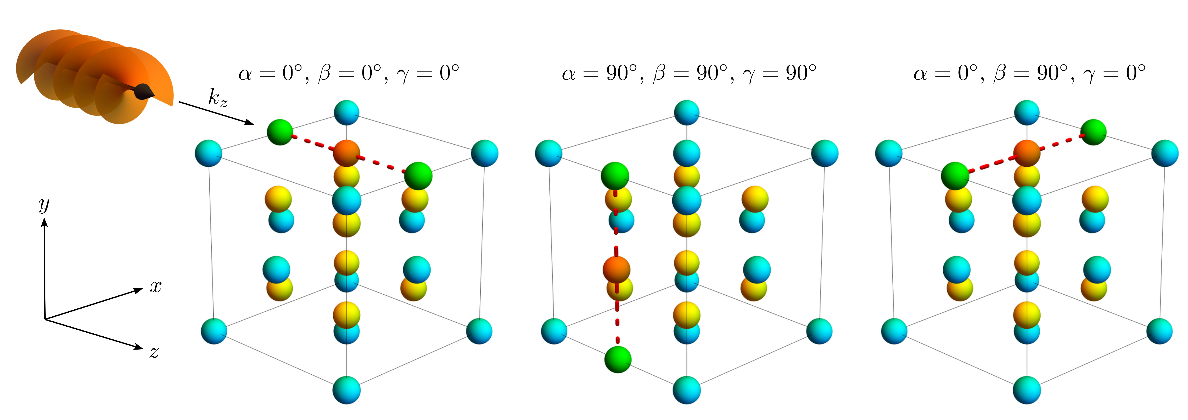
2.) Crystal orientation and quantization axis
19
Due to cubic symmetry of the crystal, there are three orientations of the EFG:

Slide 48

2.) Crystal orientation and quantization axis
19
Due to cubic symmetry of the crystal, there are three orientations of the EFG:
$${ ρ}_{ex,j}^{(tot)}=\frac{{ ρ}_{ex,j}^{q_{1}}+{ ρ}_{ex,j}^{q_{2}}+{ ρ}_{ex,j}^{q_{3}}}{3}$$
Total population:

Slide 49

2.) Quadrupole structure for a single beam
20
Excited substate ($Λ=+1$):
$$ρ_{ex,j}^{q} ∝\sum_{g}{{\left|\left\langle I_{e}m_{e}I_{g}−m_{g} | 1 Δm\right\rangle \right|}^{2}}\sum_{M}{{\left(d_{MΛ}^{1}\left(θ_{k}\right)\right)}^{2}}{\left(d_{MΔm}^{1}\left(β\right)\right)}^{2}$$
Clebsch-Gordan coefficient

Slide 50
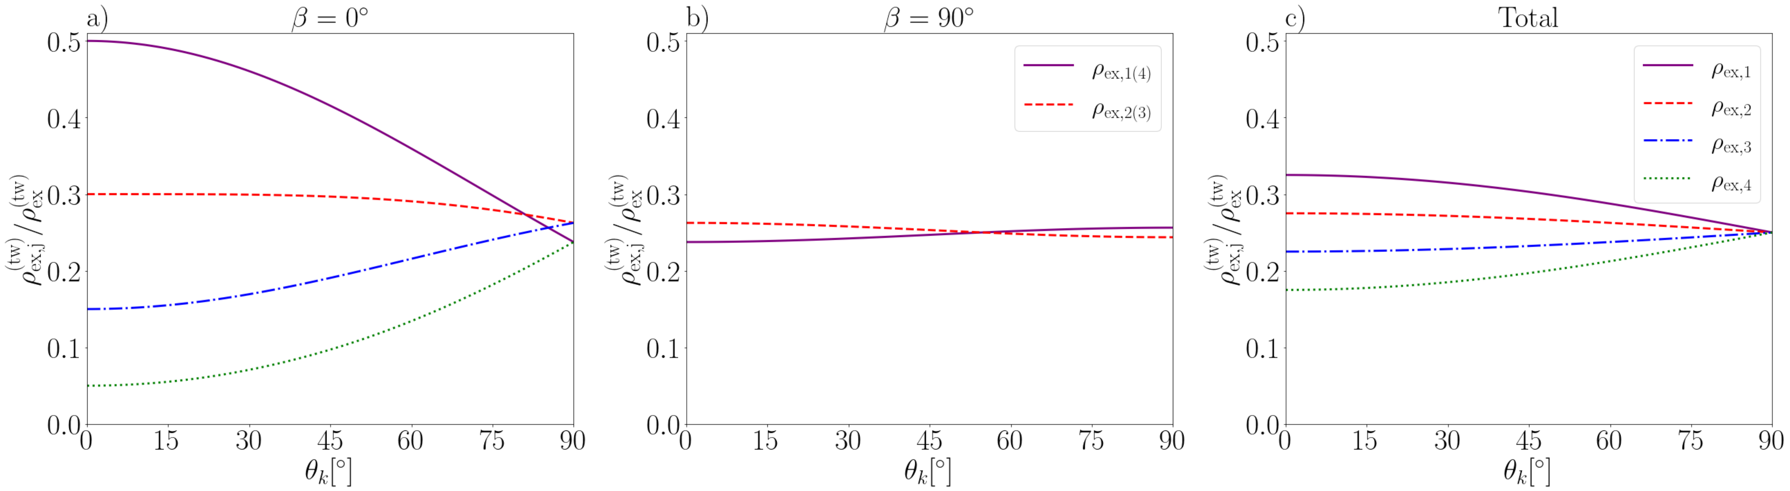

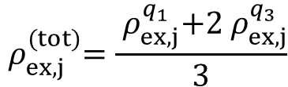

2.) Quadrupole structure for a single beam
20
Excited substate ($Λ=+1$):
$$ρ_{ex,j}^{q} ∝\sum_{g}{{\left|\left\langle I_{e}m_{e}I_{g}−m_{g} | 1 Δm\right\rangle \right|}^{2}}\sum_{M}{{\left(d_{MΛ}^{1}\left(θ_{k}\right)\right)}^{2}}{\left(d_{MΔm}^{1}\left(β\right)\right)}^{2}$$
Clebsch-Gordan coefficient
$${ ρ}_{ex,j}^{(tot)}=\frac{{ ρ}_{ex,j}^{q_{1}}+2{ ρ}_{ex,j}^{q_{3}}}{3}$$
$${ ρ}_{ex,j}^{q_{1}}(β=0°)$$
$${ ρ}_{ex,j}^{q_{2}}={ ρ}_{ex,j}^{q_{3}}(β=90°)$$

Slide 51
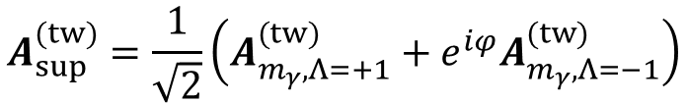
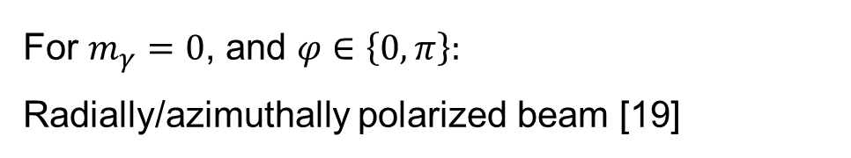
2.) Quadrupole structure for a superposition
21
Consider superposition of the form:
For $m_{γ}=0$, and $φ∈\left\{0, π\right\}:$
Radially/azimuthally polarized beam [19]
$$A_{sup}^{(tw)}=\frac{1}{\sqrt{2}}\left(A_{m_{γ}, Λ=+1}^{(tw)}+{e^{iφ}A}_{m_{γ}, Λ=−1}^{(tw)}\right)$$
[19] S. Schulz et al., Phys. Rev. A 102, 012812 (2020)

Slide 52
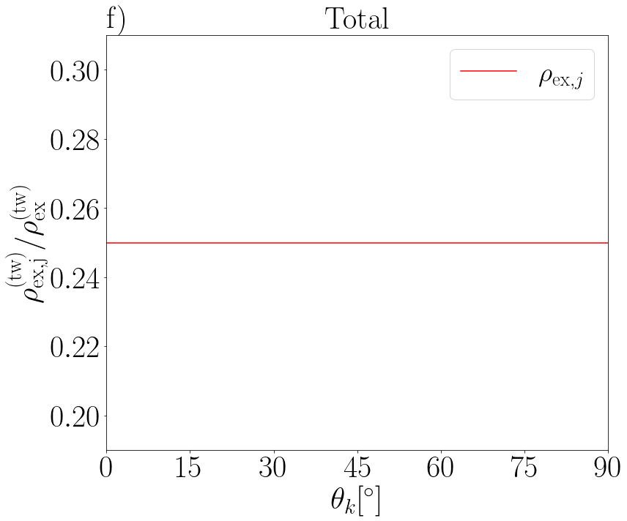
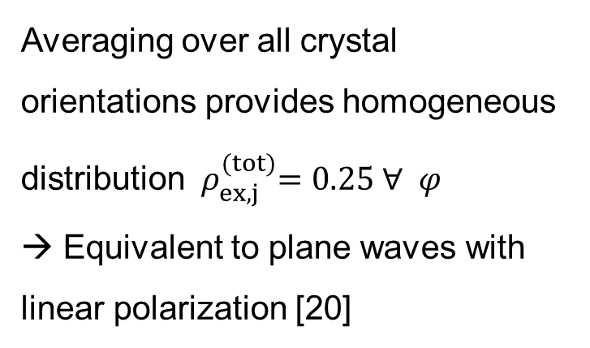

2.) Quadrupole structure for a superposition
21
Consider superposition of the form:
For $m_{γ}=0$, and $φ∈\left\{0, π\right\}:$
Radially/azimuthally polarized beam [19]
$$A_{sup}^{(tw)}=\frac{1}{\sqrt{2}}\left(A_{m_{γ}, Λ=+1}^{(tw)}+{e^{iφ}A}_{m_{γ}, Λ=−1}^{(tw)}\right)$$
$${ ρ}_{ex,j}^{(tot)}$$
Averaging over all crystal orientations provides homogeneous distribution ${ ρ}_{ex,j}^{(tot)}=0.25 ∀ φ$
→ Equivalent to plane waves with linear polarization [20]
[19] S. Schulz et al., Phys. Rev. A 102, 012812 (2020)
[20] L. v. Wense et al., Eur. Phys. A 56, 176 (2020)

Slide 53

2.) Conclusions
22
Interaction of ²²⁹Th:CaF₂ with twisted light → Position/TAM dependence vanishes
Quadrupole structure can be (slightly) modified via $θ_{k}$ along a single axis
However: Large values of $θ_{k}$ not available
Averaging over all crystal orientations provides similar quadrupole structure to plane waves

Slide 54
Thank you for your attention!
arXiv preprint, arXiv: 2404.13023

Slide 55
Backup Slides

Slide 56







2. Twisted light: k-space representation
Here: Bessel modes [10] → Most convenient to treat analytically/numerically
Vector potential [11]:
$$A^{(tw)}=A_{0}\int{e_{kΛ}e^{ik∙r}a_{ζm_{γ}}(k_{⊥})\frac{d^{2}k_{⊥}}{{\left(2π\right)}^{2}}}$$
$$k$$
$$k_{⊥}=k\sin{θ_{k}}$$
$$θ_{k}$$
Fourier amplitude:
$$k_{z}=k\cos{θ_{k}}$$
$$a_{ζm_{γ}}(k_{⊥})={\left(−i\right)}^{m_{γ}}e^{im_{γ}α_{k}}\frac{2π}{k_{⊥}}δ\left({|k}_{⊥}|−ζ\right)$$
Light beam carrying TAM (total angular momentum) projection $m_{γ}$ along propagation direction (z-axis)
Surface of a cone with constant opening angle $θ_{k}=arctan⁡(\frac{ζ}{k_{z}})$
[10] O. Matula et al., J. Phys. B. 46, 205002 (2013)
[11] S. Schulz et al., Phys. Rev. A 100, 043416 (2019)

Slide 57




2. Twisted light: Real space representation
Vector potential [10] :
$A^{(tw)}=A_{0}e^{ik_{z}z}\sum_{m_{s}}{i^{−m_{s}}}c_{m_{s}}{ η}_{m_{s}} J_{m_{γ}−m_{s}}\left(ζr_{⊥}\right)e^{i(m_{γ}−m_{s})φ_{r}}$
Some properties emerging from vector potential:
$m_{s}$ Eigenvalues of SAM $∈\{−1,0,1\}$
$c_{m_{s}}$ coefficients depending on $θ_{k}$
$η_{m_{s}}$ Eigenvectors of SAM
Annual intensity pattern
$$θ_{k}≪1$$
Helical wavefront
$$A^{(tw)}=A_{0}e^{ik_{z}z} i^{−Λ} c_{Λ} η_{Λ} J_{m_{γ}−Λ}\left(ζr_{⊥}\right)e^{i(m_{γ}−Λ)φ_{r}}$$
Beam is now characterized by a well defined OAM projection: ${ℓ=m}_{γ}−Λ$
[10] O. Matula et al., J. Phys. B. 46, 205002 (2013)

Slide 58



Calculation matrix element
$$H_{I}^{(tw)}=−\frac{1}{c} \int{j\left(r\right)⋅A^{\left(tw\right)} e^{−ik_{⊥}⋅b} d^{3} r}$$
with
$$A^{(tw)}=A_{0}\int{e_{kΛ}e^{ik∙r}a_{ζm_{γ}}(k_{⊥})\frac{d^{2}k_{⊥}}{{\left(2π\right)}^{2}}}$$
such that
$$M_{fi}=\left\langle I_{e}m_{e } | H_{I}^{\left(tw\right)} | I_{g}m_{g}\right\rangle$$
Detailed steps can be found for instance in [13], [21]
[13] L. Lu et al., Phys. Rev. Lett. 131, 202502 (2023)
[21] A. Pálffy et al., Phys. Rev. C 77, 044602 (2008)

Slide 59







1). Off axis ($b≠0$)
For all calculations${\text{:} m}_{γ}=2, Λ=1, θ_{k}=10°$ , $I=0.25$ W/cm² and only M1 amplitudes for two laser bandwidths → Smaller charge state conceivable (e.g. 3+)
For M1 amplitudes consider three transitions in proposed transition of ²²⁹Th³⁺[14]:
$$\left|\left.F_{g}=5 m_{g}=−5\right\rangle \right.→\left|\left.F_{e}=4 m_{e}=−4\right\rangle \right.$$
$$Δm=1$$
$$\left|\left.F_{g}=5 m_{g}=0\right\rangle \right.→\left|\left.F_{e}=4 m_{e}=0\right\rangle \right.$$
$$Δm=0$$
$$\left|\left.F_{g}=5 m_{g}=5\right\rangle \right.→\left|\left.F_{e}=4 m_{e}=4\right\rangle \right.$$
$$Δm=−1$$
[14] C. J. Campbell et al., Phys. Rev. Lett. 108, 120802 (2012)

Slide 60




1.) On axis ($b=0$)
11
For all calculations: Probing the E2 transition via $m_{γ}=2,∆m=2,Λ=1,$ $I=15$ W/cm² and different laser band widths → Large charge state beneficial!
Pure E2 excitation: Improve understanding of nucleus-shell coupling
Paraxial regime: Few Rabi cycles after few hours of interrogation → Large pitch angle beneficial
i)$θ_{k}=5°$
ii) $θ_{k}=10°$
iii) $θ_{k}=45°$
However: Experimentally not feasible due to laser requirements, particle confinement, …

Slide 61


State rotation
$${\left|\left.I_{g} m_{g}\right\rangle \right.}_{n}=\sum_{m_{g}′}{D_{m_{g}, m_{g}′}^{I_{g}}(α,β, γ){\left|\left.I_{g} m_{g}′\right\rangle \right.}_{ℓ}}$$
$$M_{fi}={\left\langle I_{e}m_{e } | H_{I}^{\left(tw\right)} | I_{g}m_{g}\right\rangle }_{n}$$
Wigner rotation matrix

Slide 62






Low saturation limit
Assumptions:
$Γ_{ℓ}≫Γ_{γ}$
Weak intensity
$$ρ_{gg}−ρ_{ee}≈\frac{1}{2I_{g}+1}$$
Ground state population hardly affected
$ρ_{gg}$ ground state population
$${\dot{ρ}}_{ee}=−i \sum_{g}{\frac{Ω_{eg}}{2}\left(ρ_{ge}−ρ_{eg}\right)−ρ_{ee}Γ_{γ}}$$
$ρ_{ee}$ excited state population
$$!$$
$${\dot{ρ}}_{ge}=i \frac{Ω_{eg}}{2(2I_{g}+1)}−ρ_{ge}\tilde{Γ}=0$$
$$ρ_{ee}∝\sum_{g}{Ω_{eg}^{2}}$$
More details in [20]
[20] L. v. Wense et al., Eur. Phys. A 56, 176 (2020)

Slide 63




Superposition
Consider superposition of the form:
$$A_{sup}^{(tw)}=\frac{1}{\sqrt{2}}\left(A_{m_{γ}, Λ=+1}^{(tw)}+{e^{iφ}A}_{m_{γ}, Λ=−1}^{(tw)}\right)$$
$$ρ_{ex,j}^{(tw)} ∝\sum_{g,M}{{\left|\left\langle I_{e}m_{e}I_{g}−m_{g} | 1 Δm\right\rangle \right|}^{2}}{\left(d_{MΔm}^{1}\left(β\right)\right)}^{2}\left[{\left(d_{MΛ}^{1}\left(θ_{k}\right)\right)}^{2}+{\left(d_{M−Λ}^{1}\left(θ_{k}\right)\right)}^{2}+2\cos{(φ)d_{MΛ}^{1}\left(θ_{k}\right)d_{M−Λ}^{1}\left(θ_{k}\right)}\right]$$
$$φ=π$$

Slide 64


A. Afanasev et al., New J. Phys. 20, 023032 (2018)

Slide 65

Doping orientations
Within the lattice, one of the calcium ions is replaced by the thorium ion + two more fluorine interstitial ions emerge for charge compensation.
Two preferred doping orientations where fluorine ions are either in 90° or 180° configuration

Slide 66

Usage of quadrupole excitation
Detection of nuclear excitation without fluorescence → NQRS
NQRS cannot discern between levels of the same $|m_{e}|$ → Require large population difference of$\left|\left(ρ_{ex,1}+ρ_{ex,4} \right)−\left(ρ_{ex,2}+ρ_{ex,3}\right)\right|$

Slide 67


About nuclear clocks
Quality of a clock is determined by
Accuracy ~ systematic error
Stability ~ statistical error

Slide 68

Benchmark for testing fundamental physics
Applications:
Detection of dark matter: Changes in synchronicity of a global network of nuclear clocks
Variations of fundamental constants:
  If fundamental constants change in time, so do energy levels → Clock frequencies
  $\frac{δω}{ω}=\frac{∆V_{c}}{ω}\frac{δα}{α}$

Slide 69


Nuclear relaxation channels
Radiative
Internal conversion (IC)
Radiative life time of isomeric state $O({10}^{3})$s
IC life time of isomeric state $O({10}^{−6})$s

Slide 70
Old Slides

