Slide 1
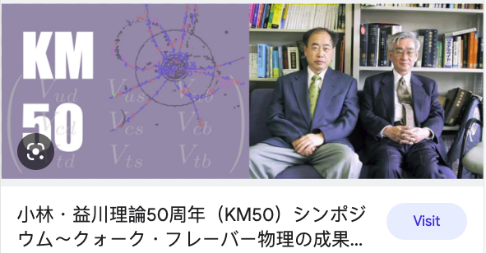


The Curious History of the CKM Matrix
--miracles happen!!--
based an a talk presented at a KEK symposium on 50 years of CKM
Stephen Lars Olsen
January 24, 2024 IHEP-UCAS seminar, Beijing

Slide 2
Pre-history: Three major discoveries in 1963-64
60 years ago
(my first year in graduate school)
Cabibbo: Flavor mixing
Gell-Mann & Zweig: Quarks/Aces
Cronin-Fitch : CP violation

Slide 3
Cabbibo Flavor Mixing
-- April 1963 --

Slide 4
Flavor mixing pre-1963:
Feynman-Gell-Mann Universality:
V-A paper: PR 109, 193 (1958)
p
same coupling for all decays, G_{F}:
ΔS=1
ΔS=1
Λ
ν
−
_
√G_{F}
e⁻
_
all these are equal
n
ΔS=0
n
ΔS=0
ν
−
_
e⁻

Slide 5
Feynman-Gell-Mann Universality meets experiment:
|ΔS|=1:
ΔS=0 :
Γ(K⁺→ μ⁺ν)
Γ(π⁺→μ⁺ν)
Bf(Λ→pe⁻ν)
Bf(Λ→pπ⁻)+Bf(Λ→nπ⁰)
ΔS=1 decays are ∼20x too small
expect: 17
measured: 1.1
16 x 10⁻³
8.5 x 10⁻⁴
PR 128, 2398 (1962):
PR 131, 868 (1963):

Slide 6

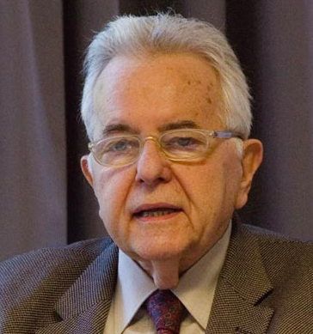
Flavor mixing post-1963:
Cabibbo universality:
PRL, 10, 531 (1963)
ΔS=0
ΔS=±1
Nicola Cabibbo
1935-2010
sinθ_{C}≈0.05
√G_{F}→ cosθ_{C} √G_{F} + sinθ_{C} √G_{F}
²
_
_
_
weak interaction quarks
Feynman-Gell-Mann universality applied to rotated quarks
s’
s
d’
θ_{c}∼15◦
“Cabibbo angle”
mass eigenstate quarks
d

Slide 7
The quark model
--January 1964 --

Slide 8
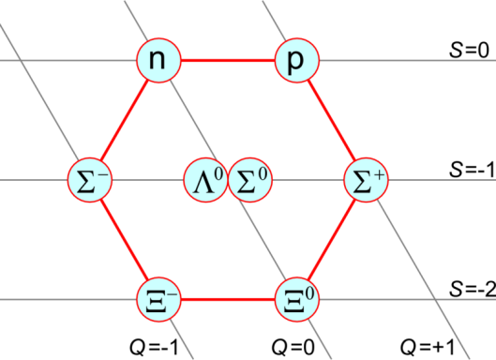
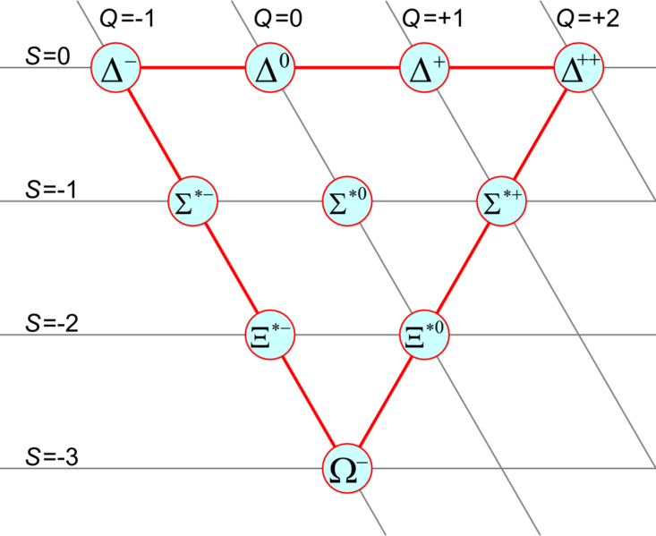
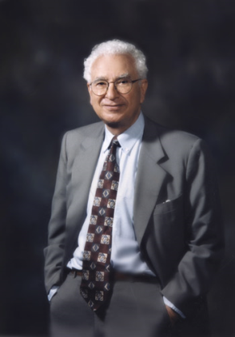
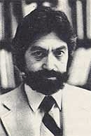
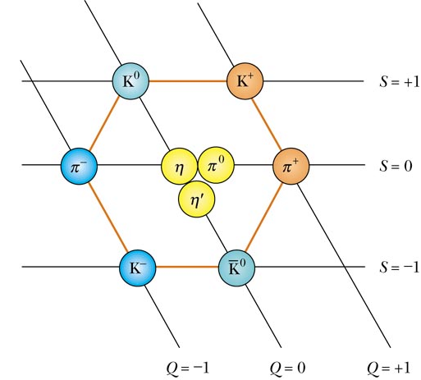
Three quarks for Mister Mark
Y=+1
Y= 0
Q=I₃+Y/2
Y=-1
“quarks”
Gell-Mann
Phys. Lett., 8, 214
irreducible
components
of SU(3)
never
published!
“aces”
treys
deuces
Zwieg

Slide 9
Discovery of CP-violaton
--July 1964 --

Slide 10
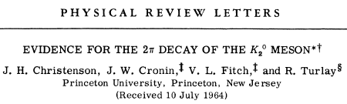
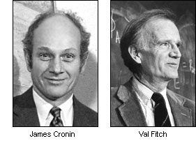
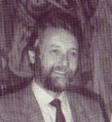
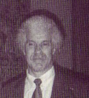
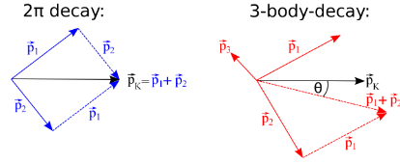
CP violation
13, 138 (1964)
K_{L}→π⁺π⁻
K_{L}→π±𝓵∓ν
Rene Turlay
James Christenson
cosθ

Slide 11
1st Some Fundamentals

Slide 12
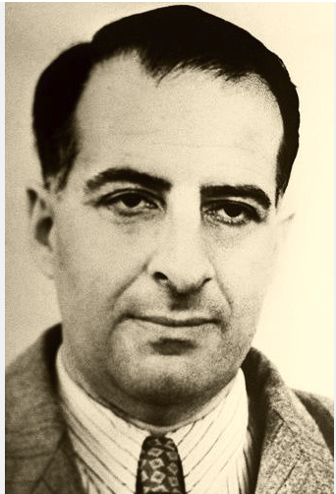
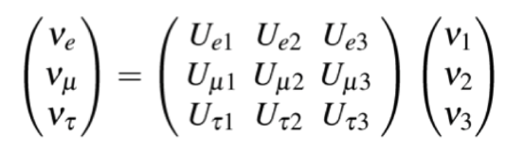
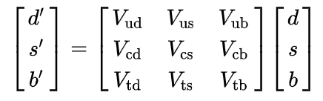
Flavor mixing: A tale of two Matrices
PMNS matrix
CKM matrix
Bruno
Pontecorvo
1958
1973
flavor
states
mass
states
flavor
states
mass
states
familiar
new
new
familiar
experiments
experiments

Slide 13
Unitarity condition
×
†
=
V_{CKM}
V_{CKM}
𝟙
1
0
0
×
=
0
0
1
0
0
1
9 equations

Slide 14
CP-violation: It’s just a phase …
particles_{init}→ particles_{final}
antiparticles_{init}→ antiparticles_{final}
2
2
CPT conserved
but CP violated
:
only differ
by a phase

Slide 15
The KM paper
February 1973

Slide 16
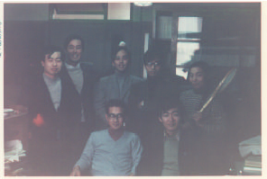
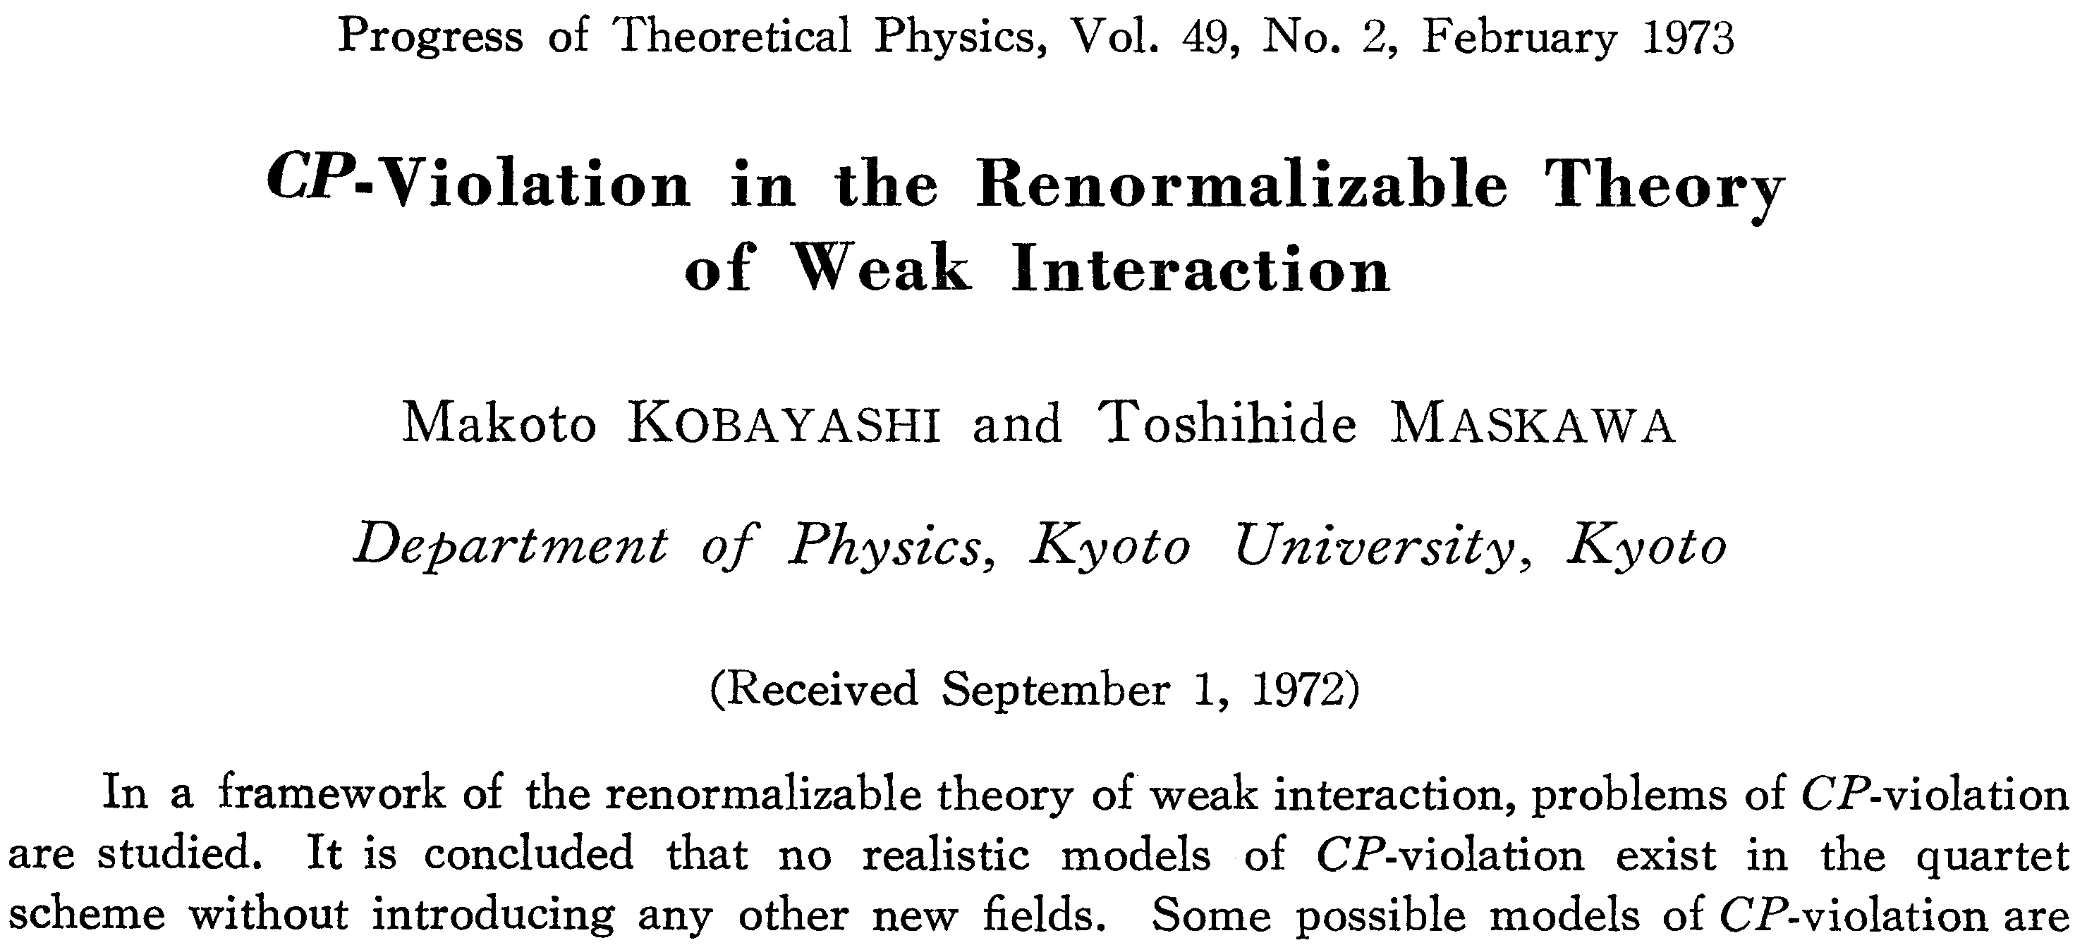
1973: Kobayashi & Maskawa
Nagoya Theory Group 1973
iNSPIRE: 11,414 citations
page 1
(of 6)
= Standard Model
“quartet scheme…= ?”

Slide 17
Questions
What is the “quartet scheme?”
Why is CP violation not possible in it?

Slide 18
The discovery of charm
as seen from Nagoya Japan

Slide 19

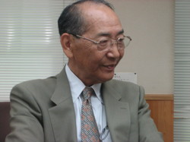
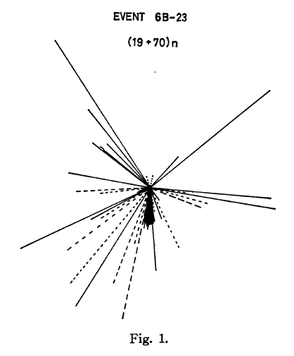
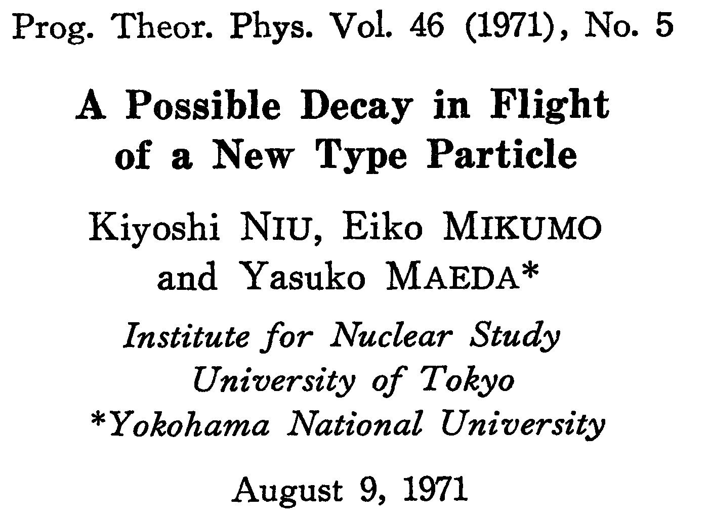
to many people in Japan, charm was discovered in 1971
1971 paper by (now) Nagoya particle physicist
Kiyoshi Niu and colleagues
iNSPIRE: 342 citations

Slide 20
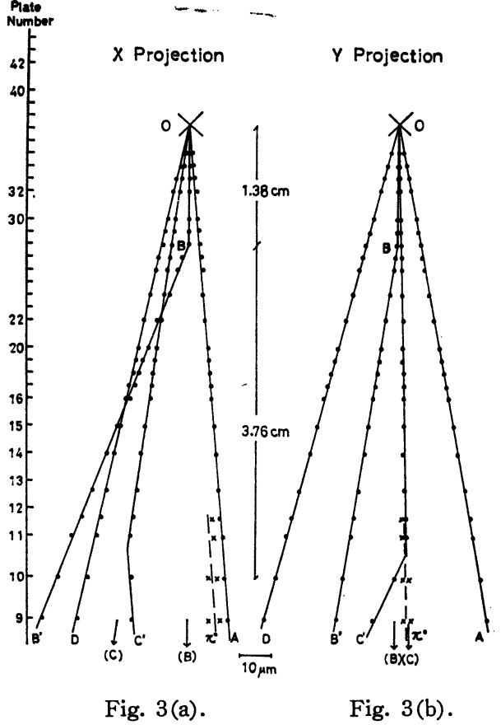
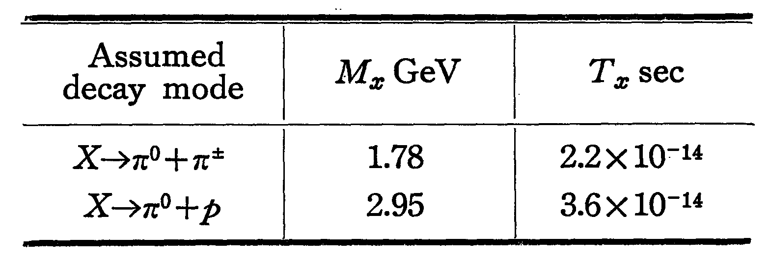

PDG-2020
B:
M_{D}=1.870 GeV
Λ_{c}: M =2.286 GeV
C:
B
B
view along track B
θ_{γγ}≈ 0.004^{𝝤}
𝛄₂
π⁰
C
𝛄₁
●
B
E_{π}0=3.2 ± 0.4 TeV
p_{π}0=627 ± 90 MeV
_{T}
B’
C
C
𝛄₁
𝛄₂
𝛄₁
B
B
𝛄₂
B’
C’
π⁰
π⁰
C’
Shuzo Ogawa (Nagoya) interpreted this event as production of one particle
with a c-quark (X→π⁰p) and one with an anti-c-quark (X→π⁰π±).

Slide 21
why no CP-violating phase with 4-quarks?

Slide 22
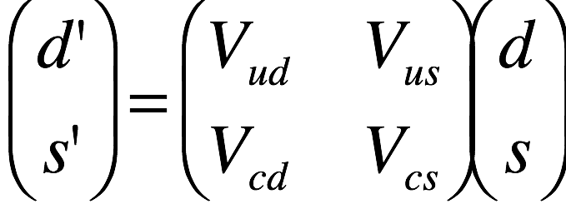
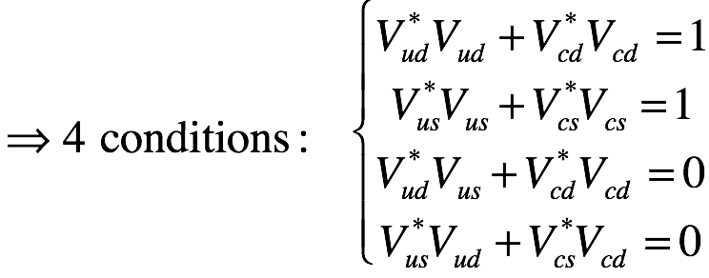
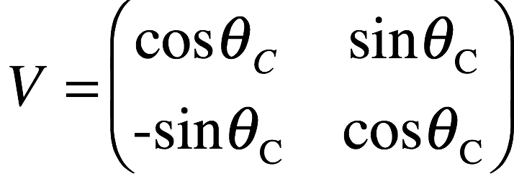
Quark-flavor-mixing for 4 flavors
Why not just add a complex phase to of the mixing matrix elements?
Can we add a complex CPV phase
to one of these matrix elements?
no room for a CP-violating phase
n_{f}=2
Number of parameters: 8
Unitarity conditions (n_{f} ) : -4
²
four quark
mixing matrix
# of arb. phases (2n_{f}-1): -3
“re-phrasing”
Weak int
eigenstates
Mass
eigenstates
# of free parameters: 1
Only 1 free parameter:
the Cabibbo angle, θ_{C}
V†V= 1

Slide 23
“re-phasing” property of the SM
multiply each quark by an arbitrary phase factor:
and simultaneously “rephase” the CKM matrix:
is unchanged:
1 overall phase can be factored out:
3 (i.e., 2N-1) arbitrary phases in CKM matrix + 1 overall (trivial) phase

Slide 24
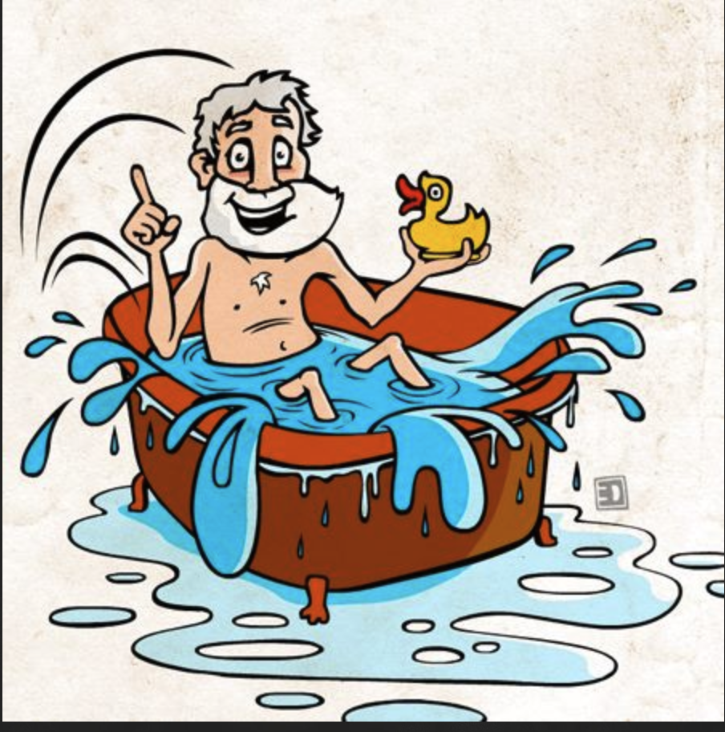
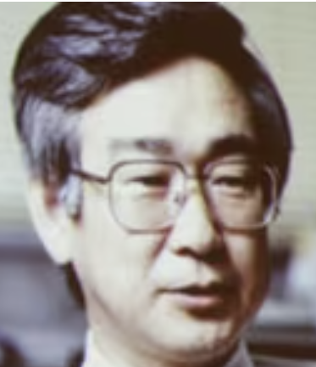
1972: Maskawa
how many free
parameters with six quarks?

Slide 25
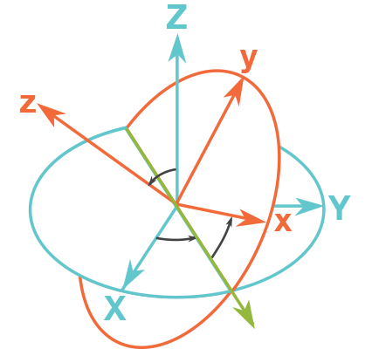
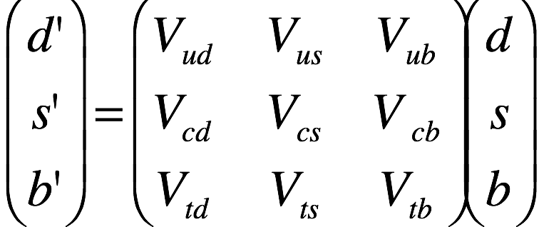
same calculation for 6 quark flavors:
Can we add a complex CPV phase
to one of these matrix elements?
Yes!
n_{f}=3
Number of parameters: 18
Unitarity conditions (n_{f} ): -9
²
# of arb. phases (2n_{f}-1): -5
b
# of free parameters: 4
s’
b’
4 free parameters:
only 3 are needed for the 3-dim rotation (Euler angles: θ₁ θ₂ & θ₃)
θ₂
s
d’
θ₁
θ₃
d
+ one left over for a CPV phase!

Slide 26
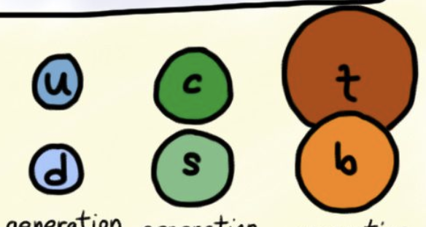
23 centuries ago: Archimedes
½ century ago: Maskawa
Eureka!!
Eureka!!
bouyancy!
6-quarks

Slide 27

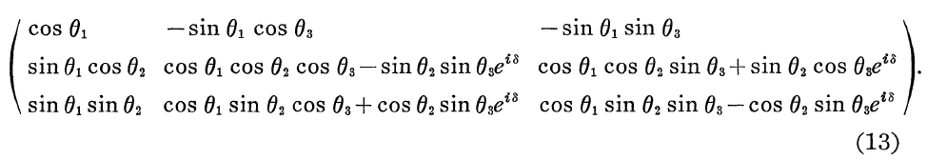
quickly add a 6th page to the paper
Makoto Kobayashi
Toshihide Maskawa
1940-2022
“6-quark model”
page 6
‘
‘
=
‘
3 Euler angles: θ₁ θ₂ & θ₃, plus 1 CP-violating phase: δ
i.e., the SM can accommodate CP violation, but only with 6 (or more) quarks

Slide 28
6 quarks it is!
: b-quark discovered at Fermilab
1995: t-quark discovered, also at Fermilab

Slide 29
two problems:
the paper is invisible
the matrix is incorrect

Slide 30
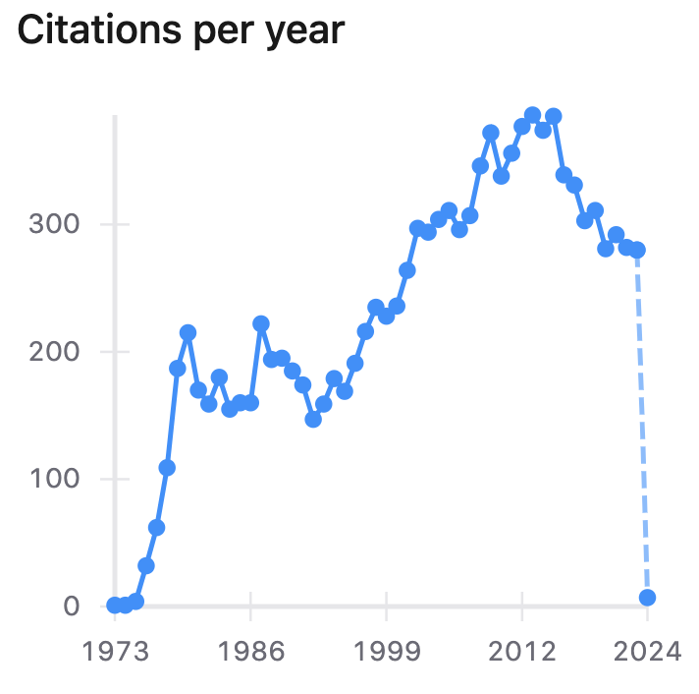
KM paper’s citation history:
Today: 11,758 cites
1st three years:
1975 1-more
1974 1-cite
1973 0-cites

Slide 31
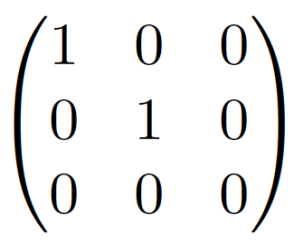
CKM matrix, 1973 version:
this is not a valid rotation matrix!
--& not even unitary--
θ₁ θ₂ & θ₃, & δ ◊ 0
for a rotation matrix R: if θ₁ θ₂ & θ₃, δ ◊ 0, R → Identity matrix
Oops!

Slide 32

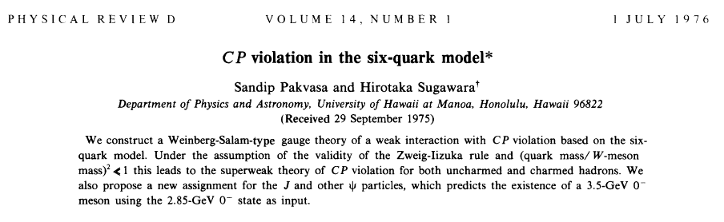
1976: KM paper is “discovered”
Sandip Pakvasa
Hirotaka Sugawara
KM typo is fixed!
who is this guy?
Typo in ref 2:

Slide 33
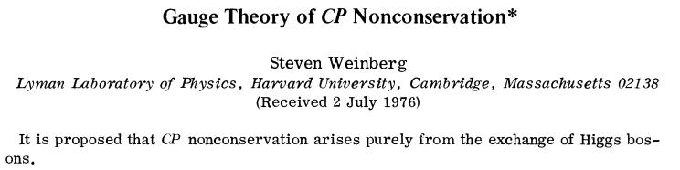
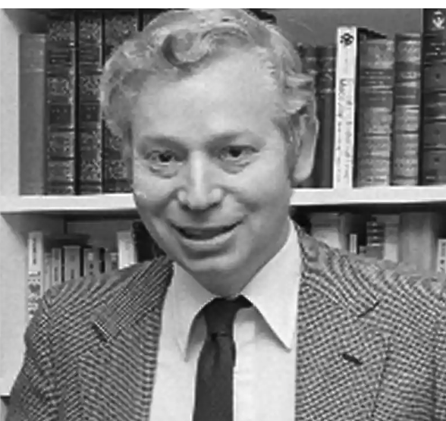


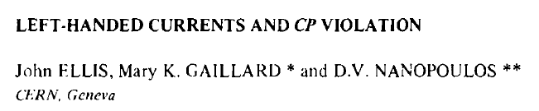

Slide 34
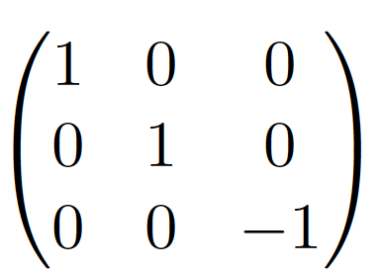
But, wait a minute …
this isn't a valid rotation matrix either!
θ₁ θ₂ & θ₃, & δ ◊ 0
Oops (again)!

Slide 35
Reparametrizing the CKM matrix
PHYSICS LETTERS B181, 123
Harari’s recommendations:
Simple relations between V_{ij} and quark mixing angles θ_{ij}
The above diagonal terms should be directly measureable
The CP phase (δ) should always be attached to θ₁₃ ← i.e., the smallest mixing angle
Easily generalizable to 4 or more quark generations

Slide 36
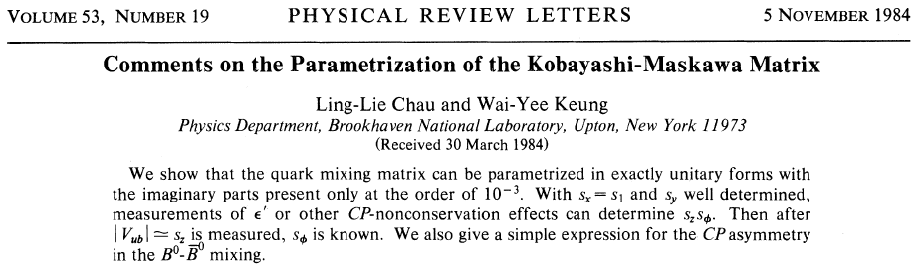
Finally…, after 12 years:
3rd rotate
around d’’
2nd rotate around
s’,include CP phase
1st rotate
around b
The PDG version since 1988
Here, all three mixing angles are between 0º and 90º
OK!
& they got the
reference right
1

Slide 37
1977, b-quarks discovered
But, are B mesons good for anything?

Slide 38
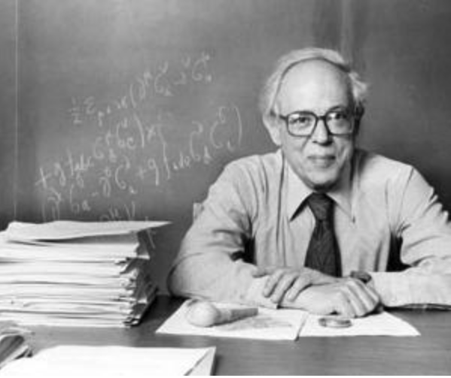
1978 Seminar by Bram Pais
“There is good news and bad news.
The good news:
- CP violation in B meson system is similar to vooo CP violation in K meson system.
The bad news:
B₁ and B₂ mass eigenstates are not distinct
lifetimes are very short (τ_{B} ≈ 1.5 ps, cτ ≈ 0.5mm)
B⁰⇔ B⁰ mixing is negligible”
Abraham “Bram” Pais 1918-2000
founding father of flavor physics
(with Gell-Mann)
correctly predicted:
-associated production
-existence of the K_{S} and K_{L} mesons
-K⁰ ⇔ K⁰ mixing
-K_{L}→K_{S} regeneration
_
_

Slide 39

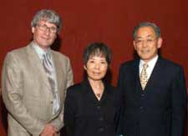

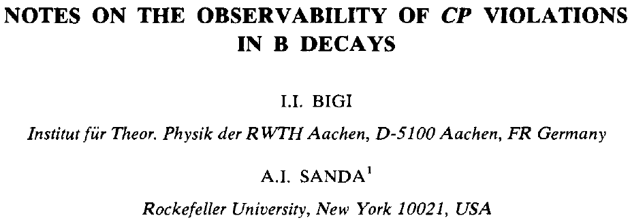
“Not so fast, … Pais may be wrong”
Ikaros Bigi
Ichiro Sanda
Ashton Carter
- experiments have 10s of millions of BB events
B⁰ ⟺ B⁰ mixing must be substantial
third generation KM mixing angles are just right
<100 μm distances between B & B decay vertices are measured
_
tests are possible, …
but only if:
Sanda’s “sweet spot”
_
very big “if”
_

Slide 40
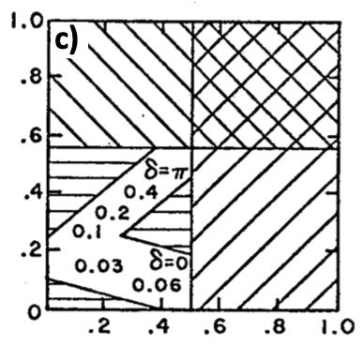
Me: CKM matrix allowed regions (1981)
neutron lifetime: (d→u e⁻ν): cosθ_{C} ⟹ V_{ud}=cosθ₁cosθ₃
ν_{μ} +Α◊dileptons:
(ν_{μ}+d → μ⁻ c +X)
sinθ_{C}⟹ V_{cd}=sinθ₁cosθ₂
kaon decay: (s→ u e⁻ν)
sinθ_{C}⟹ V_{us}=sinθ₁cosθ₃
sinθ₂
ΔM_{K}=M_{KL}-M_{KS}
ε_{K} ⟸ K_{L} CPV parameter
θ₂ & θ₃ are from the original KM
parametrization
Sanda’s
“sweet spot”
sinθ₃

Slide 41
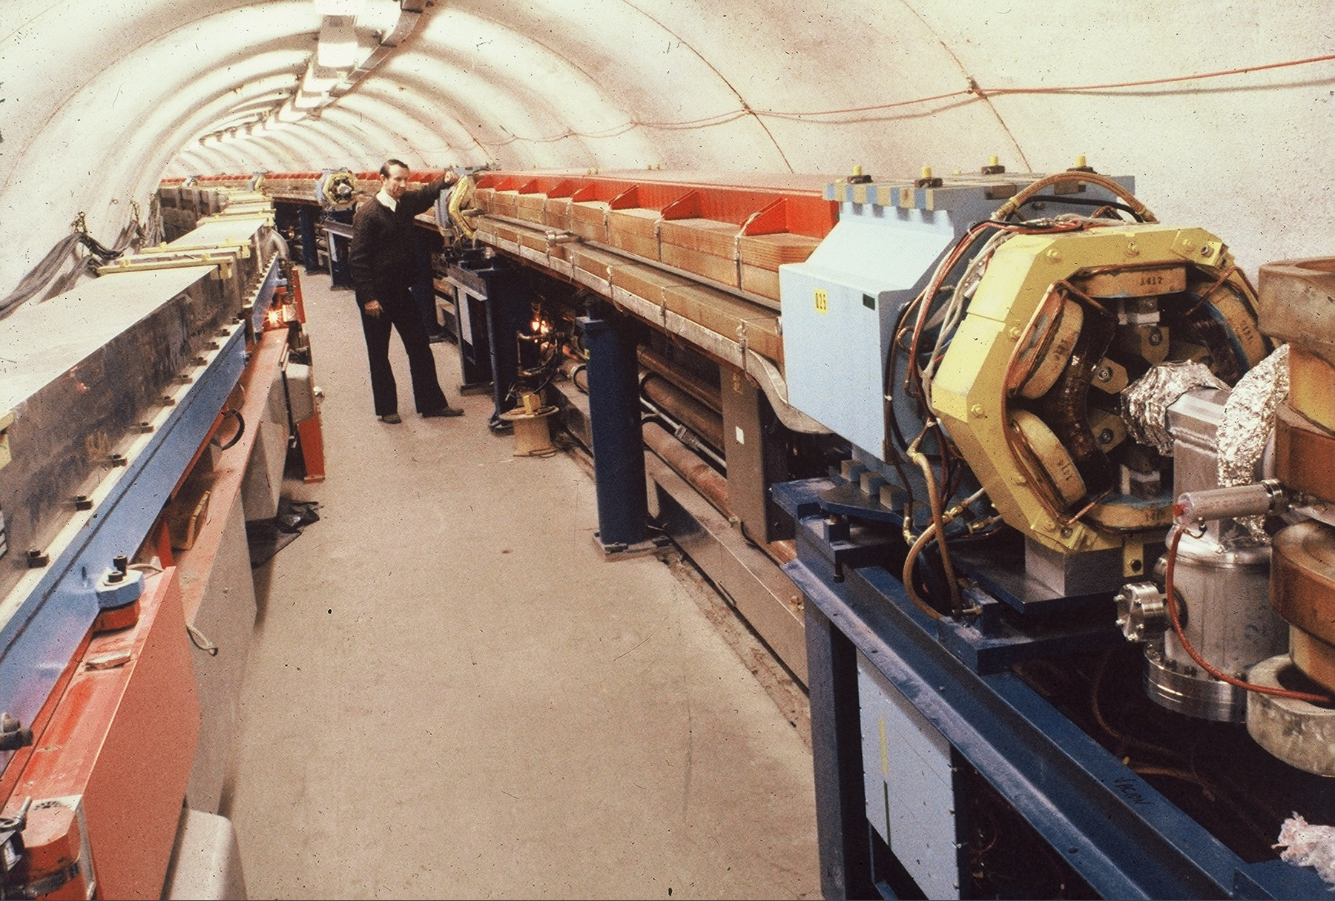
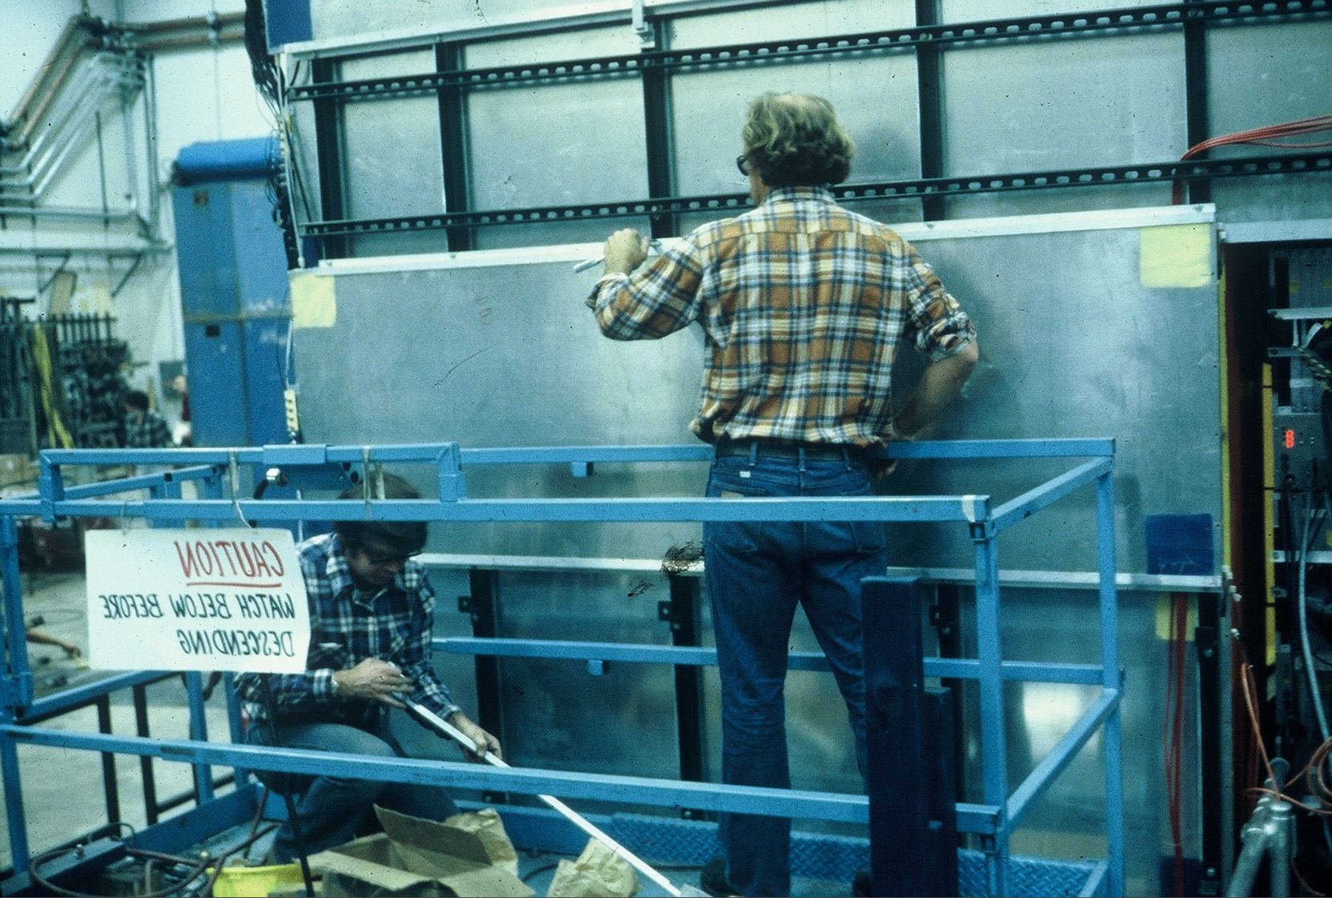
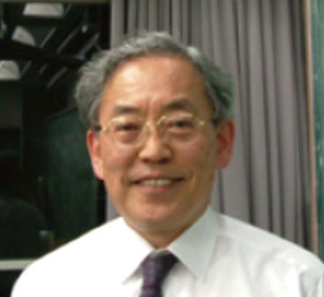
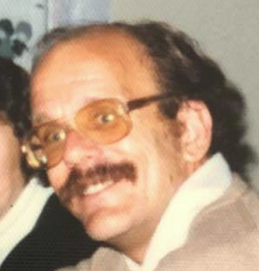
state of the art for BB production in 1981
_
CESR collider
CLEO experiment
…
𝚼(4S)→BB ~30 events/day
_
𝚼(3S)
“We need 10s of millions of BB events to study CP-violation
_
“10 million @ 30/day
= 900 years!”
𝚼(4S)
2M_{B}

Slide 42
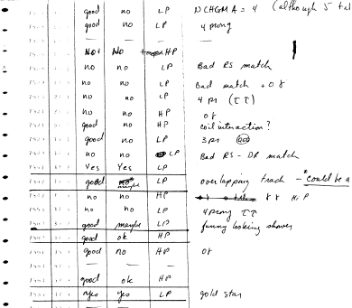
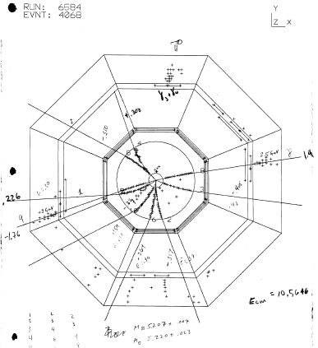
World’s 1st 𝚼(4S)→ di-electron event
Magnet coil
e⁺
e⁻
maybe”

Slide 43
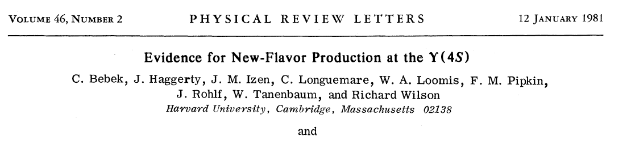

Inclusive electrons at the ϒ(4S)
something produced here
decays via Weak Ints.
d
d
d
d
B⁰
D⁰
π⁰
_
B⁰
V_{ub}
V _{cb}
*
*
u
_
𝓁⁺
𝓁⁺
ν
ν
b→c𝓁ν: p_{𝓁} < 2.3 GeV/c
b→u𝓁ν: p_{𝓁} < 2.6 GeV/c
different endpoints
no sign of any
b→u𝓁ν evts
|V_{ub}| < 0.14|V_{cb}|
b→c𝓁ν
end-point

Slide 44

Long B-meson lifetime discovered at SLAC
MAC
_
B⁰ meson
excess of
δ>0 evts
SLAC result in 1987:
τ_{B}= (1.2 ± 0.2 ) x 10⁻¹²s ➔ |V_{cb}| ≈ 0.04
δ (cm)
W. Ash et al., Phys. Rev. Lett. 58, 640 (1987)
B-meson
<γβct>~0.5mm~resolution
δ

Slide 45

the KM mixing angles are favorable
sinθ₂
Sanda’s
“sweet spot”
/
circa 1985
measurements
sinθ₃

Slide 46
Three miracles
- B-mesons mix! (Pais was wrong)
- 100-fold improvement in collider performance (few×10³² → 10³⁴)
- 10-fold improvement in detector technology (σ_{vtx}: 200μm→20μm)

Slide 47
Miracle #1

Slide 48

Miracle 1 occurred at DESY
not only do B-mesons mix, they mix substantially
same-sign
opposite-sign
Henning Schroeder
1945-2012
ARGUS: χ_{B}=0.21+0.05
faction of B⁰ mesons that morph
into a B⁰-meson before decaying
_

Slide 49
The t-quark mass is really, really high!!
t
140 ± 40 GeV !!!
⨉
⟸ TRISTAN
Guido Altarelli
1941-2015
Z. Phys. C37, 271 (1988)

Slide 50
Miracle #2

Slide 51
PEPII and KEKB
Yankee Ingenuity
(post-SSC)
大和魂
- “no-risks are allowed” DoE
- use established technologies
- set a safe bar for success:
Lum = 3x 10³³
rewrite the book on colliders
develop new tehnologies
set a high bar for success:
Lum = 10³⁴
PEPII and KEKB both achieved more
than 2x their luminosity goals
Jonathon Dorfan
Katsunobu Oide
- zero-degree crossing angle
- conventional RF systems
- standard lattice
- …
- finite crossing angle
- ARES energy storage + SCRF
- 2.5π cell structure
- interleaved sextupoles
- …

Slide 52

KEKB redefines the Luminosity state-of-the-art
~5 order of magnitude advance from 1981
KEKB 2005
1.5x10³⁴
>1 million BB pairs/day!!
_

Slide 53
Miracle #3

Slide 54

The Belle detector
Fumihiko
Takasaki

Slide 55

>1 order of magnitude advances in resolution & efficiency
~200 μm

Slide 56

July 2001
LP01 Rome
B→J/ψK_{S}
_
B→J/ψK_{S}
𝚼(4S)→BB evts: 31 million
B→J/ψ K_{S} evts: 533
B→J/ψ K_{L} evts: 570

Slide 57
July 2001
LP01 Rome
KM model is confirmed!
𝚼(4S)→BB evts: 31 million
B→J/ψ K_{S} evts: 533
B→J/ψ K_{L} evts: 570

Slide 58


December 2008: The Big Moment
No prize for Cabibbo
or Kiyoshi Niu
or Tony Sanda

Slide 59

Why not Cabibbo?
1960 paper (proposal for PCAC) by Gell-Mann & Levy:
ref. 4 in Cabibbo’s paper
~40 cites/yr for 60 yrs
iNSPIRE: 2,152 citations

Slide 60
Gell-Mann Levy page 4:`
a Vector-current mediated 0⁺→0⁺decay
(B.T.W., the half-life for ¹⁴O→¹⁴Nb⁺ is 3% longer than expected)
Even Gell-Mann’s footnotes contained Nobel Prize-winning ideas!
footnote:
Cabibbo’s “idea”
3 yrs earlier!
sin²q_{C}=0.06
cosq_{C}
q_{C}∼14º

Slide 61
Miracle #4:

Slide 62

All CKM angles have been measured

Slide 63
it didn’t have to be
CP V was 1st discovered (almost accidently*) in 1964
in a low priority experiment in “Inner Mongolia”
* the main motivation for the experiment was to study K_{L}→K_{S} regeneration

Slide 64


The AGS, Brookhaven’s 2nd HE accelerator
-- world’s first strong focusing accelerator, still running more than 60 years later --
“Inner Mongolia”

Slide 65

Brookhaven’s “inner Mongolia” beam line
a hole in the wall
shielding blocks
sweeping magnet
AGS accelerator magnets
Internal target

Slide 66


Slide 67

The Fitch-Cronin experiment
-- all recycled equipment --
Helium gas
all K_{S} have
decayed

Slide 68


5211 K_{L} ➔ π⁺ + π⁻ candidates remeasured on a commercial bubble chamber measuring machine
π⁺π⁻ “invariant mass”
M(π⁺π⁻)<M(K_{L})
~60 event peak
if the Bf were ≲0.02%, they would’ve had ≲4 signal events on a 20 event background and CPV may never have been discovered!!
M(π⁺π⁻)=M(K_{L})
π⁺
~40 K_{L}→π⁺π⁻
+
~20 K_{L}→K_{S}→ π⁺π⁻
|
θ=1º
Bf(K_{L}→π⁺π⁻)=0.2%
π⁺π⁻)>M(K_{L})
cosθ

Slide 69
Why is Bf(K_{L}→π⁺π⁻)=0.2%?
hint: it has nothing to do with weak interaction physics
Because Γ(K_{L}→π⁺π⁻π⁰)<<Γ(K_{S}→π⁺π⁻)
Q_{3π}=M_{K}-3m_{π}=81 MeV
Q_{2π}=M_{K}-2m_{π}=81 MeV
different Q values
--QCD physics--
if M_{π} were ~100 MeV, or M_{K}~600 MeV,Γ(K_{L}→3π) would be ~5xlarger
and Fitch & Cronin wouldn’t have seen a CPV signal over background

Slide 70
Miracle #5:

Slide 71


What about neutrinos?
PMNS matrix:
These mixing angles have all been measured* too!
--or will be soon--
* for Dirac neutrinos, Majorana neutrinos are another story

Slide 72
but what about 3 neutrino flavors?
Can we add a complex CPV phase
to one of these matrix elements?
n_{f}=3
Dirac Majorana
Number of parameters: 18 18
Unitarity conditions (n_{f} ): -9 -9
# of arb. phases (2n_{f}-1): -5 -3
# of free parameters: 4 6
²
b
Weak int
eigenstates
s’
b’
Yes!
Mass
eigenstates
θ₂
4 parameters, 3 or rotations
(Euler angles: θ₁ θ₂ & θ₃) with
one left over for a CPV phase
(+2 more phases for Majorana
neutrinos)
s
d’
θ₁
θ₃
d

Slide 73


Nature’s choices of Matrix elements & mass differences
Δm_{sol}
²
Δm_{atm}
²
Nova, T2K, Dune, HyperK
Daya Bay, Reno
Δm_{atm}:
²
= 320 (m/MeV) E_{n}
Δm_{sol}:
=10,500 (km/GeV) E_{n}
²
KamLAND, RENO-50, JUNO

Slide 74

MSW matter effects: L_{Earth crust}=3200 km, L_{Earth core}= 800km;
L_{Solar core} =45km
if the MSW resonanc were
up here, Ray Davis would not
have measured such a dramatic
solar-neutrino deficit.
MSW resonance
MSW resonance

Slide 75
Future

Slide 76

The Discrete symmetries: C P T
C
Violated
CP
P
Violated
CPT
Violated
??????
T
Violated

Slide 77
CPT Theorem
any Lorentz-invariant local quantum field theory with a
hermitian Hamiltonian must have CPT symmetry.
what theory is a Lorentz-invariant local quantum field theory
with a hermitian Hamiltonian?
the Standard Model

Slide 78

CPT must be violated!
In QFT, 2nd and higher perturbation
diagrams have loops:
picture (& argument) from
an Ed Witten public talk at KIAS:
when any two of the point-like
vertices coincide, there is an
infinite value & these make the
space-time integral diverge.
point-like
vertices
∞

Slide 79


How does QFT deal with these infinities?
renormalization
term
counter-term
∞+something
-∞ = something

Slide 80


Renormalization is just a stop-gap procedure. There must be some
fundamental change in our ideas, probably a change just as fundamental as the passage from Bohr's
orbit theory to quantum mechanics. When you get a number turning out to be infinite which ought to
be finite, you should admit that there is something wrong with your equations, and not hope that you
can get a good theory just by doctoring up that number.
in a 1970 interview with Dirac conducted by David Peat and Paul Buckley for the CBC show,
“Physics and Beyond”).
Dirac:
The shell game that we play ... is technically called ‘renormalization’. But no matter how clever the word,
it is still what I would call a dippy process! Having to resort to such hocus-pocus
has prevented us from proving that the theory of quantum electrodynamics is mathematically
self-consistent. It’s surprising that the theory still hasn’t been proved self-consistent one way or the other
by now; I suspect that renormalization is not mathematically legitimate
Richard P. Feynman (2014). “QED: The Strange Theory of Light and Matter”, p.128, Princeton Univ. Press
Feynman:

Slide 81
renormalizable doesn’t work for Gravity

Slide 82
Witten’s preferred solution: Strings (=non-locality)
CPT violation

Slide 83
CPT has to be violated somewhere
but where? at least by the Planck scale? …but maybe lower?
we have to keep looking
note: CP has to be violated to explain the baryon symmetry of the
Universe. Leptogenesis models say this happened at T~10¹⁴ GeV
but traces of CP V show up in K- & B-meson decay, etc.

Slide 84
main consequence of CPT violation
m_{particle} ≠ m_{antiparticle}
m_{p} - m_{p} < 0.7 eV
PDG limits
_
m_{K}0 - m_{K}0 < 5x10 ⁻¹⁰ eV
_
_
why is the K⁰-K⁰ limit 10 orders of magnitude better?

Slide 85
Nature’s greatest gift to particle physicists
a 0.1◦ phase difference between the vertices in this 2nd-order W.I. process magically produces an easily measurable CP violation in K⁰ decays
maybe it amplifies CPT violations to measurable levels

Slide 86
The Bell-Steinberger Relation
Only assumption: unitarity
sum over all mutual decay modes
The B⁻S relation only works for Kaons!
K⁰-mesons
D⁰-mesons
B⁰-mesons
π⁺π⁻, π⁰π⁰, π⁺π⁻γ
π⁺π⁻π⁰, π⁰π⁰π⁰
π±e∓ν, π±m∓ν
ππ, Kπ, KK
πππ, Kππ, KKπ, KKK
…
π𝓵ν, ρ𝓵ν, ω𝓵ν, K𝓵ν, K∗𝓵ν, …
dozens of mutual modes
hundreds of mutual modes
7 mutual modes

Slide 87

no CPT violation
with CPT violation
phases of η₊₋ & η₀₀ = φ_{SW}
phases of η₊₋ & η₀₀
no longer = φ_{SW}
𝜺
Δm=M_{KL}-M_{KS} and ΔΓ=1/τ_{KS}-1/τ_{KL}
have been precisely measured

Slide 88


SM expectations
PDG 2023
Meas

Slide 89
Bell Steinberger now
|M_{KO}-M_{K0}|<4x10⁻¹⁹ GeV@ 90% C.L.

Slide 90




How to improve?
1st: produce ∼5 billion J/ψ→K∓π±K⁰ events
2nd: plot K⁰→π⁺π⁻ decay
times for K⁻ & K⁺
3nd: fit e^{-ΔΓτ/2} × asymmetry
to Re(ε) – Acos(ΔMτ-φ)
↳π⁺π⁻
c)
● K⁻
𝝤 K⁺
φ₊₋
reduced Asymmetry
K⁰(τ)
Events/0.1τ_{S}
2π/ΔM
K⁰ decay time (τ_{S})
K⁰ decay time (τ_{S})
Bf(J/ψ→K∓π±K⁰) ≈ 0.5%:
Need >1 trillion J/ψs
2ΔM
ΔΓ
if φ₊₋ ≠ arctan ---- , learn Swedish

Slide 91

Best result to date: CPLEAR p_{stop}p→K∓π±K⁰(K⁰)
_
_
(ΔM=3.5x10⁻¹² MeV)
φ
CPLEAR PLB 458, 545 (1999)
⇒|M_{K} -M_{K}|<4 × 10⁻¹⁹ GeV
_

Slide 92

need ≳ 10¹² J/ψ events (L ∼ 5 x 10³⁴ @ 3.1 GeV)
not a big deal for a lab with a lot of e⁺/e⁻ infrastructure & experience
the 1st J/ψ e⁺e⁻ collider fit into a parking lot
≈60m
SPEAR collider
at SLAC (1972)
BEPC diameter ≈80m

Slide 93

Monochromater: factor of 10 from reduction of e⁺e⁻ CM spread
$J/ψ$ production cross-section
Xiaoshuai Qin
$δ$E_{rms}=0 keV: ${ σ}_{J/ψ}$=90000 nb
$δ$E_{rms}=57 keV: ${ σ}_{J/ψ}$=41000 nb
$δ$E_{rms}=1100keV: $σ_{J/ψ}$=3400 nb (BESIII)
$J/ψ width$: 92 keV
E+$∆E$
E-$∆E$
E
E
E-$∆E$
E+$∆E$
Alexander Zholents
CERN SL/92-27/AP
Notes:
Monochromator scheme of e+e- collision, which reduce the center of mass spread , to the value smaller than the width of J/psi resonance. The Monochromatization of e+e- collisions can be obtained by introducing a dispersion function at IP with opposite signs for the electron and positron . The monochromator scheme permits to obtain a large dispersion with low beta-function and reduce mixing of particles with different energy inside the beam by betatron oscillations. As a results, the center of mass energy spread is insensitive to the beam energy spread.

Slide 94
Timeline
1963-4: Flavor mixing & CP violations --seemingly unrelated discoveries←my 1st yr of grad school
1971: Charm found in Japan more than 3 years before it was “discovered” in the U.S.
1972; Kobayashi and Maskawa bridged the gap between CPV-violation and Flavor physics
2023: Amazingly, all the CKM and PMNS mixing angles have been measured, including CP phases
Future: CPT violations exist somewhere. If history is any guide, Nature has made them accessible

Slide 95

mid-21st century:
T
Dark matter?
…extra dimensions?
…leptoquarks?
…?
Hefei?
credit to:
Super-Colossal-Super-Duper-Collider
CERN Courier v6,
issue 10 (1966)

