Slide 1
Multi-quark states in holographic QCD
Hiwa A. Ahmed (何瓦)
School of Nuclear Science And Technology, UCAS
Weekly Group Meeting
January 26th, 2024

Slide 2
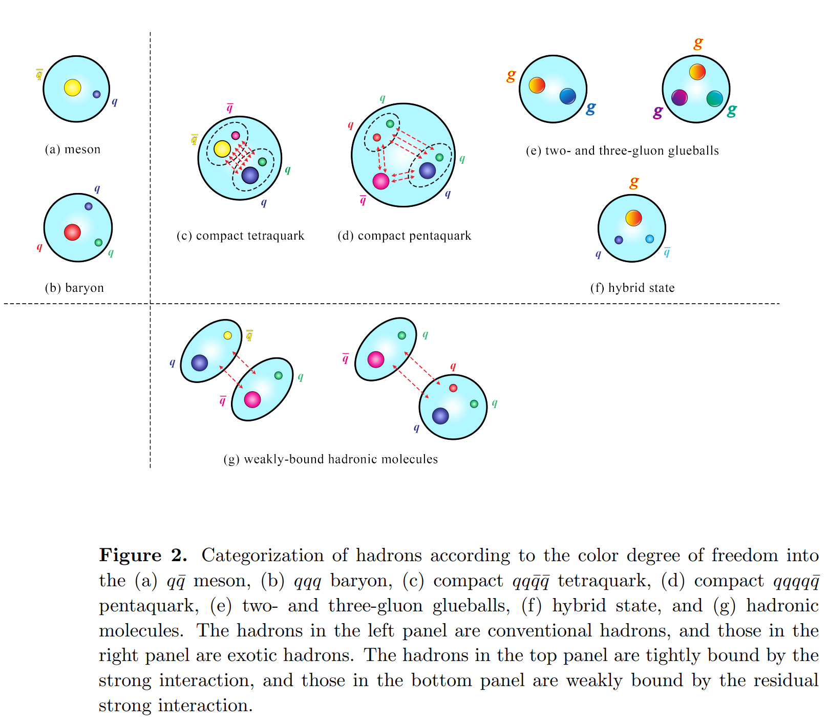
Introduction
2204.02649v2 [hep-ph]

Slide 3
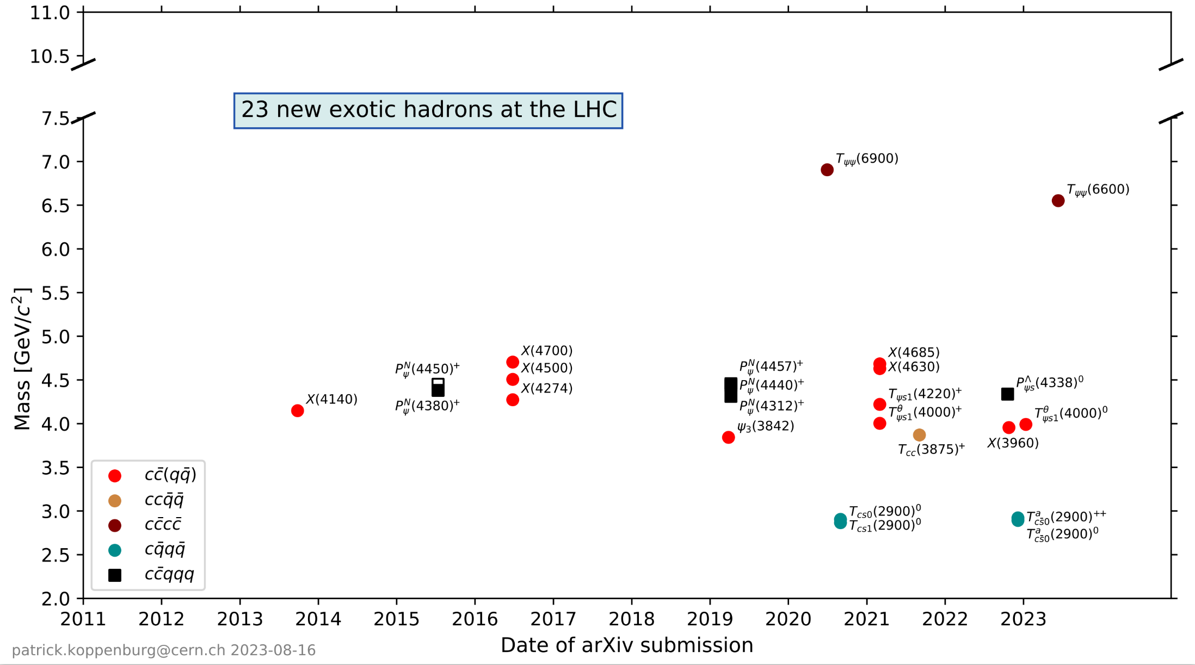
Exotic hadrons @ LHC
e-Print: 2206.15233 [hep-ex]

Slide 4
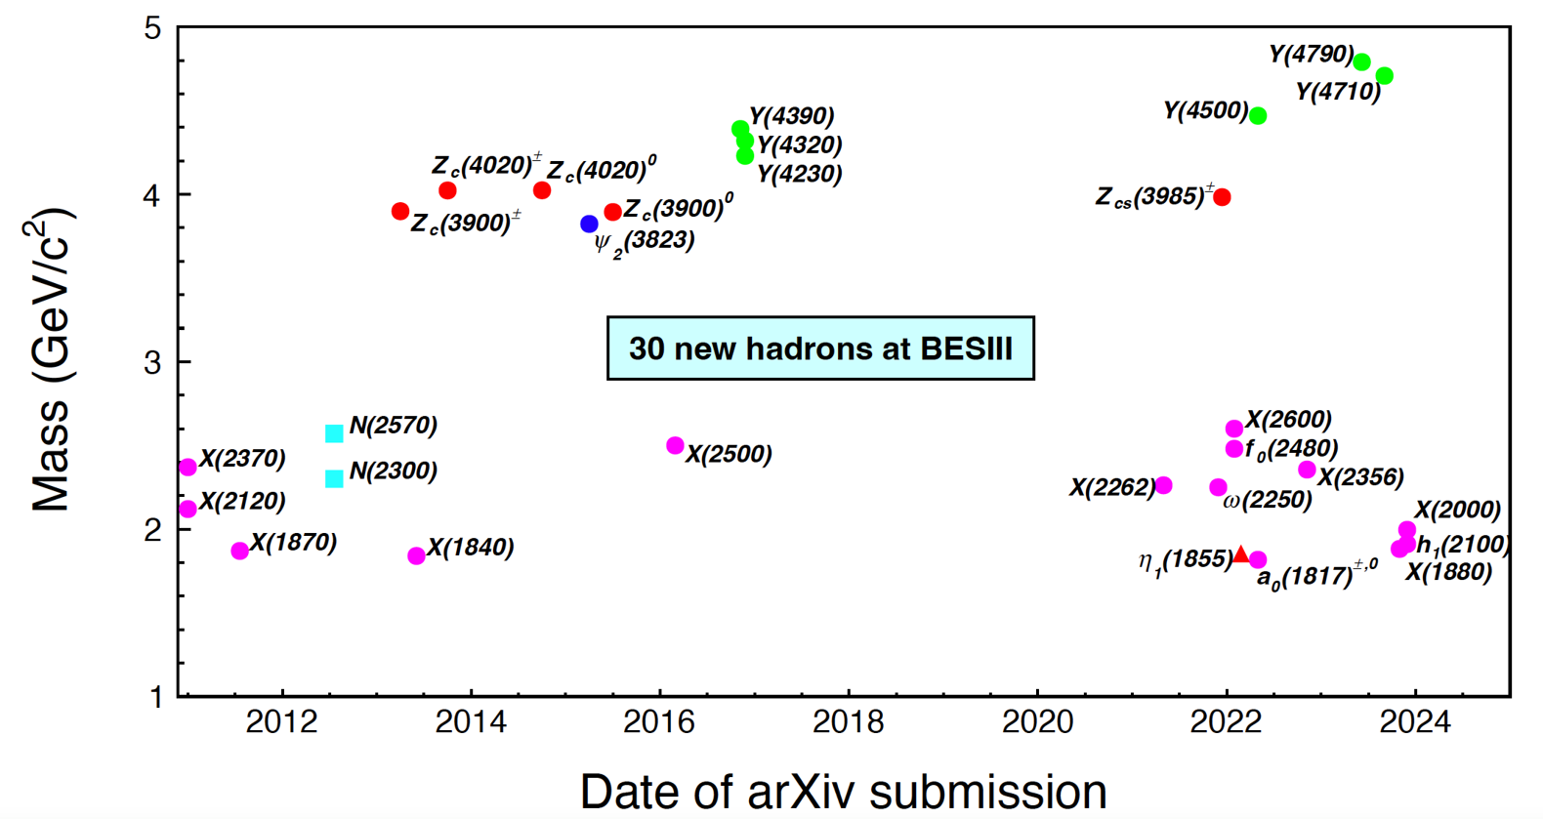
Exotic hadrons @ BESIII
Sci.Bull. 68 (2023) 2148-2150, e-Print: 2310.09465 [hep-ex]

Slide 5
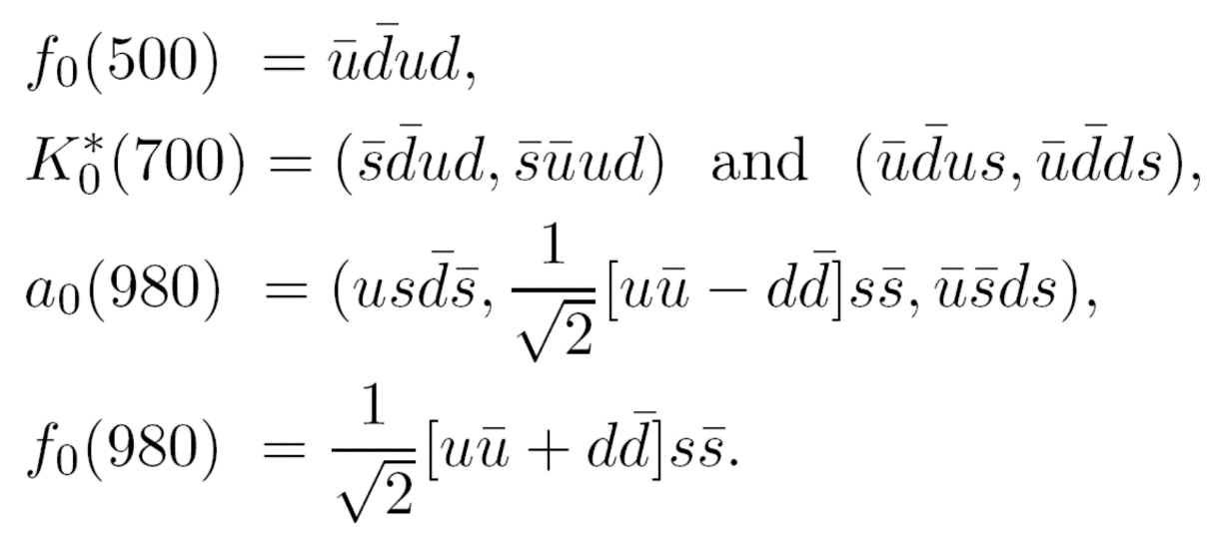
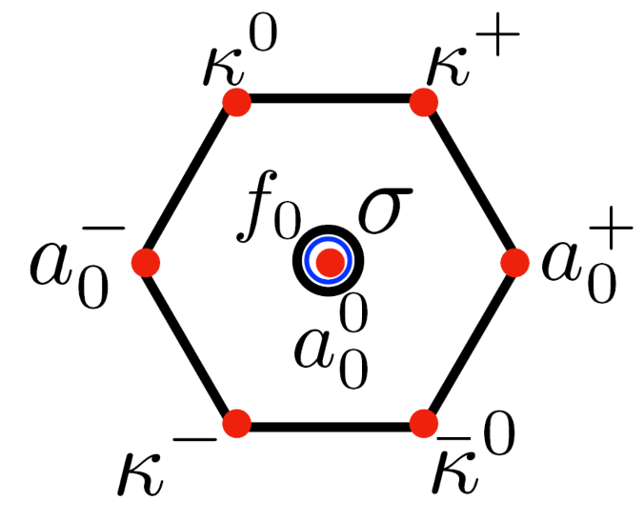
Early sign of non-$q\overline{q}$ states
The existence of a light nonet composed of four quarks (tetraquarks) with masses below $1$ GeV was suggested a long time ago (PRD 15 (1977) 281, PRD15 (1977) 267 ).
A long-standing example is the nonet consisted of $a_{0}(980)$, $f_{0}(500)$, $f_{0}(980)$, $κ_{0}^{∗}\left(700\right)$ in the light meson system which are regarded as the strong candidates for tetraquarks with the diquark-antidiquark form.

Slide 6
First approach
Phys.Lett.B 694 (2011) 252-257 , e-Print: 1007.4341 [hep-ph]
Hilmar Forkel
The dilaton-soft-wall gravity dual action
The spin-0 bulk field
The remaining, non-dynamical background fields comprise the ${AdS}_{5}$ geometry
The dilaton field which is solely responsible for conformal-symmetry breaking in the infrared

Slide 7
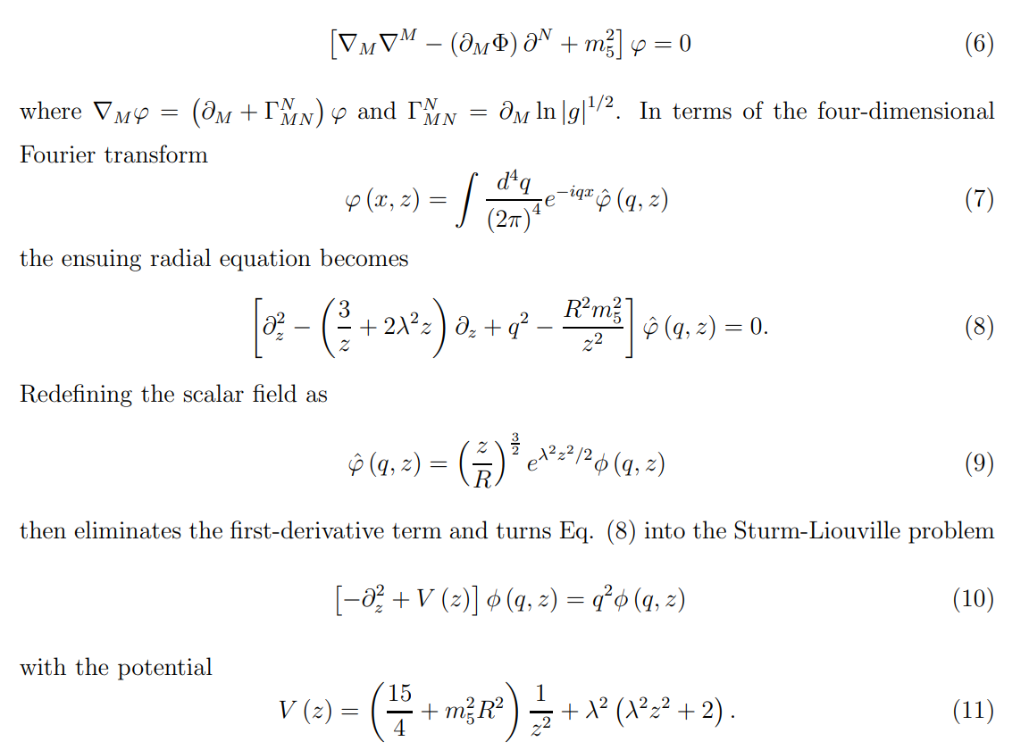
Mass spectrum
The mass spectrum of the scalar meson nonets is then determined by the $φ$-dependent, bilinear part

Slide 8
Mass spectrum
In the scalar sector the conformal dimension $∆$ of a meson interpolator prescribes the mass term in the potential
In the case of ordinary scalar mesons the quark-antiquark interpolator
The mass spectrum is given by
.

Slide 9
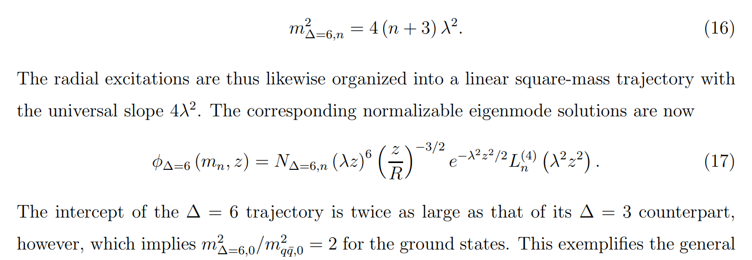
Mass spectrum
In the scalar sector the conformal dimension $∆$ of a meson interpolator prescribes the mass term in the potential
For light scalar mesons with a dominant tetraquark component,

Slide 10
Anomalous dimension
The exceptionally strong attraction required to reduce the masses of the lightest tetraquark nonet below those of the scalar $q\overline{q}$ ground state, on the other hand, is obviously not reflected in this minimal description.
Holographically, the inclusion of the anomalous dimension $γ$ turns the mass term for the bulk modes dual to the interpolator into
The $z$ dependence of $γ$ is inherited from its renormalization group (RG) flow $γ (µ)$ since the AdS/CFT dictionary translates the RG scale $µ$ into the inverse of the fifth dimension, $µ ∼ 1/z$.
The necessary qualitative requirements may be cast into the simple power-law behavior

Slide 11
Anomalous dimension
After introducing the anomalous dimension, the potential becomes
Maintaining asymptotically linear trajectories and enough repulsion to move the masses of the higher excitations upward restricts the exponent $κ$ to $κ ≲2$.
Approximate slope universality further demands $|b| ≪ 1$.
First, any $γ (z)$ which renders the correction term of the potential negative and decreases the power of z below −2 for $z → 0$would cause a physically unacceptable instability of the Sturm-Liouville solutions. In our context, the “center” at $z = 0$corresponds to the ${AdS}_{5}$ boundary, and this collapse is avoided by keeping $η > 0$.

Slide 12
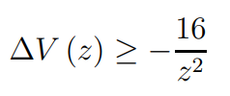
Anomalous dimension
An instability may appear even if the singularity remains $∝ 1/z^{2}$, however. Indeed, as long as the coefficient of this singularity is negative and exceeds a critical magnitude, the negative potential energy will overcome the stabilizing kinetic energy.
For the small-z behavior of the equation of motion for the potential with the correction term with a general boundary dimension d shows that such an instability is prevented as long as
In fact, taking $\tilde{∆}$ constant turns the inequality into the Breitenlohner-Freedman (BF) bound
${ m}_{5}^{2}R^{2}>−d^{2}/4$
Then $∆V$arises from the anomalous-dimension correction, has the lower bound
The inequality is saturated for (constant) $\tilde{∆}= 2$or $γ = −4$. This generates the
lower bound

Slide 13
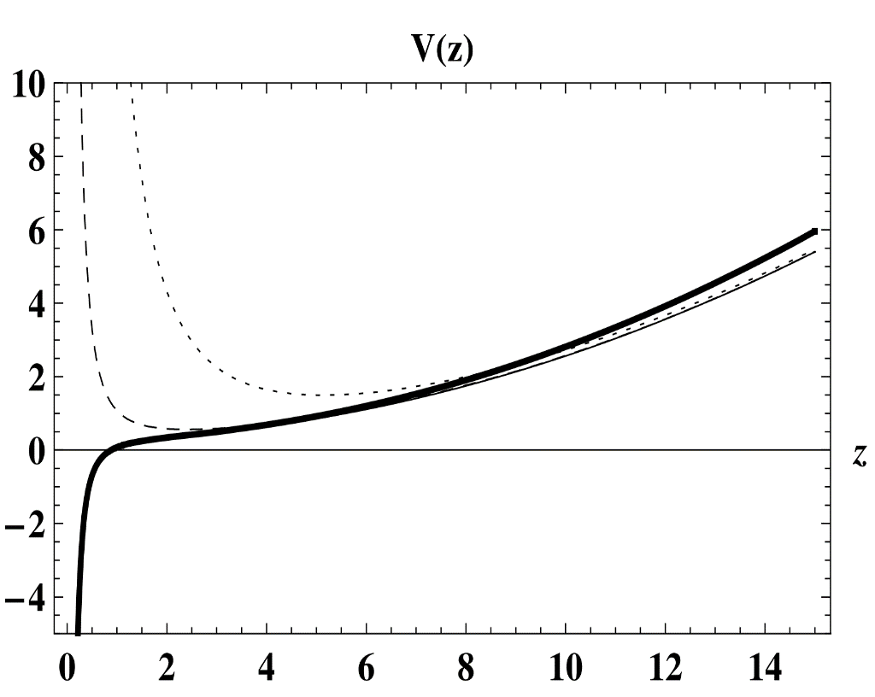
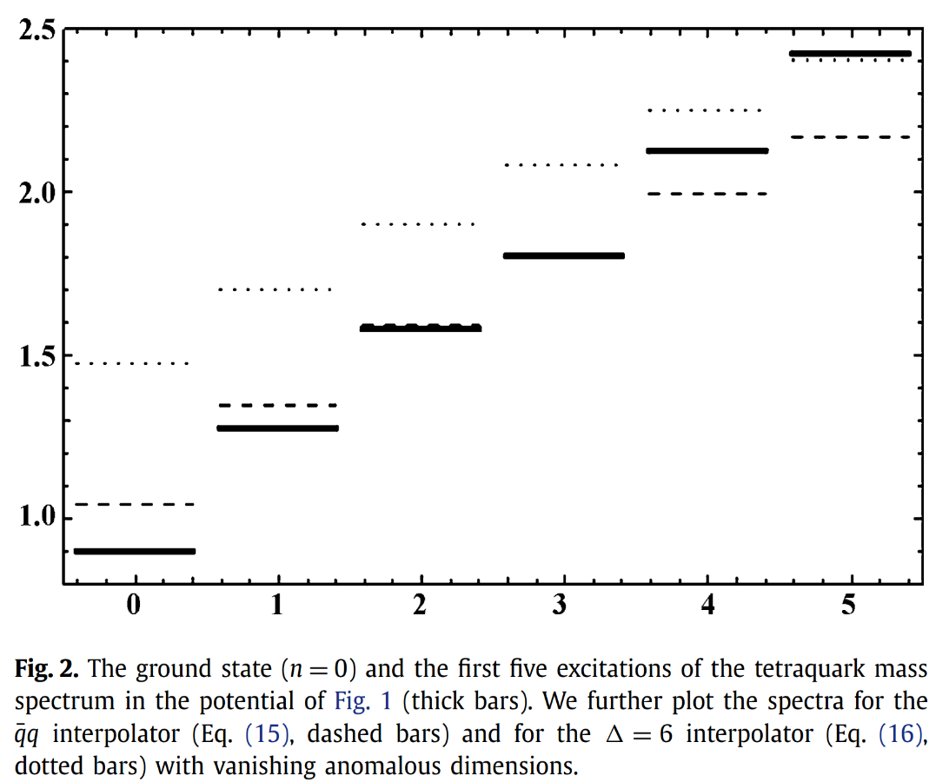
Results
To provide a concrete example for a $γ (z)$ which results in a bulk-mode potential with nearly maximal attraction for the ground state, we choose the coefficients inside the narrow range established by the criteria given above as $a = 4$, $b = 0.05$, $η = 0.001$ and $κ = 2$.

Slide 14
Second approach
Phys. Rev. D 102, 046007, e-Print: 2004.10286 [hep-ph]
Miguel Angel Martin Contreras, Alfredo Vega
The relation between hadronic squared mass and radial quantum number is considered usually as linear. when quark masses are increased, a nonlinear Regge trajectory seems better to describe hadron spectra.
In the holographic AdS/QCD context, we can parametrize this constituent quark mass effects by adding an extra $ν$ exponent to the radial trajectory as follows
This nonlinearity deviation in the trajectory should be captured in a nonquadratic static dilaton, in the same form as the original soft-wall model dilaton encloses the linearity of Regge trajectories.

Slide 15
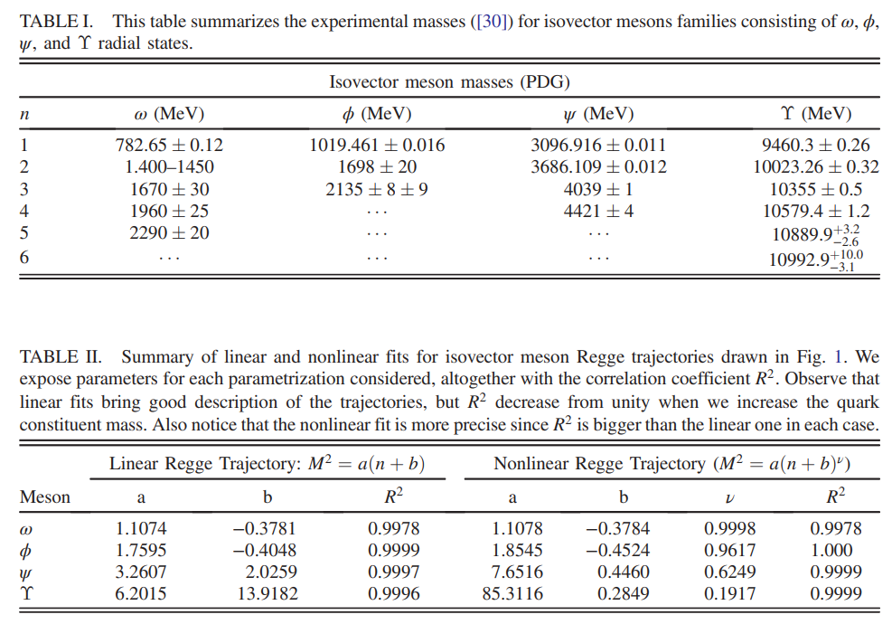
Fitting

Slide 16
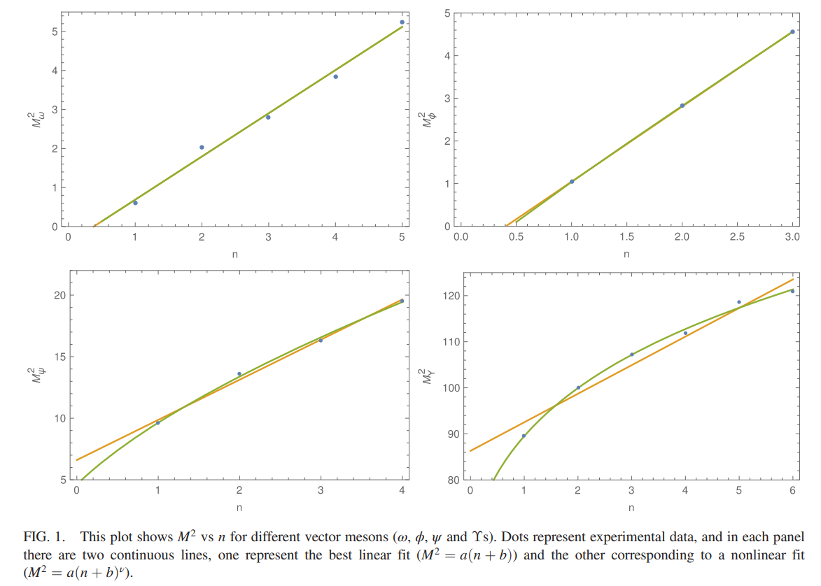
Fitting

Slide 17
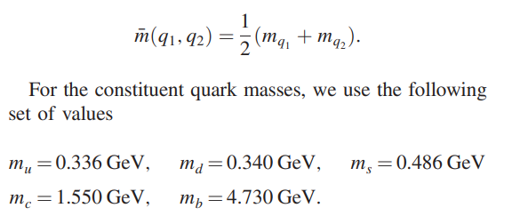
Fitting
This particular behavior suggest that $ν$ should be running with the constituent quark mass. At the holographic level, this idea will allow us to infer information about the internal structure of the hadron at hand.
The average constituent quark masses mentioned above can be defined as
For the exponent $ν$ introduced in the nonlinear fit, we propose the following parametrization in terms of the average constituent quark mass given

Slide 18
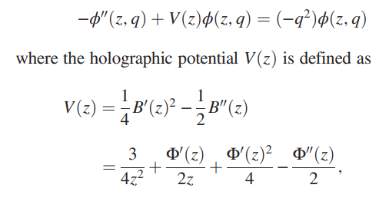
AdS/CFT
Let us consider a five-dimensional AdS Poincare patch defined by the following metric
The action for the vector fields is
From this action, and imposing the gauge fixing $A_{z}=0$, we arrive at the following equation of motion for the bulk field

Slide 19
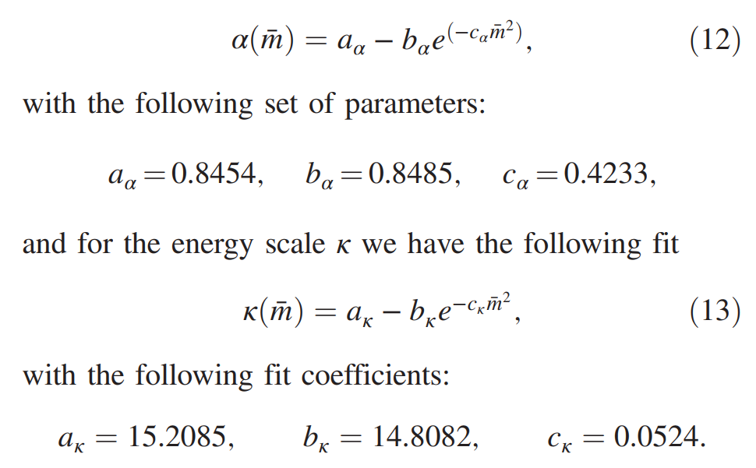
Nonlinear case
If we want to consider the case when the constituent quarks are massive, we must extend to nonlinear Regge trajectories.
A deviation in the linearity for the spectrum must be associated with a change from the usual quadratic static dilaton.

Slide 20
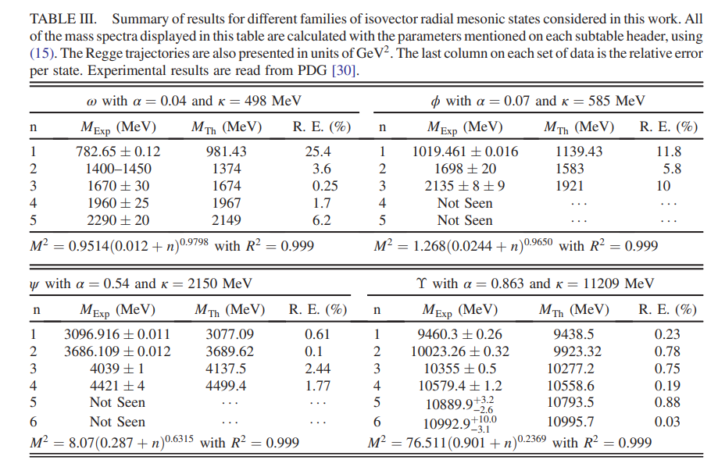
Meson Masses

Slide 21
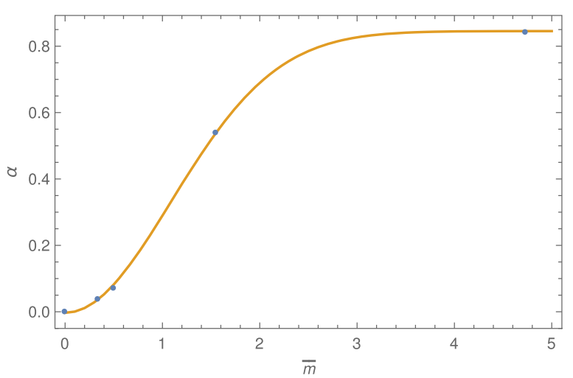
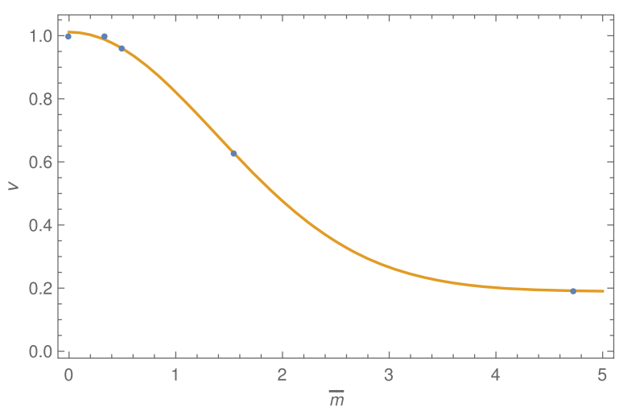
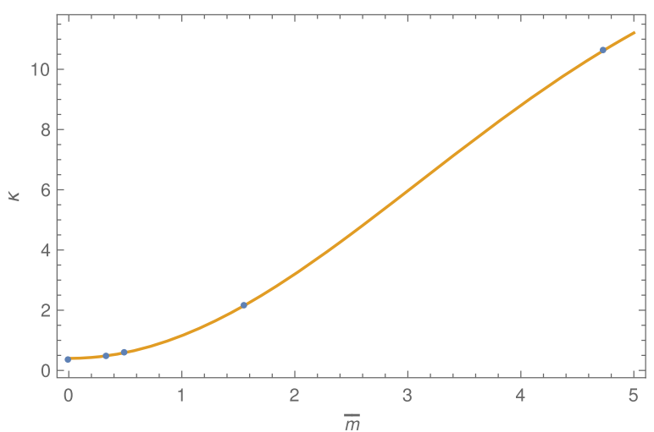
EXTRAPOLATION TO OTHER
MESONIC SPECIES
The key idea is to use the running of $α$ and $κ$ with the quark constituent mass as calibration curve to extrapolate the proper values for other mesonic samples.

Slide 22
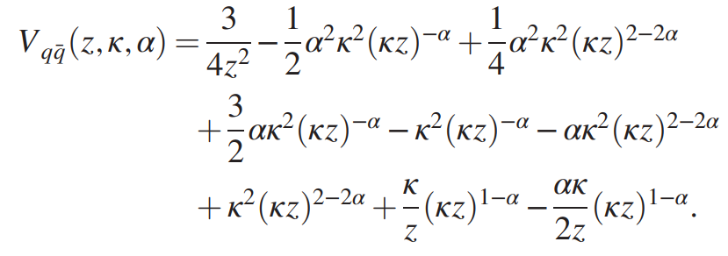
Non-$q\overline{q}$ vector states
All of the mesonic states with quantum numbers not allowed by the usual $q\overline{q}$model are called exotic.
The action for the non-$q\overline{q}$ vector field is given by
Here, we will consider the exotic meson vector states organized into two groups: multiquark states: tetraquarks, hadroquarkonium, and hadronic molecules, and gluonic excitations. We will devote to multiquark states candidates with just four constituent quarks. The methods developed here can be extrapolated to multiquark candidates also.

Slide 23
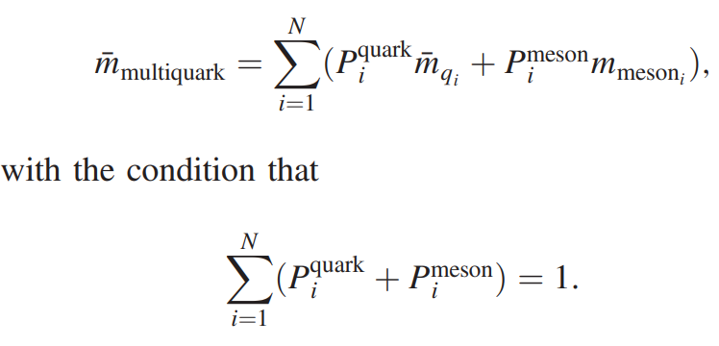
Multiquark states
In the case of multiquark states, a degeneracy appears when the conformal dimension is defined, since the conformal dimension is counting indirectly the number of constituent quarks. This dimension does not distinguish between four quarks in the diquark antidiquark pair, the hadroquarkonium or hadronic molecule configurations.
The degeneracy can be removed if we consider the constituent mass of each multiquark configuration as a collection of N constituents, quarks or mesons
In this case, we can organize the diquark and antidiquark as ${(q\overline{q})}_{1}{(q\overline{q})}_{2}$, with conformal dimension $Δ = 6$. This implies that the bulk mass is $M_{5}^{2}R^{2}=15$ for these states.

Slide 24
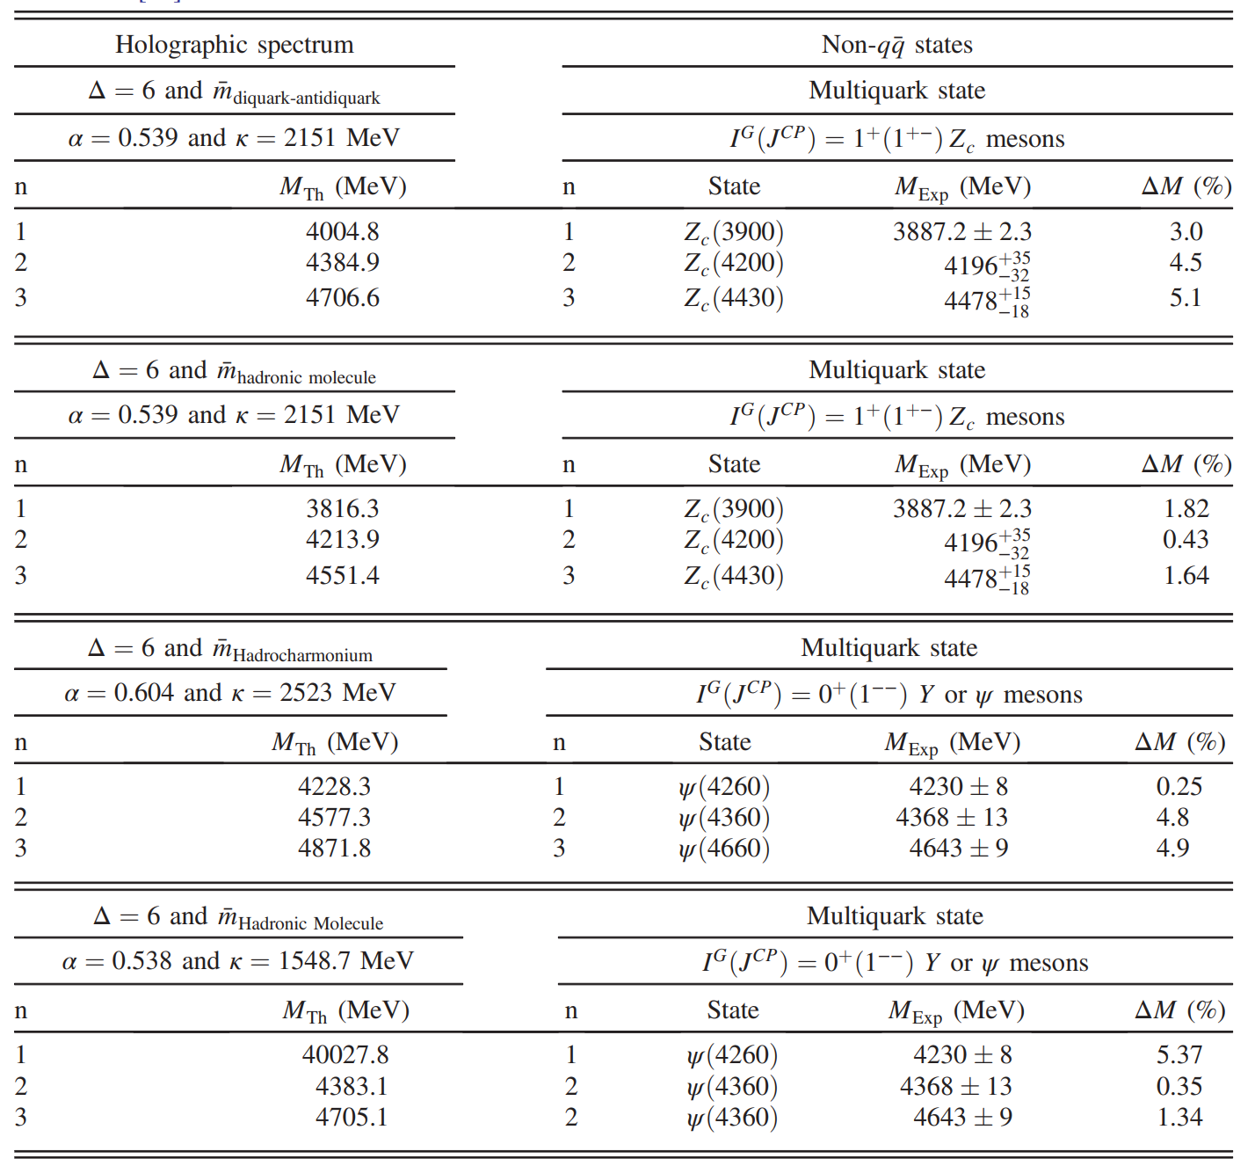
Results

Slide 25
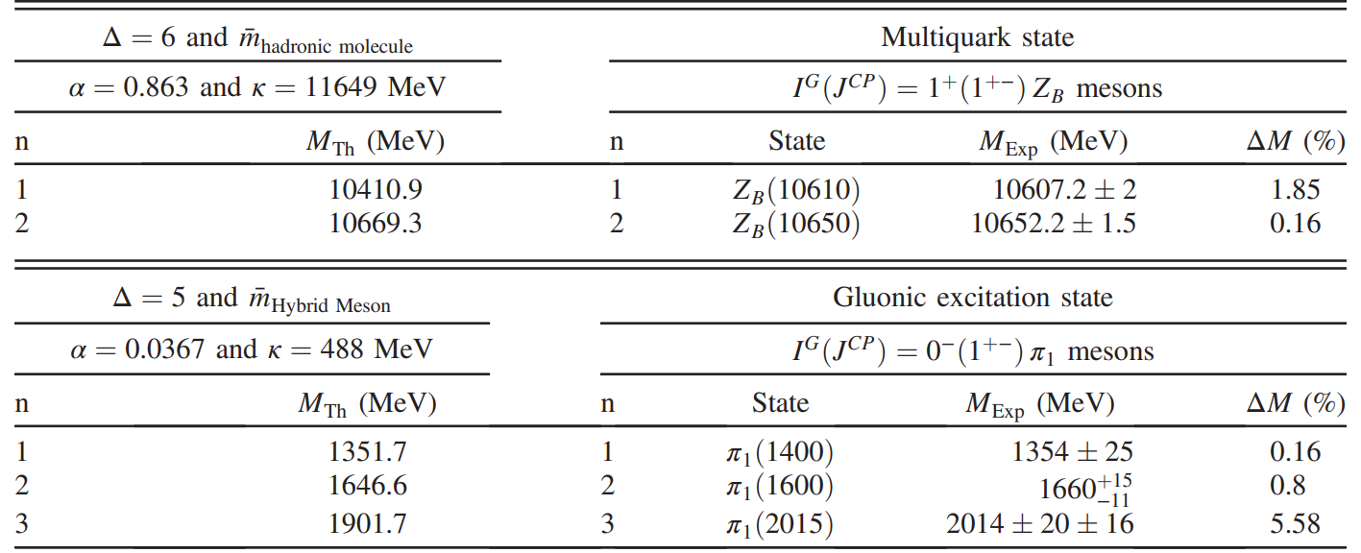
Results

Slide 26
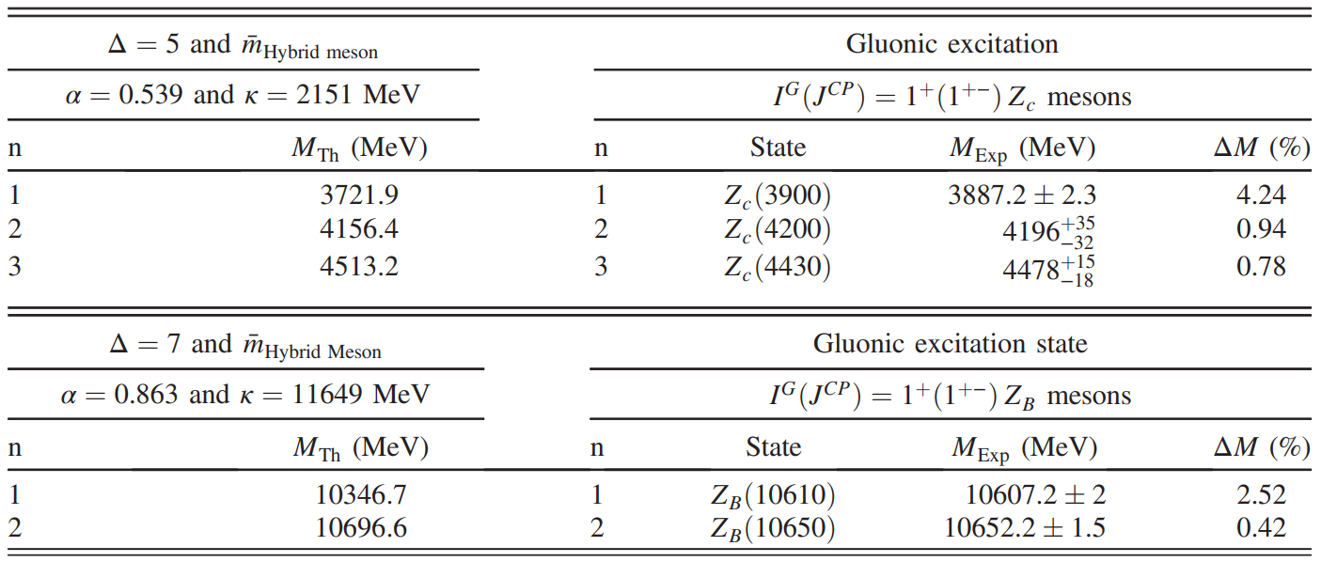
Gluonic excitations: Hybrid mesons
Gluonic excitations are defined as hadrons with constituent gluonic fields. This kind of structure is realized as pairs of quarks and antiquarks joined by gluonic flux tubes.
The mesonic states consisting of valence quarks and constituent gluons are called hybrid mesons.
Interms of the operator dimension, means that $Δ = 5$if we consider one single constituent gluon, or $Δ = 7$if we consider two constituent gluons.

Slide 27
Third Approach
Phys.Rev.D 108 (2023) 2, 026018, e-Print: 2304.10816 [hep-ph]
Nick Evans, Matthew Ward
It has been suggested that the spectrum of QCD may include a deeply bound six-quark state.
The $uuddss$ state forms a colour singlet that is antisymmetric in colour, flavour and spin, endowing it with a spatially symmetric wave function. Where the state is considered as a loosely bound state of two $Λ$ baryons, the $uuddss$ state has historically been referred to as the H dibaryon.
A bag model analysis placed this estimate a little lower at $2.15$ GeV.
At present, experimental searches for the dibaryon remain unsuccessful.
Here, we will model the sexaquark as a scalar in the bulk of the Dynamic AdS/QCD model. The scalar’s bulk mass will run in our description, dual to the anomalous dimension of the $uuddss$ operator.

Slide 28
SEXAQUARKS IN ADS/QCD
To describe the quark condensate dynamics, we allow ourselves to be guided by the D3/probe D7 system.
Here we include the running anomalous dimension in the computation of the spectrum of bound states associated with other operators made of light quarks, such as the exotic sexaquark states.
A $uuddss$ sexaquark state with a low enough mass to make it stable can be achieved, but this depends on the input assumptions about the running dimension.
The general expression for the anomalous dimension at one loop of an $n$ quark vertex is given by

Slide 29
Sexaquarks in the Hard Wall Model
We can represent the sexaquark operator by inserting a scalar field $Φ$ into AdS5 bulk space with Klein-Gordon action
The bulk mass defined as
$=45$with $Δ=9$.
Taking the IR boundary condition $φ^{′} \left(wall\right)=0,$leading to a sexaquark mass of $M = 3.77M_{ρ}≈ 2.90 GeV$. This large estimate assumes that the dimension of the quark is fixed at its maximum value throughout the strong coupling regime.
Alternatively, one could assume that the IR dimension ∆ = 6 holds for all energies instead. In this case, the sexaquark mass is substantially lower at 1.90 GeV.

Slide 30
Dynamic AdS/QCD and the Sexaquark
We will treat the sexaquark operator as a scalar field $L$ of dimension one ($L=r χ$), where the field $χ$ has a bulk mass $m^{2}=45 (Δ=9)$
We find that this is satisfied for $M_{s} = 2.27M_{ρ} ≈ 1.75 GeV$. This result would support the stable deeply bound hypothesis, although it is clearly very dependent on the assumptions made about the running dimension of the six-quark operator in the IR.

