Slide 1
Hadronic Weak Decays of Charmed Mesons
Charmed Baryons
Hai-Yang Cheng (鄭海揚)
Academia Sinica, Taipei
2024 BESIII Workshop on Charm Hadron Physics
May 11, 2024

Slide 2
Dynamic approach based on effective Hamiltonian & factorization (generalized, 1/N_{c}). We don’t have QCD-inspired theory as in B physics
-- treat effective Wilson coefficients a₁ and a₂ as phenomenological parameters to account for nonfactorizable effects
-- cannot describe weak annihilation properly and tackle long-distance effects such as FSIs
Model-independent diagrammatical approach based on SU(3): strong-interaction effects included in topological amplitudes extracted from the data
They are complementary to each other for describing nonleptonic weak decays of heavy mesons
Bauer, Stech, Wirbel (’87)

Slide 3
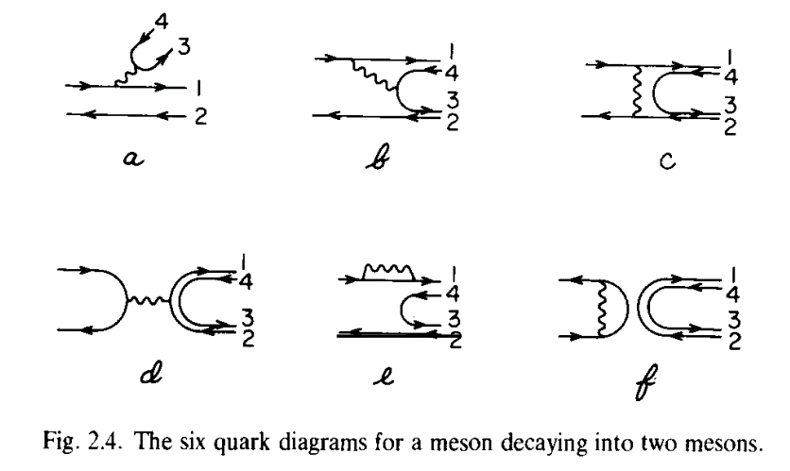
Topological Diagrammatic Approach
Ling-Lie Chau: Guangzhou Conference (1980); ICHEP (1980)
AIP Conference (1981)
Phys. Rep. 95, 1 (1983)

Slide 4
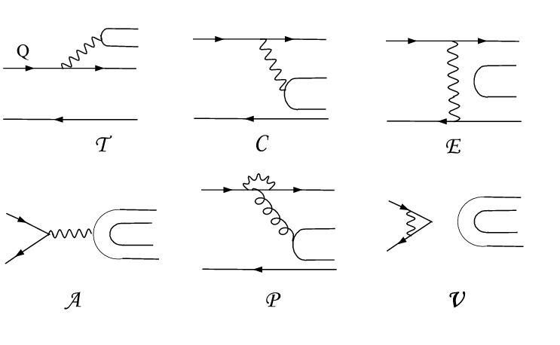
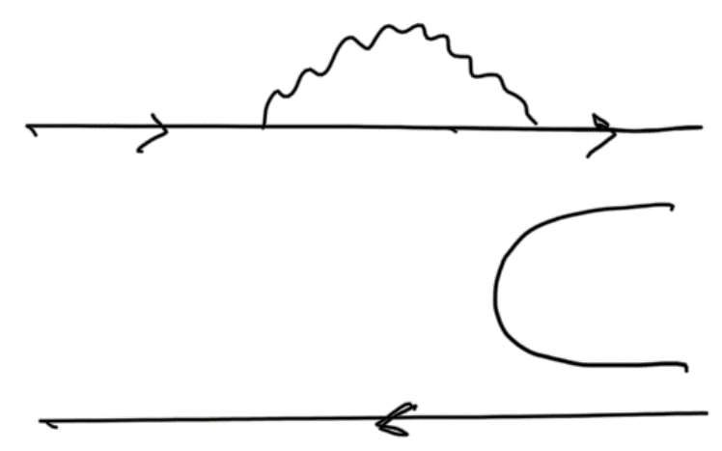
Topological Diagrammatic Approach
All two-body hadronic decays of heavy mesons can be expressed in
terms of six distinct topological diagrams [Chau (’80,’83); Chau, HYC (’86)]
(tree)
(color-suppressed)
(exchange)
(annihilation)
H (horizontal W-loop)
(vertical W-loop)
All quark graphs are topological, classified according to topologies of weak interactions and meant to have all strong interactions at all orders encoded and hence they are not Feynman graphs. That is, final-state interactions are included.

Slide 5
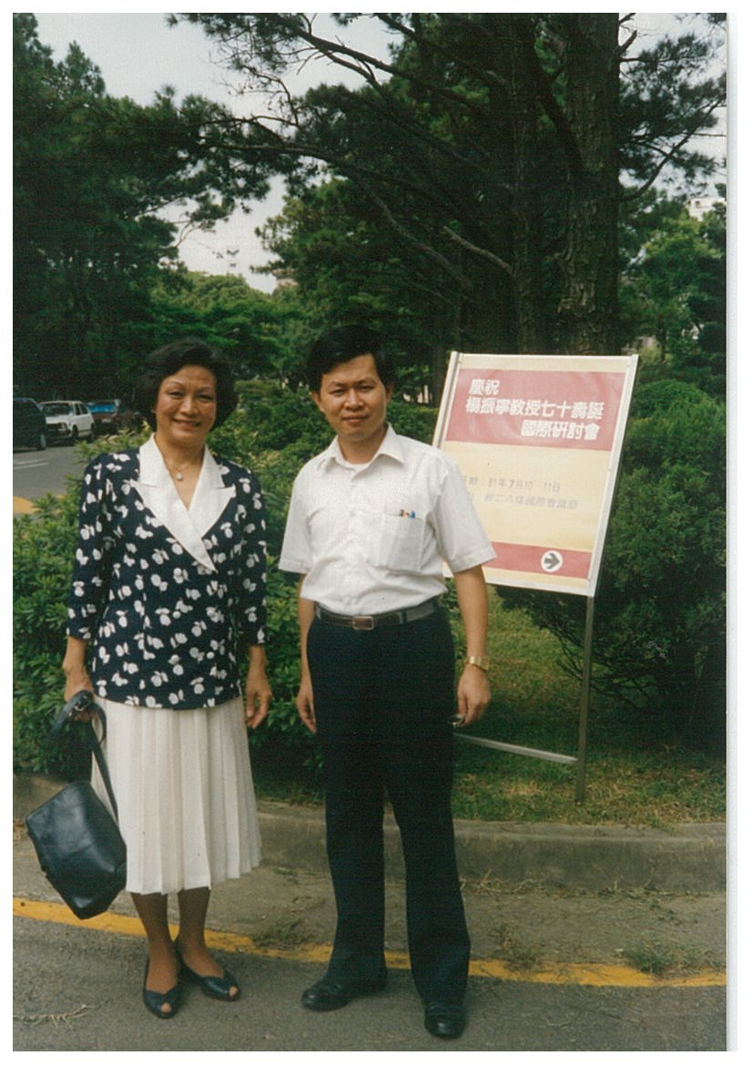
with Ling-Lie Chau (喬玲麗)
photo taken at Tsing-Hua University, Hsinchu at the occasion of a symposium of celebrating Prof. C.N. Yang’s 70 birthday

Slide 6
Topological tree amplitudes in D → PP decays
Data of D→PP decays dominated by CLEO with many being improved by BESIII
T = 3.134 ± 0.010 (taken to be real) (in units of 10⁻⁶ GeV)
C = (2.584 ± 0.014) exp[i (-151.9±0.3)º]
E = (1.472 ± 0.024) exp[i (121.7±0.4)º]
A = (0.394 ± 0.020) exp[i (14.1^{+11.0}-8.5)º]
Rosner (’99)
Wu, Zhong, Zhou (’04)
Bhattacharya, Rosner (’08,’10)
HYC, Chiang (’10, ’19, ‘23)
CF
Phase between C & T ~ 152º
W-exchange E is sizable with a large phase ⇒ importance of 1/m_{c} power corrections
W-annihilation A is smaller than E and nearly perpendicular to E
E
C
A
T
The great merit & strong point of this approach ⇒ magnitude and strong phase of each topological tree amplitude are determined
⇒ Direct CPV at tree level can be reliably estimated, e.g. $D_{s}^{+}→K^{+}η$
D. Wang (’22)
DCPV induced by penguin e.g. $D_{ }^{0}→π^{+}π^{−},K^{+}K^{−}$ can be estimated via $P^{LD}=E$
6

Slide 7


Naïve factorization
]
]
Under naïve factorization, all the predicted topological amplitudes except T are too small compared to the values extracted from the data, implying that topological amplitudes C, E and A are dominated by nonfactorizable long-distance effects.

Slide 8
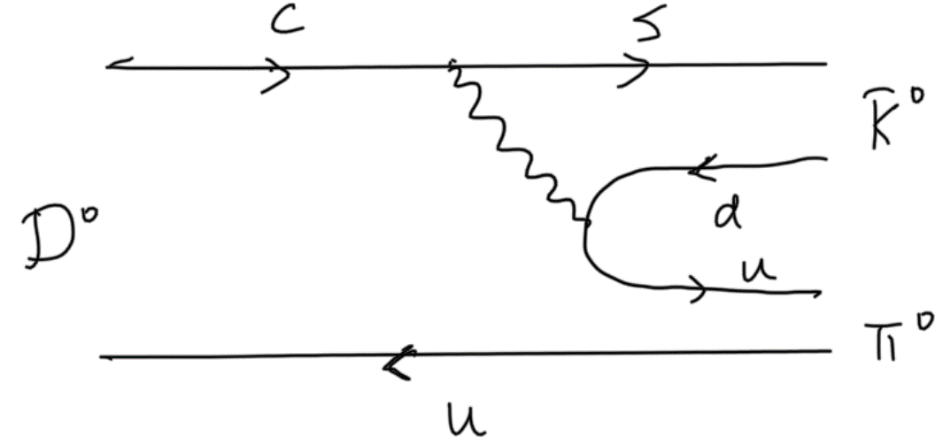
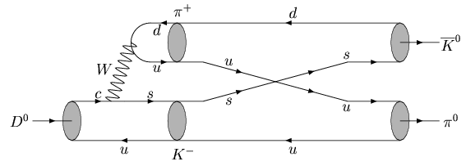
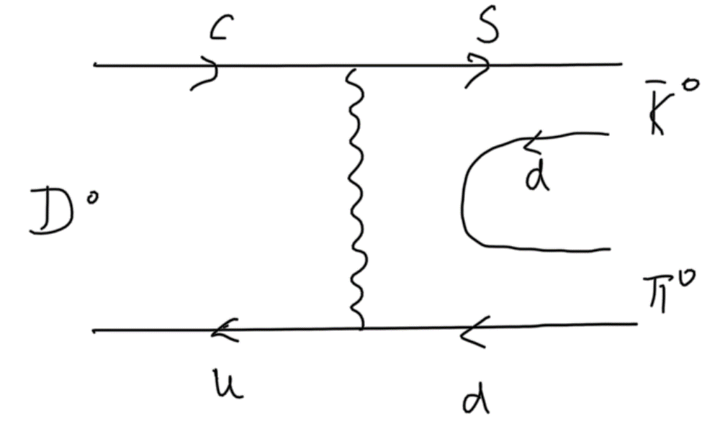
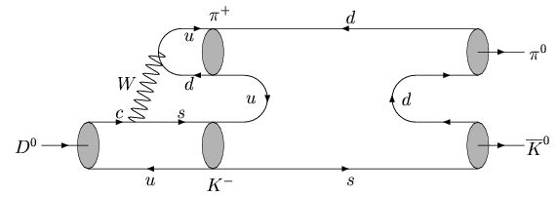
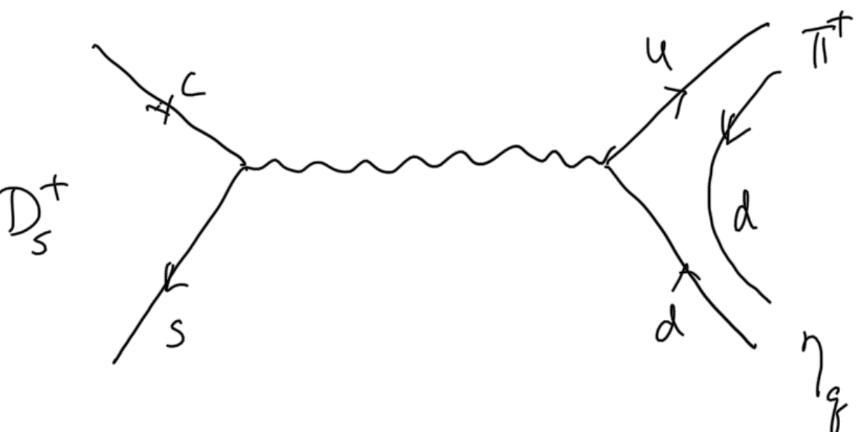
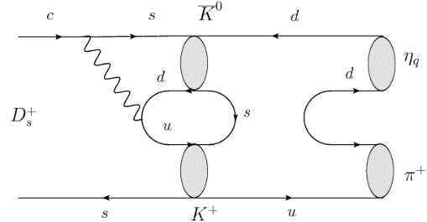
Final-state rescattering
C
E
A
E and A receive major contributions from final-state rescattering

Slide 9
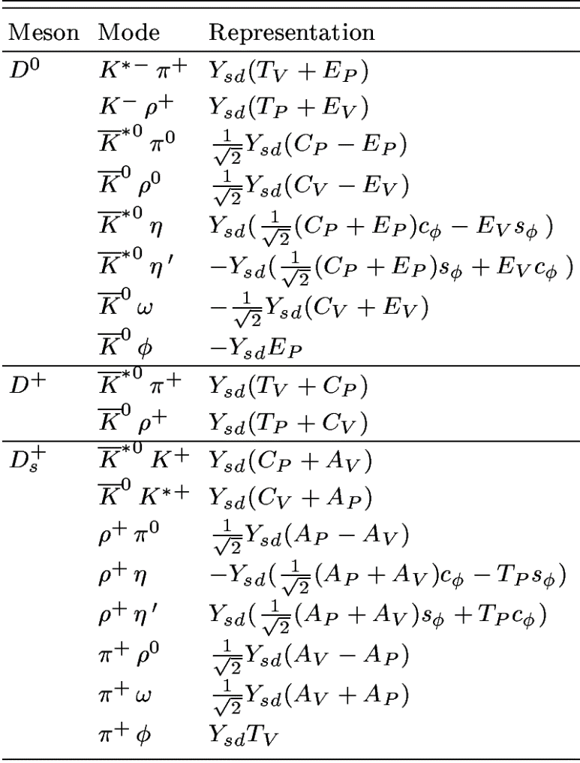
D→ VP decays
CF
T_{P}, C_{P}: P contains q of D meson
T_{V}, C_{V}: V contains q of D meson
E_{P}, A_{P}: P contains q₂ of q₁q₂
configuration
E_{V}, A_{V}: V contains q₂ of q₁q₂

Slide 10
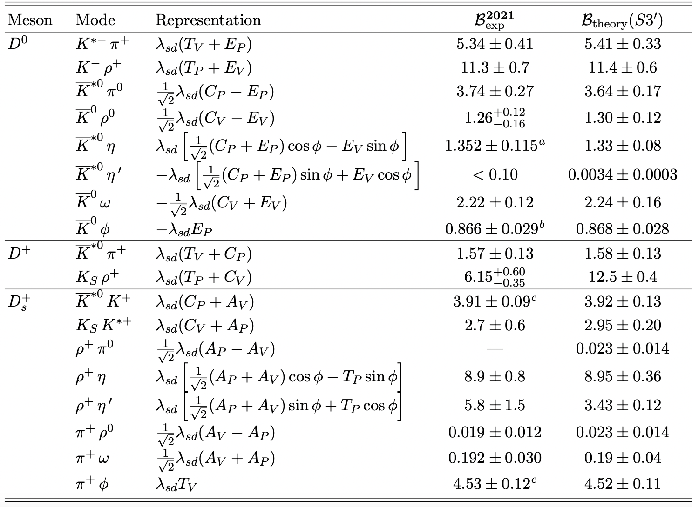
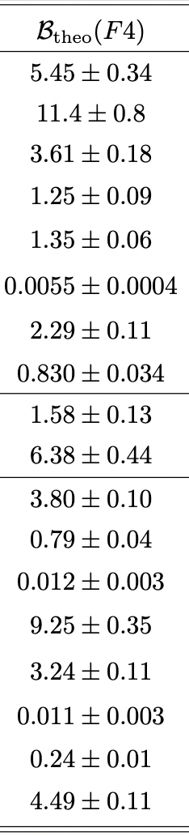
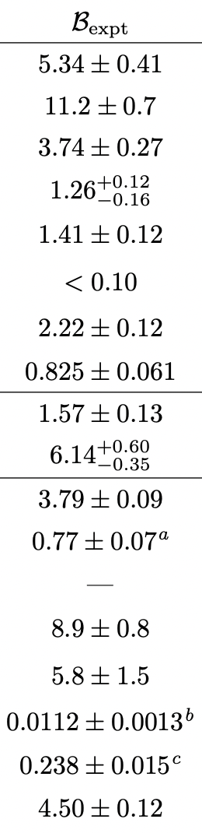
2023
CF
BESIII (’22)
LHCb (’23)
LHCb (’23)
BESIII measurement of $D_{s}^{+}→K_{S}^{0}K^{∗+}→{K_{S}^{0}K_{S}^{0}}^{ }π^{+}$ not correctly cited by PDG

Slide 11
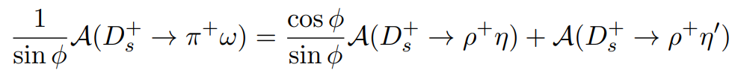
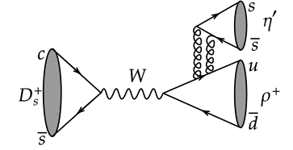
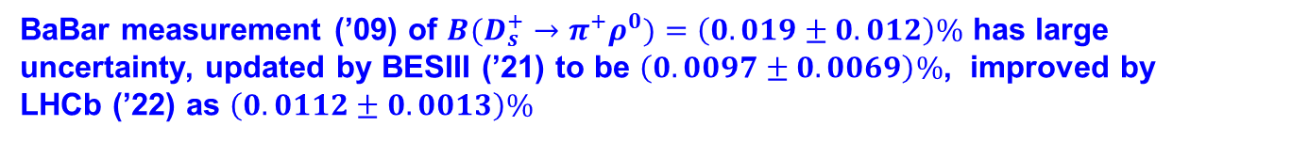

A sum rule follows from the topological approach
HYC, Chiang, Kuo (’16)
φ: η-η’ mixing angle
Measured rates of $D_{s}^{+}→π^{+}ω,ρ^{+}η$ ⇒ (2.2±0.3)%$<B(D_{s}^{+}→ρ^{+}η^{′})<$ (4.5±0.4)%
A new measurement of $D_{s}^{+}→ρ^{+}η^{′}$ by BESIII (’22) yields BF = (6.15±0.25±0.18)%. This seems to indicate an extra contribution from flavor-singlet hairpin topology SA.
Chau, HYC, Tao Huang (’92)
Topological annihilation amplitudes $A_{P},A_{V} can be$ extracted from $D_{s}^{+}→π^{+}ω,π^{+}ρ^{0}$, $π^{0}ρ^{+}$ with amplitudes proportional to $A_{V}+A_{P, }$ $A_{V}−A_{P, }A_{P}−A_{V}$, respectively.
BaBar measurement (’09) of ${B(D}_{s}^{+}→π^{+}ρ^{0})=\left(0.019±0.012\right)\%$ has large uncertainty, updated by BESIII (’21) to be $\left(0.0097±0.0069\right)\%$, improved by LHCb (’22) as $\left(0.0112±0.0013\right)\%$

Slide 12
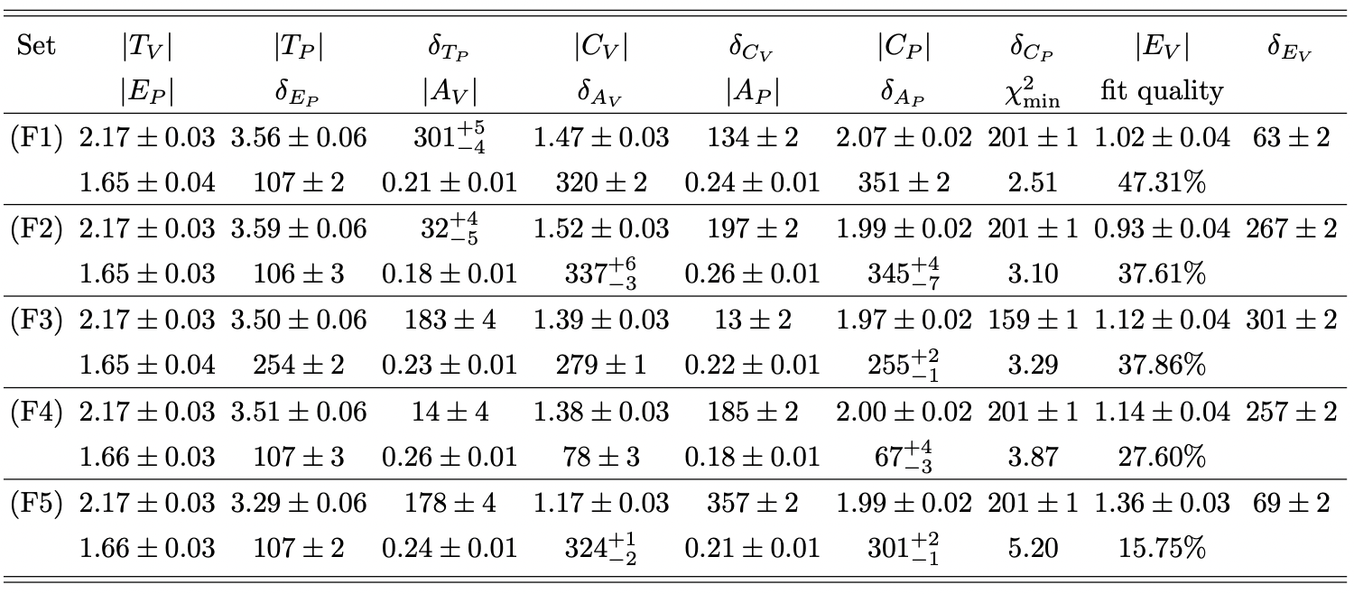
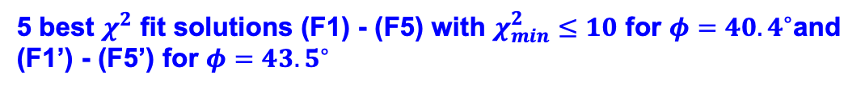
5 best $χ^{2}$ fit solutions (F1) - (F5) with $χ_{min}^{2}≤10$ for $φ={40.4}^{∘}$and (F1’) - (F5’) for $φ={43.5}^{∘}$

Slide 13
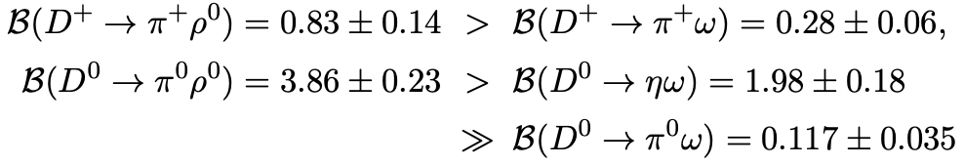
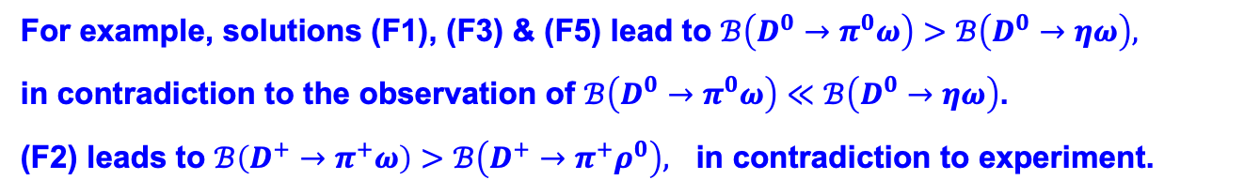

The five solutions (F1) - (F5) are discriminated by some of SCS modes:
$$D^{0,+}→π^{0,+}ω, D^{0,+}→π^{0,+}ρ^{0}, D^{0}→ηω.$$
in units of ${10}^{−3}$
Only the solution (F4) can accommodate all SCS modes
For example, solutions (F1), (F3) & (F5) lead to $ℬ\left(D^{0}→π^{0}ω\right)>ℬ\left(D^{0}→ηω\right),$
in contradiction to the observation of $ℬ\left(D^{0}→π^{0}ω\right)≪ℬ\left(D^{0}→ηω\right)$.
(F2) leads to $ℬ\left(D^{+}→π^{+}ω\right)>ℬ\left(D^{+}→π^{+}ρ^{0}\right),$ in contradiction to experiment.

Slide 14
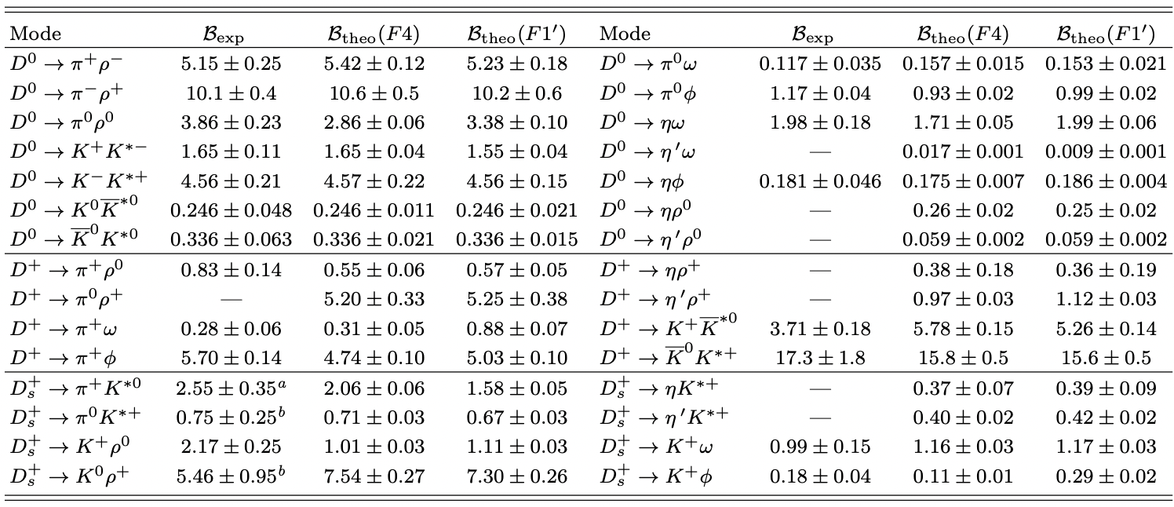



SCS D→VP decays in units of ${10}^{−3}$
$$0.19±0.02$$
$$0.20±0.09$$
1. BFs of $D_{s}^{+}→π^{0}K^{∗+},D_{s}^{+}→K^{0}ρ^{+}$absent in 2020 PDG were measured by BESIII in 2021. However, they were not cited by 2023 PDG
2. $B\left(D^{+}→{\overline{K}}^{∗0}K^{+}\right)$ =$34±16$ by 2020 PDG. BESIII 2021 results for $B\left(D^{+}→{\overline{K}}^{∗0}K^{+}\right)$ and $B\left(D^{+}→{\overline{K}}^{0}K^{∗+}\right)$ were quoted by PDG with a factor of 6 and 3, respectively, missing!

Slide 15


DCS D→VP decays
$λ_{sd}=V_{cs}^{∗}V_{ud},$ ${ λ}_{ds}=V_{cd}^{∗}V_{us}$
Can we set $T_{P,V}^{′′}=T_{p,V}$ and $E_{P,V}^{′′}=E_{p,V}$?
$$E_{V}=\left(1.14±0.04\right)e^{i{(257±2)}^{∘}}, E_{P}=\left(1.66±0.03\right)e^{i{(107±3)}^{∘}}$$
Setting $T_{P,V}^{′′}=T_{p,V}$ and $E_{P,V}^{′′}=E_{p,V}$ ⇒ $δ_{K^{∗+}π^{−}}=δ_{K^{+}ρ^{−}}={48}^{∘}$ too large compared to the measurements
$\left|δ_{K^{∗+}π^{−}}\right|={(2.4±1.1)}^{∘}$by BaBar & ${(6.1±0.7)}^{∘}$by Belle
We consider SU(3) breaking effects in W-exchange so that $T_{P}^{′′}+E_{V}^{′′}$is almost parallel to $T_{V}+E_{P}$
$$E_{V}^{′′}=1.4e^{i{220}^{∘}}E_{V}, { E}_{P}^{′′}=0.6e^{i{140}^{∘}}E_{P},$$

Slide 16
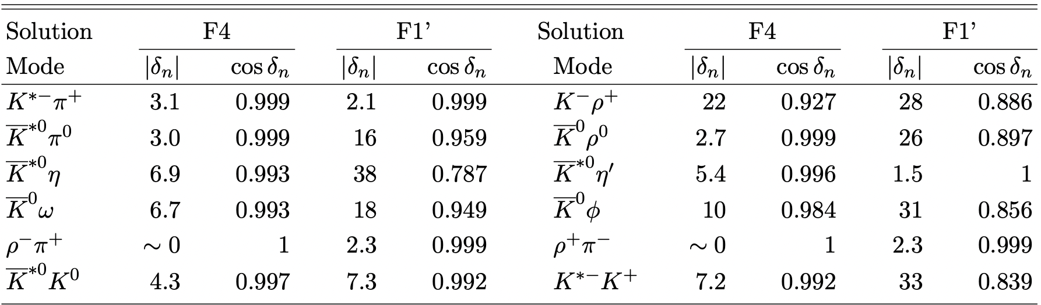
Information of $\cos{δ_{n} }$is needed for estimating $D^{0}−{\overline{D}}^{0}$ mixing parameter y

Slide 17
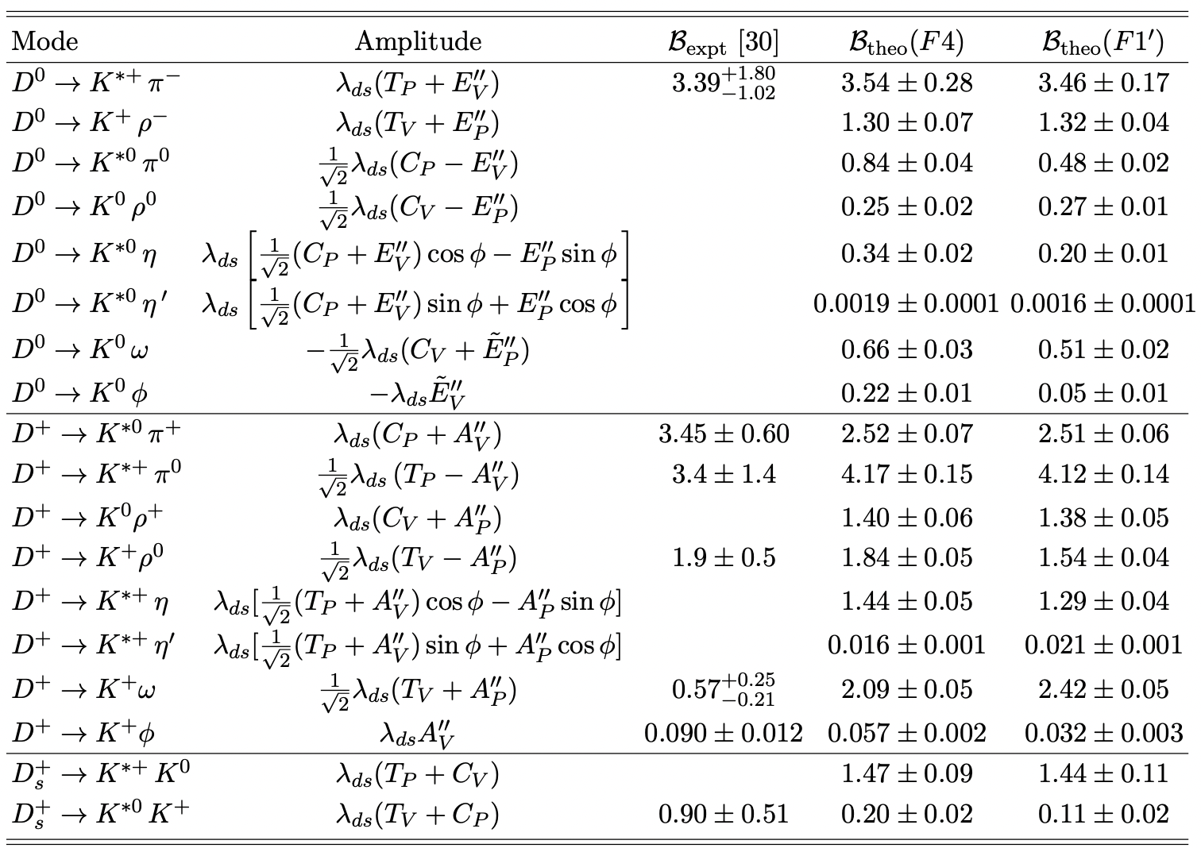

DCS D→VP decays in units of ${10}^{−3}$

Slide 18
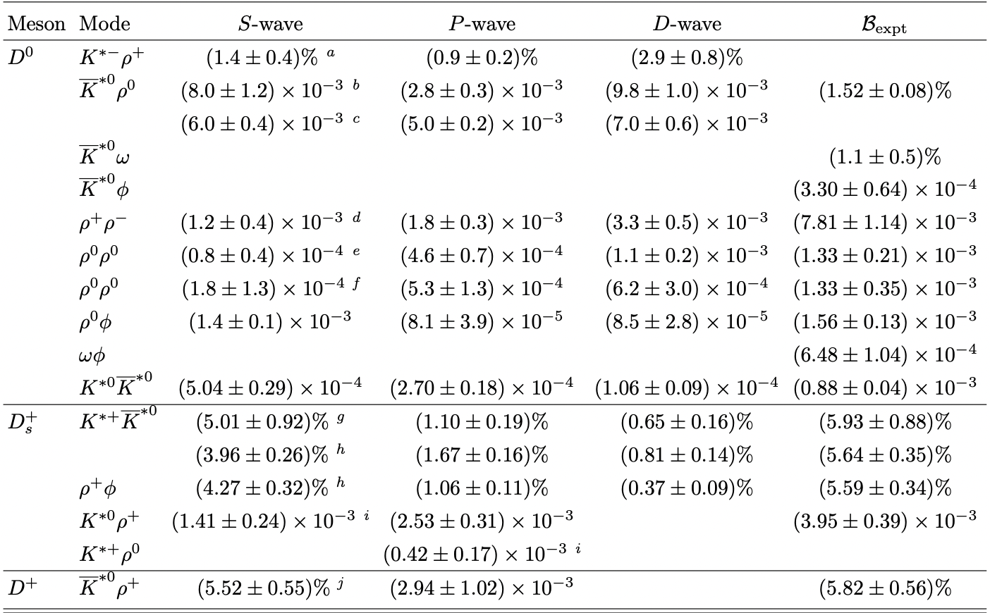

D → VV
BESIII (’19)
BESIII (’17)
LHCb (’18)
FOCUS (’03)
BESIII (’23)
BESIII (’23)
CLEO data reanalysis (’17)
BESIII (’21)
LHCb (’19)
BESIII (’21)
BESIII (’21)
BESIII (’21)
BESIII (’22)
BESIII (’22)
BESIII (’23)
Factorizable D →VV amplitudes ⇒
However, $D^{0}→K^{∗−}ρ^{+}, {\overline{K}}^{∗0}ρ^{0},{ρ^{+}ρ^{−},ρ}^{0}ρ^{0} seem$ to be D-wave dominated???

Slide 19



Contrary to charmless B→VV decays, where $f_{L}=1−O(m_{V}^{2}/m_{B}^{2}$), longitudinal polarization in charm sector is expected to be of order 0.5 or smaller
Factorizable D →VV amplitudes ⇒
Mark III (’92) ⇒ $f_{L}$ = 0.475 ± 0.271 in $D^{0}→K^{∗−}ρ^{+},$
transversely polarized in $D^{0}→ { \overline{K}}^{∗0}ρ^{0}$
BESIII (’21) ⇒ transversely polarized in $D^{0}→ωφ$ with $f_{L}<0.24$
If $D^{0}→ωφ$ and $D^{0}→ρ^{0}φ$ proceed only through internal W-emission, their branching fractions & polarizations are expected to be the same
$B(D^{0}→ρ^{0}φ\text{) = (1.56}\text{±0.13}\text{)}×{10}^{−3}, B(D^{0}→ωφ$) = (6.48±1.04)$×{10}^{−4},$
While $D^{0}→ρ^{0}φ$ behaves normally, $D^{0}→ωφ$ is transversely polarized

Slide 20
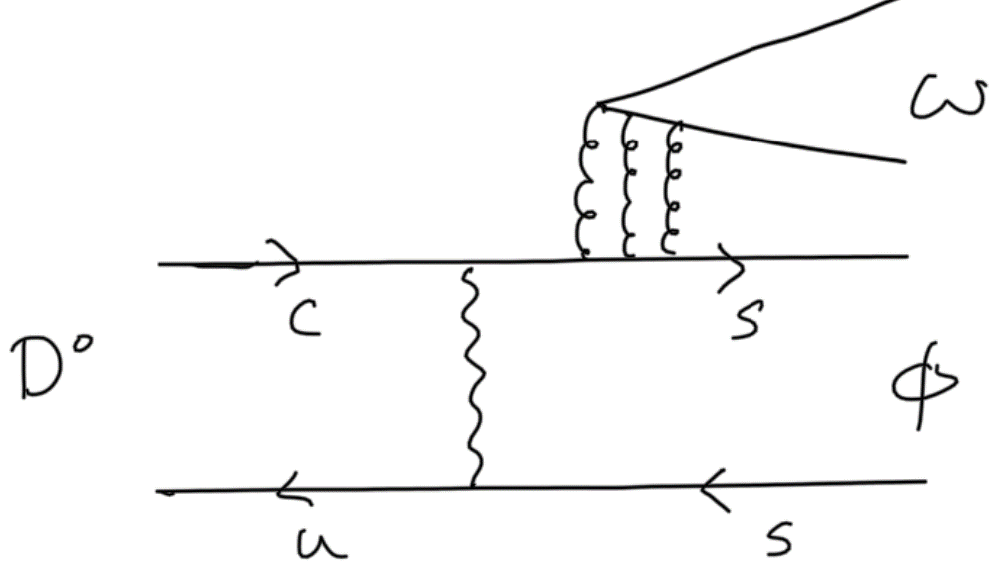
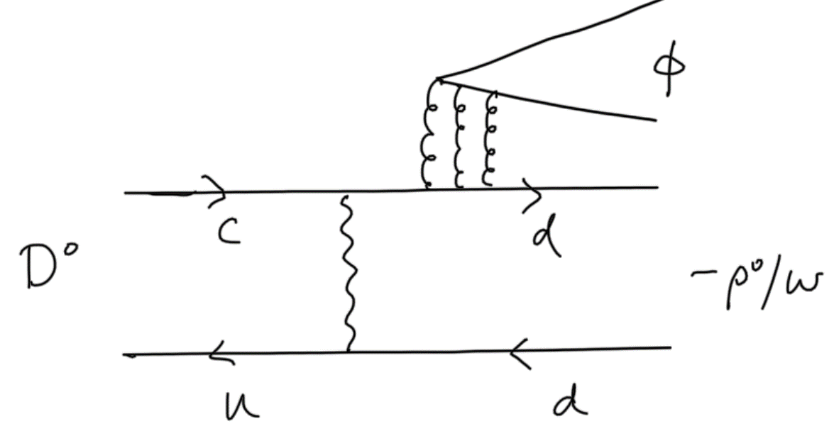


How to understand the puzzles with rate and polarization for $D^{0}→ωφ, ρ^{0}φ?$
Consider FSI through $K^{∗+}K^{∗−}$ which contributes to $D^{0}→ωφ$ and $D^{0}→ρ^{0}φ$ from external W-emission, but only to the former from W-exchange
Cao, Cheng, Zhao (2303.00535)
See the talk by Cao this afternoon
LD contributions to topological internal W-emission $C$ could be different for both $D^{0}→ωφ$ and $D^{0}→ρ^{0}φ.$
Another approach: $C$ topology is assumed to be the same for $D^{0}→ωφ, D^{0}→ρ^{0}φ$, but flavor-singlet contributions to them are different
$S_{h}^{φ}$:
$S_{h}^{ω}$:
Recall that flavor-singlet contribution is needed to explain $D_{s}^{+}→ρ^{+}η′$

Slide 21
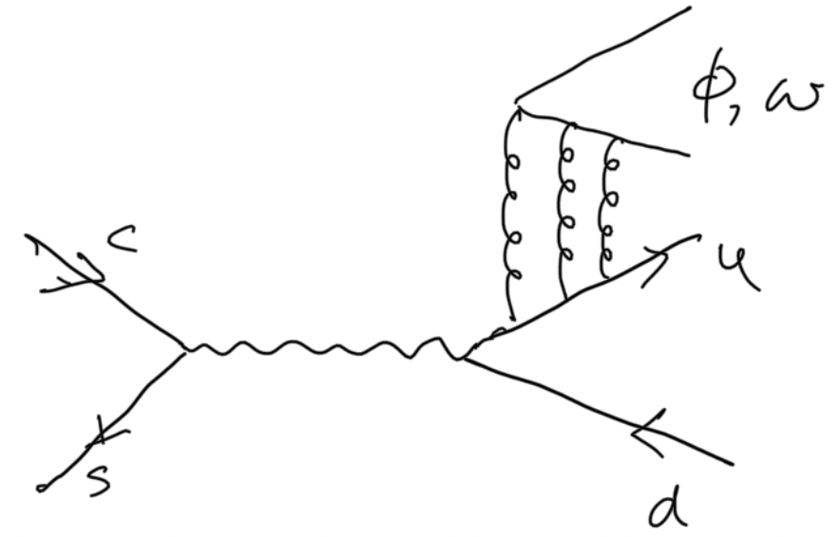



$D_{s}^{+}→ρ^{+}φ, ρ^{+}ω$ are currently measured by BESIII
A($D_{s}^{+}→ρ^{+}φ$)$=V_{cs}V_{ud }{(T}_{h}+{SA}_{h})$
A($D_{s}^{+}→ρ^{+}ω$)$={\frac{1}{\sqrt{2}}V}_{cs}V_{ud }{(A}_{h}+{SA}_{h})$
${SA}_{h}$:
Measurement of $BF(D_{s}^{+}→ρ^{+}ω$) will provide first direct information on W-annihilation

Slide 22
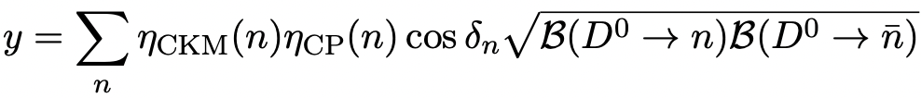
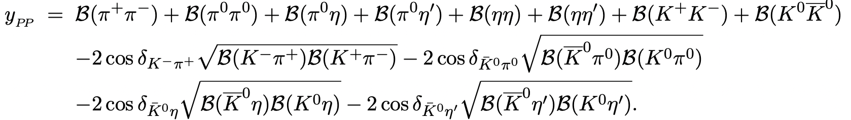
$D^{0}−{\overline{D}}^{0}$ mixing parameter y
$x=\frac{Δm}{Γ}=\frac{m_{1}−m_{2}}{Γ}=\left({0.409}_{−0.049}^{+0.048}\right)\%, y=\frac{ΔΓ}{2Γ}=\frac{Γ_{1}−Γ_{2}}{2Γ}$ $=\left({0.615}_{−0.055}^{+0.056}\right)\%,$
dominated by LD processes
Three different approaches for LD effects: inclusive, exclusive, dispersive. We focus on exclusive one: LD effects from intermediate states are summed over
$D^{0}→PP, VP, VV, SP, SV, AP, AV, TP, TV$ account for ¾ of total hadronic rates
Large cancellations between CF & DCS decays with that from SCS ones. Cancellation is prefect in SU(3) limit.

Slide 23
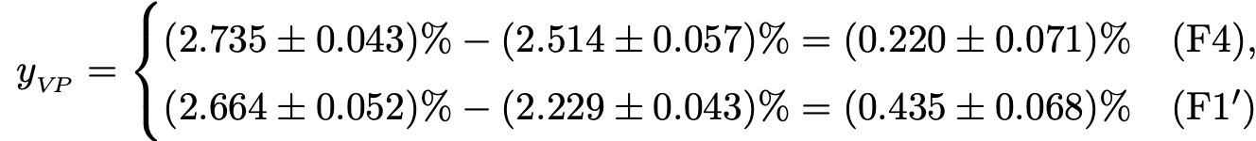
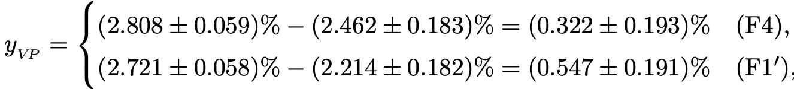

Available data as input and theory for yet-measured DCS modes $D^{0}→K^{0}π^{0}, K^{0}η^{ },K^{0}{η′}^{ }$
Use theoretical predictions of $y_{PP}$ to reduce uncertainties
⟹ $y_{PP}∼\left(0.110±0.011\right)\%$
Use calculated $\cos{δ_{n}}$ to calculate $y_{VP}$
Available data as input and theory for yet-measured DCS modes
$$y_{VP}≳\left(0.220±0.071\right)\%$$

Slide 24

Main uncertainties of $y_{VP}$ arise from yet-measured DCS modes & their phases relative to the CF ones.
It is conceivable that at least half of mixing parameter $y$ is accounted for by PP and VP modes

Slide 25
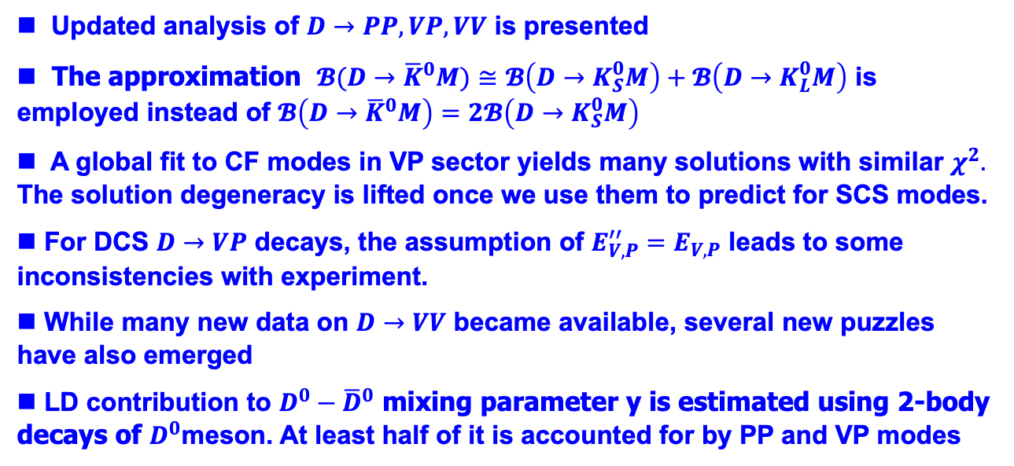
Conclusions
Updated analysis of $D→PP, VP, VV$ is presented
The approximation $𝓑(D→{\overline{K}}^{0}M)≅$ $𝓑\left(D→K_{S}^{0}M\right)+𝓑\left(D→K_{L}^{0}M\right)$ is employed instead of $𝓑\left(D→{\overline{K}}^{0}M\right)=$ $2𝓑\left(D→K_{S}^{0}M\right)$
A global fit to CF modes in VP sector yields many solutions with similar $χ^{2}.$ The solution degeneracy is lifted once we use them to predict for SCS modes.
For DCS $D→VP$ decays, the assumption of $E_{V,P}^{′′}=E_{V,P}$ leads to some inconsistencies with experiment.
While many new data on $D→VV$ became available, several new puzzles have also emerged
LD contribution to $D^{0}−{\overline{D}}^{0}$ mixing parameter y is estimated using 2-body decays of $D^{0}$meson. At least half of it is accounted for by PP and VP modes

Slide 26
Spare Slides

Slide 27
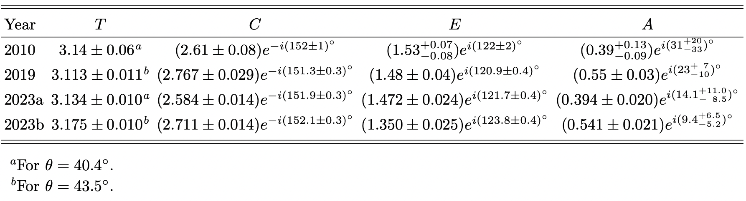

The relation $Γ\left({\overline{K}}^{0}\right)=2Γ\left(K_{S}^{0}\right)$ can be invalidated by interference between CF & DCS. To a good approximation, $ℬ(D→{\overline{K}}^{0}M)≅$ $ℬ\left(D→K_{S}^{0}M\right)+ℬ\left(D→K_{L}^{0}M\right)$
H.Y.C & Chiang
BESIII (`23), KLOE (’09)
$η−η′$ mixing angle
LHCb (’15)
$χ^{2}$ vanishes for $θ={40.4}^{∘},{ χ}^{2}=1.46 /d.o.f.$ for $θ={43.5}^{∘}$

Slide 28

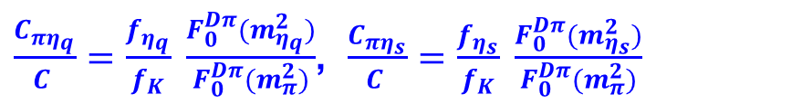
SU(3) Breaking
SU(3) breaking in T & C: calculable in terms of decay constants and form factors, f_{K} > f_{π}, F₀^{DK}(q²) > F₀^{Dπ} (q²)
SU(3) breaking in E & A: known qualitatively at best
Chau, HYC (’94)
A(D⁺→ π⁺η)=1/√2 (0.82 T+0.93 C+1.19 A)cosφ + 1.28C sinφ
A(D⁺→ π⁺η’)=1/√2 (0.82 T+0.93 C+1.61 A) sinφ - 1.28C cosφ
A(D⁺→ π⁺η)=1/√2 (T’+C’+2A’)cosφ + C’sinφ
A(D⁺→ π⁺η’)=1/√2 (T’+C’+2A’)sinφ - C’cosφ
 | Expt (10⁻³) | SU(3) | + SU(3) in T, C
BF(D⁺→π⁺η) | 3.77±0.09 | 1.90±0.16 | 3.30±0.09
BF(D⁺→π⁺η’) | 4.97±0.19 | 4.21±0.12 | 4.56±0.06

Slide 29
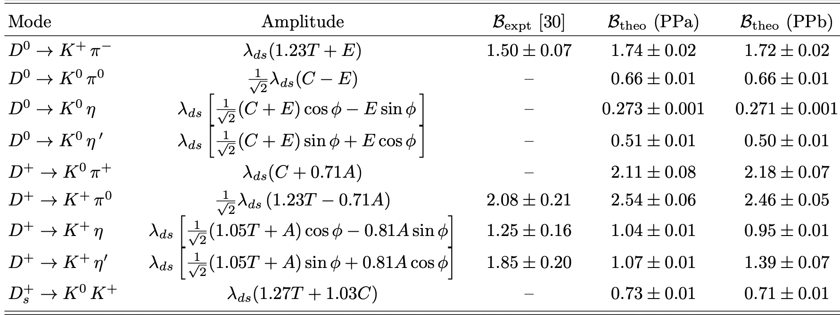
DCS $D→PP$ decays
SU(3) breaking in T also occurs in DCS modes

Slide 30
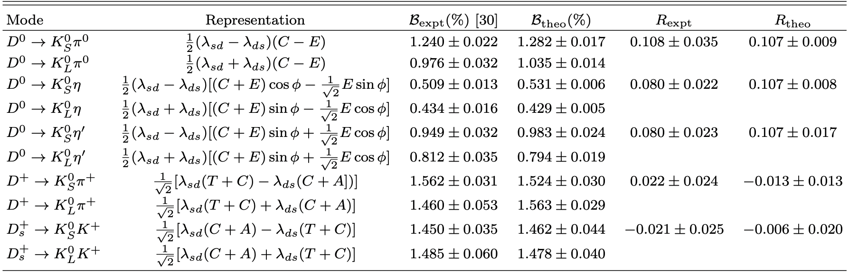
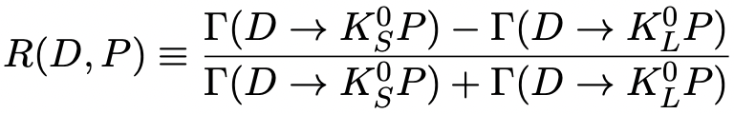

$K_{S}^{0}−K_{L}^{0}$ asymmetries
$λ_{sd}=V_{cs}^{∗}V_{ud},$ ${ λ}_{ds}=V_{cd}^{∗}V_{us}$
It is expected

