Slide 1
Challenges and Opportunities in Charm from Lattice QCD
王伟
上海交通大学
粲强子物理研讨会
2024年5月9日 郑州

Slide 2
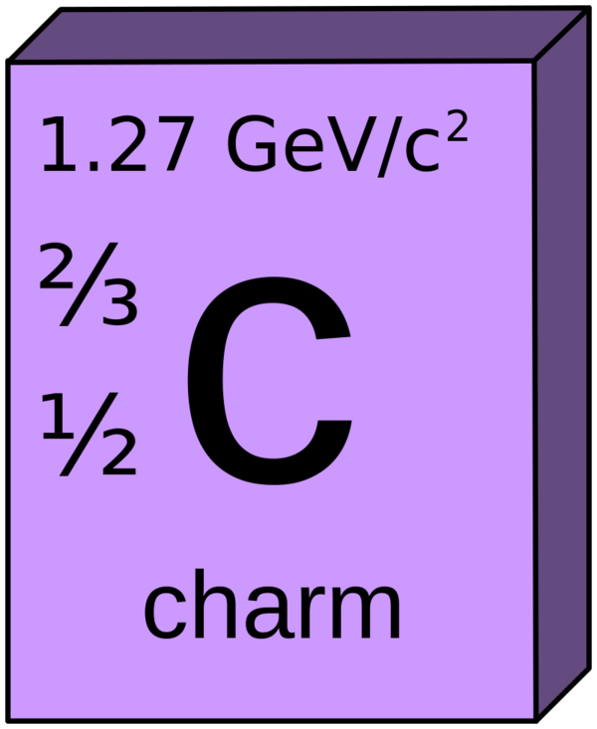
Charm
1. The strong coupling is strong:
$$α_{s}\left(m_{c}\right)\sim 0.3$$
2. The charm quark is not really heavy:
$$m_{c}\sim 1.3 GeV$$
3. There is almost no CPV in charm
ΔA_{CP}=A(K⁻K⁺)−A(𝜋⁻𝜋⁺)=(−1.54±0.29)×10⁻³
LHCb, PRL 122, 211803 (2019)

Slide 3
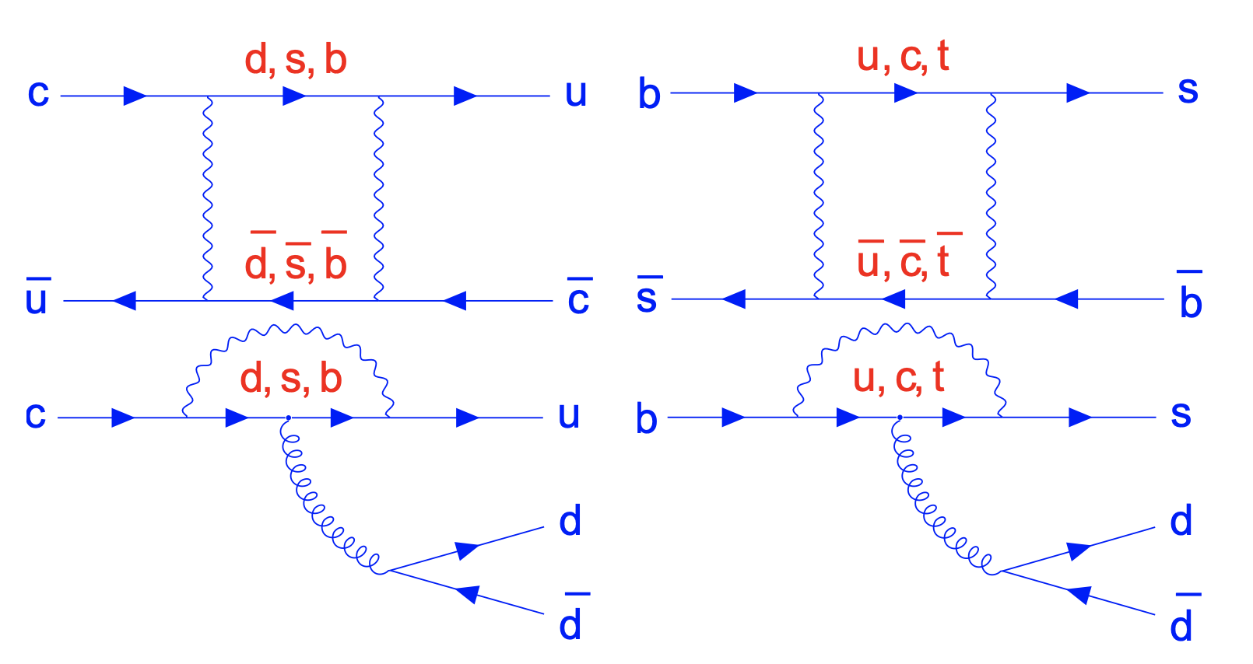
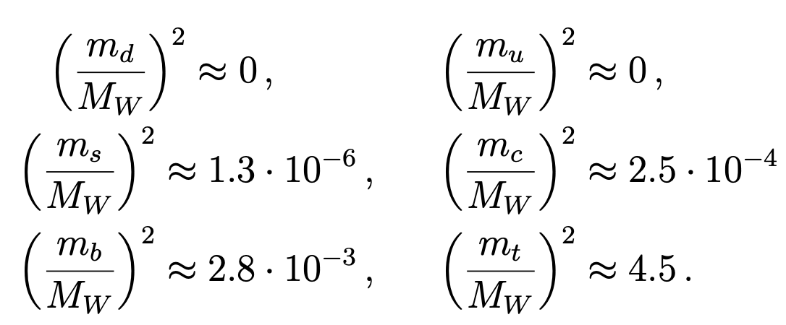
Charm
4. GIM cancellations in charm sector:
Lenz, Wilkinson, Ann.Rev.Nucl.Part.Sci. 71 (2021) 59-85

Slide 4
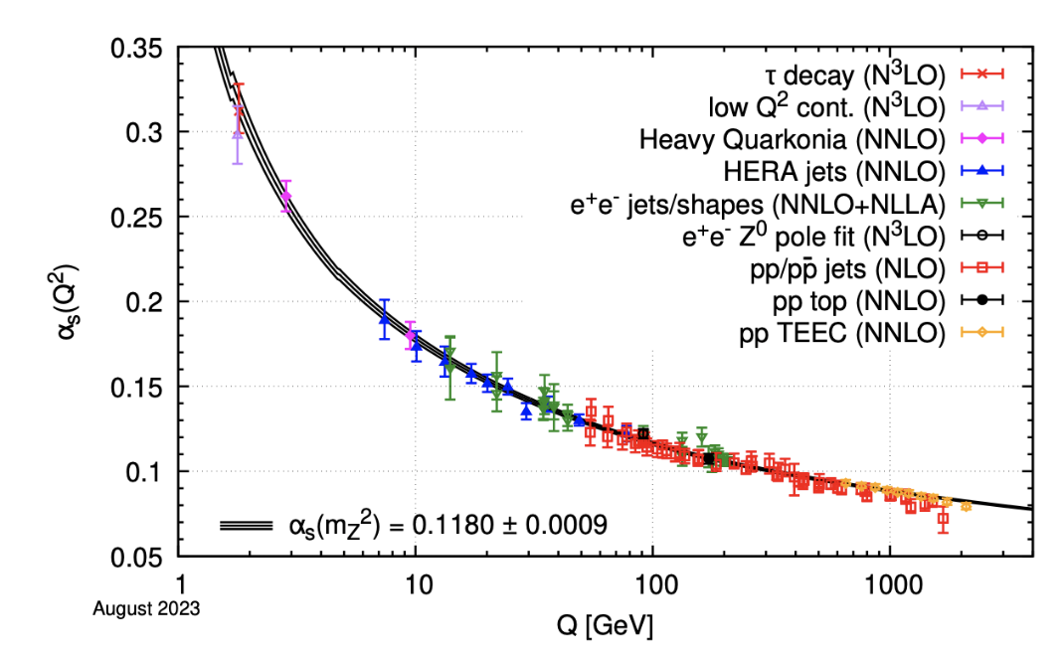
Theoretical Tools for Charm
Flavor SU(3) symmetry
HQE/Factorization
Models: Quark model
QCD sum rules
Rescattering
Lattice QCD
…
Notes:
4

Slide 6
Lattice QCD
Notes:
6

Slide 7
Lattice QCD
Notes:
7

Slide 8
Challenges
Difficult to study on lattice QCD:
Nonleptonic decays
Semi-leptonic decays into a scalar meson
D-Dbar mixing
…

Slide 9
Challenges and Opportunities
Mass
Decay Constant and Radiative/Leptonic decay rate
Form factors
Lifetime
LCDAs
Inclusive decay rates

Slide 10
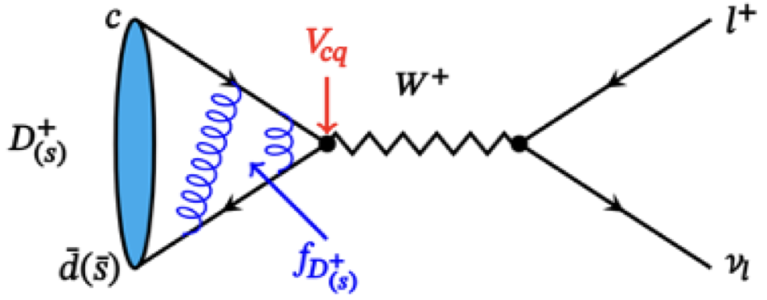
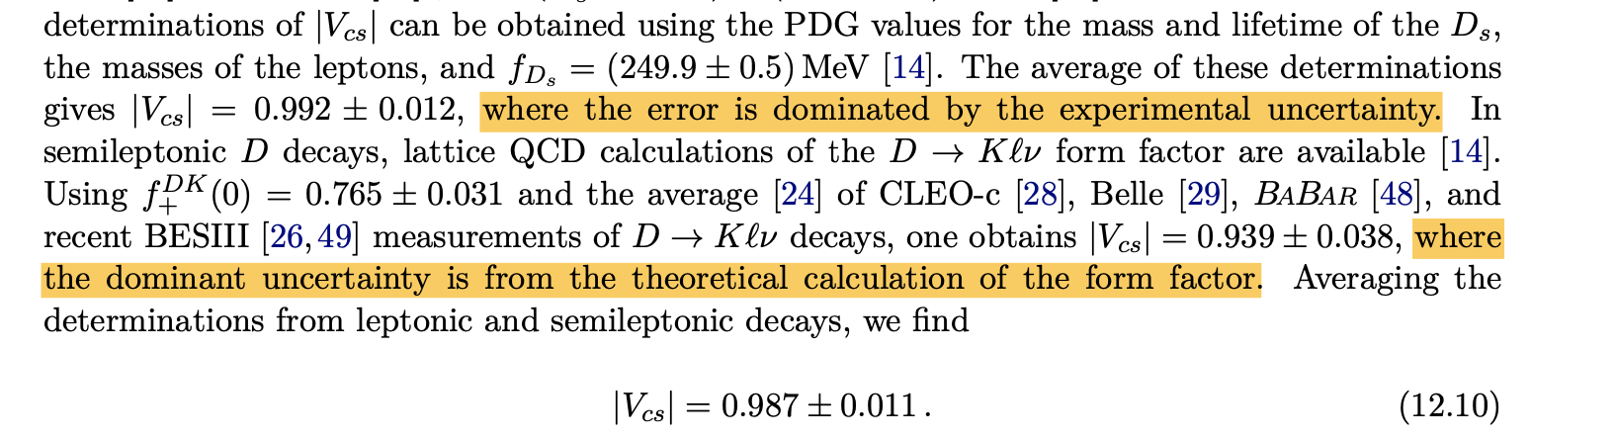
Challenges and Opportunities
PDG2021

Slide 11
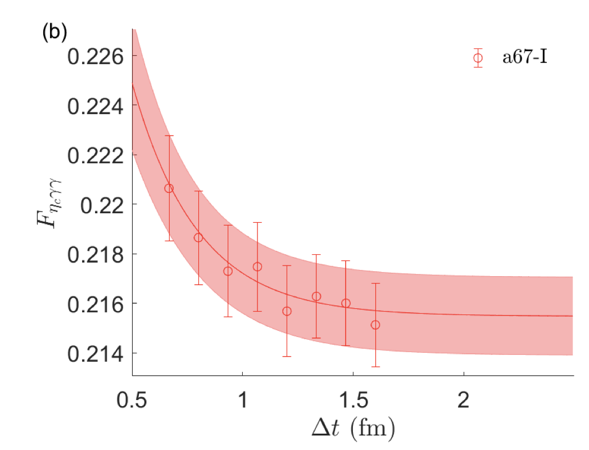
QED corrections in leptonic D decays
Meng, et.al., Sci.Bull. 68 (2023) 1880-1885

Slide 12
Challenges and Opportunities
Recent Form factors on Lattice QCD
Process | $$a[fm]$$ | $m_{π}$[MeV] | Reference
$$Λ_{c}→Λ$$ | 0.08，0.11 | 140-360 | S.Meinel, 1611.09696/PRL 2017
$$Λ_{c}→Λ(1520)$$ | 0.08，0.11 | 300-430 | S.Meinel, G. Rendon 2107.13140/PRD 2022; 2107.13084/PRD 2022
$$Λ_{c}→n$$ | 0.08，0.11 | 230-360 | S. Meinel, 1712.05783/PRD 2018
$Ξ_{c}$ $→$ $Ξ$ | 0.08，0.108 | 290, 300 | Q.A. Zhang, et.al, 2103.07064/CPC 2022
$$Λ_{c}→Λ$$ | 0.1555 | 550 | H. Bahtiyar 2107.13909/Turk.J.Phys. 2021
Notes:
12

Slide 13
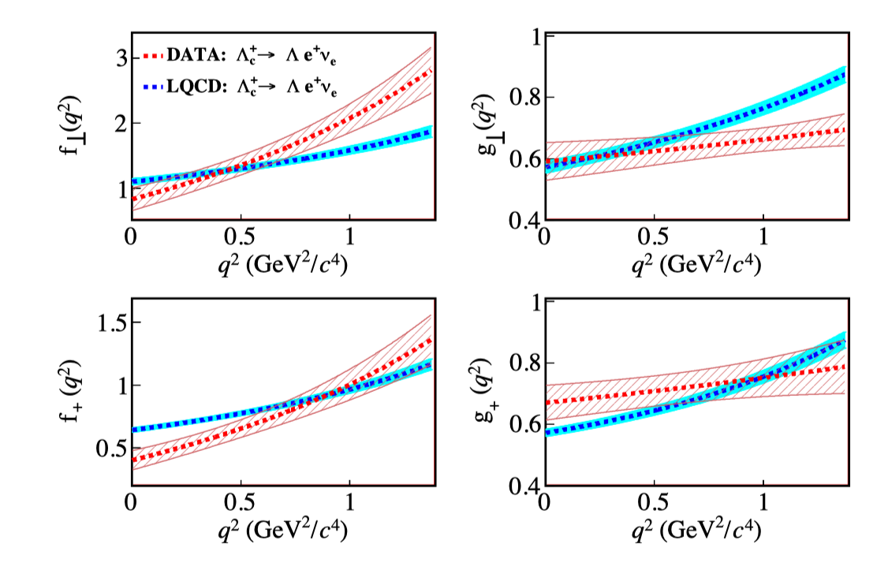
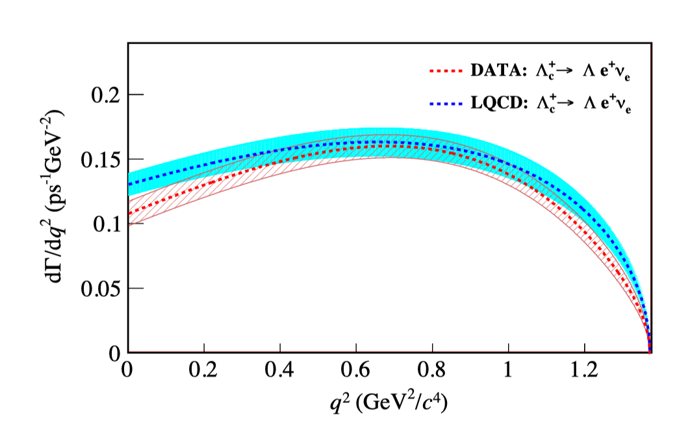
Challenges and Opportunities
13
$Λ_{c}→Λ$
no clear difference is observed within uncertainties for the resulting differential decay rate
the dependences of measured FFs show different kinematic behavior compared to those predicted from LQCD calculations.
BESIII: 2207.14149
LQCD: S. Meinel, PRL118, 082001 (2017)

Slide 14
Challenges and Opportunities
14
Large SU(3) breaking in $Ξ_{c}$ $→$ $Ξ$
1. PDG/PTEP 083C01 2020
2. Belle, 2103.06496/PRL 2021
3. ALICE, 2105.05187/PRL 2021
4. S. Meinel, 1611.09696/PRL 2017
5. Q.A.Zhang, et.al., 2103.07064/CPC 2022
F. Huang, et.al, 2110.04179/PLB 2021
Large SU(3) breaking, but difficult to understand from LQCD

Slide 15
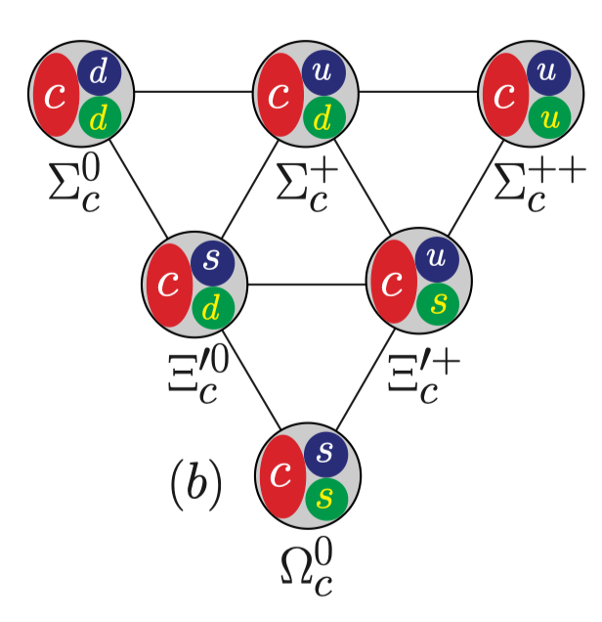
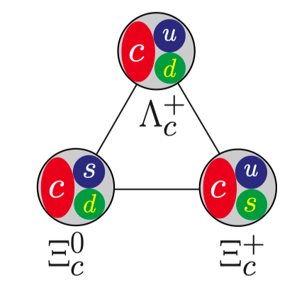
Challenges and Opportunities
15
A number of decay form factors are yet to be explored!

Slide 16
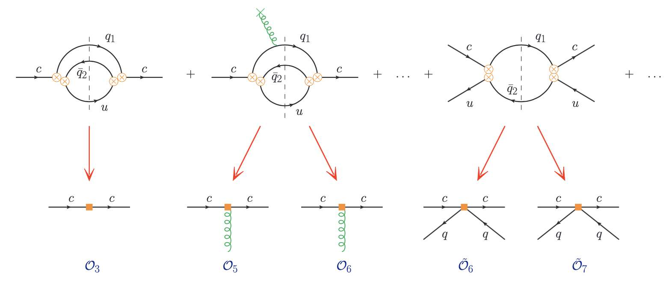
Challenges and Opportunities
16
Lifetime of charmed hadrons are described by OPE

Slide 17
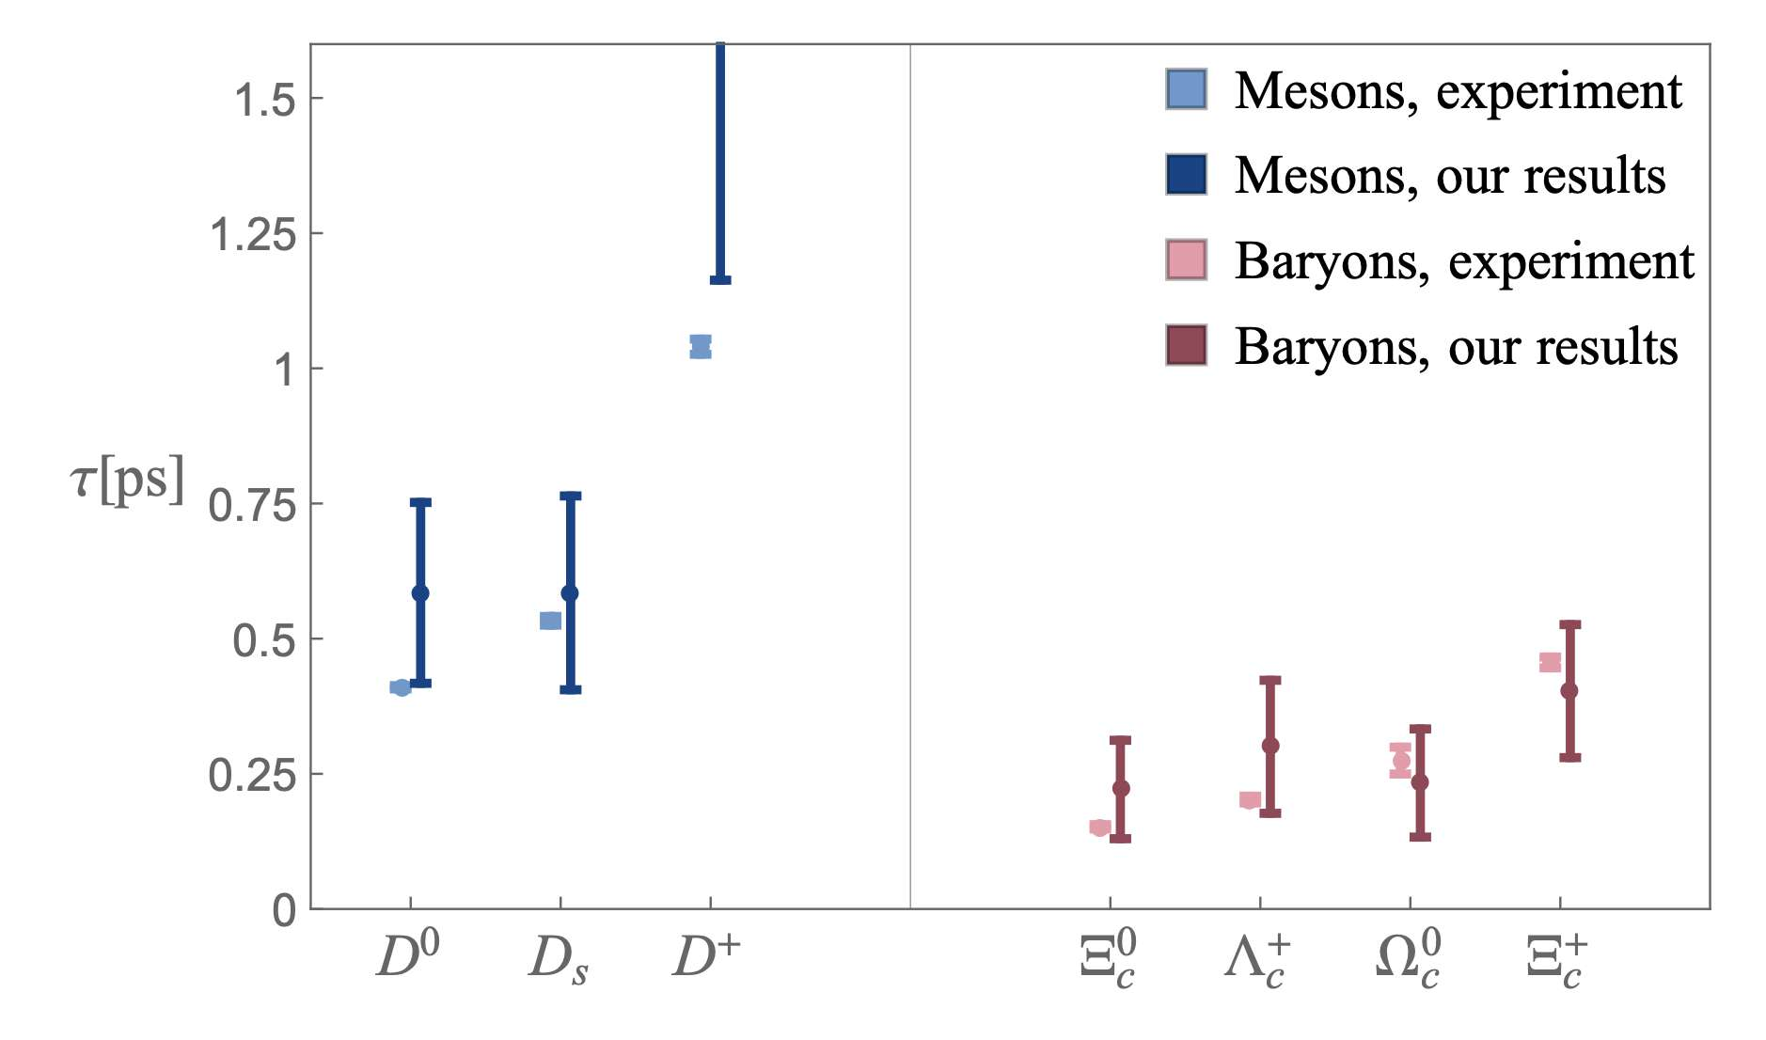
Challenges and Opportunities
17
Gratrex,Melić,Nišandžić,2204.11935

Slide 18
Challenges and Opportunities
18
From Alexander Lenz

Slide 19
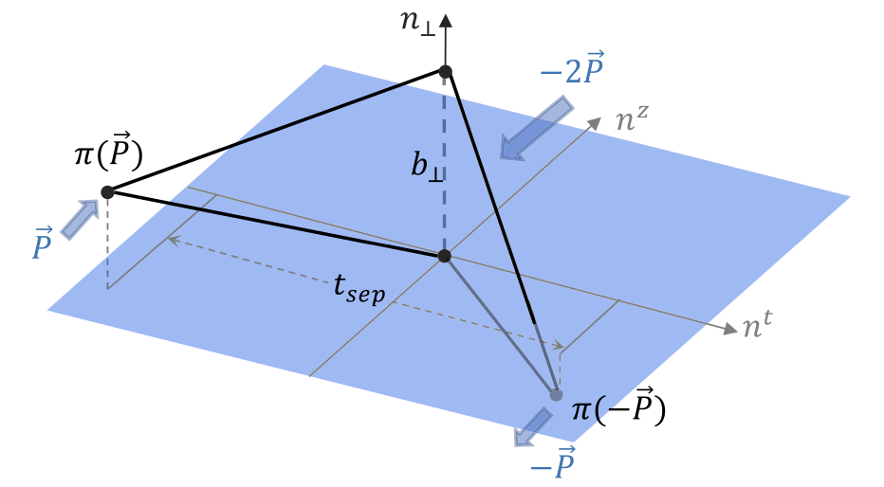
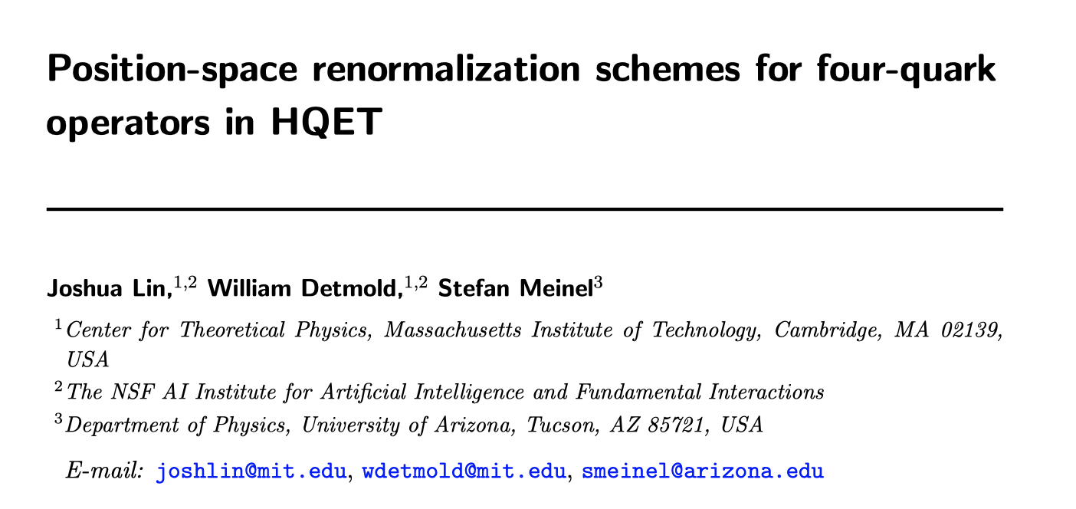
Challenges and Opportunities
19
Zhang, et.al. (LPC) PRL125,192001(2020)
Lin, Detmonld, Meinel, 2404.16191v1

Slide 20
Challenges and Opportunities
20
in units of fs (${10}^{−15}$ s)
 | $$τ(Ξ_{c}^{+})$$ | $$τ(Λ_{c}^{+})$$ | $$τ(Ξ_{c}^{0})$$ | $$τ(Ω_{c}^{0})$$
PDG (’04 ~ ’18) | 442 ± 26 | 200 ± 6 | ${112}_{−10}^{+13}$ | 69 ± 12
LHCb (’18) |  |  |  | 268 ± 26
LHCb (’19) | 457 ± 6 | 203.5 ± 2.2 | 154.5 ± 2.6
PDG (’20) | 456 ± 5 | 202.4 ± 3.1 | 153 ± 6 | 268 ± 26
LHCb (’21) |  |  | 148.0 ± 3.2 | 276.5 ± 14.1
PDG (’22,’23) | 453 ± 5 | 201.5 ± 2.7 | 151.9 ± 2.4 | 268 ± 26
Belle II (’22) |  | 203.20 ± 1.18 |  | 243 ± 49
World Ave (’23) | 453 ± 5 | 202.9 ± 1.1 | 150.5 ± 1.9 | 272.6 ± 12.0
From Hai-Yang Cheng
LHCb (’21) & Belle (’22) data were not taken into account by PDG (’23)
$τ(Ω_{c}^{0})$ obtained by LHCb (’18) from semileptonic $Ω_{b}^{−}$ decays is nearly four times larger. It has been confirmed by LHCb (’21) using promptly produced $Ω_{c}^{0}$ baryons
$τ\left(Ξ_{c}^{+}\right)>τ\left(Λ_{c}^{+}\right)>τ\left(Ξ_{c}^{0}\right)>τ\left(Ω_{c}^{0}\right)$ before 2018
$τ\left(Ξ_{c}^{+}\right)>τ\left(Ω_{c}^{0}\right)>τ\left(Λ_{c}^{+}\right)>τ\left(Ξ_{c}^{0}\right)$ after 2018
$τ(Ξ_{c}^{0})$ becomes 3.3σ larger due to new measurements from LHCb (’19, ’21)

Slide 21
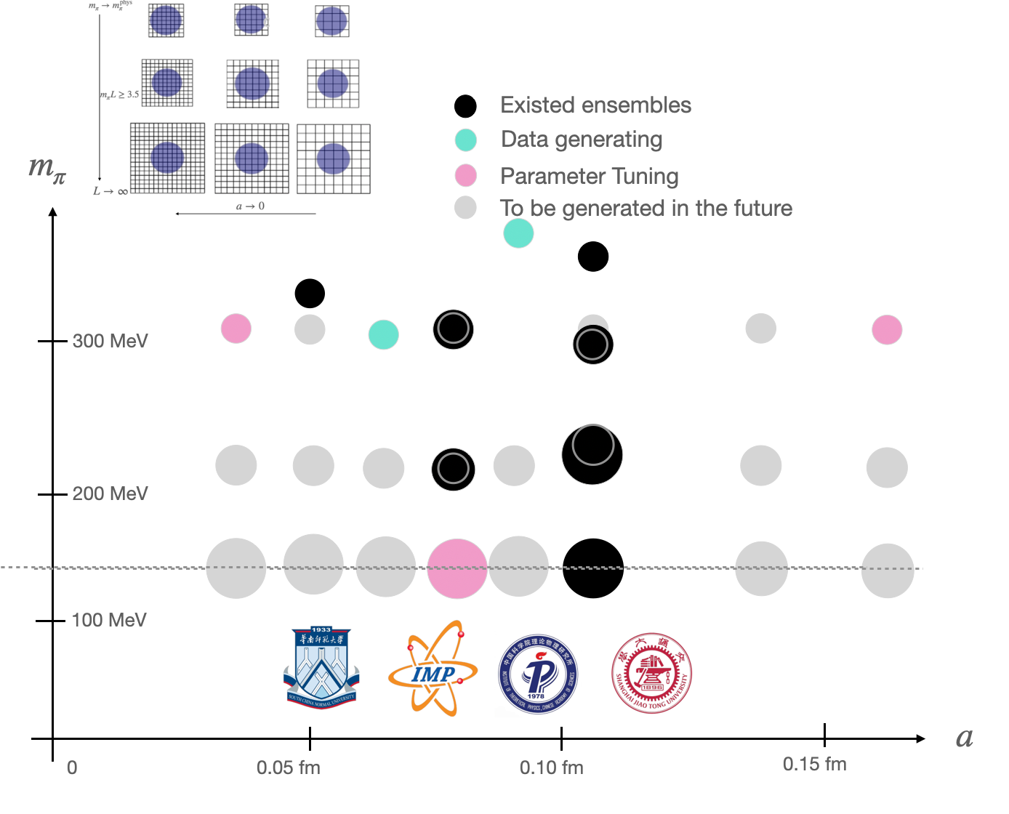
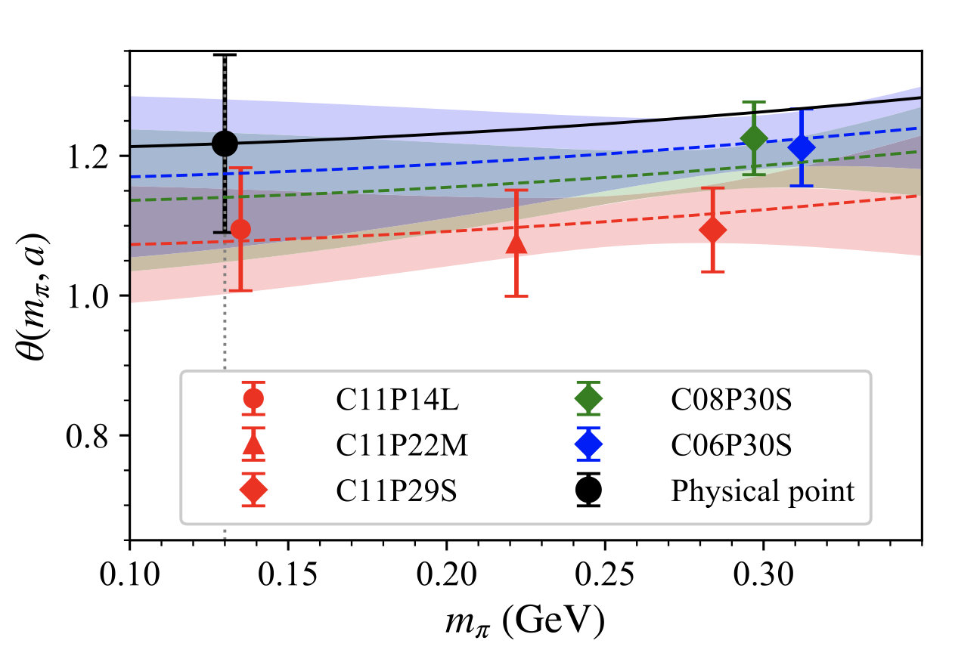
New Lattice QCD configurations
21
Hu, et.al., PRD 109, 054507 (2024)

Slide 22
Summary
Charm on the Lattice are full of challenges and opportunities.
QED corrections to decay constant and $D→γlν$
Transition Form factors:
$Λ_{c}→Λ、Ξ_{c}$ $→$ $Ξ、Ω_{c}$ $→Ω$
$Ξ_{cc}?$
Lifetime of charmed hadrons:
$D^{0},D^{+}$
Charmed Baryons
Thank you for your attention.

Slide 23
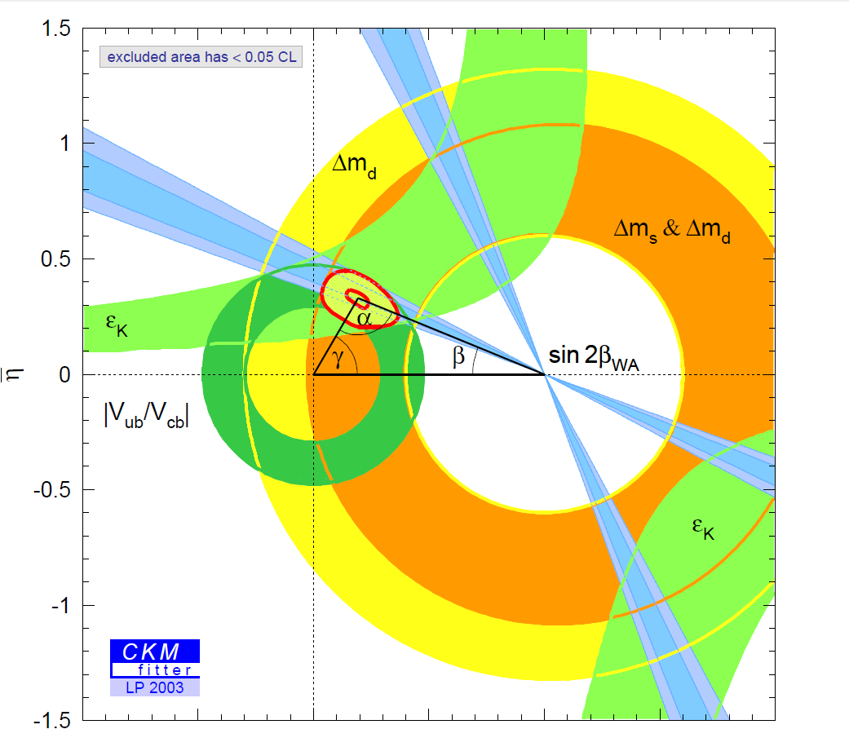
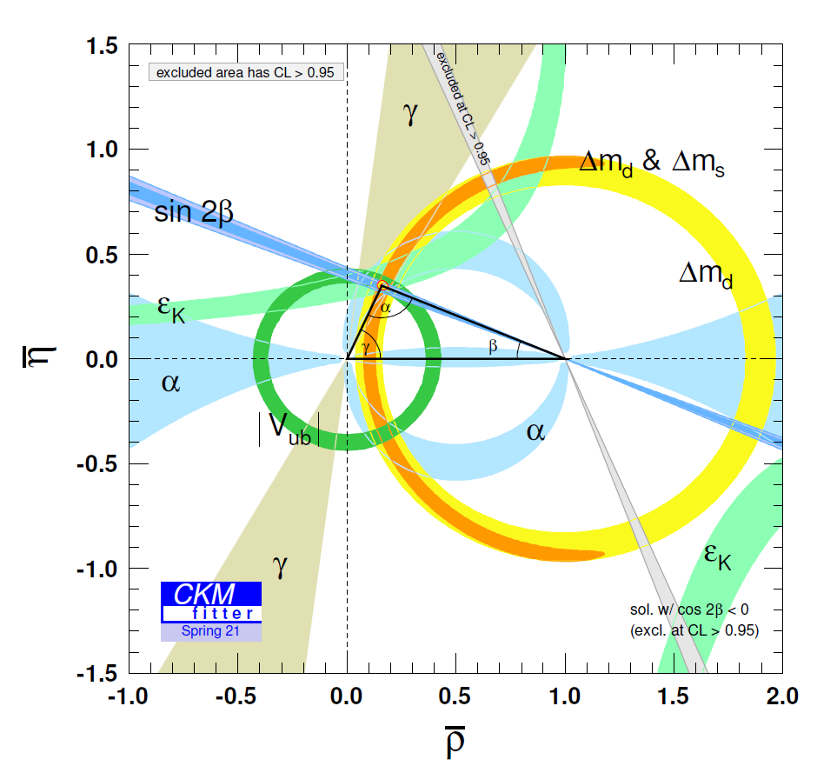
Charm
Precisely testing standard model
Study on CP violation
Time-dependent CP violation in B meson decays, [Babar& Belle 2001]
Direct CP violation in B meson decays, [Babar& Belle 2004]
Direct CP violation in D meson decays, [LHCb 2019]
Indirect search for new physics
Notes:
23

Slide 24
Challenges and Opportunities
Leptonic/Radiative Decays: $η_{c}→2γ$, $D→γlν$
Semileptonic decay form factors
Lifetime of charmed hadrons

