Slide 1
Electronics Plan for CEPC Ref-TDR
Wei Wei
2024-01-30

Slide 2
Outline
Organization & architecture of electronics
Questions to answer
Manpower requirement vs. scenario
Preliminary organization of the group

Slide 3
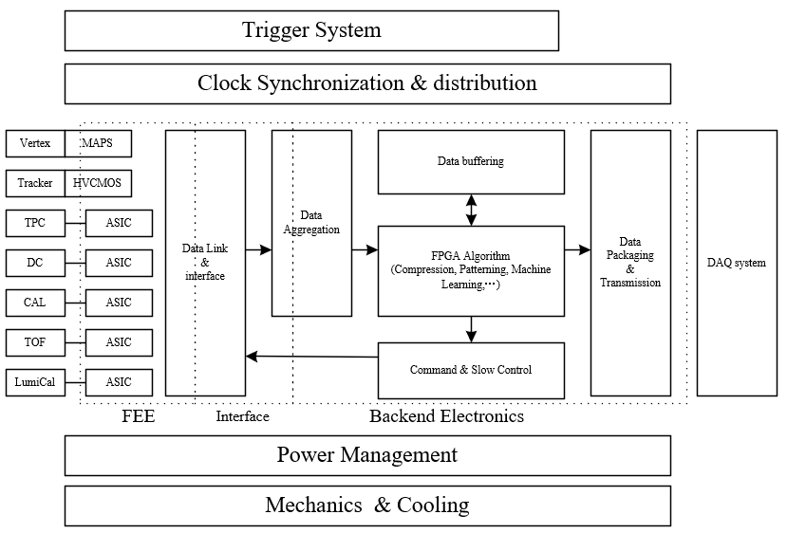
Consideration of the CEPC electronics system
electronics system
Q: (except Front ASIC) can we make the electronics system in a unified style?
Q: what is the border between detector/FEE, FEE/data interface, frontend/backend, electronics/trigger, …?

Slide 4
Questions to be answered for TDR
Sub-detector requirements
physics requirement (measurement target & parameters)
signal processing (channels, event rate, signal characteristics…)
overall system (interface, power, cooling, clocking, budget…)
Overall scheme of electronics
FEE readout to BEE for sub-det
Data link, cabling
Global consideration of BEE
On data : buffering, clocking, transmission …
Algorithm for data compression, frontend trigger, machine learning…
Interface with other systems
To Trigger: data rate, link, trigger/triggerless
Slow control
Powering & cooling
Mechanics & material budget
See backup slides for more details
CEPC requirement on electronics (@CEPC Workshop, Nanjing)

Slide 5
key target: from R&D goals to engineering goals
Vertex detector CDR vs. TDR
@TaichuPix
There might be a significant change to the design according to TDR’s parameter
Some R&D parameter in small scale may not be realistic for large detector

Slide 6
Manpower requirement vs. scenario
Scn1：General overall electronics scheme + sub-det electronics to the spec + limited key R&D in 2024 ( 7 staff + 7 stud)
Global electronics scheme with reasonable feasibility (1.5 Staff )
General system interface: powering, clocking, data link with reasonable feasibility (1 Staff +1 stud)
Sub-det electronics with specification and general readout scheme:
Staff 4.5 : Vertex 1 + Tracker 2.5 (silicon 1 + DC 1 + TPC 0.5@thu) +Cal 1
Mainly on scheme design and feasibility consideration
Other sub-dets elec (Muon+Lumi) are supposed to be fully covered by other univertisities.
Postdoc + stud 4: system evaluation for the main detectors (2) + ASIC test & performance evaluation (2)
Key R&D (2 stud):
Wireless communication & clocking (1)
Advanced algorithm on data compression & on-detector L1 trigger (1)
Scn2: General overall electronics scheme + sub-det electronics to the detailed design + general R&D in 3~5 years ( 16 staff + 40 stud)
Global electronics scheme with preliminary proved feasibility (3 Staff + 2 stud)
General system interface: powering, clocking, data link with proved feasibility & evaluation (3 Staff +2 stud)
Sub-det electronics with detailed electronics design :
Staff 10 : Vertex 2 + Tracker 6 (silicon 2.5 + DC 2 + TPC 1.5@thu) +Cal 2
Other sub-dets elec (Muon+Lumi) are supposed to be fully covered by other univertisities.
Including ASIC R&D + backend readout electronics R&D
Postdoc + stud 8: system evaluation for the main dets (2) + ASIC design, test & performance evaluation (3) + backend electronics design (3)
Main R&D (12 postdoc + stud):
Wireless communication & clocking (2)
Advanced algorithm on data compression & on-detector L1 trigger (4)
Radiation effect test & study(2)
Advanced powering & cooling (2)
Generic backend electronics hardware development (2)
Current available: 5.5 staff + 1.5 stud + 0 postdoc

Slide 7
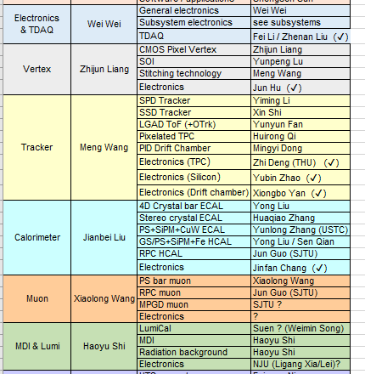
Preliminary organization of the Elec-TDR group
A dedicated colleague for each sub-det
For some parallel schemes, also followed by a dedicated colleague for each scheme
Expected a convergence of detector plans in a limited time
Especially for the Tracker & CAL
Needs help from external collaborators
Thanks Z. Deng @THU for TPC
Muon & Lumi are expected to be covered by the external collaborators
Will organize regular meetings after the plenary TDR meeting

Slide 8
BACKUP

Slide 9
The main goal of this discussion
Collect requirements from related detectors on electronics
Vertex, Tracker, TPC, Drift Chamber, CAL, LGADTOF, LumiCal…
Common question template on requirement
On physics requirement
Detector target
Parameters that measures (T, E, dE/dx, dN/dx, …)
On signal processing
Detector channels for electronics
Counting rate
Signal characteristics (Q, I, V, rising/falling edge, width…)
Dynamic rage
Requirement on measurement (linearity, accuracy…)
On overall system
Detector interface (cabling, socket, detector impedance …)
Power budget & material budget
Working conditions (temperature, cooling, special mechanics…)
…

Slide 10
Data link from FEE to backend
 | Vertex | Tracker | TPC | DC | CAL | TOF | LumiCal
Data rate per chip | 160Mbps @trigger / 4Gbps @triggerless | 1.28Gbps@triggerless | - | - | - | 6.4* 10⁻³ bit/event/chip | -
Data rate per module | 3.2Gbps@Trigger / 80Gbps@Triggerless | O(Gbps)@ module O(10Gbps)@ structure | - | - | - | - | -
Overall data rate | 205Gbps@Trigger / 5.12Tbps@Triggerless | ~40Tbps | 110Gbps | 800Gbps@Trigger / 6.4Tbps @triggerless | 93Gbps + 72Gbps |  | 33.6Gbps
Q: high speed serial link needed inside FE chips?
maybe yes for vertex & tracker, especially for triggerless mode
Q: data aggregation chip needed at the module/structure level?
maybe yes for vertex & tracker
Q: possible to follow a common protocol & interface for data link?
Interface designs may vary due to the CMOS process, protocol can be unified
Cabling? Optical? Or even wireless?
Has to be rad-tol

Slide 11
From FEE to BEE
Dedicated algorithm in FPGA may have to vary from detectors
Related to triggering, data compression, machine learning
Data aggregation for different AFE, if it is done in FPGA
Rest are possible to be designed in a unified style
Clock synchronization & distribution
Data buffering
Data packaging and transmission to DAQ
Powering
Slow control
Issue: most has an interface with other system (TRG, DAQ, Mechanics …), not well defined yet
Q: major challenges exist with huge data rate, especially triggerless
Very likely, new methodology has to be involved, yet no R&D
Q: do we need special algorithm for new physics approach, like PFA?
Needs input from physics simulation
Issue: yet not a dedicated BEE system R&D for CEPC

Slide 12
Interface between (Lvl 1) Trigger and Electronics
Common Question: Trigger or Triggerless?
For some sub-detector, data volume really an issue for triggerless
Part of the detectors on trigger, rest triggerless?
Smart & local track/cluster finding to compress data? While R&D required
Q: who needs TRG input? Who contributes to TRG?
Q: where in electronics, AFE or BEE, to communicate with TRG?
If in ASIC AFE, trigger interface has to be defined asap before finalization
The latency and data buffering is also a critical issue for the chip design
Issue: need a overall consideration on TRG strategy, not only on calculation of the data volume
 | Vertex | Tracker | TPC | DC | CAL | TOF | LumiCal
get TRG | Y | Y | Y | Y | Y | Y | Y
Generate TRG info | N | N | Y | Y | Y | Y | Y
Data volume an issue for triggerless? | Maybe 5.12Tbps | Maybe 40Tbps | - | Maybe 6.4Tbps | - | - | -

Slide 13
Interface with other systems
Clocking
How to synchronize with BX clock?
Multiple bunch spacings: Higgs: 680ns; W: 210ns; Z: 25ns
What clock needed for different detector?
Power management
Overall powering design maybe too early for CEPC
Consideration on AFE powering has to start
Serial powering? Rad-tol powering blocks?
Cooling
Has to be integrated closely with electronics system
Designs greatly depend on the cooling strategy, especially for AFEs
Air cooling or liquid cooling? Or Mixed?
Mechanics
Special mechanic scheme has to be generally defined for the design of AFE
e.g. Vertex on long Flex, ECAL module organization for HG…
Technology vender for low material still an issue
e.g. Aluminum Flex Cable for Vertex not available
Needs input if any special requirements to electronics exist

