Slide 1
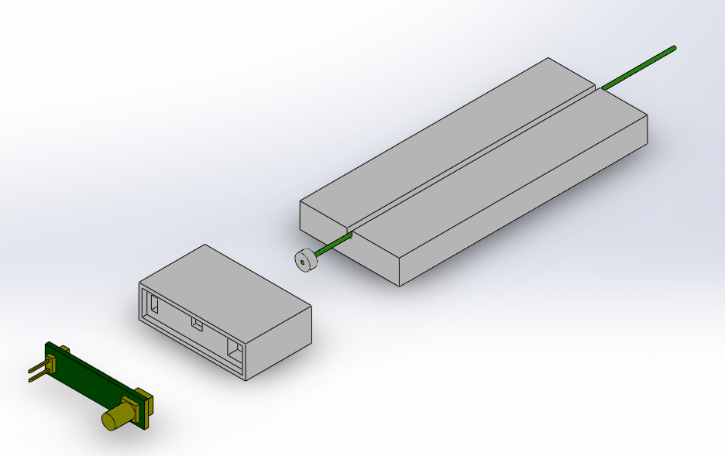
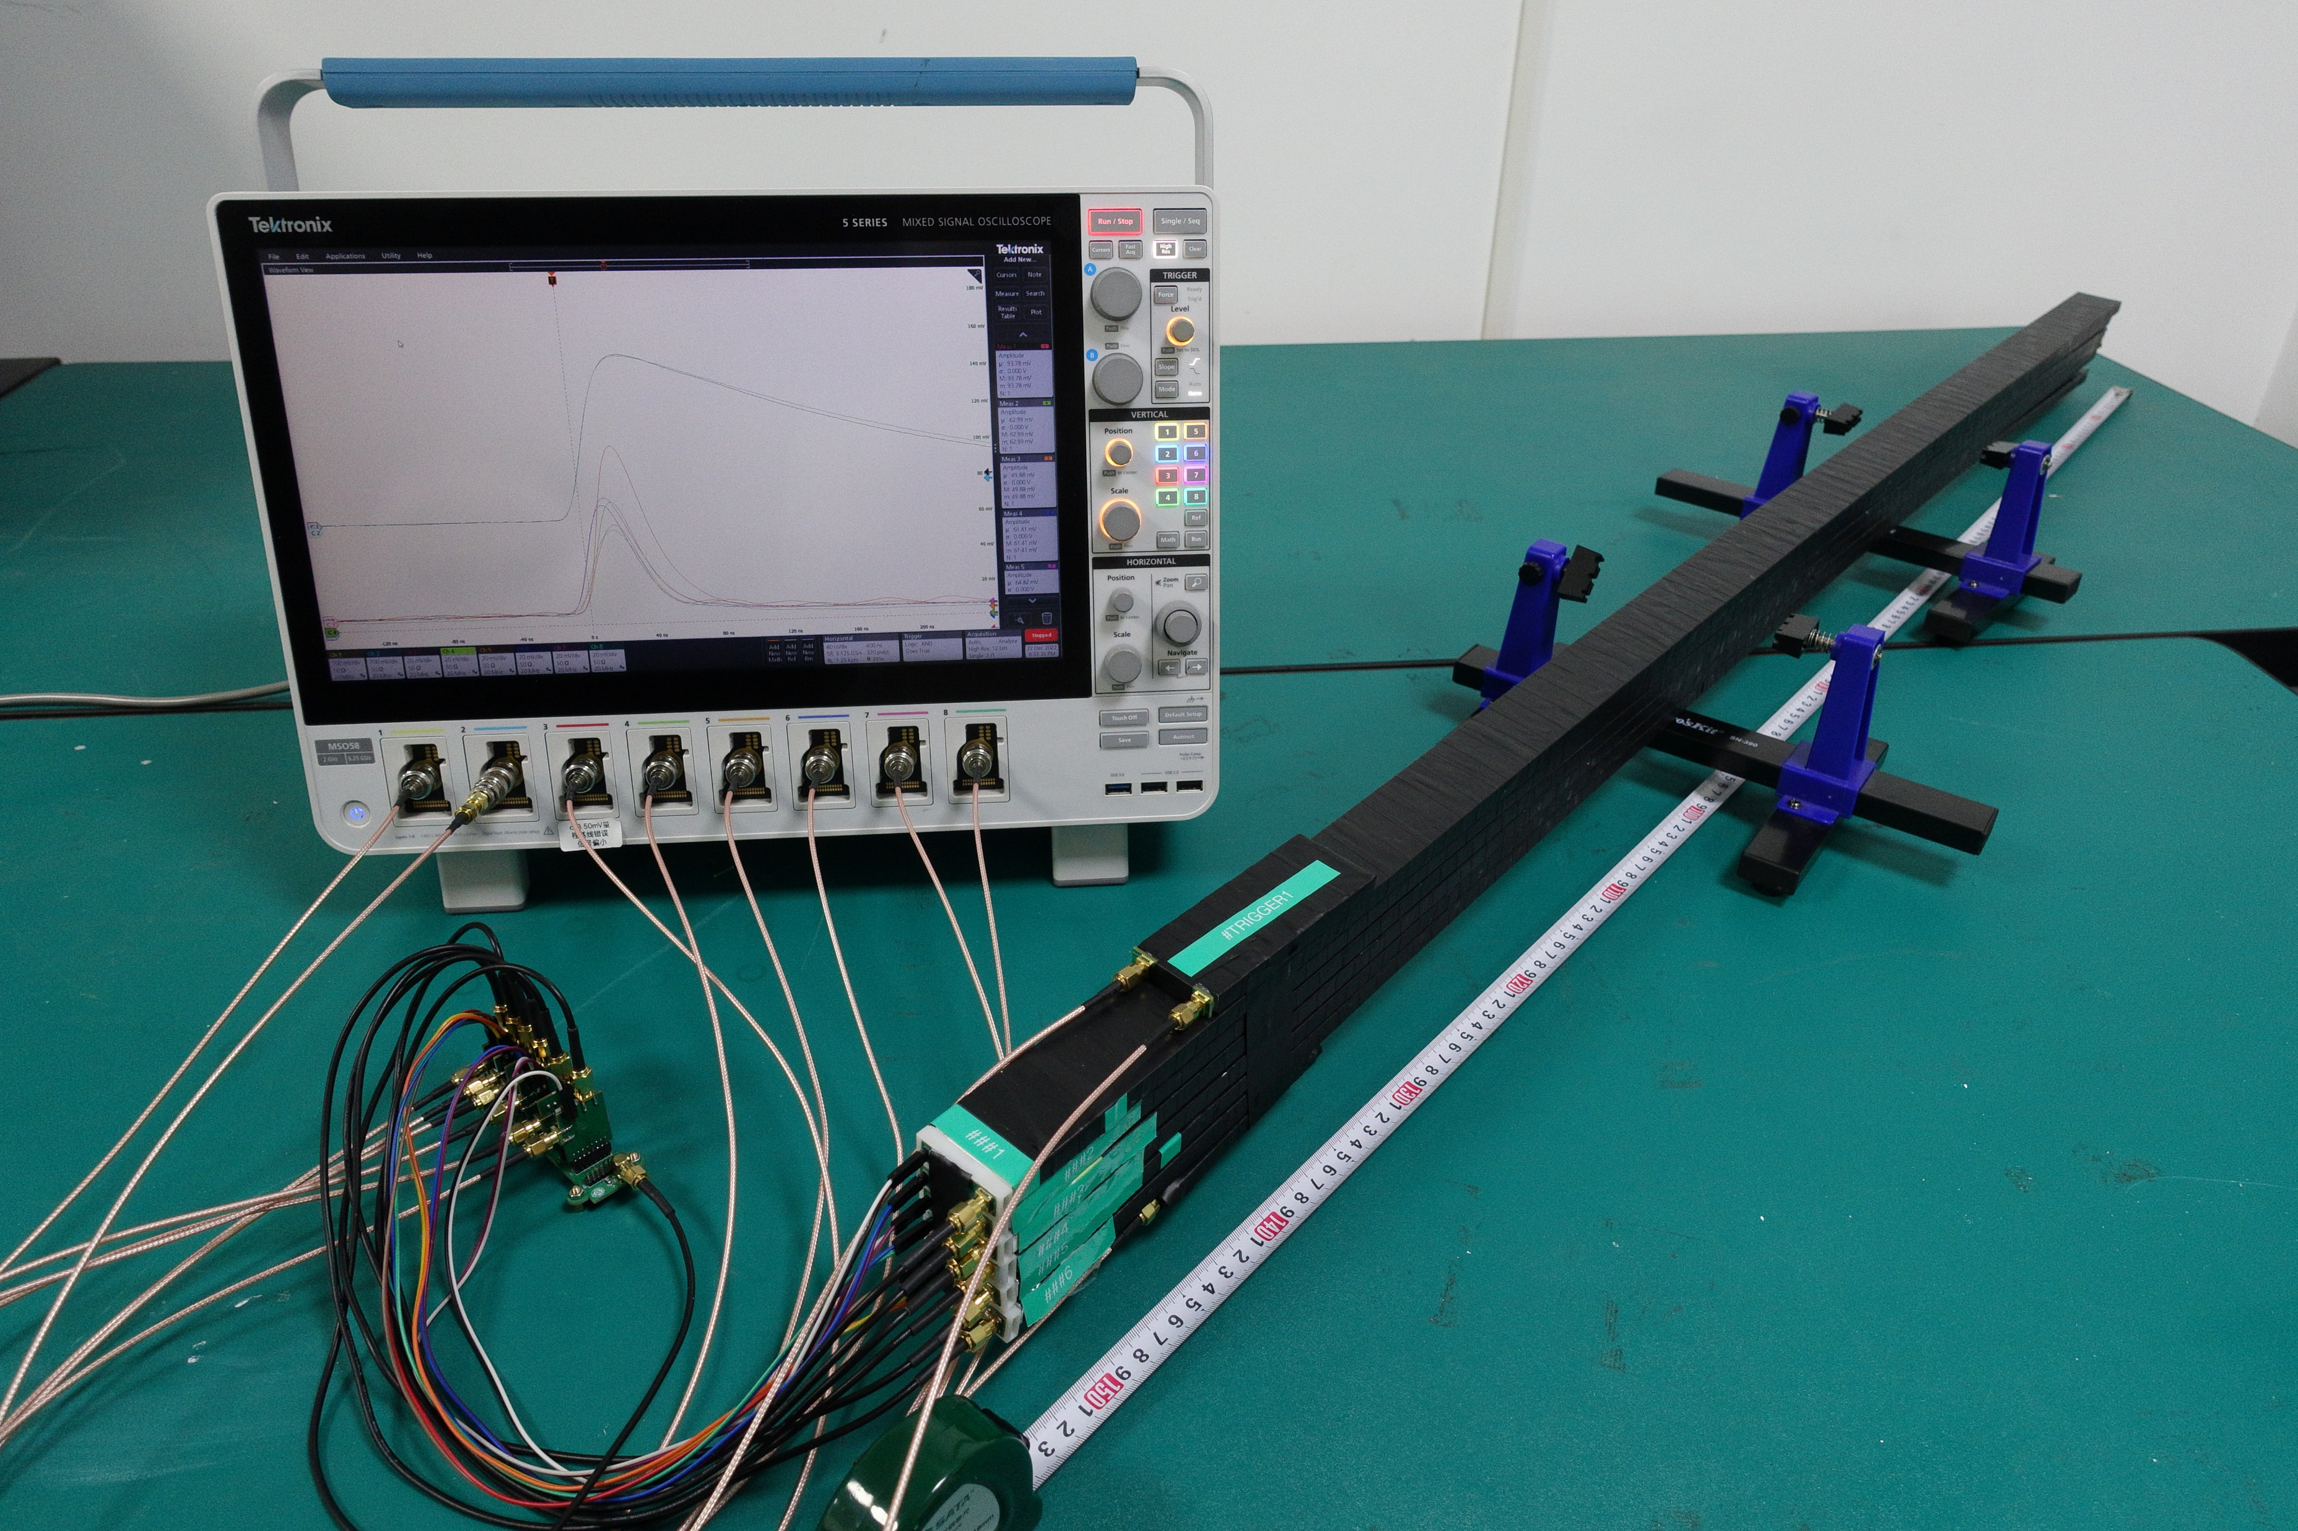
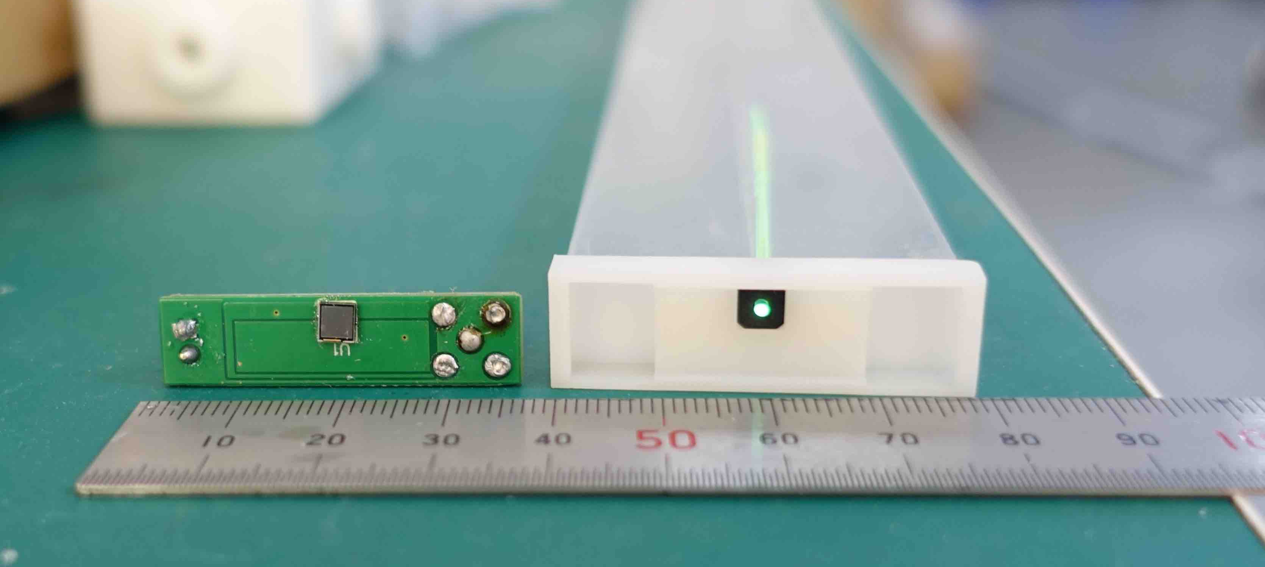
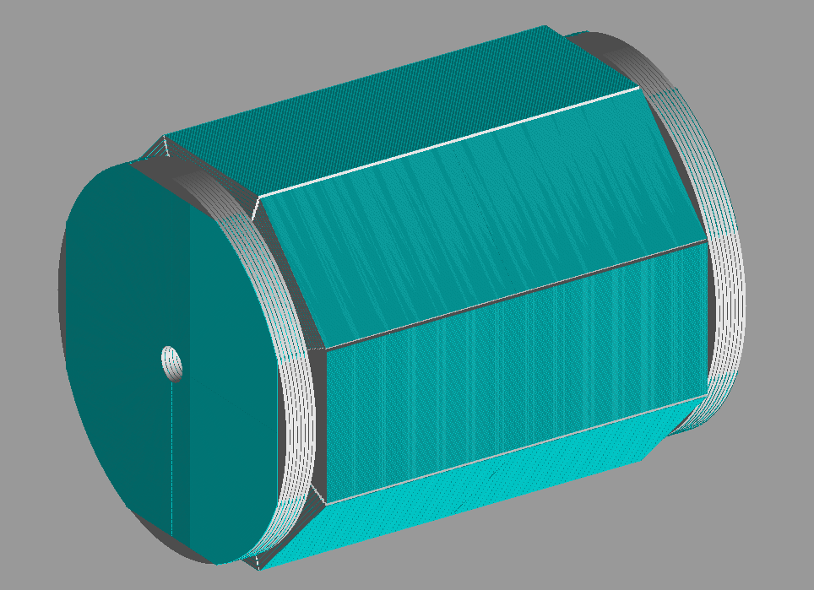
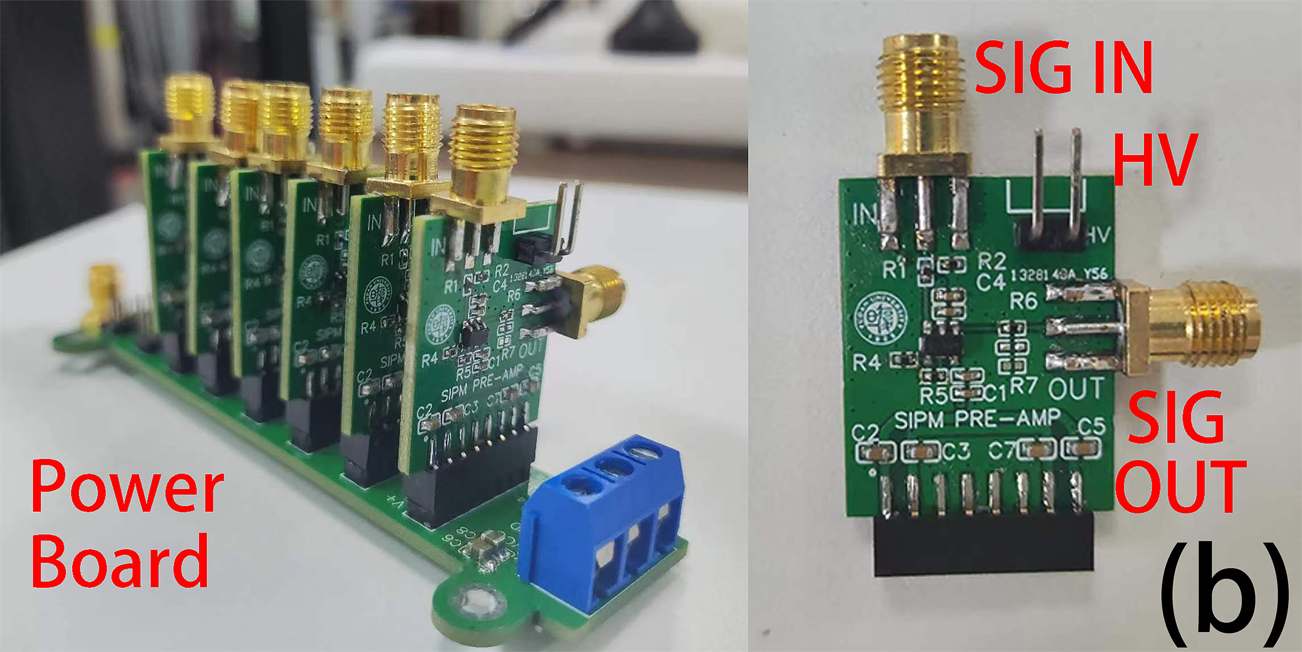

R&D for muon detector: Regular design
GNKD scintillator + Kuraray WLS fibre + NDL SiPM($3mm×3mm$)
Similar to Belle II KLM
$$1cm×4cm×150cm$$
https://chinaxiv.org/abs/202305.00148
To be published in NST.
To be submitted soon.
Good efficiency at far end, 98% at 7 p.e.
Preamplifers
Detector simulation

Slide 2
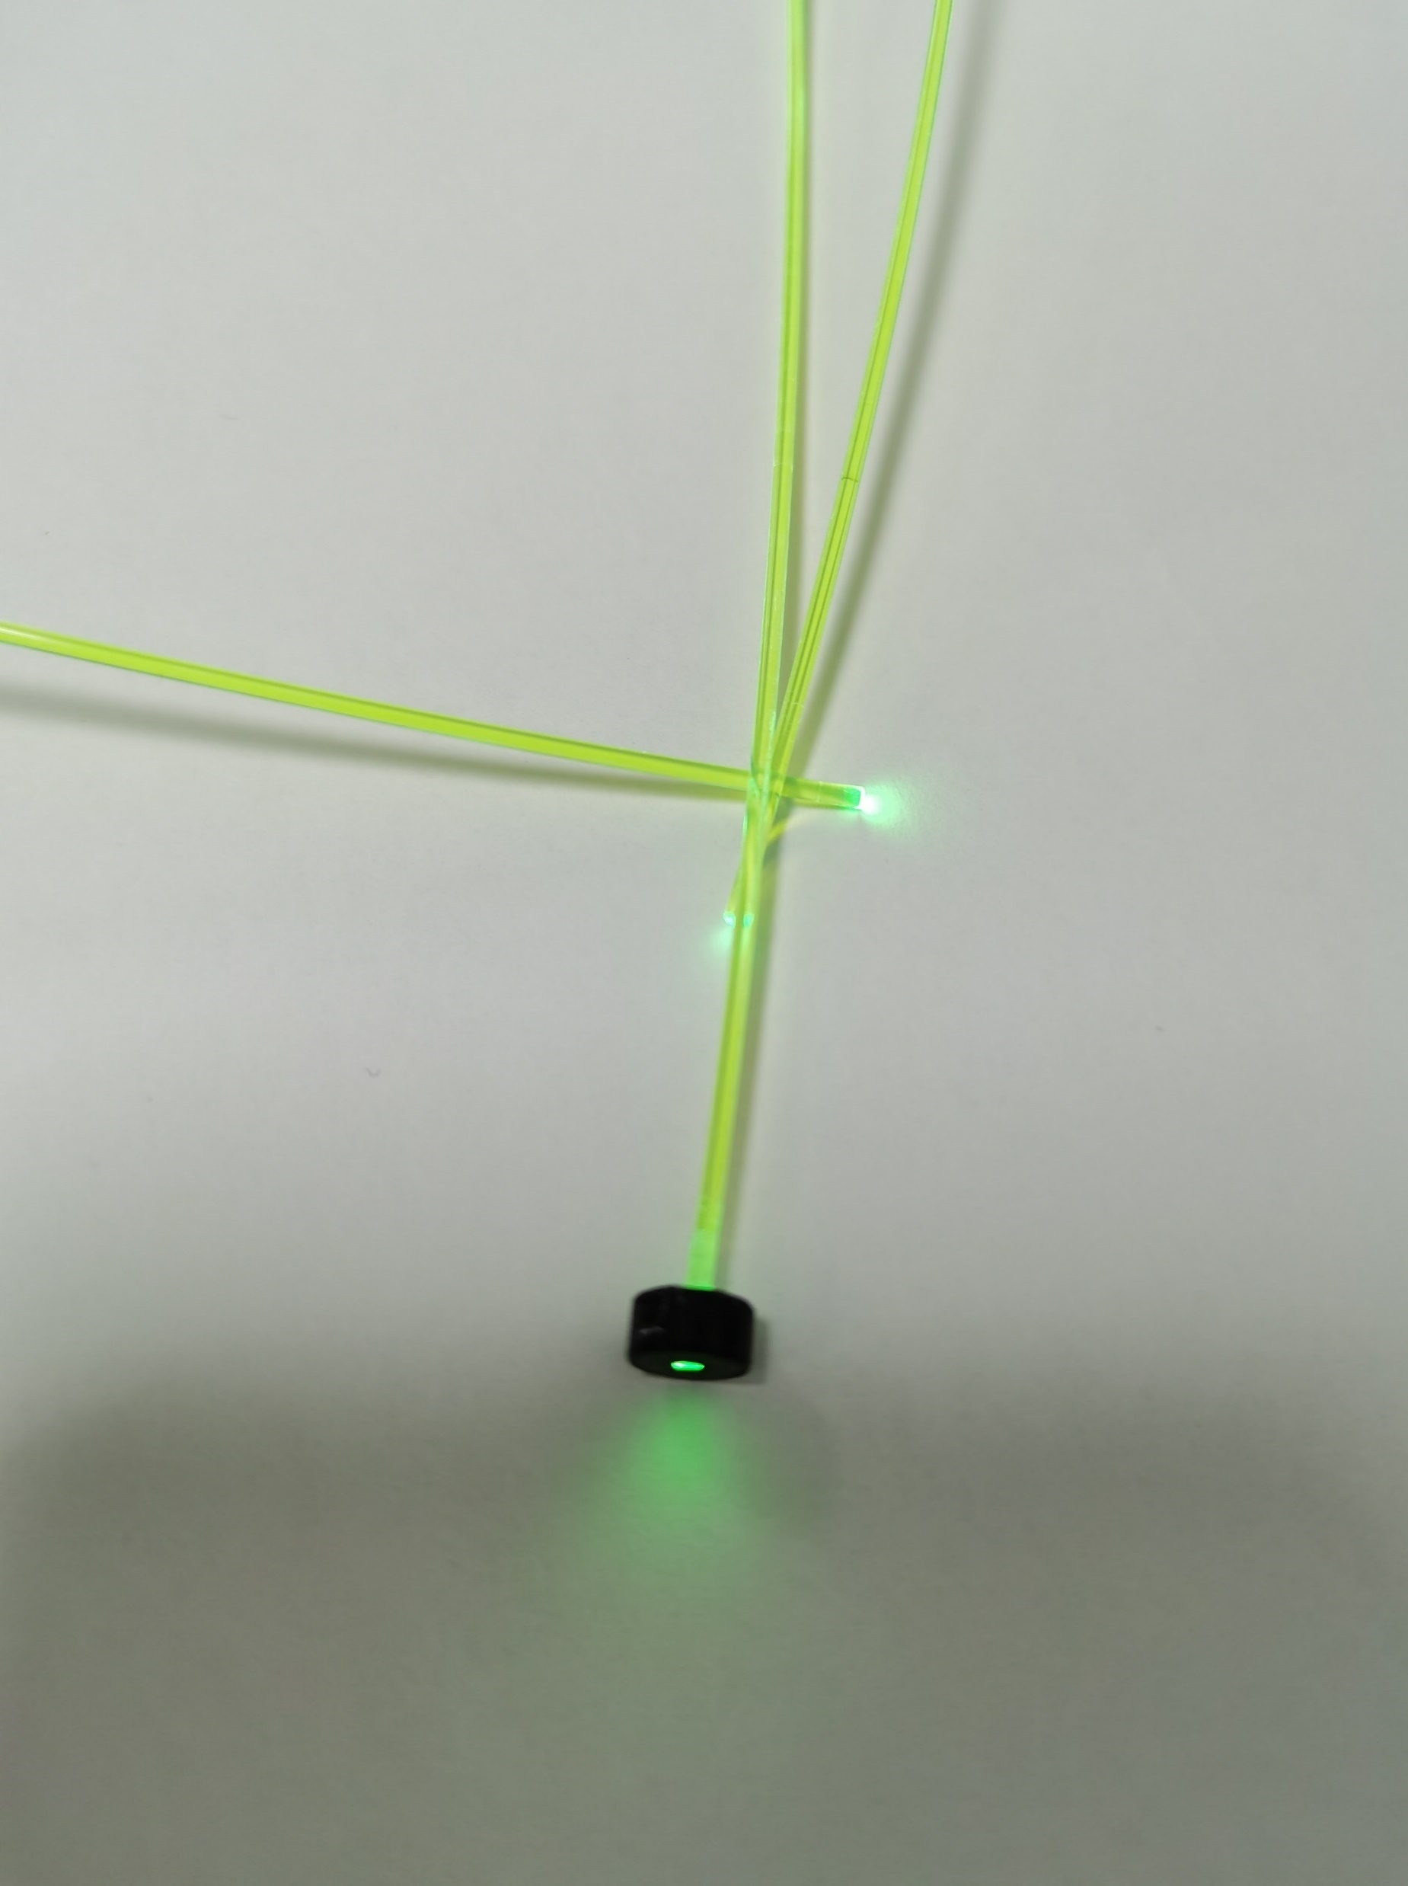
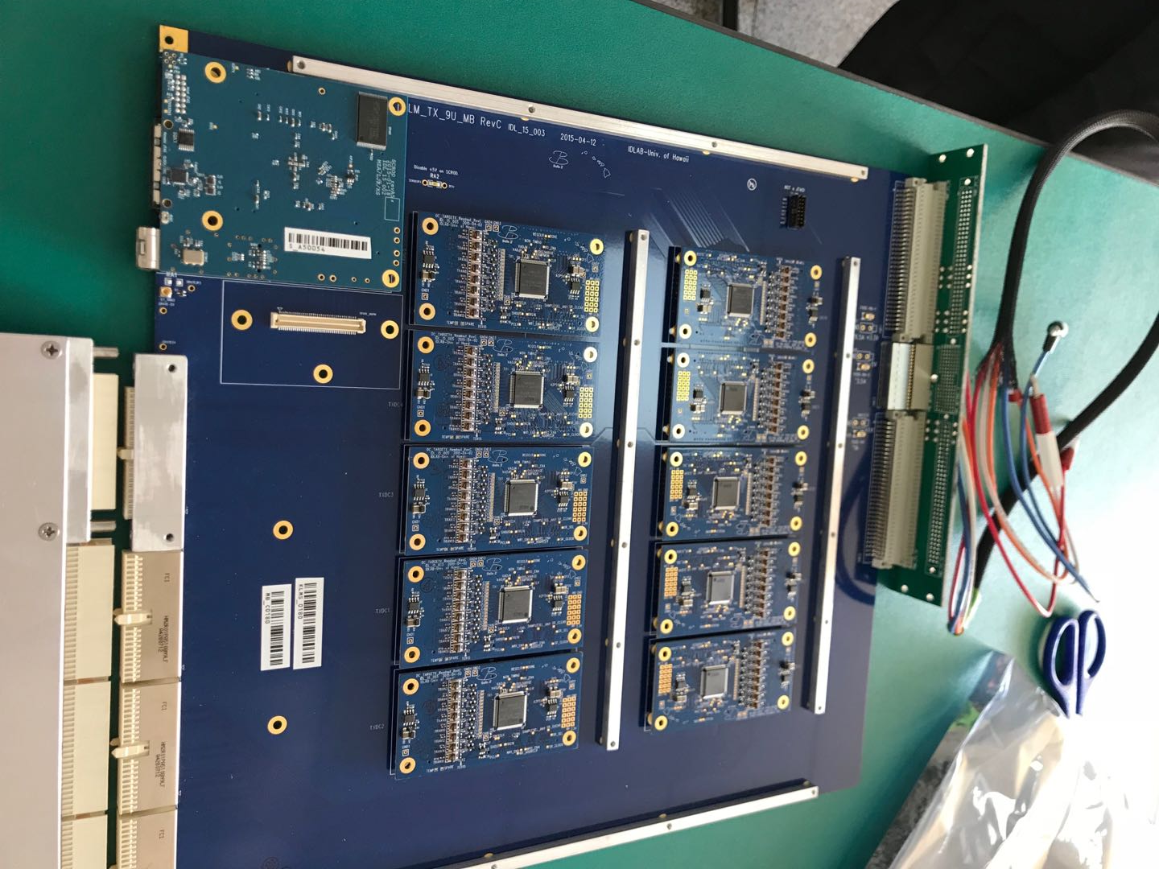
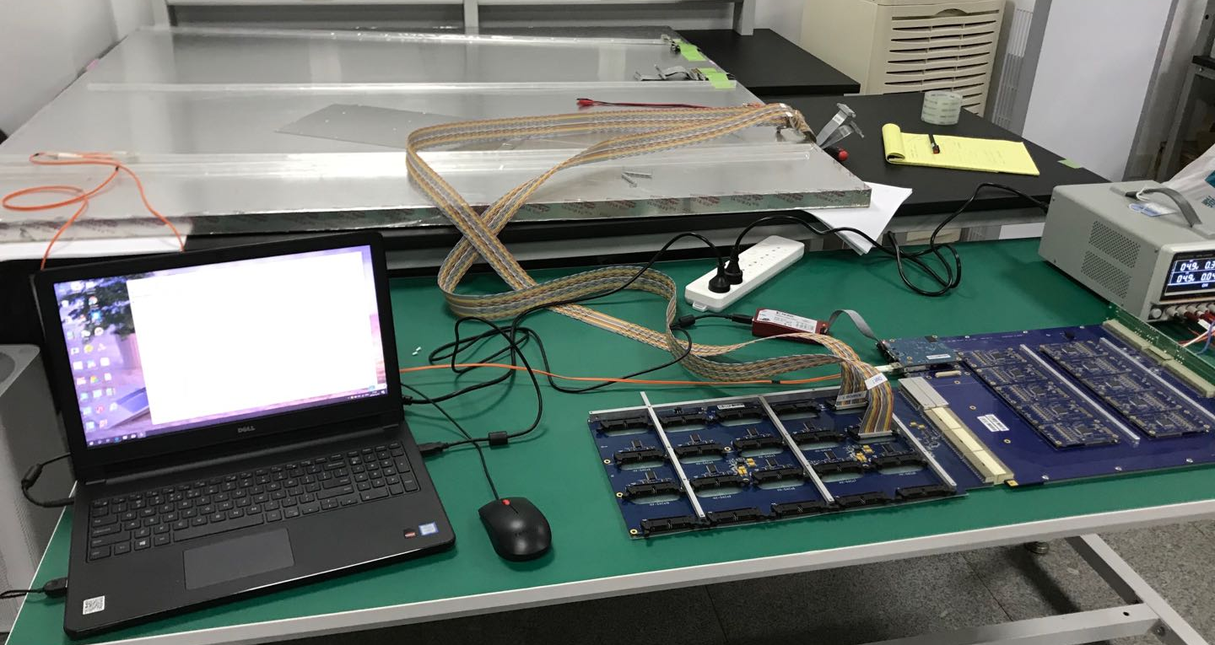
Plan of R&D in the near future
Build layers of prototype modules, like Belle II KLM, and carry out CR tests.
R&D on the readout motherboard: USST+Fudan, ongoing
R&D on new SiPM based on LGAD: IHEP+Fudan, ongoing
Improve the design of scintillator strip: GNKD+Fudan, good status
R&D on new WLS fiber: GNKD+Fudan? Will do.
Improve the G4 simulation.
Kuraray WLS fiber
FPGA
KLM spare module
Readout motherboard
KLM Readout
10 TargetX

Slide 3
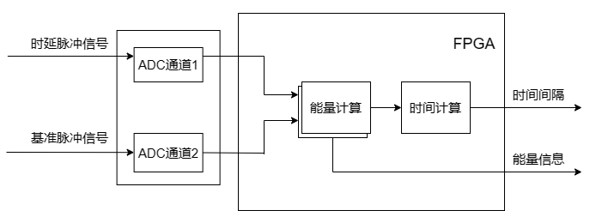
核脉冲信号能量测量与时间测量
1. 研制10-100MS/s、多通道、高精度ADC采集卡
·使用相对低采样率的ADC实现高精度能量测量和时间测量
·ADC的采样率可调，10-100 MS/s

Slide 4
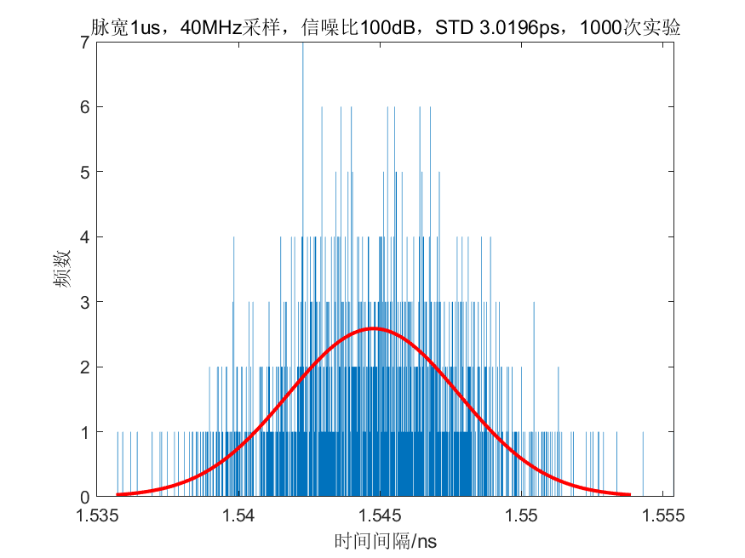
核脉冲信号能量测量与时间测量
2. 研究FPGA的硬件算法，实现高精度能量测量与时间测量
·使用matlab进行仿真，两个核脉冲脉宽为1us，信噪比100dB
·以40MHz采样率的ADC为例，进行1000次实验，得到时间间隔高斯分布图
·1000次实验所得时间间隔std为3.0196ps
·ADC采集的数据进行积分可得能量信息

Slide 5
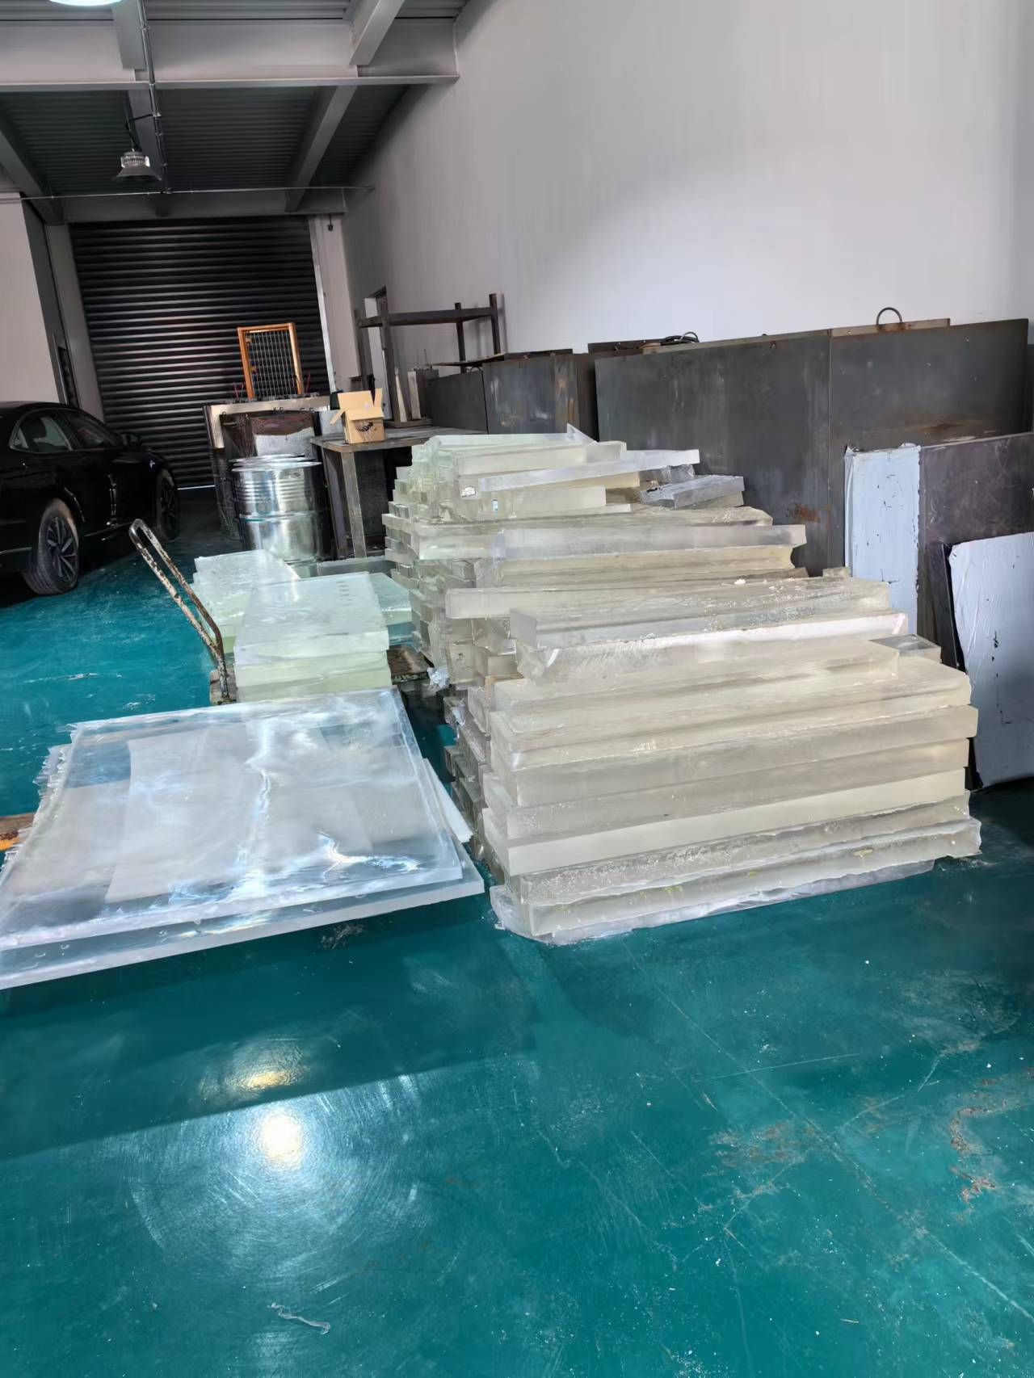
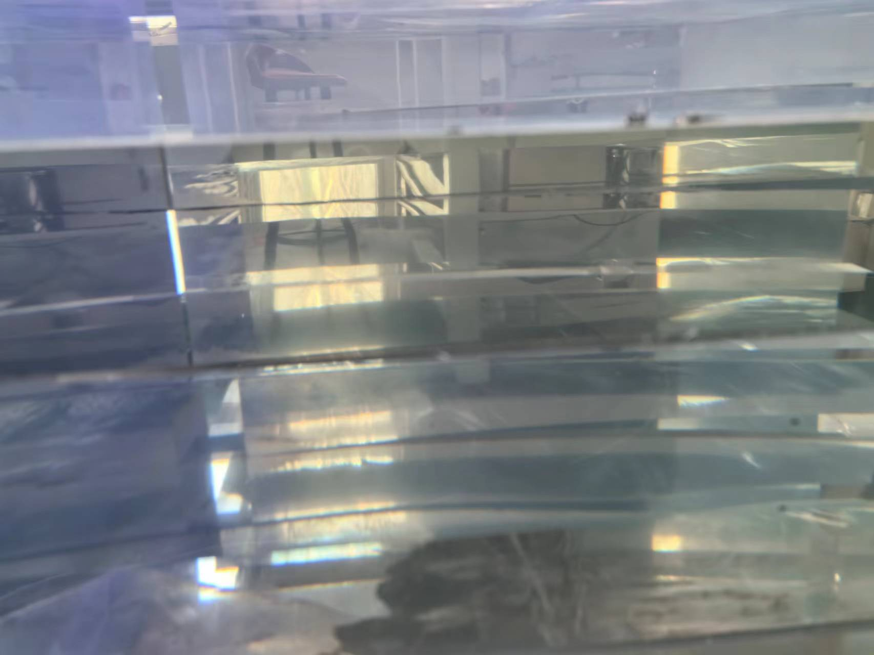
国产塑闪

