Slide 1
Vertex detector toward TDR
Zhijun Liang (IHEP)
梁志均 （中国科学院高能物理研究所）

Slide 2
Vertex detector Towards TDR study
Major change from CDR to TDR
Beam pipe diameter: 28mm (CDR) → 20mm (TDR) (reduce 30%)
Instant Luminosity per IP:
Z pole: 32×10³⁴ cm⁻²s⁻¹ (CDR) → 192 ×10³⁴ cm⁻²s⁻¹ (TDR, 50MW) (6 times increase)
ZH: 5.6×10³⁴ cm⁻²s⁻¹ (CDR) → 8.3 ×10³⁴ cm⁻²s⁻¹ (TDR) (~1.5 times increase)
Action item
Need to consider Higgs/Z pole/ WW/ ttbar run
Accelerator can switch operation mode in a short time scale
Connection to Physics→ Optimize the geometry, physics case
First vertex layer: Radius=12mm (TDR candidate) or Radius =16mm (CDR design) ?
Connection to MDI →
Estimate the hit rate from background, Fluence and total ionization dose estimation
Mechanical and cooling solution
Connection to DAQ and electronics → Data Rate in Higgs/Z pole/ WW/ ttbar
Work together to select Technology based on all aspects

Slide 3
List of key parameter
Material budget
Data rate
Cost
技术成熟度
Position resolution(现在，预期5-7年后）
Time stamp precision → offline ,physics, DAQ
功耗 (现在，预期5年后）
Radiation （补充实验）
工艺稳定性, technology availability in future
外单位合作

Slide 4
Timeline
2024年2月底，技术方案定型
→software 数字化模型:cluster size，efficiency, time stamp，Material budget
2024年2月底， MDI 最终background estimation
2024年3月底，几何结构定型

Slide 5
Backup

Slide 6
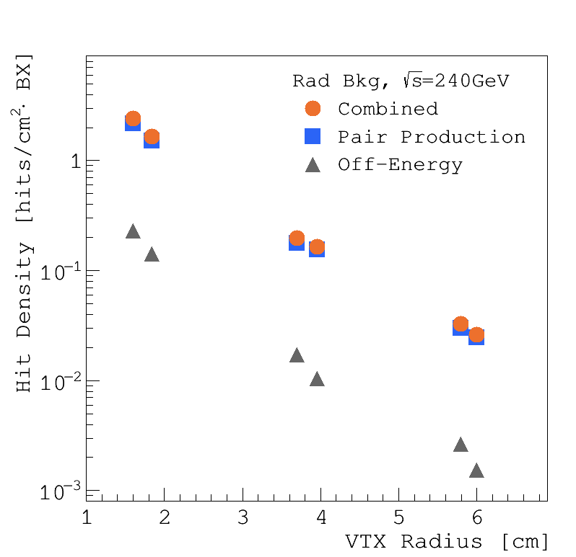
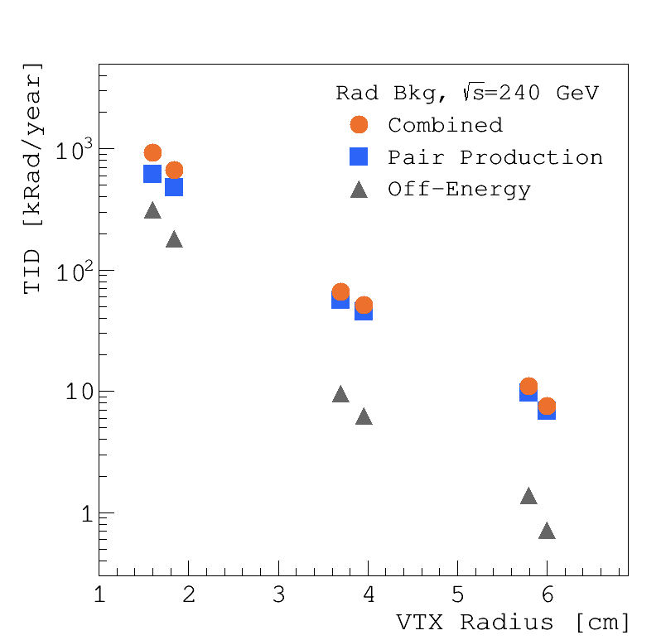
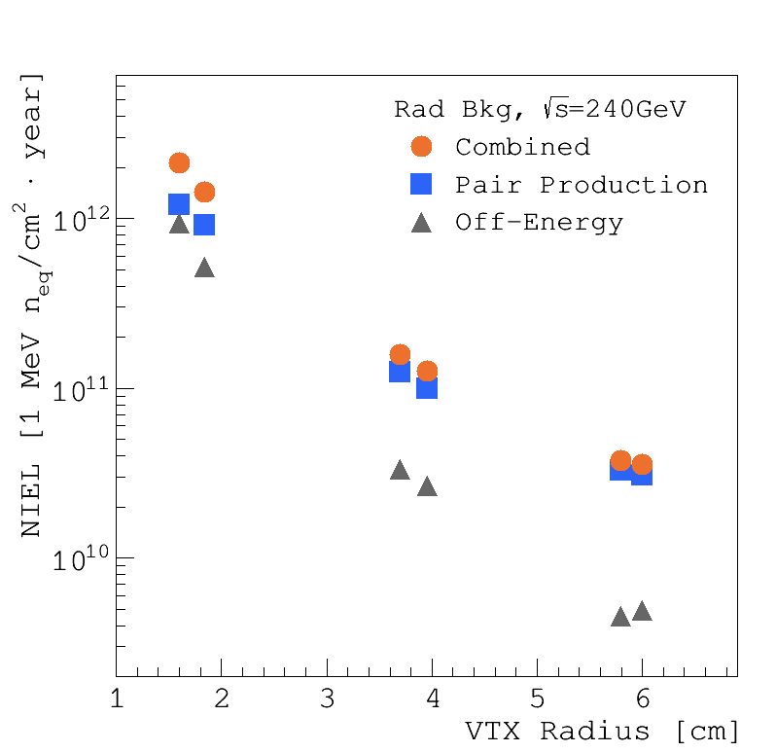
Hit rate and radiation from background (input for vertex)
Waiting for the update on background estimation (Haoyu)
First guess of background based on input (Haoyu)
Instant Luminosity increase → radiation hardness requirement increased, tiny impact on hit density
Beam pipe diameter: 28mm → 20mm : Expect 3-5 times larger hit density and radiation
Hit density per crossing (CDR)
Total ionization dose (CDR)
Fluence (CDR)

Slide 7
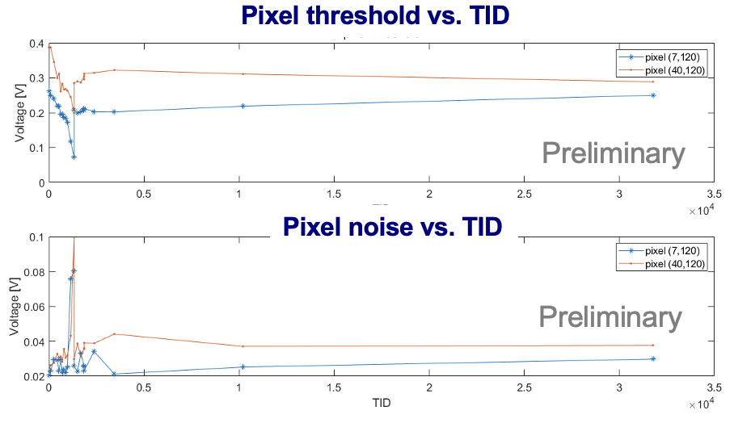
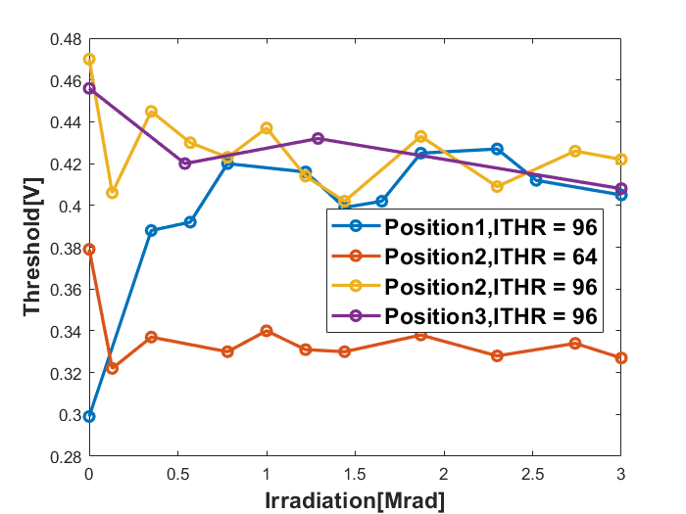
Radiation hardness (Total ionization dose)
First guess on Radiation requirement (need final input from Haoyu):
Taichupix2 was irradiated in-situ tested up to 30 Mrad
Based on LHC experience, chip have potential to survive serval hundred Mrad
Initial input on TID | First layer radius=16mm (CDR vertex design) | First layer radius=12mm (TDR design candidate)
ZH (240GeV) 8 year | ~1 Mrad/year | 3-5 Mrad/year
Z pole (91GeV) 2 year | ~60 Mrad/year | 200-300 Mrad/year
Taichupix2 irradiation test
Taichupix3 irradiation test
Pixel threshold vs. TID

Slide 8
Hit rate and radiation from background (input for vertex)
Waiting for the update on background estimation (Haoyu)
First guess of background based on input (Haoyu)
Instant Luminosity increase → radiation hardness requirement increased, tiny impact on hit density
Beam pipe diameter: 28mm → 20mm : Expect 3-5 times larger hit density and radiation
Hit rate and radiation from Background (CDR study, from Haoyu)

Slide 9
Radiation hardness (Total ionization dose)
First guess on Radiation requirement (need final input from Haoyu):
Taichupix2 was irradiated in-situ tested up to 30 Mrad
Based on LHC experience, chip have potential to survive serval hundred Mrad
Initial input on TID | First layer radius=16mm (CDR vertex design) | First layer radius=12mm (TDR design candidate)
ZH (240GeV) 8 year | ~1 Mrad/year | 3-5 Mrad/year
Z pole (91GeV) 2 year | ~60 Mrad/year | 200-300 Mrad/year
Taichupix2 irradiation test
Taichupix3 irradiation test
Pixel threshold vs. TID

Slide 10
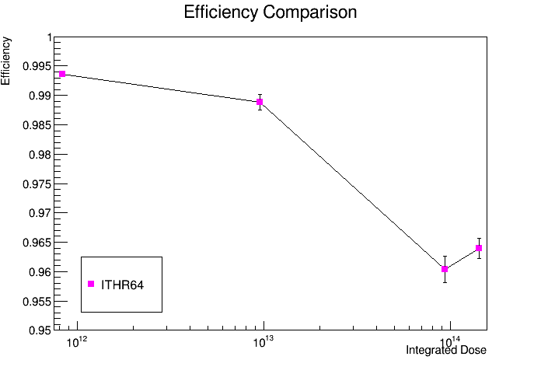
Radiation hardness (neutron Fluence)
First guess on Radiation requirement (need final input from Haoyu):
CDR requirement: ~2*𝟏𝟎^{𝟏3}𝒏_{𝒆𝒒}⋅ 𝒄𝒎-𝟐 ⋅ 𝒚𝒓
TDR requirement: 1-6 *𝟏𝟎^{𝟏4}𝒏_{𝒆𝒒}⋅ 𝒄𝒎-𝟐 ⋅ 𝒚𝒓 (depending on radius)
Whether CEPC MAPS sensor can survive 𝟏𝟎^{𝟏4}𝒏_{𝒆𝒒}⋅ 𝒄𝒎-𝟐 ?
neutron fluence 𝒏_{𝒆𝒒} 𝟏𝟎^{𝟏𝟐} ⋅ 𝒄𝒎-𝟐 ⋅ 𝒚𝒓 | First layer radius=16mm (CDR vertex design) | First layer radius=12mm (TDR design candidate)
ZH (240GeV) | 3 | 9-15
Z pole (91GeV) | 120 | 360-600
Radiation of Taichu @ CSNS ( up to 1.5*𝟏𝟎^{𝟏4}𝒏_{𝒆𝒒} )
DUT is irradiated TaichuPix with modified process
Preliminary result (by Yiming)
Efficiency >99% @ 𝟏𝟎^{𝟏3}𝒏_{𝒆𝒒}
Efficiency >95% @ 1.5* 𝟏𝟎^{𝟏4}𝒏_{𝒆𝒒}

Slide 11
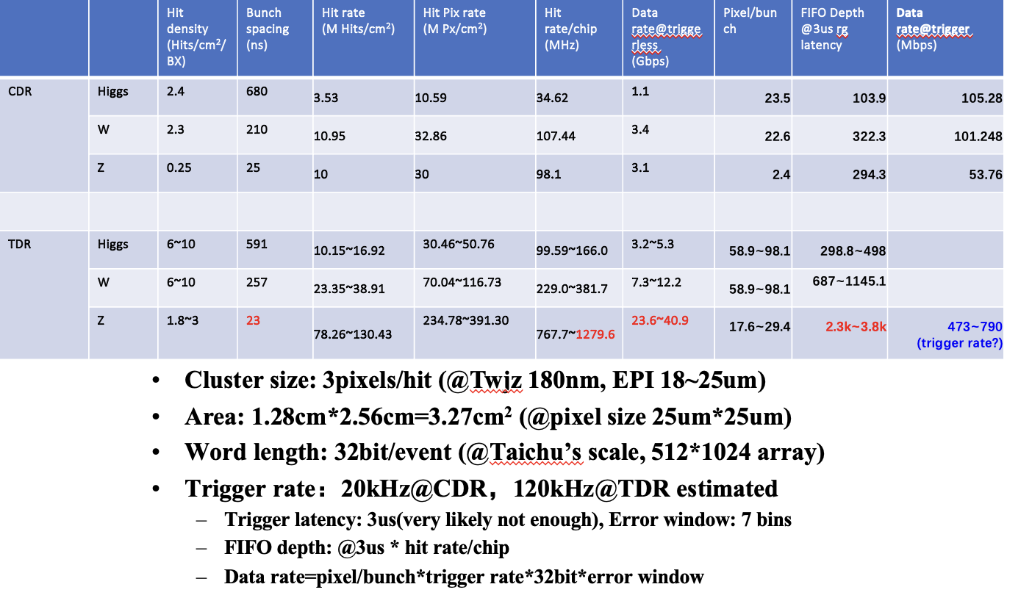
Hit density
First guess on Radiation requirement (need final input from Haoyu):
CDR : ~2 hits cm⁻² BX ⁻¹
TDR requirement: 2~10 hits cm⁻² BX ⁻¹(depending on radius)

Slide 12
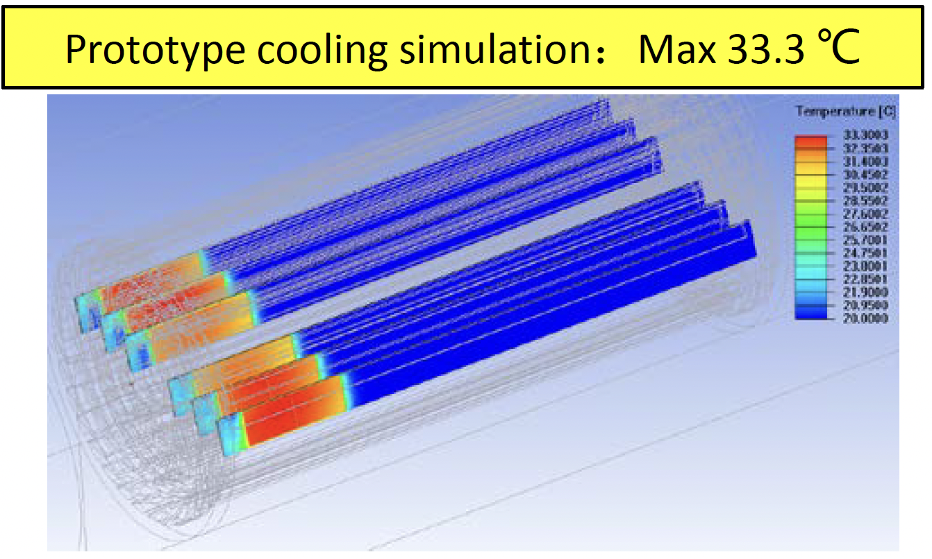
Summary： Action item
Based on initial input of background, compare advantage and disadvantage of different layout
First layer radius 12mm Vs 16mm
Still waiting for final input of background from MDI group (Haoyu)
Revisit vertex time resolution and occupancy, spatial resolution requirement
Roadmap for R & D (Taichu –like/ Jadepix –like architecture)
Finalize the readout architecture design ( need to consider trigger design)
Integration vertex design with beam pipe in MDI region
For Cooling design and support structure, Cabling, and frontend boards location

