Slide 1
Electronics Plan for CEPC Ref-TDR
Wei Wei
2024-02-01

Slide 2
内容
CEPC TDR整体情况
各子系统现状概述
电子学
顶点探测器
Pixel(Jadepix/Taichu)，SOI，Stitching
Tracker
Silicon(HVCMOS), LGAD TOF, TPC, Drift Chamber
Cal
Muon
LumiCal
通用模块（data link，power，clock）
整体架构
TDAQ
近期工作
例会形式、组织方式
讨论
汇总urgent问题和接口需求

Slide 3
人员结构

Slide 4
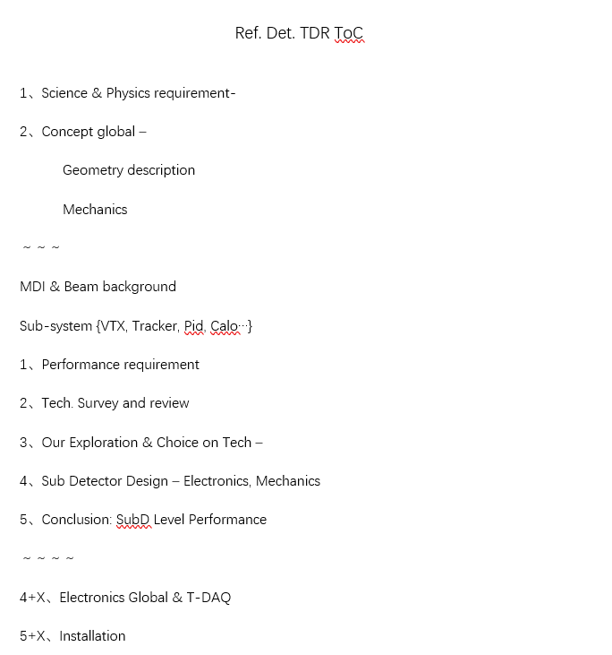
Ref-TDR初步任务（暂定内容）

Slide 5
近期工作Proposal
我们的TDR整体任务
确定各子系统可行性方案（有R&D结果更佳）
部分需基于关键R&D结果的结论，尽快开展（如是否采用无线传输、机器学习……）
第一步，明确各子系统接口，优先明确以下：
数据量和物理目标、本底vs事例，理顺数据链和系统结构，使TDAQ可以开展工作：
数据链条：探测器→前端→后端→TDAQ
对前端信号处理的要求，开始考虑前端、后端方案
信号链条：探测器→前端→后端
近期需尽快同各对应子探测器系统开展相关讨论，避免独立设计
已有R&D工作，需结合加速器更新后的TDR指标重新审视方案
开始整体方案的考虑和调研
统一风格的数据传输方案可行性
前端芯片传输协议
后端-TDAQ传输方案
王所特别布置：应该考虑无线传输方案，可仅部分采用
统一风格的电源方案可行性
前端抗辐照电源供电、后端电源方案
探测器整体地网络需求
功耗、散热及冷却需求
时钟与同步

Slide 6
近期工作Proposal-续
第二步，在对各子探测器需求有一定了解的基础上，初步明确触发方案及电子学接口
初步的message：仅讨论如何触发，在哪里触发，不再采用任何triggerless的误导性说法
各探测器系统触发的实现方案
前端芯片缓存+触发 vs 后端FPGA+板载RAM+触发 vs TDAQ缓存+触发……
判断依据：各方案触发性能+成本+元器件可行性
FPGA+机器学习方案可行性
触发系统探测器数据汇总后的全局触发方案
需要结合各探测器物理模拟结果
王所部署：部分触发工作可能需要借助电子学力量实现
第二步（并行），结合电子学、触发的可行性，在短期内协助完成探测器多并行方案的down select
预计时间：3~4月前——我们的第一个关键时间节点
接下来：以收敛后的探测器系统，开始细化电子学、触发方案
后续再讨论
逐渐汇总通用模块需求

Slide 7
TDR任务流图（待凝练成CPM计划）
顶点探测器
顶点R&D1
阶段2
协助各子系统方案收敛
明确电子学TDAQ具体设计参数
阶段3
电子学前端接口明确，开展前端方案制定
TDAQ形成整体触发策略和方案
阶段1
明确电子学+TDAQ整体需求
顶点R&D2
Tracker
TrackerR&D1
CAL
TrackerR&D2
Muon
……
LumiCal
2024.02~03
2024.03~04
阶段4
明确电子学、TDAQ的全部接口参数
各子探测器触发方案、缓存方案
Elec-TDAQ传输方案
时钟方案
阶段5
经物理仿真、迭代，确认方案可行性
形成TDR文字初稿
阶段5
电子学形成各子探测器完整初步方案
电子学初步形成整体架构设计
明确通用模块需求，部署后续关键R&D
TDAQ形成完整初步方案
TDR初稿：2024.12
TDR发布：2025.06

Slide 8
Outline
Organization & architecture of electronics
Questions to answer
Manpower requirement vs. scenario
Preliminary organization of the group

Slide 9
Consideration of the CEPC electronics system
electronics system
Q: (except Front ASIC) can we make the electronics system in a unified style?
Q: what is the border between detector/FEE, FEE/data interface, frontend/backend, electronics/trigger, …?

Slide 10
Questions to be answered for TDR
Sub-detector requirements
physics requirement (measurement target & parameters)
signal processing (channels, event rate, signal characteristics…)
overall system (interface, power, cooling, clocking, budget…)
Overall scheme of electronics
FEE readout to BEE for sub-det
Data link, cabling
Global consideration of BEE
On data : buffering, clocking, transmission …
Algorithm for data compression, frontend trigger, machine learning…
Interface with other systems
To Trigger: data rate, link, trigger/triggerless
Slow control
Powering & cooling
Mechanics & material budget
See backup slides for more details
CEPC requirement on electronics (@CEPC Workshop, Nanjing)

Slide 11
key target: from R&D goals to engineering goals
Vertex detector CDR vs. TDR
@TaichuPix
There might be a significant change to the design according to TDR’s parameter
Some R&D parameter in small scale may not be realistic for large detector

Slide 12
Manpower requirement vs. scenario
Scn1：General overall electronics scheme + sub-det electronics to the spec + limited key R&D in 2024 ( 7 staff + 7 stud)
Global electronics scheme with reasonable feasibility (1.5 Staff )
General system interface: powering, clocking, data link with reasonable feasibility (1 Staff +1 stud)
Sub-det electronics with specification and general readout scheme:
Staff 4.5 : Vertex 1 + Tracker 2.5 (silicon 1 + DC 1 + TPC 0.5@thu) +Cal 1
Mainly on scheme design and feasibility consideration
Other sub-dets elec (Muon+Lumi) are supposed to be fully covered by other univertisities.
Postdoc + stud 4: system evaluation for the main detectors (2) + ASIC test & performance evaluation (2)
Key R&D (2 stud):
Wireless communication & clocking (1)
Advanced algorithm on data compression & on-detector L1 trigger (1)
Scn2: General overall electronics scheme + sub-det electronics to the detailed design + general R&D in 3~5 years ( 16 staff + 40 stud)
Global electronics scheme with preliminary proved feasibility (3 Staff + 2 stud)
General system interface: powering, clocking, data link with proved feasibility & evaluation (3 Staff +2 stud)
Sub-det electronics with detailed electronics design :
Staff 10 : Vertex 2 + Tracker 6 (silicon 2.5 + DC 2 + TPC 1.5@thu) +Cal 2
Other sub-dets elec (Muon+Lumi) are supposed to be fully covered by other univertisities.
Including ASIC R&D + backend readout electronics R&D
Postdoc + stud 8: system evaluation for the main dets (2) + ASIC design, test & performance evaluation (3) + backend electronics design (3)
Main R&D (12 postdoc + stud):
Wireless communication & clocking (2)
Advanced algorithm on data compression & on-detector L1 trigger (4)
Radiation effect test & study(2)
Advanced powering & cooling (2)
Generic backend electronics hardware development (2)
Current available: 5.5 staff + 1.5 stud + 0 postdoc

Slide 13
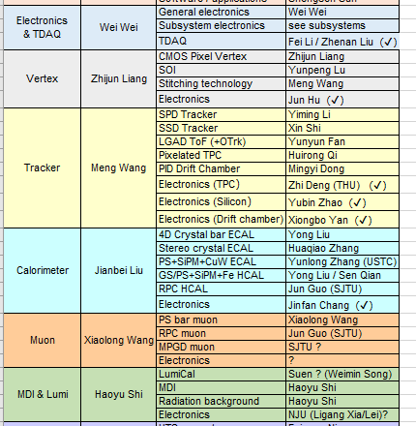
Preliminary organization of the Elec-TDR group
A dedicated colleague for each sub-det
For some parallel schemes, also followed by a dedicated colleague for each scheme
Expected a convergence of detector plans in a limited time
Especially for the Tracker & CAL
Needs help from external collaborators
Thanks Z. Deng @THU for TPC
Muon & Lumi are expected to be covered by the external collaborators
Will organize regular meetings after the plenary TDR meeting

Slide 14
BACKUP

Slide 15
The main goal of this discussion
Collect requirements from related detectors on electronics
Vertex, Tracker, TPC, Drift Chamber, CAL, LGADTOF, LumiCal…
Common question template on requirement
On physics requirement
Detector target
Parameters that measures (T, E, dE/dx, dN/dx, …)
On signal processing
Detector channels for electronics
Counting rate
Signal characteristics (Q, I, V, rising/falling edge, width…)
Dynamic rage
Requirement on measurement (linearity, accuracy…)
On overall system
Detector interface (cabling, socket, detector impedance …)
Power budget & material budget
Working conditions (temperature, cooling, special mechanics…)
…

Slide 16
Data link from FEE to backend
 | Vertex | Tracker | TPC | DC | CAL | TOF | LumiCal
Data rate per chip | 160Mbps @trigger / 4Gbps @triggerless | 1.28Gbps@triggerless | - | - | - | 6.4* 10⁻³ bit/event/chip | -
Data rate per module | 3.2Gbps@Trigger / 80Gbps@Triggerless | O(Gbps)@ module O(10Gbps)@ structure | - | - | - | - | -
Overall data rate | 205Gbps@Trigger / 5.12Tbps@Triggerless | ~40Tbps | 110Gbps | 800Gbps@Trigger / 6.4Tbps @triggerless | 93Gbps + 72Gbps |  | 33.6Gbps
Q: high speed serial link needed inside FE chips?
maybe yes for vertex & tracker, especially for triggerless mode
Q: data aggregation chip needed at the module/structure level?
maybe yes for vertex & tracker
Q: possible to follow a common protocol & interface for data link?
Interface designs may vary due to the CMOS process, protocol can be unified
Cabling? Optical? Or even wireless?
Has to be rad-tol

Slide 17
From FEE to BEE
Dedicated algorithm in FPGA may have to vary from detectors
Related to triggering, data compression, machine learning
Data aggregation for different AFE, if it is done in FPGA
Rest are possible to be designed in a unified style
Clock synchronization & distribution
Data buffering
Data packaging and transmission to DAQ
Powering
Slow control
Issue: most has an interface with other system (TRG, DAQ, Mechanics …), not well defined yet
Q: major challenges exist with huge data rate, especially triggerless
Very likely, new methodology has to be involved, yet no R&D
Q: do we need special algorithm for new physics approach, like PFA?
Needs input from physics simulation
Issue: yet not a dedicated BEE system R&D for CEPC

Slide 18
Interface between (Lvl 1) Trigger and Electronics
Common Question: Trigger or Triggerless?
For some sub-detector, data volume really an issue for triggerless
Part of the detectors on trigger, rest triggerless?
Smart & local track/cluster finding to compress data? While R&D required
Q: who needs TRG input? Who contributes to TRG?
Q: where in electronics, AFE or BEE, to communicate with TRG?
If in ASIC AFE, trigger interface has to be defined asap before finalization
The latency and data buffering is also a critical issue for the chip design
Issue: need a overall consideration on TRG strategy, not only on calculation of the data volume
 | Vertex | Tracker | TPC | DC | CAL | TOF | LumiCal
get TRG | Y | Y | Y | Y | Y | Y | Y
Generate TRG info | N | N | Y | Y | Y | Y | Y
Data volume an issue for triggerless? | Maybe 5.12Tbps | Maybe 40Tbps | - | Maybe 6.4Tbps | - | - | -

Slide 19
Interface with other systems
Clocking
How to synchronize with BX clock?
Multiple bunch spacings: Higgs: 680ns; W: 210ns; Z: 25ns
What clock needed for different detector?
Power management
Overall powering design maybe too early for CEPC
Consideration on AFE powering has to start
Serial powering? Rad-tol powering blocks?
Cooling
Has to be integrated closely with electronics system
Designs greatly depend on the cooling strategy, especially for AFEs
Air cooling or liquid cooling? Or Mixed?
Mechanics
Special mechanic scheme has to be generally defined for the design of AFE
e.g. Vertex on long Flex, ECAL module organization for HG…
Technology vender for low material still an issue
e.g. Aluminum Flex Cable for Vertex not available
Needs input if any special requirements to electronics exist

