Slide 1
Magnetic-field-induced squeezing effect
Long-Gang Pang, et. al， 1602.06176.
G. S. Bali, et. al, 1311.2559.
Notes:
My topic is thermal production of charms and charmonia in quark-gluon plasma. This work is collaborated with Kai Zhou, Carsten Greiner and Pengfei Zhuang.

Slide 2
Important signal
Due to the paramagnetic nature of the QGP at high temperatures, the spatially inhomogeneous magnetic field configuration exerts an anisotropic force density that competes with the pressure gradients resulting from purely geometric effects.
The magnetic squeezing suppresses the momentum anisotropy of the plasma by up to 20% at the LHC energy, and also leaves its imprint on the elliptic flow v2 of charged pions.

Slide 3
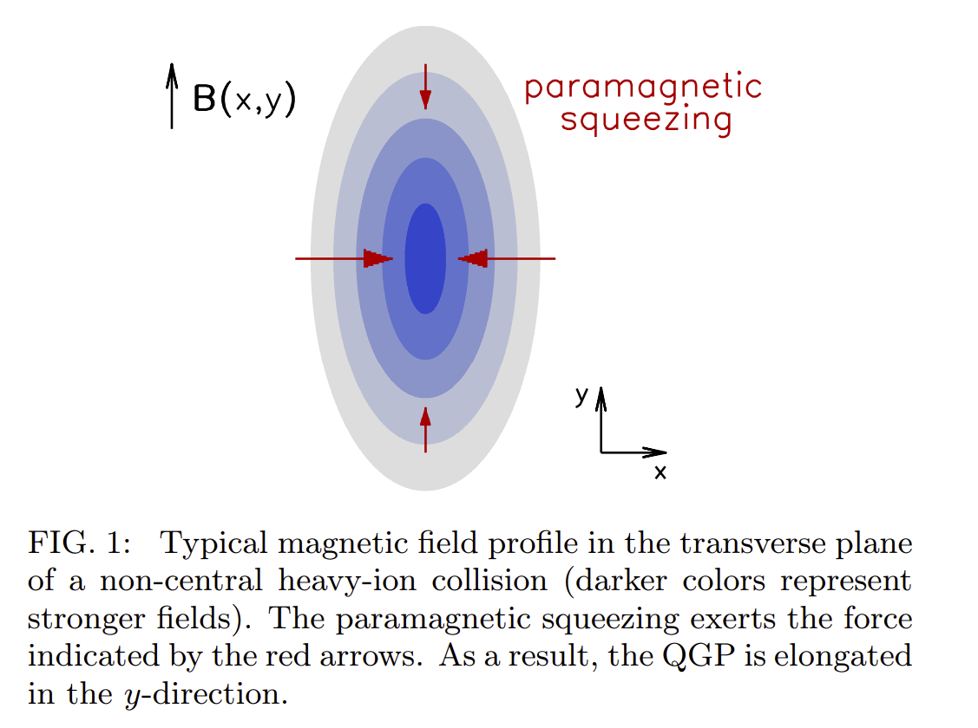
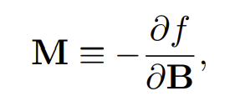
Paramagnetic squeezing
paramagnetic squeezing : the magnetic field configuration exerts an anisotropic force density on the QGP that compresses matter in the transverse plane.

Slide 4
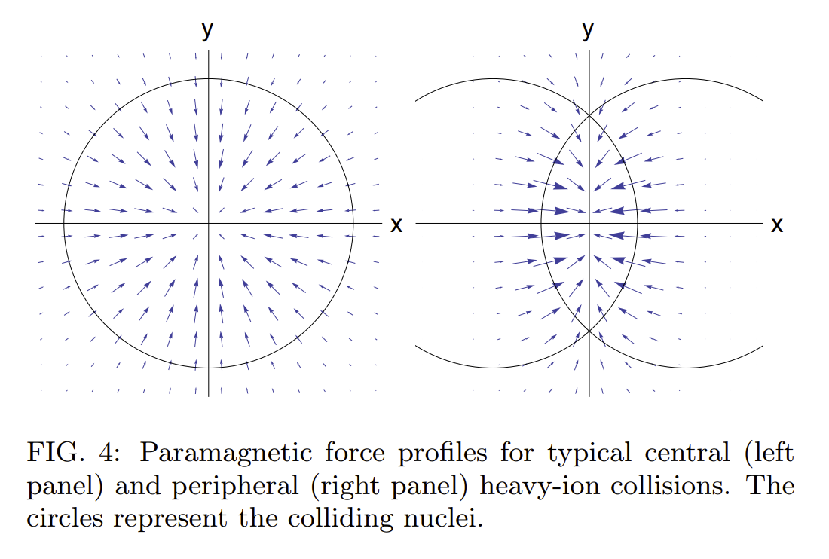
Paramagnetic squeezing

Slide 5
magnetization of QCD

Slide 6
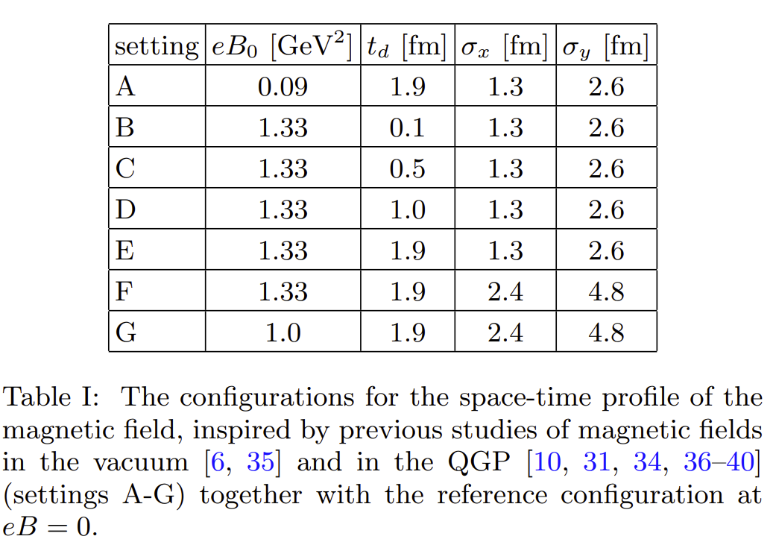
Magnetic field profile

Slide 7
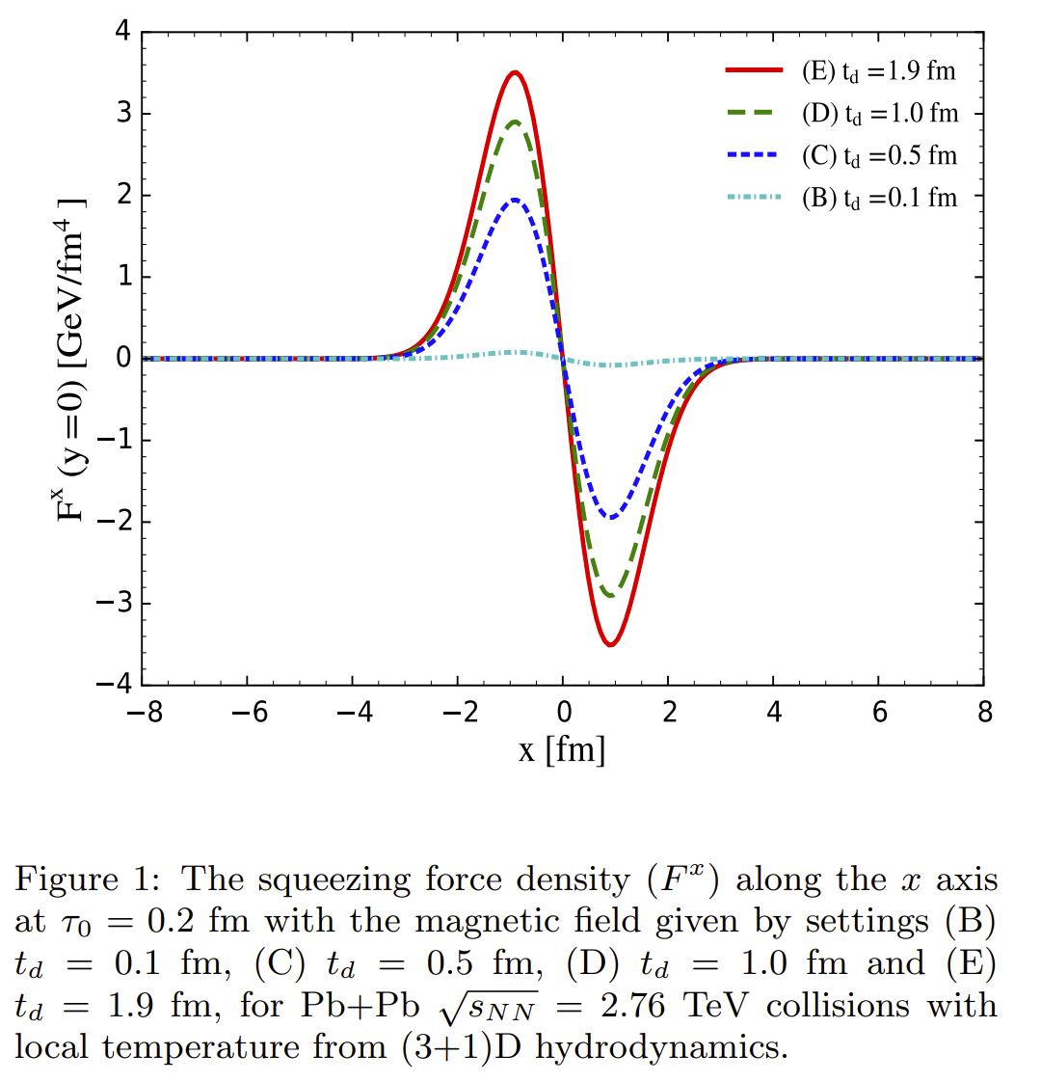
Squeezing force density

Slide 8
Squeezing effect on v2
The hydrodynamic equations in the presence of the squeezing force
In a purely magnetic background

Slide 9
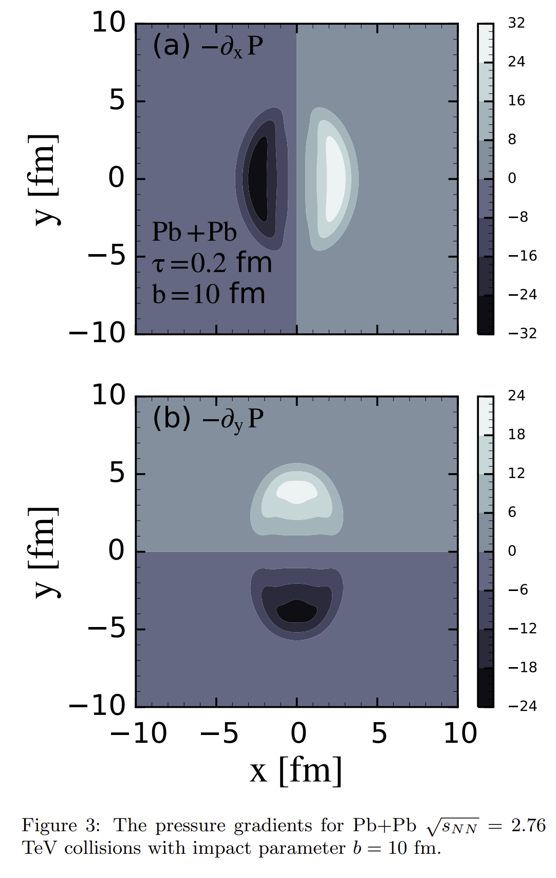
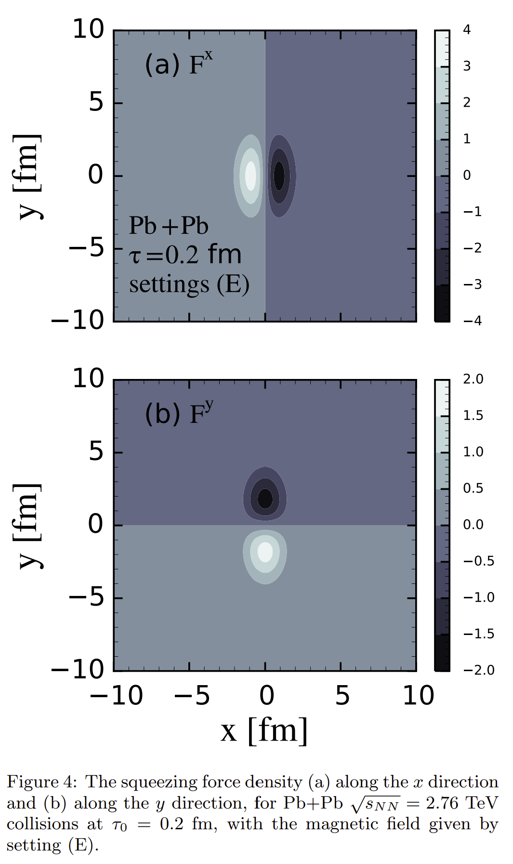
Squeezing effect on v2

Slide 10
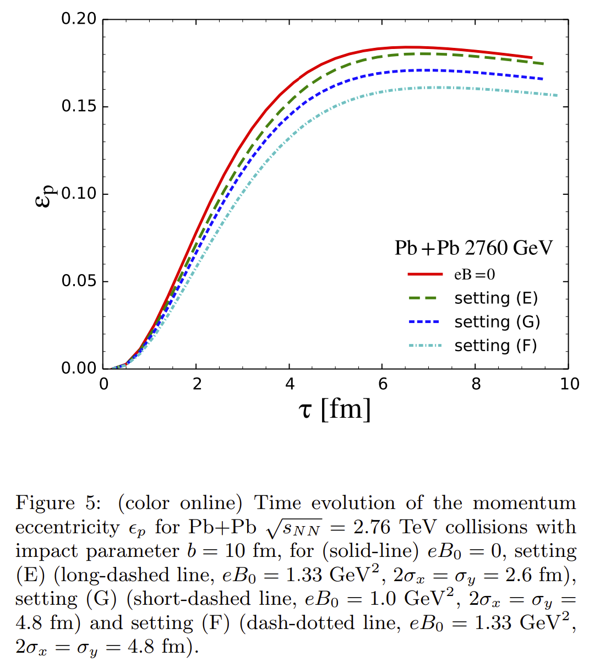
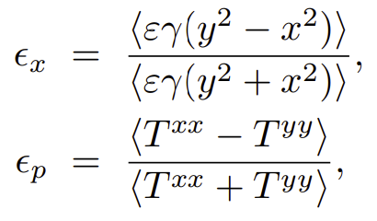
Squeezing effect on v2

Slide 11
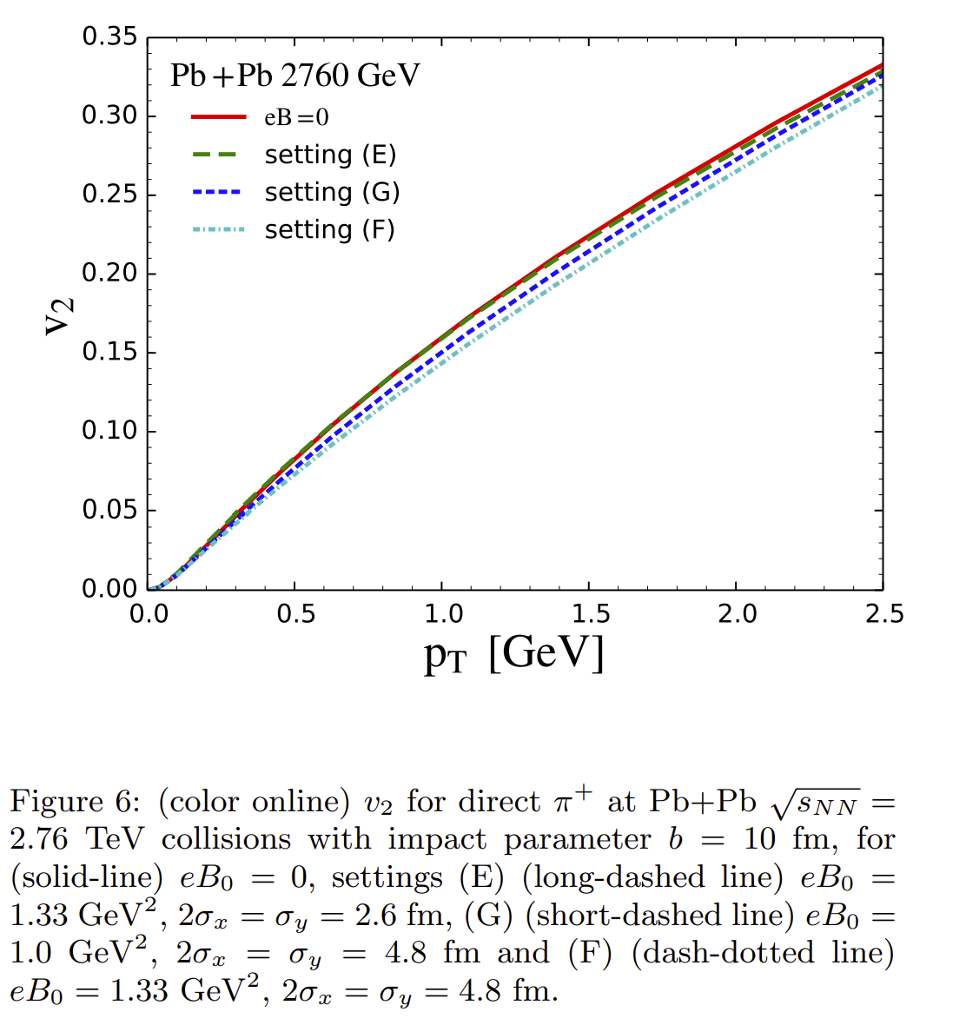
Squeezing effect on v2
The impact on the pT differential anisotropic flow for direct π + emitted from the freezeout hypersurface.

Slide 12
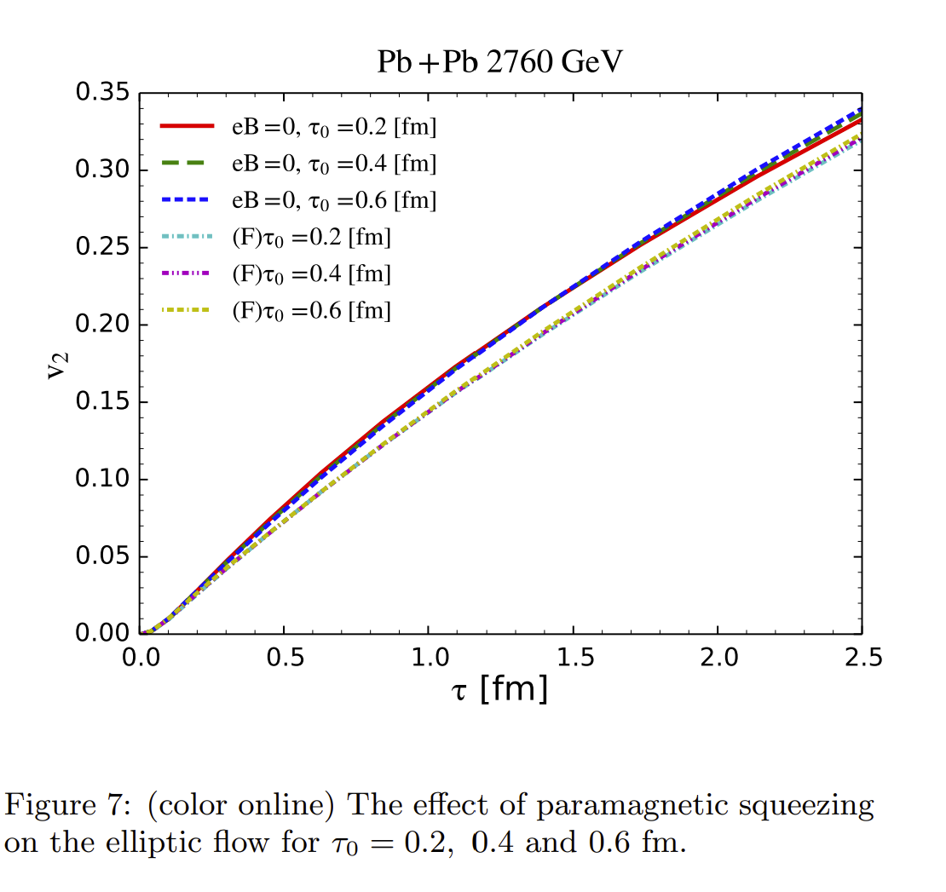
Squeezing effect on v2

Slide 13
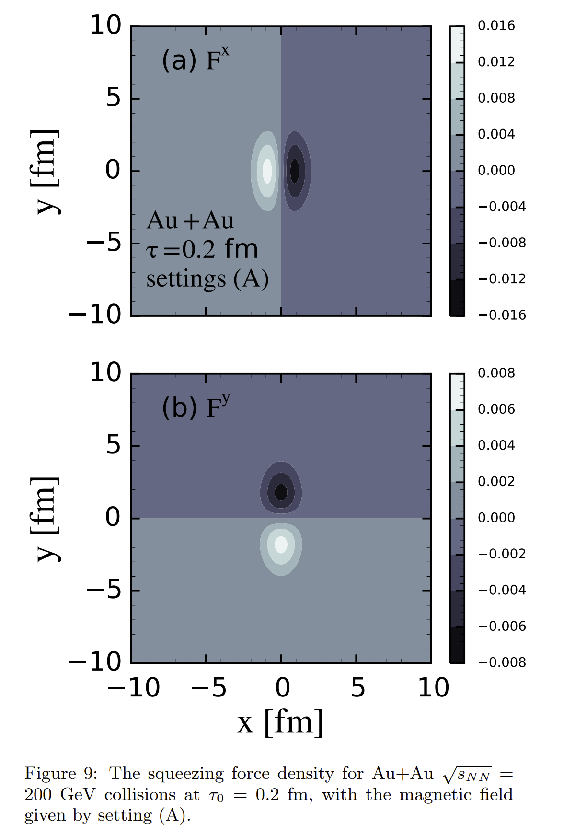
Squeezing effect on v2

Slide 14
New idea
1. We can estimate the squeezing force in low energy collision system with more realistic magnetic field. In the low-energy collision, the magnetic field persists for an extended duration. The effect of magnetic squeezing effect on v2 is more explicit.

Slide 15
New idea
2. We can study the squeezing force effect of dynamical mass on the QGP.
$$\vec{F}=−∇_{x}E_{p}=−{[∇}_{x}m(x)]\frac{m(x)}{E_{p}}$$

Slide 16
Thank You!

