Slide 1
Down-select criteria: inputs and considerations
Performance: major driver
Physics benchmarks
Detector level
Cost: major boundary conditions
Estimates: total cost, key components
Technical maturity
A key feature for Technical Design Report: distinguishable from Conceptual Design

Slide 2
Down-select criteria: a first template
Category | Items | Details | Priority | Remarks
Performance | Boson Mass Resolution (BMR) | BMR<4% | A | H/Z/W/top full physics programs
 | Detector | EM/hadronic energy linearity and resolution | A
 |  | Separation Power (only for 2 particles?) |  | Incident angles; particle energy
 |  | $π^{0}$ Resolution | B? | (Mostly) Flavor physics, potentials in jets
Cost | Total Cost Estimates | Key components and crucial uncertainties |  | Availability, lead time and possible risks
Technical Readiness Level | Review of existing prototypes | TRL score: 1-9 |  | TRL will also need separate/dedicated criteria
Priority for performance/detector requirements & specs: (A) must-have; (B) plus; (C) not essential

Slide 3
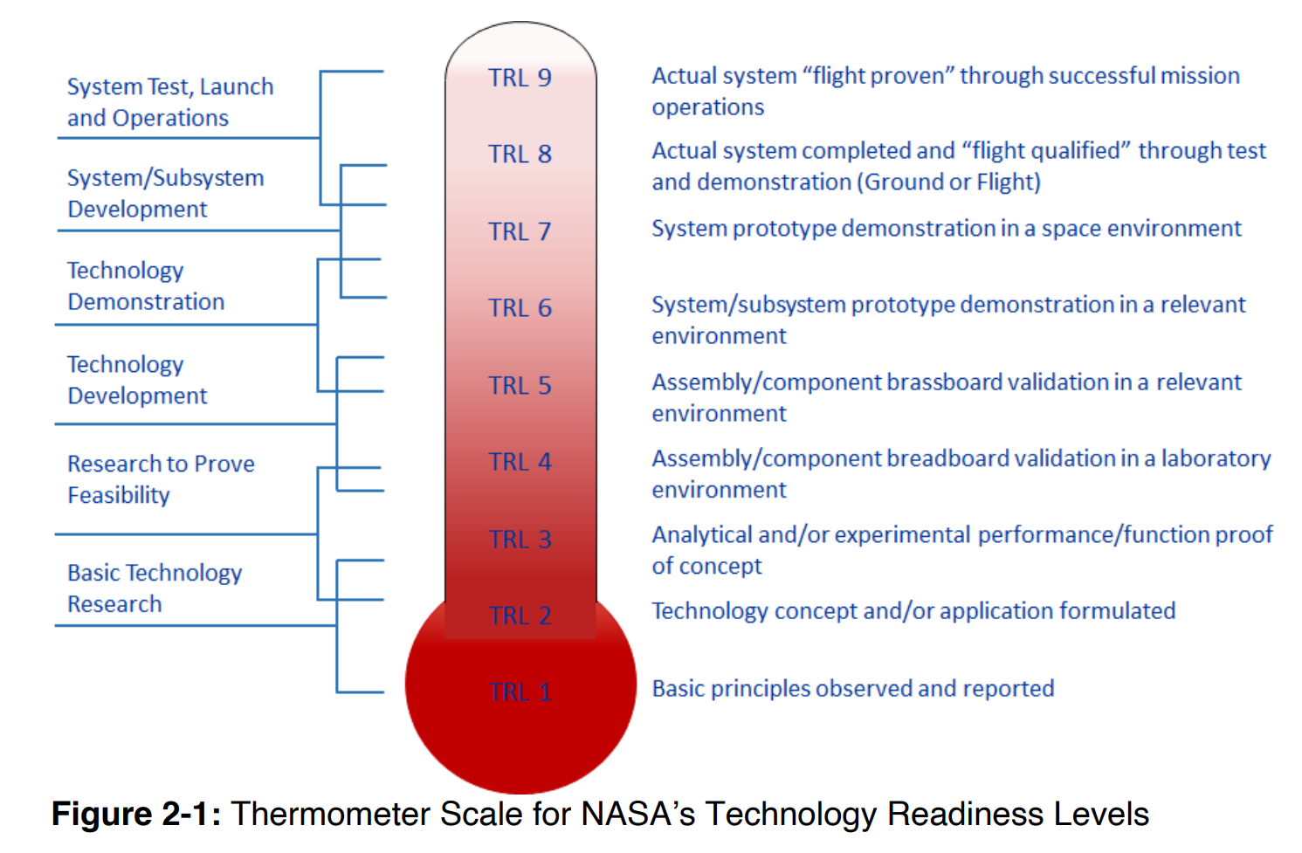
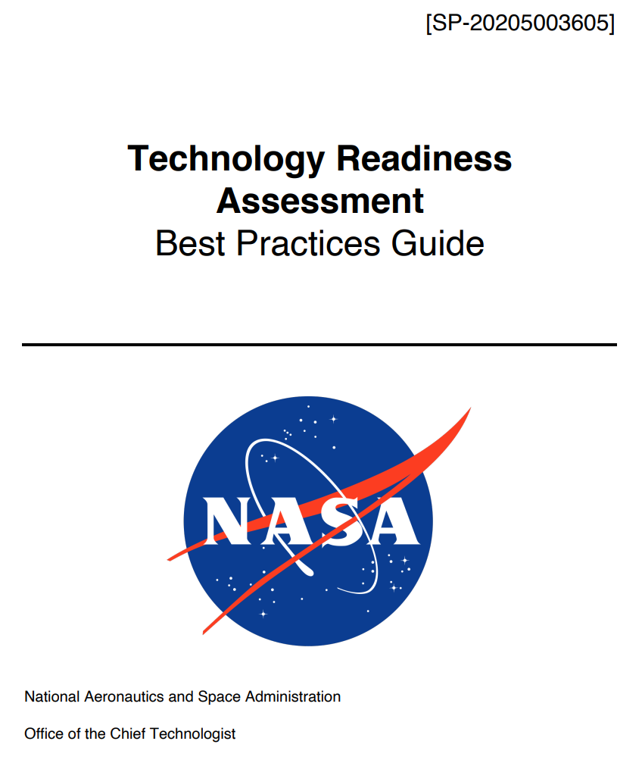
TRL: extra information
https://ntrs.nasa.gov/api/citations/20205003605/downloads/%20SP-20205003605%20TRA%20BP%20Guide%20FINAL.pdf

Slide 4
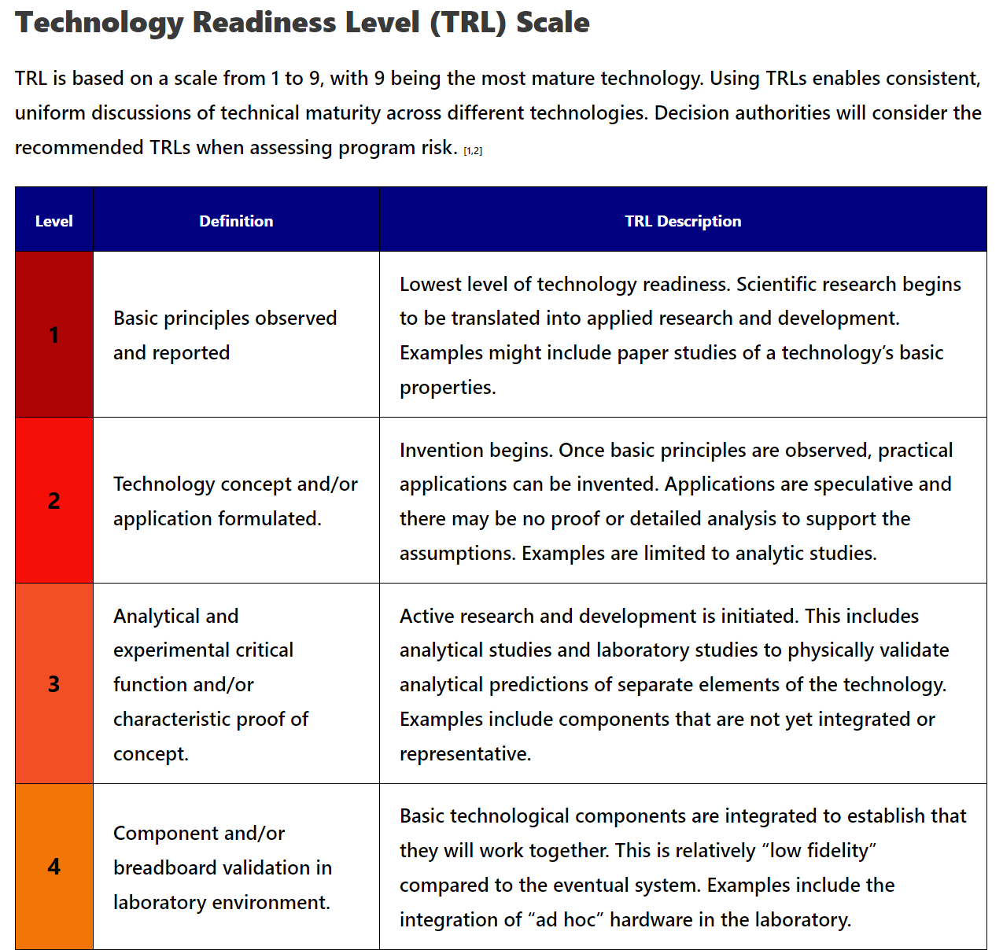
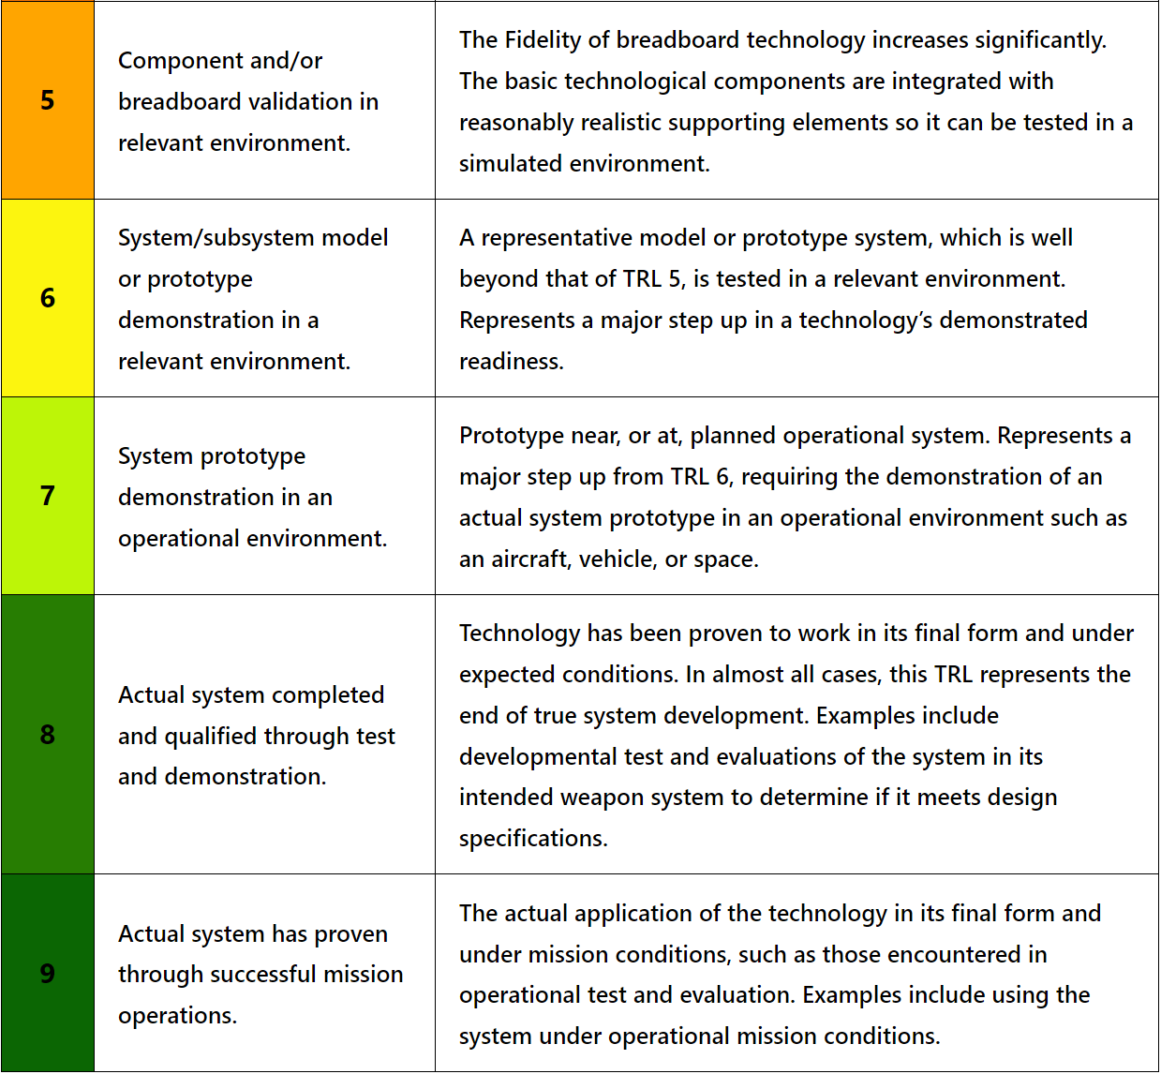
TRL: extra information
https://acqnotes.com/acqnote/tasks/technology-readiness-level

Slide 5
Feedback from Manqi
Performance: BMR, PID in Jets
Solve - Overlap in Z decay (~ns) ~ 1% level occupancies
Integration
Power Consumption - Cooling
Mechanics
Data stream
Tech. (Electronic) & Accessibility
Tech. Spin-off

Slide 6
Updated inputs for selection criteria: calorimetry system
Performance
BMR < 4%
PID in jets: lepton ID, (plus hadron ID)
EM energy resolution
Pi0 reconstruction: efficiency, purity, mass resolution
Pile-up at Z-pole
Technical options
PFA-oriented
Plastic scintillator ECAL and HCAL
Silicon ECAL, glass-RPC HCAL
4th conceptual design: crystal/glass ECAL (several geometry options), glass HCAL
Status: to be confirmed (including full simulation, prototyping R&D, performance)
Plastic scintillator ECAL and HCAL: Yunlong
Silicon ECAL, glass-RPC HCAL: Haijun
Crystal/glass ECAL: Yong, Huaqiao
Glass HCAL: Sen
Boundary conditions
Longitudinal depth: ECAL=${24X}_{0}$, HCAL=${6λ}_{I}$; detector geometry (constraints to be reviewed)
Baseline geometry: R_in=1.8m, L=5.0m
Electronics
Inputs of electronics for calorimeters: Jinfan Chang (invited for further discussions),
Power consumption and cooling
Cost estimates
Electronics (number of channels), …
Re-convene for further discussions:
on Feb. 23, 2024

