Slide 1
Criteria for the sub-system option selection: a template (draft) for the calorimetry system
Jianbei Liu (USTC); Miao He, Yong Liu (IHEP)
CEPC TDRrd Meeting, Feb. 6, 2024
Materials based on the Meeting on Feb. 4, 2023: “Discussion on a template of criteria to down-select calorimeter options” (agenda at https://indico.ihep.ac.cn/event/21571/ )
Participants (8): F. Guo (minutes), J. Liu (chair), Y. Liu, M. Ruan, S. Qian, S. Sun, H. Zhang, Y. Zhang
Talk updated after collective discussions; meeting minutes

Slide 2
Down-select criteria: inputs and considerations
Performance: scientific driver
  Boson Mass Resolution; detector-level performance
Cost: boundary conditions
  Estimates: total cost, key components
Technical maturity
  A key feature for Technical Design Report: distinguishable from Conceptual Design

Slide 3
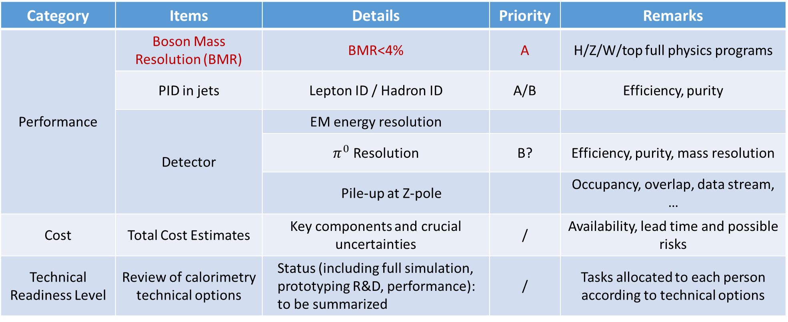
Down-select criteria: a first template
Category | Items | Details | Priority | Remarks
Performance | Boson Mass Resolution (BMR) | BMR<4% | A | H/Z/W/top full physics programs
 | PID in jets | Lepton ID / Hadron ID | A/B | Efficiency, purity
 | Detector | EM energy resolution
 |  | $π^{0}$ Resolution | B? | Efficiency, purity, mass resolution
 |  | Pile-up at Z-pole |  | Occupancy, overlap, data stream, …
Cost | Total Cost Estimates | Key components and crucial uncertainties | / | Availability, lead time and possible risks
Technical Readiness Level | Review of calorimetry technical options | Status (including full simulation, prototyping R&D, performance): to be summarized | / | Tasks allocated to each person according to technical options
Priority for performance, detector requirements & specs: (A) must-have; (B) plus; (C) not essential
Boundary conditions: longitudinal depth (ECAL=${24X}_{0}$, HCAL=${6λ}_{I}$); detector geometry (constraints to be reviewed)

