Slide 1

中国科学院高能物理研究所
Institute of High Energy Physics, CAS
CEPC探测器磁体
轭铁与漏场
宁飞鹏
2024.02

Slide 2

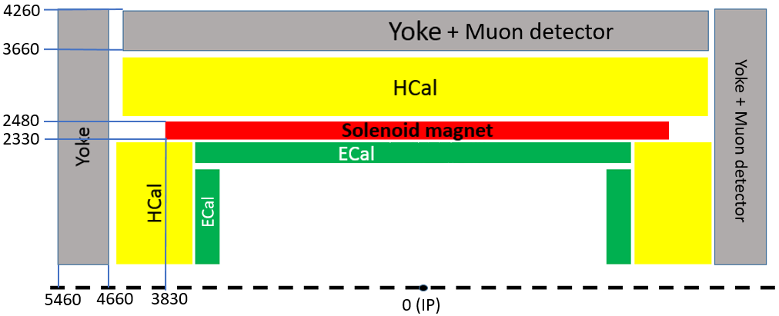
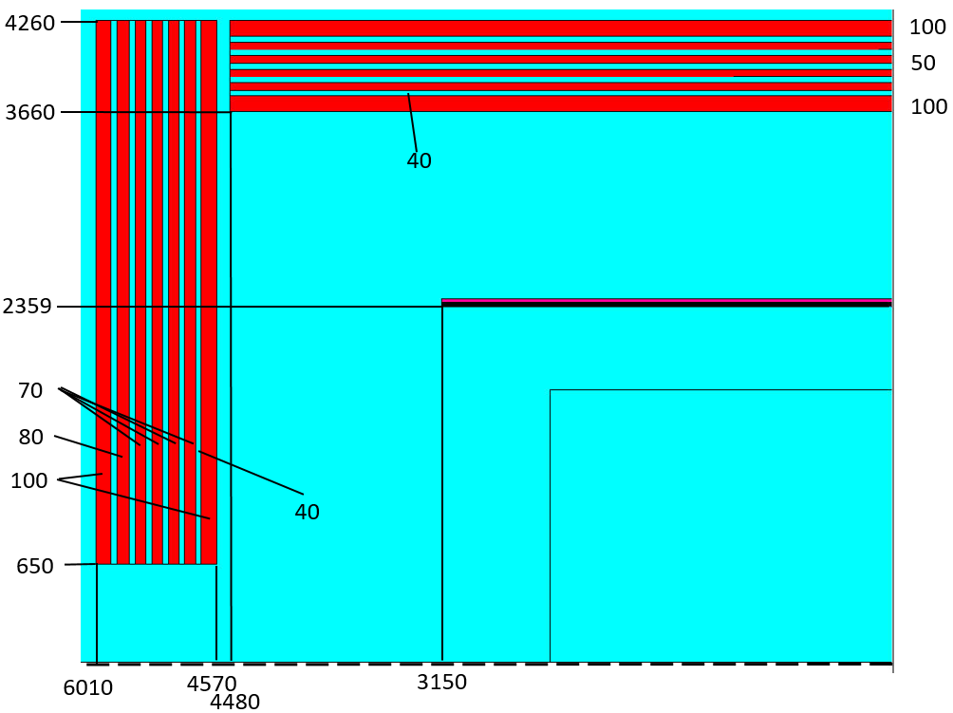
高温超导磁体内置时
轭铁和漏场
Stray field |  | HTS inside | 与轭铁表面距离
50 Gs | R direction | 16.3m | 12m
 | Z direction | 19.9m | 14.4m
100 Gs | R direction | 12.6m | 8.3m
 | Z direction | 15.7m | 10.2m
 | IDEA* | CDR(CEPC) | CEPC 4th detector
Central field (T) | 2 | 3 | 3
Length of coil (mm) | 6000 | 7606 | 7350
Outer shell external diameter(mm) |  | 8700 | 4960
Inner shell inside diameter(mm) | 4200 | 6800 | 4660
Iron yoke mass [kt] | 2.9 | 12.573 | 1.143

Slide 3
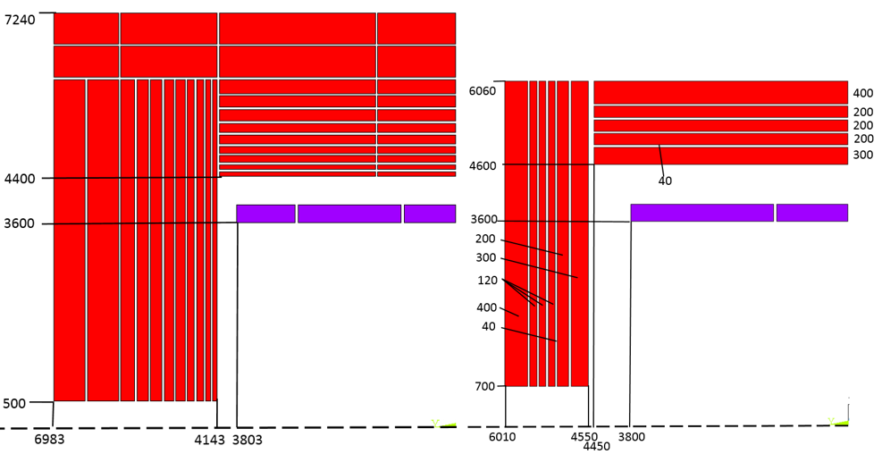
CDR低温超导磁体轭铁减重方案
Stray field |  | CEPC CDR | New Version
50 Gs | R direction | 13.6 m | 20.6 m
 | Z direction | 15.8 m | 25.5 m
100 Gs | R direction | 10 m | 16.4 m
 | Z direction | 11.6 m | 20.1 m
 | CEPC original | CEPC New version
Barrel yoke inner diameter (mm) | 8800 | 9200
Barrel yoke outer diameter (mm) | 14480 | 12120
Total length of yoke (mm) | 13966 | 12020
Weight of barrel yoke (t) | 5940 | 3137
Weight of each end cap (t) | 3316.6 | 1144
Total weight of yoke (t) | 12573 | 5425
这个轭铁方案是曾经计算过的一种减重方案，依据是桶部轭铁表面100mm处的漏磁场与CMS相同。

Slide 4
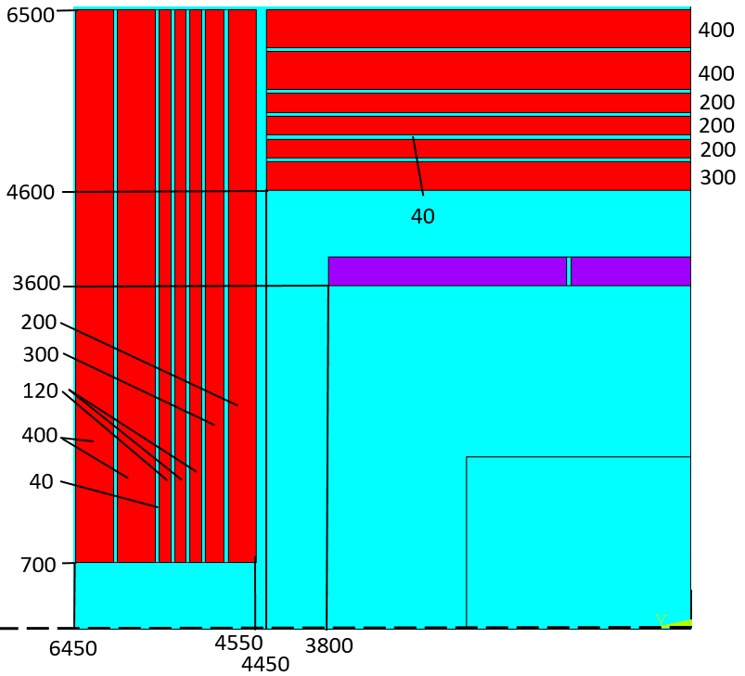
LTS外置与HTS内置相同漏磁场轭铁方案
Booster 位置磁场(径向R=25m）：
CDR version | 8.4 Gauss
CDR less yoke | 28 Gauss
HTS inside | 13.4 Gauss
LTS outside | 14 Gauss
Stray field |  | CEPC CDR | CEPC new version | HTS inside | LTS outside
50 Gs | R direction | 13.6 m | 20.6 m | 16.3m | 16.2m
 | Z direction | 15.8 m | 25.5 m | 19.9m | 20.1m
100 Gs | R direction | 10 m | 16.4 m | 12.6m | 12m
 | Z direction | 11.6 m | 20.1 m | 15.7m | 15.6m
新低温超导磁体轭铁方案，漏磁场范围与高温超导内置方案相当

Slide 5
内外置相同漏场时所需轭铁
 | CEPC CDR | LTS outside | HTS inside
Barrel yoke inner diameter (mm) | 8800 | 9200 | 7320
Barrel yoke outer diameter (mm) | 14480 | 13000 | 8520
Total length of yoke (mm) | 13966 | 12900 | 12020
Weight of barrel yoke (ton) | 5940 | 4276 | 664
Weight of each end cap (ton) | 3316.6 | 1761 | 222.5
Total weight of yoke (ton) | 12573 | 7798 | 1109

Slide 6
相同漏磁场内外置方案所需经费
估价：内置磁体采用高温超导方案HTS，外置磁体采用低温超导方案LTS。
 | LTS outside | HTS inside
Yoke weight (ton) | 7798 | 1109
Yoke cost (3万元/吨，材料及加工) | 23,394 | 3,327
Magnet cost (万元)
Total cost (万元)
轭铁
  材料单价：￥6千/吨
  加工费 *3

Slide 7
Detector magnets with iron yoke
 | CMS | SiD | ILD | CLIC_ILD | CLIC_SiD | CEPC | Fcc-ee
Central field(T) | 4 | 5.0 | 4.0 | 4.0 | 5.0 | 3
Max. field(T) | 4.6 | 5.75 | 4.77 |  | 5.8 | 3.5
Coil inner diameter (mm) | 6360 | 5462 | 7220 | 7202 | 5488 | 7200
Coil outer diameter (mm) | 6980 | 6224 | 7940 | 7888 | 7008 | 7800
Coil length (mm) | 12400 | 5586 | 7350 | 7890 | 6230 | 7600
Superconductor length(Km) | 45.4 | 26.8 |  |  | 40 | 30.35
Dimension of Superconductor(mm) | 22×64 | 21.6×64 |  |  | 97.4× 15.6 | 23×75
Layers | 4 | 6 | 4 |  | 5 | 4
Total turns | 2168 | 1459 | 1260 |  |  | 1288
Stored energy(GJ) | 2.69 | 1.59 | 2.27 |  | 2.3 | 1.3
Inductance(H) | 14.2 | 9.9 | 9.26 |  | 14 | 10.4
Nominal current(A) | 19200 | 17724 | 22500 |  | 18000 | 15779
Cold mass weight(t) | 220 | 130 | 168 | 210 | 170
Yoke weight | 10000 | 3360 | 13400 | 8900 | 10800
Zhao Wei, IHEP, July 12, 2018

Slide 8
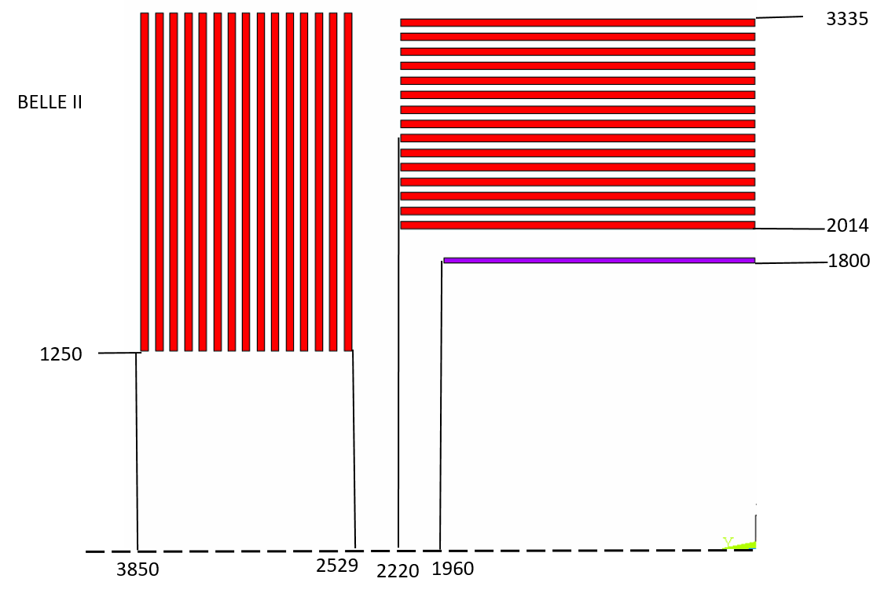
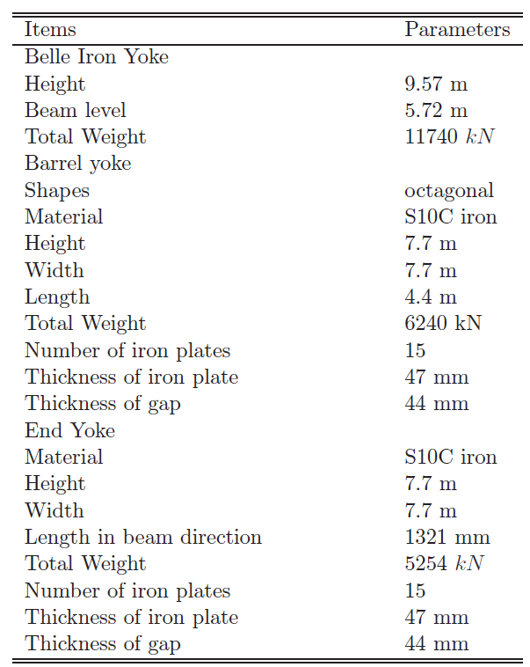
Stray field of BESIII and BELLE II
Outer radius of barrel yoke (mm) | 2620
Total length of yoke (mm) | 5600
Wight of barrel yoke (t) | 400
Wight of each end cap (t) | 100
Total weight of yoke(t) | 600
Central magnetic field | 1.0 T
Coil length | 3.5 m
Internal diameter | 1.49 m
Operating current | 3.369 kA
Stored energy | 11 MJ
Central magnetic field | 1.5 T
Coil length | 4.440 m
Internal diameter | 3.6 m
Operating current | 4.4 kA
Stored energy | 35 MJ

Slide 9
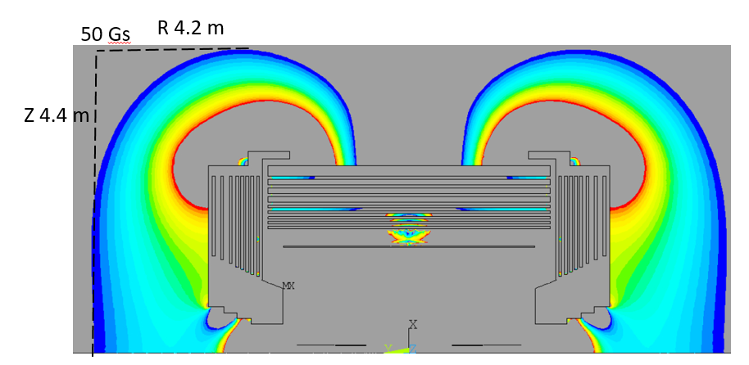
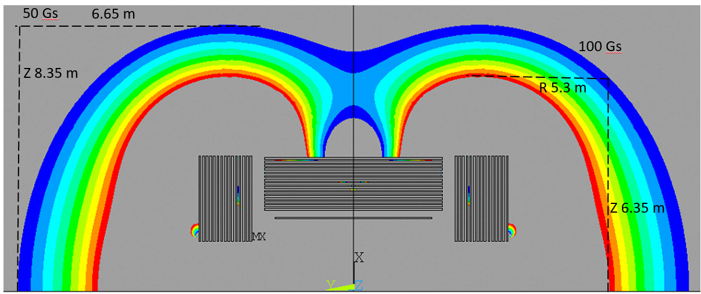
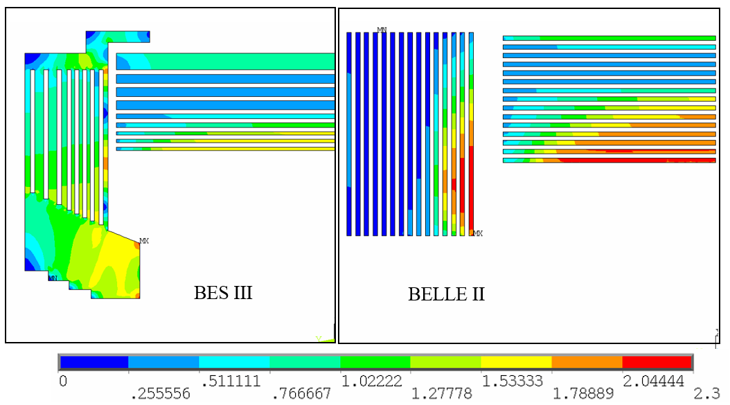
Stray field of BESIII and BELLE II
Stray field 50 gauss and 100 gauss distribution(blue part is 50 gauss, red part is 100 gauss)
Stray field |  | BESIII | BELLE II
50 Gs | R direction | 4.2 m | 6.65 m
 | Z direction | 4.4 m | 8.35 m
100 Gs | R direction |  | 5.3 m
 | Z direction |  | 6.35 m

Slide 10
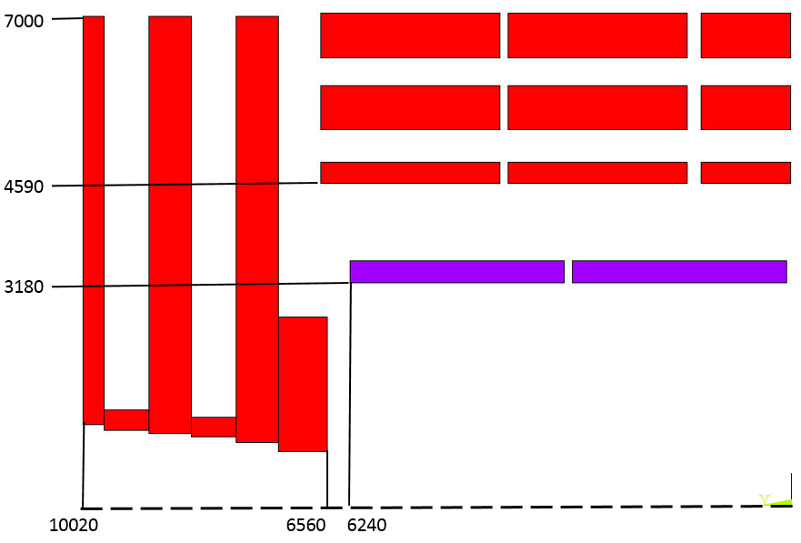
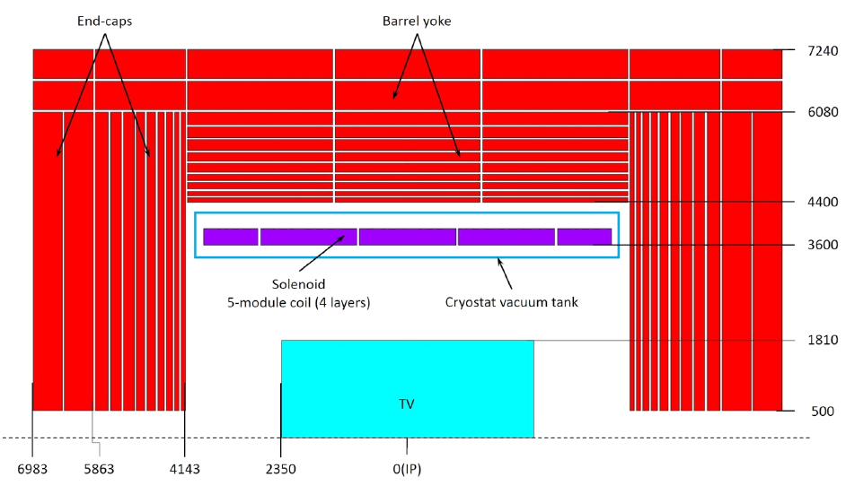
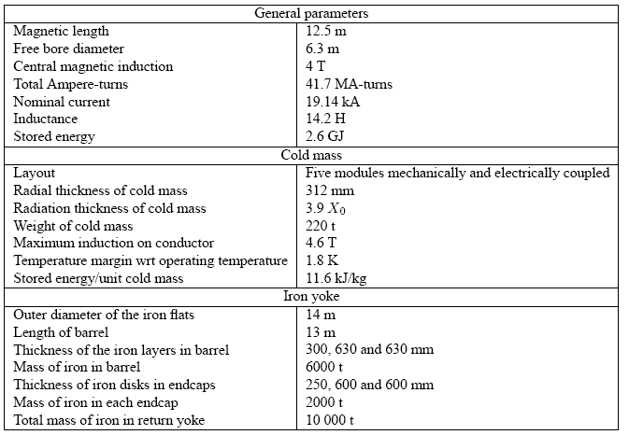
Stray field of CMS
低温恒温器内半径(mm) | 3400 | 桶部轭铁外半径(mm) | 7240
低温恒温器外半径(mm) | 4250 | 外围轭铁总长(mm) | 13966
低温恒温器长度(mm) | 8050 | 桶部轭铁重量(t) | 6122
冷重(t) | 165 | 每个端部轭铁重量(t) | 3419
桶部轭铁内半径(mm) | 4400 | 轭铁总重(t) | 12959

Slide 11
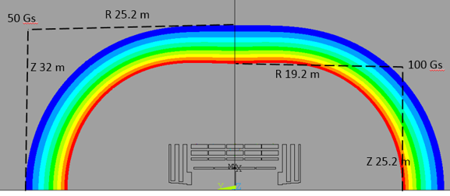
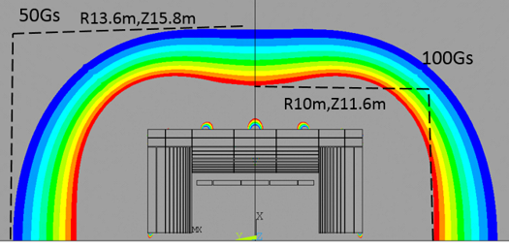
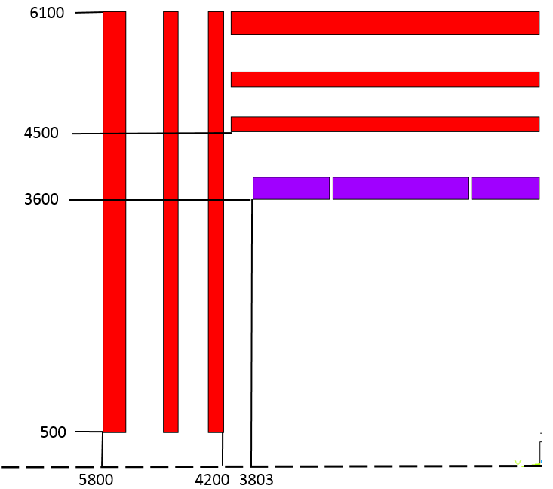
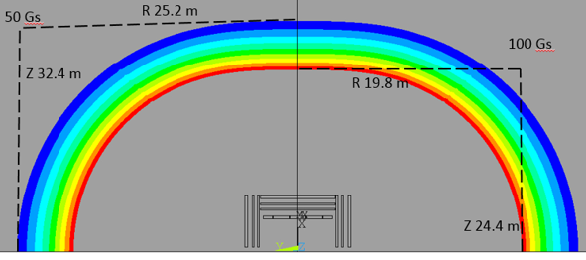
Stray field of CMS
Stray field |  | CMS | CEPC CDR
50 Gs | R direction | 25.2 m | 13.6 m
 | Z direction | 32 m | 15.8 m
100 Gs | R direction | 19.2 m | 10 m
 | Z direction | 25.2 m | 11.6 m

Slide 12
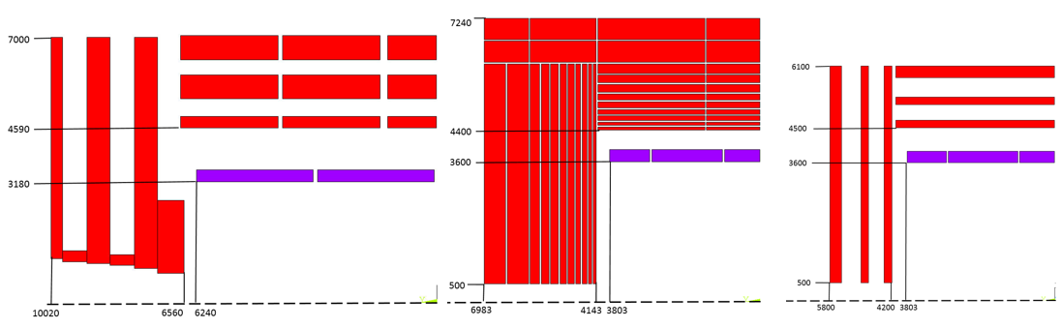
Stray field of CMS
Stray field |  | CMS | CEPC CDR | CEPC减重后
50 Gs | R direction | 25.2 m | 13.6 m | 25.2m
 | Z direction | 32 m | 15.8 m | 32.4 m
100 Gs | R direction | 19.2 m | 10 m | 19.8 m
 | Z direction | 25.2 m | 11.6 m | 24.4 m
 | CMS | CEPC原始 | CEPC轭铁减重后
中心场强 (T) | 4 | 3 | 3
超导线圈内径 (mm) | 6360 | 7200 | 7200
超导线圈长度 (mm) | 12480 | 7606 | 7606
桶部轭铁内径 (mm) | 9180 | 8800 | 9000
桶部轭铁外径 (mm) | 14000 | 14480 | 12200
磁铁(包含轭铁)轴向总长度 (mm) | 20040 | 13966 | 11600
桶部轭铁重量 (t) | 6000 | 6122 | 1608
每个端部轭铁重量 (t) | 2000 | 3419 | 678
轭铁总重 (t) | 10000 | 12960 | 2963
CEPC减重后漏磁场的范围与CMS接近，轭铁重量从原来的12960 t减小到了2963 t，重量不到原来的四分之一。这样轭铁的造价将大幅减少，同时由于重量的大幅减少，吊装轭铁的设备、山洞开孔的尺寸等相关的费用都大大降低。

Slide 13
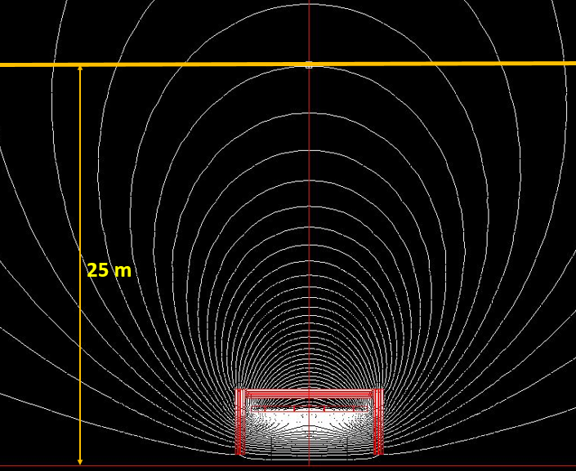
Magnetic field strength at booster ring
The detector stray field can reach the booster and influences the beam dynamics of booster. The current study shows that the correction to the detector stray field seems possible at low field (less than 50 gauss) level by orbit correction.
add correctors
Dou Wang, Yuan Zhang, Daheng Ji, Feipeng Ning, Impacts of Detector Stray Field on Booster, AP NOTE, ACC-AP-NOTE-2020-001, Receive Date (October 15, 2020)

Slide 14
轭铁设计
宁飞鹏
2019.7

Slide 15
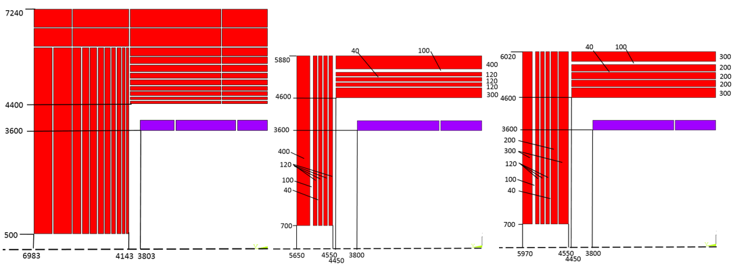
外形尺寸对比
CDR original version
New version I
New version II

Slide 16
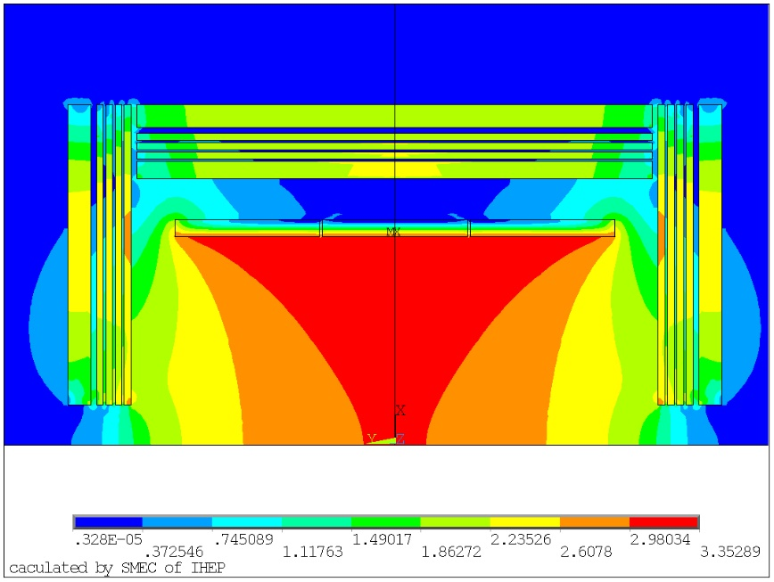
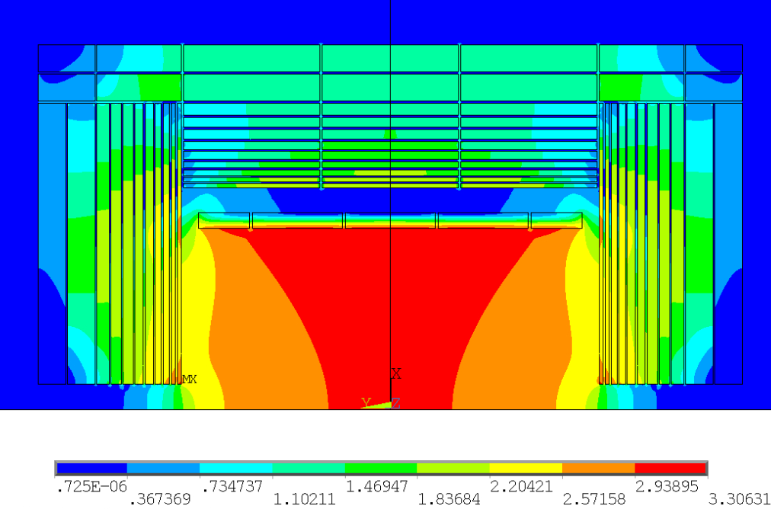
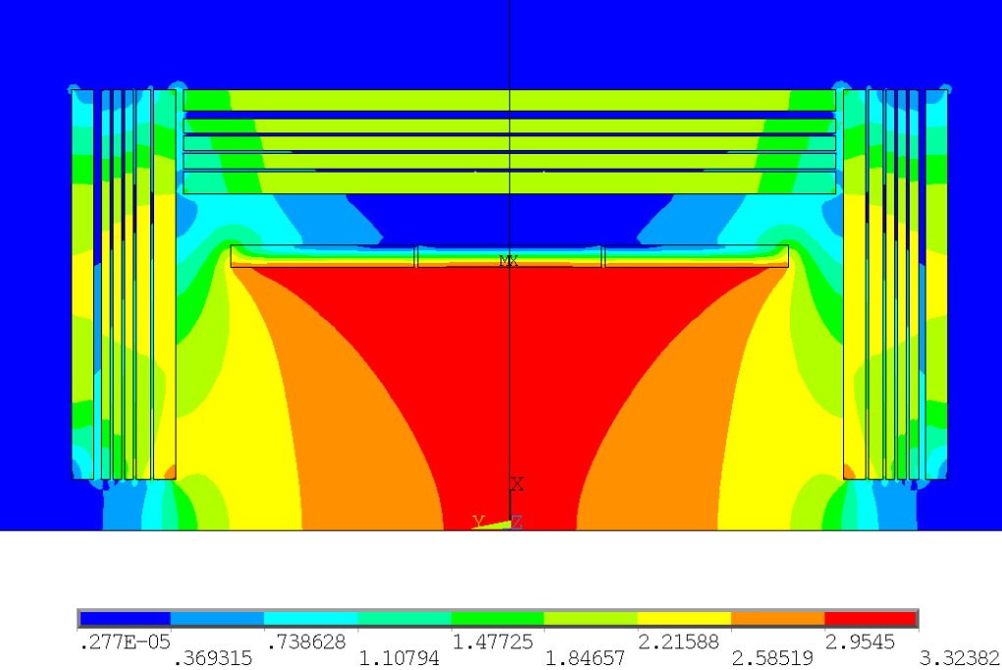
总磁场分布
New version I
铁越多，中心磁场越均匀。
CDR original version
New version II

Slide 17
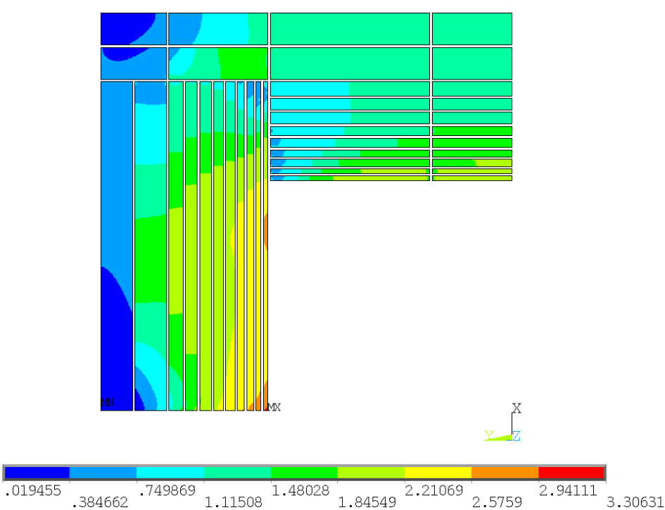
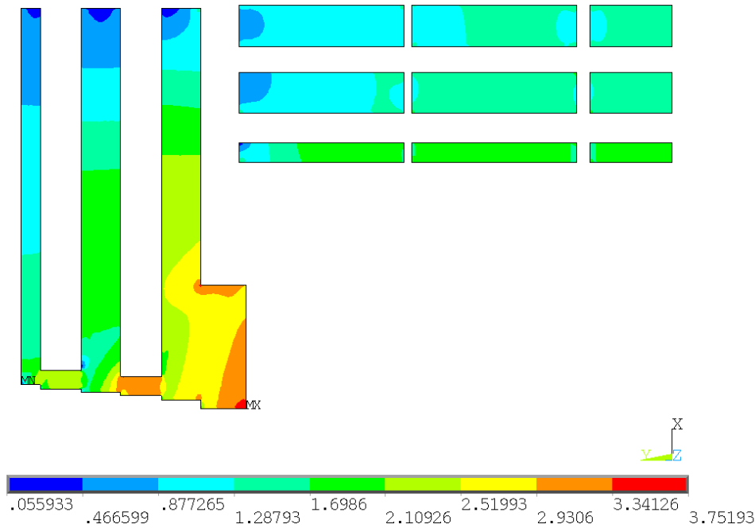
轭铁上磁场分布
CMS
CEPC original version
可以看到，CMS轭铁上的磁场与CEPC CDR中轭铁上相差不多，CEPC 轭铁上的场更小，对磁场的屏蔽效果也更好。

Slide 18
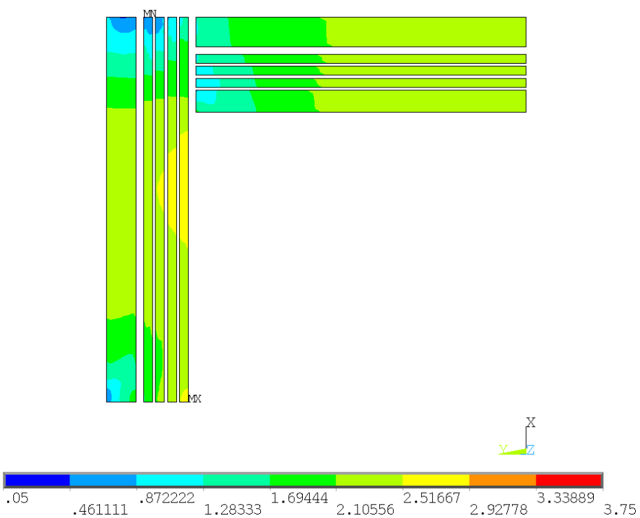
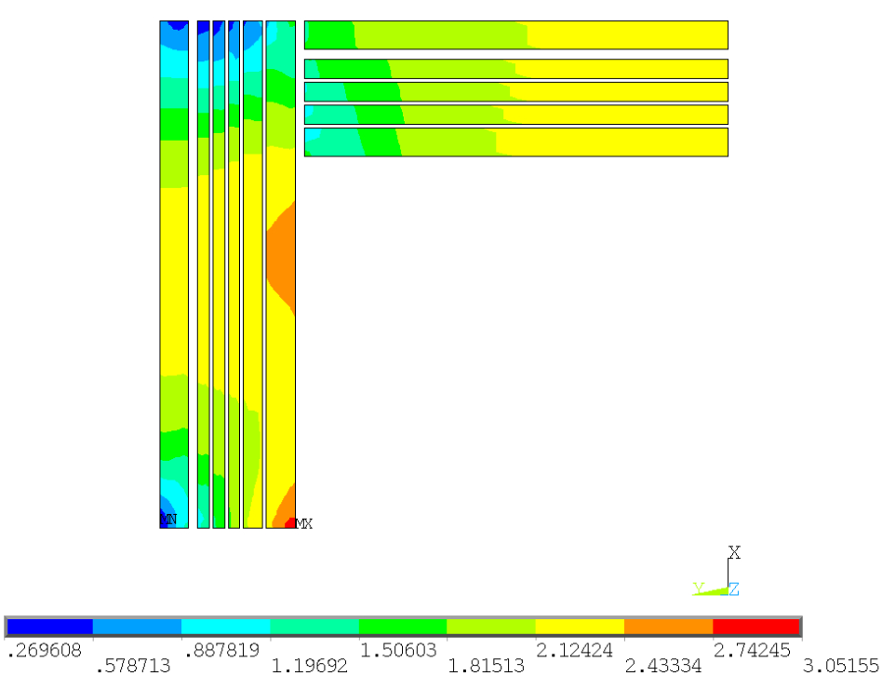
New version 轭铁上磁场分布
New version I
New version II
最外层轭铁上的磁场基本都已经饱和，所以此时继续近距离加铁对漏磁场的贡献较小。

Slide 19
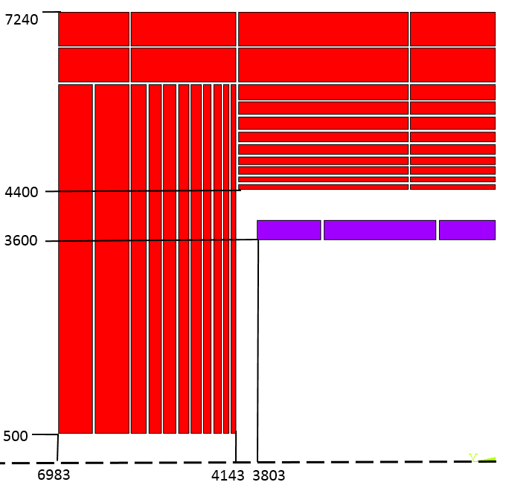
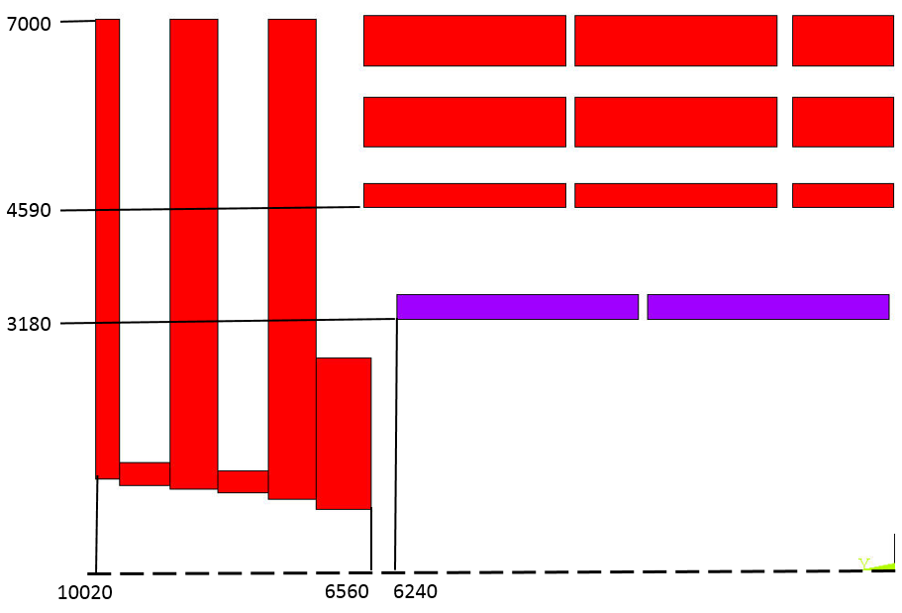
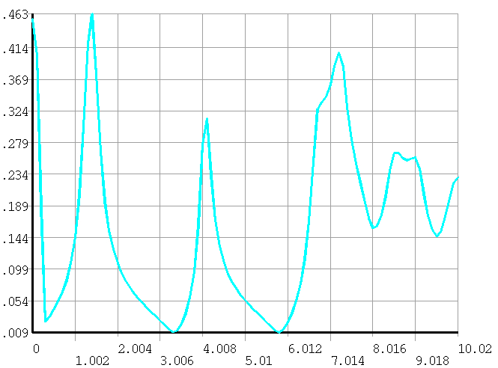
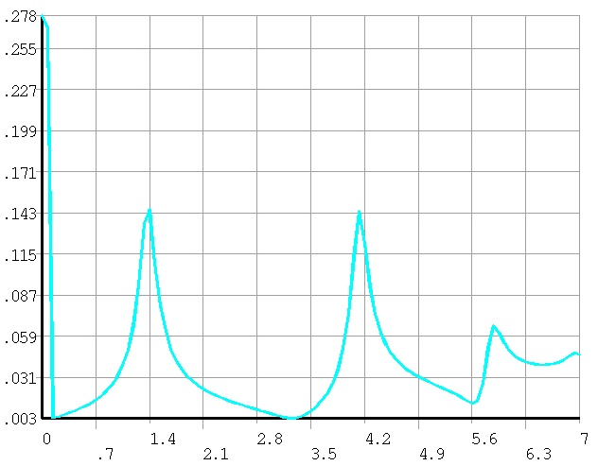
Barrel

Slide 20
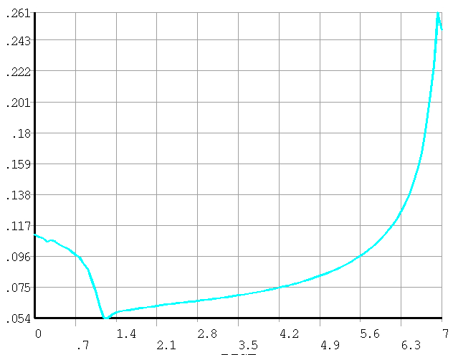
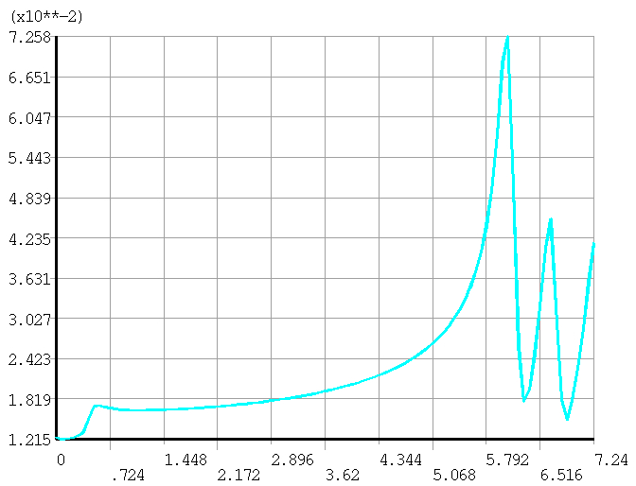
End

Slide 21
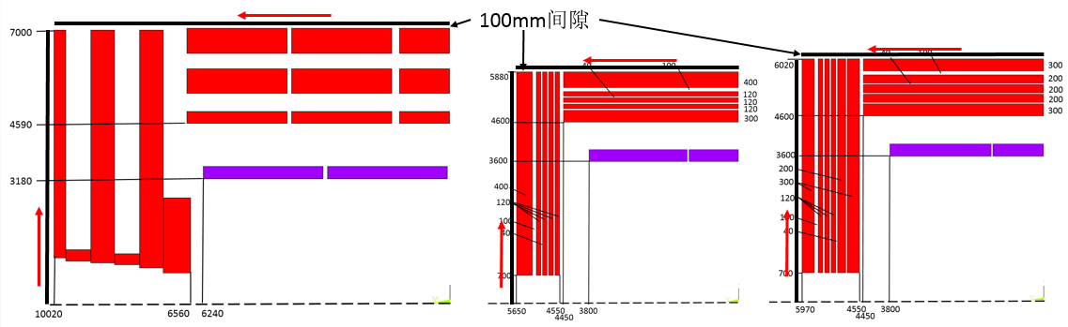
与CMS磁场对比
磁场分布曲线，如图所示：
桶部距离桶部最外层轭铁100mm，从中心到轭铁边缘
端部距离端部最外层轭铁100mm，从中心到轭铁边缘

Slide 22
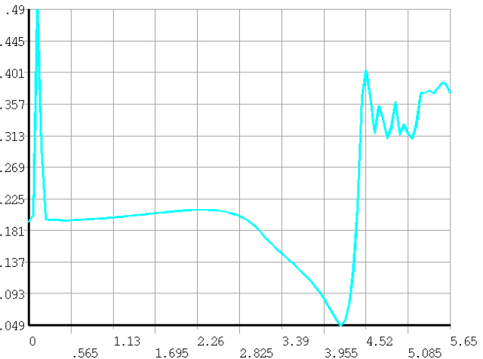
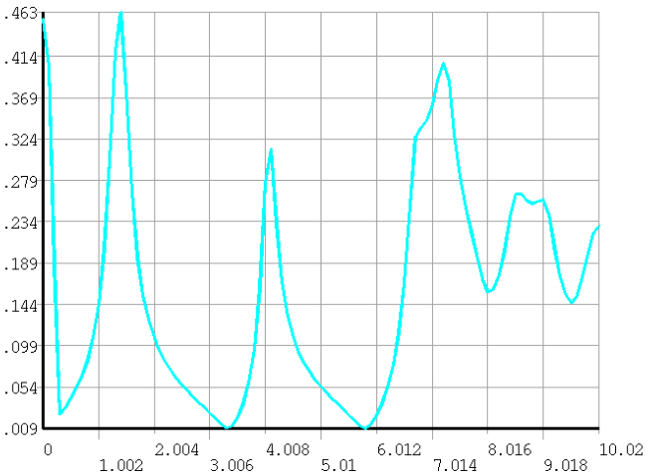
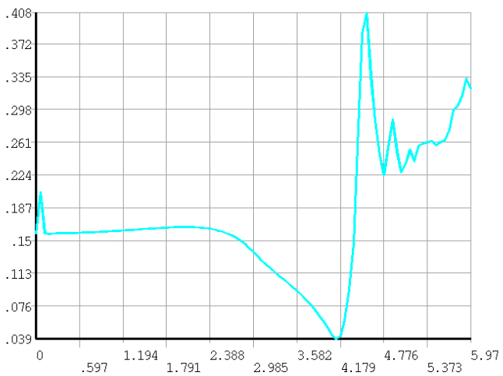
桶部轭铁上100mm磁场分布
CEPC
Version I
CEPC
Version II
CMS

Slide 23
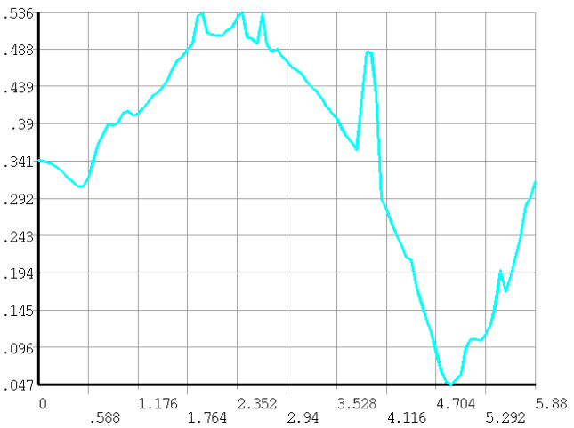
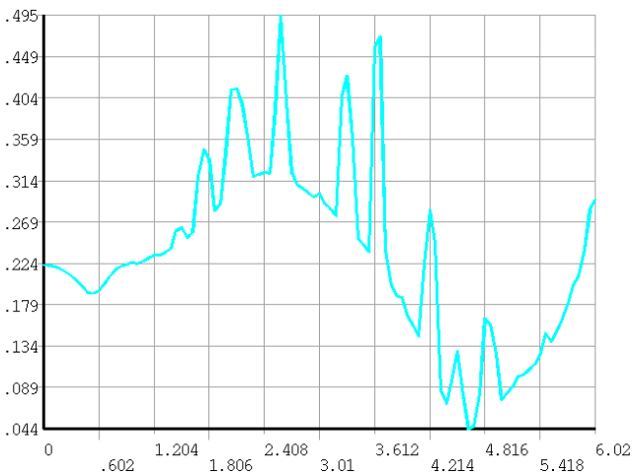
端部轭铁上100mm磁场分布
CEPC
Version I
CEPC
Version II
CMS

Slide 24
漏磁场对比
Stray field |  | CMS | CEPC original | New Version I | New Version II
50 Gs | R direction | 25.2 m | 13.6 m | 22.7 m | 21.6 m
 | Z direction | 32 m | 15.8 m | 28.3 m | 26.7 m
100 Gs | R direction | 19.2 m | 10 m | 18.1 m | 17.2 m
 | Z direction | 25.2 m | 11.6 m | 22.5 m | 21.1 m
Booster 位置磁场(径向R=25m）：
Original version | 8.4 Gs
New version I | 37.3 Gs
New version II | 31.7 Gs

Slide 25
磁体参数
 | CMS | CEPC original | CEPC New version I | CEPC New version II
Central field (T) | 4 | 3 | 3 | 3
Operating current (A) | 19600 | 15779 | 17361 | 16967
Inner diameter of coil (mm) | 6360 | 7200 | 7200 | 7200
Length of coil (mm) | 12480 | 7606 | 7600 | 7600
Barrel yoke inner diameter (mm) | 9180 | 8800 | 9200 | 9200
Barrel yoke outer diameter (mm) | 14000 | 14480 | 11760 | 12040
Total length of yoke (mm) | 20040 | 13966 | 11300 | 11940
Weight of barrel yoke (t) | 6000 | 5940 | 2512 | 2873
Weight of each end cap (t) | 2000 | 3316.6 | 762 | 1053
Total weight of yoke (t) | 10000 | 12573 | 4036 | 4980

Slide 26
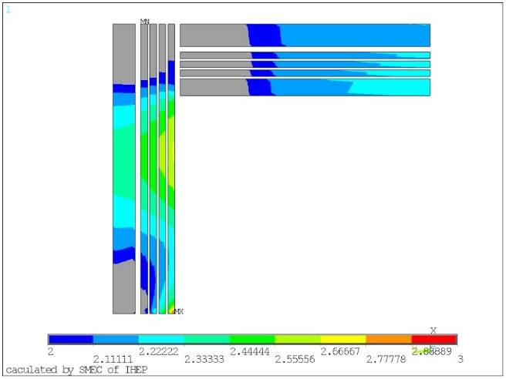
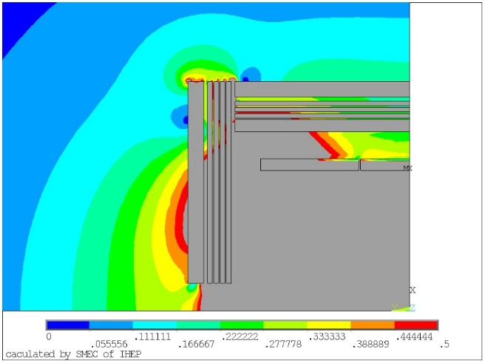
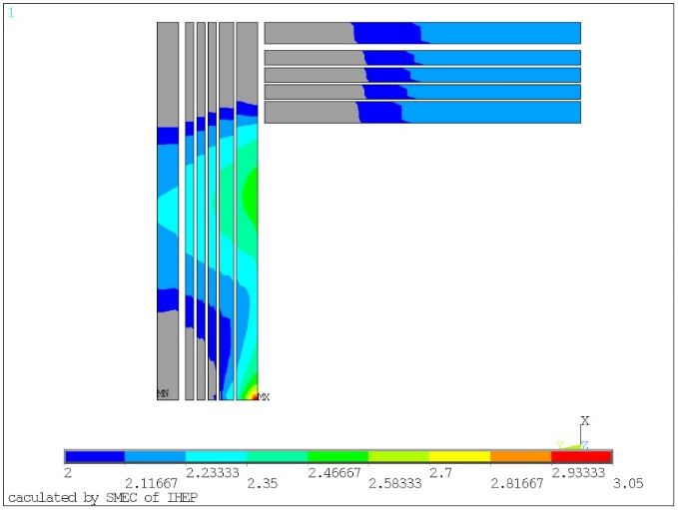
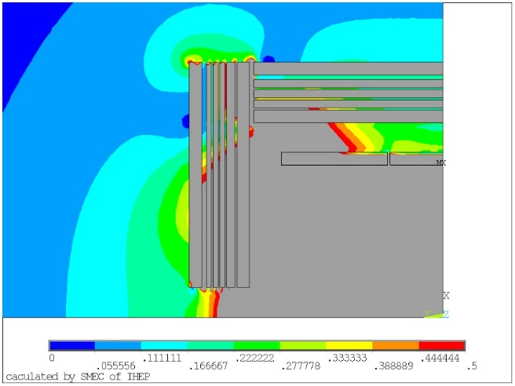
轭铁及其附近磁场分布
轭铁上场强大于2T的部分（彩色）
轭铁附近磁场分布（0 - 0.5T）
New version I
New version II

Slide 27
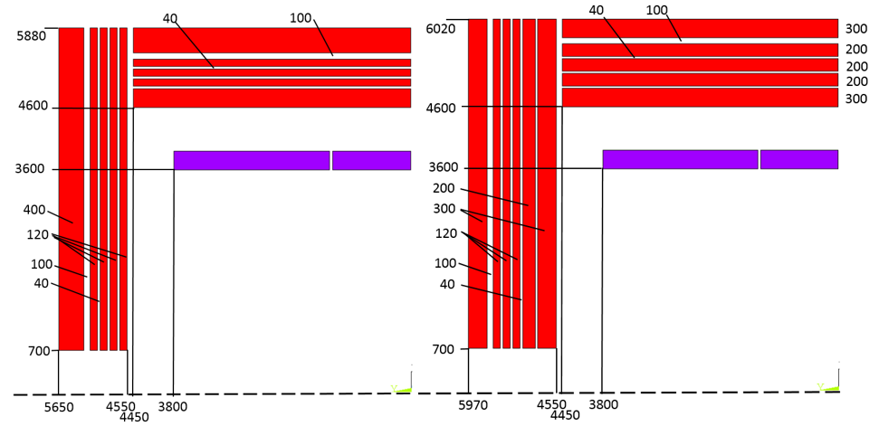
端部受力
端部轭铁从内到外 | Version I （t） | Version II （t）
1 | 1364 | 3161
2 | 1129 | 1632
3 | 956 | 788
4 | 792 | 633
5 | 1367 | 488
6 |  | 564

Slide 28
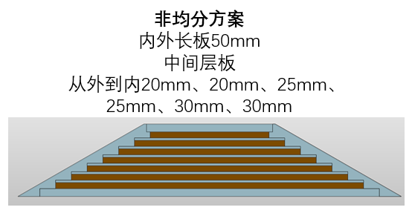
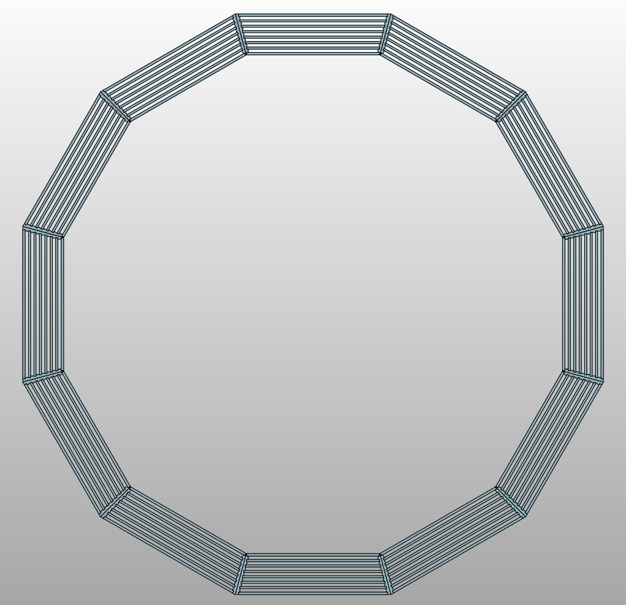
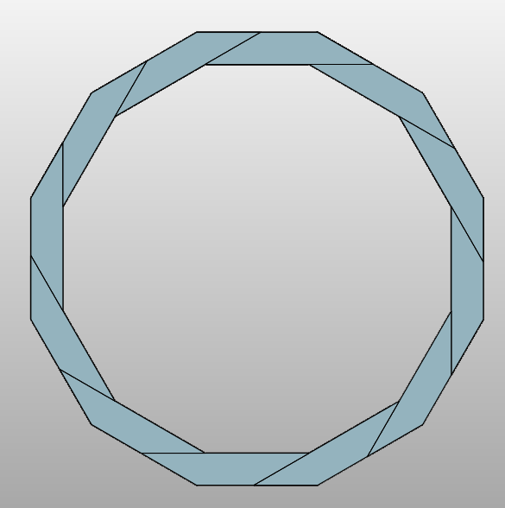
最新版轭铁
轭铁总重量目前是：1155吨；
桶轭约625吨，桶轭十二个模块，单个模块约52吨；
单个端轭约265吨，两个端轭一共530吨；

