Slide 1
CP violation of baryon decays with $Nπ$ rescatterings
汪建鹏 兰州大学
第二十一届重味物理与CP 破坏研讨会@衡阳 2024-10-26
Based on: Chin.Phys.C 48 (2024) 10, 101002
In collaboration with Prof. Fu-Sheng Yu

Slide 2
Outline
Motivation : Why baryon CPV?
New proposal: $Nπ$ re-scattering picture for $Λ_{b}$ CPV
Numerical results and phenomenological suggestions
Summary

Slide 3
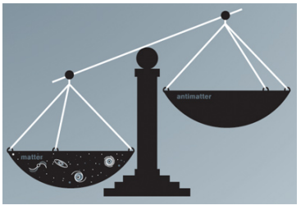
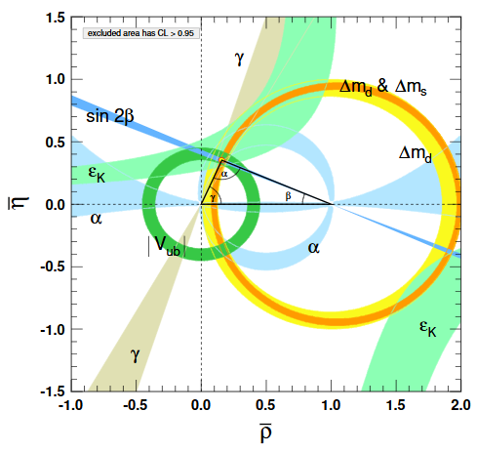
CP Violation
C and CP violation are important
Dynamical path to baryon anti-baryon asymmetry
Precise test of Standard Model
Sensitive to new physics
Meson system: High precision era
Baryon sector: Both of theoretical and experimental challenge
Principal question: how to find baryon CPV?
CKM unitary triangle

Slide 4
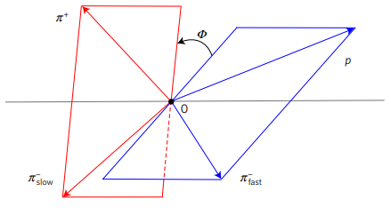
CP Violation
Direct CP asymmetries
$$A_{CP}\left(Λ_{b}→pπ^{−}\right)=\left(−3.5±1.7±2.0\right)\% A_{CP}\left(Λ_{b}→pK^{−}\right)=\left(−2.0±1.3±1.0\right)\%$$
$$ΔA_{CP}=A_{CP}\left(Λ_{b}→pK^{−}\right)−A_{CP}\left(Λ_{b}→pπ^{−}\right)=0.014±0.022±0.010$$
[LHCb, 2018]
CP asymmetries induced by asymmetry parameters
See previous talks
$A_{CP}^{α}\left(Λ→pπ^{−}\right)=\text{−}\text{0.006 }\text{±}\text{ 0.012 }\text{±}\text{ 0.007}$ $A_{CP}^{α}\left(Λ→pπ^{−}\right)=\text{+0.013}\text{±}\text{0.007}\text{±}\text{0.011 }$
[BESIII, 2019],[BelleII,2023]
Triple product asymmetries and CPV
Future
[LHCb, 2018,2019...]

Slide 5
CP Violation
Theoretical side
Dynamical calculations
PQCD [Lu, Wang, Zou, Ali, Kramer, 2009], [Zhou...2022], [Yu,Han,Li,FSY,HnLi...2024] ……
QCDF with diquark approximation [Hong-Wei Ke...,2019]
SU(3) flavor symmetry [X.G He...,2015]
GFA [Geng,Liu 2021,2022]
FSI with hardonic loop [Jia,Jiang,JPWang,FSYu 2024]
Phenomenological discussions
Partial wave CP asymmetries [Z.H.Zhang 2021,2022]
Asymmetry parameters CPV [X.G He...1986,1995,2000], [JPWang, FSYu,2022]……
Triple product asymmetries [Geng, Liu 2021], [JPWang,FSY,QinQin]...
Charmed $Λ_{b}→DN^{∗}→Kπ pπ$ decays [YFShen, JPWang,QinQin 2023]……
Lack of dynamical researches for multibody decays as $Λ_{b}→p3π,pKππ…$
See Jia Jie Han’s talk
$$Br\left(Λ_{b}→p3π\right)=2×{10}^{−5}$$
$Br\left(Λ_{b}→pKππ\right)=5×{10}^{−5}$
Large experimental statistics!! But theory is difficult since many resonances are involved

Slide 6
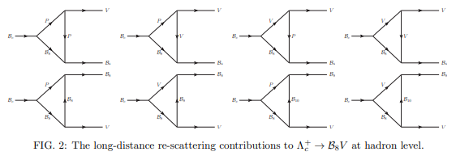
CP Violation
Theoretical opportunity
Final state interactions for charm baryon CPV [Jia,Jiang,JPWang,FSYu 2024]
The applications for $Λ_{b}$ decays are expected [JPWang,ZDDuan,Lu,Li,FSY in preparation]
However, not all problems can be addressed well by FSI with hadronic loops since too many resonances are involved. It is not easy for experiment to isolate single resonance such as N(1440), N(1520), N(1535)...

Slide 7
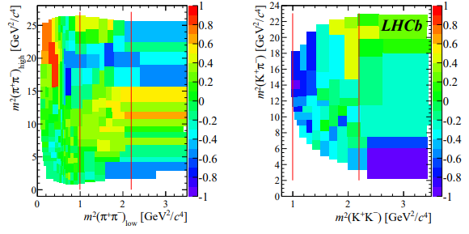
$Nπ$ re-scatterings
Too many resonances for $Λ_{b}→p3π,pKππ…$
Possible resonances from $Nπ$ and $Nππ$
Close to each other, with large decay widths. No clear dominant one
$$π^{+}π^{−}→K^{+}K^{−}$$
Employing $Nπ→Nπ,Nππ$scattering data to predict $Λ_{b}→p3π,pKππ$ CP asymmetries. Naturally, it involves all possible resonances in principle
Nonresonant Contributions
[HYCheng...2020]
$$B^{+}→π^{+}π^{+}π^{−}$$
$$B^{+}→K^{+}π^{+}K^{−}$$
Alberto C. dos Reis

Slide 8
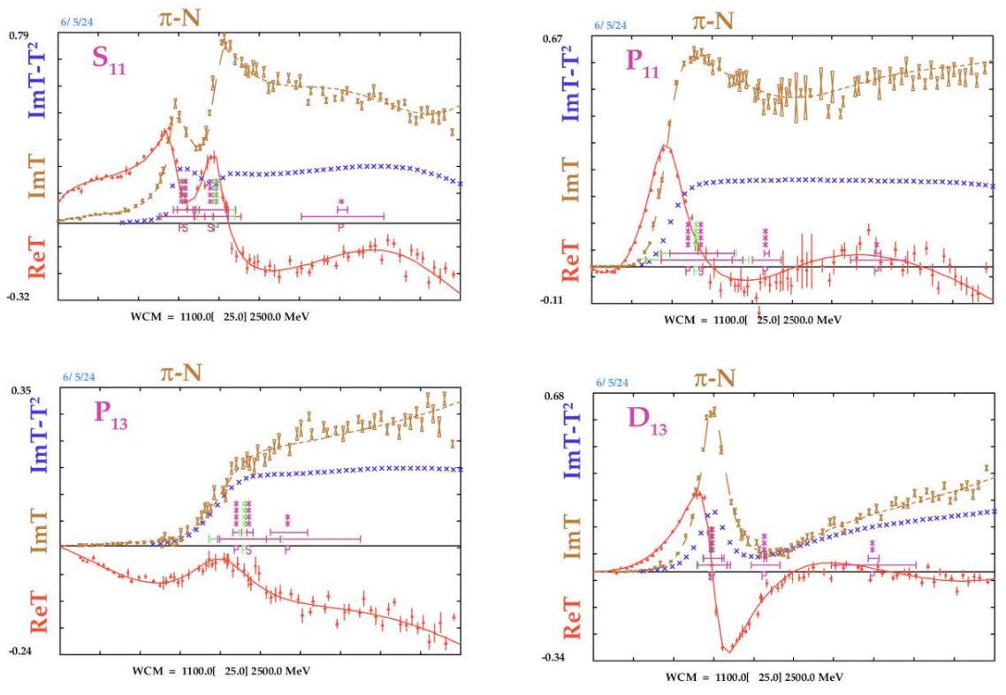
$Nπ$ re-scatterings
$N^{∗}$ usually from $Nπ$ and $Nππ$ scatterings
Data from SAID program
https://gwdac.phys.gwu.edu
$Nπ→Nπ$
Skip specific resonance, and use more precise strong phases
Data driven and model independent

Slide 9
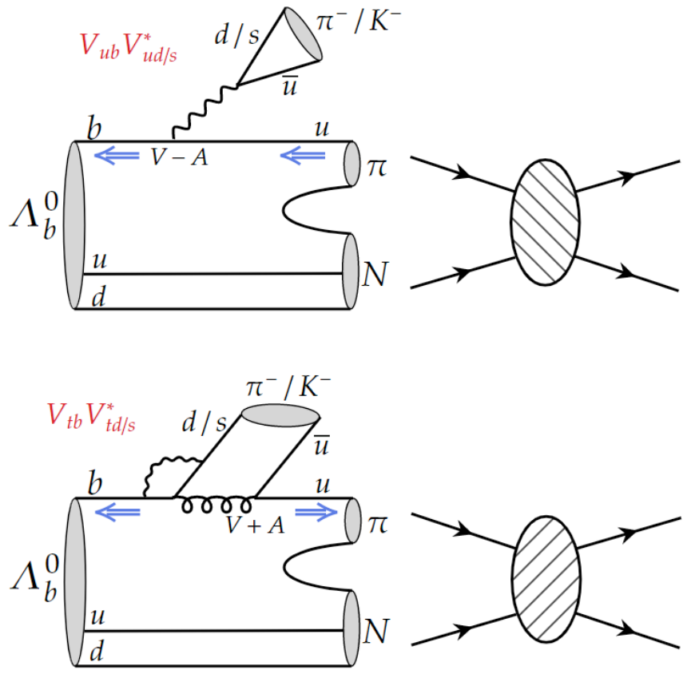
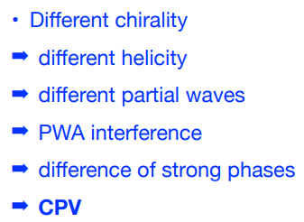
$Nπ$ re-scatterings
Tree
Penguin
Short distance
weak interactions
Long distance $Nπ$ re-scatterings
JPWang, FSY 2024 CPC
Weak phase
Strong phase

Slide 10
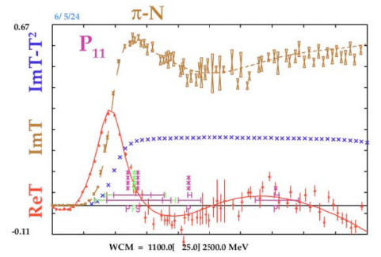
$Nπ$ re-scatterings
$Nπ→Nπ$ data from SAID program https://gwdac.phys.gwu.edu
Tree
Penguin
Data driven
Model independent
Short distance
weak interactions
Long distance $Nπ$ re-scatterings
Weak phase
Strong phase

Slide 11
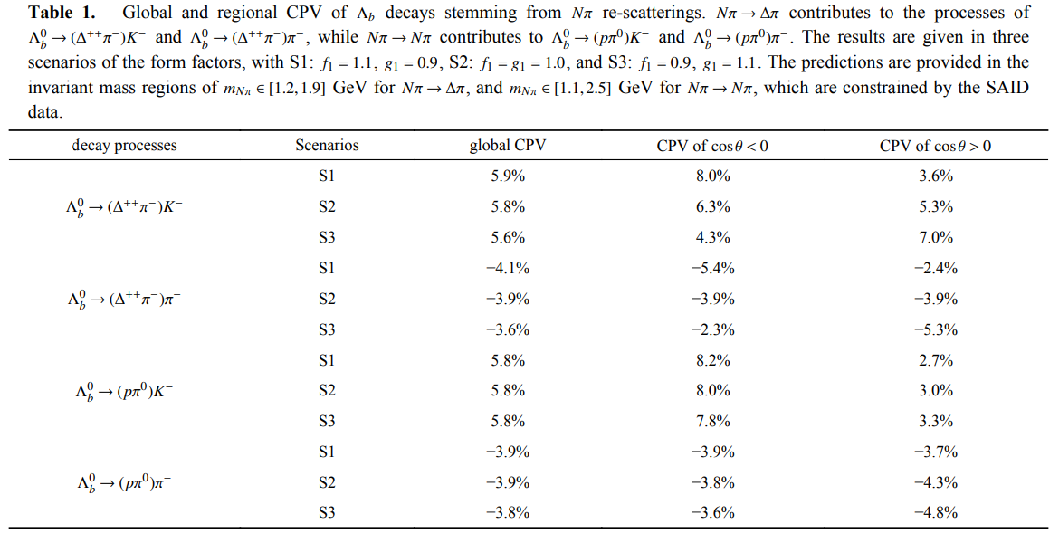
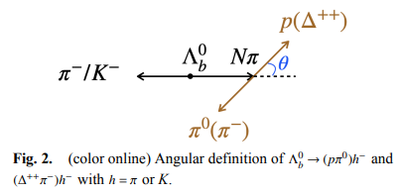
$Nπ$ re-scatterings
We need $Λ_{b}→Nπ$ form factors which full results are absent. Here, we only consider Lorentz structures of $f_{1}γ^{μ}$ and$g_{1}γ^{μ}γ^{5}$, and three possible scenarios
Complex effective Wilson coefficients are used to include quark loop contributions
We consider $Δ^{++}$ state in $Nπ→Nππ$ scatterings for simplicity
Experimental analysis could be performed in specific Dalitz region

Slide 12
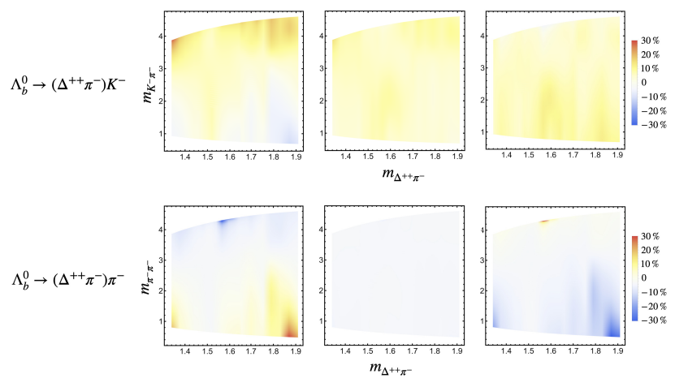
$Nπ$ re-scatterings
Large regional CP asymmetries emerge in Dalitz distributions
Like B meson three body decays, large region CPV emerge, and can be tested in the experiments

Slide 13
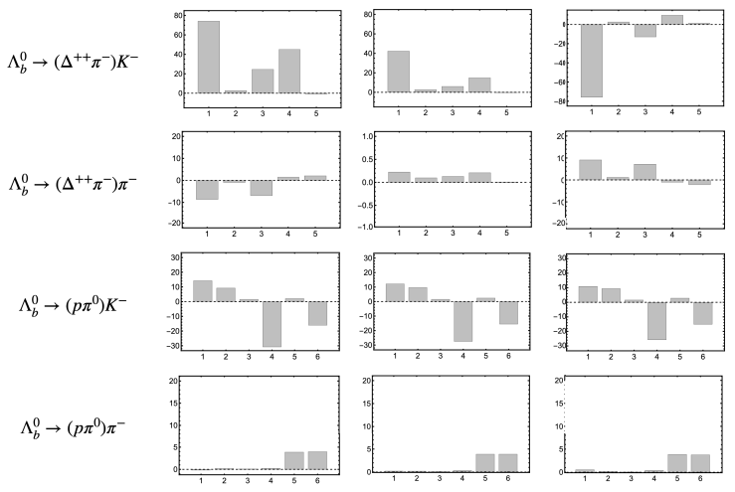
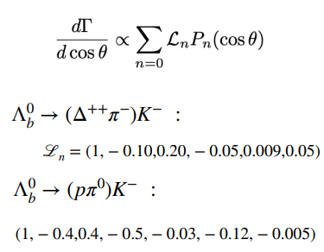
$Nπ$ re-scatterings
The CPV defined by Legendre moments also are given

Slide 14
Phenomenological suggestions and summary
Suggestions: processes
Currently, we only consider $Nπ→pπ^{0}$ and $Nπ→Δ^{++}π^{−}$ to show our results
Full analysis of $Nπ→pπ^{+}π^{−}$ will be done in the near future
$Λ_{b}→Nπ$ form factors can be improved in the future
Thank you

Slide 15
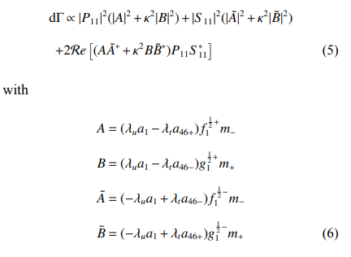
Back up

