Slide 1
Geo of LumiCal & Beyond

Slide 2
Suen Hou

Slide 3
Suen Hou

Slide 4
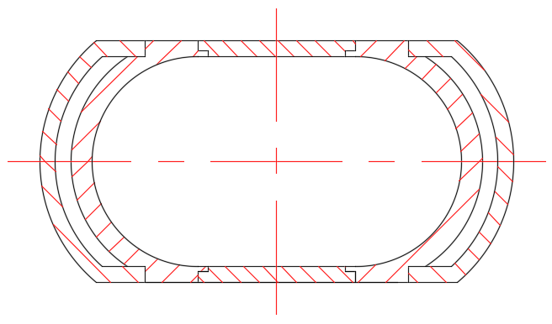
General introduction of beampipe
J. Zhang, Q. Ji
General drawing
a. The extending Al pipe
b. The central Be pipe
c. Air channel
d. Carbon fiber cylinder
e. Combination flange
BPM
LumiCal
Vertex
LumiCal
BPM
Extending pipe
Both sides : Double
Top and Bottom : Single
Basic Structure:
1) Components : a, b, c, d and e
2) Detectors : BPM, LumiCal and Vertex
Total length : 1400 mm
Updated design :
1) Added detector : BPM
2) Extending pipe : The Extending pipe is designed from conical pipe to runway profile
3) Thermal analysis of Beampipe

Slide 5
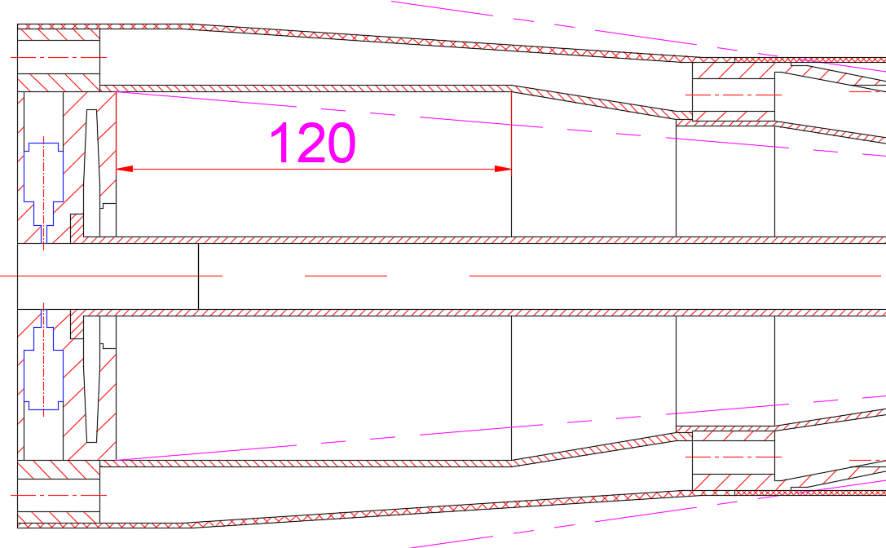
Detailed Structure
J. Zhang, Q. Ji
Three detectors --- BPM and LumiCal
BPM
1. A 2 or 4 electrode-BPM is installed in
each flange
LumiCal
1. Near the flanges, axial length is 120mm
Installation position
LumiCal
The runway type structure is for greater installation space for the lumical
BPM : 2 or 4 electrodes

Slide 6
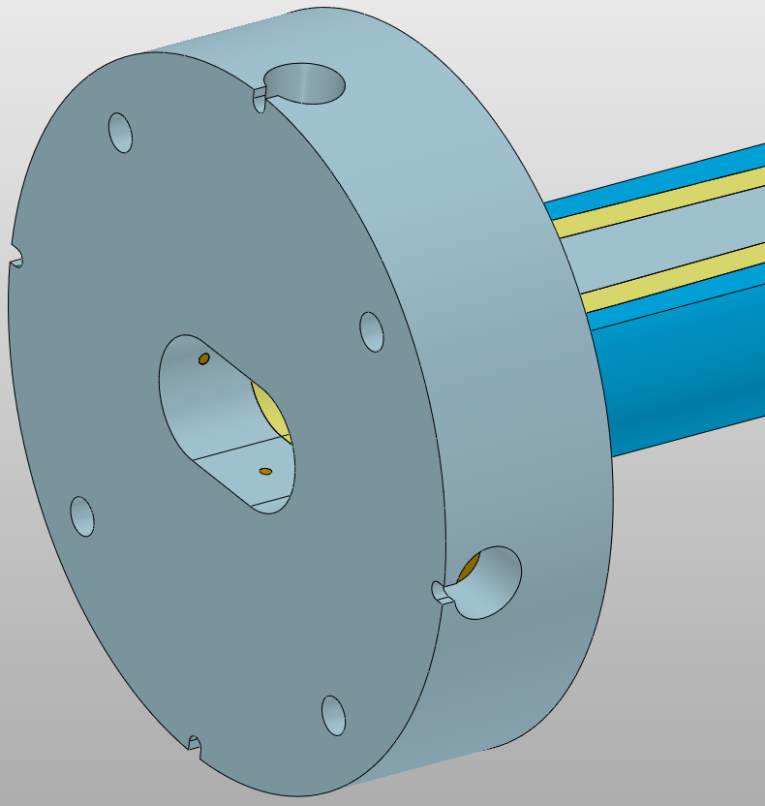
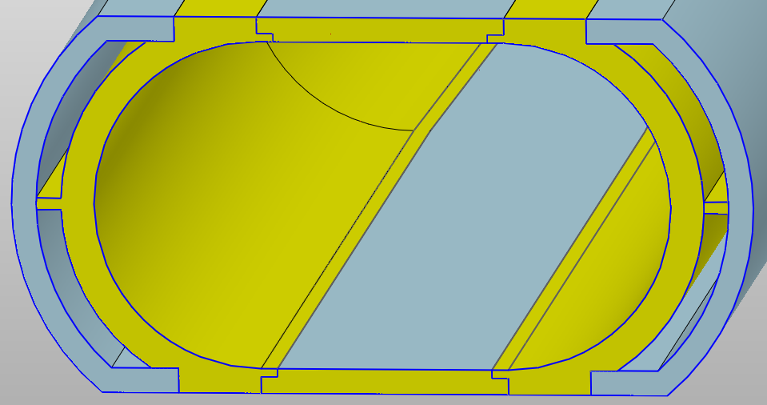
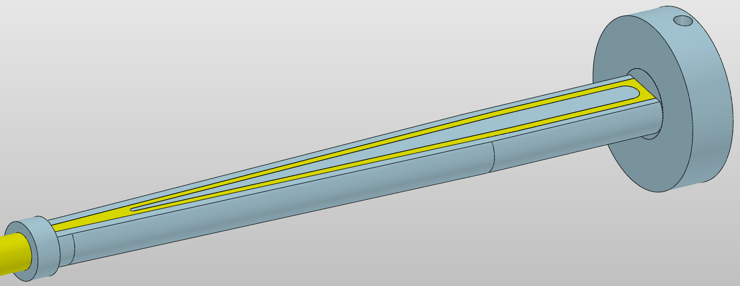
Detailed Structure
J. Zhang, Q. Ji
The extending Al pipe --- Gradient runway type
Thickness of single layer beryllium sheet : 1.5 mm
Double layer
construction
Double layer
construction
Take away
Take away
HOM heat
HOM heat
Coolant : H₂O
Installation space for LumiCal
Total length : 525 mm
The extending Al pipe

Slide 7
Haijing Wang

Slide 8
Haijing Wang

Slide 9
Haijing Wang

Slide 10
Haijing Wang

Slide 11
Haijing Wang

