Slide 1
Vertex readout electronics
Jun Hu
2024.2.22

Slide 2
前端电子学
后端电子学
时钟与触发
电子学工艺及散热

Slide 3
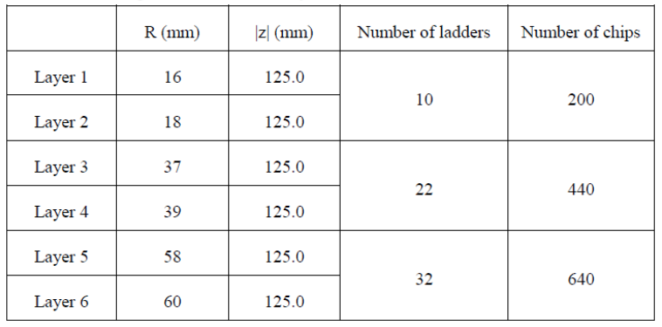
已知需求
通道数：64 double-side ladders
~1280 chips
数据率：160Mbps/chip @trigger
3.2Gbps / ladder

Slide 4
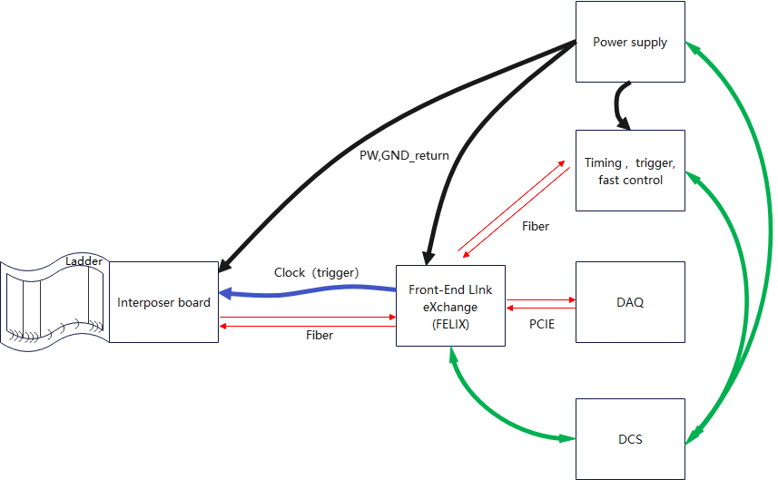
Power supply
Provide higher voltage to front-end
Interposer board
DC-DC：low power supply provider for front-end
Data aggregation to high speed link/optical link（lpGBT, VTRX+）
Chip configuration transmission
Clock and trigger distribution
Clock, trigger, fast control
Fanout the common information to FELIX
Sync with FELIX and provide clean clock，
Front-end module
X64@10Gb/s
FELIX
Route data between optical link of front-end and the highspeed network of DAQ system
Connect with TTC and get synced clock, global trigger decision, reset and so on.
Fanout low speed clock, trigger and reset to front-end
Back-end
(off detector)

Slide 5
Front-end module
Flex
PCB : 1300/Pcs
Component (connectors) : 200/Pcs
Assembly (bonding, glue) : 100/pcs
In total ：1600/Pcs X 64 X 2 = 205k
测试及老化？
Interposer board
ASIC：?

Slide 6
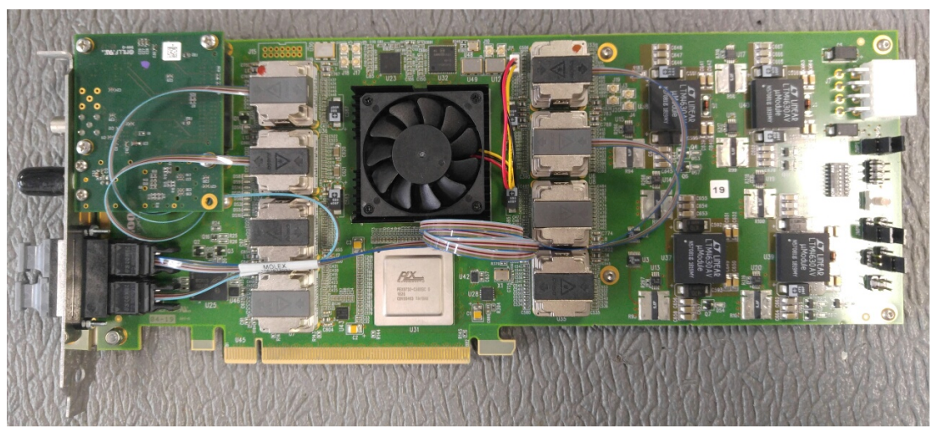
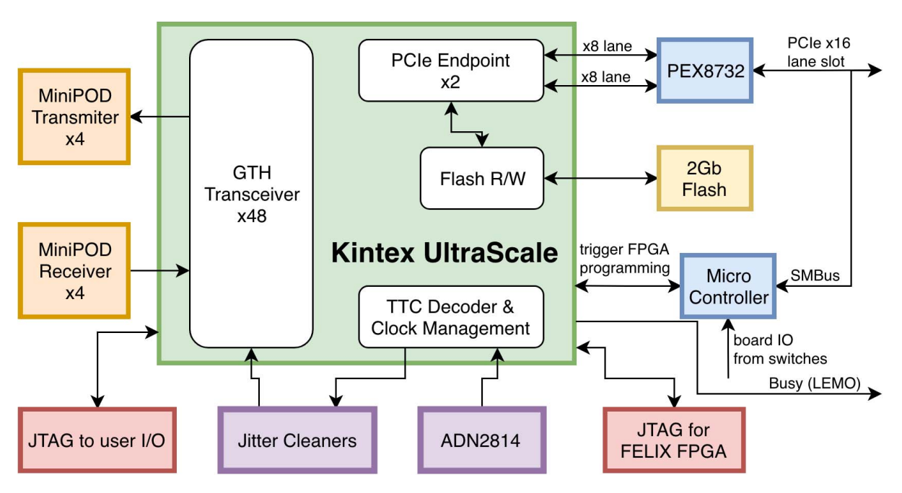
FELIX

Slide 7
FPGA选型考虑
主要综合考虑可用IO资源，成本及可获取性考虑
 | KC705 (XC7K325T-2FFG900C) | KCU105 (XCKU040-2FFVA1156E) | VC709 (XC7VX690T-2FFG1761C) | VCU108 (XCVU095-2FFVA2104E) | XCKU115
Logic Cells(k) | 326 | 530 | 693 | 1,176 | 1451
DSP Slices | 840 | 1920 | 3,600 | 768 | 5520
Memory(Kbits) | 16,020 | 21,100 | 52,920 | 60,800 | 75,900
Transceivers | 16(12.5Gb/s) | 20(16.3Gb/s) | 80(13.1Gb/s) | 32(16.3Gb/s) and 32(30.5Gb/s) | 64(16.3Gb/s)
I/O Pins | 500 | 520 | 1,000 | 832 | 832
Cost | 2748 (650) | 3882(1500) | 8094 | 7770

Slide 8
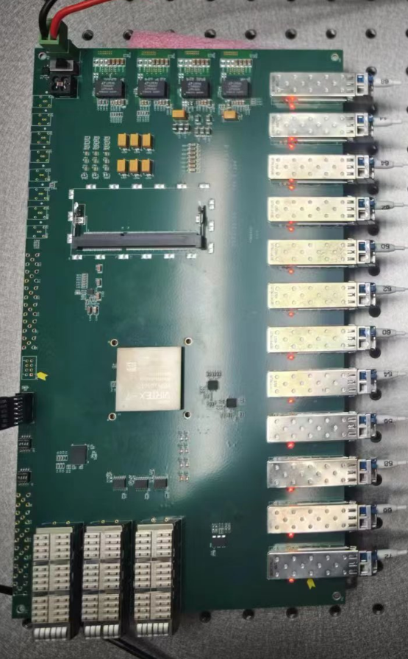
PCB : 4000
Component: 22000
FPGA : 8000
Jitter clean: 400
CDR: 350
DCDC/LDO: 1000
DDR: 250 / 16GB
Opti-connector: 1500
Others：500
WR endpoint : 10000
Assembly : 2000
Test and aging：2000
In total： 30000
XC7VX690T-2FFG1158C
支持1路 X16 PCIE + 32 ch GXH

Slide 9
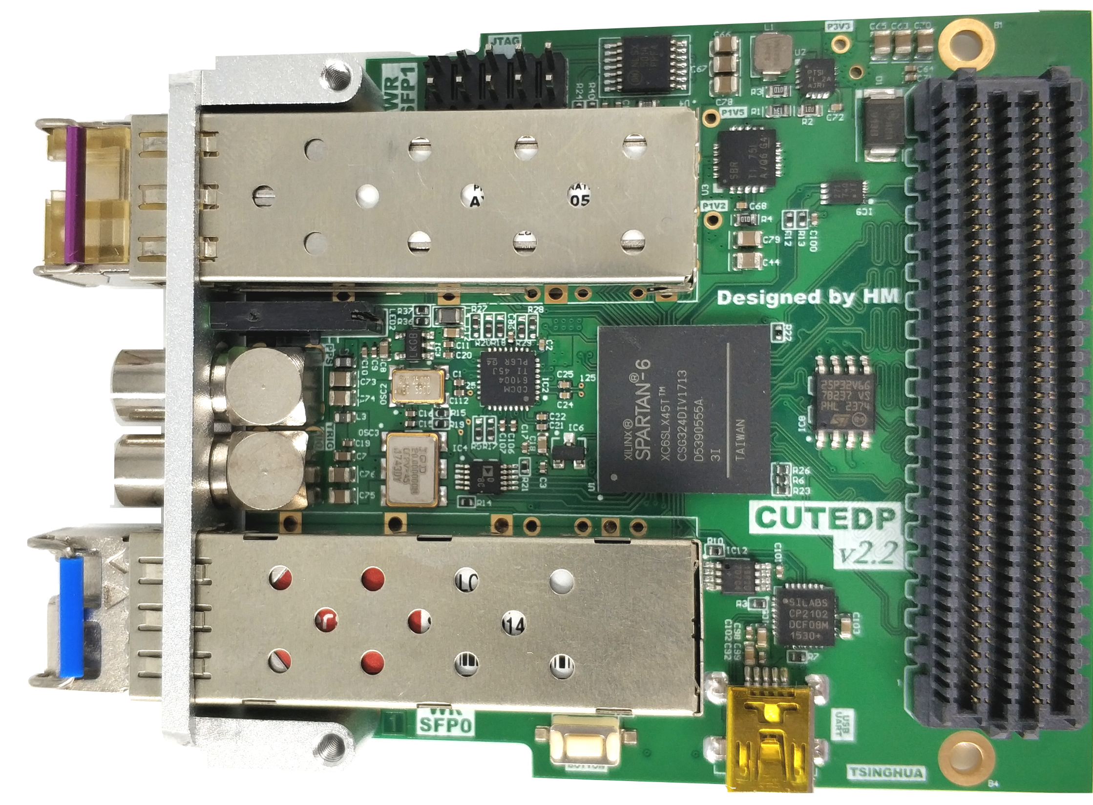
时钟系统（WR）
WR Switch : 40000
WR endpoint : 10000

Slide 10
电源
前端功耗
芯片功耗约为0.4W，按80%效率计算，输出功率0.5W，
每个ladder 功耗 （0.5W + 0.5W) X 20 = 20W
20W/channel带冗余，每通道500元，64通道总计32000元
后端功耗
单板约为64W，每通道1000元，2块总计2000元

Slide 11
线缆
电源线：直径大约2mm，线上电阻<1欧@100m, 单价2元/米
同轴电缆：单价5元/米，每通道2根，
光纤：2元/米
长度按50m计算，每米单价14元

Slide 12
 | Cost | Number | In total
FELIX | 30000 | 2 | 60000
TTC | 40000 | 1 | 40000
Power supply |  |  | 34000
cable | 14 | 50mX64 | 44800
不包含预研费用

