Slide 1
CEPC vertex detector towards TDR
Zhijun Liang,

Slide 2
Towards TDR
Aim to have a draft of TDR by the end of 2024.
System level design, choose baseline technology
Electronics, service and mechanics needs to be included
Major change from CDR to TDR
Beam pipe diameter: 28mm (CDR) → 20mm (TDR) (reduce 30%)
Instant Luminosity per IP:
Z pole: 32×10³⁴ cm-2s-1 (CDR) → 192 ×10³⁴ cm⁻²s⁻¹ (6 times increase)
ZH: 5.6×1034 cm-2s-1 (CDR) → 8.3 ×10³⁴ cm-2s-1 (TDR) (~1.5 times increase)

Slide 3
Subsystem and management for TDR

Slide 4
Weekly meeting
Group Meeting every Thursday afternoon (first meeting last Thursday)
https://indico.ihep.ac.cn/event/21543/
From last meeting, Discussion about the choice of technology
Discussion with L3 Stitching (Mingyi) and SOI (Yunpeng)
Agree to focus CMOS pixel for reference TDR baseline

Slide 5
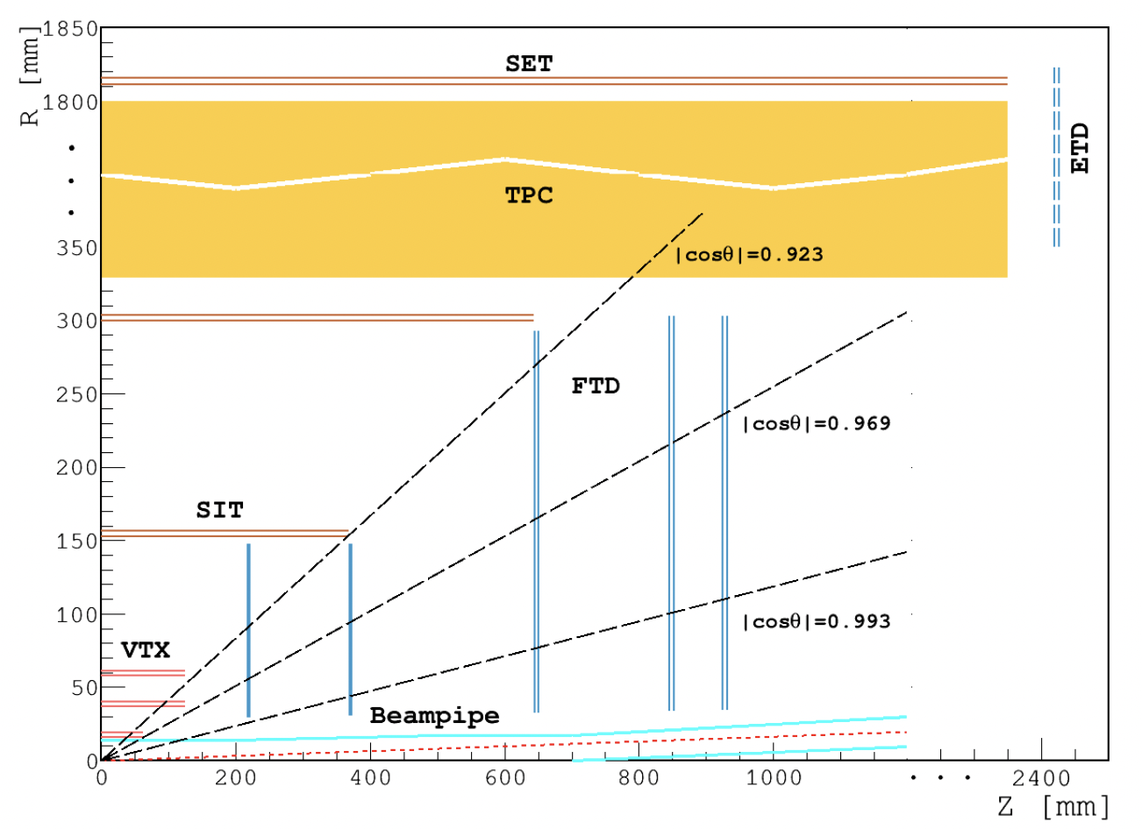
Some mechanics related issue
First informal discussion with Jinyu on mechanics issue yesterday
Cos(theta) coverage
Difficult to reach Cos(theta) <0.993, given the constrained from mechanics and service
Cos(theta) <0.969 is more reasonable ? Any update on global design from CDR ?
The endcap Interference with Beam pipe support tube
Need to iterate with Beam pipe design
Beam pipe design from Jiquan

Slide 6
Key parameters
Single-point spatial resolution (now and in the next 5 years)
Time stamp precision requirement (to be discussed with Shengsun Sun)
Material budget
Cost estimation
Occupancy
Max data rate that can be handled by this technology (now, and in the next 5 years)
Radiation hardness (now, and in the next 5 years)
Power dissipation (now, and in the next 5 years)
Expected Technology availability in the future
Technology Readiness

Slide 7
Plan
Expect to get background input from MDI group this week
End of March: Plan to work with electroncs group to finalize the design
Readout architecture
End of March: finalize the detector geometry and mechnical design

Slide 8
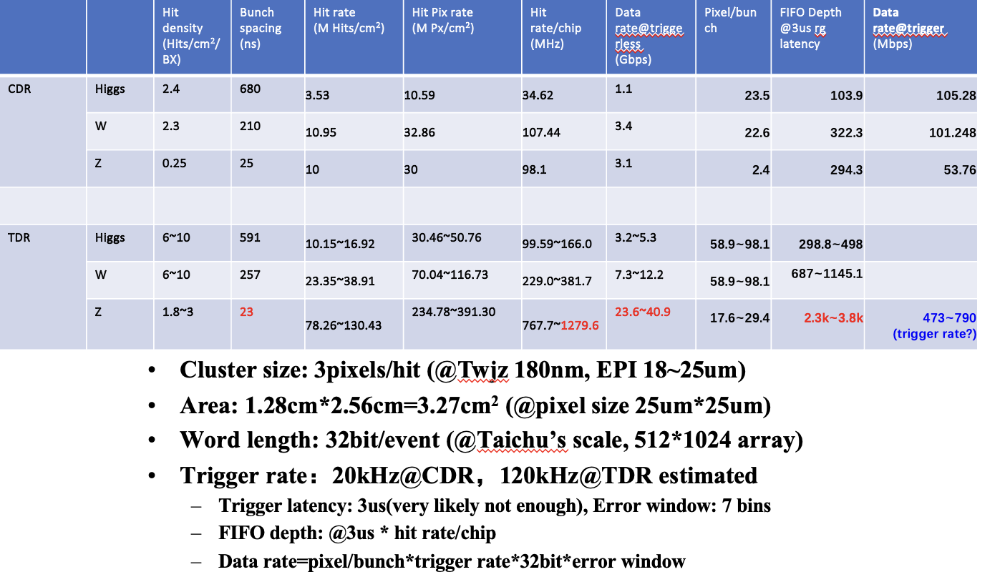
Backup: Plan

Slide 9
Backup: Minute of last meeting (Feb 1st )
Vertex Detector Meeting Minutes
Date: 2024/2/1 Time: 14:30 – 16:00 Participants: Zhijun Liang, Mingyi Dong, Wei Wei, Ying Zhang, Jun Hu, Hongyu Zhang, Ouyang Qun, Yang Zhou, Jinyu Fu, Tianya Wu, Manqi Ruan, Miao He Minutes: Zhijun Liang
Report on the R&D status of sub-detectors
Zhijun: Introduction to the CEPC reference TDR project and updates on the TDR key parameters from the accelerator TDR related to the Vertex detector
Discussions:
Mingyi: Meng Wang assigned Mingyi to be the acting L3 contact for Stitching technology
Mingyi: Stitching does not contradict with SOI or CMOS pixel. Propose to mention Stitching technology as one option in the reference TDR, but it is not competing for the baseline design for this TDR study
Weiwei: Propose to add Ying Zhang as the frontend electronics L3 contact in this TDR project
Zhijun: In TDR, we should mention the key parameters for now and in the next 5 years when the CEPC detector is going to be built. Cooling design will be based on the expected Power dissipation in 5 years.
Discuss the key parameters for justifying the choice of technology:
Single-point spatial resolution (now and in the next 5 years)
Time stamp precision requirement (to be discussed with Shengsun Sun from the reconstruction group)
Material budget
Cost estimation
Max data rate that can be handled by this technology (now, and in the next 5 years)
Radiation hardness (now, and in the next 5 years)
Power dissipation (now, and in the next 5 years)
Expected Technology availability in the future
Technology Readiness
Discuss about including more people from Universities, will do from next meeting.
Discussion about the timeline (draft):
By early March: finalizing the selection of technology
By early April: first version of vertex layout geometry
Discussion with Yunpeng @ Feb 5th
Minutes: Zhijun Liang
Yunpeng propose to focus on CMOS pixel technology, He propose to work on L3 CMOS related topic.
Agree on focusing on CMOS pixel technology as baseline for reference TDR

