Slide 1
Detecting anomalous CP violation in heavy ion collisions through baryon-electric charge correlations
David Frenklakh, Dmitri E. Kharzeev, and Andrea Palermo
arXiv:2402.06754v1

Slide 2
As a consequence of the CP violation
The Chiral Magnetic Effect (CME) electric current
The Chiral Vortical Effect (CVE) baryon current
Old: The γ correlator between two particle species i and j
New: Mixed baryon-electric charge correlator
where i runs over the species of electrically charged hadrons (Q) while j runs over the baryon species (B).

Slide 3
CVE the baryon current
separates baryons along the direction of the angular velocity.
where $N_{B,\overline{B}}^{↑,↓}$is the number of (anti)baryons observed above and below the reaction plane.
Integrate the equation of CVE current
If all the quantities above are homogeneous in space

Slide 4
The azimuthal distribution of hadrons of type i
$$\frac{dN_{i}}{dφ_{i}}=\frac{N_{i}}{2π}[1+2a sin \left(φ_{i}−Ψ_{RP}\right)+\sum_{k}{2 v_{k}\cos{(k\left(φ_{i}−Ψ_{RP}\right))}]}$$
Only the protons and Λ hyperons are observed,
using $N_{Λ} ≈ 0.5N_{p} \text{,}a_{p} \text{=}{ a}_{Λ}$.

Slide 5
At 5.02TeV, $∆γ_{CVE}$ recently extracted by the ALICE Collaboration
$\overline{Λ} Λ$and $\overline{p} p$correlations are not accounted for in the data
Using
this chiral chemical potential is
Here they estimate $f_{CVE}≈f_{CME}/30 = 0.3\%.$

Slide 6
The charges separated by the CME current is
Assuming

Slide 7
The component of ∆γ driven by chiral effects is only a fraction of the ∆γ observed experimentally; we denote this fraction as $f_{CE}$:

Slide 8
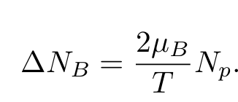
The CVE
For µB ≪ T
New: Mixed baryon-electric charge correlator
where i runs over the species of electrically charged hadrons (Q) while j runs over the baryon species (B).

Slide 9
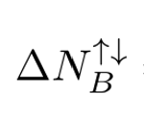
Considering only pions, protons, and Λ hyperons in the final state
Using the azimuthal distribution of hadrons

Slide 10
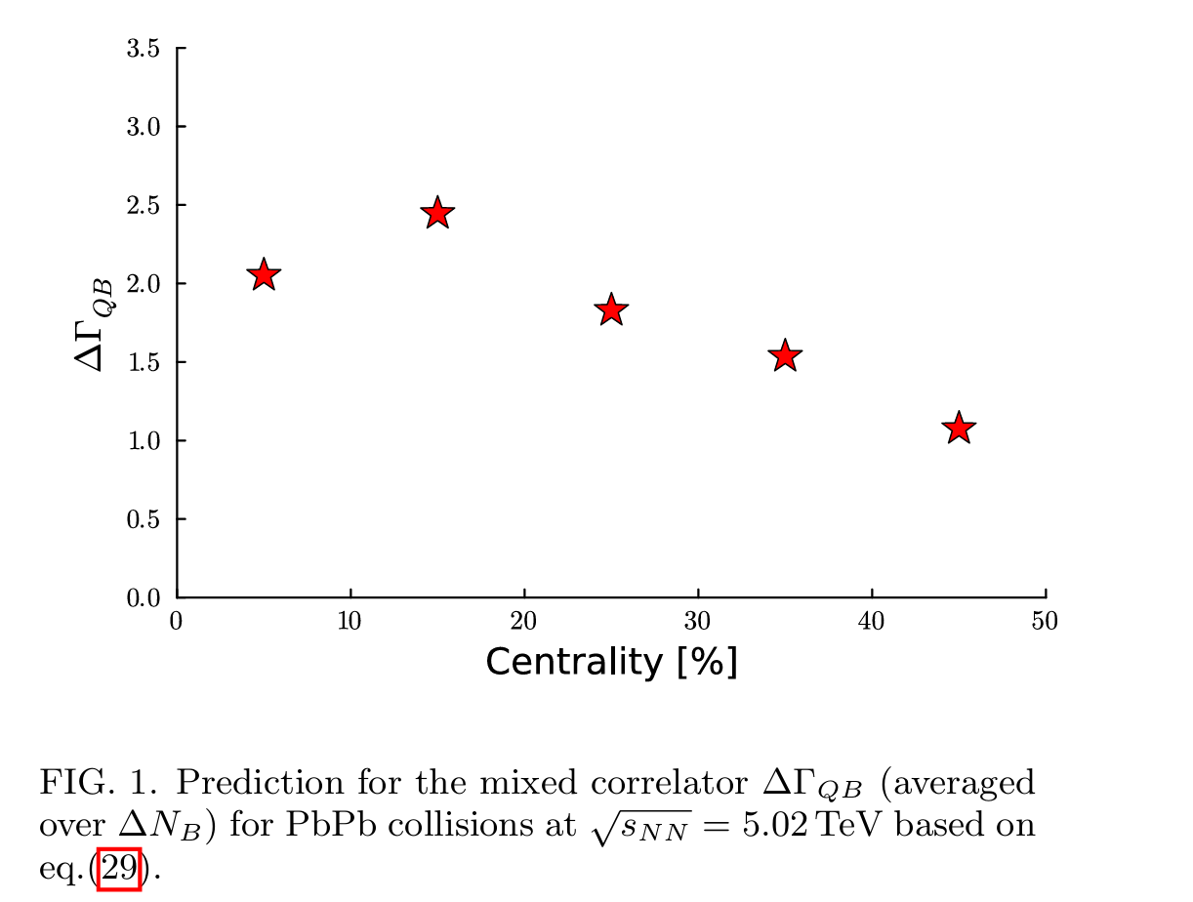

Slide 11
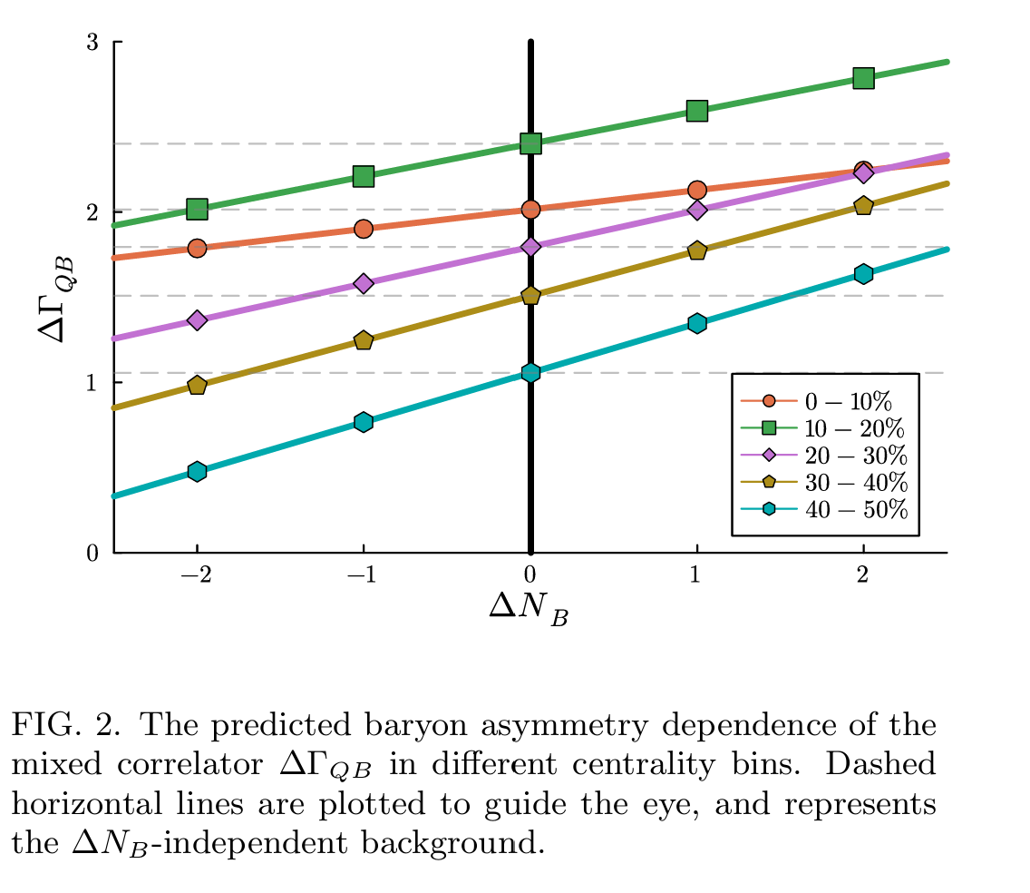
The expected relation without background
${ΔN}_{B }^{↑,↓}$ can have different value and sign event-by-event.
In the presence of background,
where quantities with a star superscript denote a reference measurement of $∆Γ_{QB}$at a specific $∆N_{B}^{∗}$and $f_{Γ}$ is the mixed-correlator signal fraction.
≈ 2%

Slide 12
Test in AMPT 200GeV Au+Au collision

Slide 13
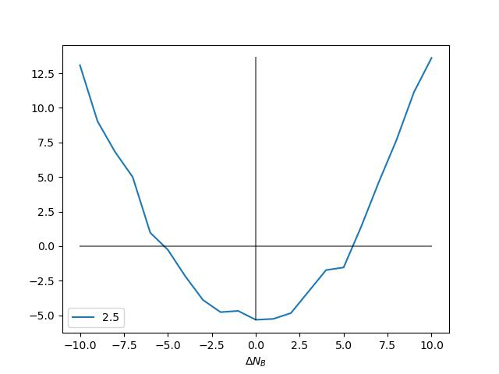
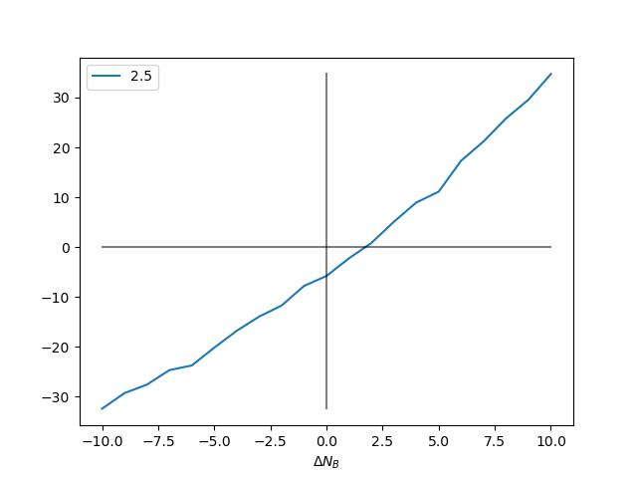
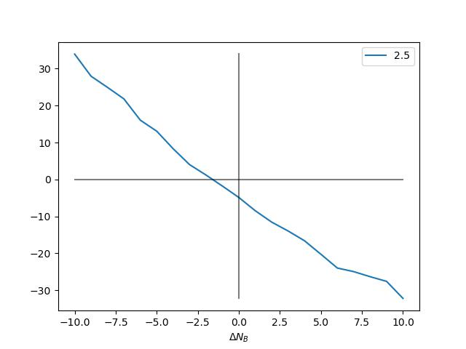
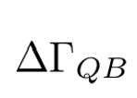
No CVE,CME
$$ΔN_{Q}>0$$
$$ΔN_{Q}<0$$
All $ΔN_{Q}$

Slide 14
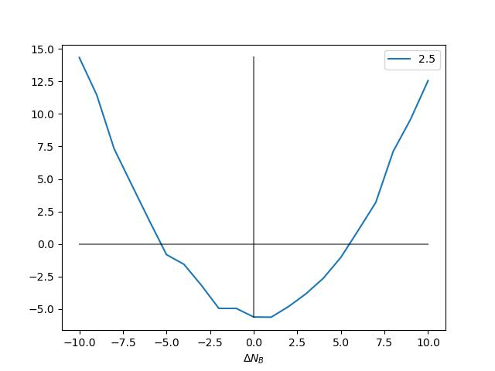
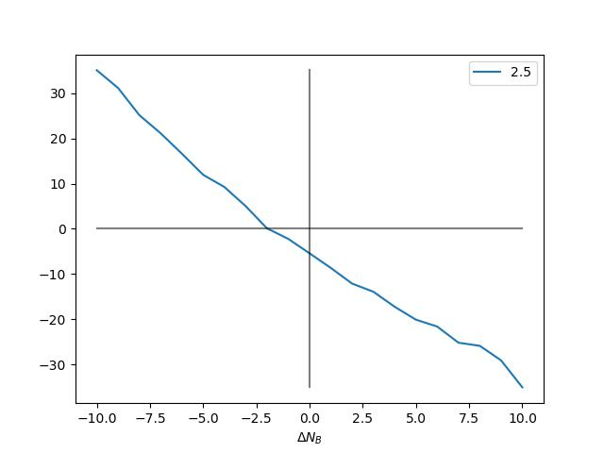
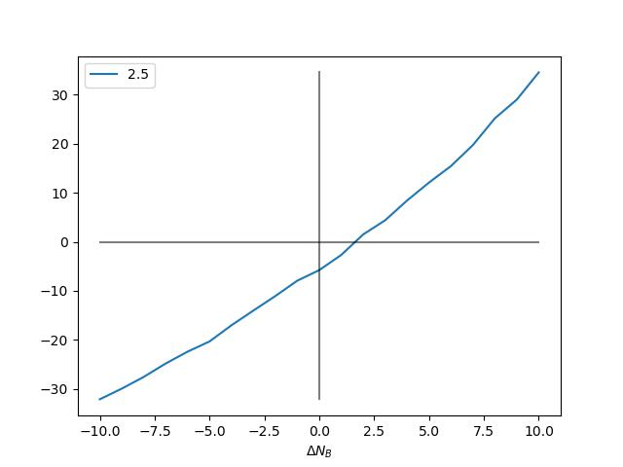
No CVE,
$$ΔN_{Q}>0$$
$$ΔN_{Q}<0$$
All $ΔN_{Q}$
Consider
CME
no CME

Slide 15
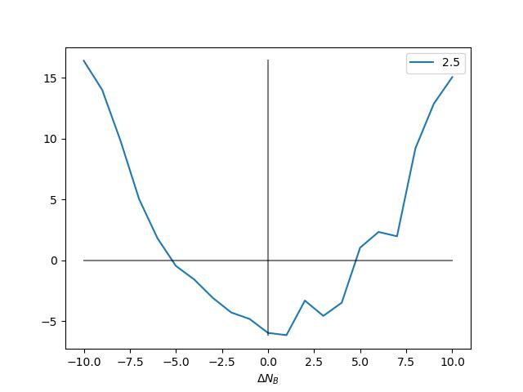
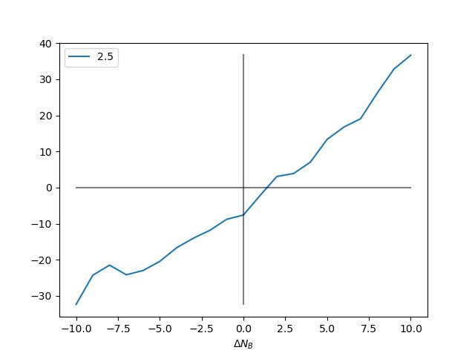
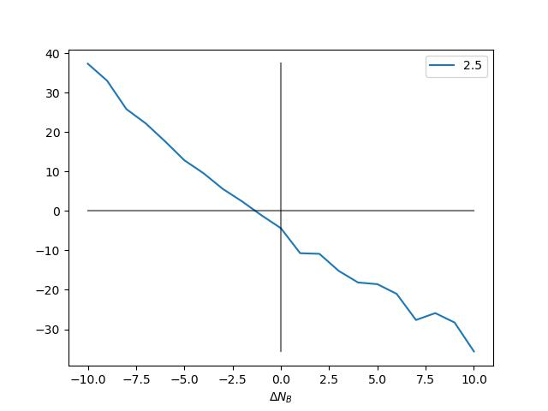
$$ΔN_{Q}>0$$
$$ΔN_{Q}<0$$
All $ΔN_{Q}$
Consider
CVE
no CVE

Slide 16
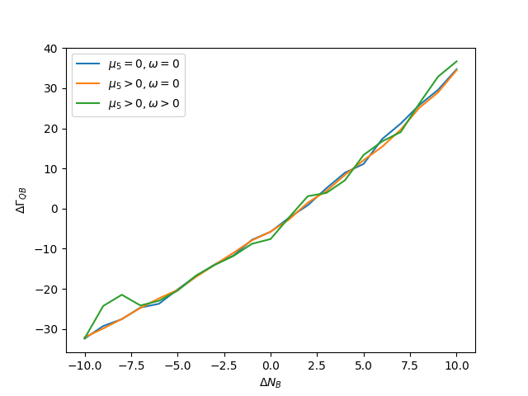
$$ΔN_{Q}>0$$

Slide 17
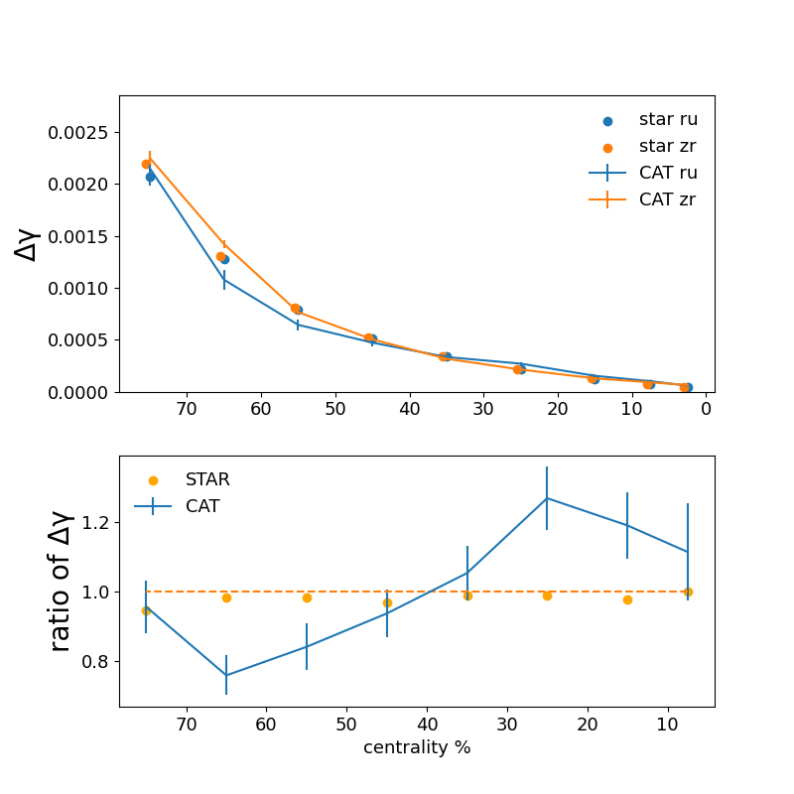
$$μ_{5}=aT+b\sqrt{eB}$$
If $a_{ru}≫a_{zr}$

