Slide 1
CEPC Calorimeter Options: Input Materials (Template)
Name (Affiliation)

Slide 2
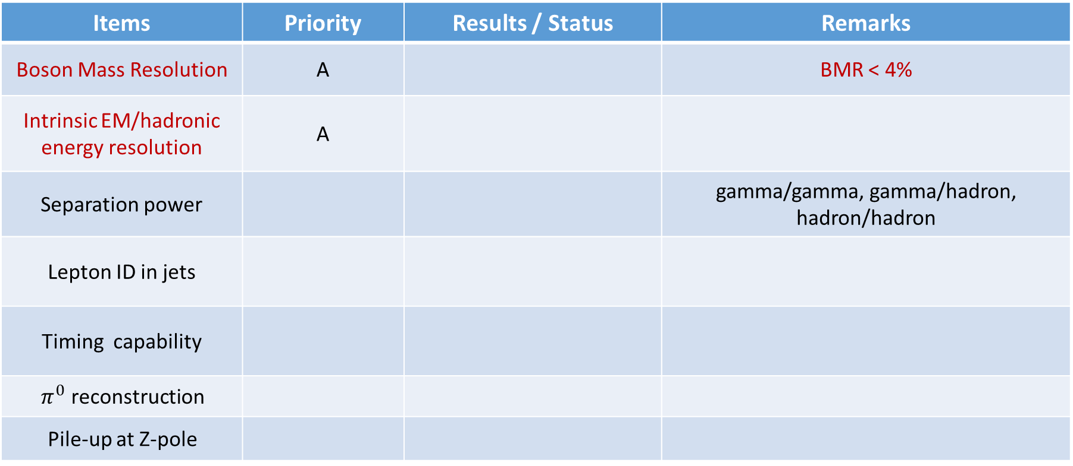
Performance
Items | Priority | Results / Status | Remarks
Boson Mass Resolution | A |  | BMR < 4%
Intrinsic EM/hadronic energy resolution | A
Separation power |  |  | gamma/gamma, gamma/hadron, hadron/hadron
Lepton ID in jets
Timing capability
$π^{0}$ reconstruction
Pile-up at Z-pole
Priority/importance for performance requirements: (A) must-have; (B) plus; (C) not essential

Slide 3
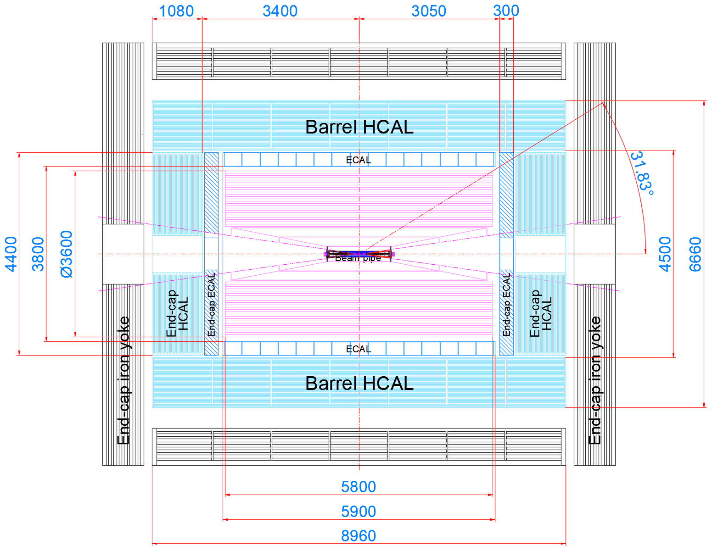
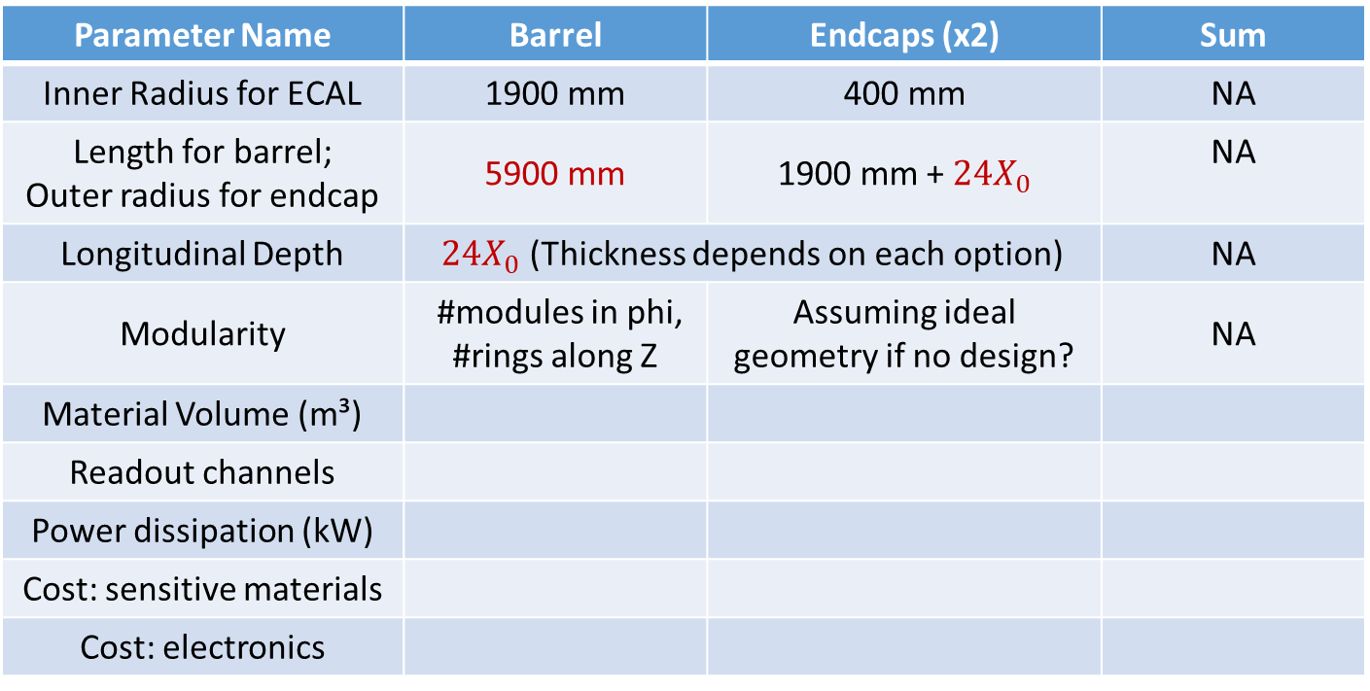
Cost
Mechanics Design by Quan Ji
(Mar. 1, 2024)
Cost table template for ECAL
Parameter Name | Barrel | Endcaps (x2) | Sum
Inner Radius for ECAL | 1900 mm | 400 mm | NA
Length for barrel; Outer radius for endcap | 5900 mm | 1900 mm + $24X_{0}$ | NA
Longitudinal Depth | $24X_{0}$ (Thickness depends on each option) |  | NA
Modularity | #modules in phi, #rings along Z | Assuming ideal geometry if no design? | NA
Material Volume (m³)
Readout channels
Power dissipation (kW)
Cost: sensitive materials
Cost: electronics
* Note: ECAL endcaps will encompass barrel
Please also consider to indicate in extra or supporting materials
Unit cost for key components and materials
References for unit cost or estimates
Uncertainty or risks if applicable

Slide 4
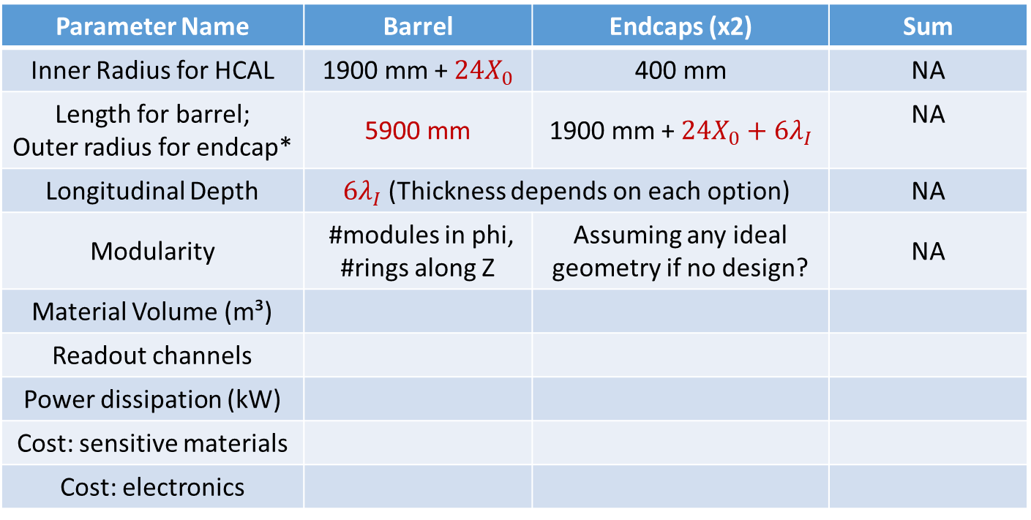
Cost
Mechanics Design by Quan Ji
(Mar. 1, 2024)
Cost table template for HCAL
Parameter Name | Barrel | Endcaps (x2) | Sum
Inner Radius for HCAL | 1900 mm + $24X_{0}$ | 400 mm | NA
Length for barrel; Outer radius for endcap* | 5900 mm | 1900 mm + $24X_{0}+6λ_{I}$ | NA
Longitudinal Depth | $6λ_{I}$ (Thickness depends on each option) |  | NA
Modularity | #modules in phi, #rings along Z | Assuming any ideal geometry if no design? | NA
Material Volume (m³)
Readout channels
Power dissipation (kW)
Cost: sensitive materials
Cost: electronics
* Note (different!): HCAL endcaps will be contained within barrel
Please also consider to indicate in extra or supporting materials
Unit cost for key components and materials
References for unit cost or estimates
Uncertainty or risks if applicable

Slide 5
Technical readiness level
Status and plans of simulation studies and R&D (a table template)
Person power
Category | Status | Design 1 | Other Alternative Design (if any)
Technical Readiness Level | Full Simulation (system level)
 | Full Simulation (module level)
 | Prototyping R&D (common)
 | Prototyping R&D (modules, units)

