Slide 1
Software & Simulation toward Reference Detector TDR
SUN Shengsen
CEPC Detector TDR Plenary Meeting, Feb. 27, 2024

Slide 2
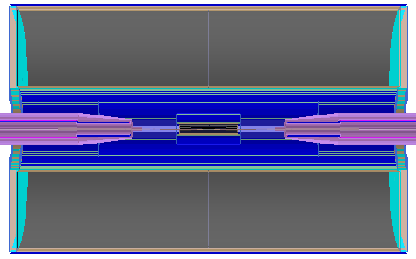
Status of CEPCSW: Toward A Software Version Release
Monday Afternoon 15:00 Multi-disciplinary 228
https://indico.ihep.ac.cn/category/1044/
Geometry:
Preliminary of vertex and tracker (TPC)
Updates of geometry and material of ECal and HCal
Accurate description of detector: Input from hardware
MDC software: release into CEPCSW
dN/dx: simulation of endcap part, release into CEPCSW
ECal: optimization of performance
Arbor porting: Similar BMR, partly using CEPCSoft
Auto-Validations
MDI+Tracker (Silicon+TPC)
VTX: $\left|cosθ\right|<0.99$
Tracker: $\left|cosθ\right|<0.85,$
$0.6m<R<1.8m$
3 layers silicon

Slide 3
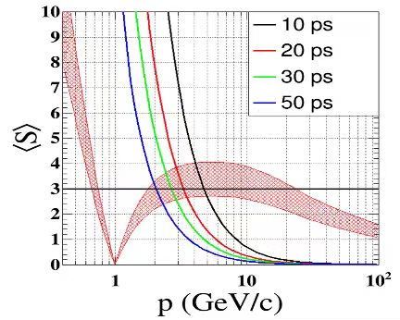
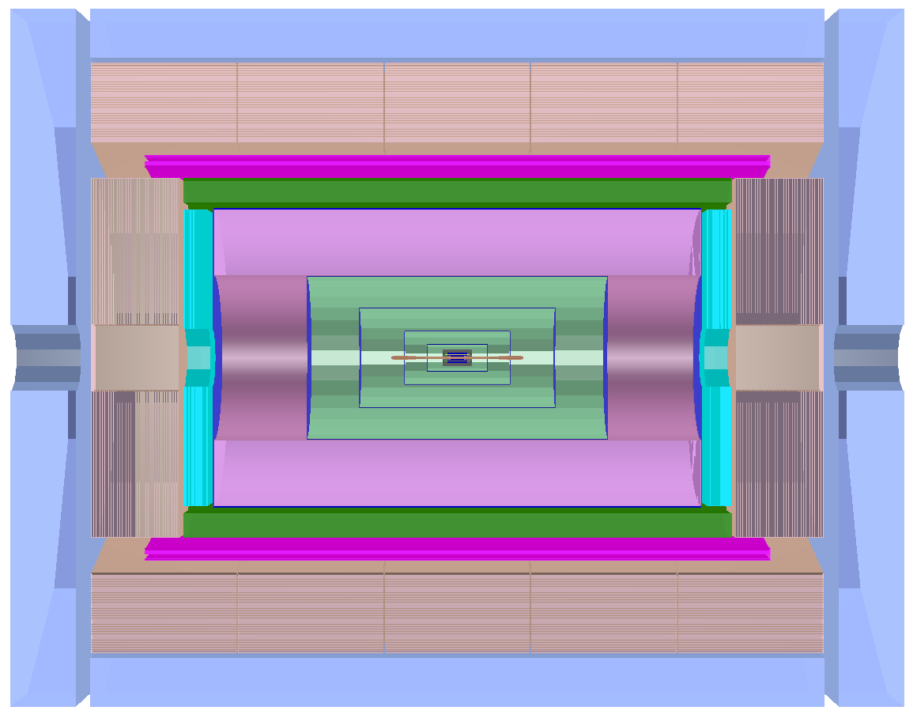
Two Questions about TOF
Discussion with Zhijun
Detection Capacity:
Compensation in 0.7~1.1 GeV/c
Particle can NOT reach TOF: $0.81GeV<p<1.54GeV$
$$p_{T}=0.3qBR>0.81GeV/c$$
$$p>1.54GeV@cosθ=0.85$$
Consider energy loss and material budget, even worse
TOF @ 0.6m?
Event Start Time (Collision Time) is Necessary？
Accuracy of time measurements of each sub-detector?
Trigger in any kind of pattern?
Physics Requirements?

Slide 4
Beam Background
Discussion with Haoyu
Beam background simulation: Generator-like
Interfaces and converter
Distributions (detection unit/time dependent)
Simulation of synchrotron radiation
Thanks manpower contributions!
Thank you!

