Slide 1
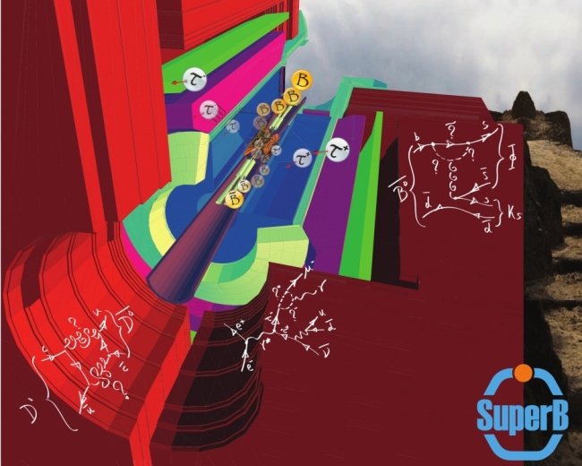
SuperB Physics Programme
Adrian Bevan
IHEP, Beijing, 21st October 2011
email: a.j.bevan@qmul.ac.uk

Slide 2
Overview
Introduction
Data samples available at SuperB
Topics
τ physics
B_{u,d,s} physics
D physics: a few highlights
See the other talks during this workshop (AB, Giorgi, Meadows, Neri, Rama, Sokoloff).
Precision EW
Spectroscopy
Interplay
Precision CKM
Golden modes
Summary

Slide 3
Introduction
Current flavour physics landscape is defined by BaBar, Belle and the Tevatron.
We learned that CKM is correct at leading order.
Placed indirect constraints on NP that will last well into the LHC era. (e.g. H⁺ searches).
SuperB will start taking data in 2016, and the first full run is expected in 2017.
LHCb will have re-defined some areas of flavour physics on that timescale [and take data through to 2017 shutdown].
LHC may (or may not) have found new particles.
Existing mass scale exclusions are model dependent.
In both scenarios results from SuperB can be used to constrain flavour dynamics at high energy.

Slide 4
J. Ellis

Slide 5
LHC Results on SUSY (slide from A. Cakir, Lomonosov XV)
So far no evidence for SUSY.
The SUSY mass scale is now looking likely to be above 1TeV.
This has interesting implications for some of our measurements.
We need to make sure our benchmark processes and assumed scales are still valid as these contours are updated.
Trivial SUSY doesn't exist.

Slide 6
J. Ellis
Need to re-introduce neglected parameters
(ignored because of the curse of dimensionality).
Should use flavour data to constrain NP, currently only a sub-set of observables are used.
... and small tanβ is dead.

Slide 7
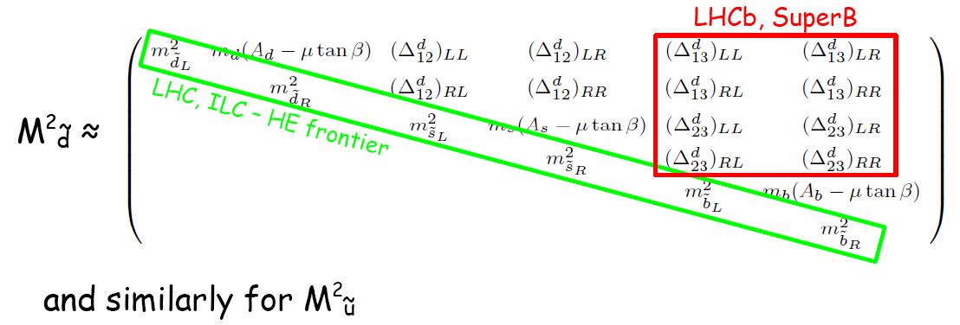
Introduction
Example: Consider MSSM as an illustration of SUSY
Simple, and being constrained by the LHC but general enough to illustrate the issue:
In many NP scenarios the energy frontier experiments will probe the diagonal elements of mixing matrices.
Flavour experiments are required to probe off-diagonal ones.
e.g. MSSM: 124 (160 with ν_{R}) couplings, most are flavour related.
Δ's are related to NP mass scale.

Slide 8
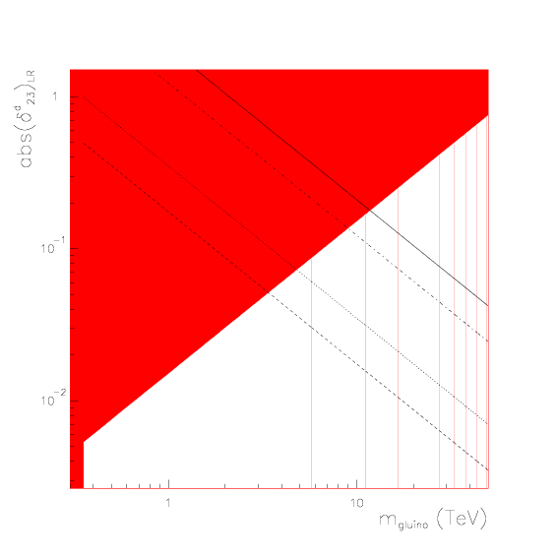
SUSY
e.g. MSSM with generic squark mass matrices.
Use Mass insertion approximation with to constrain couplings:
Can constrain the δ^{d}_{ij}'s using
LHC constraints on the gluino mass, mean couplings are non-zero, and SuperB can provide an upper bound on Λ_{NP}.
1
10⁻¹
10⁻²
δ measured with greater than 3σ significance
1 10 0
e.g. see Hall et al., Nucl. Phys. B 267 415-432 (1986)
Ciuchini et al., hep-ph/0212397

Slide 9
SUSY
e.g. MSSM with generic squark mass matrices.
Use Mass insertion approximation with to constrain couplings:
Can constrain the δ^{d}_{ij}'s using
LHC constraints on the gluino mass, mean couplings are non-zero, and SuperB can provide an upper bound on Λ_{NP}.
1
10⁻¹
10⁻²
δ measured with greater than 3σ significance
e.g. if LHC excludes 1 TeV gluinos, and SuperB measures (δ^{d}₂₃)_{LR}~0.05 would imply Λ_{NP} < 3.5 TeV.
1 10 0
e.g. see Hall et al., Nucl. Phys. B 267 415-432 (1986)
Ciuchini et al., hep-ph/0212397

Slide 10
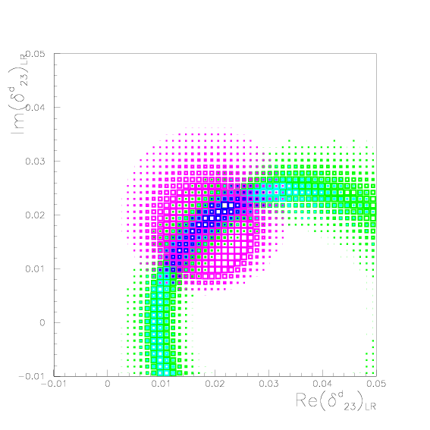
Introduction
e.g. MSSM with generic squark mass matrices.
Use Mass insertion approximation with to constrain couplings:
Can constrain the δ^{d}_{ij}'s using
0.05
0.04
0.03
0.02
0.01
0.0
−0.01
−0.01 0 0.01 0.02 0.03 0.04 0.05
e.g. see Hall et al., Nucl. Phys. B 267 415-432 (1986)
Ciuchini et al., hep-ph/0212397

Slide 11
The rest of this talk is an overview
More details can be found in the following references:
Conceptual Design Report:
arXiv:0709.0451
Valencia Physics Workshop Report:
arXiv:0810.1312
Detector White Paper:
arXiv:1007.4241
Accelerator White Paper:
arXiv:1009.6178
Physics White Paper:
arXiv:1008.1541
Impact Document:
arXiv:1109.5028

Slide 12
Recently submitted to the archive

Slide 13
Data samples available at SuperB
Two distinct modes of operation:
4S region: ϒ(1S) – ϒ(6S).
Charm threshold region: ψ(3770) and nearby thresholds.

Slide 14
Data samples available at SuperB
ϒ(4S) region:
75ab⁻¹ at the 4S.
Also run above / below the 4S.
~75 x10⁹ B, D and τ pairs.
ψ(3770) region:
1ab⁻¹ at threshold.
Also run at nearby resonances.
~4 x 10⁹ D pairs at threshold in a dedicated one year run.

Slide 15
τ Physics
The programme includes
Charged Lepton Flavour Violation
CP Violation
τ EDM
τ g-2
Precision |V_{us}| measurements
[This talk]

Slide 16
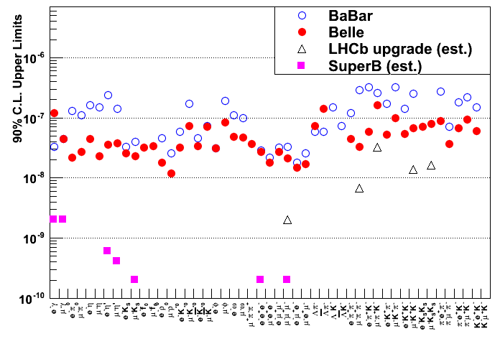
Lepton Flavour Violation (LFV)
ν mixing leads to a low level of charged LFV (B~10⁻⁵⁴).
Enhancements to observable levels are possible with new physics scenarios.
Searching for transitions from 3rd generation to 2nd and 1st, i.e.
and
N.B. e⁻ beam polarisation
helps suppress background.
Two orders of magnitude improvement at SuperB over current limits.
Hadron machines are not competitive with e⁺e⁻ machines for this.
Note: SuperB has only evaluated a few of the accessible modes.

Slide 17
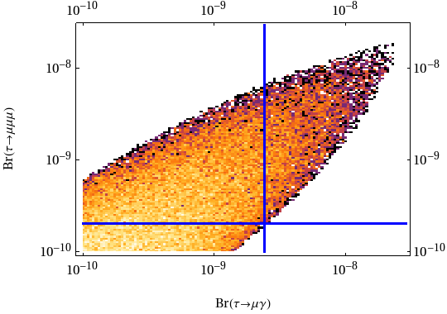
The golden LFV modes: hb
Symmetry breaking scale assumed: 500GeV.
NP scale assumed: 500GeV.
Current experimental limits are at the edges of the model parameter space
SuperB will be able to significantly constrain these models, and either find both channels, or constrain a large part of parameter space.
c/o M. Blanke
M. Blanke et al. arXiv:0906.5454

Slide 18
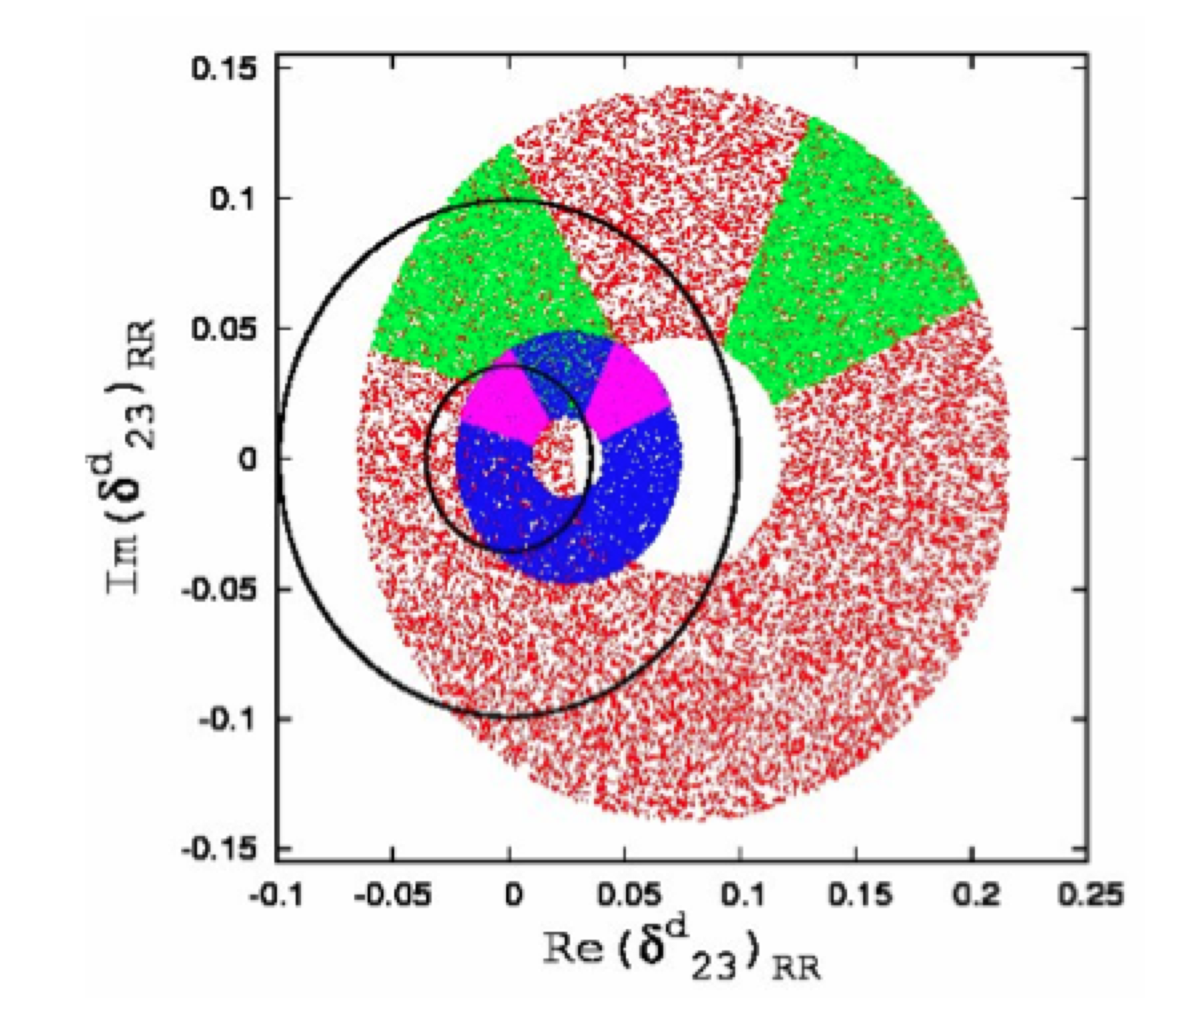
Specific example: k
Only cleanly accessible in e⁺e⁻ (golden modes: μγ, 3 lepton).
Model dependent NP constraint.
Correlated with other flavour observables: MEG, LHCb etc.
BLUE
RED
Not updated to latest results from LHCb
Φ_{s} + Δm_{s}
Δm_{s}
Parry and Zhang Nucl.Phys.B802:63-76,2008

Slide 19
B_{u,d,s} Physics
The programme includes
Rare decays
CKM angles and sides
CPT
[This talk]
[This talk]

Slide 20
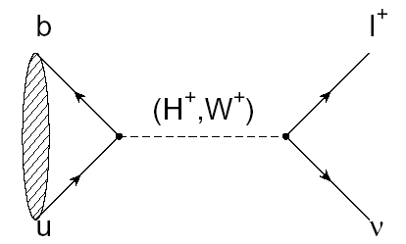
B_{u,d} physics: Rare Decays
Example:
Rate modified by presence of H⁺
Currently the inclusive b to sγ channel excludes m_{H+} < 295 GeV/c².
The current combined limit places a stronger constraint than direct searches from the LHC for the next few years.

Slide 21
B_{u,d} physics: Rare Decays
Example:
Need 75ab⁻¹ to observe pseudoscalar and vector modes.
With more than 75ab⁻¹ we could measure polarisation.
Sensitive to models with
Z', RH currents and light scalar particles.
e.g. see Altmannshofer, Buras, & Straub
Constraint on (ε, η) now
with 75ab⁻¹
(Theoretical uncertainties)
(Experimental uncertainties)

Slide 22
b→ sl⁺l⁻
SuperB can measure inclusive and exclusive modes:
Crosscheck results to understand source of NP.
Important as theory uncertainties differ.
Expect: 10-15,000 K*μμ and 10-15,000 K*ee events.
SuperB can study all lepton flavours:
Equal amounts of μ and e final states can be measured.
Need both of these to measure all NP sensitive observables.
LHCb will accumulate slight more events in the μμ mode.
Expect superior statistics wrt LHCb for ee mode.
S/B~ 0.3, c.f. S/B~1.0 for LHCb.
Can also search for K^{(*)}τ⁺τ⁻ decay.
... and constrain Majorana ν's using like sign final states.
Also of interest for D_{s} decays to K^{(*)}ll final states near charm threshold.

Slide 23
TDCPV in B decays (i.e. CKM angles β & α)
There are many redundant measurements of the CKM angles that are potential probes of NP.
Can also measure α using all modes: ππ, ρπ, ρρ, a₁π
Current precision = BaBar to avoid having to worry about correlated errors in averages when performing extrapolations

Slide 24
B_{s} physics
Can cleanly measure A^{s}_{SL} using 5S data
SuperB can also study rare decays with many neutral particles, such as , which can be enhanced by SUSY.
Little Higgs (LTH) scenario

Slide 25
D Physics
The programme includes
Mixing
CP Violation
Quantum Correlation based measurements
Rare decays
See the talks by AB, Brian, Matteo, Mike, Nicola for more details on the SuperB charm programme

Slide 26
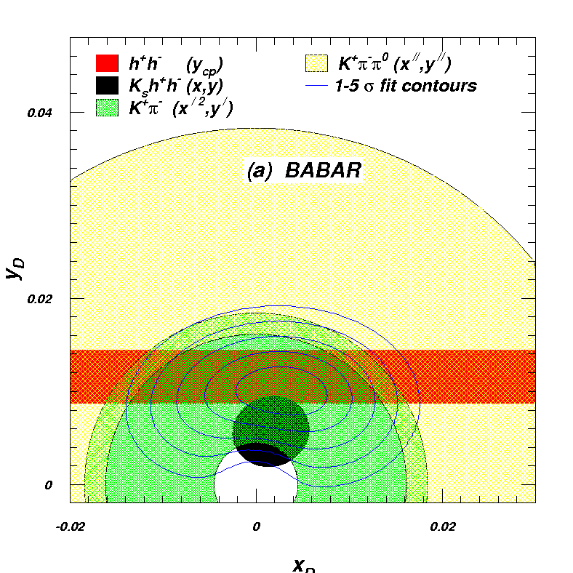
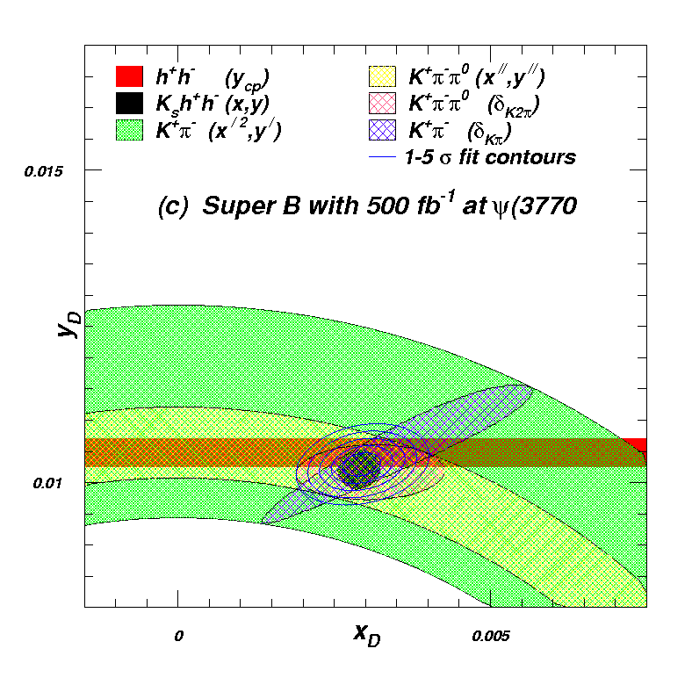
Charm Mixing
Collect data at threshold and at the 4S.
Benefit charm mixing and CPV measurements.
Also useful for measuring the Unitarity triangle angle γ (strong phase in D→Kππ Dalitz plot).
See the talk by Nicola Neri

Slide 27
The quest for the final angle of the CKM matrix: β_{c}
The charm cu triangle has one unique element: β_{c}
Precision measurement of mixing phase in many channels (<2°)
Constrain β_{c,eff} using a Isospin analysis
Search for NP and constrain β_{c,eff} ~ 1°.
Can only fully explore in an e⁺e⁻ environment.
Data from the charm threshold region completes the set of 5 |V_{ij}| to measure: needs SuperB to perform an indirect test of the triangle.
AB, Inguglia, Meadows, arXiv:1106.5075
See the talk by Brian Meadows

Slide 28
Charm Mixing: Summary
Can perform a precision measurement of charm mixing.
TDCPV study of K⁺K⁻ will provide a 1.3° measurement of the mixing phase (arXiv:1109.4494).

Slide 29
Rare D Decays (some examples)
Use 4S and ψ(3770) data to search for a number of important channels:
Measure of the long distance contributions to the di-muon mode.
Enables us to understand if μμ exhibits new physics or not.
Expect to reach sensitivities ~10⁻⁷.
SM rate is ~1×10⁻⁸.
Threshold running and D recoil techniques will play a role.
See arXiv:1008.1541
Invisible final state is helicity suppressed in the SM.
Sensitive to new scalar particles (e.g. Dark Matter etc).
Experimentally need to use the D recoil technique to search for these states :
i.e. fully reconstruct one D meson, and search for the rare decay using whatever is left.
two-neutrino final state will be hard, irreducible backgrounds going down the beam pipe).
invisible+γ may be another story.
Work in progress
See PRD82:034005, 2010
See the talk by AB

Slide 30
Precision EW Physics

Slide 31
Precision Electroweak
sin²θ_{W} can be measured with polarised e⁻ beam:
√s=ϒ(4S) is theoretically clean, c.f. b-fragmentation at Z pole.
Measure LR asymmetry in
at the ϒ(4S) to same precision as LEP/SLC at the Z-pole.
Complements measurements planned/underway at lower energies (QWeak/MESA).
SuperB
Polarised electrons possible at ψ(3770) if boost kept below ~0.6
Need to evaluate precision at that energy
Plot adapted from QWeak proposal (JLAB E02-020)

Slide 32
Spectroscopy

Slide 33
Spectroscopy
Wide range of searches that can be made:
SM searches, and understanding the properties particles, e.g. of X, Y, Z (establishing quantum numbers and resolving issues in the field).
Searching for light scalar particles (Higgs and Dark Matter candidates).
Di-lepton and 4-lepton final states can be used to test:
lepton universality (c.f. NA62, many possible measurements in this area).
models of Dark Forces (few GeV scalar field in the dark sector).
Remember that BaBar's most cited paper is the discovery of the D_{sJ}.

Slide 34
Interplay
Combine measurements to elucidate structure of new physics.
✓
✓
✓
✓
✓
✓
✓
✓
✓
✓
✓
✓
✓
✓= SuperB can measure this
More information on the golden matrix can be found in arXiv:1008.1541, arXiv:0909.1333, and arXiv:0810.1312.

Slide 35
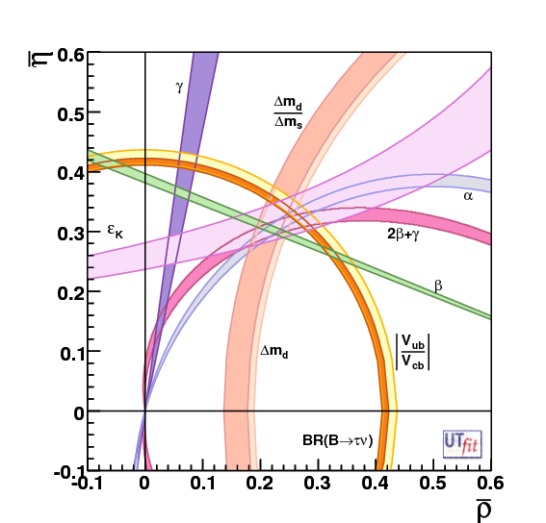
Precision CKM constraints
The "dream" scenario with 75ab⁻¹
Unitarity Triangle Angles
σ(α) = 1−2°
σ(β) = 0.1°
σ(γ) = 1−2°
CKM Matrix Elements
|V_{ub}|
Inclusive σ = 2%
Exclusive σ = 3%
|V_{cb}|
Inclusive σ = 1%
Exclusive σ = 1%
|V_{us}|
Can be measured precisely using τ decays.
|V_{cd}| and |V_{cs}|
can be measured at/near charm threshold.
SuperB Measures the sides and angles of the Unitarity Triangle.

Slide 36
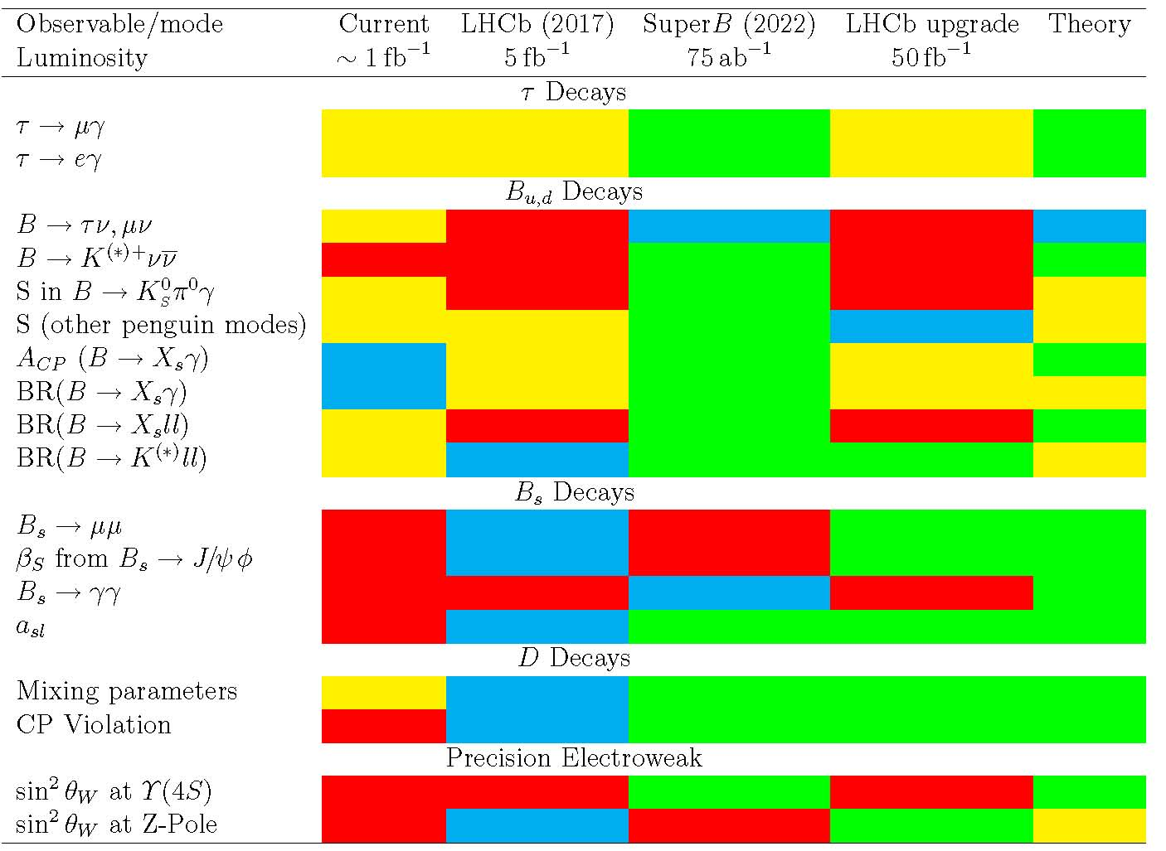
Golden Measurements: General
Benefit from polarised e⁻ beam
very precise with improved detector
Statistically limited: Angular analysis with >75ab⁻¹
Right handed currents
SuperB measures many more modes
systematic error is main challenge
control systematic error with data
SuperB measures e mode well, LHCb does μ
Clean NP search
Theoretically clean
b fragmentation limits interpretation

Slide 37
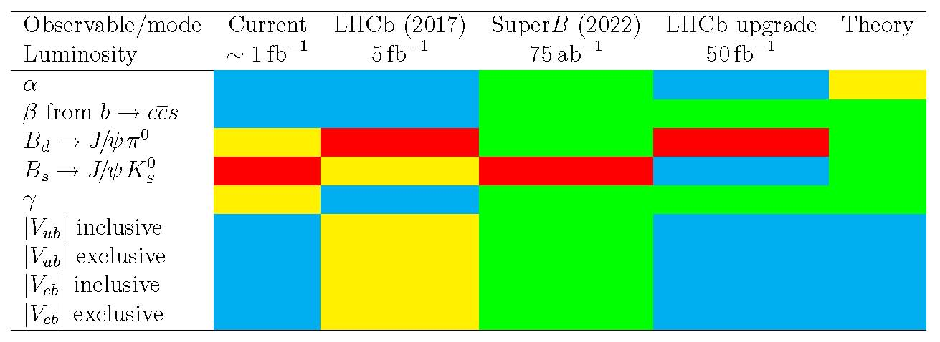
Golden Measurements: CKM
Comparison of relative benefits of SuperB (75ab⁻¹) vs. existing measurements and LHCb (5fb⁻¹) and the LHCb upgrade (50fb⁻¹).
LHCb can only use ρπ
βtheory error B_{d}
βtheory error B_{s}
Need an e⁺e⁻ environment to do a precision measurement using semi-leptonic B decays.

Slide 39
+ A number of charm decay
analogues under investigation

Slide 40
With the exceptions of y_{CP} and K*μμ, there are no planned or existing experiments that will surpass SuperB precision in these modes for at least the next two decades.
The best place to measure the other 33 golden modes is SuperB!

Slide 41
Of course, this summary is based on what we will be able to measure and is an important part of the bigger picture.
Globally the community has a strong flavour physics programme and many other inputs will help in elucidating the detailed nature of new physics.
With the exceptions of y_{CP} and K*μμ, there are no planned or existing experiments that will surpass SuperB precision in these modes for at least the next two decades.
The best place to measure the other 33 golden modes is SuperB!

Slide 42
Physics programme in a nutshell
Versatile flavour physics experiment:
Probe new physics observables in wide range of decays.
Pattern of deviation from Standard Model can be used to identify structure of new physics.
Clean experimental environment means clean signals in many modes.
Polarised e⁻ beam benefit for τ LFV searches (unique feature).
Charm threshold running adds many more observables, and improves potential of SuperB (unique feature).
Measure angles and sides of the Unitarity triangle.
Measure other CKM matrix elements at threshold and using τ data.
SuperB is working on a TDR for 2012.
Will be followed by a physics book some time later.
Plenty of open areas for newcomers to work on!

