Slide 1
LGAD based time of flight and outer tracker
Yunyun Fan, Mei Zhao, Mengzhao Li, Zhijun Liang
On behalf of the ToF group
Mar. 1, 2024

Slide 2
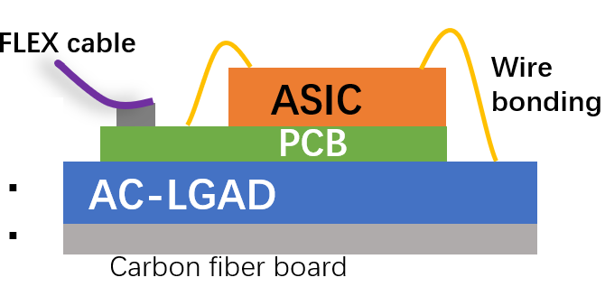
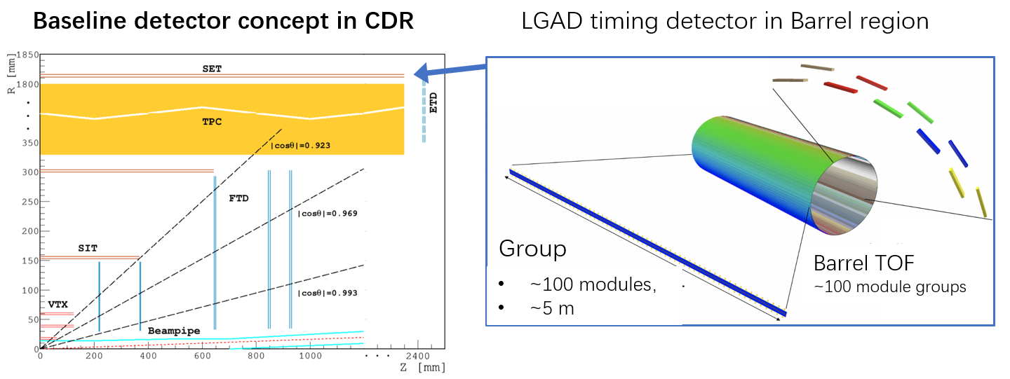
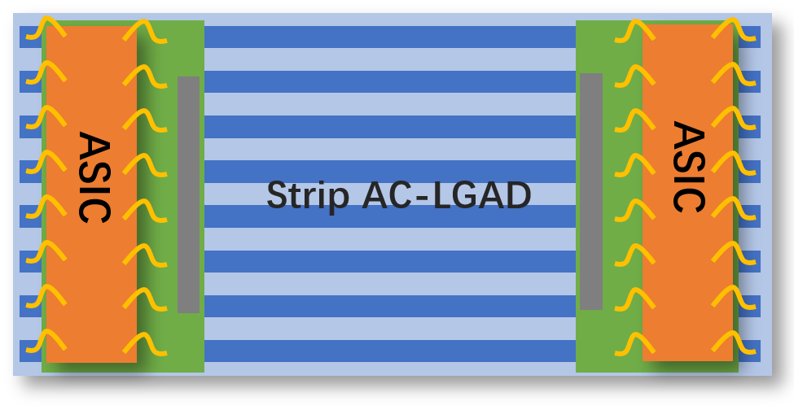
CEPC 4D outer tracker
CEPC 4D outer tracker concept design：
Y
  Should be part of SET (silicon wrapper layer outside TPC or drift chamber)
  Serve as Timing detector and part of the tracker
  Barrel : 50 m² , Endcap 20 m² , ~ 10⁶ channels
  Strip AC-LGAD ( each strip: 4 or 10 cm × 0.05cm)
    Timing resolution: 30-50 ps
    Position resolution: ~ 10 μm @ R-phi direction
    ~ 1mm @ z direction
Z
Strip AC-LGAD + ASIC ：
TOT->amplitude->charge sharing->position
TOA+TOT->timing (time–amplitude correction)
mzli@ihep.ac.cn

Slide 3
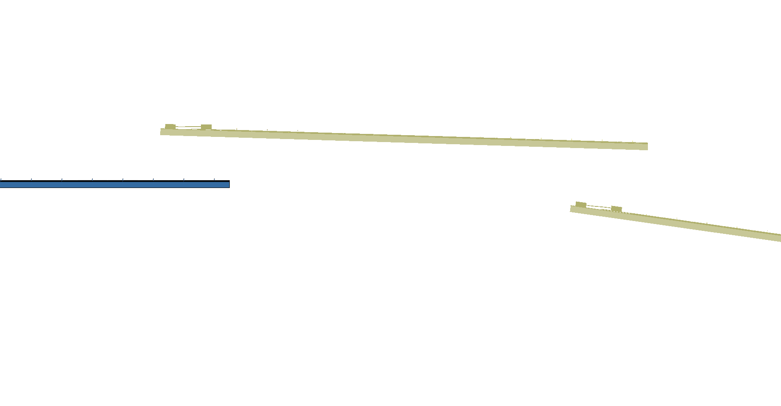
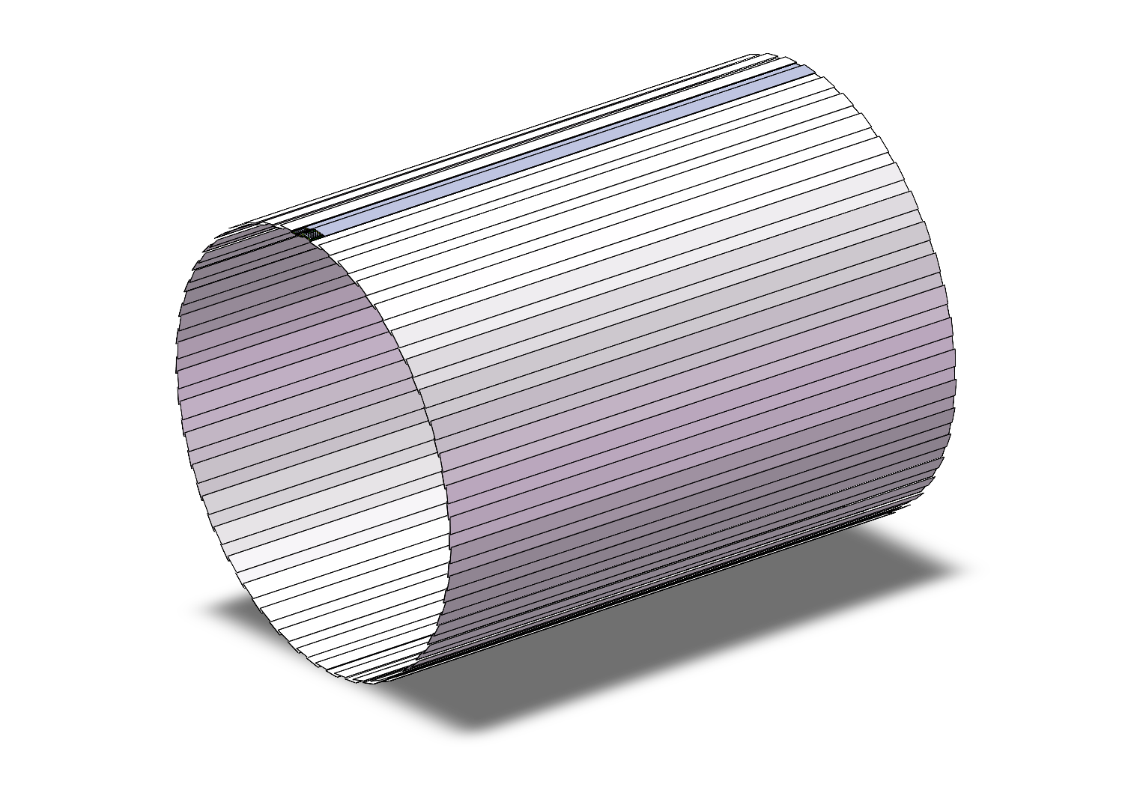
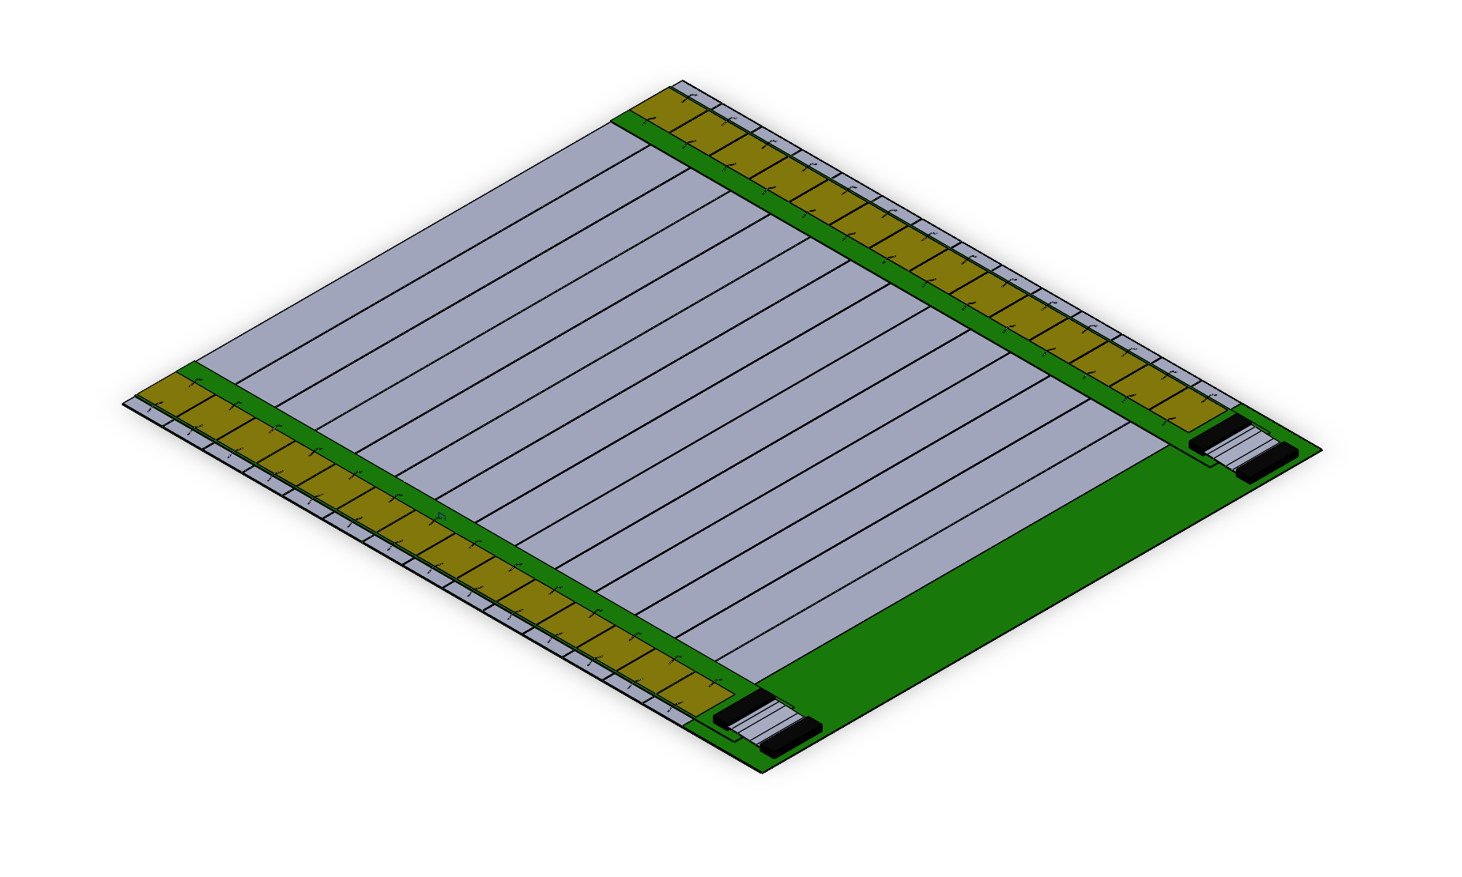
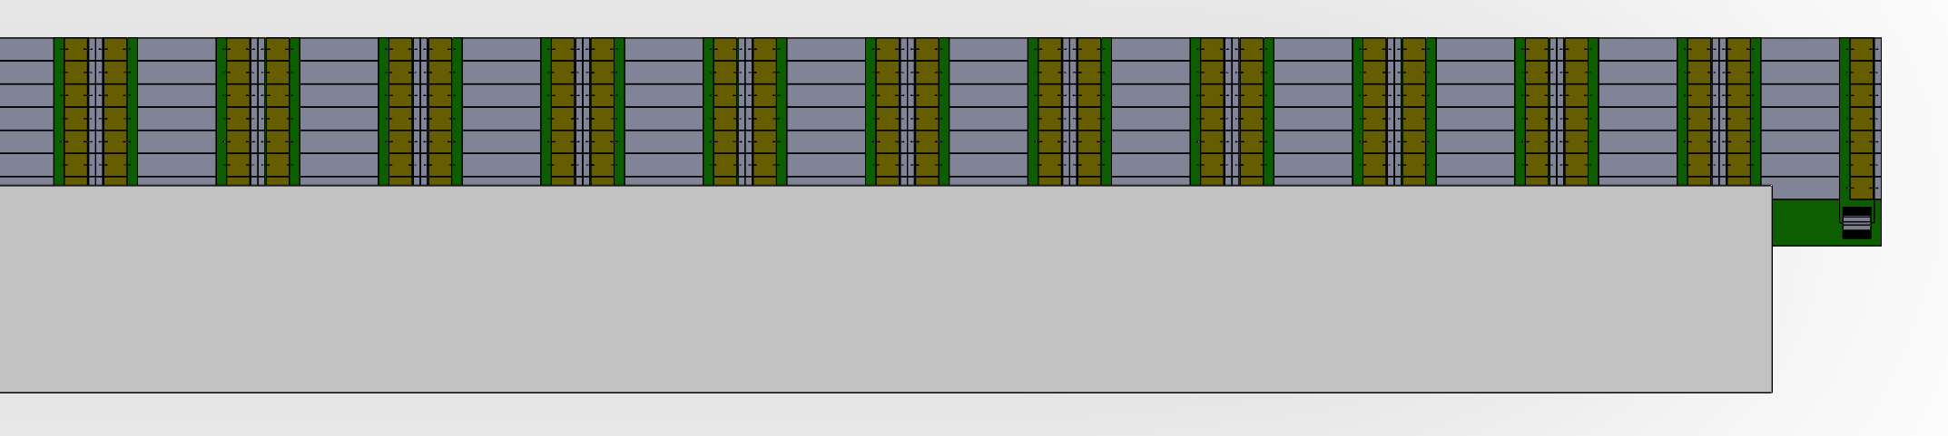
Arrangement of the ToF with strip LGAD
One layer ToF
R= 1800 mm
H～5000mm
One layer:
90 ladders，45 ladders each side,
36 modules/ladder，14 strip/module
Total modules needed：
45 *2*36 = 3240 modules
Module
140mm x 160mm
Ladder

Slide 4
Backup

Slide 6
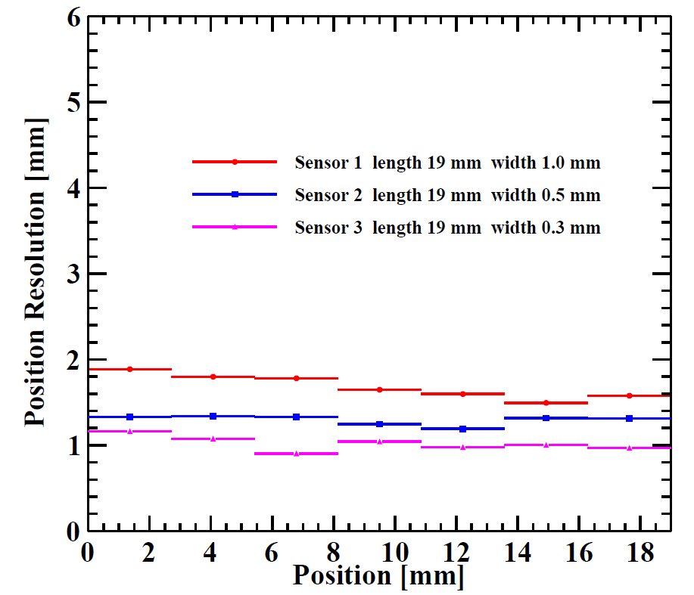
Strip direction resolution from double side readout

Slide 7
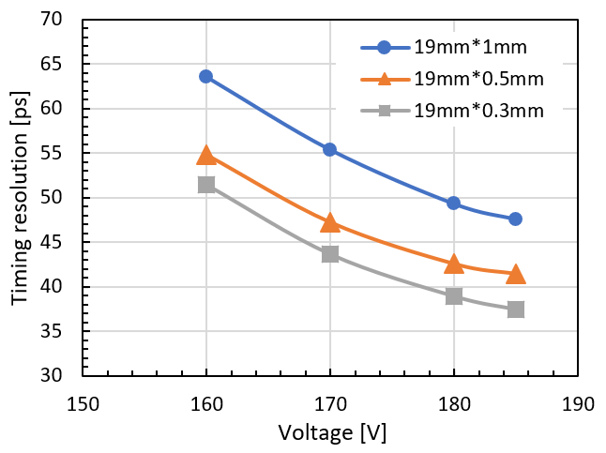
Timing resolution (different dimension of strip )

Slide 8
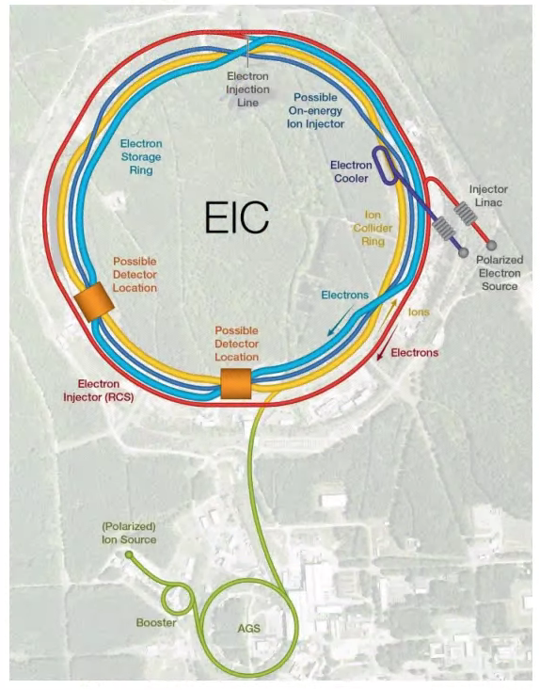
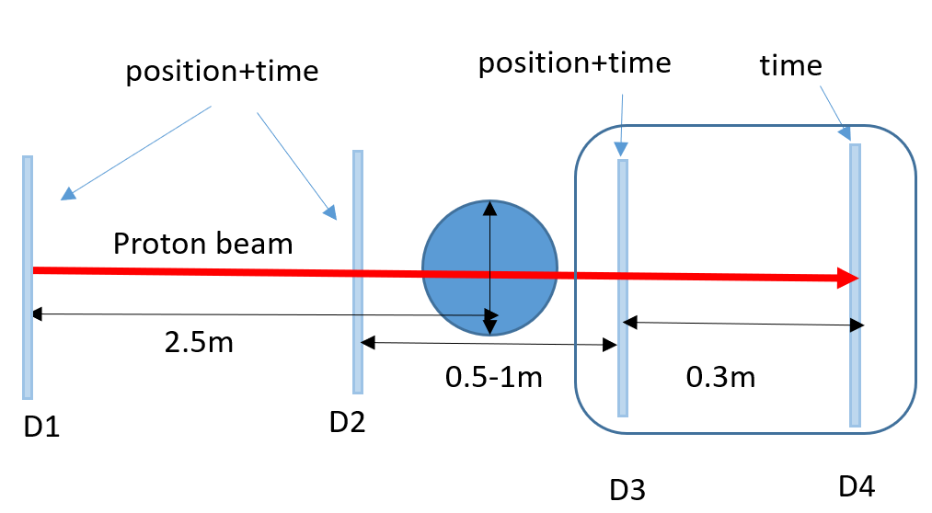
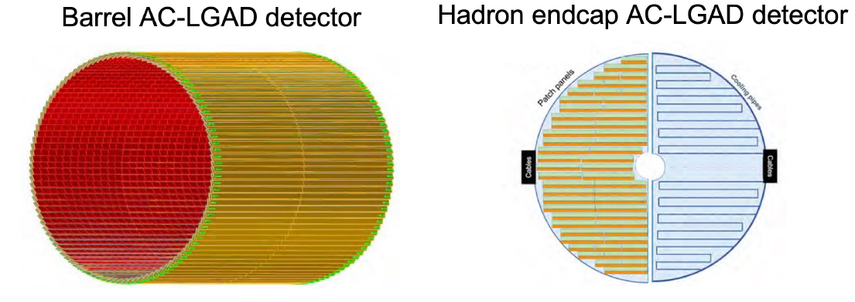

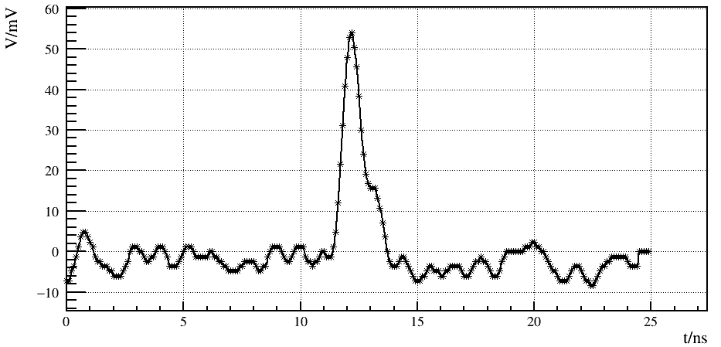
Application of AC-LGAD
Electron-Ion Collider (EIC)：Timing-tracker
Nuclear Medicine Instruments：
Such as proton therapy and proton CT
10.9 m²
2.22 m²
X-ray detectors @ advanced light sources
HEPS @ Beijing
other applications
Beam Telescope for Beam Test Platform
LiDAR: Positioning and Navigation
Track and time detectors in other particle physics and nuclear physics experiments
…
6 KeV X-Ray
mzli@ihep.ac.cn

Slide 9
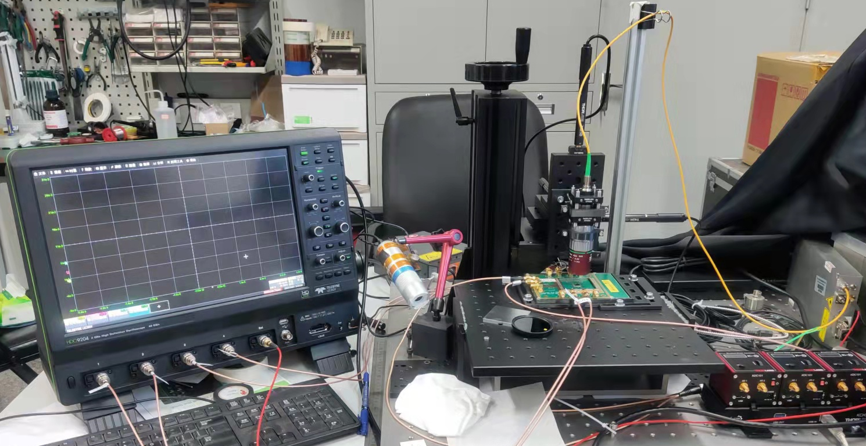
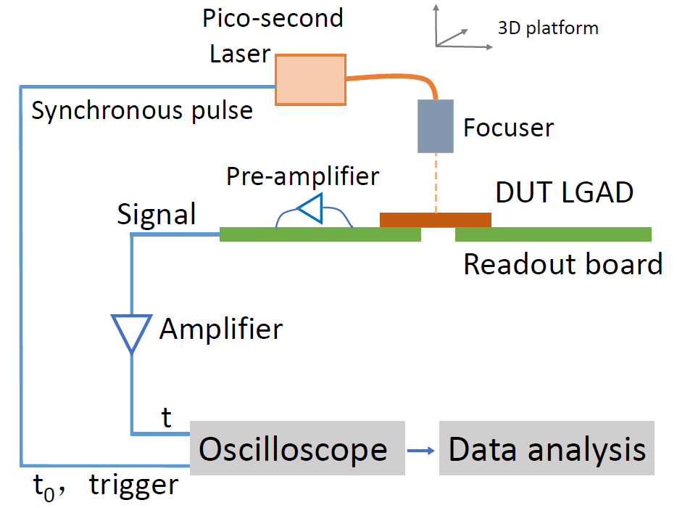
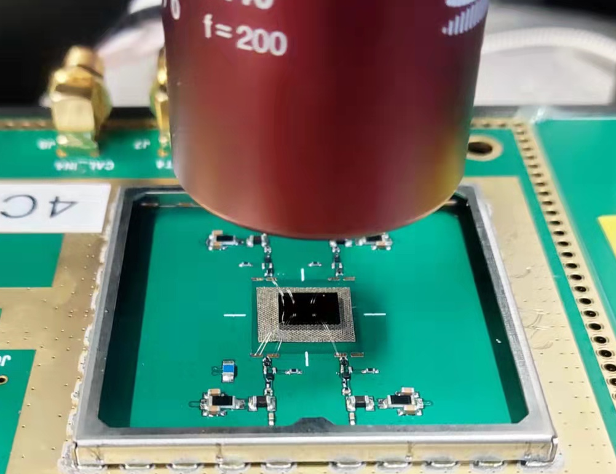
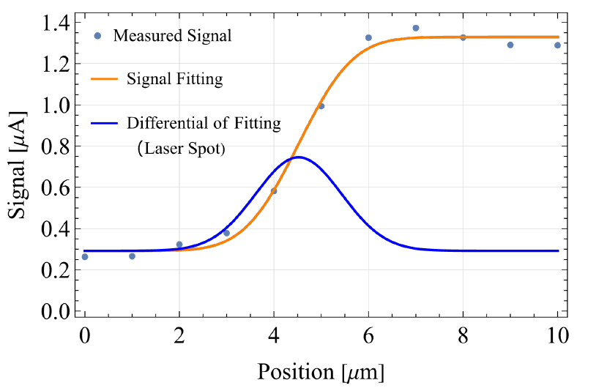
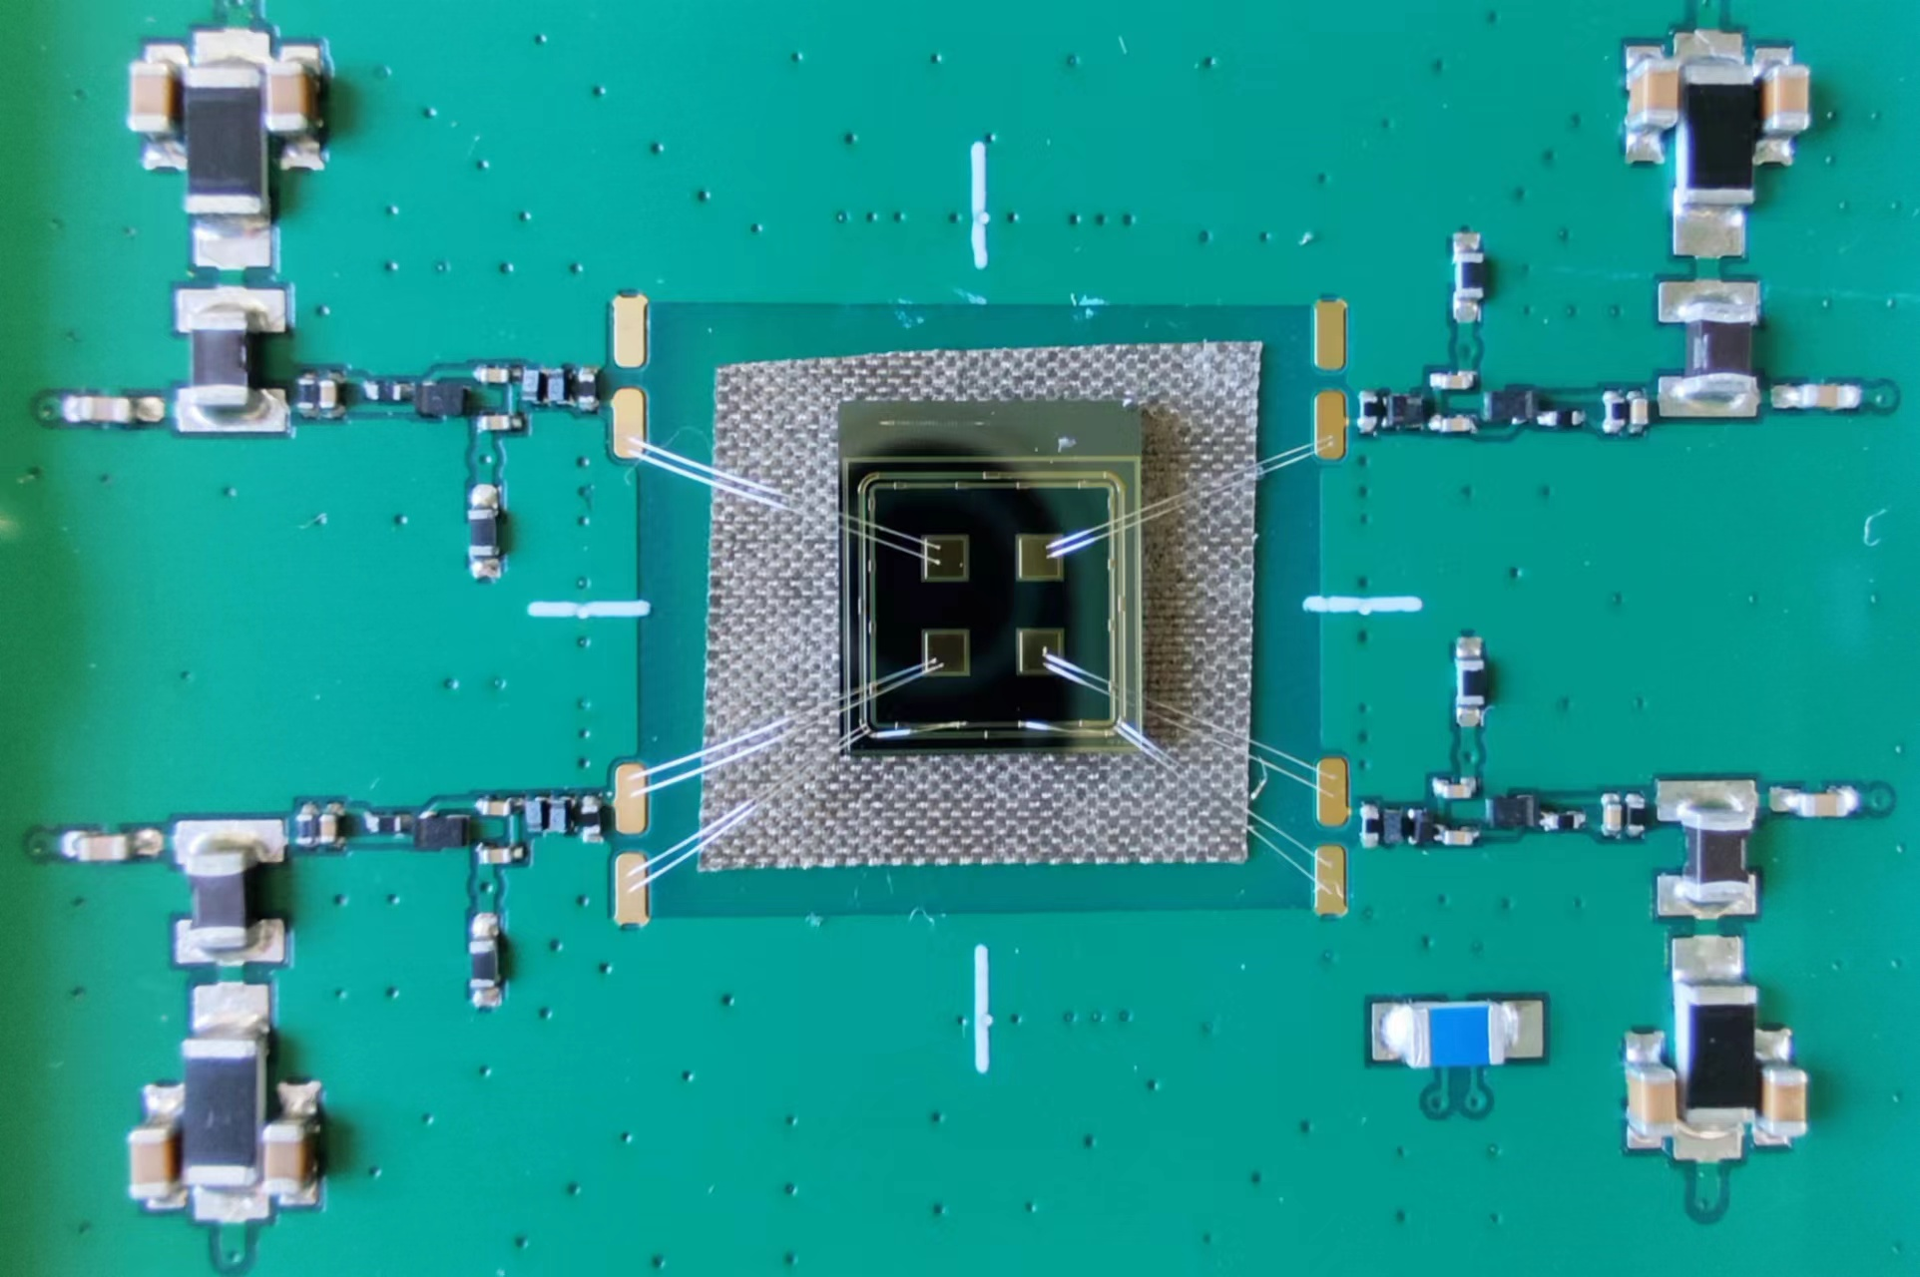
4.1 AC-LGAD sensor test ： Picosecond laser test
Picosecond laser scanning system
3D platform
Sensor & Board
focuser
Picosecond laser 1064nm
Picosecond laser scanning system
Displacement accuracy 1 μm
Automated scanning
Picosecond laser 1064nm
Spot size 2~5 μm
mzli@ihep.ac.cn

Slide 10
Plan and funding needed
AC-LGAD sensor
  Small MPW chips developed, but there is no full-size sensor
  Still need 2~3 round of engineering run (2M RMB)
ASIC:
  Expect to develop based on ASIC chip developed TOF-PET (1.5M RMB)
  Still need at least one engineering run to modify this ASIC chip for AC-LGAD
    Sensor capacitance and raising time is difference
    Clock structure and logic is different
 | CEPC TOF
AC-LGAD runs | 2 M RMB
ASIC engineering run | 1.5 M RMB
Total | 3.5 M RMB

Slide 11
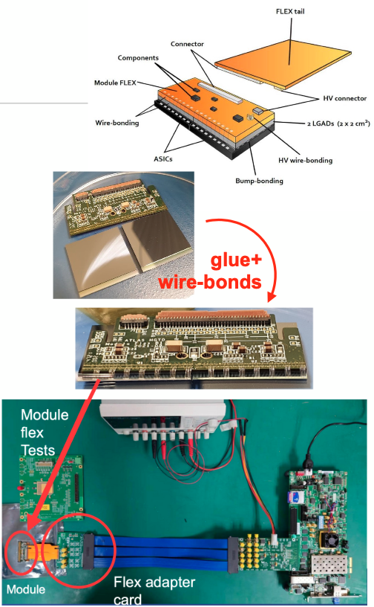
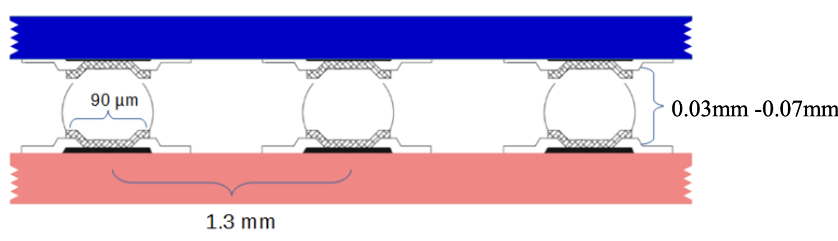
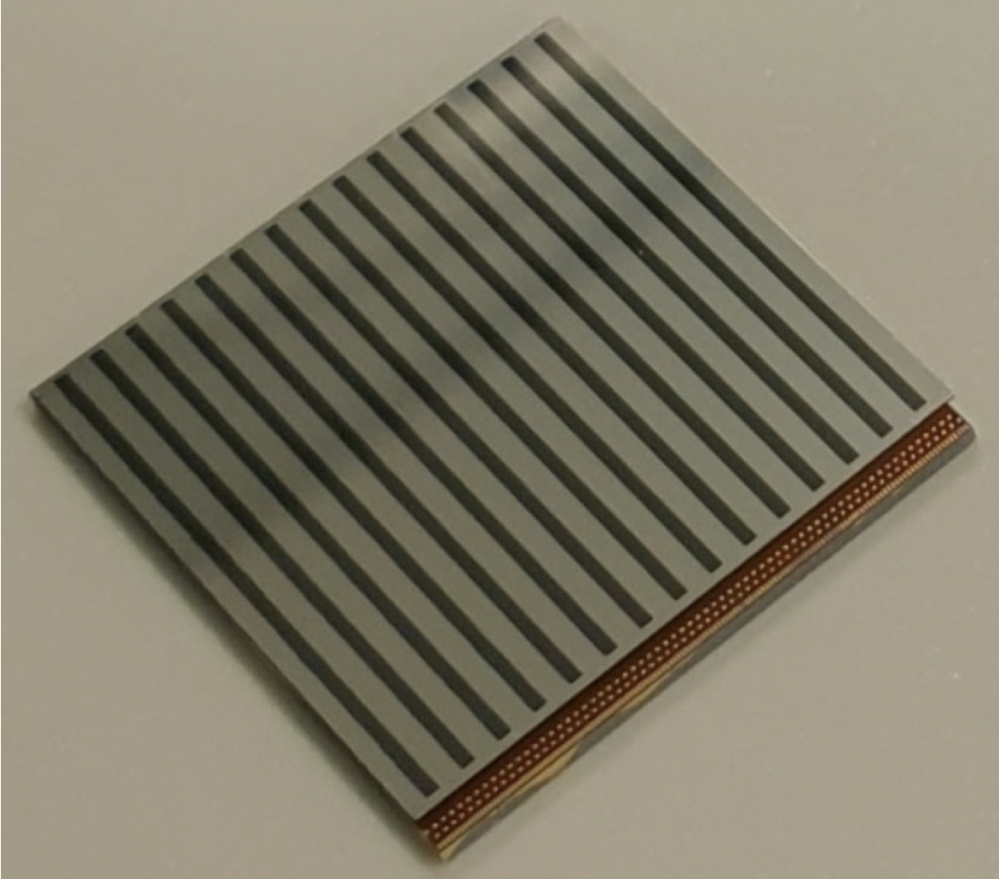
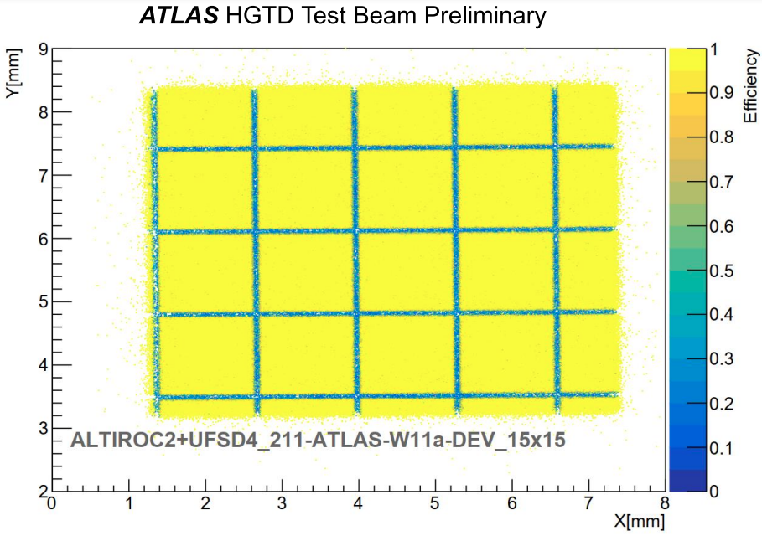
HGTD Module assembly
225 front-end channels (15 ×15) in each module
  Fast ASIC and LGAD connected by bump bonding
  Dead area between pixels is about 50 μm
15 ×15 pixels efficiency map
In module beam test
Jigs tools

