Slide 1

第九届XYZ研讨会
Study of the a₀ (1710)
肖 楮 文（ Chu-Wen Xiao ）
广西师范大学（ Guangxi Normal University ）
合作者：Xiaonu Xiong, Zhi-Feng Sun, Wen-Chen Luo
Zhong-Yu Wang, Jing-Yu Yi, Wei Liang, Yu-Wen Peng
Jia-Jun Wu……
2024.5. 西安

Slide 2
Outline
Introduction
Formlism
Results
Summary

Slide 3
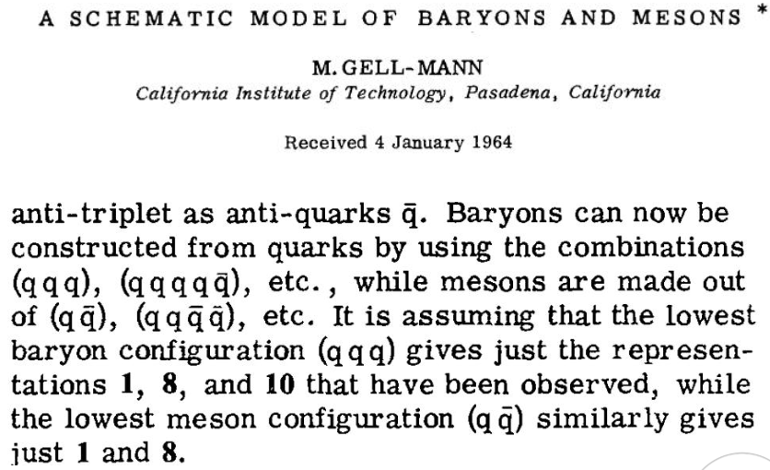
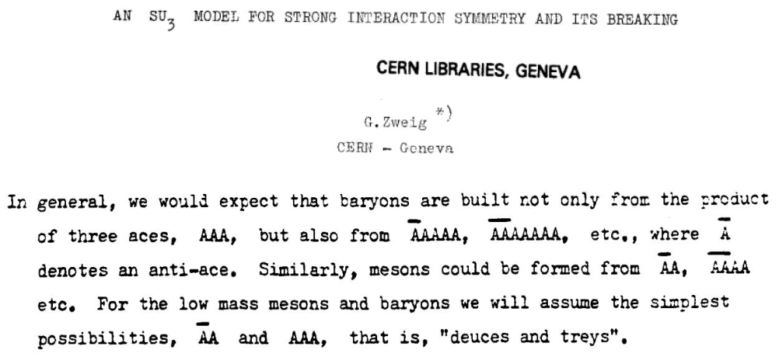
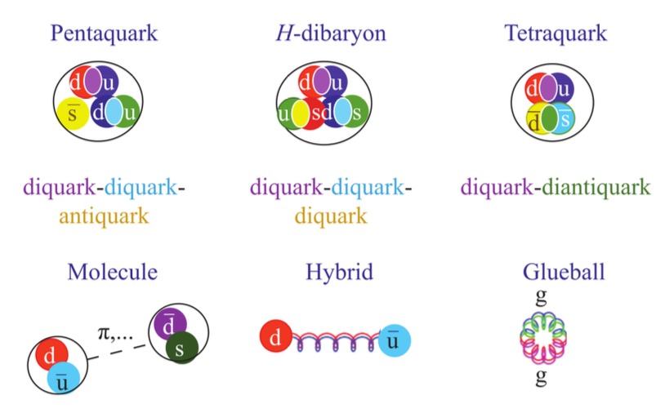
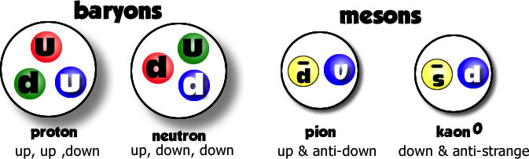
§1. Introduction
Quark model
Exotic States

Slide 4
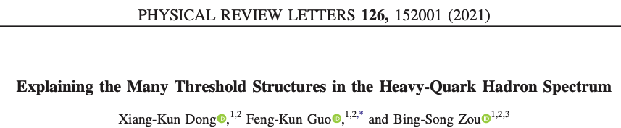
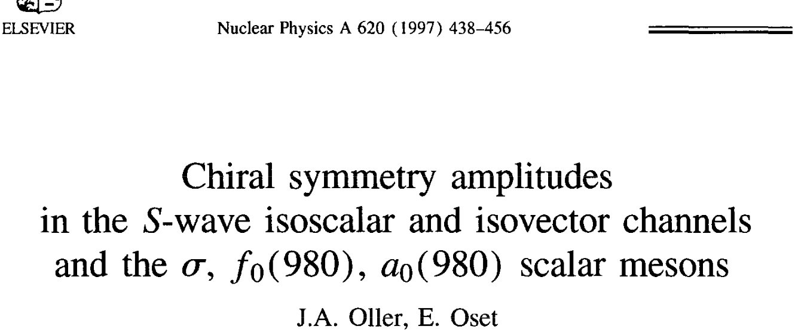
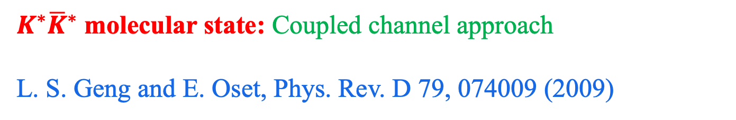

Molecular nature
F.-K. Guo, C. Hanhart, U.-G. Meißner, Q. Wang, Q. Zhao and B.-S. Zou, Rev. Mod. Phys. 90, 015004 (2018)
H.-X. Chen, W. Chen, X. Liu and S.-L. Zhu, Phys. Rept. 639, 1 (2016)
N. Brambilla, S. Eidelman, C. Hanhart, A. Nefediev, C. P. Shen, C. E. Thomas, A. Vairo and C. Z. Yuan, Phys. Rept. 873, 1 (2020)
f₀ (1710) was discovered about 40 years ago:
Etkin, et al., Phys. Rev. D 25, 1786 (1982)
C. Edwards, et al., Phys. Rev. Lett. 48, 458 (1982)
$K^{∗}{\overline{K}}^{∗}$ molecular state: Coupled channel approach
L. S. Geng and E. Oset, Phys. Rev. D 79, 074009 (2009)
$K\overline{K}$ molecular state
Glueball: Bei-Jiang Liu’s talk
But, its isovector partner a₀(1710) were NOT found for a long time……..

Slide 5
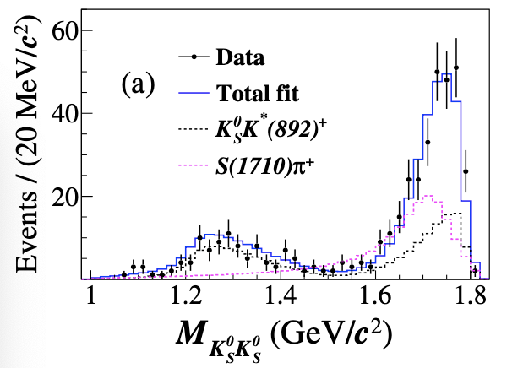
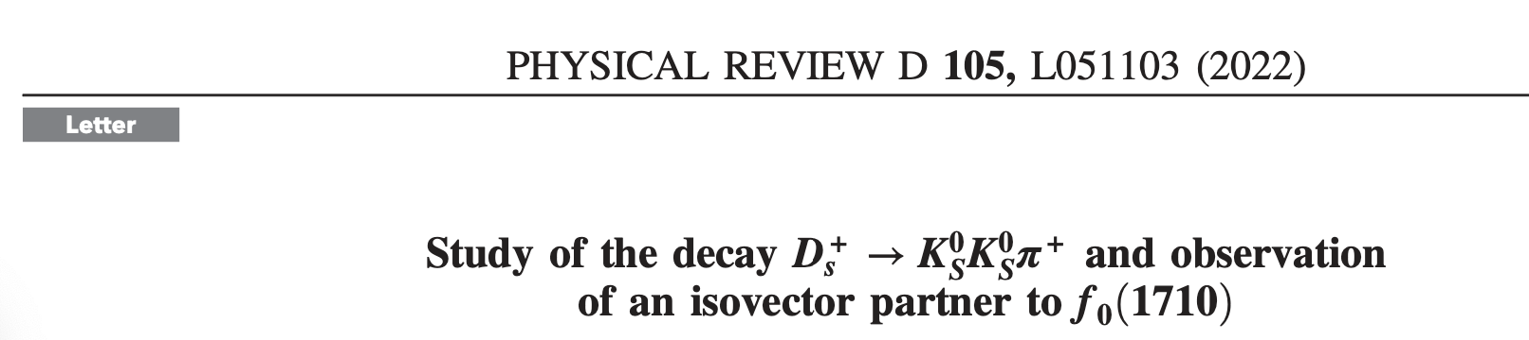
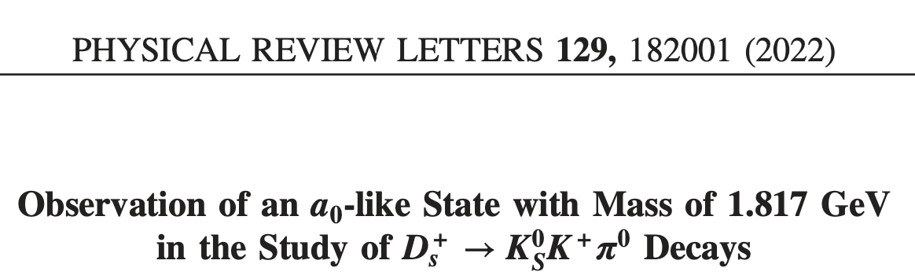
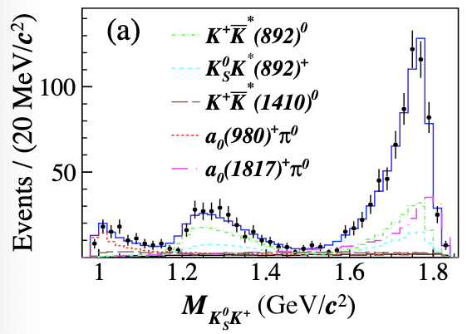
Recent Findings from BESIII

Slide 6
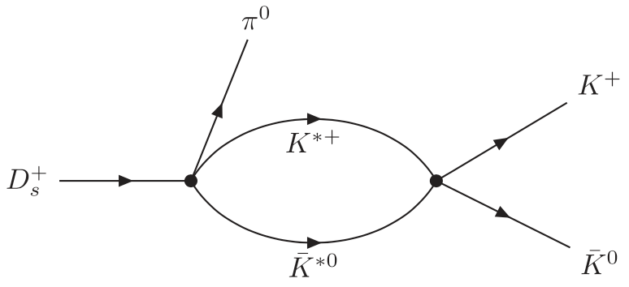
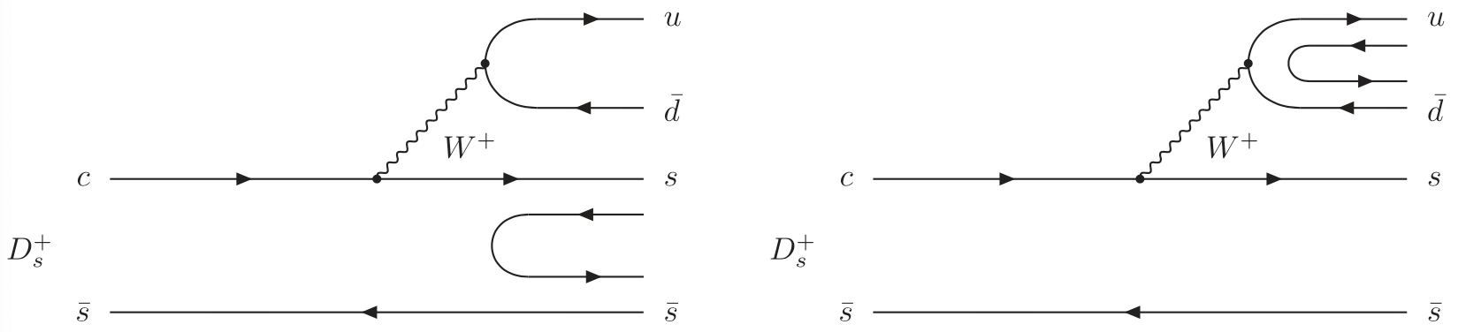

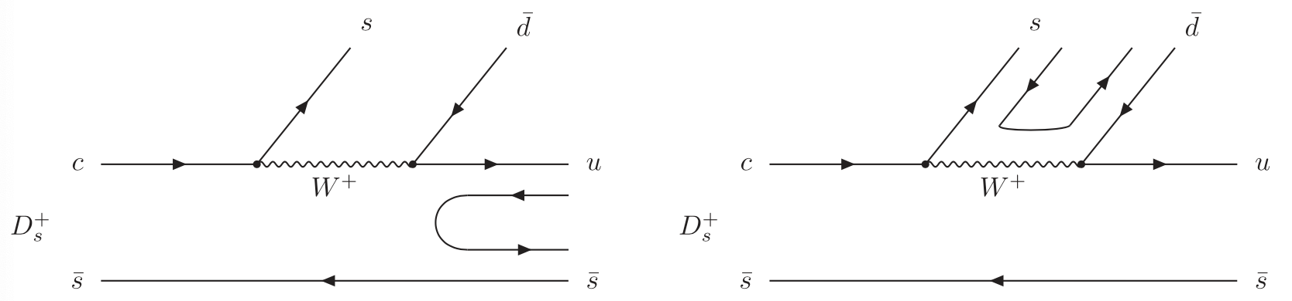
§2. Formalism
Final state interaction
S-wave

Slide 7
Coupled Channel Unitary Approach：solving Bethe-Salpeter equations, which take on-shell approximation for the loops.
where V matrix (potentials) can be evaluated from the interaction Lagrangians.
D. L. Yao, L. Y. Dai, H. Q. Zheng and Z. Y. Zhou, Rept. Prog. Phys. 84, 076201 (2021)
J. A. Oller and E. Oset, Nucl. Phys. A 620 (1997) 438
E. Oset and A. Ramos, Nucl. Phys. A 635 (1998) 99
J. A. Oller and U. G. Meißner, Phys. Lett. B 500 (2001) 263

Slide 8

G is a diagonal matrix with the loop functions of each channels:
The coupled channel scattering amplitudes T matrix satisfy the unitary：
To search the poles of the resonances, we should extrapolate the scattering amplitudes to the second Riemann sheets:

Slide 9
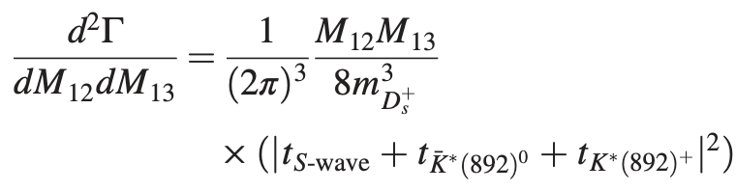
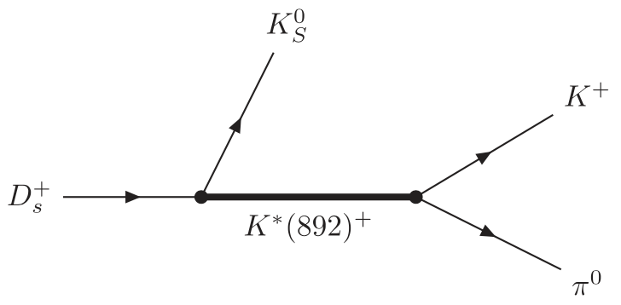
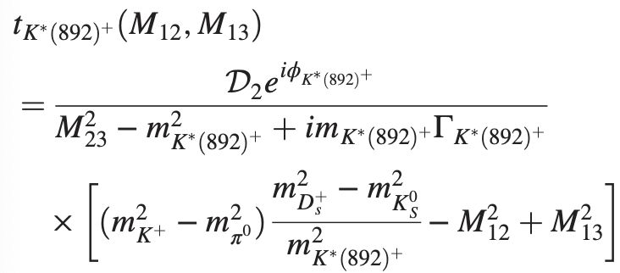
P wave contribution
Z. Y. Wang, Y. W. Peng, J. Y. Yi, W. C. Luo and CWX, Phys. Rev. D 107 (2023) 116018.

Slide 10


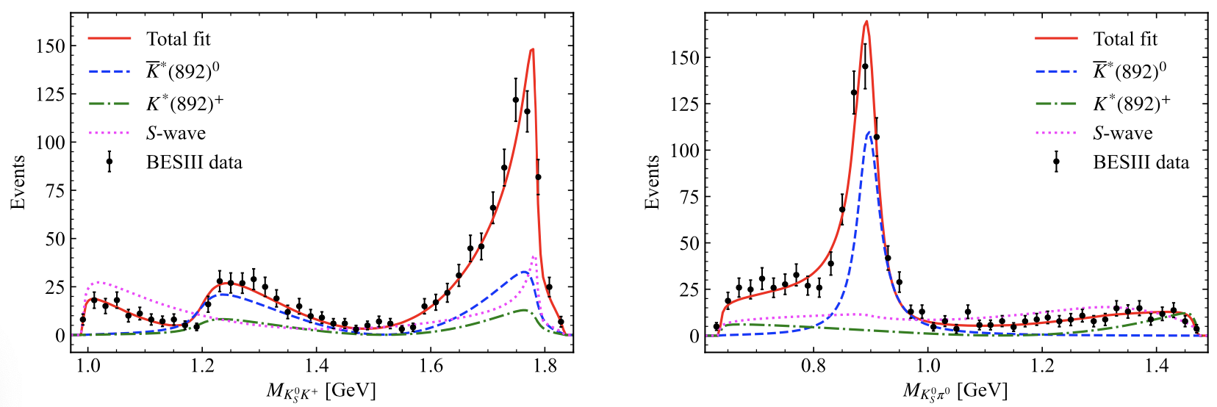
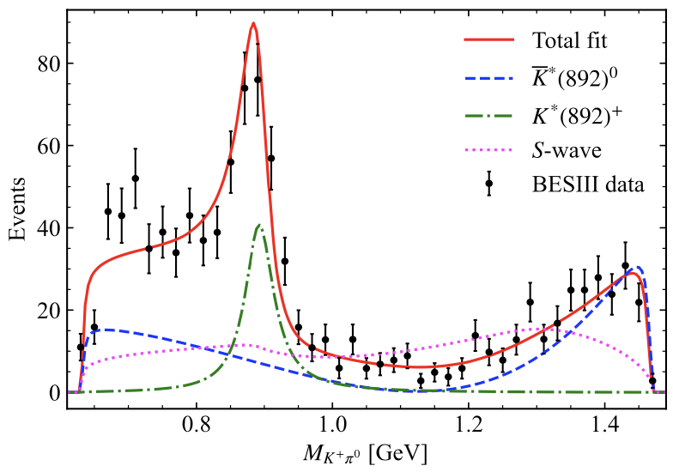

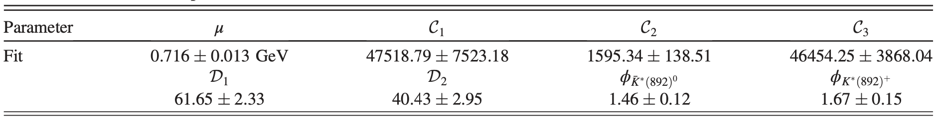
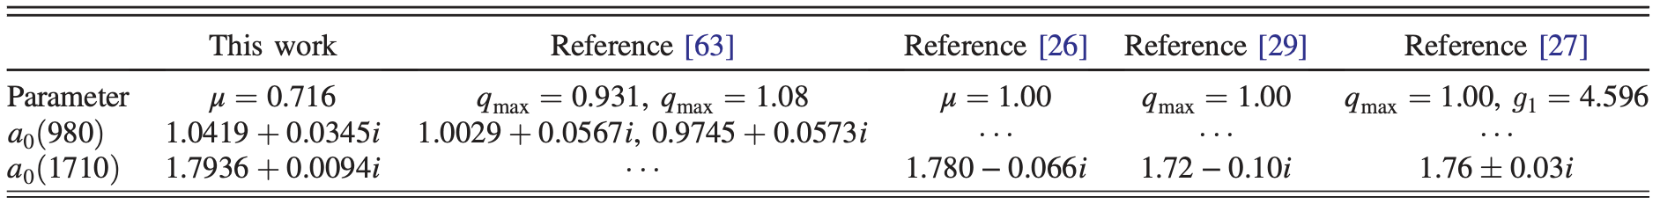
§3. Results

Slide 11
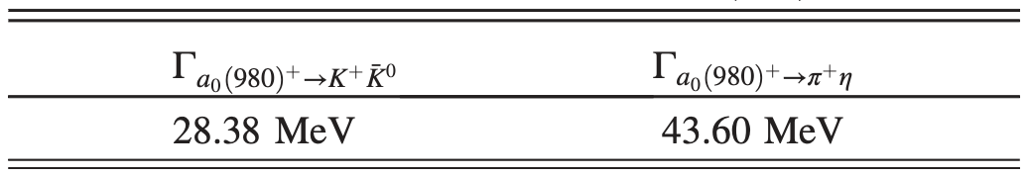
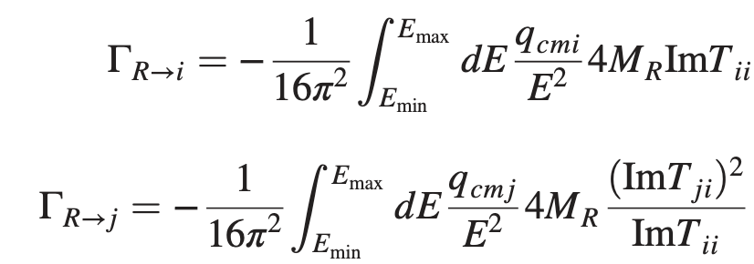
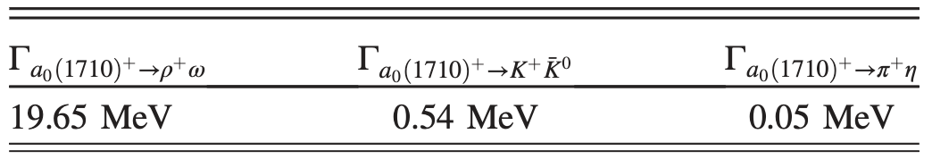
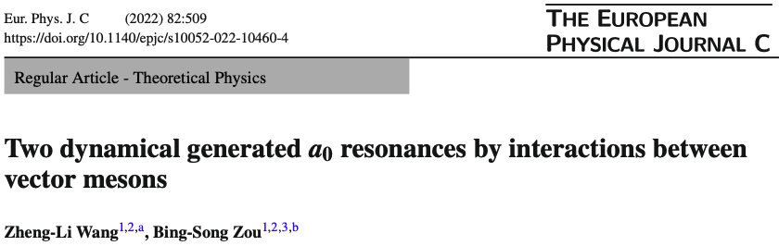
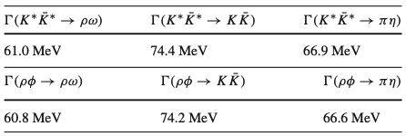
Partial decay widths

Slide 12
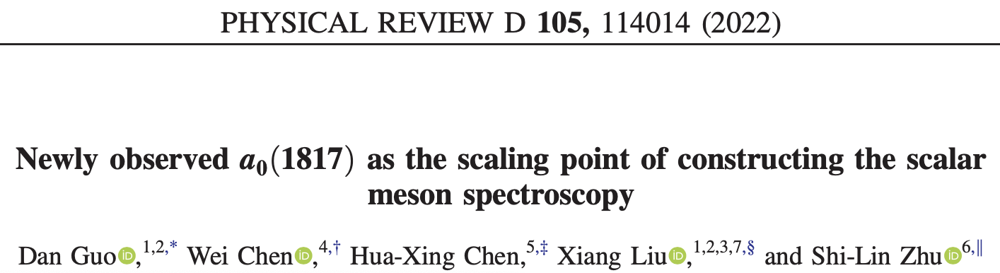
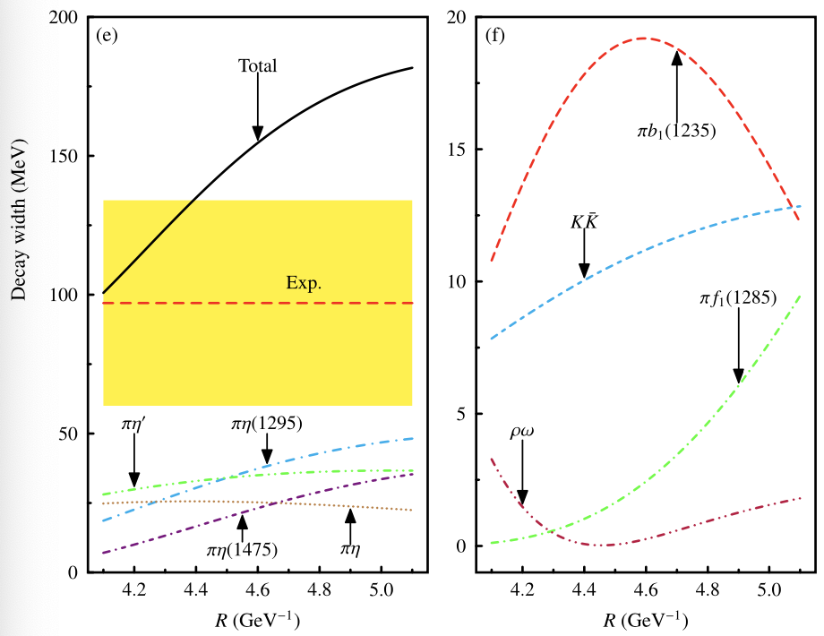
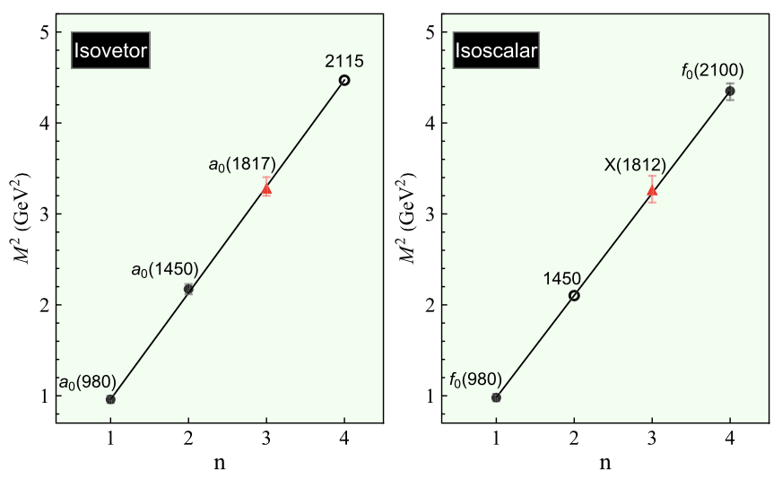
Regge trajectory
E. Oset, L. R. Dai and L. S. Geng, Sci. Bull. 68 (2023) 243-246.

Slide 13
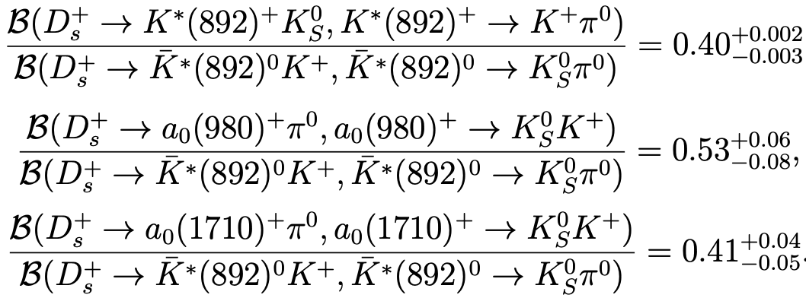

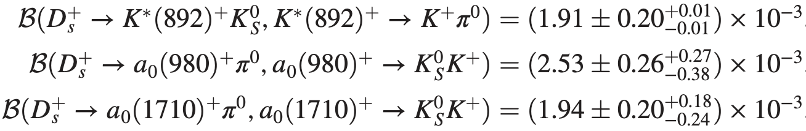
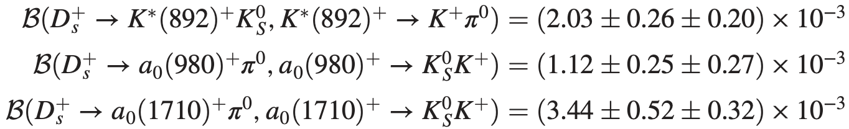
Branching ratios
Our predictions
BESIII measurements

Slide 14


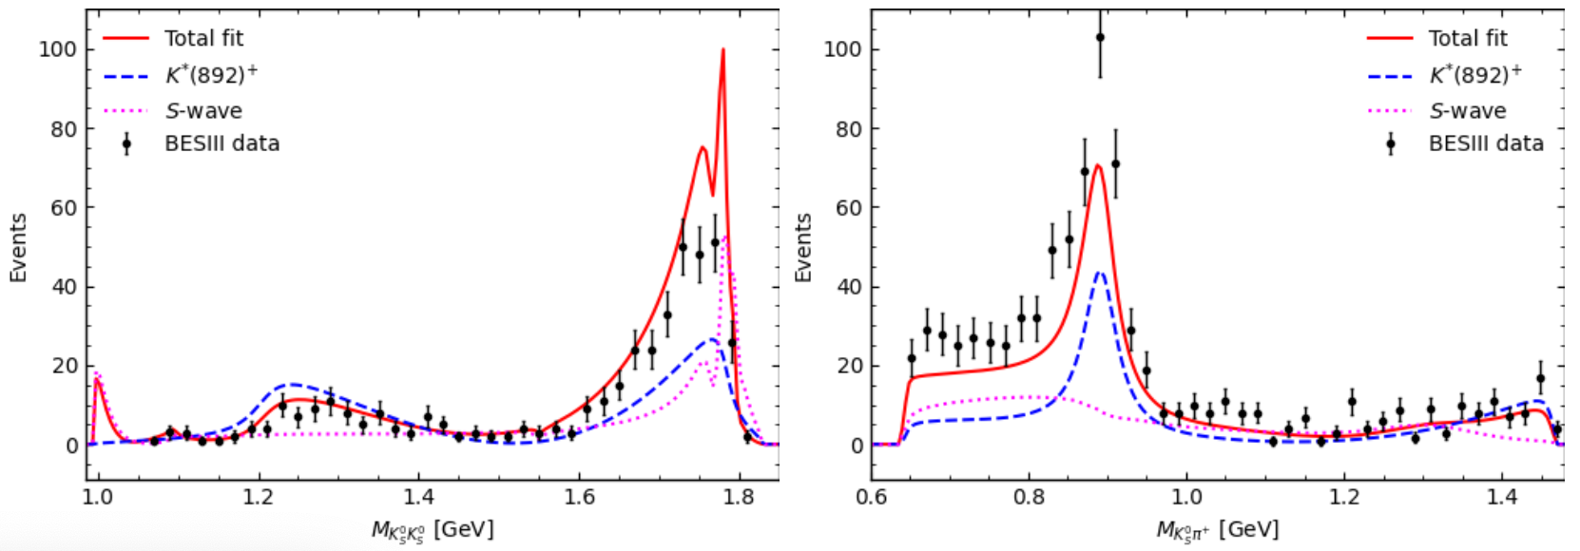


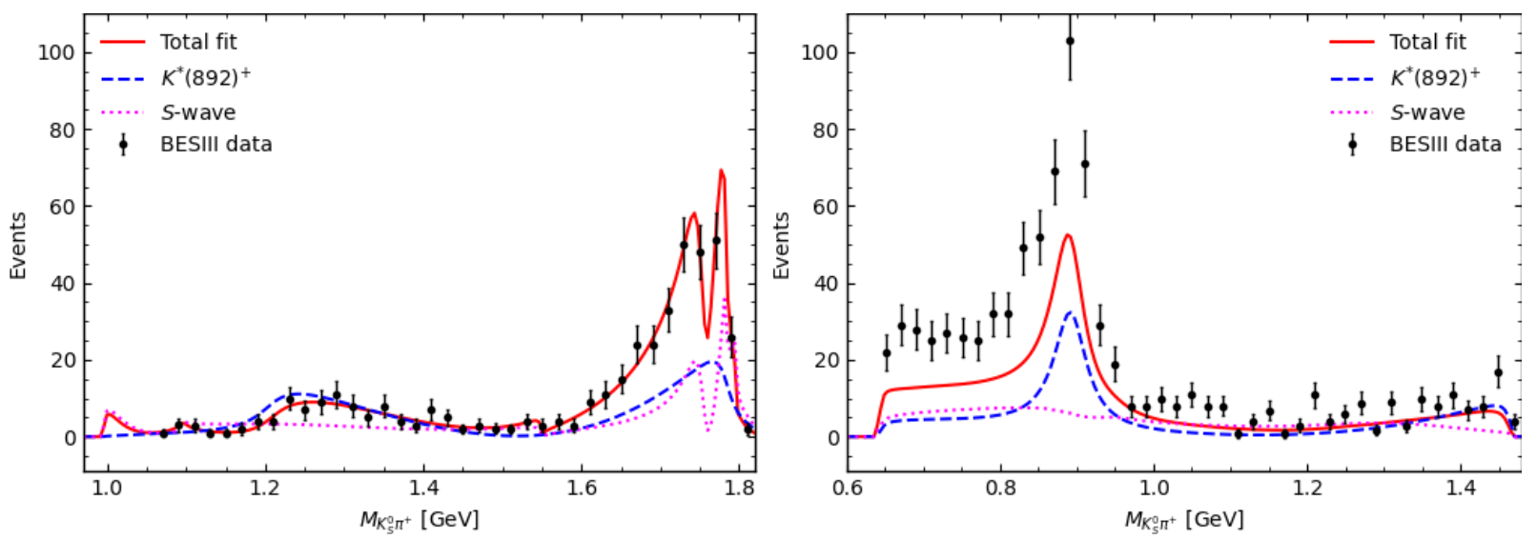
Combined fit
eleven coupled channels
Only fit K_{S}⁰K_{S}⁰

Slide 15
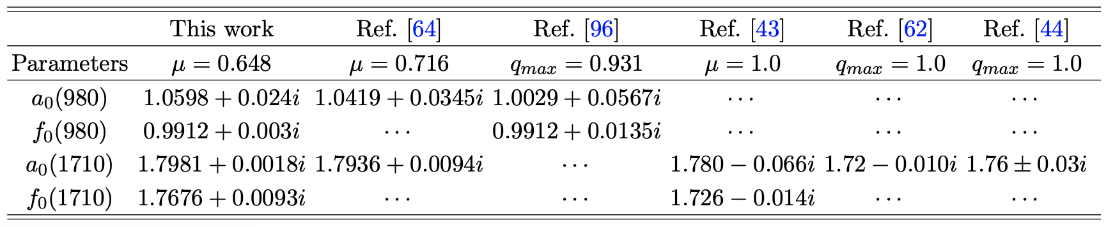
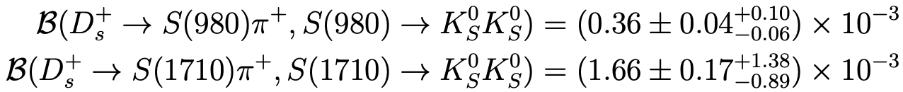
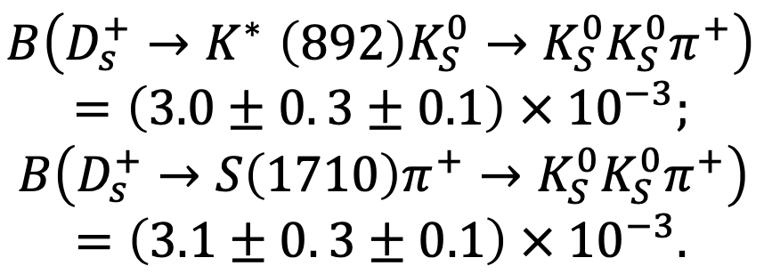
Our results
BESIII measurements
Y. W. Peng, W. Liang, X. Xiong and CWX, arXiv2402.02539.
L. R. Dai, E. Oset and L. S. Geng, Eur. Phys. J. C 82, 225 (2022)
X. Zhu, D. M. Li, E. Wang, L. S. Geng and J. J. Xie, Phys. Rev. D 105, 116010 (2022)

Slide 16


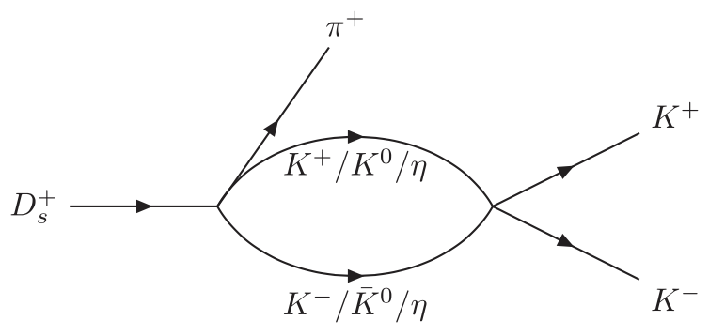

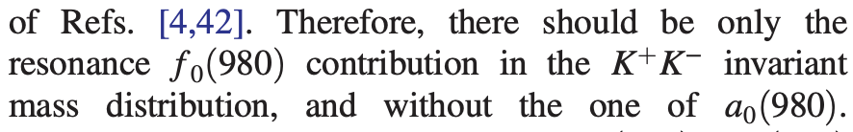
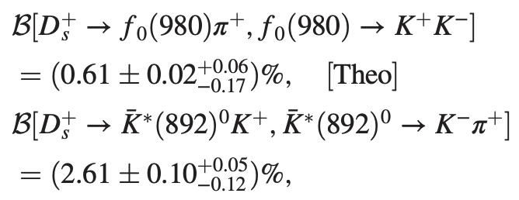
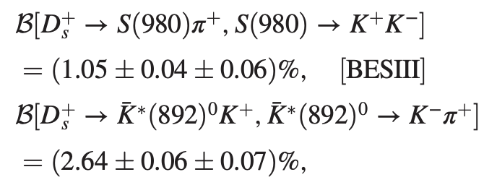
Z. Y. Wang, J. Y. Yi, Z. F. Sun and CWX, Phys. Rev. D 105 (2022) 016025.

Slide 17
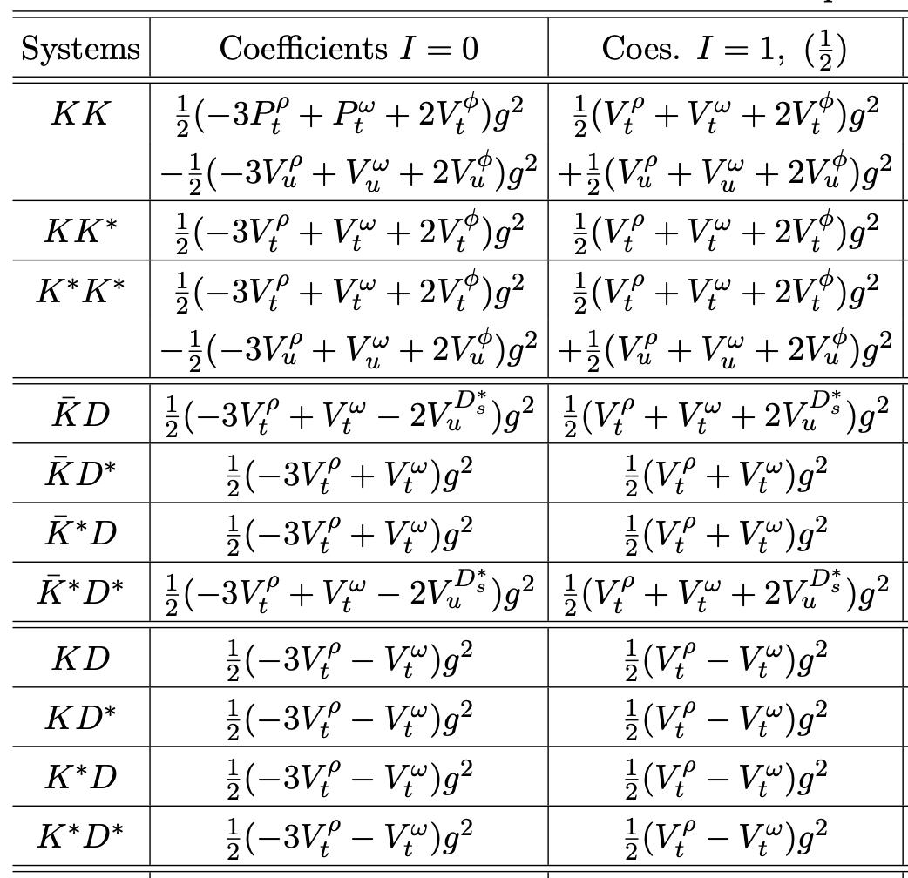
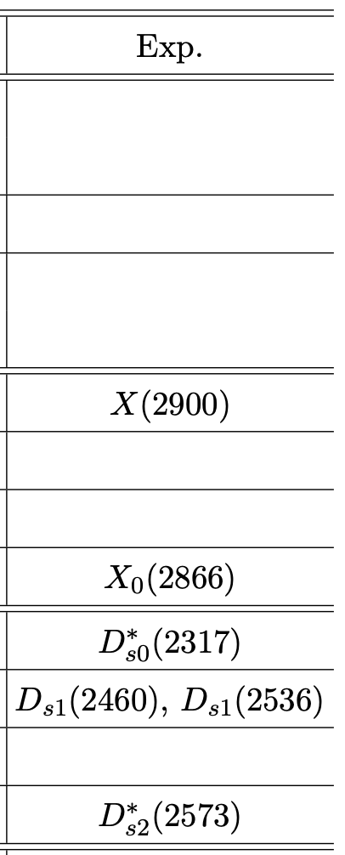




We try to investigate……
Bo Wang’s talk

Slide 18


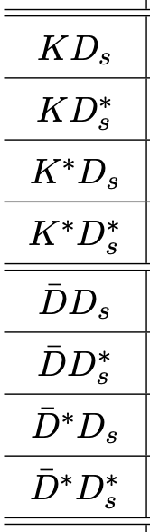
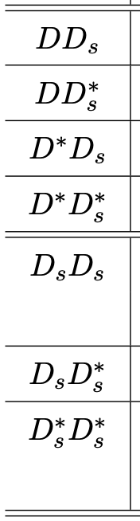
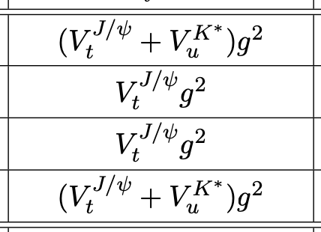
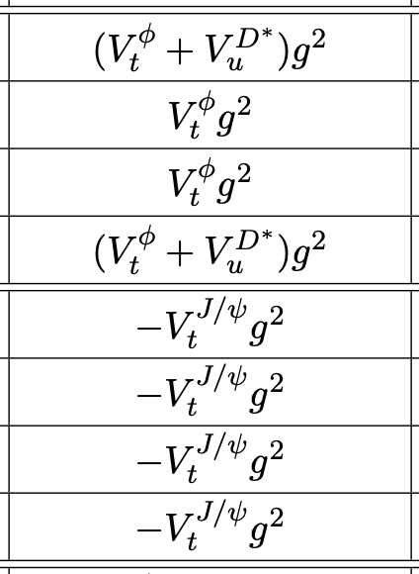
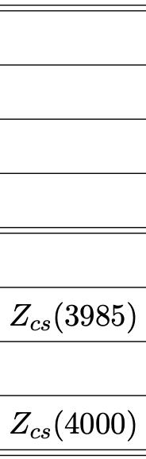
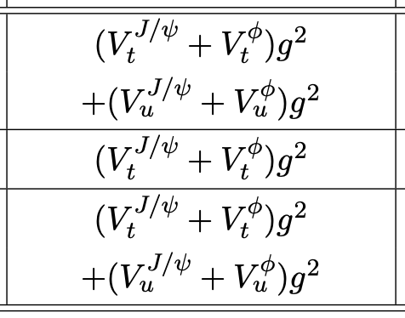


CWX, J. J. Wu….

Slide 19
§4. Summary
We use the final state interaction formalism to investigate the Ds three-body weak decays.
In the final state interaction, the f₀ / a₀ (1710) and/or f₀ / a₀ (980) states are dynamically generated (molecular nature).
Related branching ratios are evaluated, some of which are consistent with the experiments.
Hope future experiments and theories bring more clarifications on these issues…….

Slide 20
Thanks for your attention!
感谢大家的聆听！

