Slide 1
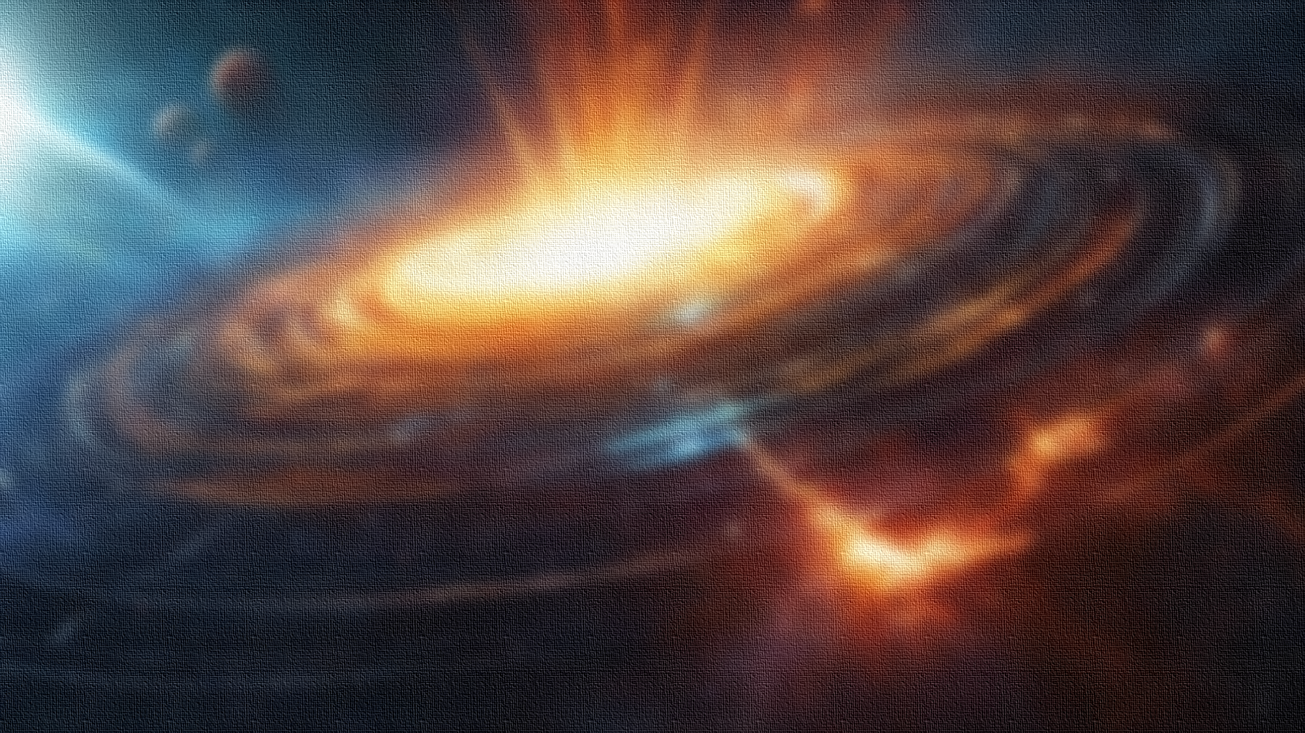
Spontaneously generated Chromo-magnetic field from gluon dynamics
Spontaneously generated Chromo-magnetic field from gluon dynamics
Xu Kun @ Group Meeting
2024/02/23
The first report in 2024

Slide 2
Effective potential of gluodynamics in background of Polyakov loop and chromo-magnetic field
arXiv:2112.01043v1

Slide 3
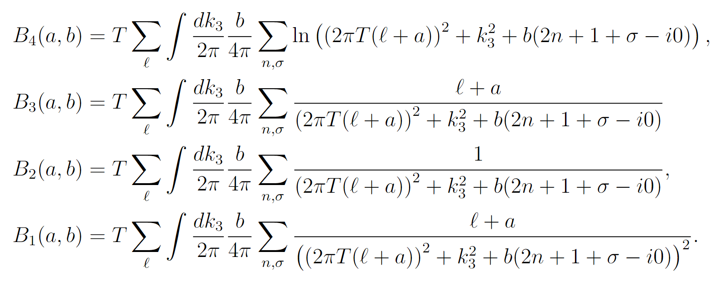
Effective potential of SU(2) on the two-loop level:
Chromo magnetic field 3rd component
Landau level:
n=0,1,2…
$$σ=±2(,0)$$
spin

Slide 4
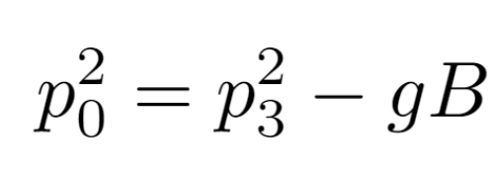
Tachyonic mode/tachyonic state
Gluon spectrum under chromo-magnetic field
Landau level for n = 0 and s = −1
Effective gluon mass
becomes imaginary and it is responsible for the imaginary part, and unstable

Slide 5
Effective potential of SU(2) on the two-loop level adding tree contribution:
Only chromo-magnetic field:
$$T=0$$
magnetic field
Has a non-trivial minimum:

Slide 6
high-T case:
Black body radiation
From two-loop
One loop:
Two loops:

Slide 7
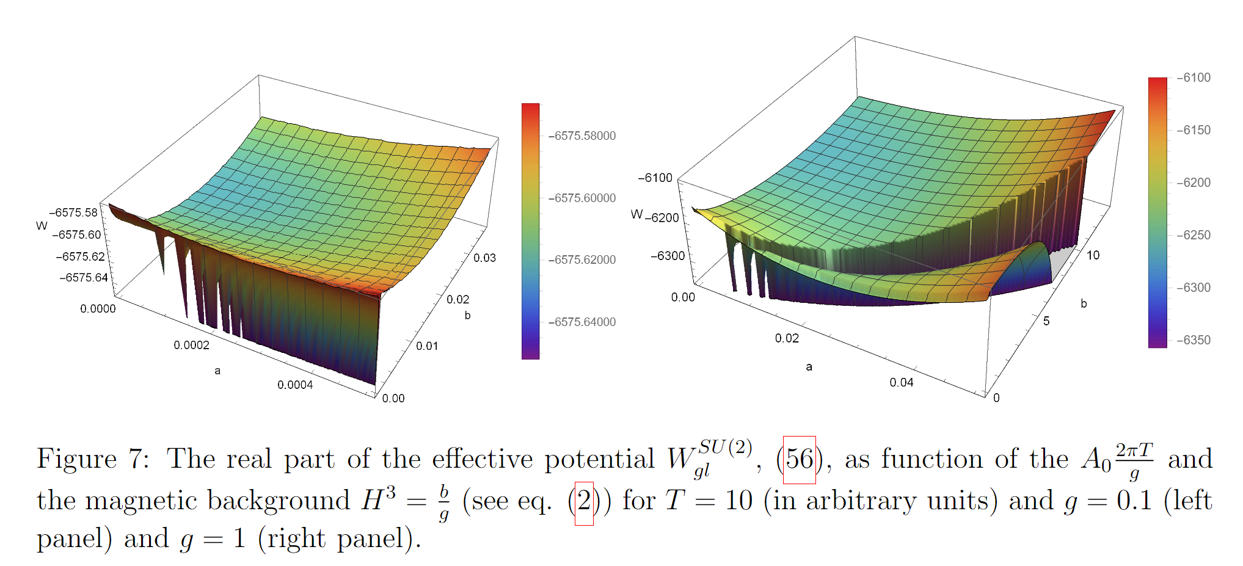
Only $A_{0}$ field:
Both field:

Slide 8
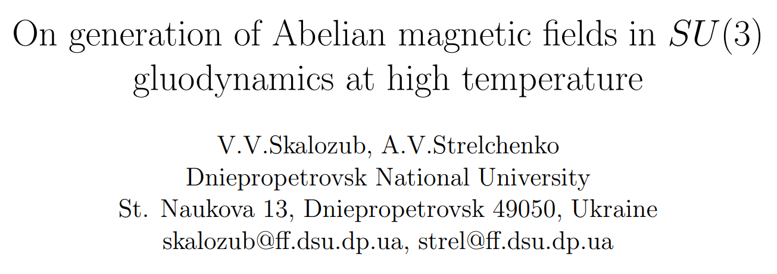
https://arxiv.org/abs/hep-ph/0208071v4
SU(2):hep-ph/9905302
Lagrangian of pure gluons:
In the presence of external chromo-magnetic field:
classic
quantum
isotopic
hypercharge
classic background field
Two independent external chromo-magnetic fields along z-axis

Slide 9
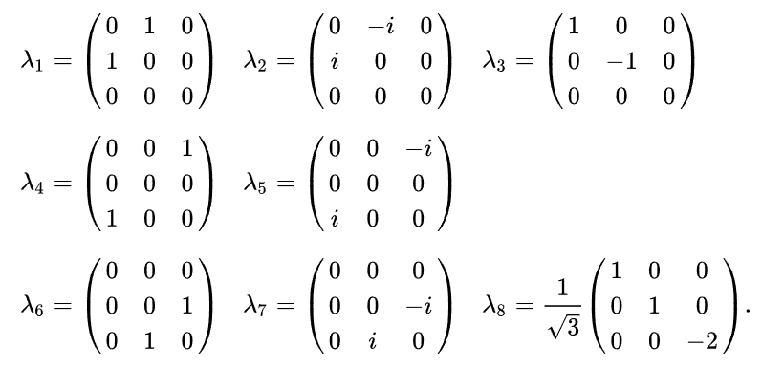
Gell-Mann matrices

Slide 10
Define charged gluons:
Lagrangian of the charged gluons :
Kinetic term
Self-interaction
interaction of r=1
interaction of r=2
interaction of r=3

Slide 11
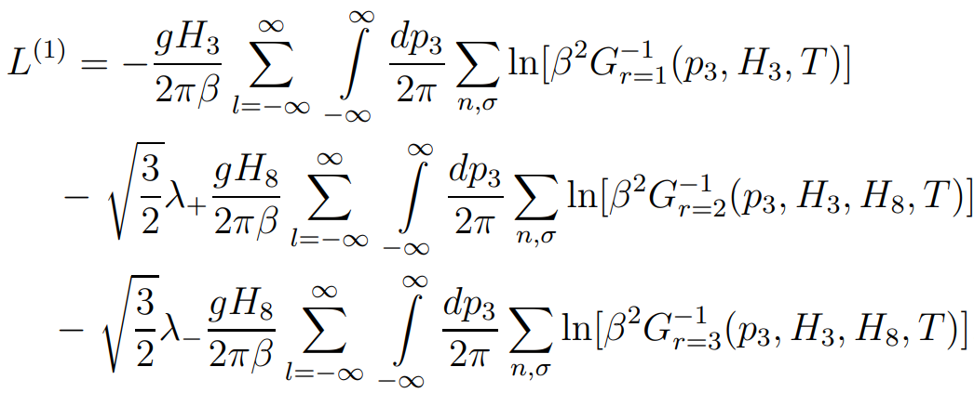
one-loop contribution of the charged gluons:
$G_{r}$: the propagator of color r in the presence of H3 and H8
In one-loop order the neutral gluon contribution is a trivial H-independent constant, which is omitted here.

Slide 12
Charged gluons:
$$Π^{r}$$
PO of charged gluons averaged over physical states
Details: Phys. Atom. Nucl. 63, 1956 (2000)
Neutral gluons:
Polarization function, behave as Debye mass

Slide 13
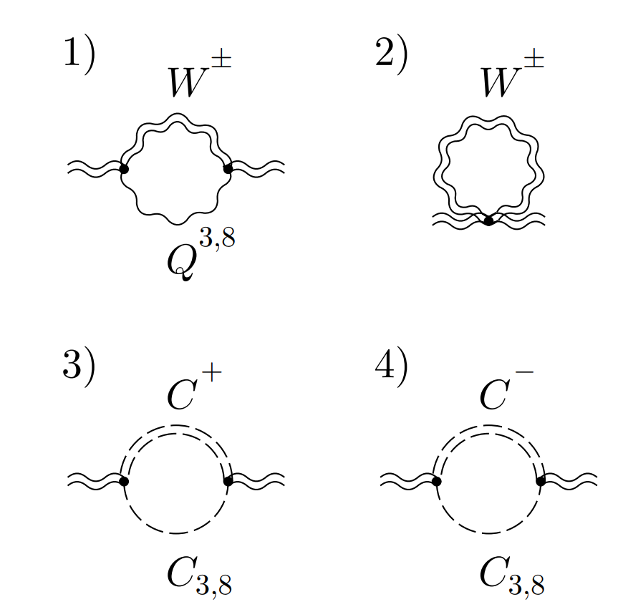
Polarization operator of charged gluons in the one-loop approximation
the average over the physical states values for the gluon PO
Details: Phys. Atom. Nucl. 63, 1956 (2000)

Slide 15
High temperature limit:
Vacuum instability
Charged gluons, only n=0, σ=1
cancel
only the longitudinal neutral modes
$$×$$

Slide 16
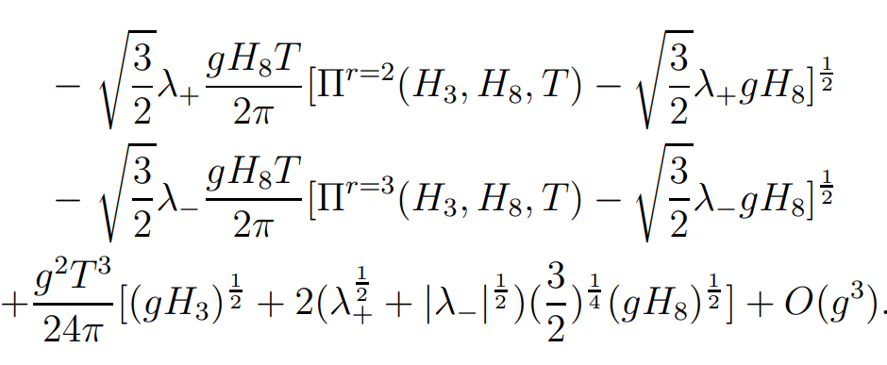
effective Lagrangian at High temperature:
Contribution from neutral gluons is of higher order, and can be ignored

Slide 17
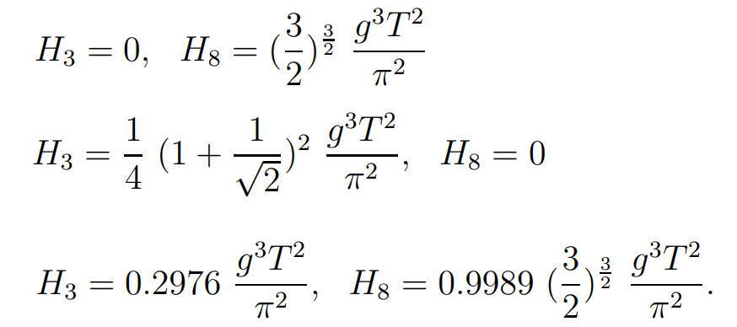
the stationary equations:
three nontrivial solutions:
approximation

Slide 18
Conclusion: chromo-magnetic field is spontaneously generated by gluodynamics. $H_{3}$ and $H_{8}$ for SU(3)
Propose: chromo-magnetic NJL model (cMNJL)
$$H=H_{3}λ_{3}+H_{8}λ_{8}=\left(\begin{matrix}H_{3}+\frac{H_{8}}{\sqrt{3}} & 0 & 0 \\ 0 & H_{3}−\frac{H_{8}}{\sqrt{3}} & 0 \\ 0 & 0 & −\frac{2}{\sqrt{3}}H_{8}\end{matrix}\right)$$

Slide 19
https://arxiv.org/pdf/0711.2845.pdf

