Slide 1
Track Finding for CEE TPC
Hao Qiu, Dhananjaya ﻿Thakur, Aiqiang Guo
Institute of modern physics (IMP)
实验粒子物理径迹重建研讨会– 郑州大学 – 2024-05

Slide 2
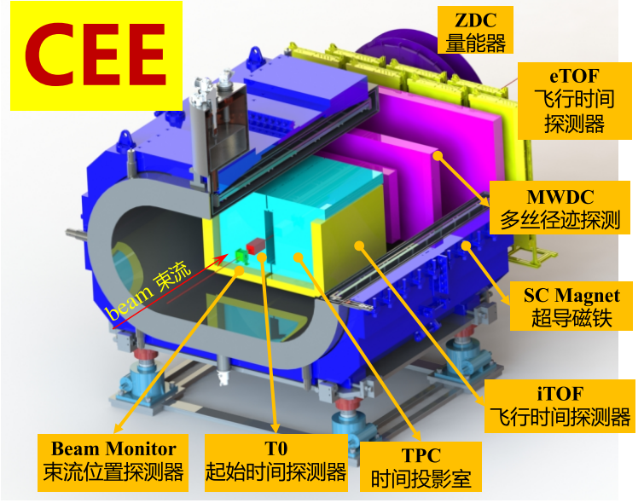
Introduction of CEE
The Cooler-Storage-Ring External-target Experiment (CEE) is a spectrometer to study the properties of nuclear matter at high baryon density region.
The first large-scale nuclear physics experimental apparatus in China
Main scientific objectives:
Searching for the QCD critical point
Studying the equation of state of asymmetric nuclear matter at high density and low temperature.

Slide 3
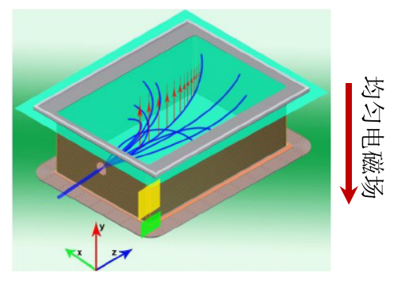
TPC of CEE
﻿A charged particle ionizes the gas along its flight path, and the ionized electrons drift towards the readout plane, where they are collected. The readout signals provide the 3D position and arrival time.
The particle's momentum is determined by its deflected trajectory in the magnetic field.
Sensitive area: 500$×$900$×$800($×$2) mm

Slide 4
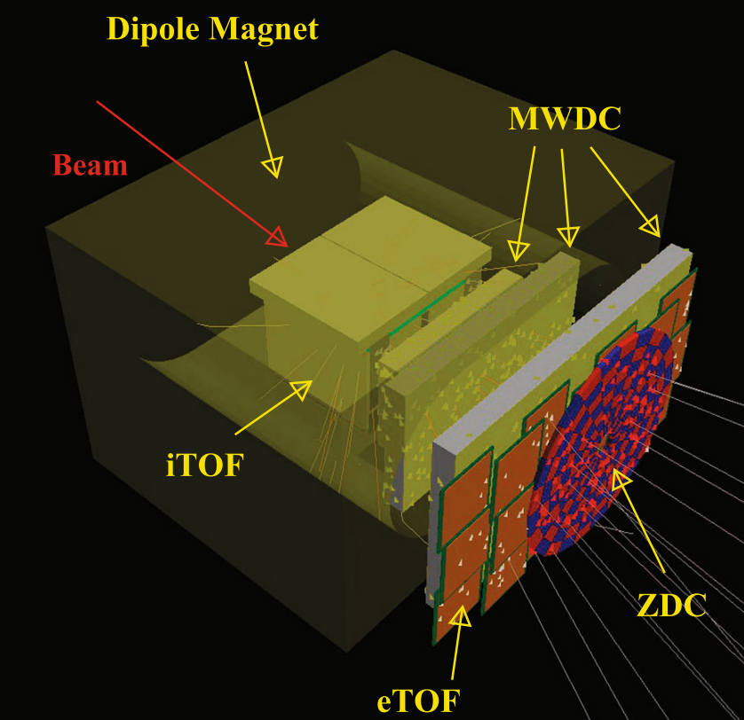
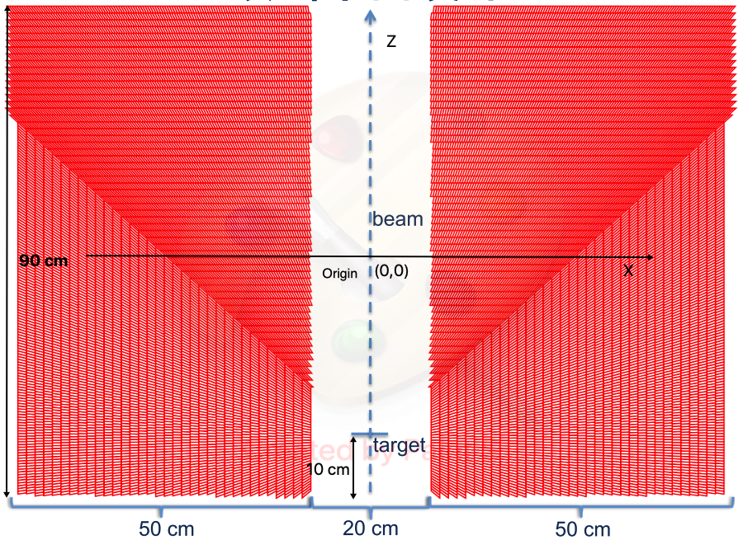
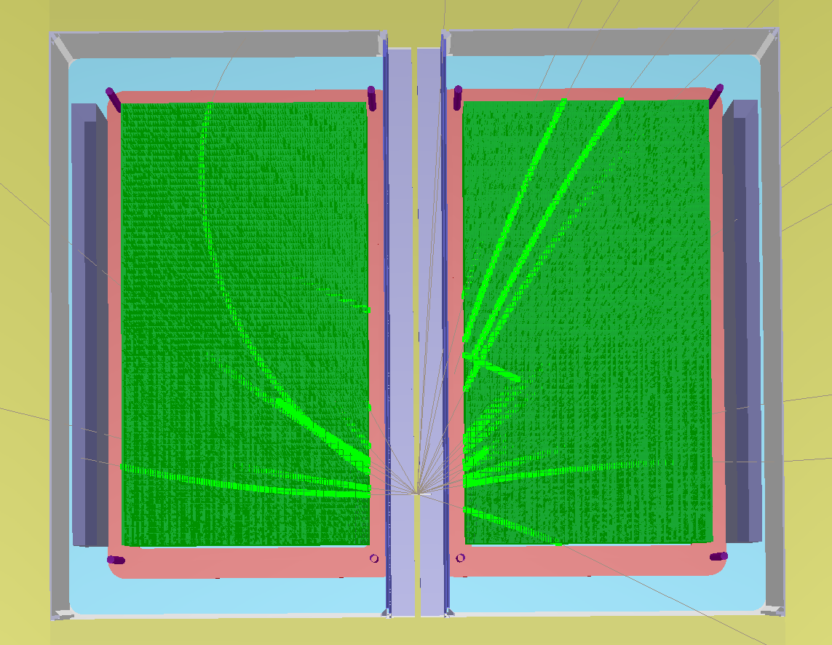
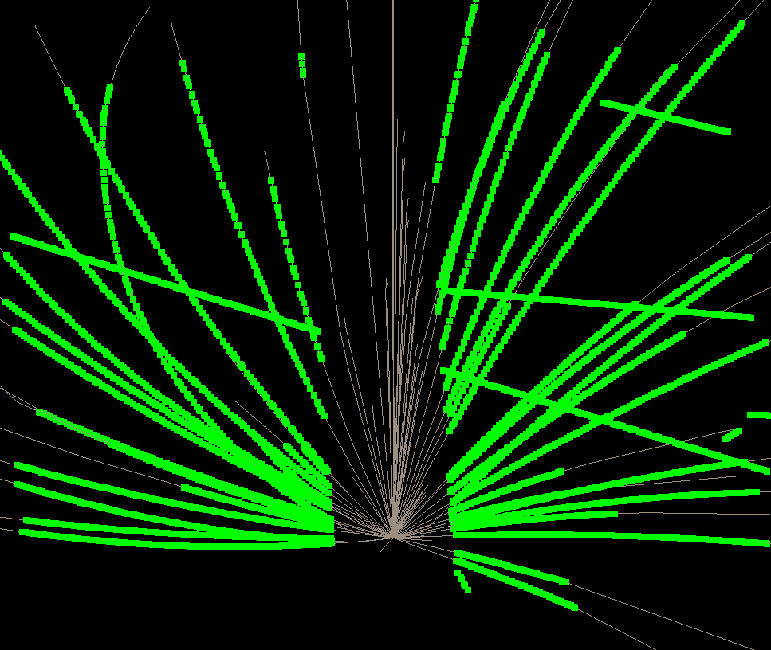
TPC of CEE
TPC
• Number of readout channels not less than 10,000
• Momentum resolution reaching 5%
• Track reconstruction residual better than 300 µm
• Dual-track discrimination capability less than 3 cm
• Track reconstruction efficiency better than 90%
56 row
34 row

Slide 5
Concept of Graph theory
Just look at an example
Direction
Edge
B
B is the neighbor of A,
A is not the neighbor of B
A
Cell
Three key elements in Graph theory
Node(cell)-doublet
Edge
Direction

Slide 6
How does graph work?
Goal: find the longest path from a root cell →longest Path problem
0
0
0
0
0
0
0
0
0
0
0
0
0
0
Each cell has an initial state value

Slide 7
How does graph work?
Goal: find the longest path from a root cell →longest Path problem
0
0
0
0
0
1
1
1
1
0
1
1
1
1
Each cell has an initial state value
Evolution: loop all the cell, update the state according to rule:
If Si = Si_{neighbor}
Then Si = Si_{neighbor} +1

Slide 8
How does graph work?
Goal: find the longest path from a root cell →longest Path problem
0
0
0
0
0
1
1
1
1
0
2
2
1
1
Each cell has an initial state value
Evolution: loop all the cell, update the state according to rule:
If Si = Si_{neighbor}
Then Si = Si_{neighbor} +1
Repeat the evolution to N generation according to graph

Slide 9
How does graph work?
The state of cell only depend on its neighbors
Multiple tracks can be found simultaneously !! Sort of parallel computing
Goal: find the longest path from a root cell →longest Path problem
0
0
0
0
0
1
1
1
1
0
2
2
1
1
Each cell has an initial state value
Evolution: loop all the cell, update the state according to rule:
If Si = Si_{neighbor}
Then Si = Si_{neighbor} +1
Repeat the evolution to N generation according to graph

Slide 10
The workflow of CA
Create Graph
Create doublet and cell
Connect cell
Evolution
Find Ntuplet

Slide 11
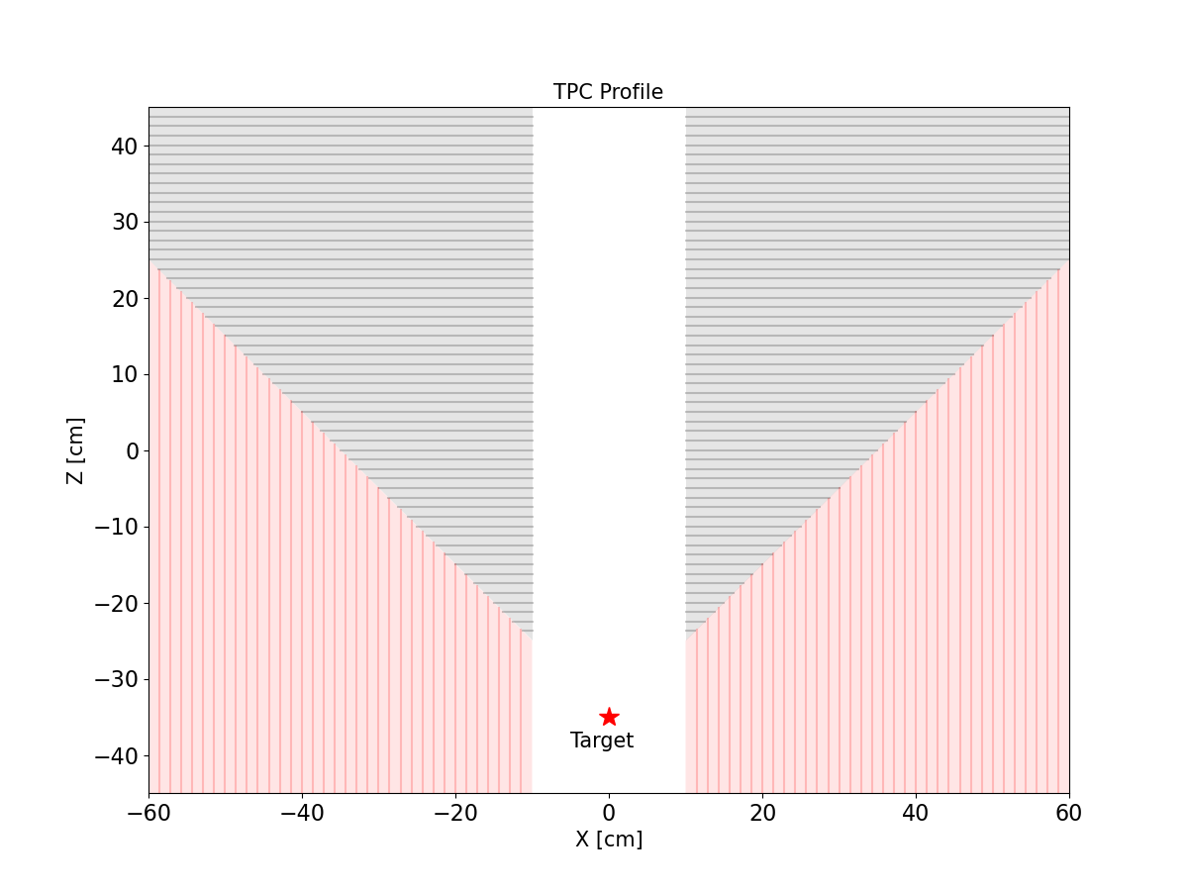
Graph creation
Graph 3
Graph 2
Graph 4
Graph 1
IP

Slide 12
Cell creation
The doublet creation
Only the 2 hits on the layer-pair passing the dphi and dz (or dx, dy) selection are chosen
Reduce the combination in the cell creation
IP

Slide 13
Cell connection
The cell connection
The condition in RZ plane
$θ_{RZ}$ is determined by the minimum Pt and material budget
The condition in XY plane
$θ_{XY}$ is determined by the minimum Pt and material budget and B field
Z
B
$$θ_{RZ}$$
R
Y
B
$$θ_{XY}$$
X

Slide 14
The track candidates
A RootCell is defined as the first cell of the path and length of the path should be longer than minimum hit requirement (5 in our case)
Each RootCell can create multiple track candidates with the same length
Multiple track candidates can be cleaned by the chisq of the fit in following step

Slide 15
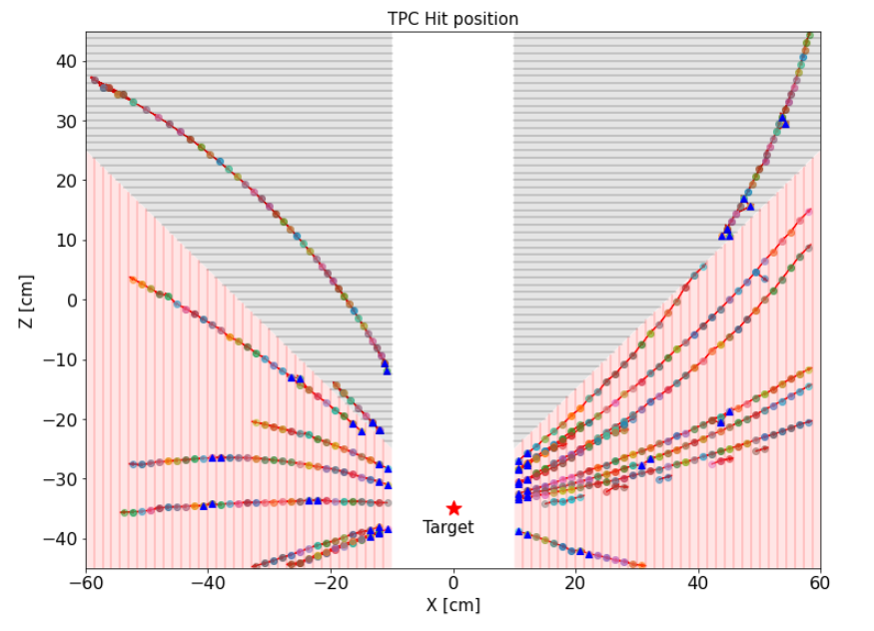
Event display
Generated Hit
Found Cells by CA

Slide 16
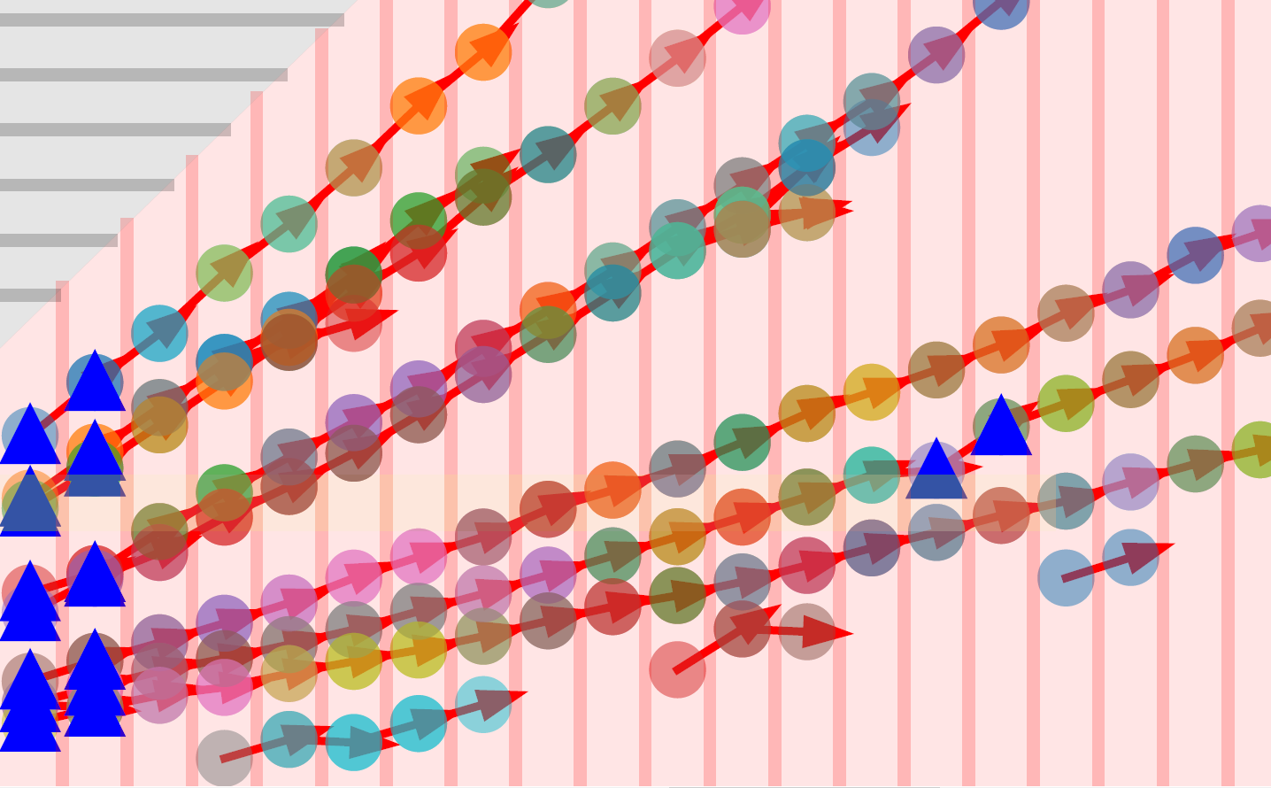
Event display
Generated Hit
Found Cells by CA

Slide 17
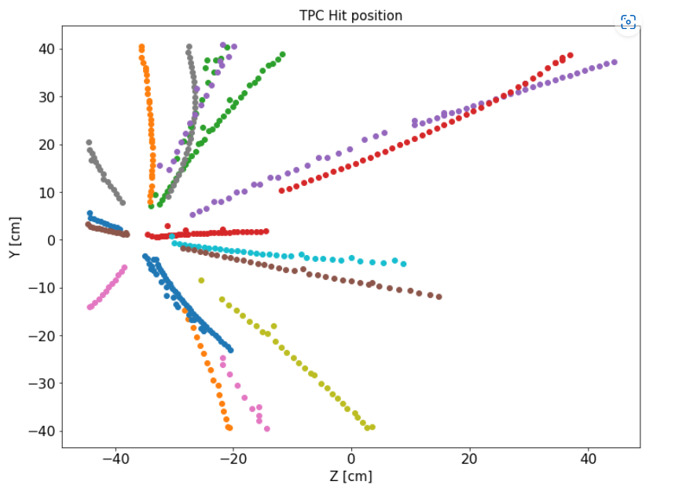
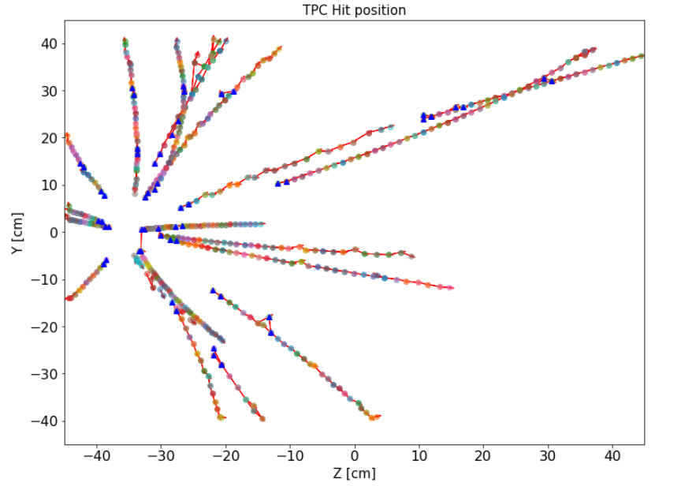
Event display
Generated Hit
Found Cells by CA

Slide 18
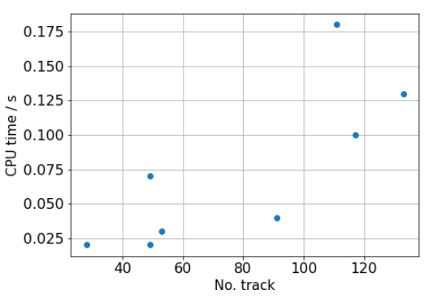
Performance

Slide 19
Track merging
Select the longest track segment as seed of the track

Slide 20
Track merging
Select the longest track segment as seed of the track
Extend to the next layer, pick an addition hit if it pass the selection criteria

Slide 21
Track merging
Select the longest track segment as seed of the track
Extend to the next layer, pick an addition hit if it pass the selection criteria
Extend to the 1st layer
Repeat the procedure in the inversed direction

Slide 22
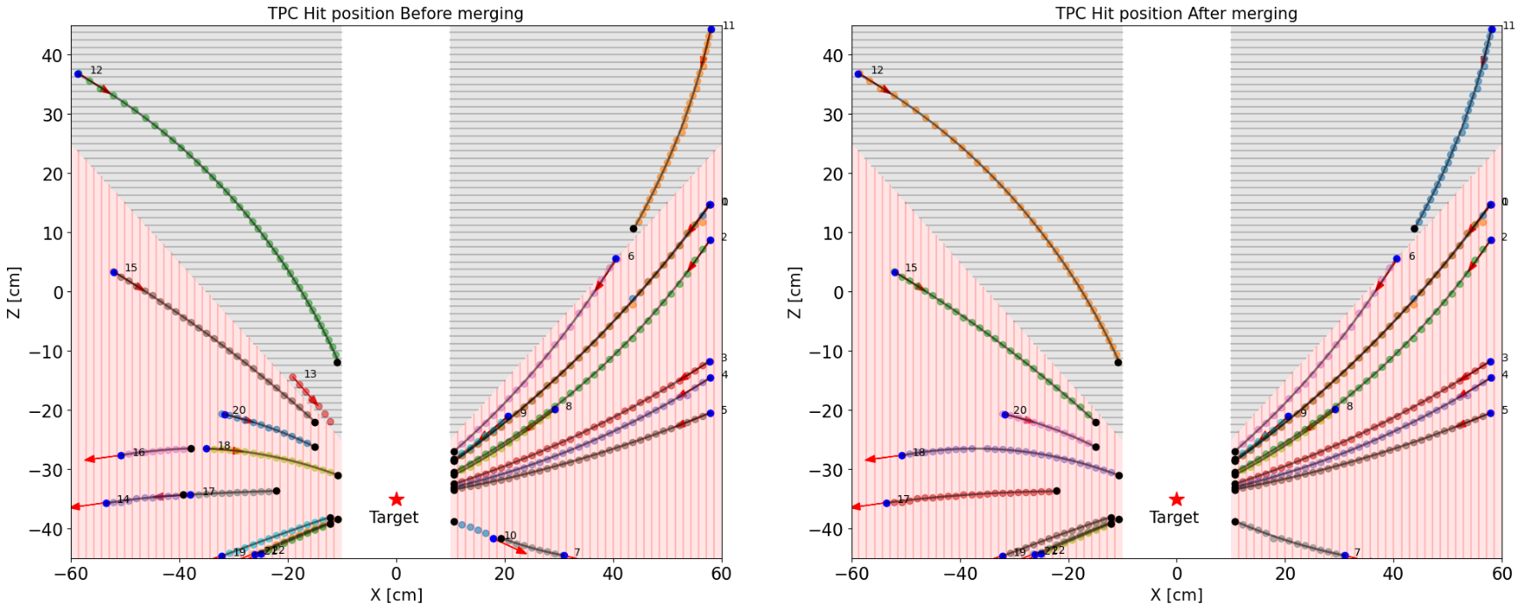
Track merging

Slide 23
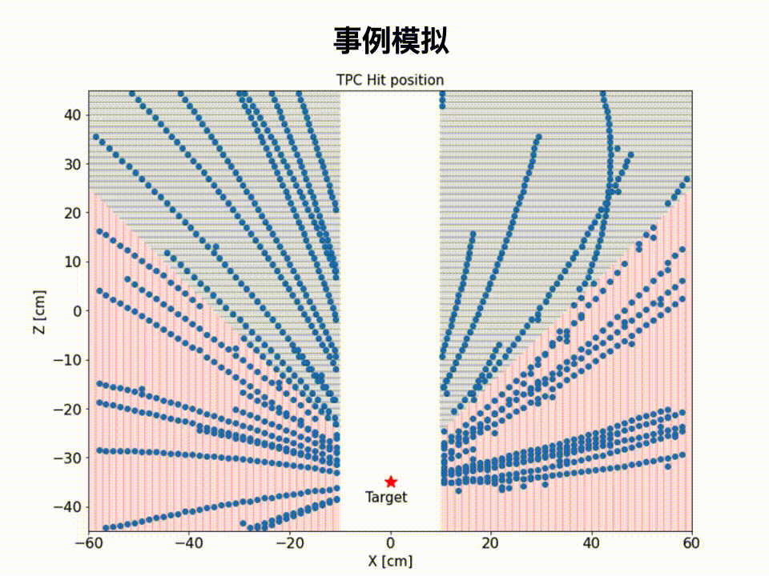
Workflow of CEE TPC TF algorithm
Event Simulation
Track finding by CA
Track fitting by KF
Track merging by CKF

Slide 24
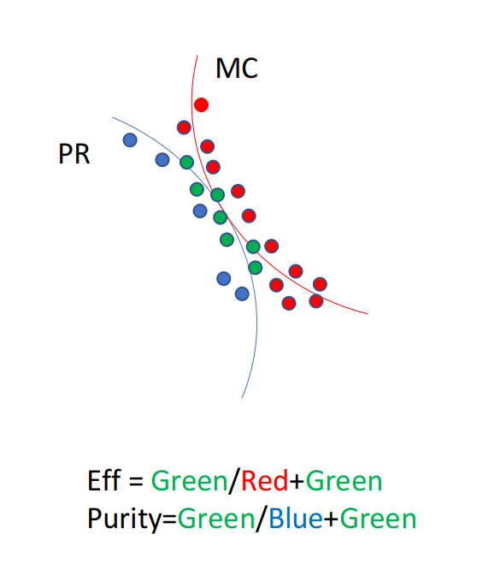
Hit efficiency and purity
Hit efficiency
$ε=\frac{correcttly found hits}{generated hit on a track}$
Hit purity
$p=\frac{correcttly found hits}{all found hits on a track}$

Slide 25
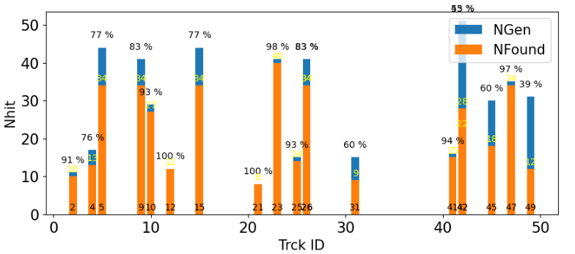
Efficiency and Purity : Efficiency

Slide 26
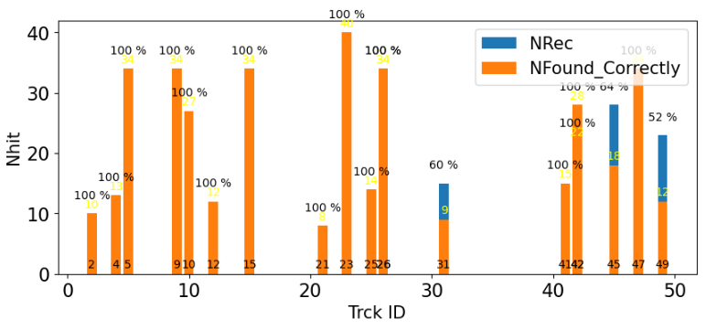
Efficiency and Purity : Purity

Slide 27
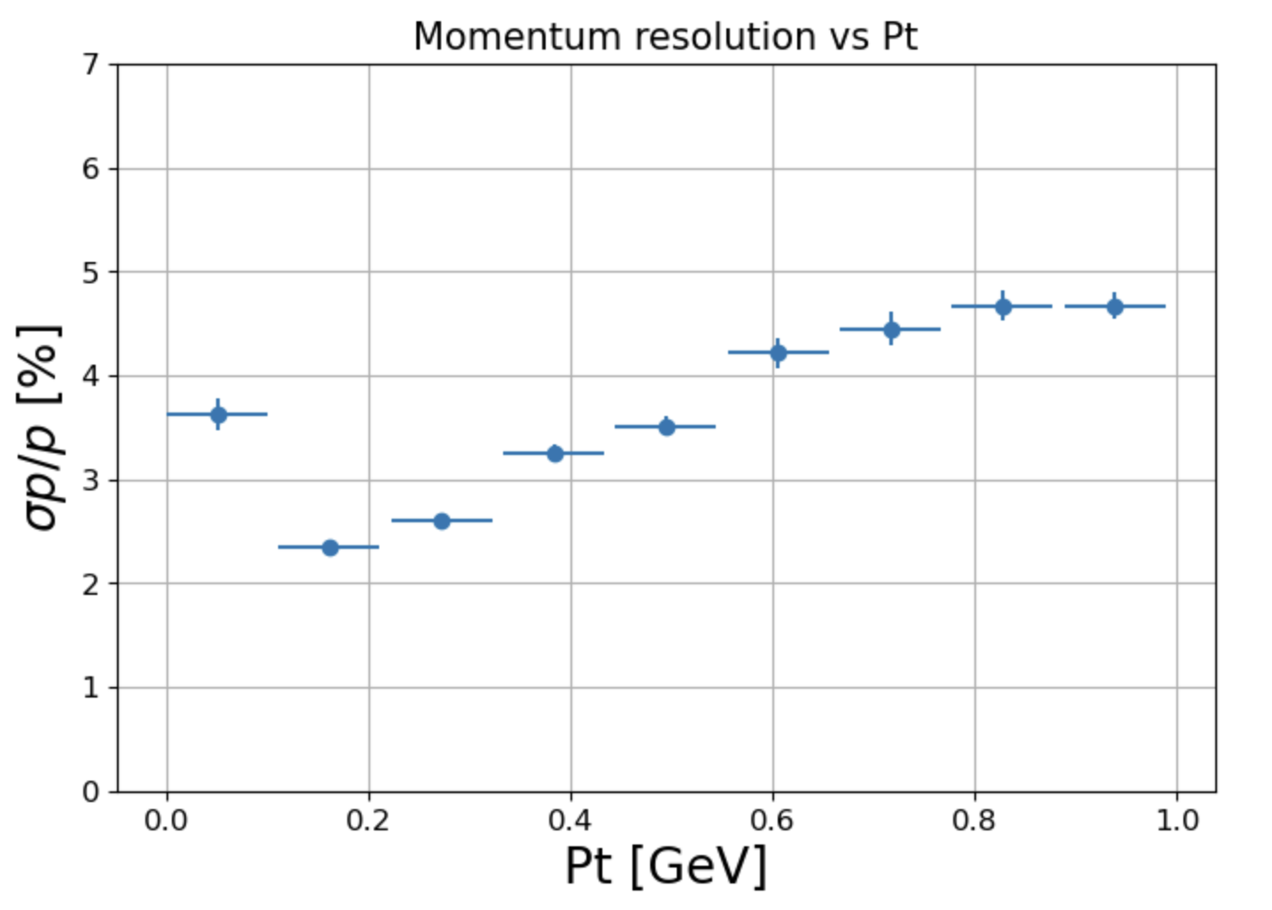
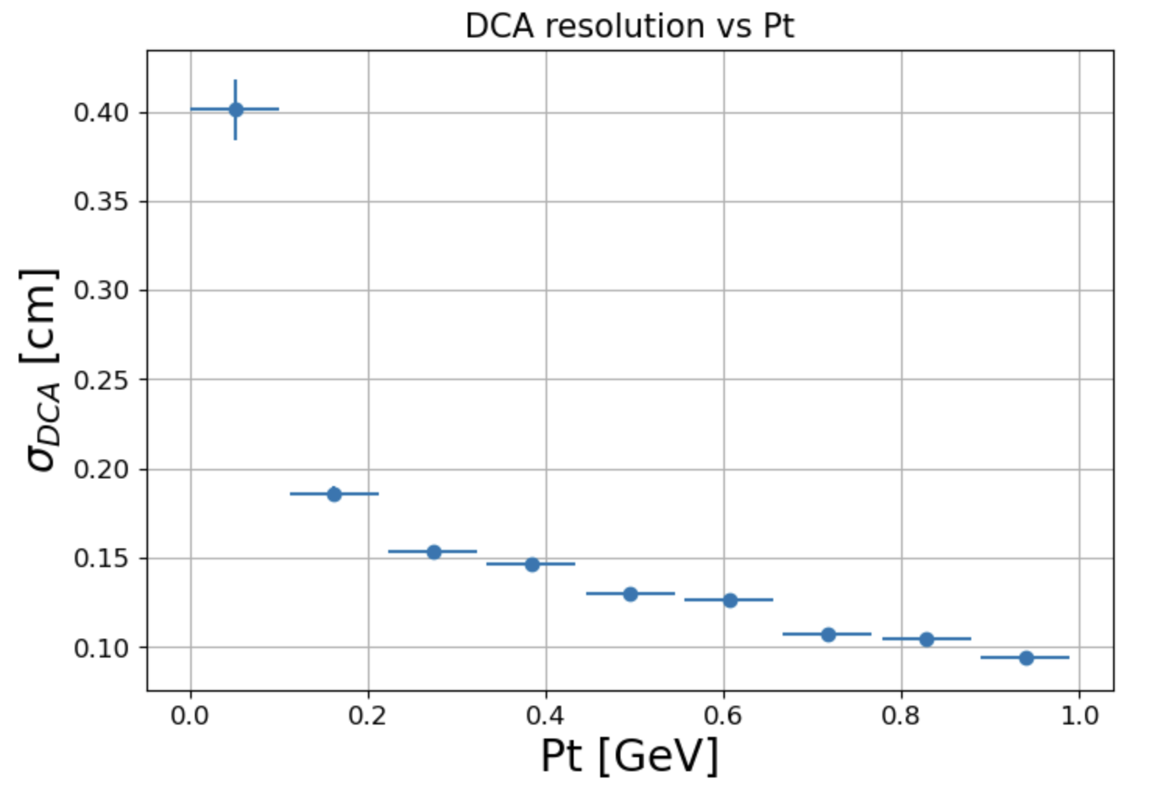
Momentum and DCA resolution
The momentum resolution is less than 5%
The DCA resolution is less than 0.3 cm [P > 0.1 GeV]

Slide 28
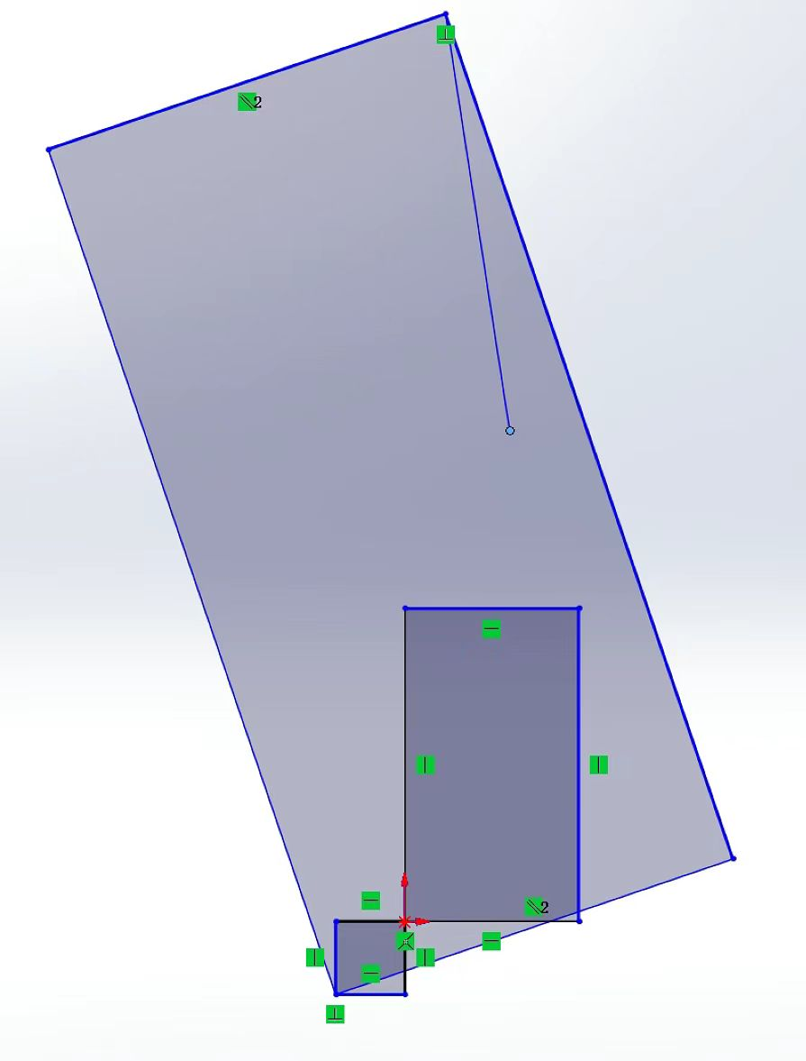
Results from Beam Test
z
TPC
x
2 adjacent pad rows
16 rows in total

Slide 29
Results from Beam Test
z
TPC
x
2 adjacent pad rows
16 rows in total

Slide 30
Results from Beam Test
z
TPC
x
2 adjacent pad rows
16 rows in total

Slide 31
Summary
Track finding algorithem based on CA is developed for CEE TPC
The algorithm is proven to have good speed
The parameters of geometrical requirement need to be optimized to get higher efficiency
The momentum and DCA resolution meet the CEE experiment requirement
Thank You !!

Slide 32
Backup

Slide 33
The coordinate
2 changes:
The origin is at IP
The Z axis is the same as the direction of B field
z
y
x
OLD
NEW

