Slide 1
GNN-Based Tracking Reconstruction for the Fermilab Muon g-2 Experiment
Bingzhi Li

Slide 2
1
Contents
Brief introduction to the Muon g-2 Experiment
Tracking Reconstruction in the Muon g-2 Experiment
GNN-based Tracking Reconstruction
Summary and Outlook

Slide 3
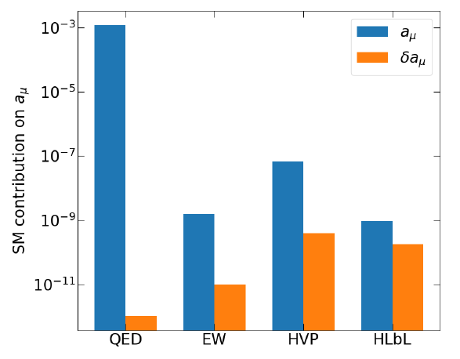
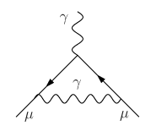
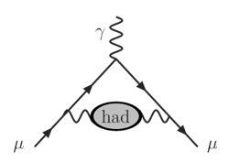
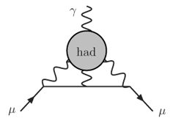
2
Brief introduction to the Muon g-2 Experiment
The muon is the secondary generation lepton
~200 times heavier than the electron, ~40,000 times more sensitive
Magnetic moment $μ$ is connected to spin $S$via dimensionless factor $g$
$μ=g\frac{e}{2m}S$, g=2 given by Dirac for spin ½ particles
Existence of the magnetic “anomaly”
Known as Schwinger term: $a_{l}^{QED,1loop}=\frac{α}{2π}≈0.00116$
Contributions to $a_{μ}$ come from QED, EW and Hadronic
$a_{μ}=\frac{g−2}{2}=a_{μ}^{QED}+a_{μ}^{EW}+a_{μ}^{HVP}+a_{μ}^{HLbL}$

Slide 4
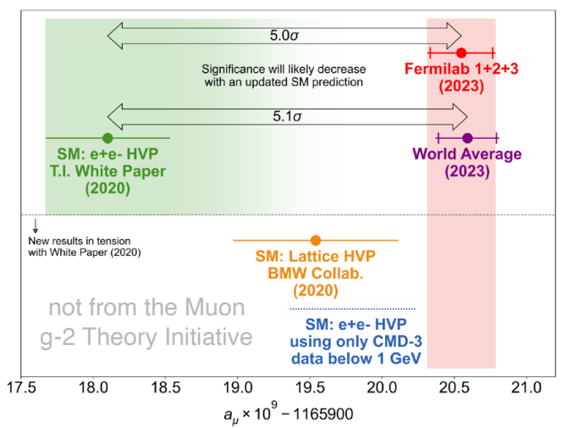
3
Brief introduction to the Muon g-2 Experiment
The Fermilab muon g-2 experiment aims to measure $a_{μ}$ to 140ppb
The latest measurement precision is ~200 ppb
5σ discrepancy between Fermilab along result and SM value (white paper)
Lattice HVP calculation and CMD3 experiment results reduce the discrepancy
Expect results to be published by 2025

Slide 5
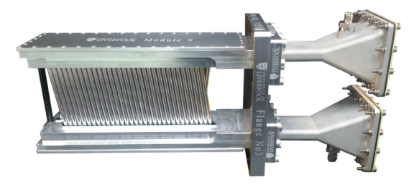
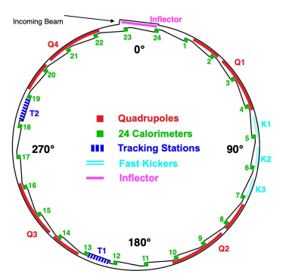
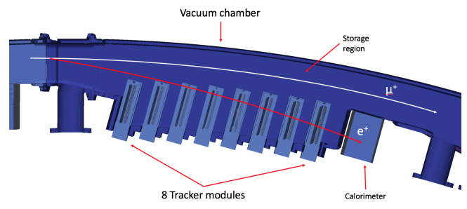
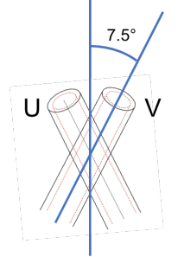
4
Tracker Detector in the Muon g-2 Experiment
50:50 Argon Ethane gas straw tube
Time resolution 650ps / Position resolution 0.1mm
Tracker system: totally have 2048 tubes
2 station $×$ 8 module $×$ 2 view $×$ 2 layer $×$ 32 tubes
Vacuum Chamber
Storage Region
8 tracker modules
Calorimeter

Slide 6
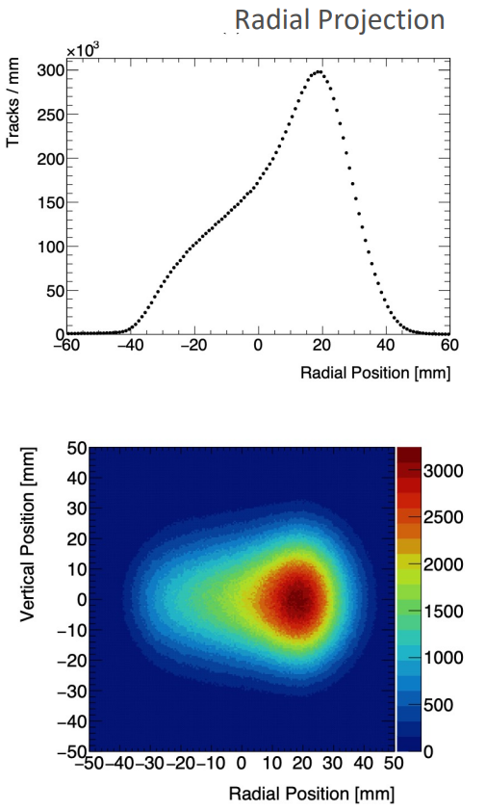
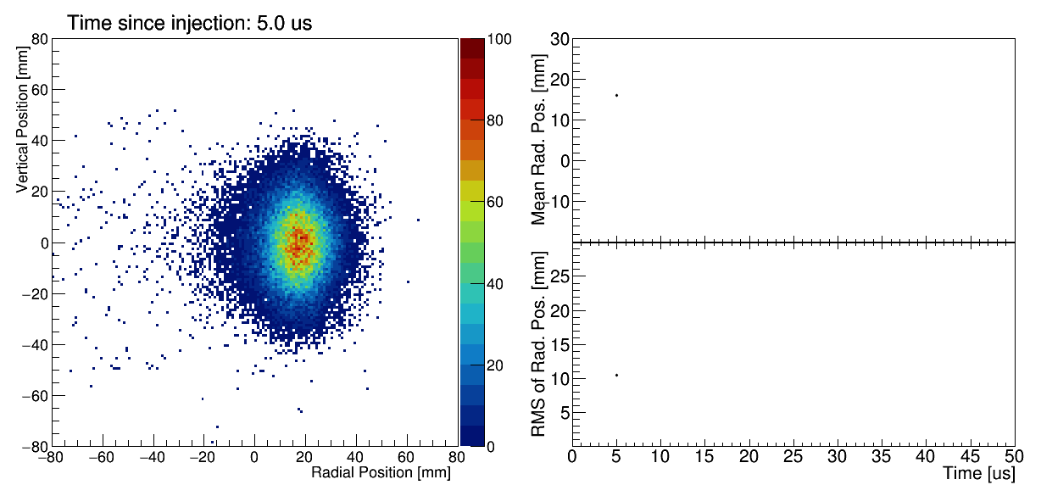
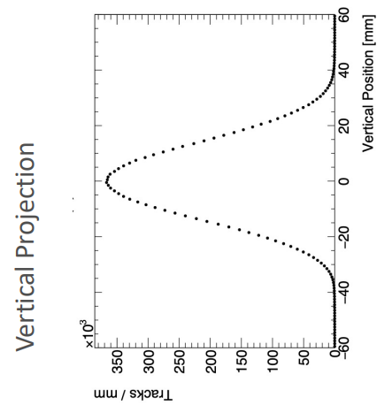
5
Motivation of the Tracker System
Beam Position: measure the muon-beam spatial profile, along with projections in the radial and vertical directions
Beam Momentum: Make an independent measurement of positron momentum
Beam Dynamics: Characterize position and width CBO modulations, horizontal and vertical

Slide 7
6
Tracking Reconstruction Workflow
taken from Fermilab muon g-2 internal note 215

Slide 8
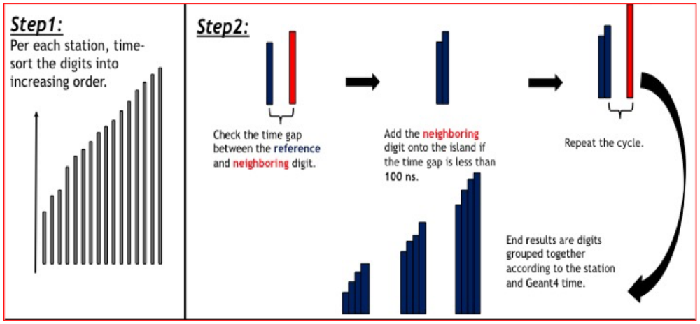
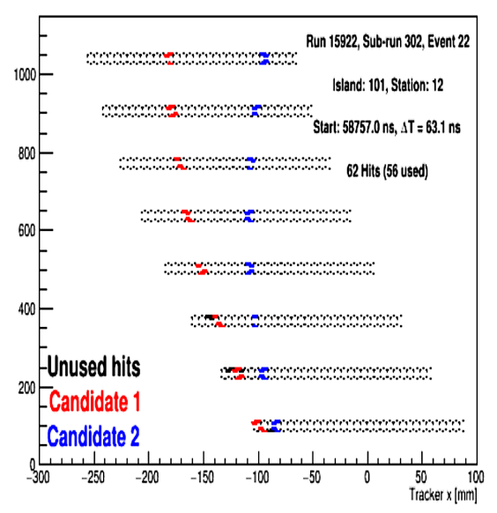
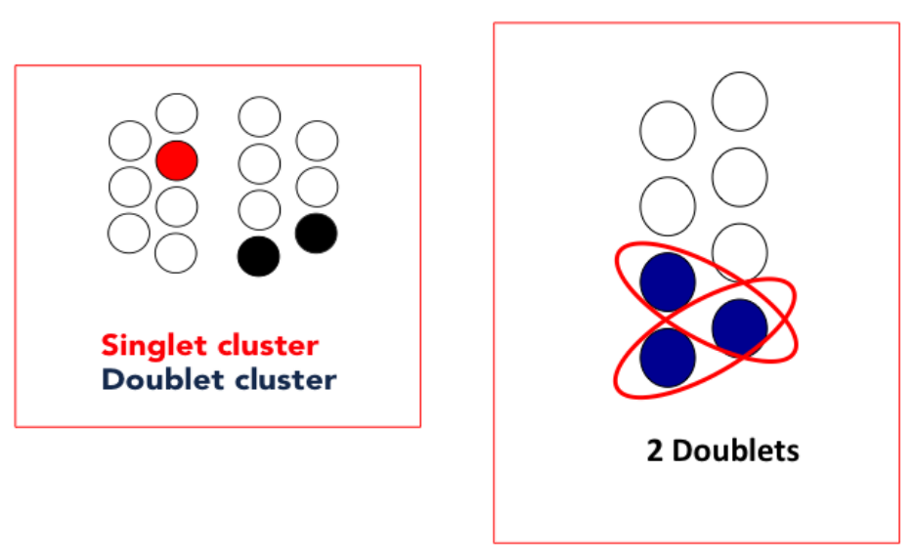
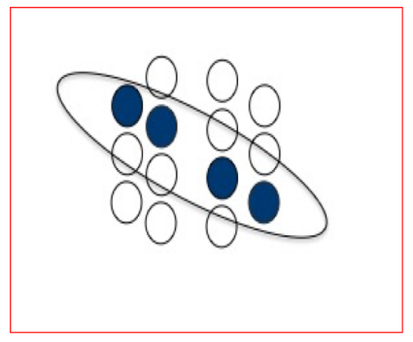
7
Default Tracking Reconstruction Workflow
Time island
Track Finding & Fit
Clustering
Seeding

Slide 9
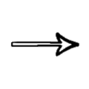
8
GNN V.S. official workflow
Raw digits
Island
Motivation
Further improve tracking efficiency
Find more tracks (more statistics)
Speed up production
Better beam dynamics monitoring and measurement
Prepare for the next generation experiment at J-PARC
build graph
clustering
apply model
seeding
GNN
Finding
build edges
finding
GNN
track fitting
build track
cleaning
GNN
vertex fitting
T0 finder
DCA
track fitting
vertex fitting

Slide 10
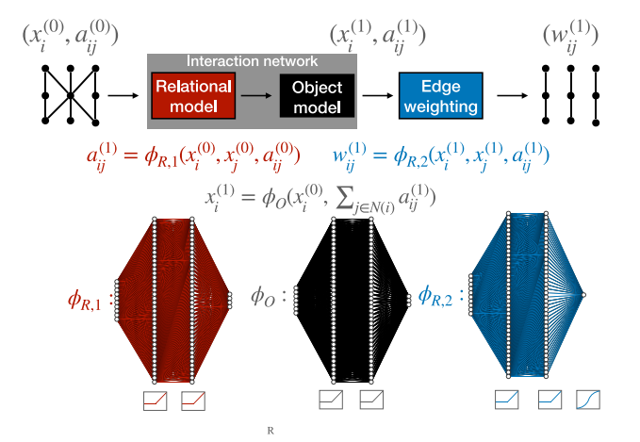
9
Typical GNN ML Track Finding Workflow
Module Map: Based on simulation and geometry information, connect all hits that may belong to the same particle.
Connected Components: apply a low cut on edge classification score s>0.1, if just a single path, then find a track
+walkthrough: if more than 1 path exist, select the higher scores to form multi-path
Metric Learning: Use MLP to embed the hits into an 2-dimensional latent space to make the hits which belong to the same particle to be as closer as possible. Then use a fixed radius to connect the hits to build graph.

Slide 11
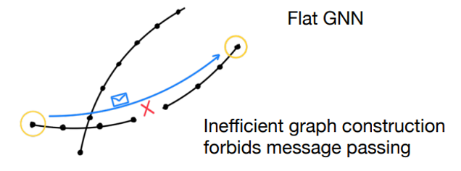
10
Limitations
The method to build the graph is specific in different tracker geometry:
For different experiment, need specific detector geometry / pattern map
Metric learning may losing truth edges
Edges are connected based on a limited range of detector layers:
Long tracks might get split to multiple short tracks in clustering step
Further merging needed

Slide 12
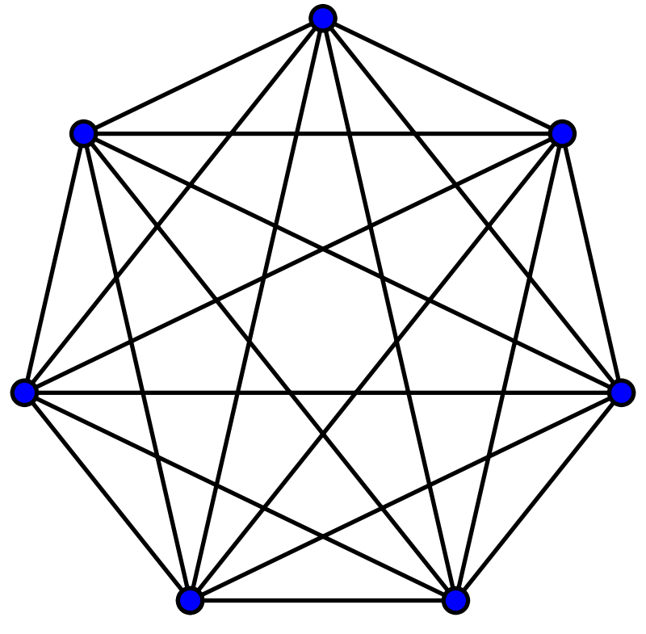
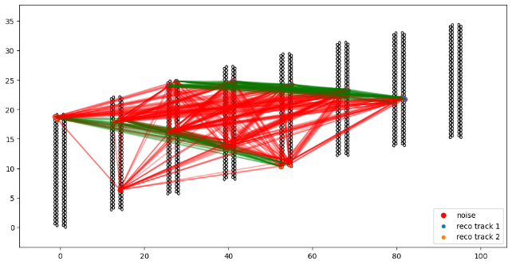
11
Build Fully Connected Graph
Use fully connected graph to overcome the limitations
Easy to construct the graph: each node are connected with each other
No truth edge missing, but need more memory
Suitable for any tracker system, no need to consider the geometry
Allow long-range communications
Easy to cluster the nodes to form tracks using graph theory
Edge label: fake edges / truth edges
Truth edge:
edge between the nodes which are belong to the same reconstructed track
Fake edge:
edge between the nodes which are not belong to the same track
not all edges are shown to have a better view

Slide 13
12
GNN Architecture
Embedding the node features and edge features into a high-dimension latent space to get the node representation $h^{0}$ and edge representation $x^{0}$
The messages between node $i$ and node $j$ are generated through a network $φ_{m}$
$$m_{ij}^{l}=φ_{e}(h_{i}^{l},h_{j}^{l},x^{l})$$
The edge representation will be updated through a network $φ_{x}$ with residual connection
$$x_{i}^{l+1}=x_{i}^{l}+φ_{x}(m_{ij}^{l})∙x_{i}^{l}$$
The node representation will be updated through a network $φ_{h}$ with residual connection
$h_{i}^{l+1}=h_{i}^{l}+φ_{h}\left(h_{i}^{l},\sum{w_{ij}m_{ij}^{l}}\right)$ where $w_{ij}=φ_{w}(m_{ij}^{l})$
Repeat step 2-4 for L layer, then use a classifier network $φ_{c}$ to judge whether the edges exist between node $i$ and node $j$：$s_{ij}=φ_{c}(h_{i}^{L},h_{j}^{L})$
Loss Function: Binary Cross Entropy loss

Slide 14
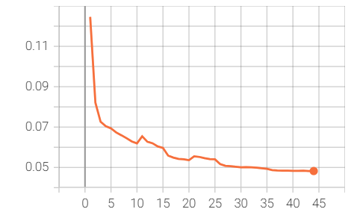
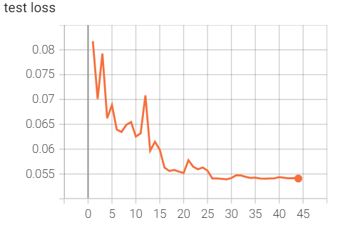
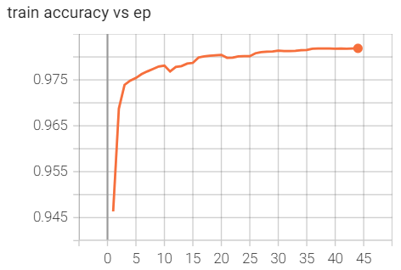
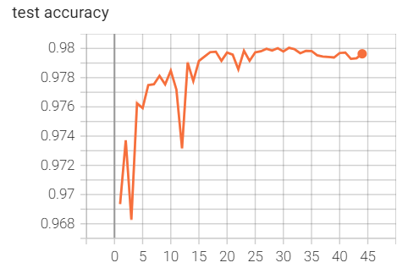
13
GNN Track Finding: Edge Classification
Training and Performance of the GNN edge classification
train loss
test loss
Quickly converge around 25 epoch
Edge classification accuracy: 98%
train accuracy
test accuracy

Slide 15
14
GNN Track Finding: Node Clustering
Remove the fake edges according to the GNN model
Perfect condition:
All fake edges are removed
All hits belong to a track are connected to each other
No link connection between different tracks and noises
Track #1
Track #2
Noises
Practice condition: not 100% accuracy (98%)
truth edges $→$ fake edges, be removed
fake edges $→$ truth edges, remaining
Hard to use a simple complete condition cut to form track
But the connection within a track should be still tight according to the accuracy
Truth edges are missing (show in red)
Fake edges are remaining (show in green)

Slide 16
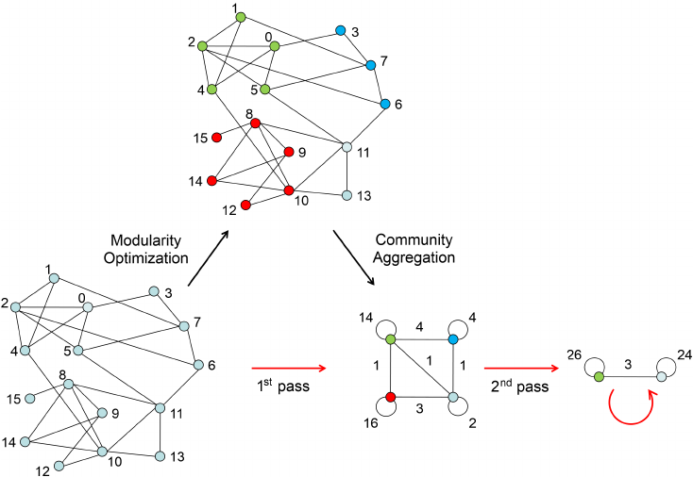
15
GNN Track Finding: Node Clustering
Adopt a classical graph analysis method to select the tracks from the output graph:
Louvain Algorithm
Louvain algorithm is an unsupervised community discovery algorithm based on modularity: $Q=\sum_{c}{[\frac{\sum_{in}{ }}{2m}−(\frac{\sum_{tot}{ }}{2m})^{2}]}$
The fully connected graph method has both high efficiency and robustness:
The edge accuracy is ~98%
Even one hit disconnected with its neighbor hit, it not likely loss connection with all the other hits in the same track
The noise hit is hard to get connection with most/all the track hits

Slide 17
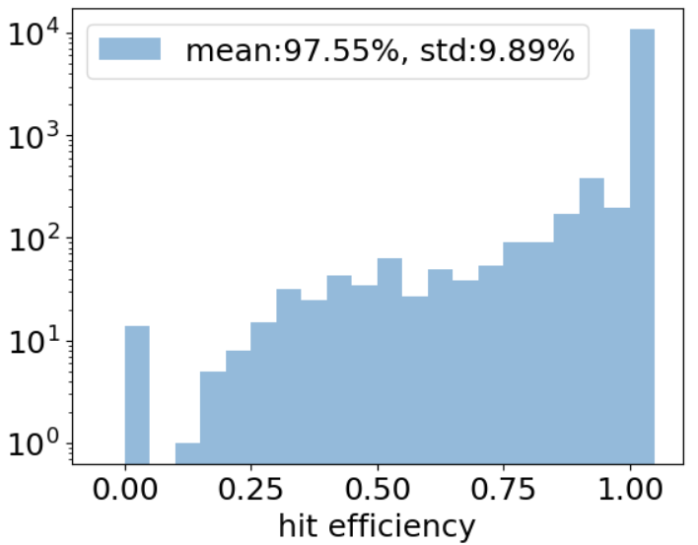
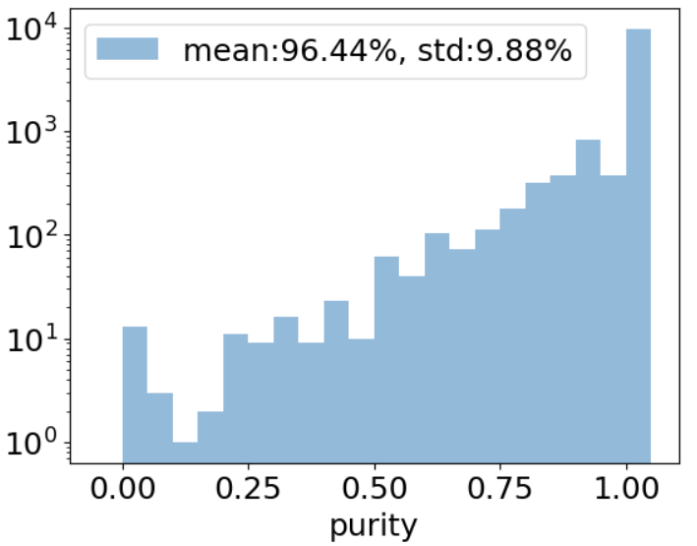
16
GNN Track Finding: Efficiency and Purity
$ε=\frac{N_{GNN matched hits in a track}}{N_{total truth hits in this track}}$
$$p=\frac{N_{GNN matched hits in a track}}{N_{total GNN predicted hits in this track }}$$
Promising result:
Test on synthetic data and real data
Hit efficiency and purity [%]:
Synthetic: 98.8$±5$.9 / 99.3$±2.7$
Real: 97.6$±$9.9 / 96.4$±$9.9 (using official reconstructed tracks as truth to train, will involve noises)
Next will test on simulation data to verify the performance

Slide 18
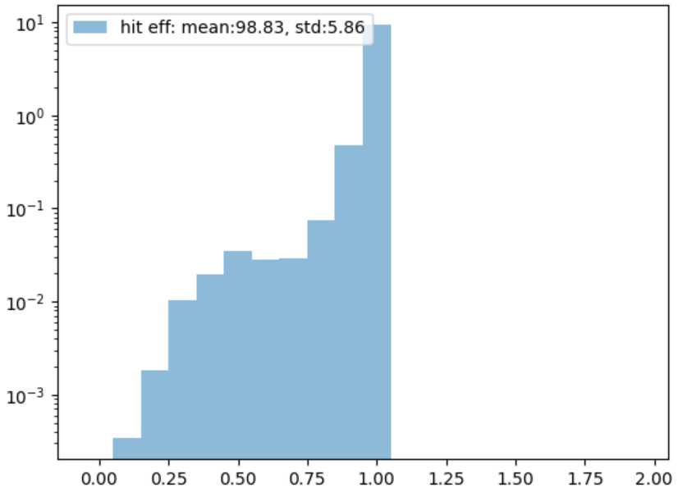
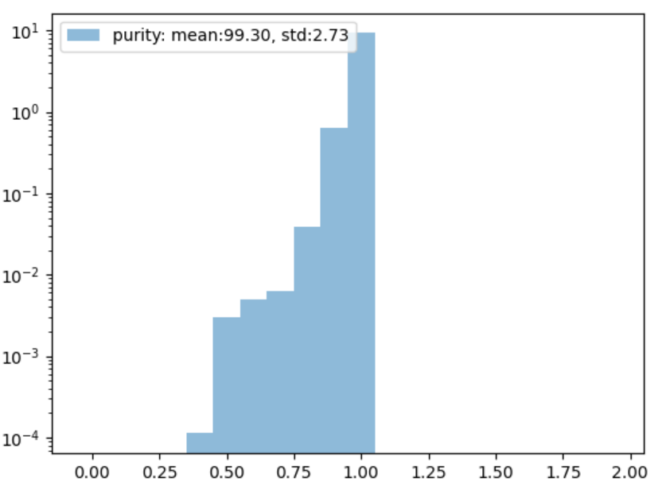
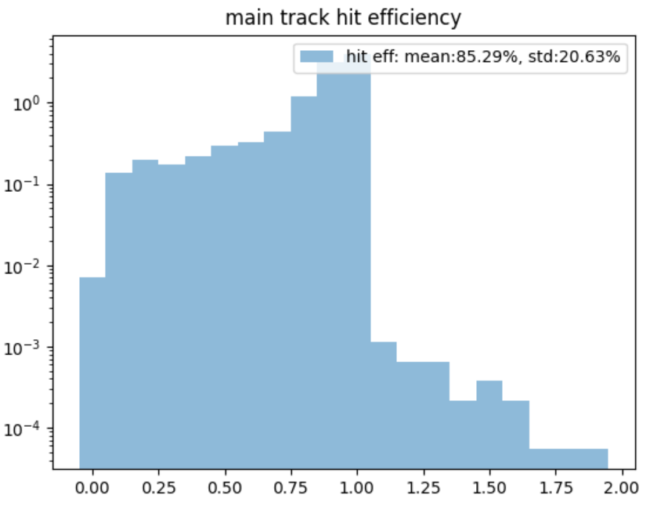
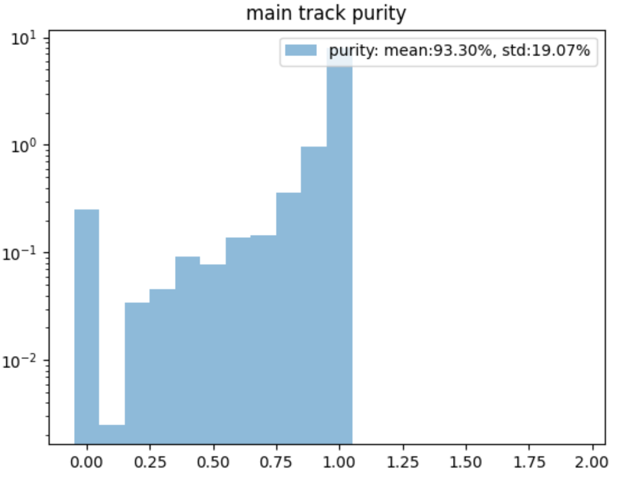
17
GNN Track Finding: comparison
Hit Efficiency
Purity
Compare the GNN method and official finding method in synthetic data
The efficiency and purity are both better than the official method
GNN
Main
Trk
Purity
Recon method | Hit efficiency % | Purity %
GNN | 98.83(5.86) | 99.30(2.73)
Main track | 85.29(20.63) | 93.30(19.07)
Hit Efficiency

Slide 19
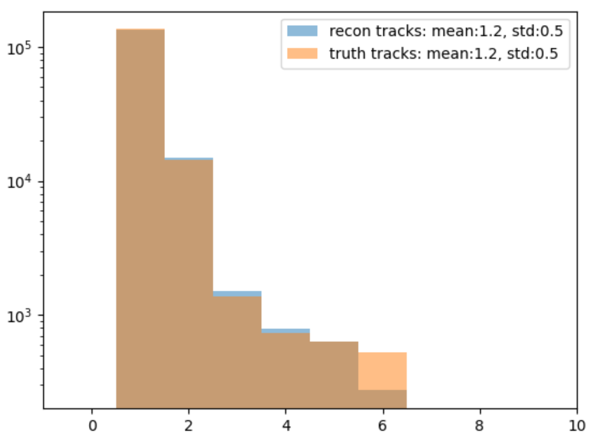
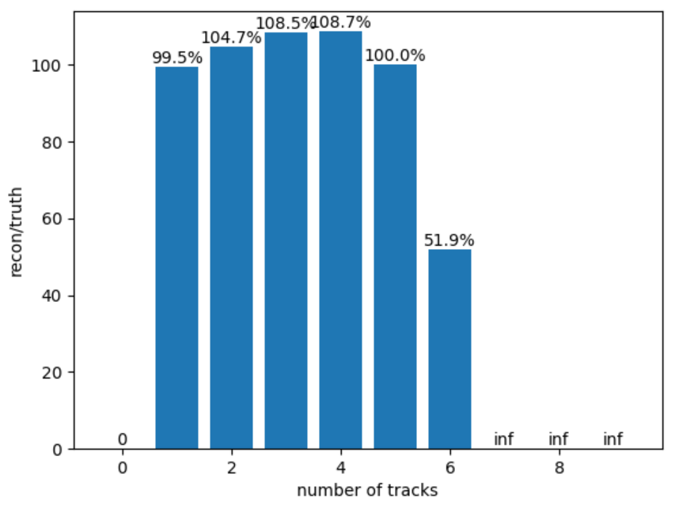
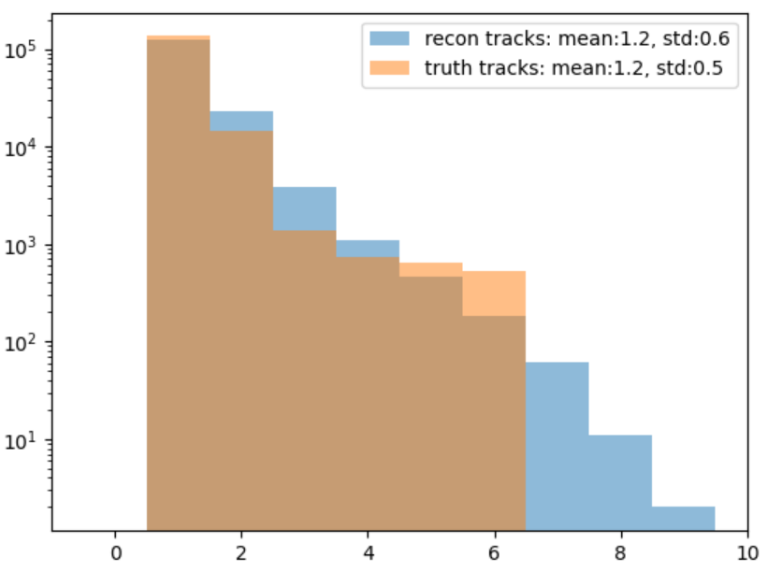
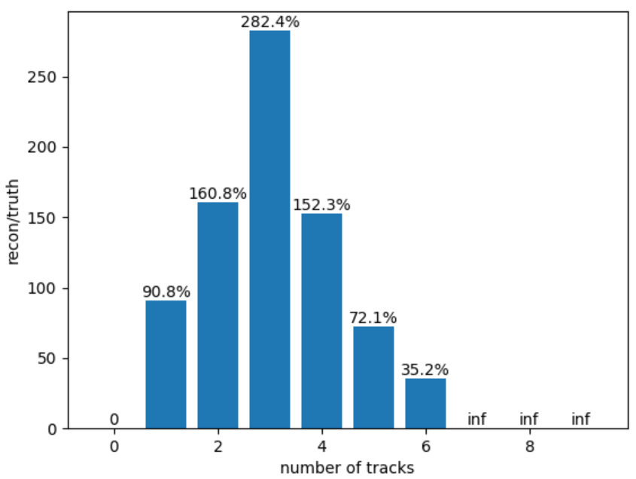
18
GNN Track Finding: comparison
For the multi-track finding the GNN perform well up to 5 tracks in a single island
While the official method perform pool for multi-tracks condition
GNN
Main
Trk
Track Efficiency:
$ε_{trk}=\frac{N_{pred_truth_track}}{N_{all_truth_track}}$
method | N=1 | N=2 | N=3 | N=4 | N=5 | N=6
GNN | 99.5 | 104.7 | 108.5 | 108.7 | 100.0 | 51.9
Main track | 90.8 | 160.8 | 284.4 | 152.3 | 72.1 | 35.2

Slide 20
19
Summary and Outlook
Tracker is one of the key detector system components of the muon g-2 experiment
Tracking measurement and reconstruction play a important role in various aspects of the experiment: Field, Beam Dynamics …
GNN in tracking is motivated by current limitations in tracking efficiency and speed
Developed a fully connected GNN workflow to solve the challenges
Further studies needed:
GNN for Track fitting
Verify the GNN workflow in simulation data
Test the feasibility of GNN methods in analysis
Preheat the GNN method for the next generation of experiments in J-PARC

Slide 21
谢谢！
Thanks

Slide 22
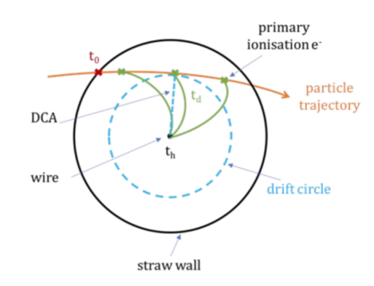
GNN Vertex Fitting:
Use fitted tracks to extrapolate the vertex
Use GEANE package in GEANT4 to do the extrapolation: 2.5s process ~400 time island
Want to use GNN and GPU to speed up this progress: 12G 2080Ti: 8s ~ 35,000 time island, ~25x faster
Increase the memory and update the GPU can make it even faster (100x or even 1000x)
decay vertex
Vacuum Chamber
Storage Region
8 tracker modules
Calorimeter
Input data:
Track finding features
Add high level features
(momentum, position and drift time, DCA)

Slide 23
GNN Vertex Fitting: Architecture
Same structures like finding step 1 to 4
Aggregate the final node representation $h^{L}$ and then use a regression network to predict the vertex info (time, position, momentum)
3 individual GNN are trained to extract time, position and momentum separately
Regression Loss Function:
Huber Loss:
SmoothL1 Loss:
Log Cosh Loss:

Slide 24
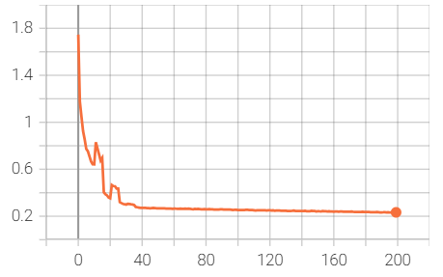
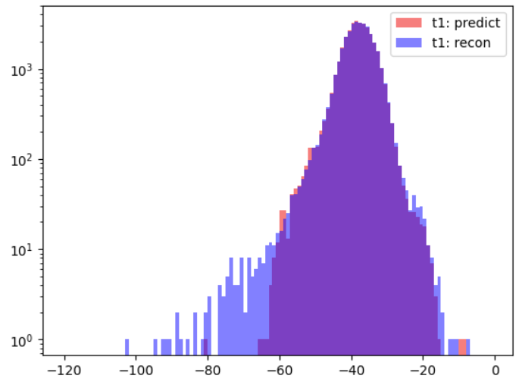
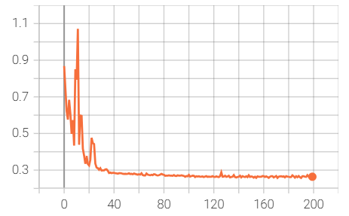
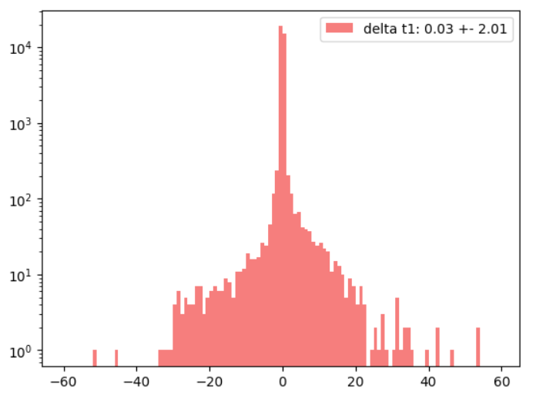
GNN Vertex Fitting: Time
Train loss
Recon Δt
GNN Δt
$$Δt=t_{v}−{\overline{t}}_{t}$$
$t_{v}$：vertex time
${\overline{t}}_{t}$：mean time of track
Δt [ns]
Test loss
Difference between GNN and recon vertex time:
0.03ns $±$ 2.01ns
Similar time resolution between recon and simulation

Slide 25
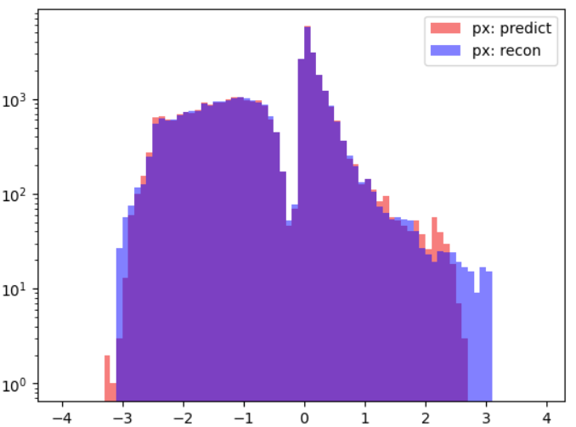
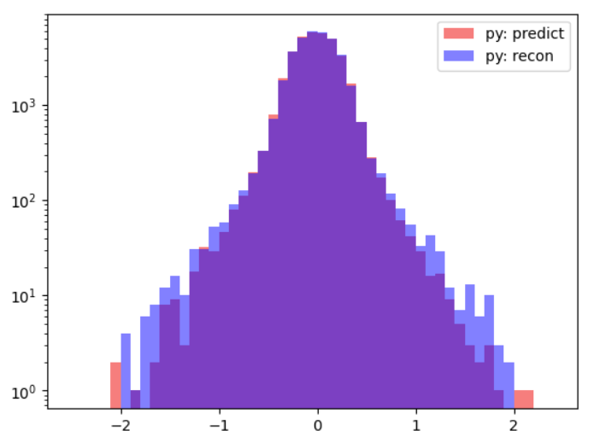
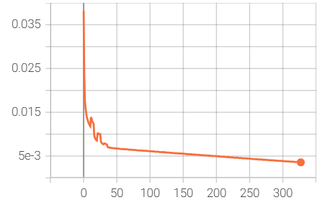
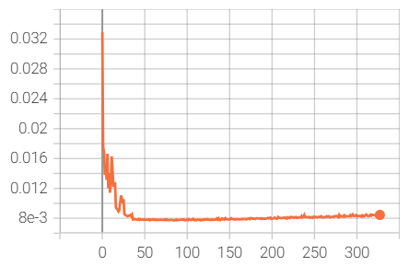
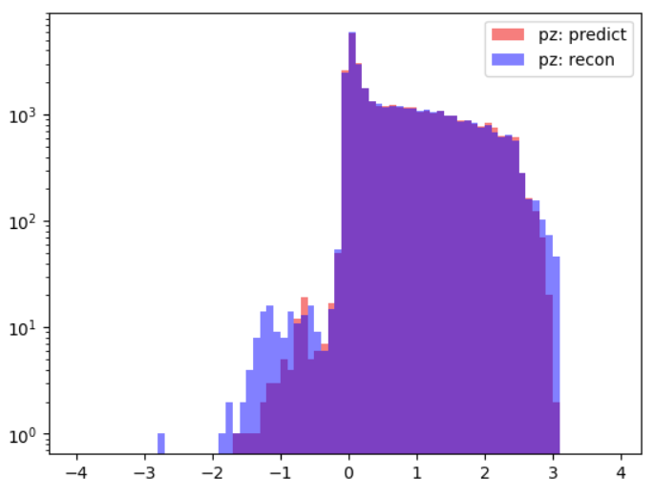
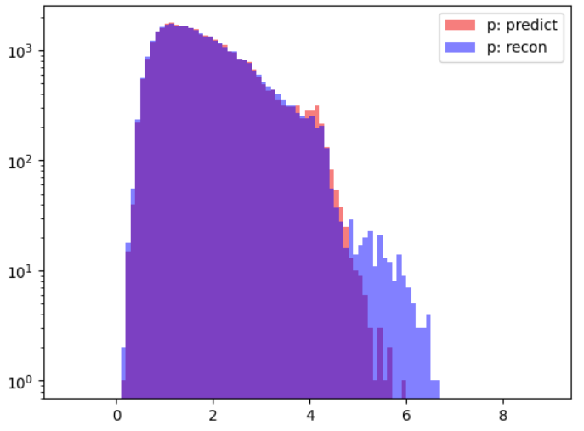
GNN Vertex Fitting: Momentum
px [GeV]
Recon
GNN
py [100MeV]
Train loss
Test loss
pz [GeV]
p [GeV]
Distributions of momentum are almost similar, mismatch mainly at the tail
The mean $∆$momentum are <5 MeV level, the RMS are at ~100MeV level

