Slide 1
Progress in last week of Elec-TDAQ
Thursday link：https://indico.ihep.ac.cn/event/21711/
Discussed on general architecture of Elec-TDAQ, converged into two main frameworks: ATLAS-like & CMS-like
  Key point is the trigger strategy:
    ATLAS-like: FEE participate into the trigger decision, software trigger
    CMS-like: BEE participate into the trigger decision, FEE only send out all the raw data (“FEE-triggerless”), hardware trigger
  Tends to prefer CMS-like trigger
    Simpler FEE & ASIC, higher engineering feasibility within limited time
    Precondition: FEE can send out all the data
      Needs to know all the data rate before trigger (plus all the noise & background) of all sub-det
      Most of the value provided before by sub-det are data rate after trigger
  For few particular sub-det, like vertex, if needed (very likely), possible to provide a special & simple but fast L0 trigger, with less latency (e.g. 3 us)
  BEE & Trigger common board possible to each merge into a single board
    Needs further discussion to clarify the functionality division depending on trigger strategy

Slide 2
Progress in last week of Elec-TDAQ
Preliminary discussion on Muon R&D Elec → CEPC Elec-TDAQ framework compatible design
  Further Q: what is the real requirement to Muon Elec
  Further Q: can Muon FEE compatible with CAL SiPM readout? → ASIC can be used
Initiated Power & Data link subsection work in Elec-TDAQ
  Power: Jun Hu; Data Link: Di Guo (CCNU); Grounding: Lei Fan

Slide 3
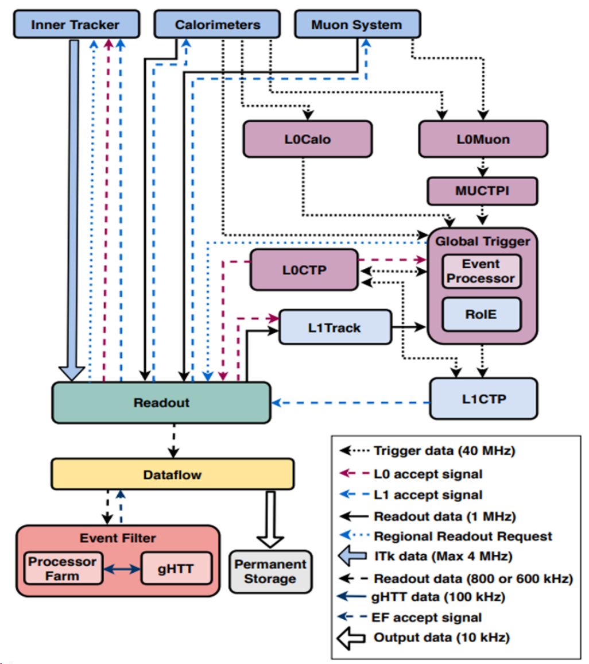
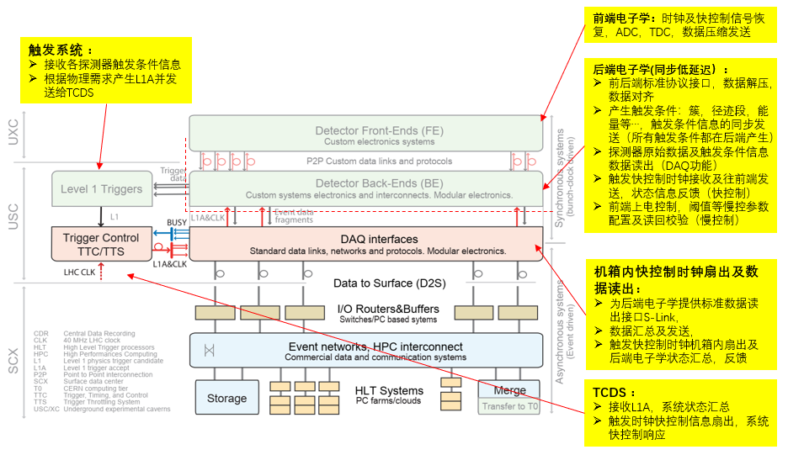
ATLAS vs CMS TDAQ framework
ATLAS BEE:
  receive the data after triggered; buffered on FEE; Trigger communicate with FEE
CMS BEE:
  receive the data before trigger; buffered on BEE; Trigger communicate with BEE
Note: a special L0-trigger goes to the inner tracker in ATLAS

Slide 4
Muon R&D Elec → Framework compatible design
To CEPC BEE
Leave the current FEE, remove FPGA board & Power
Add FEE Data link, all data go directly to BEE
Use common Power module (Pol-based)
Further Q: what is the real requirement to Muon Elec
Further Q: can Muon FEE compatible with CAL SiPM readout? → ASIC can be used

Slide 5
Recent plan
Define the final framework of Elec-TDAQ
  Make clear the raw data rate before trigger
Cost estimation for TPC & DC, TOF & Si Strip

