Slide 1
CEPC vertex detector towards TDR
Zhijun Liang,
On behalf of CEPC vertex working group

Slide 2
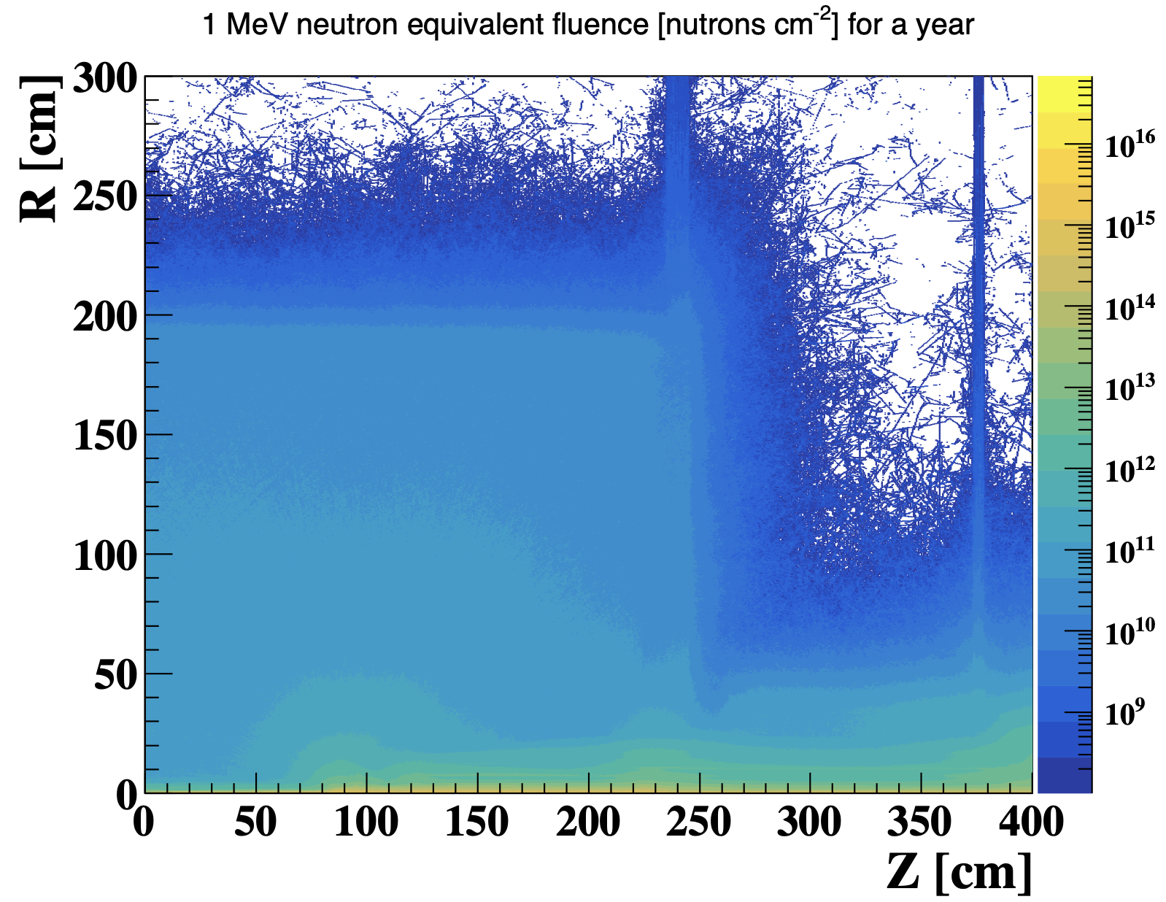
Plan: MDI background input
Got 1st offical background input from MDI group last week
Request MDI group to provide the background distribution and raw data
Get background hit density distribution in vertex detector in software

Slide 3
Readout architecture
End of March: Plan to work with electronics group to finalize the design
Readout architecture is the key for next step
Readout speed and buffer size are the major concern
Question
Physics requirement to Vertex detector Time stamp uncertainty
Manqi suggested to ask event building experts
What is the trigger latency? 3us or 10us ?
Impact to Jadepix-like readout (Analog buffer )
Impact to Taichu-like readout (FIFO depth)
 | Jadepix4-like readout | Taichu-like readout
Time stamp uncertainty (Higgs/WW/Z runs ) | 5/12/120 bins | 1/1/1 bins
Data rate@trigger (Z run ) | ~1200 Mbps | ~120 Mbps
Data rate@triggerless(Gbps) (Higgs/WW/Z runs ) | 0.3/?/3.8 Gbps | 0.4/1/6 Gbps

Slide 4
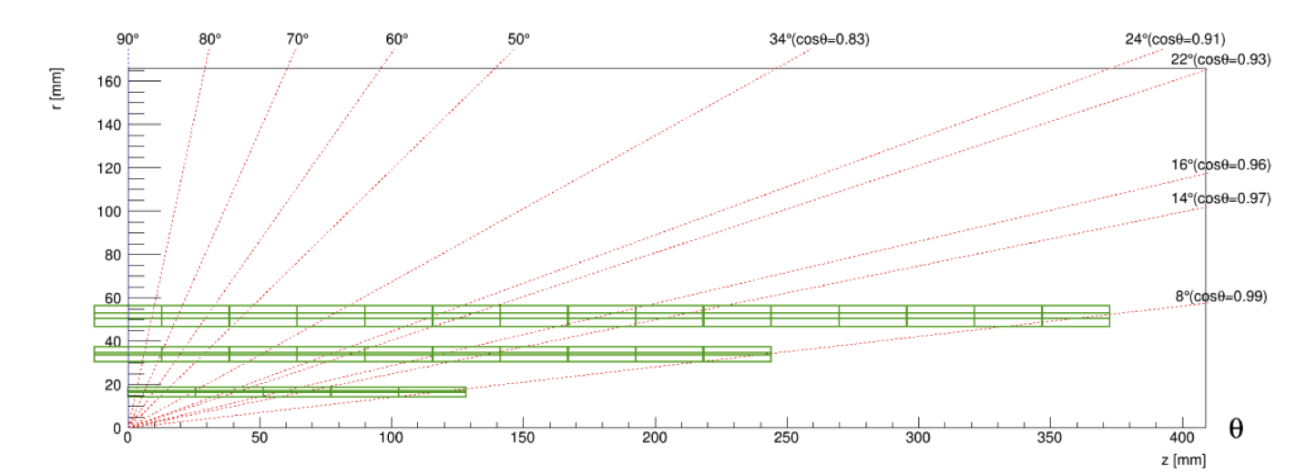
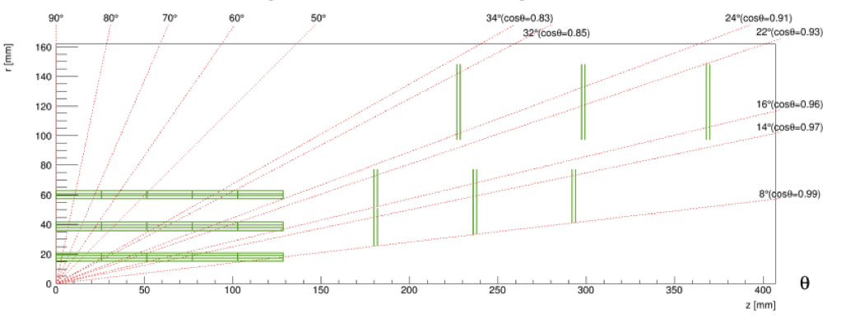
Plan : geometry and layout optimzation
End of March: finalize the detector geometry and mechnical design
Physics Layout optimization
How to deal with Endcap ?
Feasibility study of 2 layout ( mechanics support, cooling, cable ….)
Vertex detector MOST2 prototype layout has been implement in CEPCSW
Try to perform further optimization with full simulation
Long barrel
Short barrel With endcap

Slide 5
backup

Slide 6
Weekly meeting
Group Meeting every Thursday afternoon (2nd meeting last Thursday)
https://indico.ihep.ac.cn/event/21543/
From last meeting, Discussion about the choice of technology
Discussion with L3 Stitching (Mingyi) and SOI (Yunpeng)
Agree to focus CMOS pixel for reference TDR baseline

Slide 7
Key parameters
Single-point spatial resolution (now and in the next 5 years)
Time stamp precision requirement (to be discussed with Shengsun Sun)
Material budget
Cost estimation
Occupancy
Max data rate that can be handled by this technology (now, and in the next 5 years)
Radiation hardness (now, and in the next 5 years)
Power dissipation (now, and in the next 5 years)
Expected Technology availability in the future
Technology Readiness

