Slide 1
Tracker for reference detector TDR
WANG Meng 王萌
2024.3.5

Slide 2
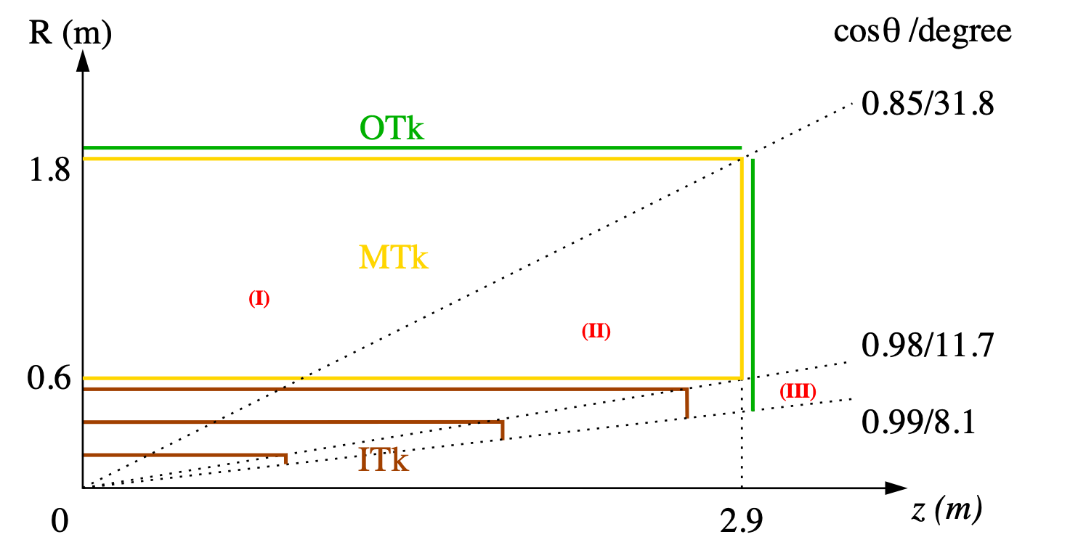
CEPC tracking system, draft
Three tracking regions
barrel, full Main + Si trackers
endcap, partial Main tracker
forward, Si tracker only

Slide 3
status and plan
TPC vs DC
comparison tables of performance and cost to be filled up by March 8th.
silicon tracker
optimize geometrical layout
determine requirements of single-point resolutions
investigate readout electronics
estimate cost for different scenarios with pixel and/or strip sensors
LGAD and TOF
A conceptual design for the outer tracker with 4D capability was ready.
The necessity of TOF for Higgs run needs further study.
more details in minutes at: https://indico.ihep.ac.cn/event/21728/

