Slide 1
Tracker for CEPC reference detector TDR
WANG Meng 王萌
2024.3.25

Slide 2
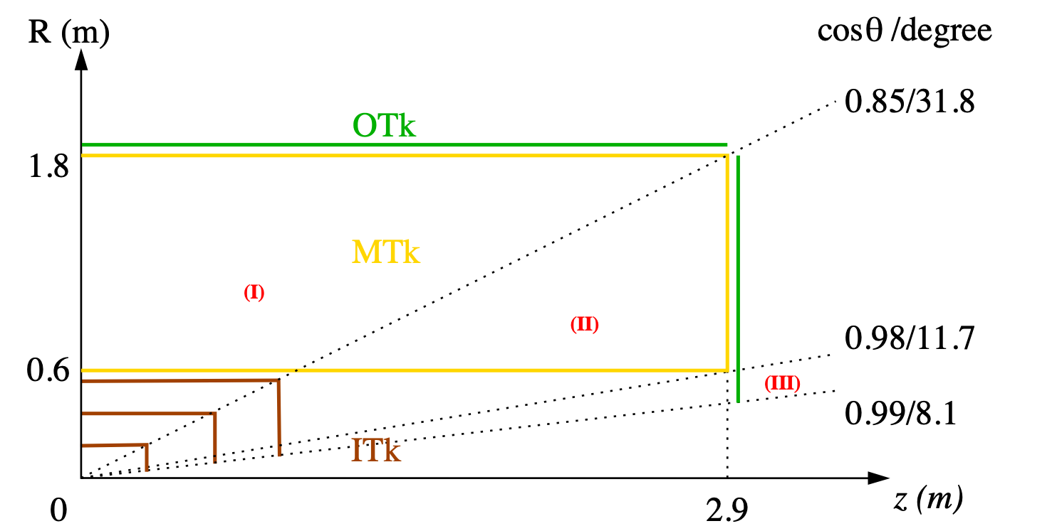
CEPC tracking system, draft
Three tracking regions
barrel: full Main + Si trackers
endcap: partial Main tracker
forward: Si tracker only

Slide 3
TPC vs DC
a mini-review will be held at IHEP on April 2nd. https://indico.ihep.ac.cn/event/22016/
 | unit | TPC, Higgs | TPC, Z | DC, Higgs | DC, Z
B-field | T | 3 | 2 | 3 | 2
Performance
material budget barrel | X0 | 1.20% |  | 1.14%
material budget endcap | X0 | 17% |  | 28% (plate) + 1.8% (cable)
Npoint of measurement/full-trk |  | 2300 | 2300 | 66 | 66
point resolution in rφ, max | μm | 120 | 400 | 100 | 100
point resolution in rz | μm | 100 -- 400 | 200 -- 800 | 2000 | 2000
momentum resolution: σ(pT)/pT = a·pT ⨁ b
a | 1/GeV | 1.2E-05 | 2.7E-05 | 2.1E-05 | 3.2E-05
b |  | 5.9E-04 | 9.0E-04 | 7.7E-04 | 1.2E-03
K/π separation power @ 20GeV |  | 3σ | 3σ | 3.1 σ | 3.1 σ
dE/dx or dN/dx resolution |  | 3.2% | 3.2% |  | 2.5--2.6%
hit rate, max |  |  |  |  | 70 kHz/cell
occupancy, max |  |  |  |  | 11%
note |  | pad 0.5x0.5 mm2, ch 2x3e7 |  | cell size 18x18mm2, 27.6 kCells

Slide 4
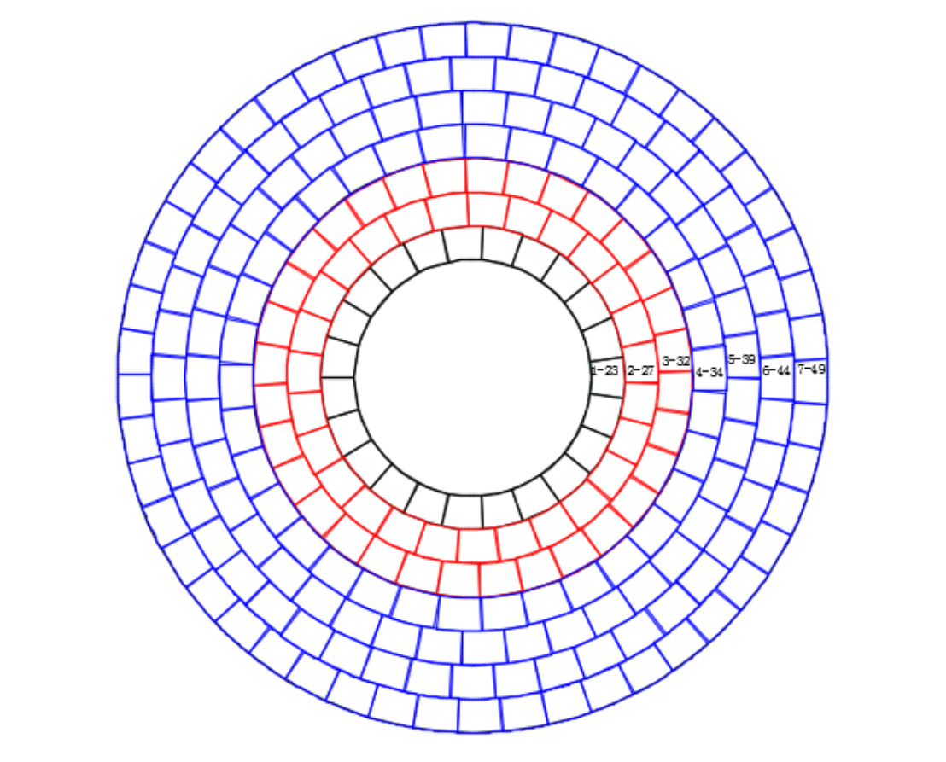
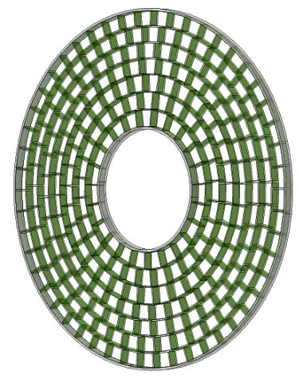
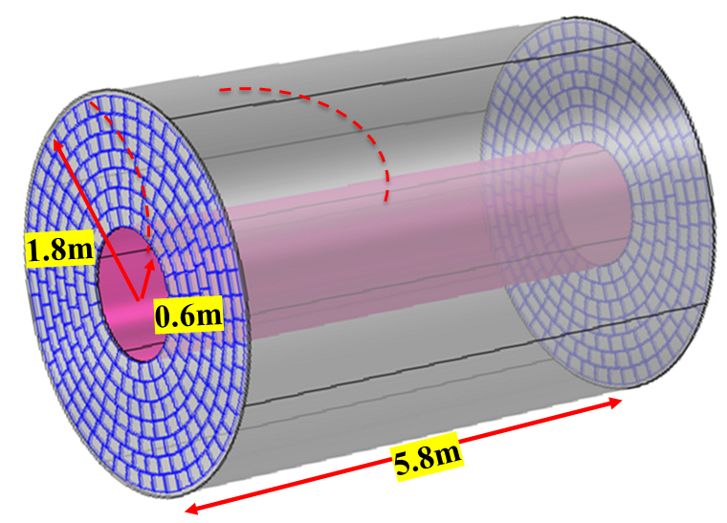
Easy-to-install modular design of TPC for TDR
High granularity readout TPC can operate at Higgs run in 3.0T and Tera-Z run in 2.0T
Easy-to-install modular design: optimized modules in the endcap
Coverage of the sensitivity readout area increased to 96%
Cost estimation: ~170 Million RMB (Detector 80 Million + Electronic/DAQ 90Million)
Optimization of Geometry of TPC detector and the Endplate
4

Slide 5
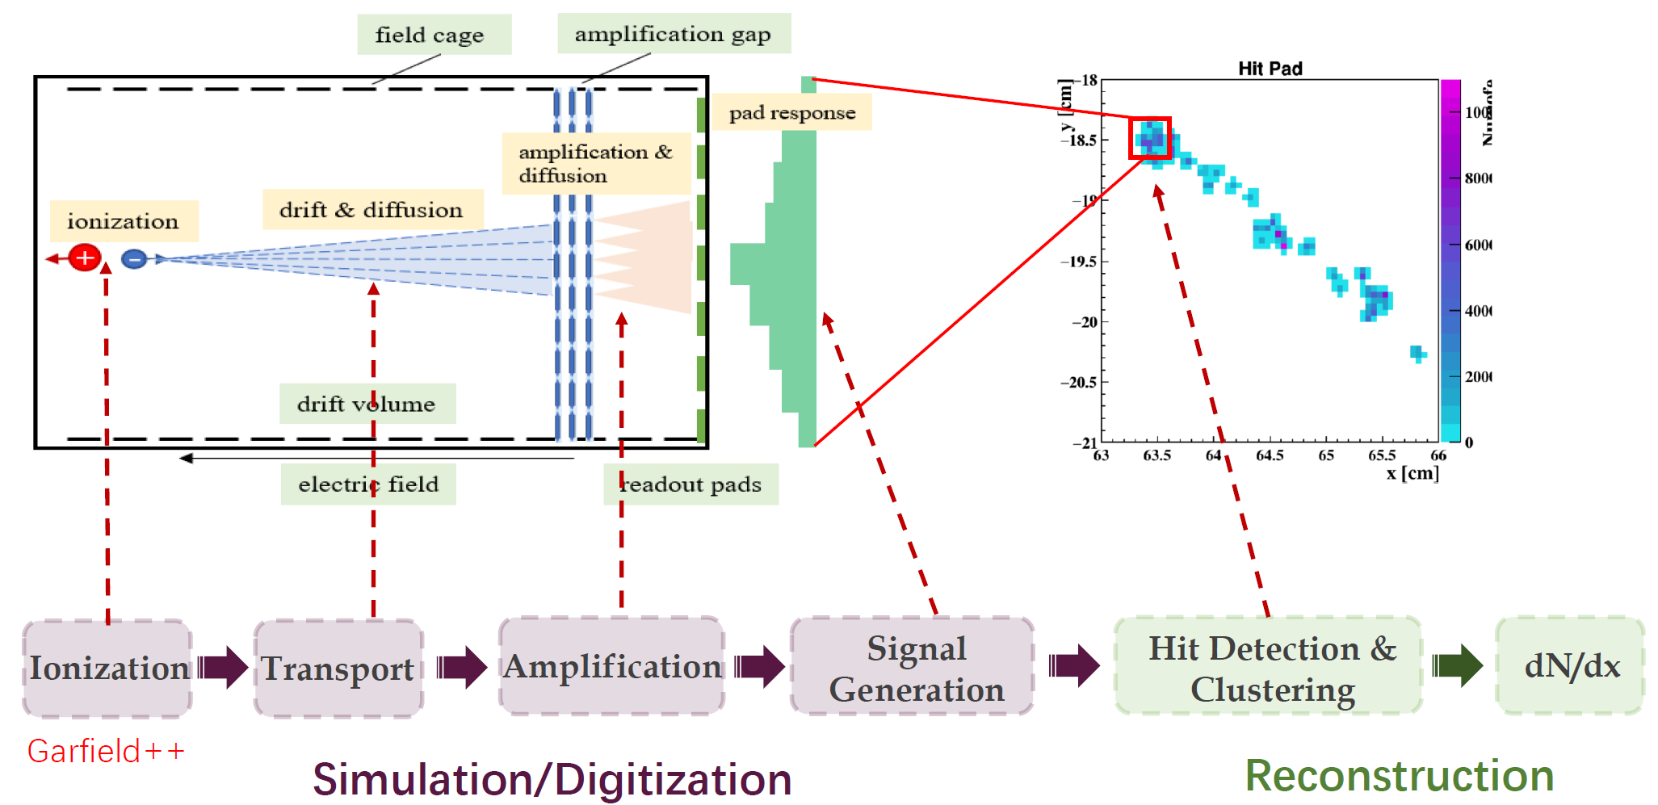
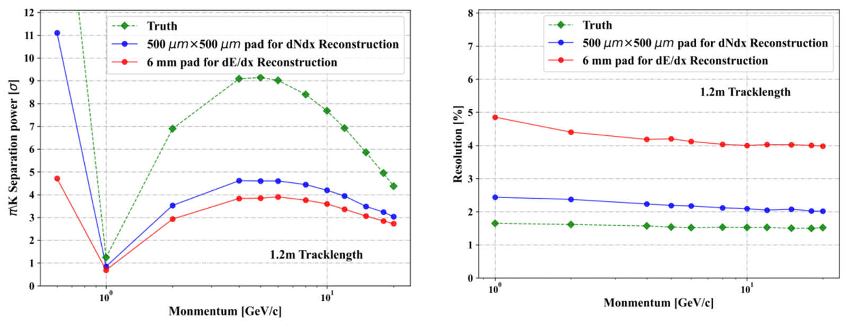
Status of the simulation of pixelated TPC for TDR
Full simulation framework of pixelated TPC developed using Garfied++ and Geant4 at IHEP
Investigating the π/κ discrimination capability using reconstructed clusters, a 3σ separation at 20GeV with 50cm drift length can be achieved
dN/dx has significant potential for improving PID resolution
Simulation of TPC detector under 3T/2T and T2K mixture gas
5

Slide 6
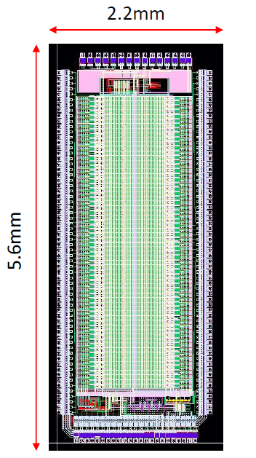
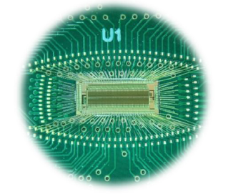
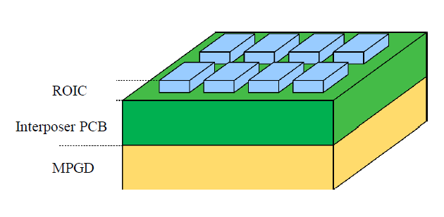
Status of the prototype of pixelated TPC for TDR
R&D on Pixelated TPC readout for CEPC TDR
Macro-Pixel TPC ASIC chip was started to developed and 2nd prototype wafer has done and tested
The TOA and TOT can be selected as the initiation function in the ASIC chip
500μm×500μm pixel readout designed
Time resolution: 14bit (5ns bin)
Power consumption: <1mW/pixel (2nd prototype)
~100mW/cm²
Technology: 180nm CMOS -> 60nm CMOS
High metal coverage: 4-side bootable
Prototyping pixelated TPC detector using the chips
Principle of the prototype is no problem for testing
The validation of prototype in April and May
Photo and layout of ASIC Chip R&D for TPC
Prototyping pixelated TPC detector using the chips
6

Slide 7
drift chamber

Slide 8
Updated parameters
R extension | 600-1800mm
Length of outermost wires（cosθ=0.85） | 5800mm
Thickness of inner CF cylinder： (for gas tightness, no load) | 200μm (0.08% X₀)
Thickness of outer CF cylinder： (for gas tightness, no load) | 300μm (0.13% X₀)
Outer CF frame structure： | Equivalent CF thickness: 1.8 mm (0.77% X₀)
Thickness of end Al plate: | 25mm (28% X₀)
Cell size: | ~ 18 mm × 18 mm
Cell number | 27623
Diameter of field wire (Al coated with Au) | 60μm
Diameter of sense wire (W coated with Au) | 20μm
Ratio of field wires to sense wires | 3:1
Gas mixture | He/iC₄H₁₀=90:10
Gas + wire material | 0.16% X₀

Slide 9
Cost
1.1 |  | Chamber |  | unit | 2880.00
 | 1.1.1 | End plate | 405 | 2 | 810.00
 | 1.1.2 | Outer frame structure | 500.00 | 1 | 500.00
 | 1.1.3 | Inner and outer cylinders | 150.00 | 1 | 150.00
 | 1.1.4 | Wire | 460.00 | 含30%余量 | 460.00
 | 1.1.5 | Feedthrough | 530.00 | 含20%余量 | 530.00
 | 1.1.6 | Wire test system | 50 | 1 | 80
 | 1.1.7 | Wiring tooling | 300 | 1 | 350
1.2 |  | Electronics |  |  | 5170.00
 | 1.2.1 | Readout Channel | 0.17 | 27623*1.1(10%备件) | 5170.00
1.3 |  | HV and Gas system |  |  | 340.00
 | 1.3.1 | High Voltage system | 220.00 | 6机箱，50插件 | 220.00
 | 1.3.2 | Gas system | 120.00 | 1 | 120.00
total |  |  |  |  | 8390

Slide 10
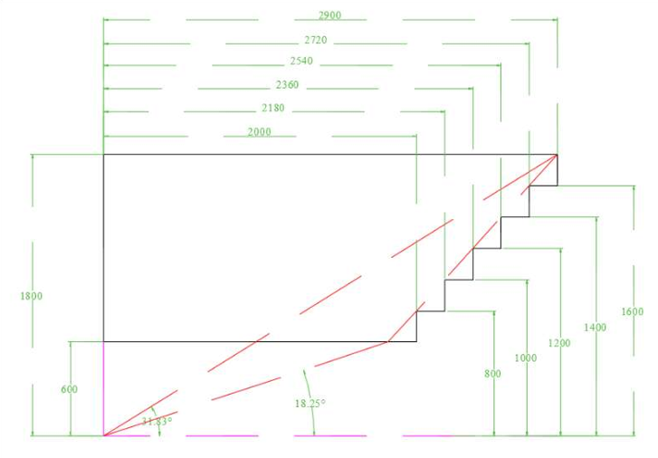
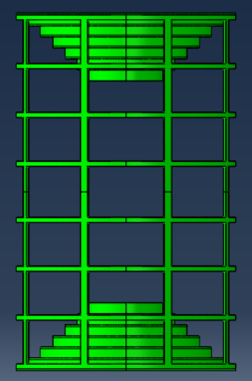
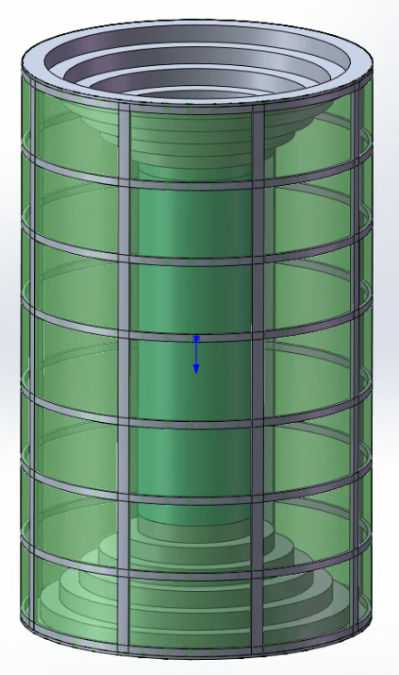
Overall Design
CF Frame structure：8 longitudinal hollow beams + 8 annular hollow beams + inner CF cylinder and outer CF cylinder
Length : 5800mm
Outer radius: 1800mm，Inner radius: 600mm；
Thickness of each end plate: 25mm，weight :1100kg

Slide 11
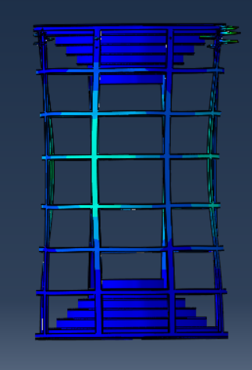
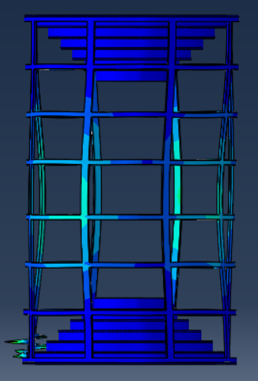
Loads: Wire tension+ Axial self weight ：
Horizontal self weight
Buckling coefficient : ~14
The structure is stable
Vertical self weight
Buckling coefficient : ~12

Slide 12
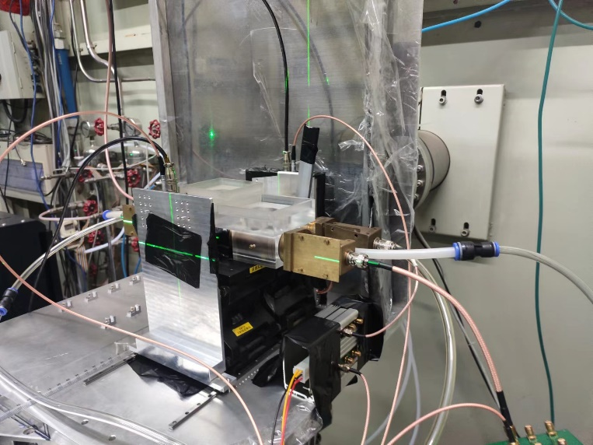
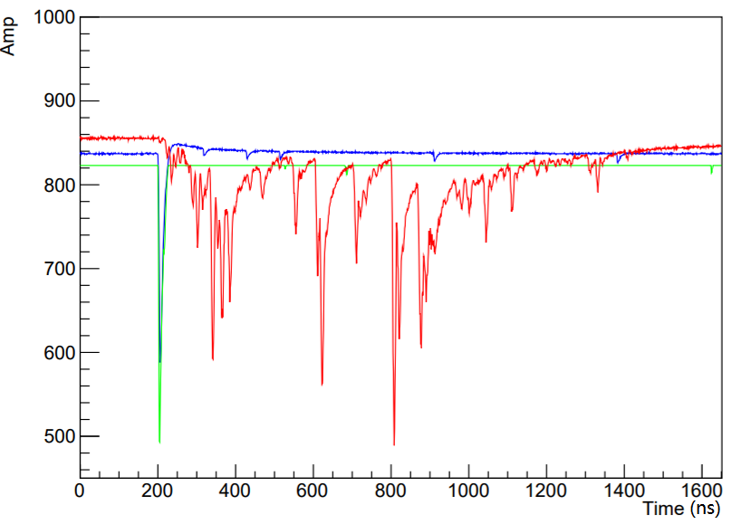
Beam test with detector prototype (IHEP)
Signal waveform (rad)
Trigger signals (blue and green)
Beam
Two drift tubes + preamps + ADC (1GHz)
The system was tested with electron beam at IHEP

Slide 13
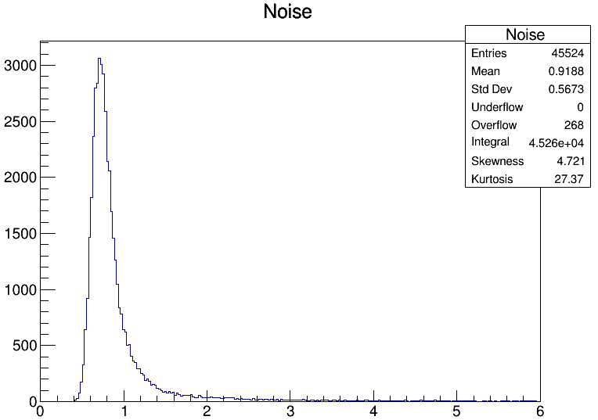
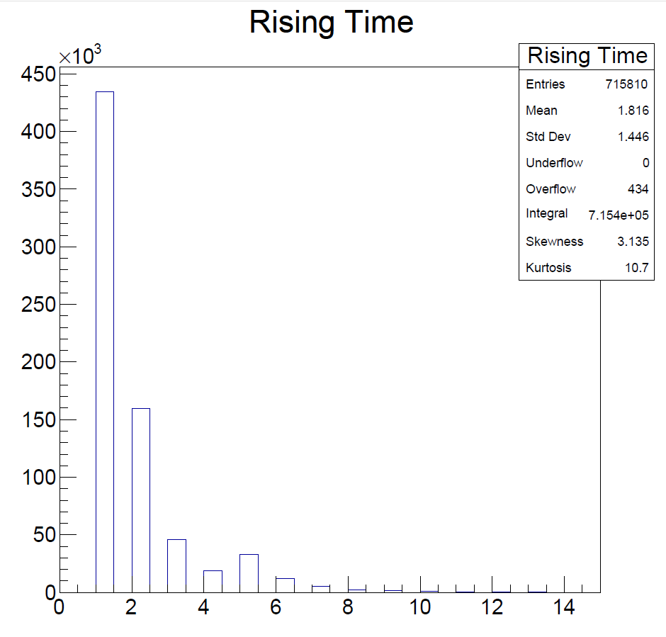
Preliminary analysis
Low noise and high bandwidth preamplifiers
Rise time : ~ ns
Clear peaks
Reconstruction

Slide 14
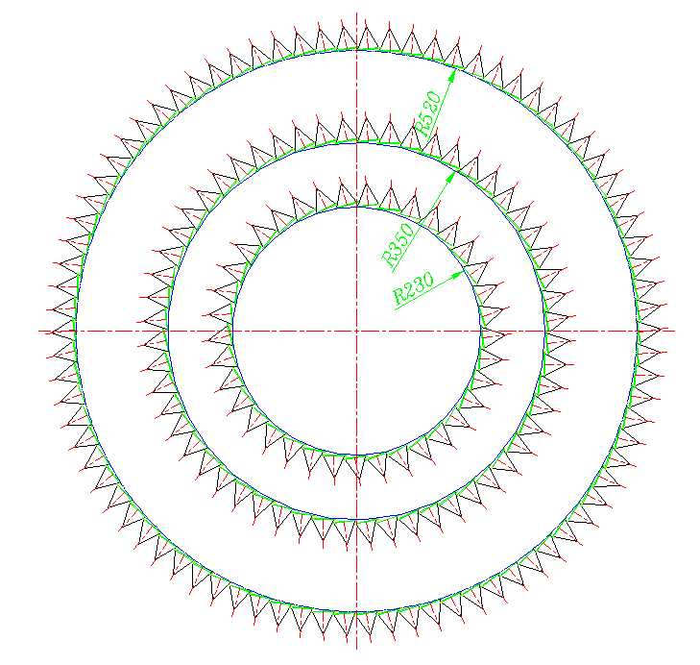
CMOS pixel tracker
Design goal for future fulls-size chip
Spatial resolution <10 µm
Time resolution <10ns (ideally 3-5ns, to achieve bunch tagging) <- most challenging
Power consumption: as low as possible, ~100mW/cm² level
sensor cost estimated
data rate estimated ➔ electronics
truss structure mechanical design is in progress
layout optimisation is in progress

Slide 15
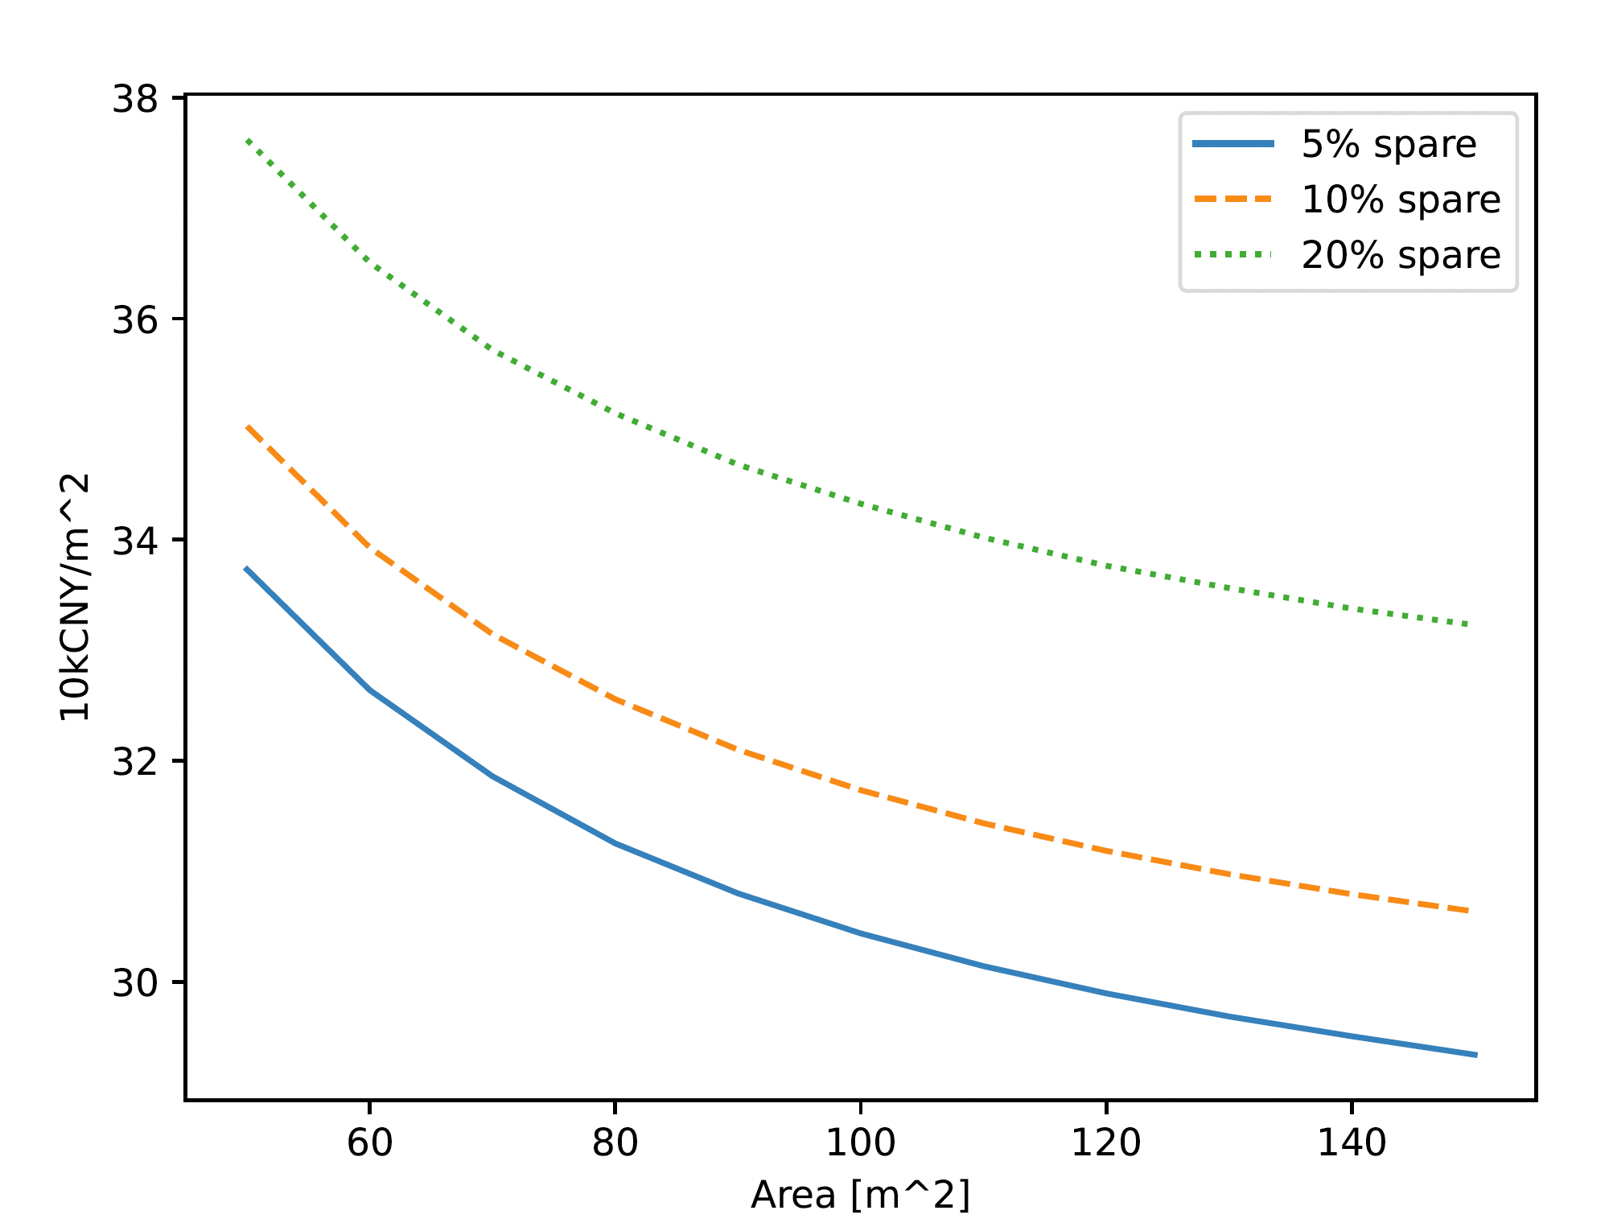
HVCMOS cost
Sensor cost scales with area
NTO overhead is a small fraction
Quotes for SMIC 55nm process
12-inch wafer with 1k Ohmcm resistance
56k USD/m² <~ 400k CNY/m²
Unit cost drops when area increases
SET 66 m² ➔ 26 MCNY
万元/平米
SIT only
SIT + SET

Slide 16
Data rate estimation
Key assumptions: Event rate 112kHz, track multiplicity 100, cluster size 3, bits per hit 48; Beam bkg to be added
Layer | Hit density [kHz/cm²] | Data rate /chip [Mbps] | Data rate / module [Mbps] | Data rate / layer [Gbps]
Barrel SIT 1 | 5.2 | 1.0 | 8.0 | 1.5
SIT 2 | 2.2 | 0.43 | 3.5 | 1.5
SIT 3 | 0.79 | 0.15 | 1.2 | 1.4
SET | 0.08 | 0.02 | 0.13 | 1.4
Endcap SIT 1 | 1.3 | 0.24 | 2.0 | 0.17
SIT 2 | 0.57 | 0.11 | 0.87 | 0.17
SIT 3 | 0.26 | 0.05 | 0.41 | 0.22
SET | 0.03 | 0.006 | 0.05 | 0.24
Total data rate: 6.6 Gbps for SIT+SET, or 5.0 Gbps for SIT only
=> Data rate is generally low for SIT (to confirm for the innermost layer); similar readout scheme can be adopted as SET

Slide 17
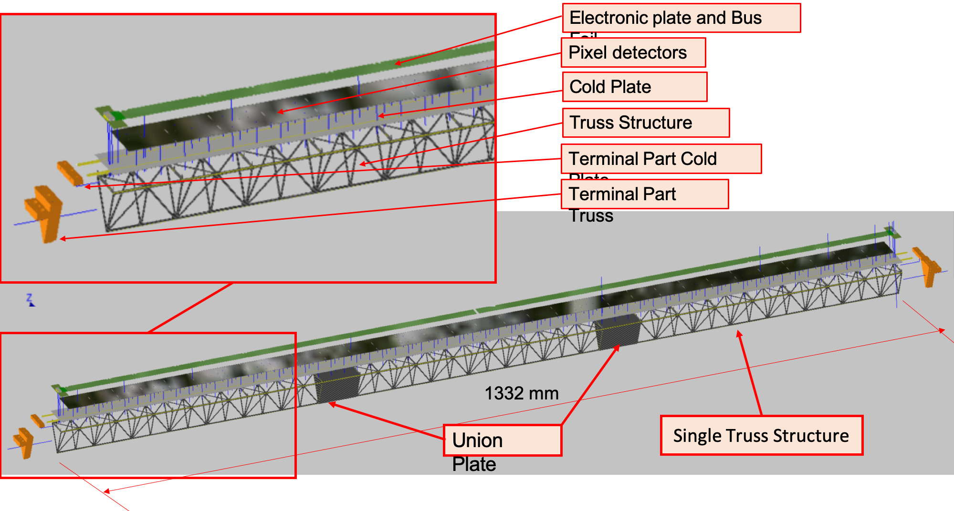
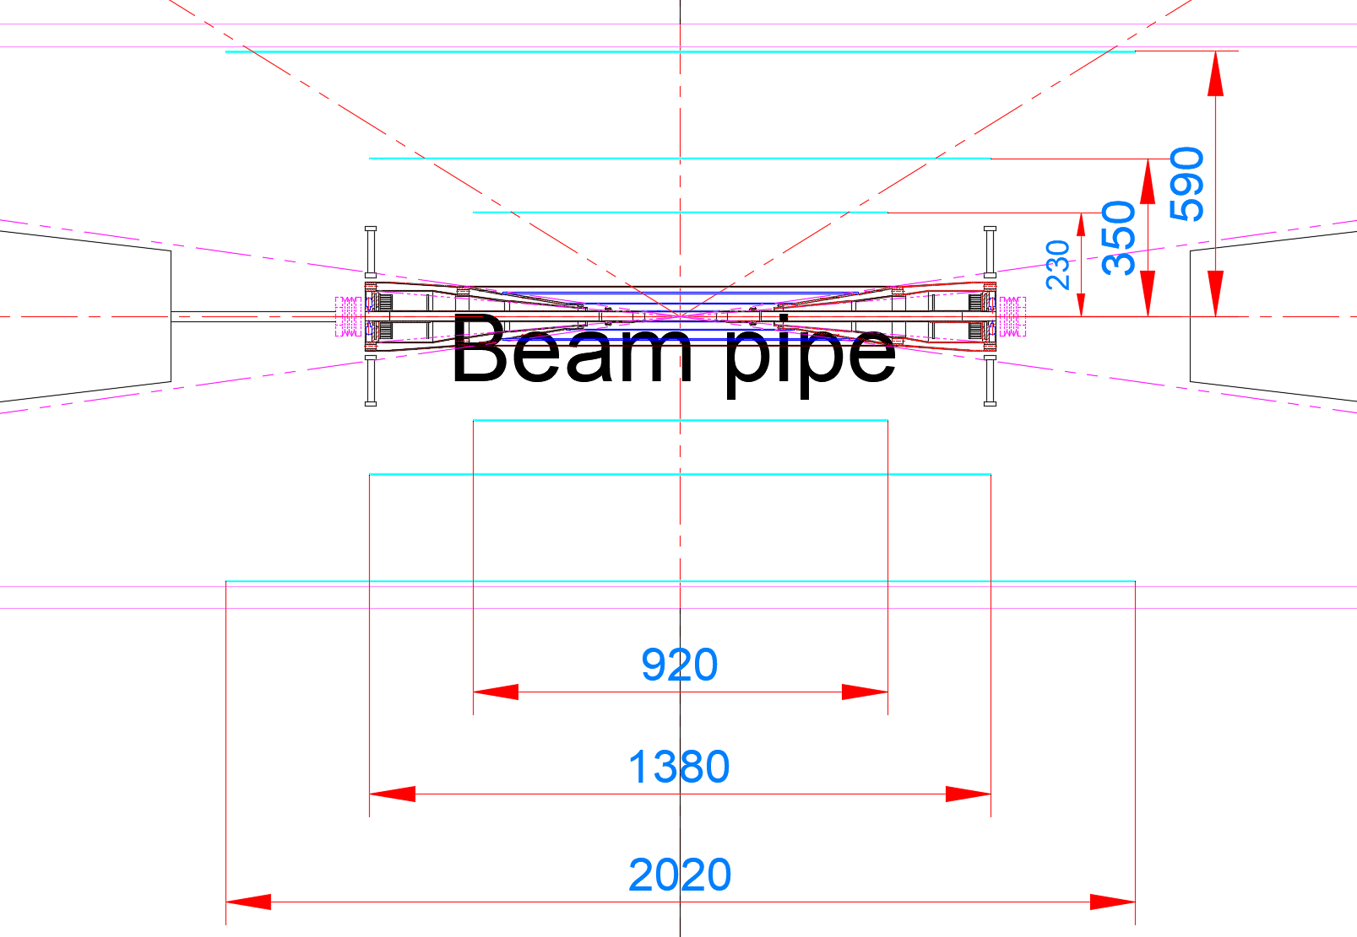
Mechanical design
Dedicated discussions with mechanical group to understand boundary conditions
Outer radius: < 600mm
Inner radius: > 150mm (if vertex using endcaps) or > 75mm (if vertex adopts long barrel option)
Truss structure to support barrel ladders for minimum material budget
Design and simulation in place for 2nd SIT layer in CDR by INFN Pisa (1.3m in length)
Truss-based design for the whole SIT ongoing
Space for truss to be considered in layout optimization
SIT and beampipe should be considered together in the mechanical design
Filippo Bosi, Fabrizio Palla
Quan Ji, Jinyu Fu, Junsong Zhang

Slide 18
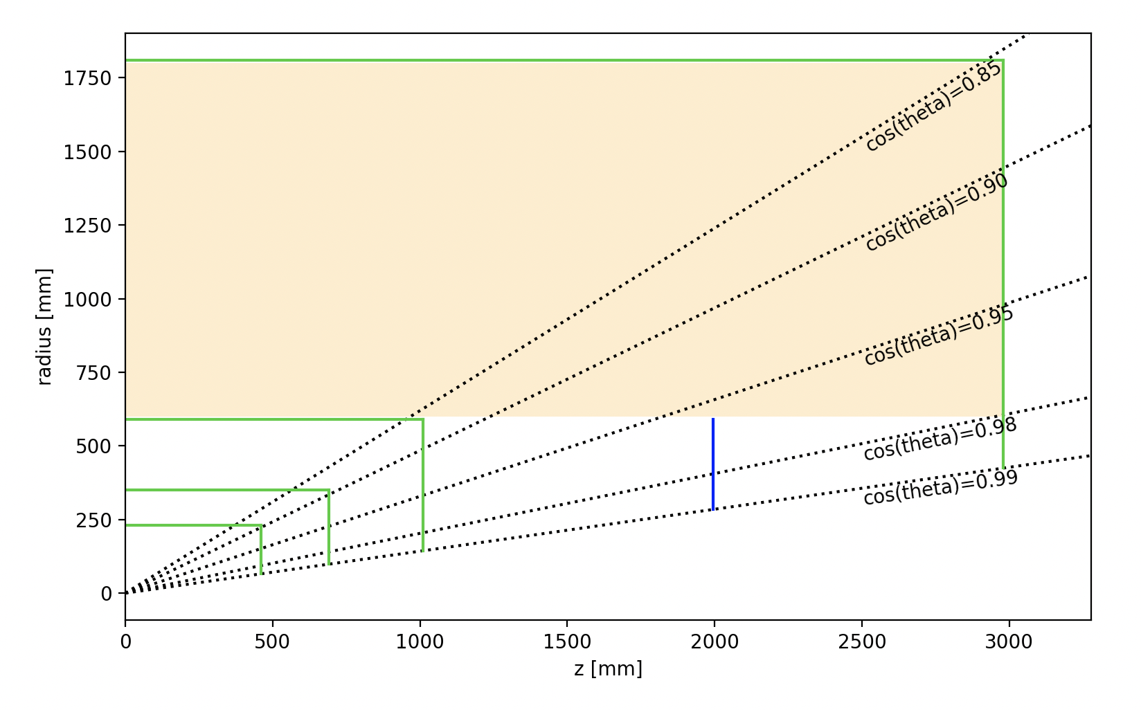
Layout optimisation
Initial layout available for mechanical/ software/electronics design
Optimisation campaign based on fastMC to converge on:
Radii of the 3 layers (really the middle layer as the 1st and 3rd are defined by boundaries)
Position of the endcap disks
Inclination angles of endcaps
An extra layer of endcap added to ensure enough hits in forward region (position to be optimized)
An extra layer of endcap may be needed to ensure enough hits in forward region (position to be optimized)
Gang Li, Meng Wang, Qinglin Geng, Xiaojie Jiang, Yiming Li

Slide 19
silicon microstrip tracker

Slide 20
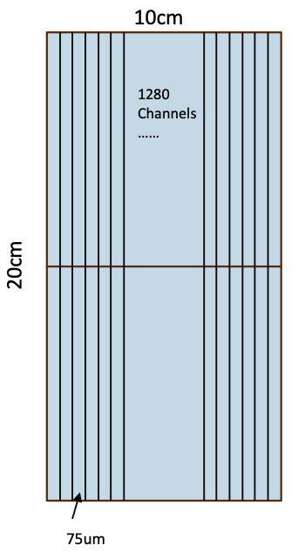
SET Module
Zhan Li
Strip length 20cm
Two 10 cm X 10 cm stitching
Strip pitch 75um
Practical for wire-bonding
1280 channels per module
Compatible with ASIC design
Single Module
Area | 20cm x 10cm
Strip pitch | 75um
# channels | 1280

Slide 21
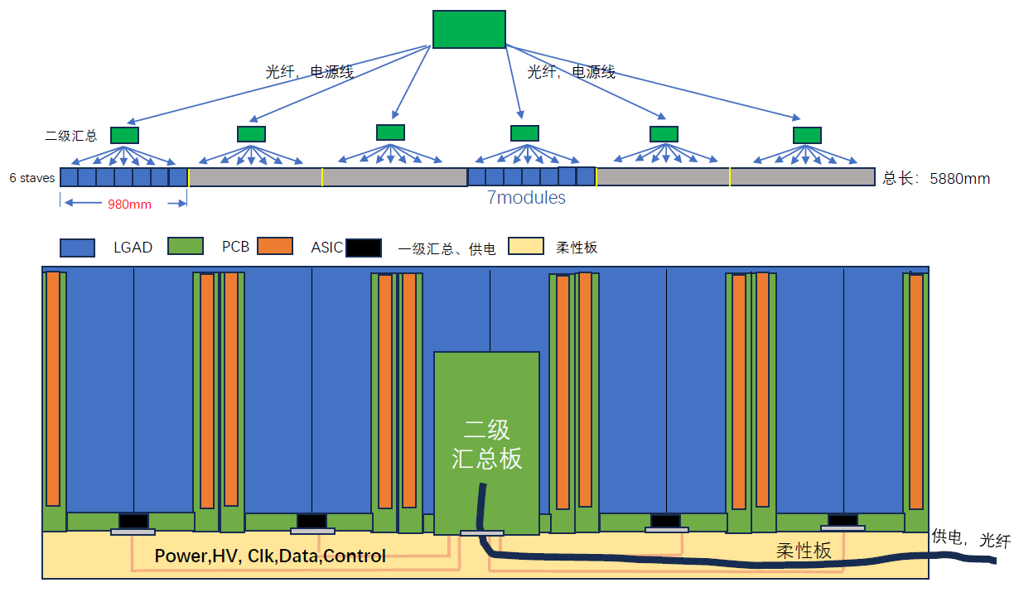
Preliminary Readout Strategy for Si Strip
Xiongbo Yan
Readout scheme with two levels of data concentration
Module Level
Stave Level
Common design with TOF

Slide 22
Cost estimation Sensor + ASICs
Items | Unit Cost (RMB) | Quality | Total (10k RMB)
Sensors | 5500 | 6612 | 3637
Electronics |  |  | 1825
Total |  |  | 5462

Slide 23
LGAD

Slide 24
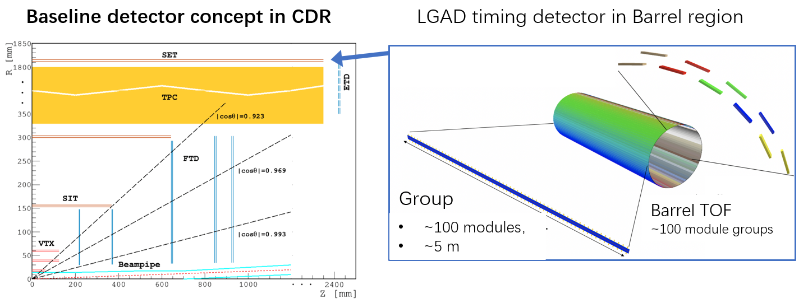
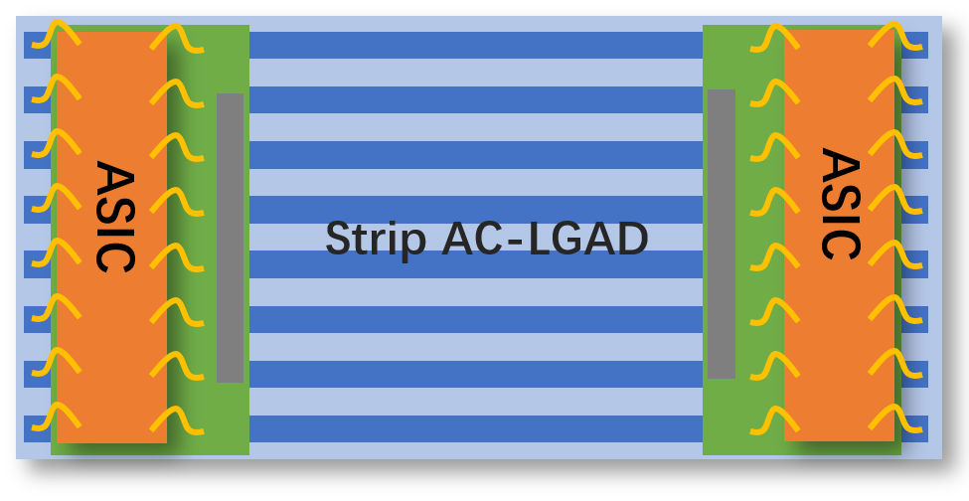
CEPC 4D outer tracker
CEPC 4D outer tracker concept design：
Y
Should be part of SET (silicon wrapper layer outside TPC or drift chamber)
Serve as Timing detector and part of the tracker
Barrel : 50 m² , Endcap 20 m² , ~ 10⁶ channels
Strip AC-LGAD ( each strip: 4 or 10 cm × 0.05cm)
Timing resolution: 30-50 ps
Position resolution: ~ 10 μm @ R-phi direction
~ 1mm @ z direction
Z
Strip AC-LGAD + ASIC ：
TOT->amplitude->charge sharing->position
TOA+TOT->timing (time–amplitude correction)
mzli@ihep.ac.cn

Slide 25
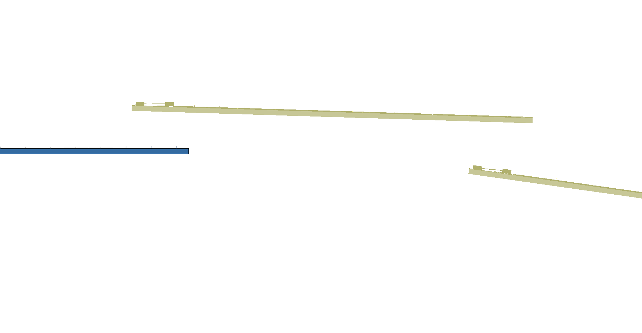
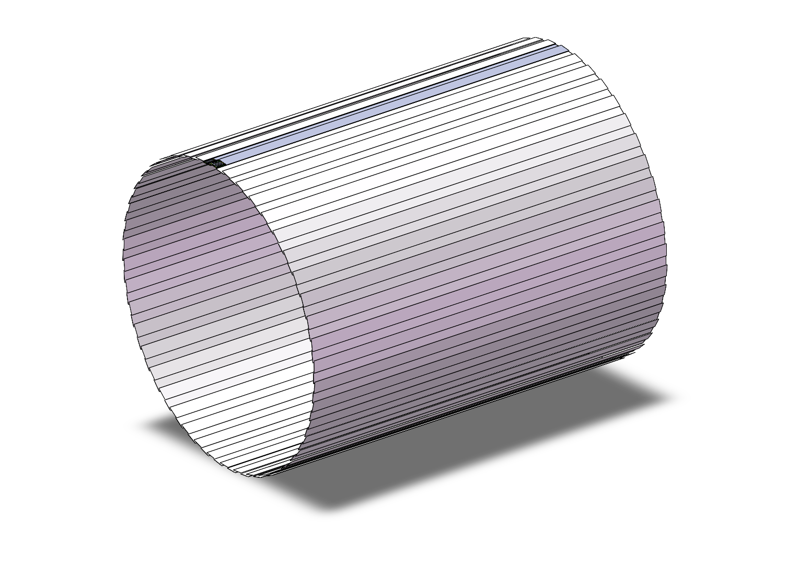
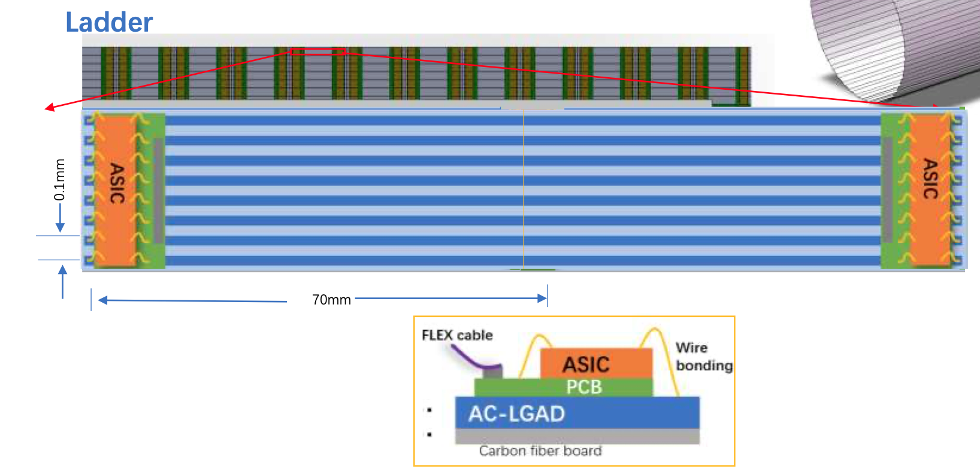
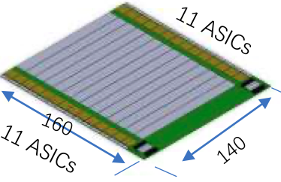
Arrangement of the ToF with strip LGAD
One layer ToF
R= 1800 mm
H～5800mm
One layer: 3780 modules
90 ladders，45 ladders each side,
42 modules/ladder，
22 ASIC/module，128 Channel/ASIC
Module
140mm x 160mm

Slide 26
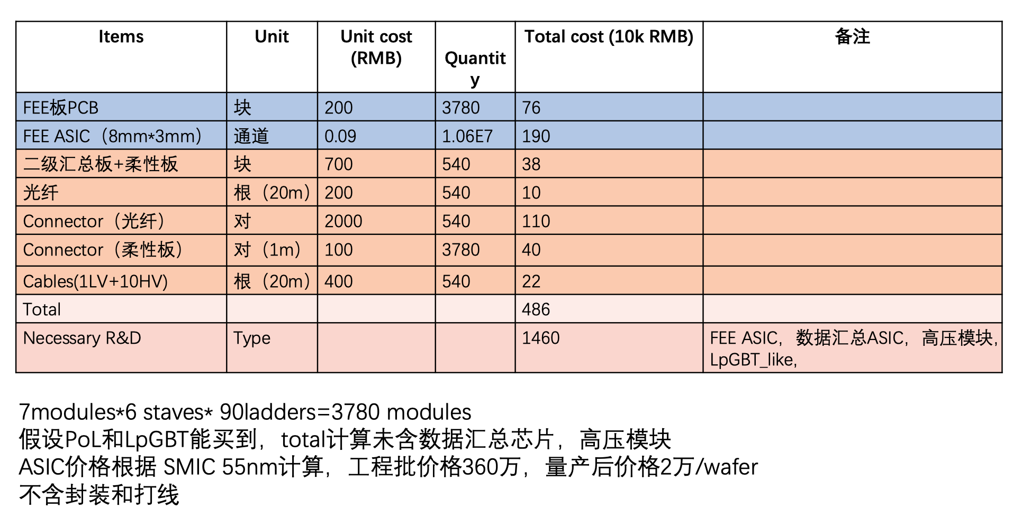
Electronic System Cost of LGAD ToF and OTracker

Slide 27
backup

Slide 28
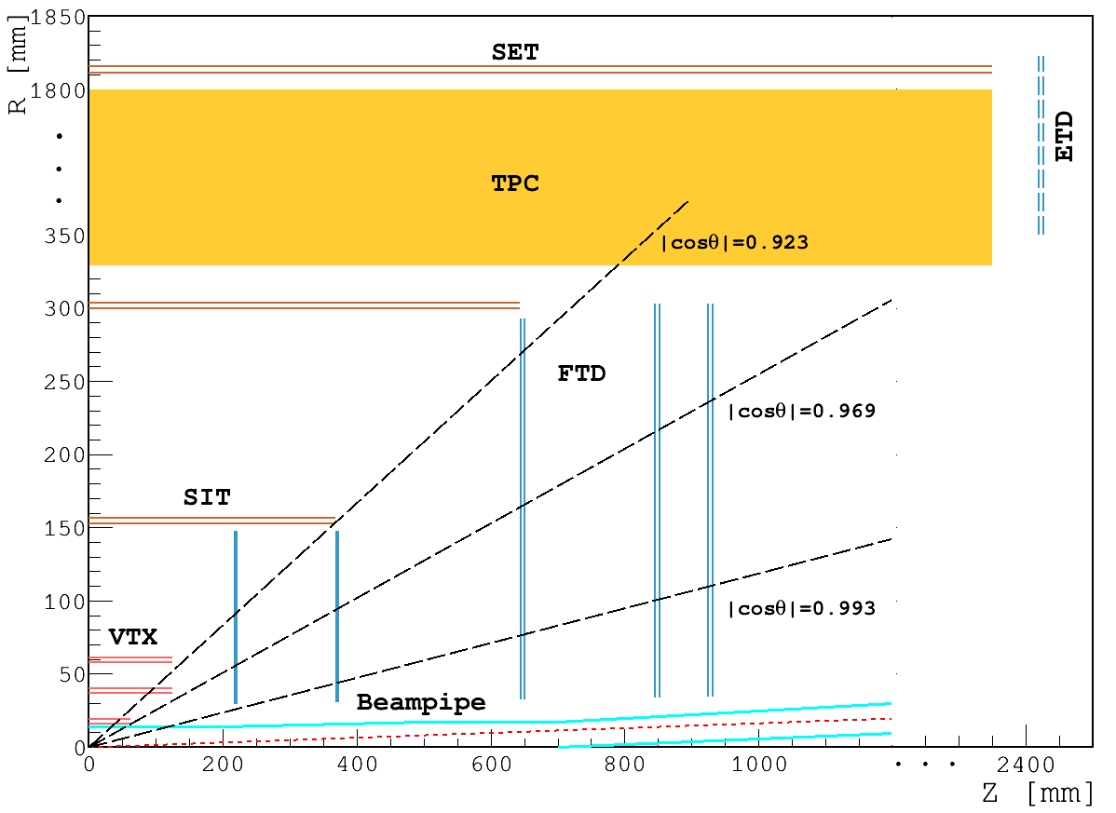
CDR layout for acronyms

