Slide 1
TPC readout electronics
Zhi Deng
2024/03/07

Slide 2
Overview
Pixel readout for PID
  pixel: 0.5x0.5 mm², rin = 0.6 m, rout = 1.8 m
  3x10⁷ ch. per endplate，252 modules in 17cm x 21 cm

Slide 3
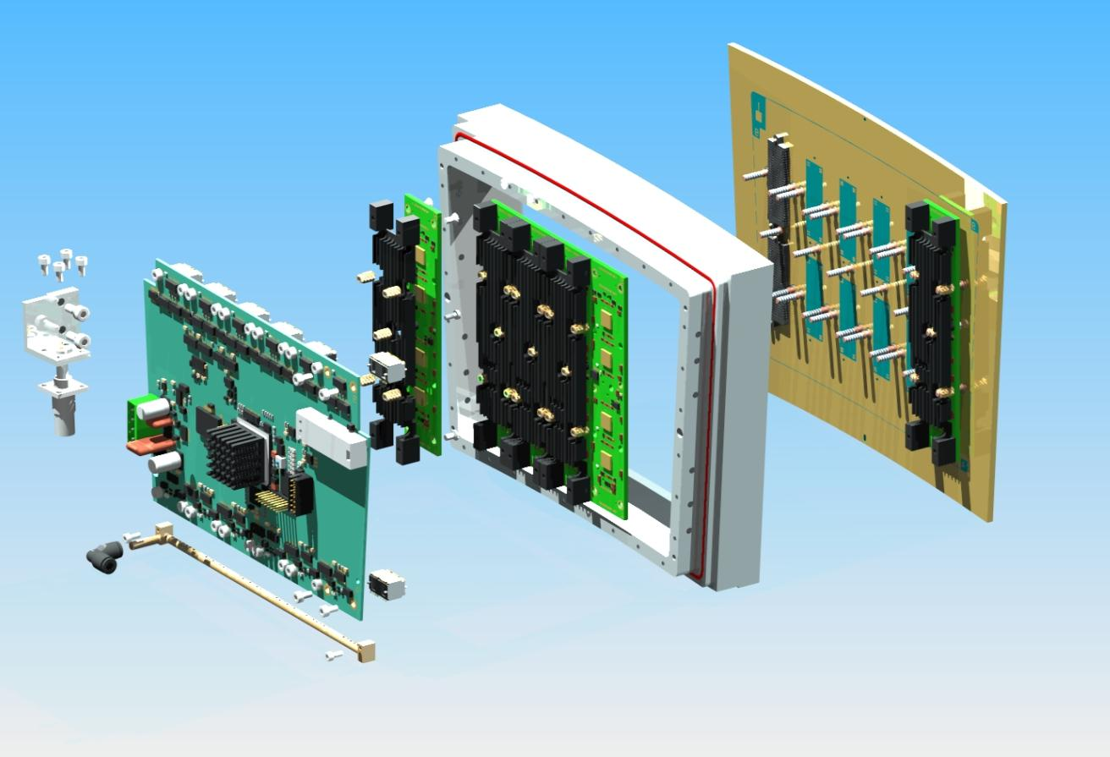
Modular Readout
In total 142.8k ch. /module, divided into ~4 FEE board
FEE board
  Pixel ROIC: energy & timing pickoff & digitization
  De-randomize buffer (buffer size =?)
  Data serialization
GBT-like board:
  data collection
  CLK distribution
  Power distribution

Slide 4
Modular Readout
Power
  Limit: <10 kW/endplate ~ 58.82 W/module ~14.71 W/FEE board
  1.8/2.5V, 180 nm (optional 130nm for better performance)
Avg. data bandwidth (raw data)
  80 particles/BX, 12,000 hit/particle, 32(48)b/hit
  1 Endplate: 1.228(1.843) Tbps @ 40M BX
  1 Module: 4.873(7.314) Gbps
  1 FEE board: 1.218(1.829) Gbps

Slide 5
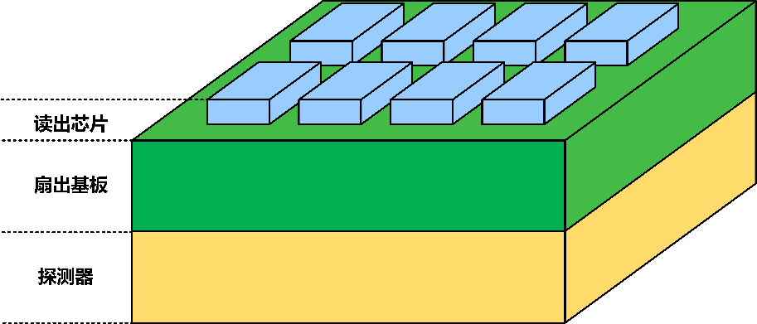
FEE: sub-module
Concept R&D design
  ROIC +Interposer PCB as RDL
  High metal coverage, 4-side buttable
  Low power Energy/Timing measurement ASIC
    ~100 e noise
    5 ns drift time resolution
    100 mW/cm² (250uW/ch) ~ 35.7 W/module ~ 6.069 kW/endplate
ROIC
Interposer PCB
MPGD

Slide 6
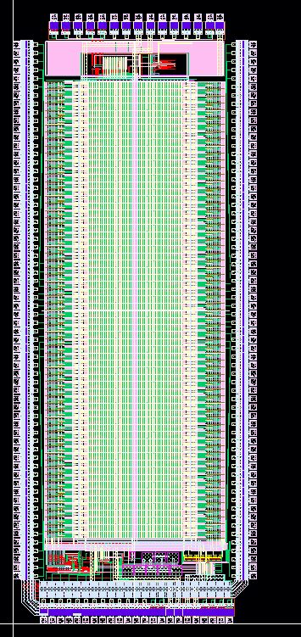
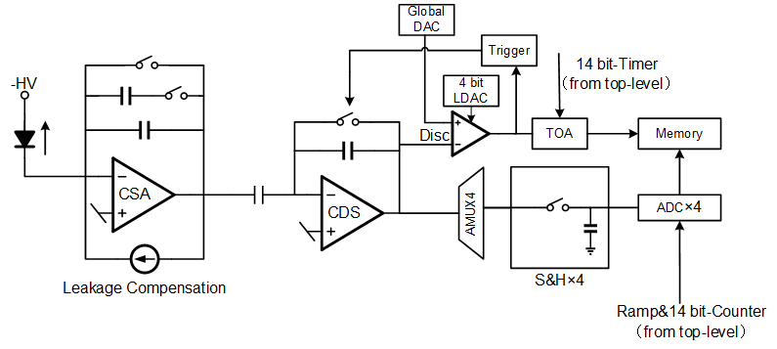
FEE: pixel ROIC
2.2mm
Charge Sensitive Preamplifier(CSA)
CDS amplifier provides additional gain and noise shaping
14-bit Wilkinson type ADC each pixel
Timing discriminator with14-bit TOA (Time of Arrival) information
5.6mm

Slide 7
TPC FEE cost
Items | Unit | Unit cost (RMB) | Quantity | Total cost (10k RMB)
FEE ASIC | ch | 0.4 | 60,000,000 | 2400.00
Connector | pair | 200 | 10,000 | 200.00
Cables | piece | 500 | 1,000 | 50.00
Total |  |  |  | 2650.00

