Slide 1
CEPC vertex detector towards TDR
Zhijun Liang

Slide 2
Towards TDR
Aim to have a draft of TDR by the end of 2024.
System level design, choose baseline technology
Electronics, service and mechanics needs to be included
Major change from CDR to TDR
Beam pipe diameter: 28mm (CDR) → 20mm (TDR) (reduce 30%)
Instant Luminosity per IP:
Z pole: 32×10³⁴ cm⁻²s⁻¹ (CDR) → 192 ×10³⁴ cm⁻²s⁻¹ (TDR, 50MW) (6 times increase)
ZH: 5.6×1034 cm-2s-1 (CDR) → 8.3 ×10³⁴ cm-2s-1 (TDR) (~1.5 times increase)

Slide 3
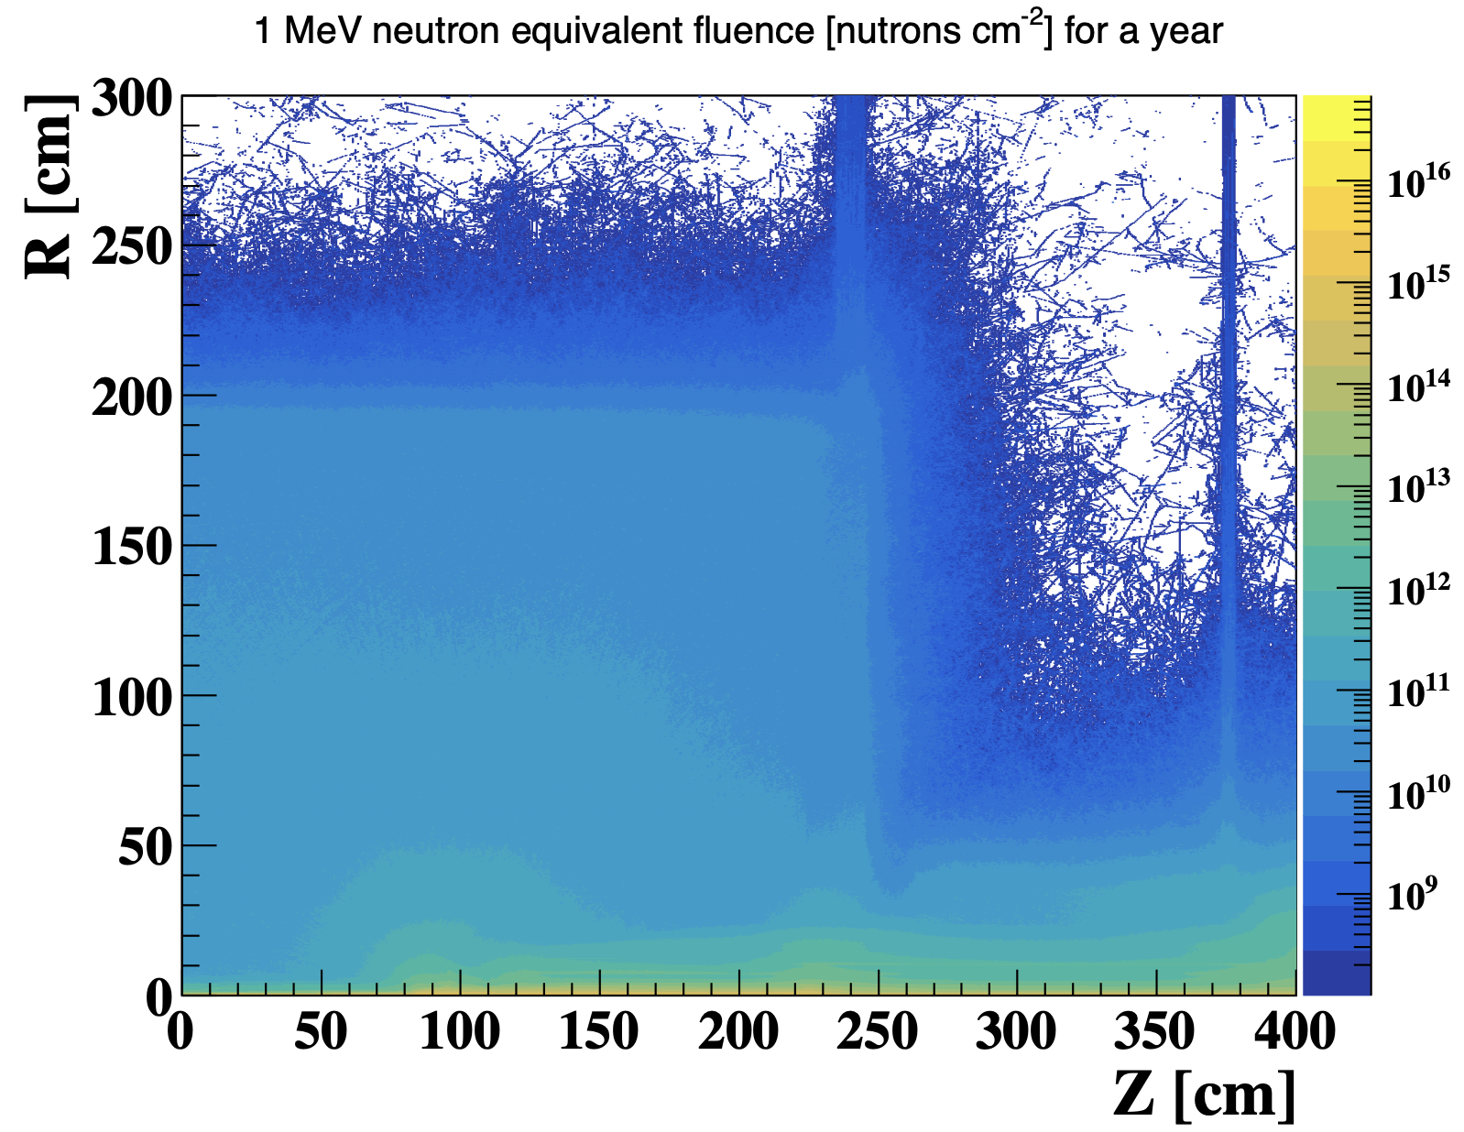
Plan: MDI background input
Got 1st offical background input from MDI group last week
Request MDI group to provide the background distribution and raw data
Get background hit density distribution in vertex detector in software
→ Haoyu, Tianyuan

Slide 4
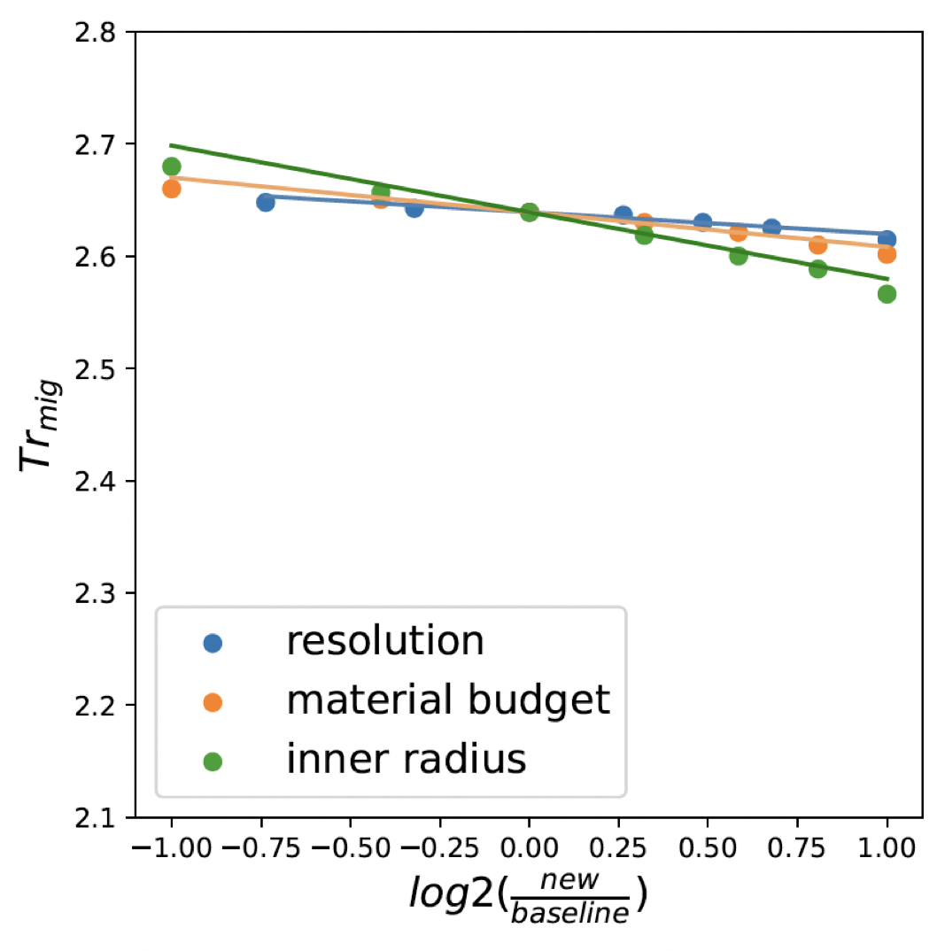
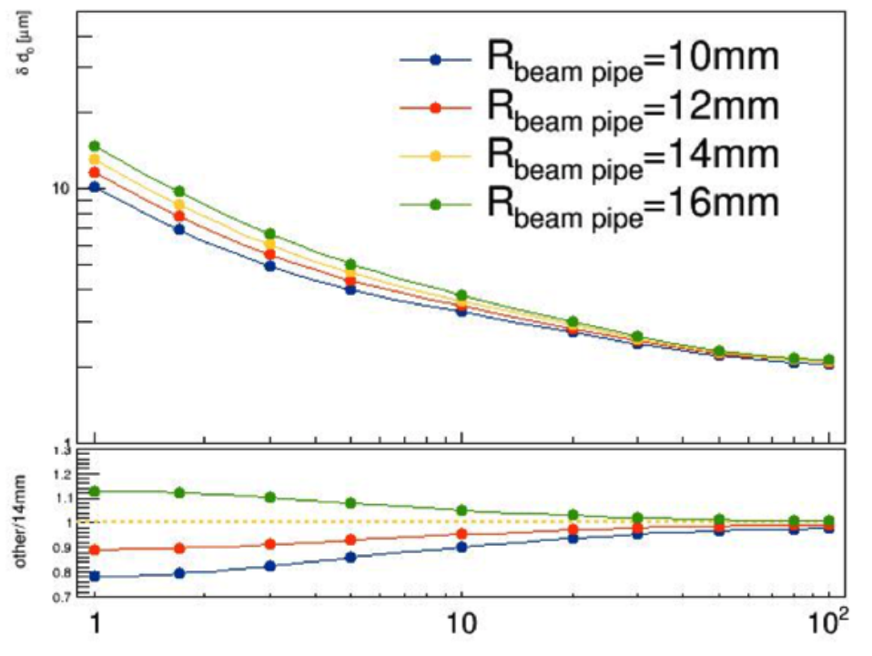
Priority of key parameters
1st priority: Small inner radius, close to beam pipe (new baseline beam pipe radius=10um )
2nd priority: Low material budget <0.15% X0 per layer
^{3rd} priority: High resolution pixel sensor： 3~5 μm
Question : d0 and Z0 requirement ?

Slide 5
CMOS pixel chip key parameters
Key parameters need to specify in TDR for the CMOS pixel chip
 | What we achieved now | what we expect to achieve in next 5 years
Spatial resolution | 3~5 um | ~3um
Power dissipation (Air cooling ) | ~100 mW /cm2 ? | <50 mW /cm2 ?
Max data rate that can be handled by this technology
Radiation hardness | 3Mrad ?
Time stamp precision

Slide 6
Readout architecture
End of March: Plan to work with electronics group to finalize the design
Readout architecture is the key for next step
Readout speed and buffer size are the major concern
Question
Physics requirement to Vertex detector Time stamp uncertainty
Manqi suggested to ask event building experts
What is the trigger latency? 3us or 10us ? Or triggerless
Impact to readout architecture design

Slide 7
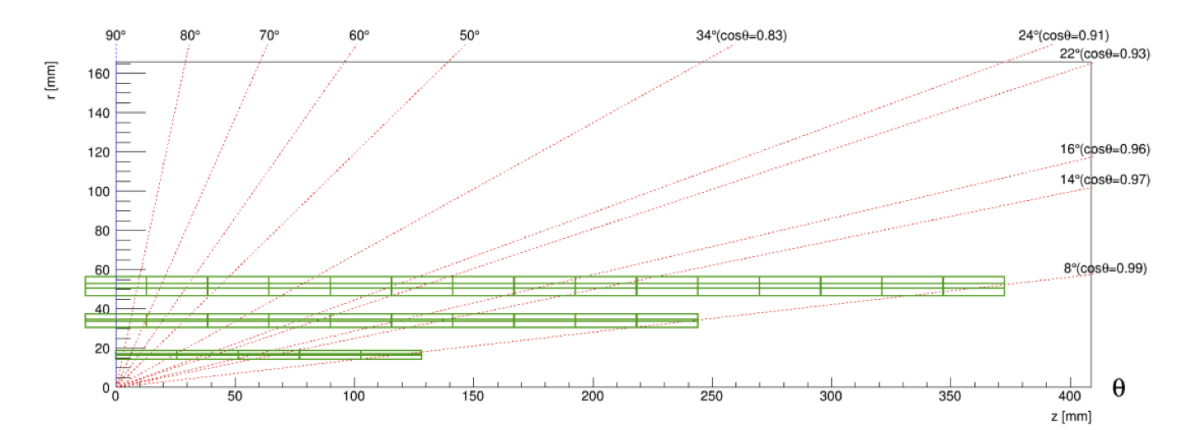
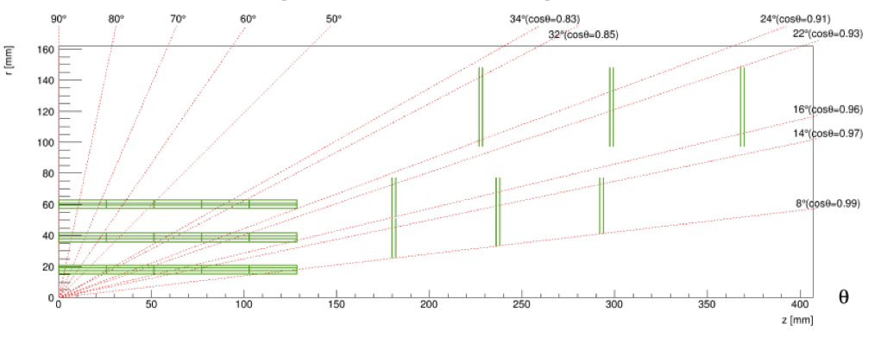
Plan : geometry and layout optimzation
End of March: finalize the detector geometry and mechnical design
Physics Layout optimization
How to deal with Endcap ?
Feasibility study of 2 layout ( mechanics support, cooling, cable ….)
Vertex detector MOST2 prototype layout has been implement in CEPCSW
Try to perform further optimization with full simulation
Long barrel
Short barrel With endcap

Slide 8
backup

Slide 9
Weekly meeting
Group Meeting every Thursday afternoon (2nd meeting last Thursday)
https://indico.ihep.ac.cn/event/21543/
From last meeting, Discussion about the choice of technology
Discussion with L3 Stitching (Mingyi) and SOI (Yunpeng)
Agree to focus CMOS pixel for reference TDR baseline

Slide 10
Key parameters
Single-point spatial resolution (now and in the next 5 years)
Time stamp precision requirement (to be discussed with Shengsun Sun)
Material budget
Cost estimation
Occupancy
Max data rate that can be handled by this technology (now, and in the next 5 years)
Radiation hardness (now, and in the next 5 years)
Power dissipation (now, and in the next 5 years)
Expected Technology availability in the future
Technology Readiness

