Slide 1
CEPCSW ------ VXT section
Tianyuan Zhang
2024.03.07

Slide 2
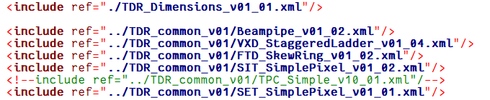
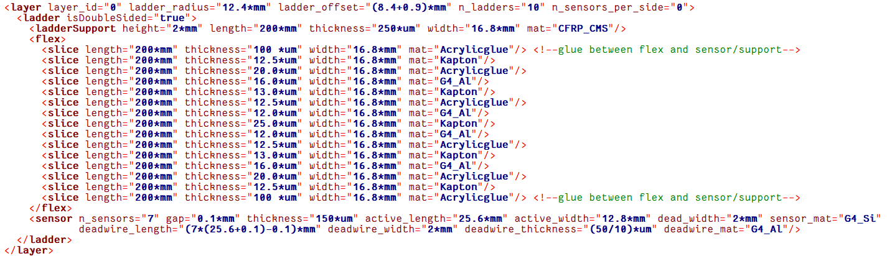
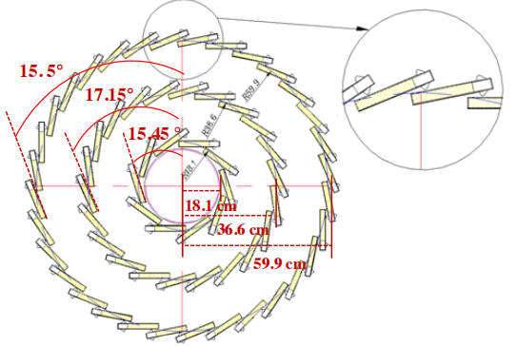
Configuration of VTX & Ladder support

Slide 3
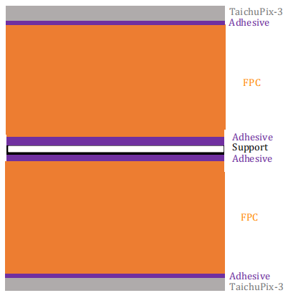
150um Si
100um Acrylicglue
12.5um Kapton
20um Acrylicglue
16um G4_Al
13um Kapton
12.5um Acrylicglue
12um G4_Al
25um Kapton
12um G4_Al
12.5um Acrylicglue
13um Kapton
16um G4_Al
20um Acrylicglue
12.5um Kapton
100um Acrylicglue
250um CFPR
100um Acrylicglue
12.5um Kapton
20um Acrylicglue
16um G4_Al
13um Kapton
12.5um Acrylicglue
12um G4_Al
25um Kapton
12um G4_Al
12.5um Acrylicglue
13um Kapton
16um G4_Al
20um Acrylicglue
12.5um Kapton
100um Acrylicglue
150um Si
four layers of G4_Al
two layers of G4_Al
Changes in thickness of various materials

Slide 4
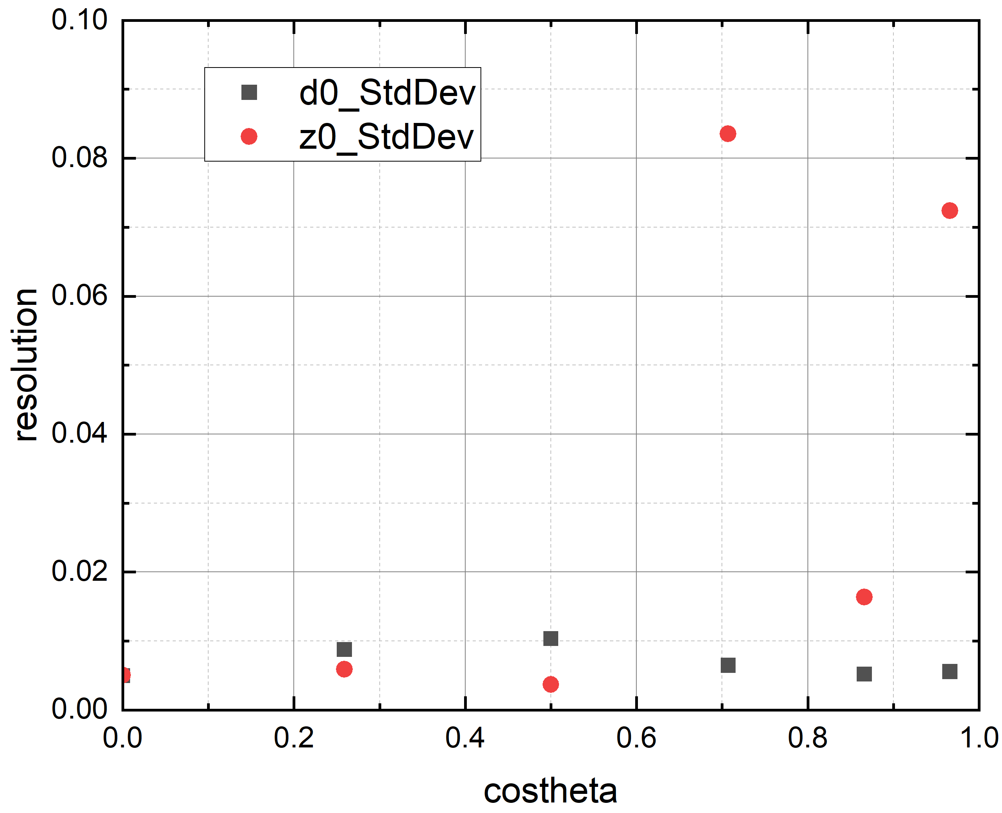
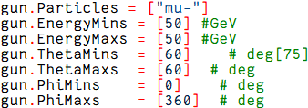
0.007419
when costheta = 0.5, particles_energy are 1, 5, 10, 20, 50 and 100, respectively.
Costheta values correspond sequentially
theta = 90°, 75°, 60°, 45°, 30°, 15°,
when particles_energy = 50GeV;
When costheta = 0, d0 is better than 5um;

