Slide 1
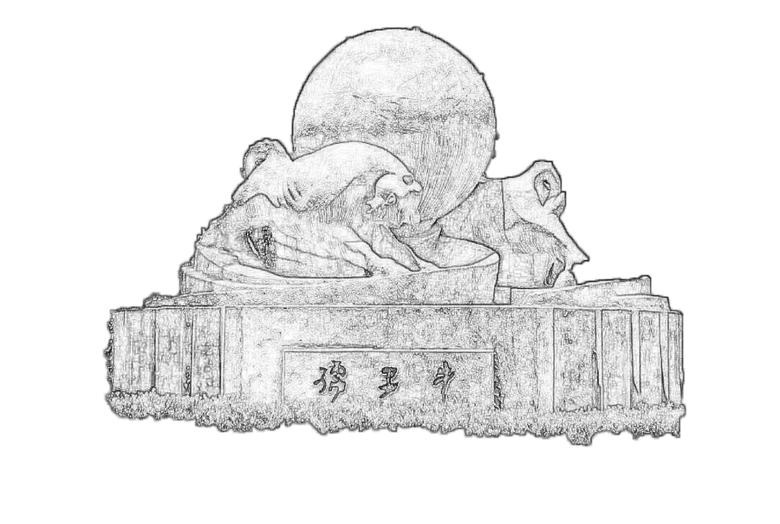
Sci-ECAL MIP results update
2024/03/08
Jiaxuan Wang

Slide 2
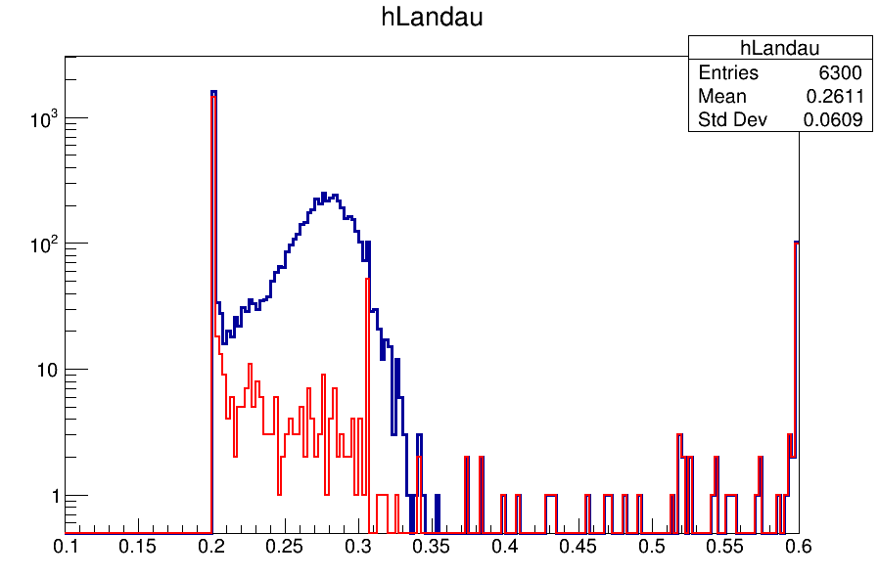
Motivation
Old method: center of gravity method, and fit once
New method: fit multi times
Data selection : center of gravity method
To exclude the noise hit far away from real muon track(more than 10 strips far away)
First fitting:
To exclude the noise hit near the real muon track(2 strips far away)
Second fitting:
To exclude the noise not on the track
Third fitting:
Get the real track and real hits
Landau MPV from MIP spectrum
Muon energy reconstruction in channel level
0.305MeV
Blue : All channels
Red : Dead Channels
MeV

Slide 3
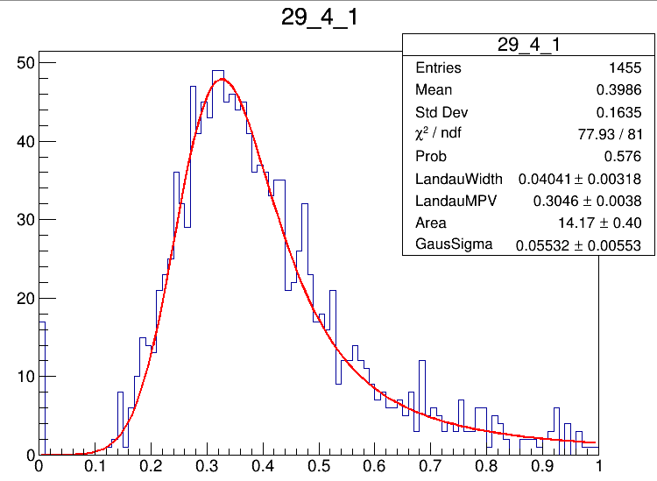
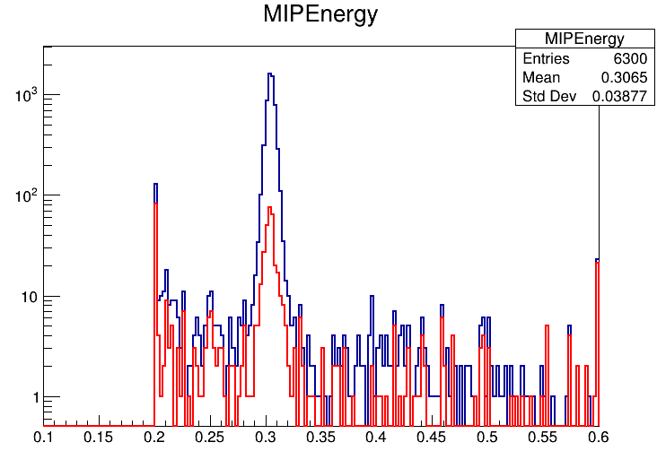
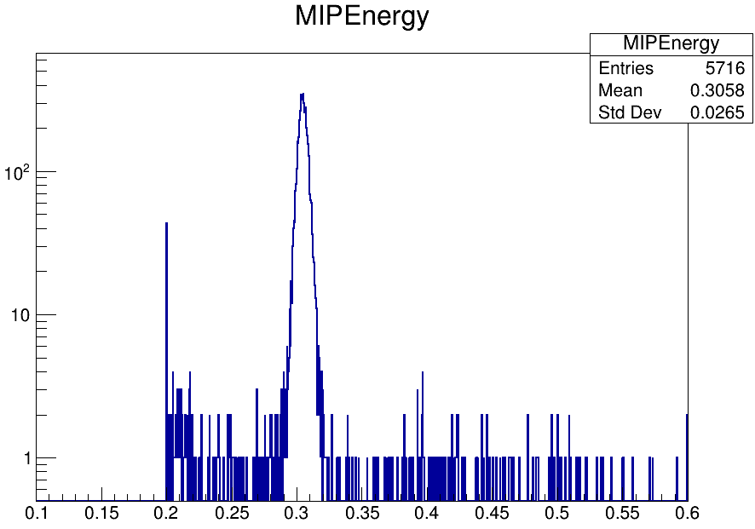
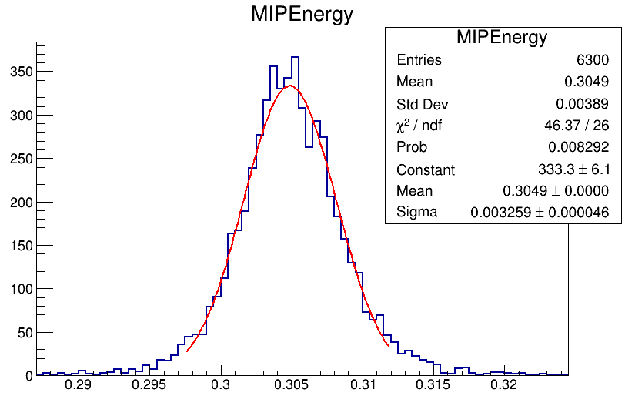
Muon energy reconstruction
Muon energy using new MIP calibrated results
Mean value around 0.3049 MeV
MeV
0.305MeV
Blue : All channels
Red : Dead Channels
MeV
MeV

Slide 4
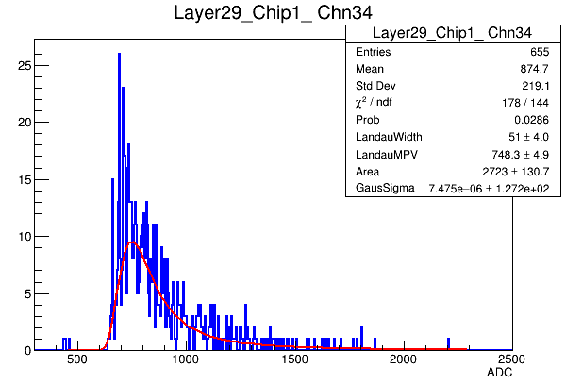
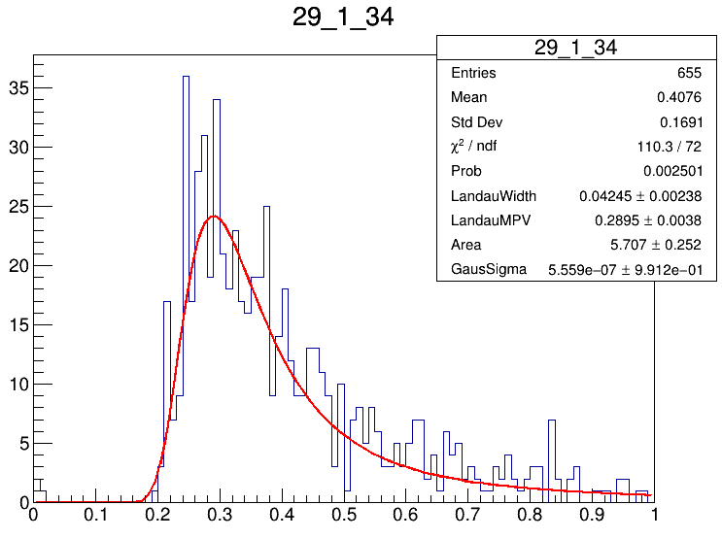
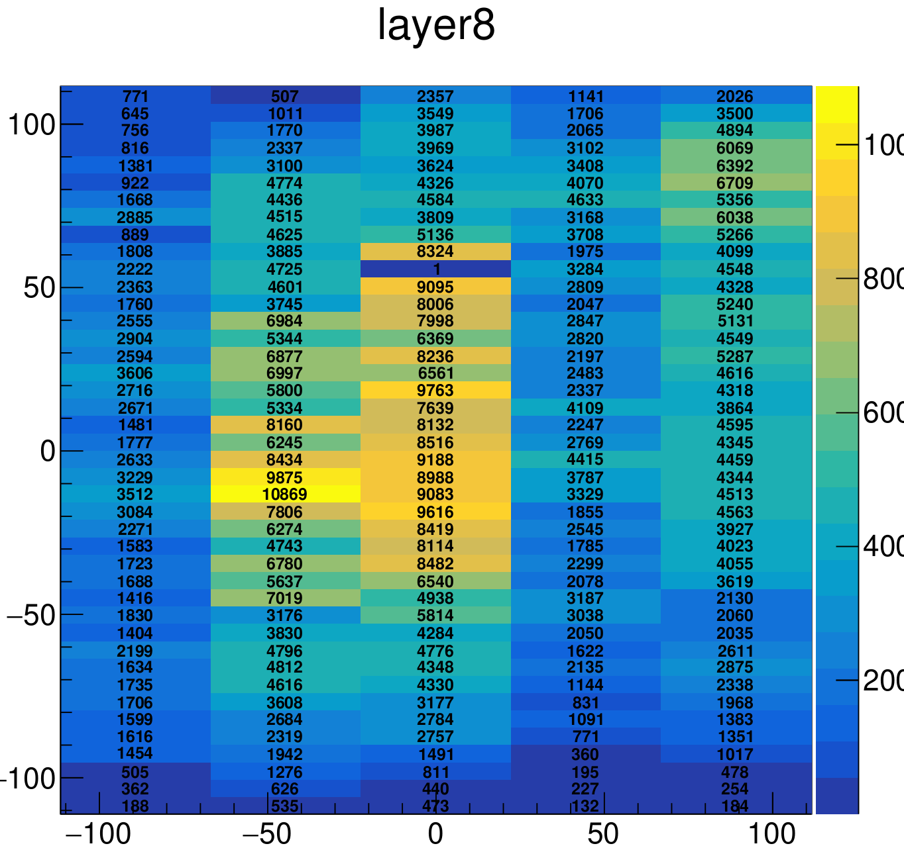
Abnormal channels
Still some abnormal channels
Dead-channel list update
MeV
 | Inadequate statistics | Fit problem | Total dead channels
Percentage | 9.26% | 5.03% | 14.29%
Channels | 584 | 317 | 901

