Slide 1
LGAD based time of flight and outer tracker
Yunyun Fan

Slide 2
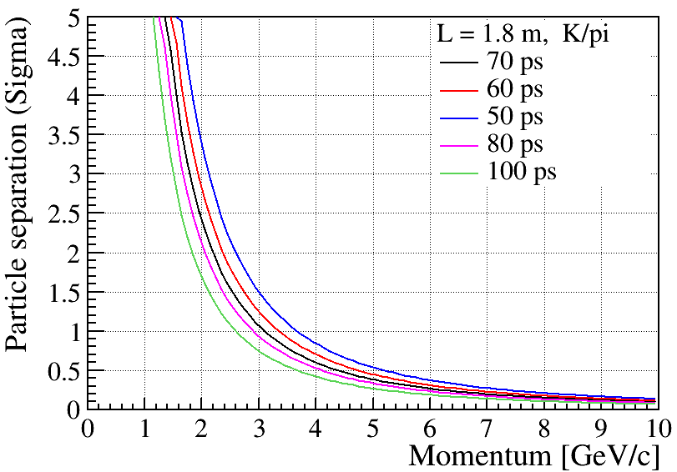
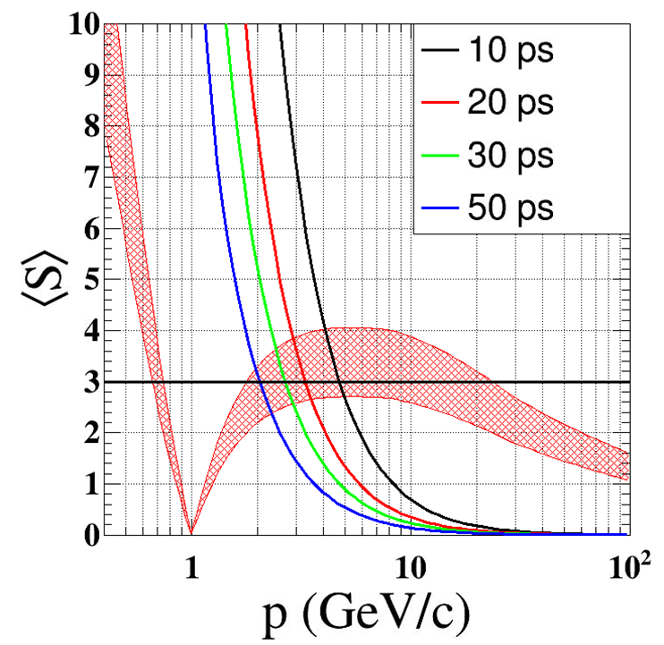
Physics requirement
3 sigma K/pi seperation below 2GeV
  50 ps precision is the target

Slide 3
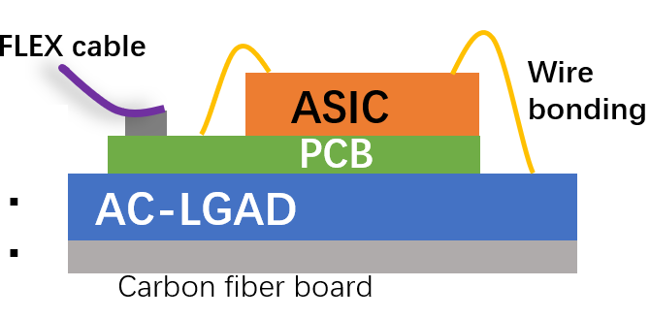
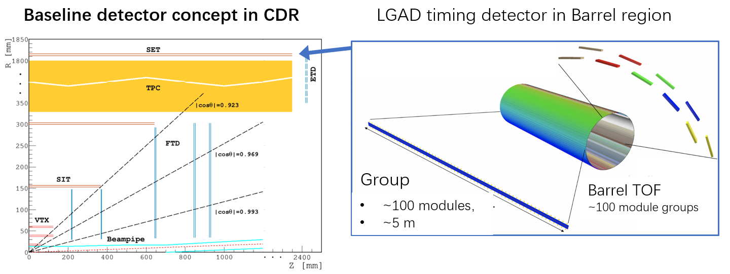
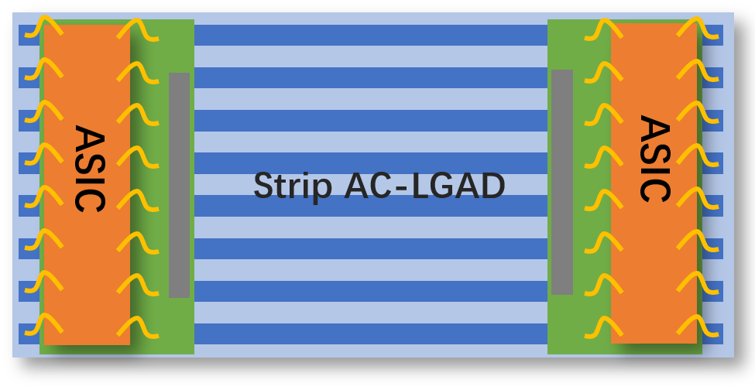
CEPC 4D outer tracker
CEPC 4D outer tracker concept design：
Y
  Should be part of SET (silicon wrapper layer outside TPC or drift chamber)
  Serve as Timing detector and part of the tracker
  Barrel : 50 m² , Endcap 20 m² , ~ 10⁶ channels
  Strip AC-LGAD ( each strip: 4 or 10 cm × 0.05cm)
    Timing resolution: 30-50 ps
    Position resolution: ~ 10 μm @ R-phi direction
    ~ 1mm @ z direction
Z
Strip AC-LGAD + ASIC ：
TOT->amplitude->charge sharing->position
TOA+TOT->timing (time–amplitude correction)
mzli@ihep.ac.cn

Slide 4
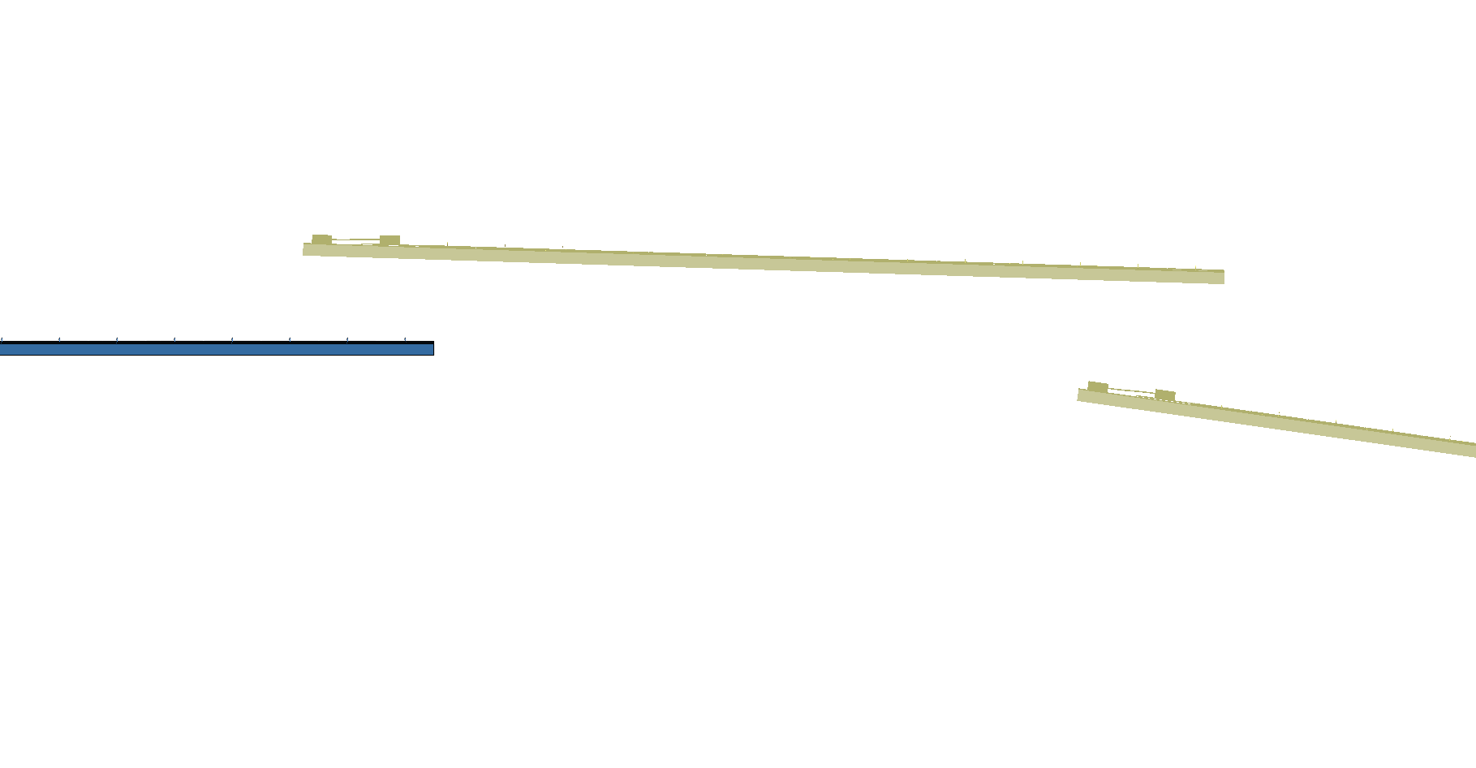
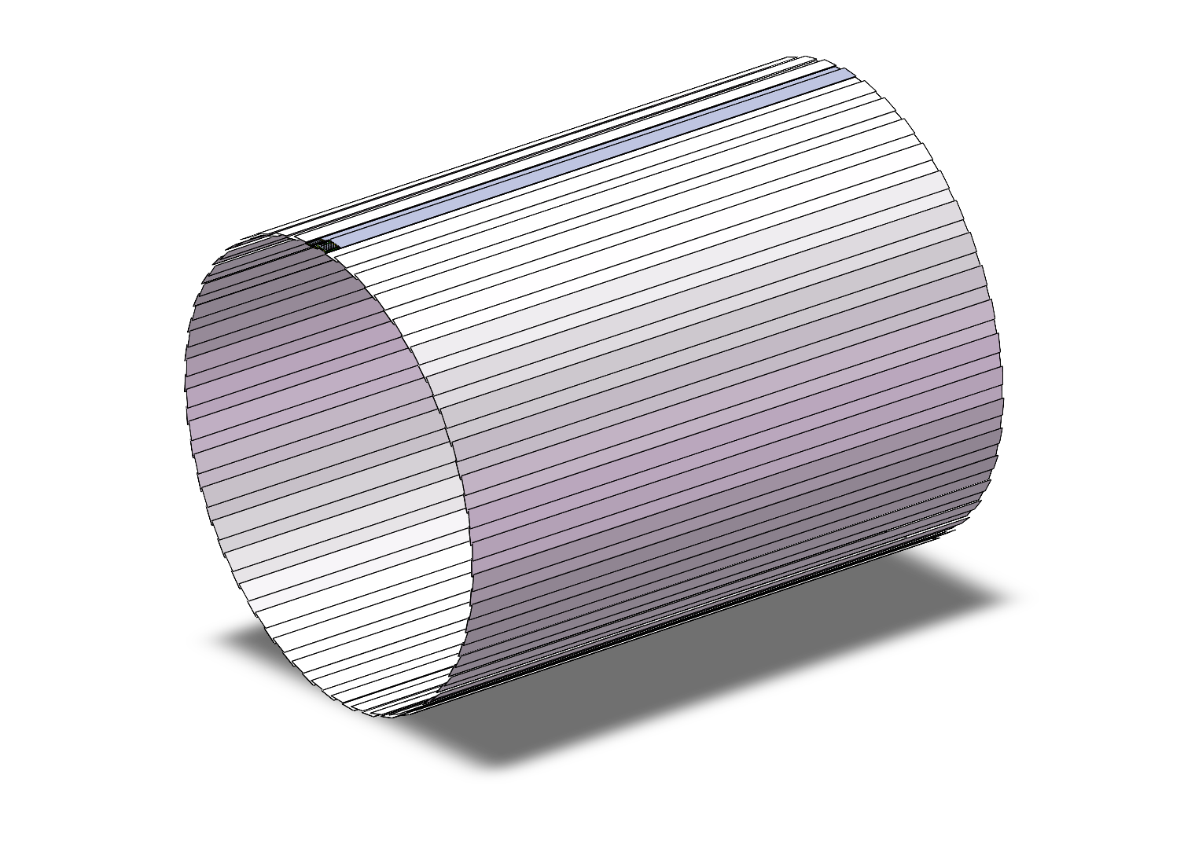
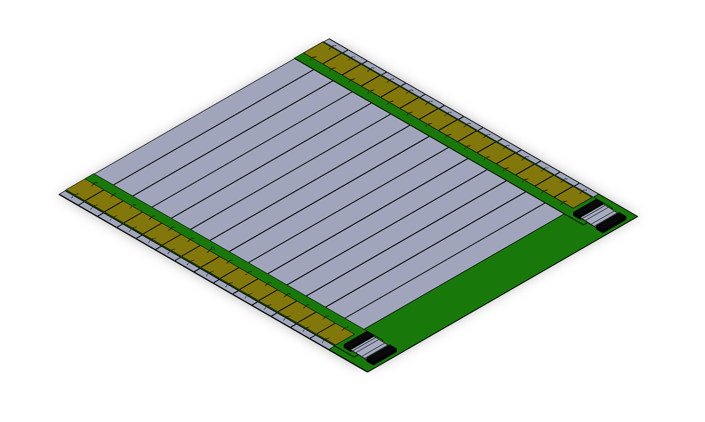
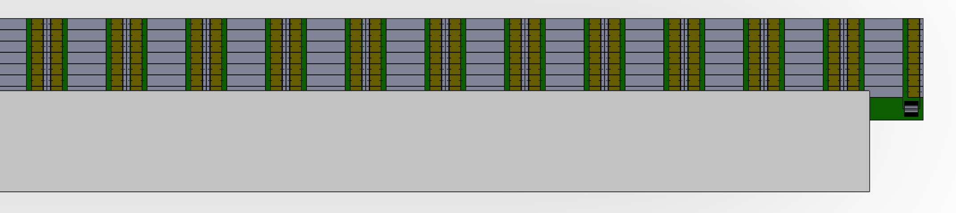
Arrangement of the ToF with strip LGAD
One layer ToF
R= 1800 mm
H～5800mm
One layer:
90 ladders，45 ladders each side,
42 modules/ladder，28 ASIC/module
Total modules needed：
45 *2*42 = 3780 modules
Module
140mm x 160mm
Ladder

Slide 5
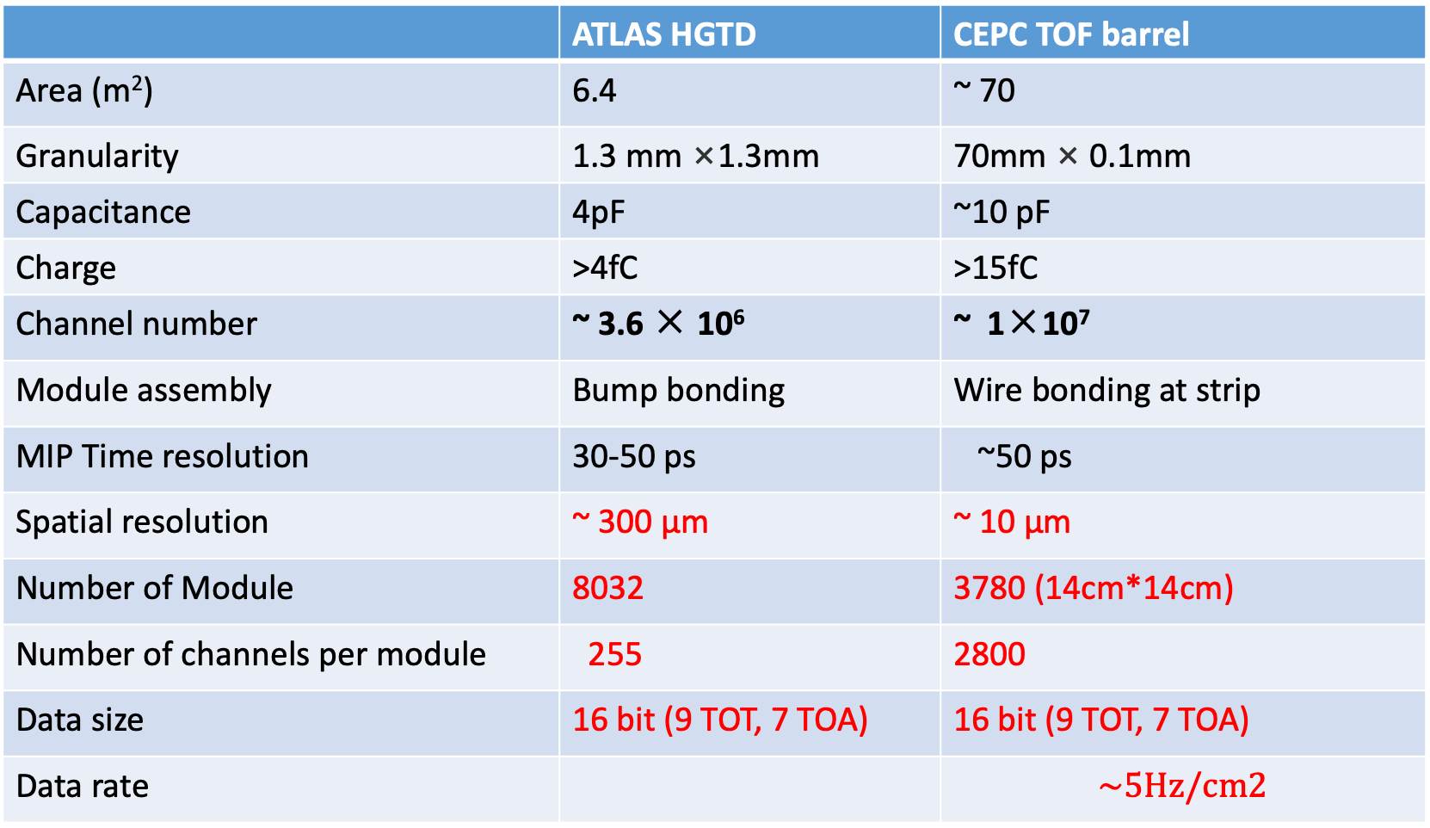
ATLAS HGTD VS CEPC TOF detector
 | ATLAS HGTD | CEPC TOF barrel
Area (m²) | 6.4 | ~ 70
Granularity | 1.3 mm ×1.3mm | 70mm × 0.1mm
Capacitance | 4pF | ~10 pF
Charge | >4fC | >15fC
Channel number | ~ 3.6 × 10⁶ | ~ 1×10⁷
Module assembly | Bump bonding | Wire bonding at strip
MIP Time resolution | 30-50 ps | ~50 ps
Spatial resolution | ~ 300 μm | ~ 10 μm
Number of Module | 8032 | 3780 (14cm*14cm)
Number of channels per module | 255 | 2800
Data size | 16 bit (9 TOT, 7 TOA) | 16 bit (9 TOT, 7 TOA)
Data rate |  | $$\sim 5Hz/cm2$$

Slide 6
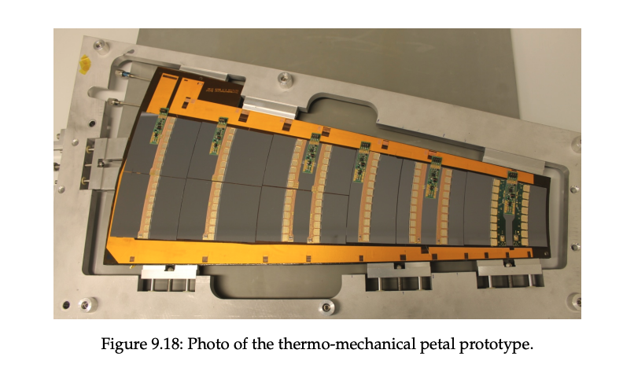
Endcap design
ITK strip dendcap

Slide 7
Backup

Slide 9
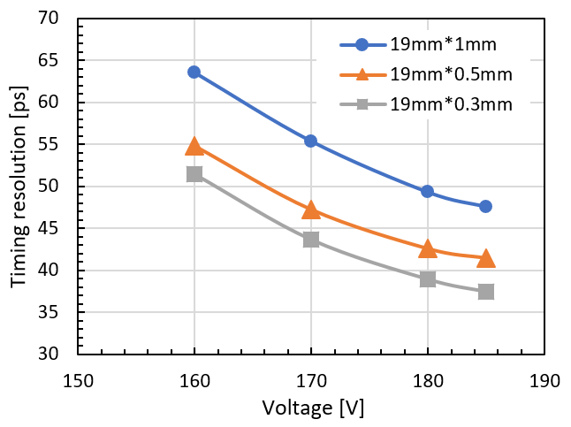
Timing resolution (different dimension of strip )

Slide 10
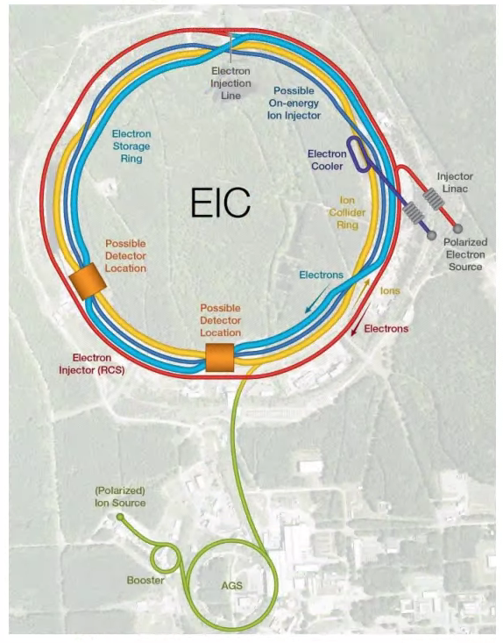
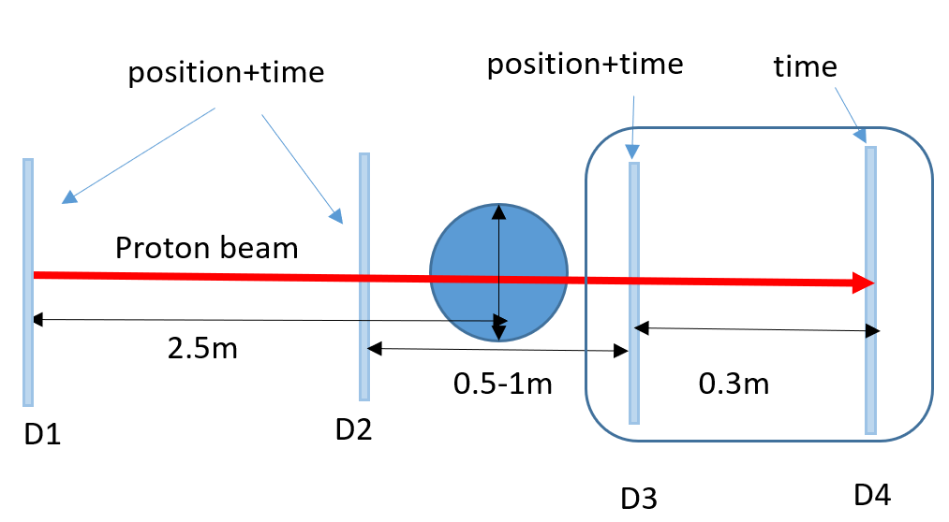
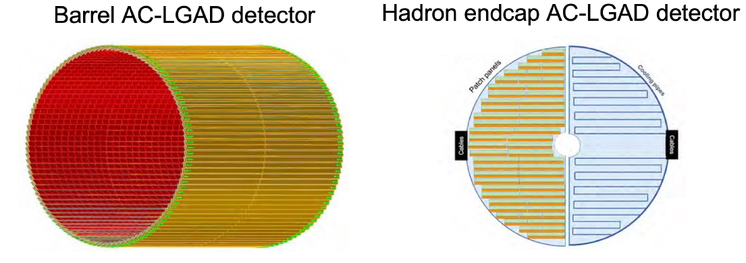

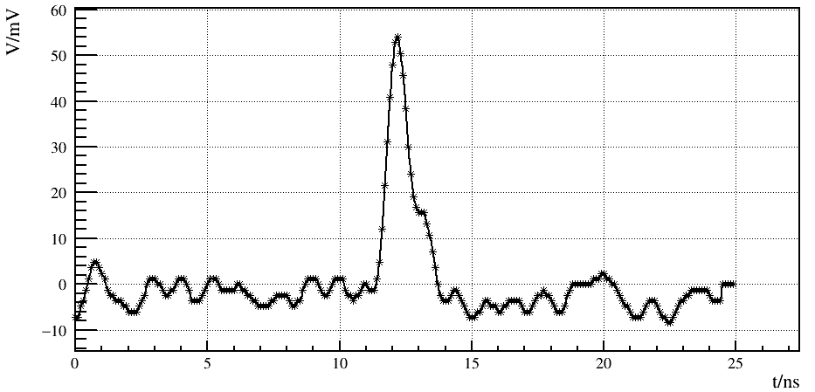
Application of AC-LGAD
Electron-Ion Collider (EIC)：Timing-tracker
Nuclear Medicine Instruments：
Such as proton therapy and proton CT
10.9 m²
2.22 m²
X-ray detectors @ advanced light sources
HEPS @ Beijing
other applications
Beam Telescope for Beam Test Platform
LiDAR: Positioning and Navigation
Track and time detectors in other particle physics and nuclear physics experiments
…
6 KeV X-Ray
mzli@ihep.ac.cn

Slide 11
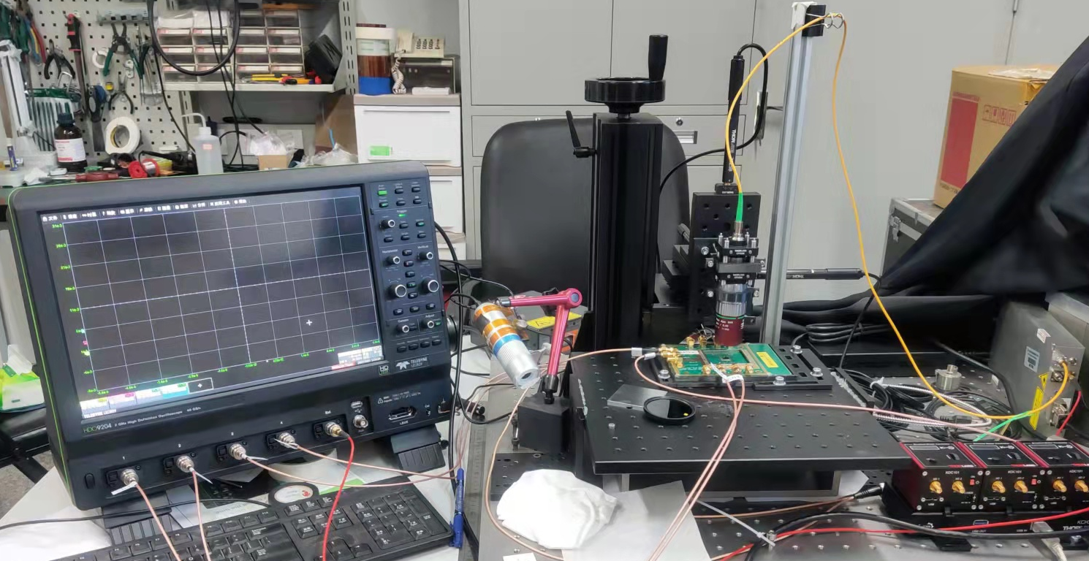
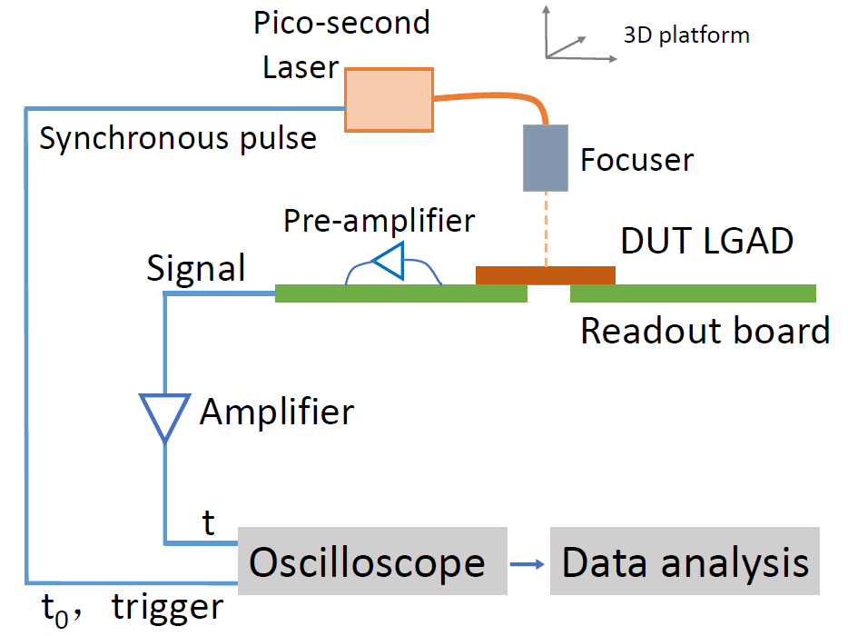
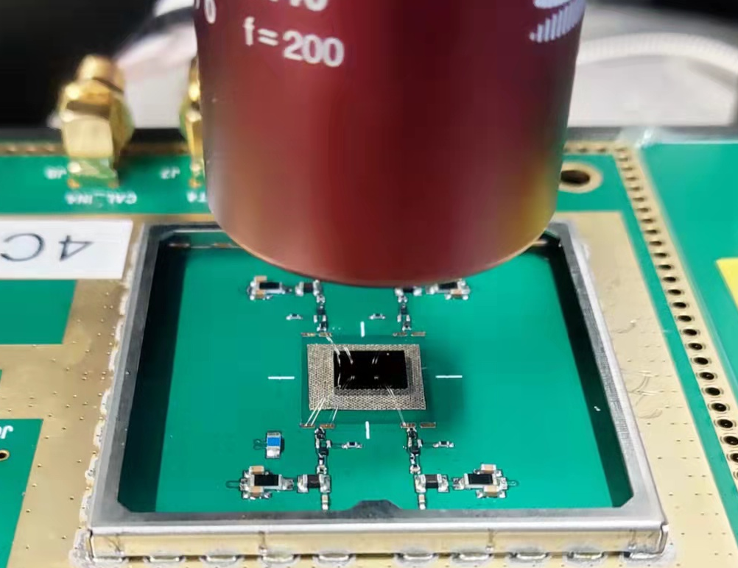
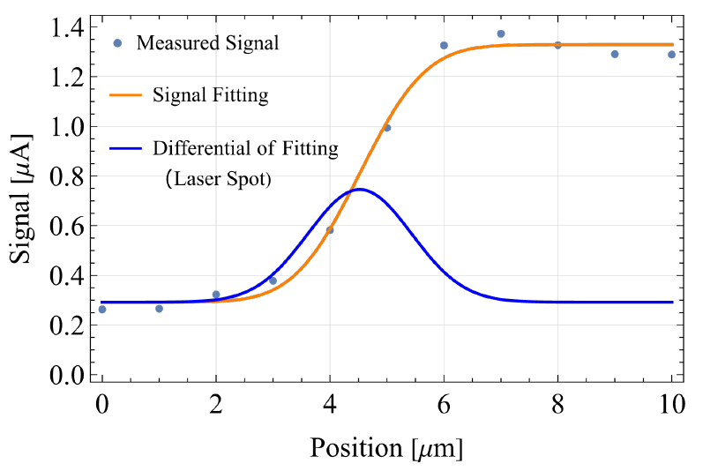
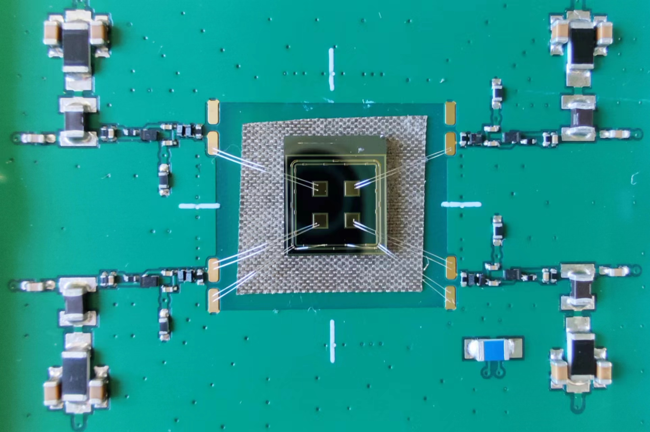
4.1 AC-LGAD sensor test ： Picosecond laser test
Picosecond laser scanning system
3D platform
Sensor & Board
focuser
Picosecond laser 1064nm
Picosecond laser scanning system
Displacement accuracy 1 μm
Automated scanning
Picosecond laser 1064nm
Spot size 2~5 μm
mzli@ihep.ac.cn

