Slide 1


Preliminary readout scheme of TPC & DC & cost estimation
Zhi Deng, Yubin Zhao, Huirong Qi, Mingyi Dong, Wei Wei
On behalf of the Elec-TDAQ Group for Ref-TDR
2024-03-08

Slide 2
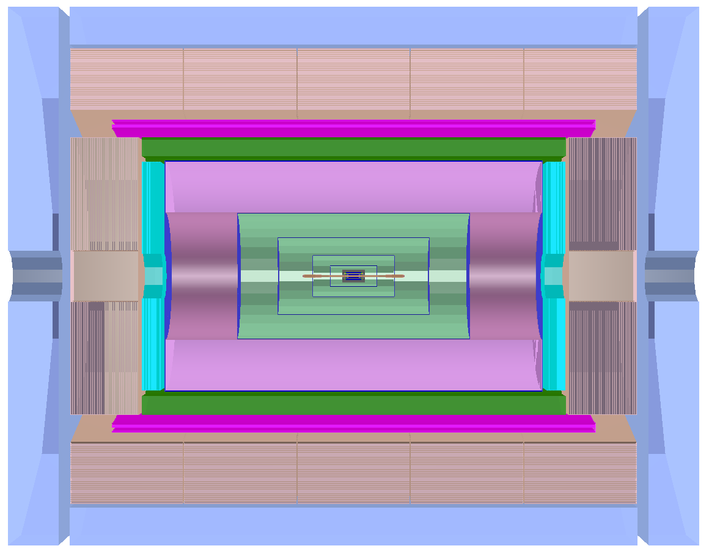
Global view for the TPC & DC Elec-TDAQ system
FEE-2
To BEE
FEE-1:
A rad-hard (analog) FEE
FEE-2:
Non rad-hard FEE for data buffering, in low dose region
(TPC may not need)
FEE-1
FEE-1
To BEE
FEE-2

Slide 3
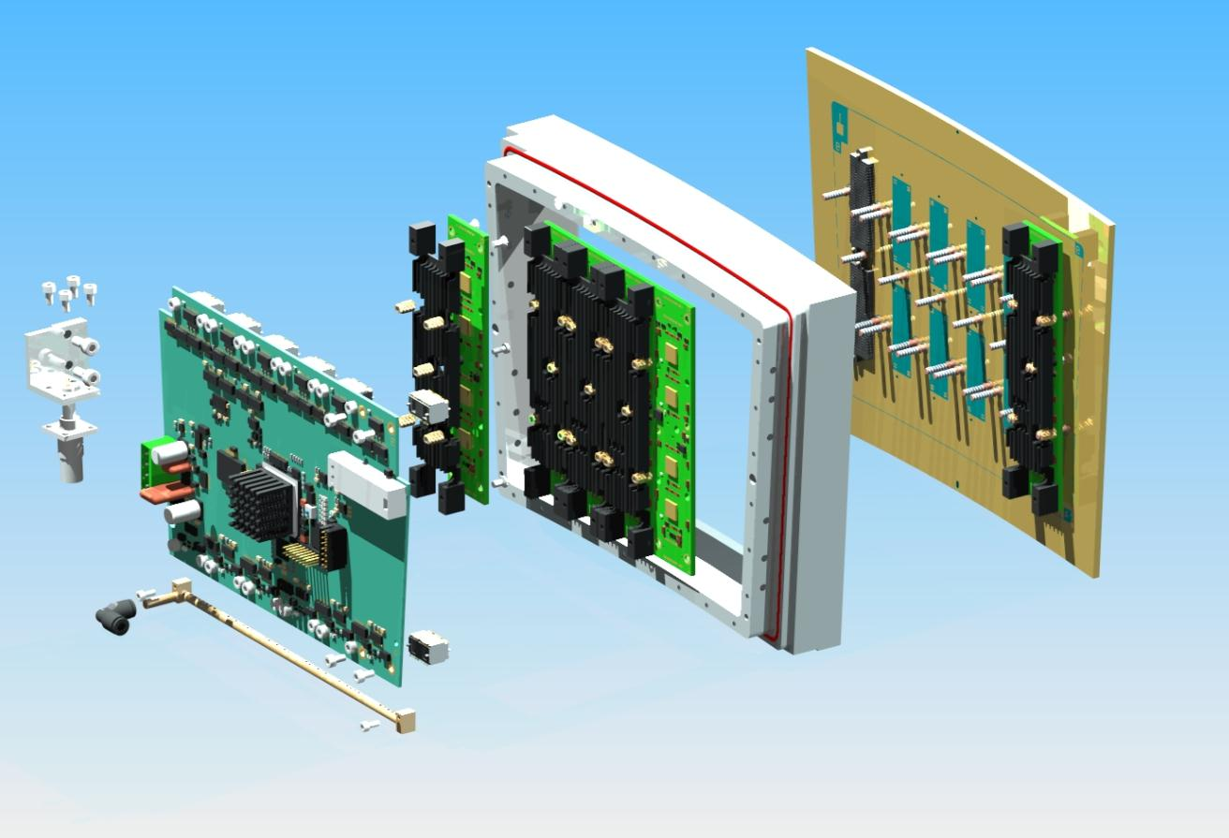
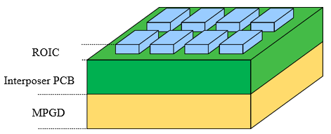
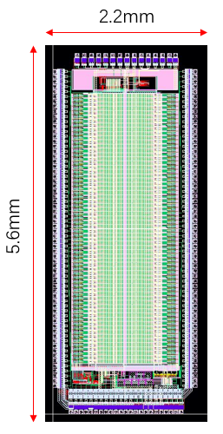
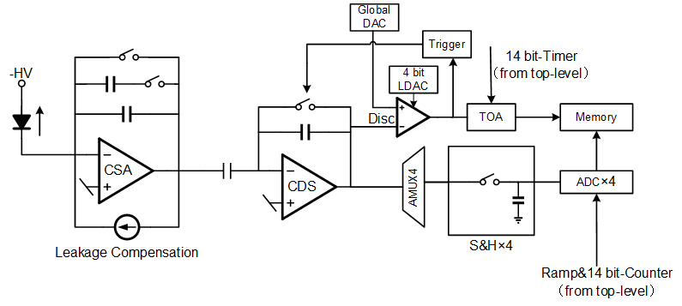
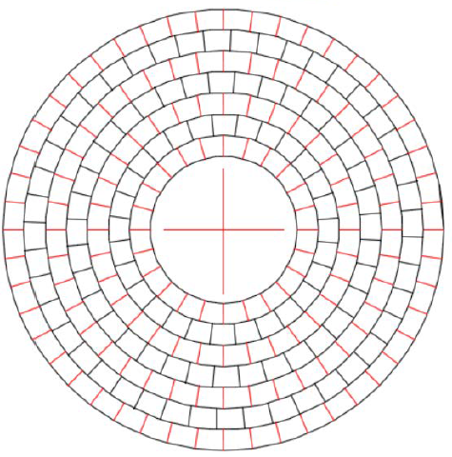
Preliminary readout scheme of Pixel TPC
FEE-0*4
An integrated board with ASIC & MPGD, N(now 4) for a module
0.5mm*0.5mm / pixel
ASIC
MPGD
Concentration- Power-Link Board
Fiber
BEE
128 chn ASIC, Q+T measurement
142.8k pixel/module → 1115 chip/module→ 279 chip/FEE-0
Power:
Limit: <10 kW/endplate ~ 39.7 W/module ~10 W/FEE-0
35mW/ASIC ~ 280uW/chn
Data rate:
80 particles/BX, 12,000 hit/particle, 32(48)b/hit, @ 40M BX Z pole
1 Module: 4.873(7.314) Gbps (Q: hit rate of the inner module? )
~252 Module/Endplate

Slide 4
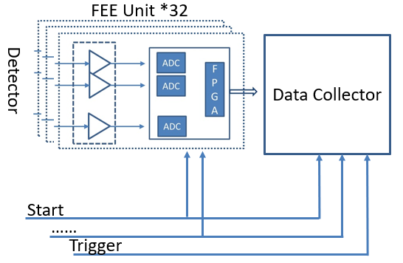
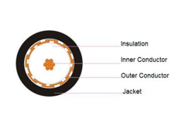
Preliminary readout scheme of Drift Chamber
BEE
12 chn
Grp by sector
Total 27623 chn
ADC
ADC
x12
Fiber
FPGA
RAM
To BEE
ADC
x12
ADC @1.3Gsps 12bit
RAM to average 12 chn in a sector
Read by wave envelope of 1.5 us with waveform-- compatible with calibration requirement (0.5Gbps/ 12chn)
High Bandwidth Preamp
100mW/ch -> 2.7kW
Analog signal on Cable
2.8mm per co-ax
12 signals + 1 Power
3dB attenuation @ 280MHz

Slide 5
Preliminary cost estimation (mostly FEE+BEE)
Item | Unit | Unit cost (10k yuan) | Quantity | Total cost (10k yuan) | Comment
FEE ASIC | ch | 0.00004 | 60,000,000 | 2400 | Mixed integrated module
Connector | pair | 0.02 | 10,000 | 200 | To concentration board
Cables | piece | 0.05 | 1,000 | 50 | FEE-0 to concentration board
BEE Brd | Board | 2 | 16 | 32
Total |  |  |  | 2682
Necessary R&D | Type | 400 | 2 | 800 | FEE+ concentration
FEE Preamp | Board | 0.24 | 2302 | 550
FEE Digital Brd | Board | 1.68 | 2302 | 3900 | Mostly ADC
FEE Mix Cable | piece | 0.12 | 2302 | 280
BEE Brd | Board | 2 | 72 | 144 | Mostly FPGA
Total |  |  |  | 4874
Necessary R&D | Type | 0 | - | 0
TPC
DC
BEE: 10Gbps Link/port, with 32 ports(chn)

Slide 6
Comment on cost
Common part (Power, Crate, HV…) not included
  Won’t impact on the level of the cost
Spare component (备件) not considered yet
For DC, if customized-ADC can be used, cost can be greatly saved
  JUNO-ADC is a competitive candidate
For both sub-det, R&D fee especially for ASIC, not included
  But almost fixed for each ASIC, ~several million rmb
  ASIC is calculated only by mass production case

Slide 7
Comment on readiness
DC:
  most are ready, if COTS are used as calculated
    Q: if the current COTS preamp rad-hard?
  If ASIC applied, needs two R&Ds
    High bandwidth preamp: med challenge
    High speed high accuracy ADC: normally high challenge but with mature experience
  Current cost can fully covered both R&D
TPC:
  Comprehensive R&Ds should be carried out for the FEE module for pixel TPC
  ASIC R&D needed:
    FEE-ASIC: architecture ready but power should be controlled (low to med challenge)
    Concentration chip: w/o show stopper (low challenge)
  R&D of Packaging and assembly for FEE module needed:
    High density with multiple chips
    FEE to the concentration board
  Extra R&D fee besides the mass production cost is necessary

Slide 8
Common questions
What is the inner hit rate of TPC?
  Now the 7Gbps/module is only the average data rate
What is the radiation level?
  At the endplate
  At the Muon corner
  --useful to see if some rad-hard FPGA can be used
  --to check the DC fast preamp at the endplate
Material budget satisfied?
  TPC: ~2 stacks of PCB
  DC: cable fanout
Will TPC or DC participate in the trigger decision?

Slide 9
BACKUP - TPC
By Zhi Deng, Huirong Qi

Slide 10
Overview
Pixel readout for PID
  pixel: 0.5x0.5 mm², rin = 0.6 m, rout = 1.8 m
  3x10⁷ ch. per endplate，252 modules in 17cm x 21 cm

Slide 11
Modular Readout
In total 142.8k ch. /module, divided into ~4 FEE board
FEE board
  Pixel ROIC: energy & timing pickoff & digitization
  De-randomize buffer (buffer size =?)
  Data serialization
GBT-like board:
  data collection
  CLK distribution
  Power distribution

Slide 12
Modular Readout
Power
  Limit: <10 kW/endplate ~ 58.82 W/module ~14.71 W/FEE board
  1.8/2.5V, 180 nm (optional 130nm for better performance)
Avg. data bandwidth (raw data)
  80 particles/BX, 12,000 hit/particle, 32(48)b/hit
  1 Endplate: 1.228(1.843) Tbps @ 40M BX
  1 Module: 4.873(7.314) Gbps
  1 FEE board: 1.218(1.829) Gbps

Slide 13
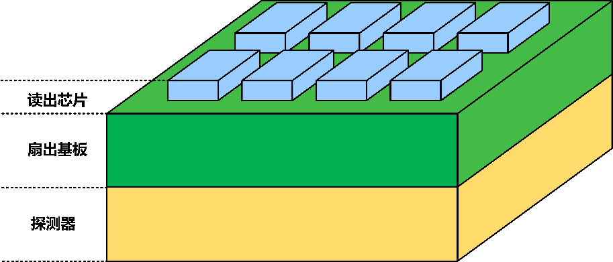
FEE: sub-module
Concept R&D design
  ROIC +Interposer PCB as RDL
  High metal coverage, 4-side buttable
  Low power Energy/Timing measurement ASIC
    ~100 e noise
    5 ns drift time resolution
    100 mW/cm² (250uW/ch) ~ 35.7 W/module ~ 6.069 kW/endplate
ROIC
Interposer PCB
MPGD

Slide 14
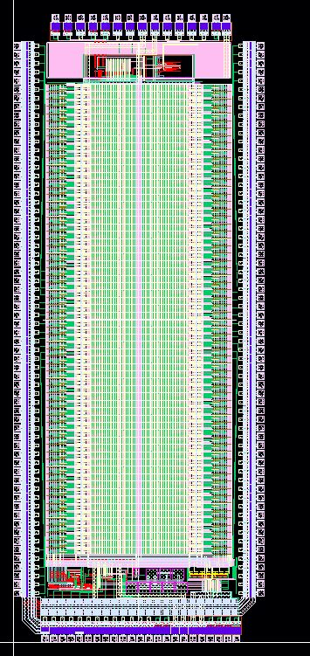
FEE: pixel ROIC
Charge Sensitive Preamplifier(CSA)
CDS amplifier provides additional gain and noise shaping
14-bit Wilkinson type ADC each pixel
Timing discriminator with14-bit TOA (Time of Arrival) information
2.2mm
5.6mm

Slide 15
TPC FEE cost
Items | Unit | Unit cost (RMB) | Quantity | Total cost (10k RMB)
FEE ASIC | ch | 0.4 | 60,000,000 | 2400.00
Connector | pair | 200 | 10,000 | 200.00
Cables | piece | 500 | 1,000 | 50.00
Total |  |  |  | 2650.00

Slide 16
BACKUP - DC
By Yubin Zhao, Mingyi Dong

Slide 17
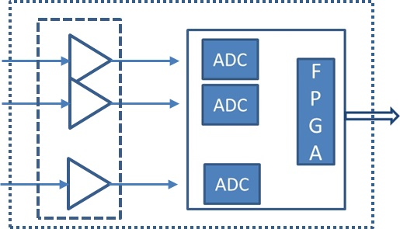
电子学架构
FEE单元
  前置放大器
    12ch
  连接电缆
  数字化板
数据汇总
  对应32FEE单元
电源
  48VDC
FEE Unit *32
Detector
Data Collector
Start
……
Trigger

Slide 18
前置放大器
商用放大器方案
  总通道27623
  12ch/board
  LMH6629
  两级放大，跨阻增益2500Ω
  芯片驱动能力较大±250mA
  功耗100mW/ch
  供电：±2.5V，GND
  造价200元/ch

Slide 19
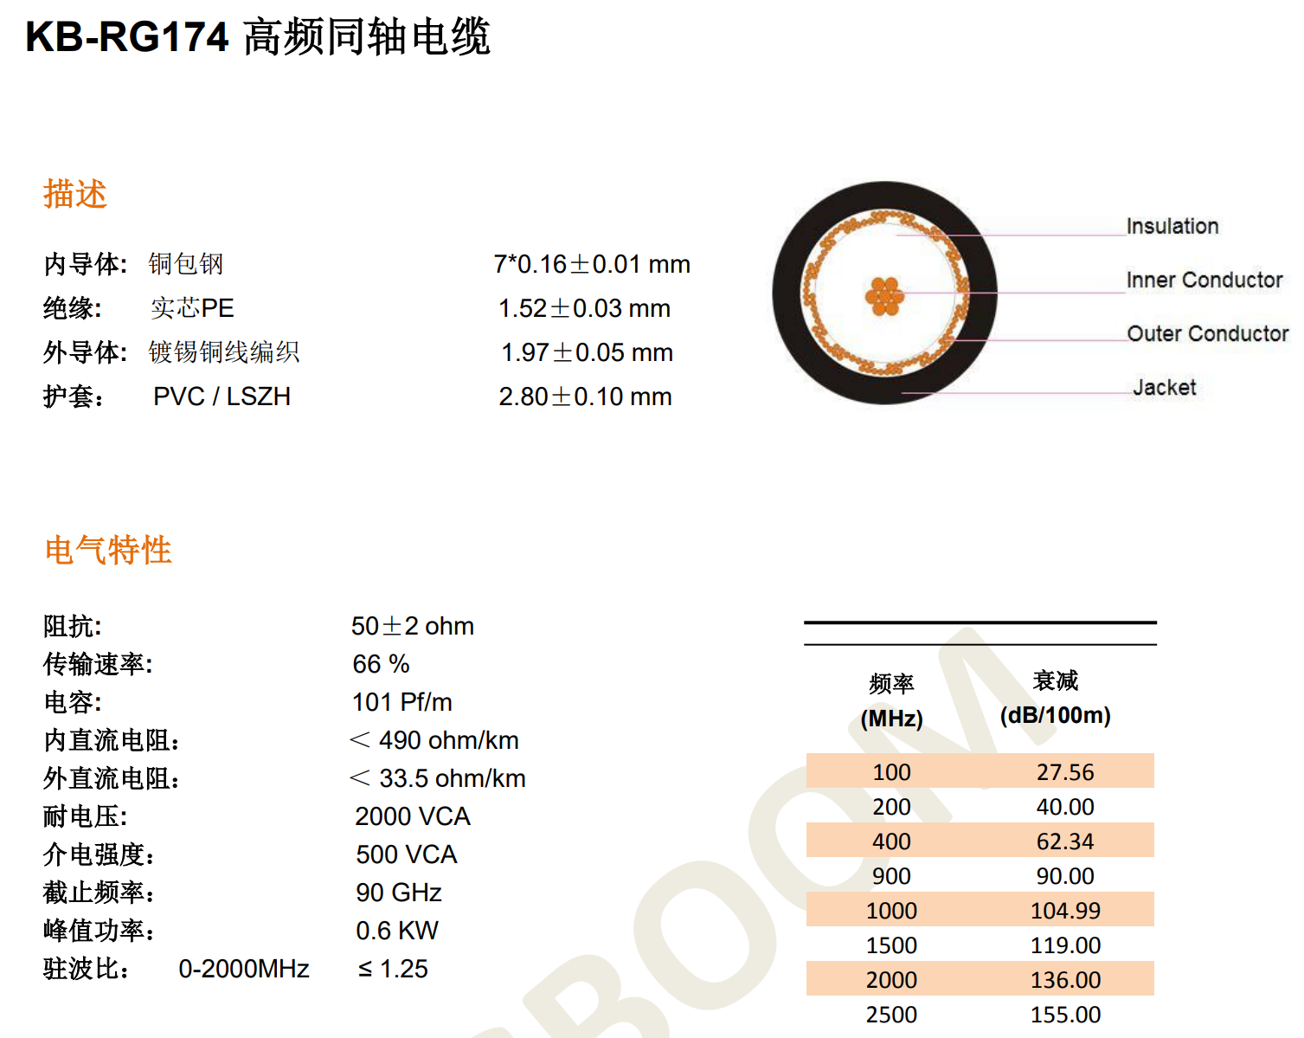
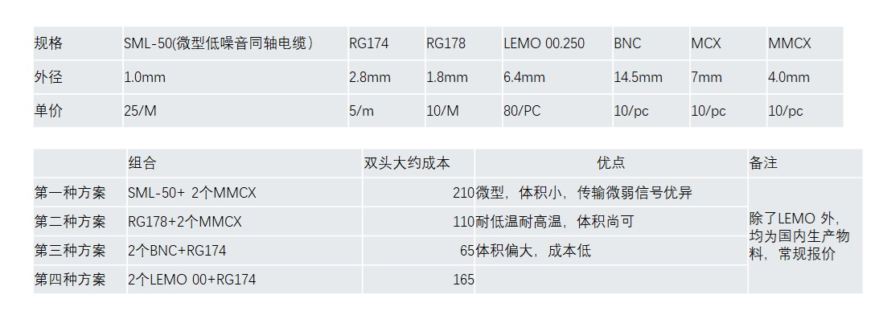
连接电缆选择
电缆的选择
  KB-RG174同轴电缆
    送前放模拟信号到数字化板
    每根长度~7m
    200Mhz时衰减~3dB
    阻抗50Ω
    外径：2.8mm
    27623根
  混合缆
    12同轴+1电源线
  混合缆造价：1200元/根

Slide 20
数字化板
数字板构成
  高速ADC+时钟
    采样率1.3G
    位数12bit
    2chs/ADC
    采样窗口1.5us
  FPGA+RAM
    6ADCs/chip
    无触发信号，采用自触发来进行0压缩
    波形传输
    数据暂存
  其他
数字板功耗：1.7W/ch
数字板造价：1400元/ch

Slide 21
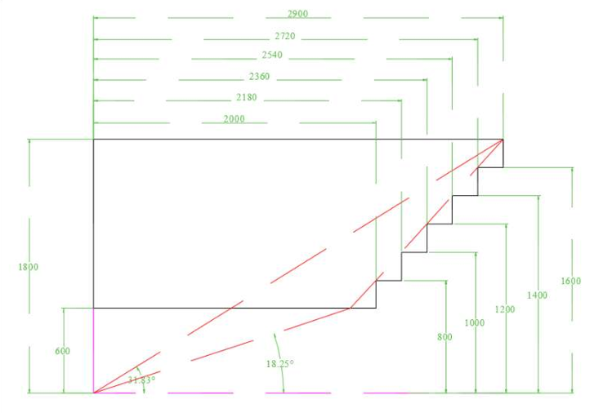
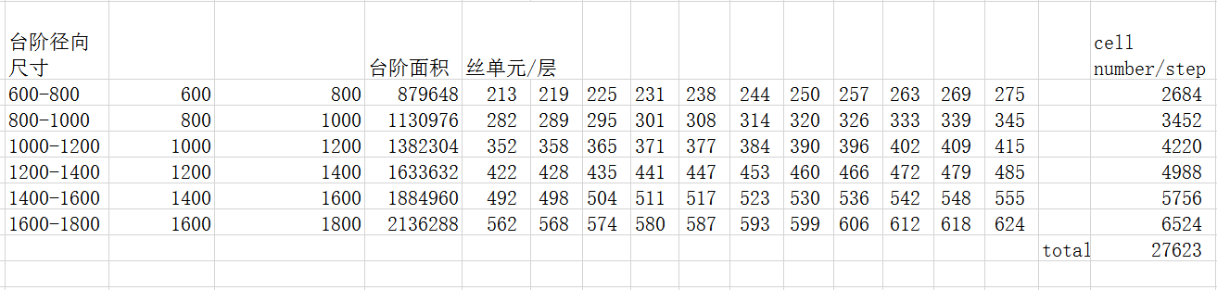
数据量分析
数据量预估
  预估条件
    采样率1.3Gsps，取样窗口1.5us，这样单次事例数据量2k*2Byte
    最内层事例率70K，最外层10k，平均事例率~30k
    需要0压缩，按5%着火率计
    每个数字板对应12个前放通道
  预估结果：
    576Mbit/board

Slide 22
经费
说明：价格单位：万元
考虑备件通道数按30000计（实际27623）
Item | Unit | Unit cost | Quantity | Total cost
FEE 前放 | 块 | 0.24 | 2500 | 600
FEE 数字板 | 快 | 1.68 | 2500 | 4200
FEE混装缆 | 根 | 0.12 | 2500 | 300
数据汇总板 | 块 |  | 80
电源
机箱
其他线缆
测试费用
合计 |  |  |  | 5100

