Slide 1

中国科学院高能物理研究所
Institute of High Energy Physics, CAS
CEPC Detector Magnet Ref TDR
Physical Design Magnet_RT V1
Feipeng NING
2024.03

Slide 2

Outline
Magnetic parameters
Physical design of the detector magnet
Yoke and stray field
Ongoing work

Slide 3
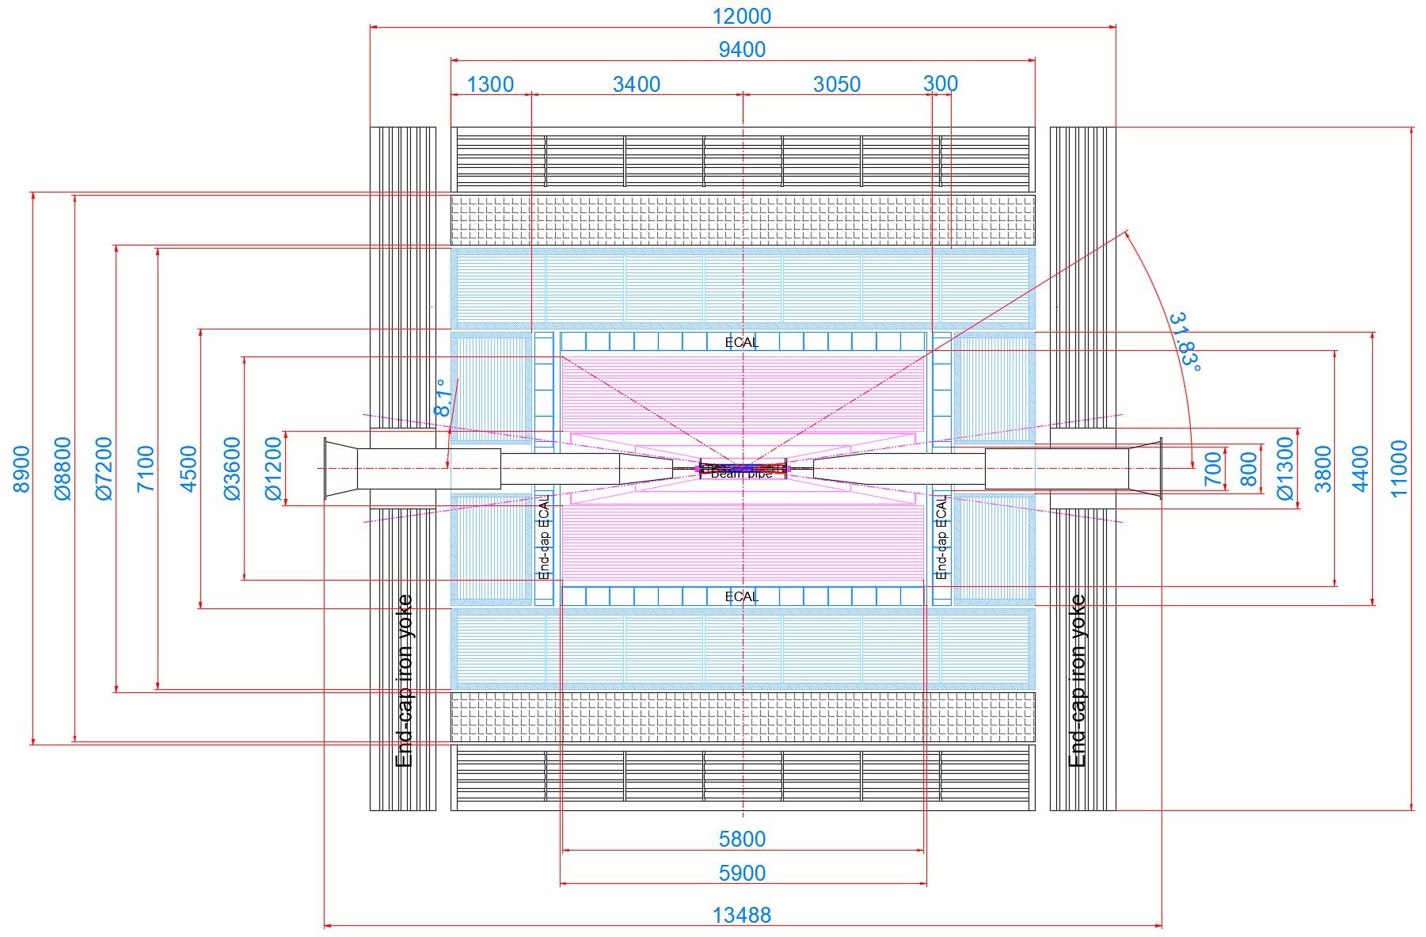
1. Magnet parameters
Magnet Interface：
Item | Value (mm)
Inner diameter | 7200
Out diameter | 8800
Length | 9400
Thickness | 800

Slide 4
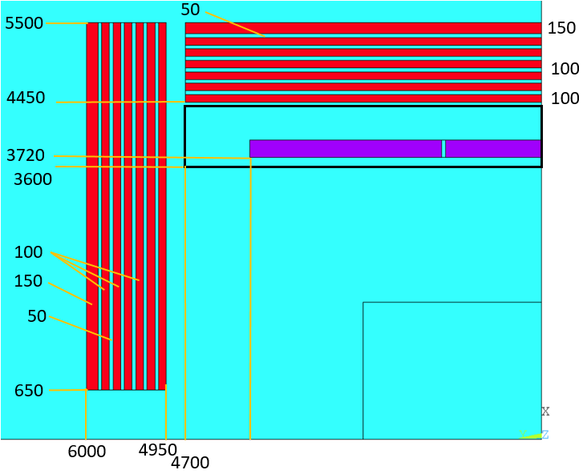
1. Magnet parameters
Coil parameters:
Coil parameters | Value
Inner radius (mm) | 3720
Length (mm) | 7690
Current (A) | 17940
Stored energy (GJ) | 1.6
Inductance (H) | 10
Layers | 4

Slide 5
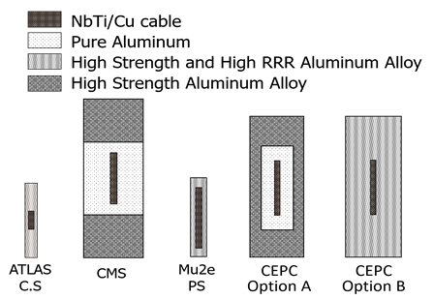
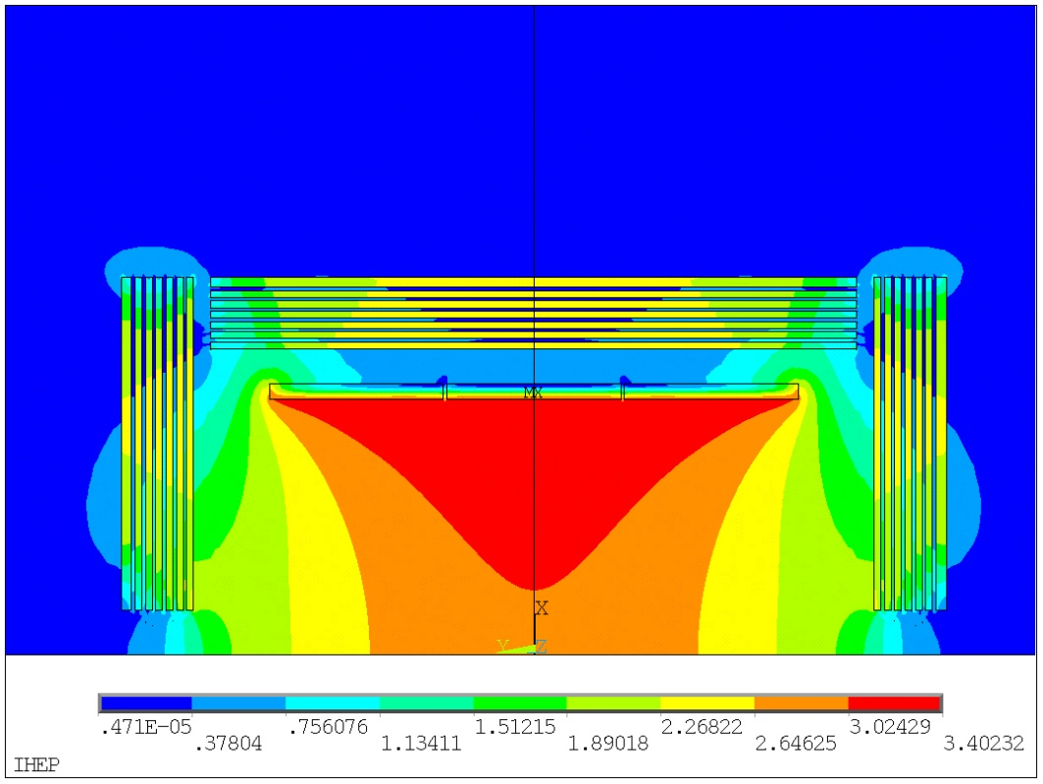
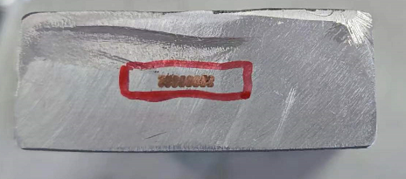
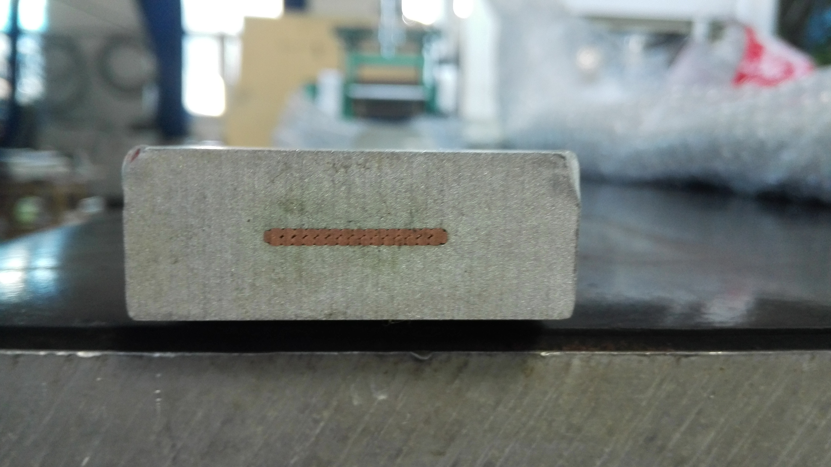
2. Physical design of the detector magnet
Magnetic field distribution:
Two options of CEPC aluminum stabilized LTS conductor are on R&D.
Option A
Option B
Dummy cable 22*56mm²

Slide 6
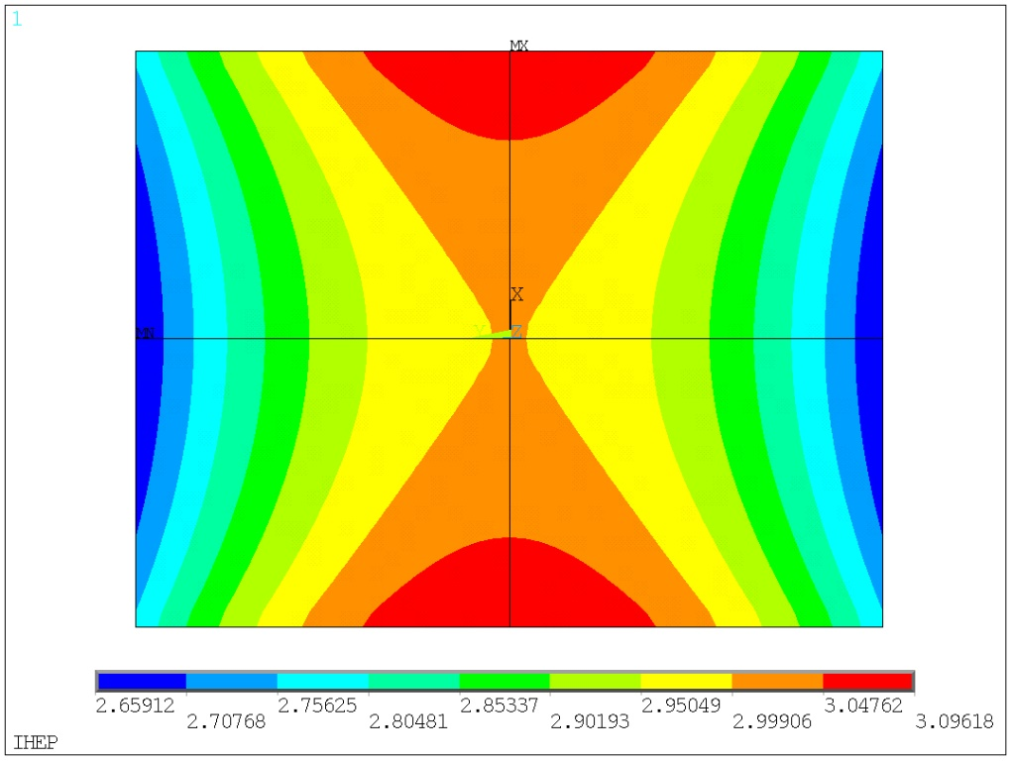

2. Physical design of the detector magnet
Magnetic field distribution of the Track Volume:
The non uniformity of Tracking Volume (diameter 3.62m,length 4.7m) is 14.6%
Bmax= 3.09618242
Bmin = 2.65912069
Bmax-Bmin= 0.4370617310
Peak-Peak non-uniformity:
$B_{p}=\frac{B_{max}−B_{min}}{B_{center}}$ = 14.6%
 | Peak-peak non uniformity
Ref TDR | 14.6%
4th Design | 16.7%
CDR | 9.2%

Slide 7
Yoke parameters:
3. Yoke and stray field
 | Mass (ton)
Barrel yoke | 1812
Each End yoke | 570
Total | 3000
 | Ref TDR | CDR(CEPC) | CEPC 4th detector
Central field (T) | 3 | 3 | 3
Length of Yoke (m) | 12 | 14 | 11.1
Outer diameter(m) | 11 | 14.5 | 8.5
Inner diameter(m) | 8.9 | 8.8 | 7.3
Total yoke mass [kt] | 3 | 12.573 | 1.143

Slide 8
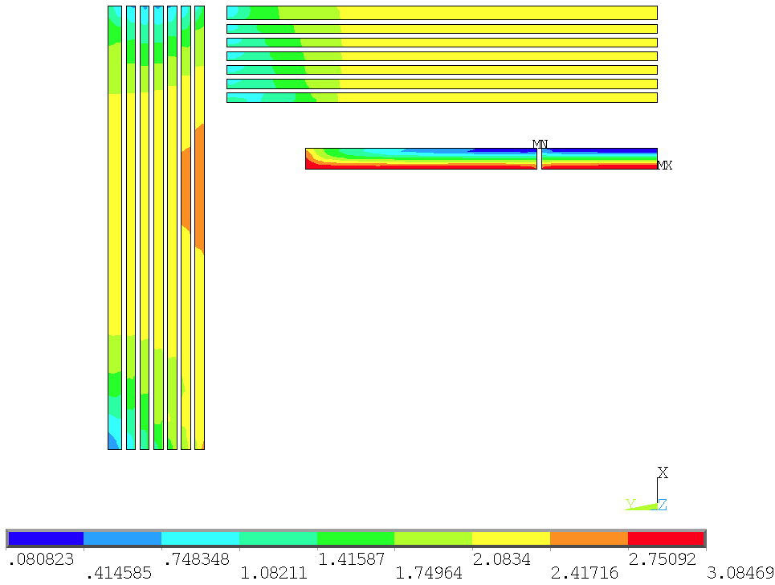
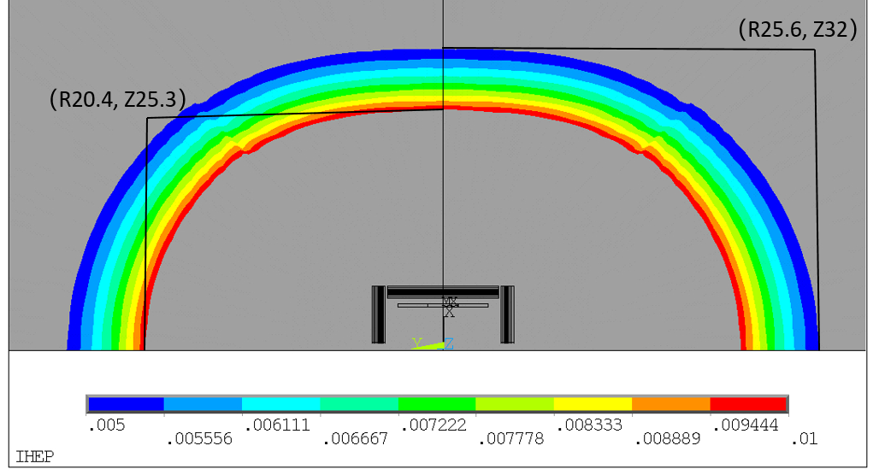
stray field:
3. Yoke and stray field
Stray field |  | Ref TDR | CEPC CDR | 4th design
50 Gs | R direction | 25.6 m | 13.6 m | 16.3m
 | Z direction | 32 m | 15.8 m | 19.9m
100 Gs | R direction | 20.4 m | 10 m | 12.6m
 | Z direction | 25.3 m | 11.6 m | 15.7m
50 Gauss and 100 Gauss distribution

Slide 9
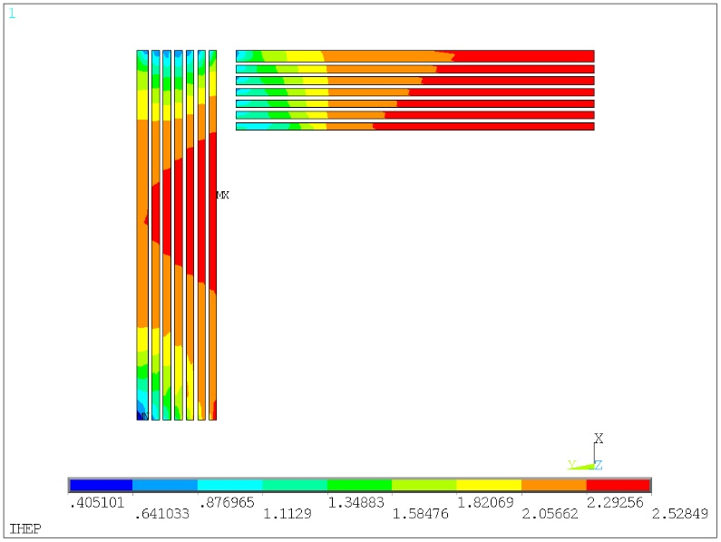
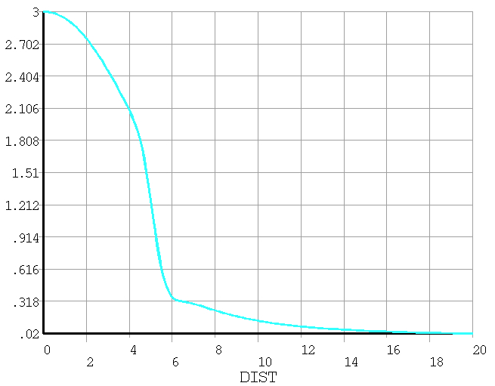
stray field:
3. Yoke and stray field
The magnetic field distribution from 0 to 20 m in axial direction:
The magnetic field on the yoke iron is saturated.
Stray field away from yoke (unit, Gauss):
 | 5m | 10m | 15m
Radial | 664 | 235 | 100
Axial | 1080 | 385 | 174

Slide 10
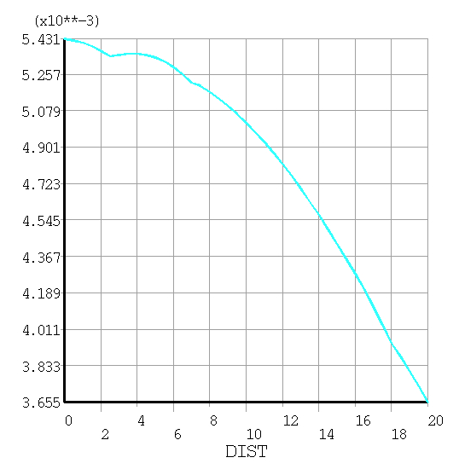
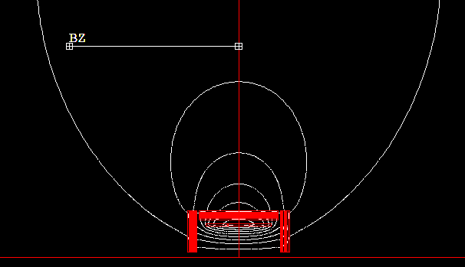
Magnetic field at the booster ring
Are there any other requirements for stray magnetic fields?
25m
From 54Gs to 36Gs
The detector stray field can reach the booster and influences the beam dynamics of booster. The current study shows that the correction to the detector stray field seems possible at low field (less than 50 gauss) level by orbit correction.
Add correctors
A little higher than 50 Gs at the booster location.
The impact of the stray field on the beam is being evaluated.
  Anti-solenoid or Yoke?
Dou Wang, Yuan Zhang, Daheng Ji, Feipeng Ning, Impacts of Detector Stray Field on Booster, AP NOTE, ACC-AP-NOTE-2020-001, Receive Date (October 15, 2020)

Slide 11
Any requirements?
1, magnetic field uniformity of Tracking volume?
2, stray field on detectors, electronics, power source, Vacuum pumps?
3, stray field on beam?
4, stray field on booster?

Slide 12
Work towards TDR
1, Optimization design of LTS cable;
2, Cryogenic system research;
3, Mechanical structure research;
4, Quench detection and protection system;
5, Yoke and stray field;
6, HTS options study.

