Slide 1
Tracker for reference detector TDR
WANG Meng 王萌
2024.3.12

Slide 2
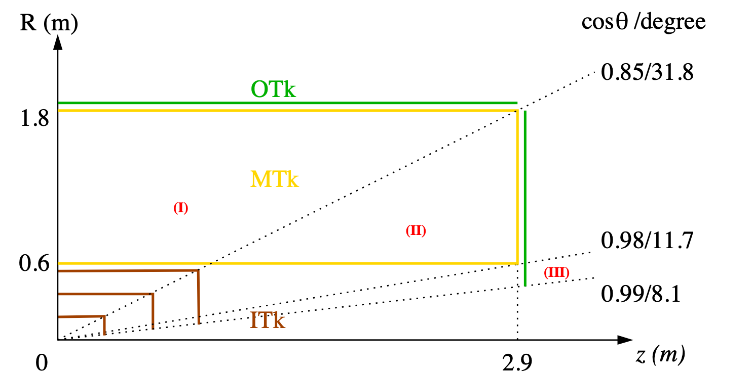
CEPC tracking system, draft
Three tracking regions
barrel, full Main + Si trackers
endcap, partial Main tracker
forward, Si tracker only

Slide 3
status and plan
TPC vs DC
comparison tables of performance almost ready
silicon pixel tracker
initial design of module, stave, readout, and barrel layout
discuss readout with electronics group
silicon microstrip tracker
The single-layer strip is sufficient.
Initial design of barrel module.
LGAD and TOF
update the design of LGAD based TOF, in particular the readout scheme.
more details in minutes at: https://indico.ihep.ac.cn/event/21849/

Slide 4
TPC vs DC: performance

