Slide 1
CEPC vertex detector towards TDR
Zhijun Liang,
On behalf of CEPC vertex working group

Slide 2
Towards TDR
Aim to have a draft of TDR by the end of 2024.
System level design, choose baseline technology
Electronics, service and mechanics needs to be included
Major change from CDR to TDR
Beam pipe diameter: 28mm (CDR) → 20mm (TDR) (reduce 30%)
Instant Luminosity per IP:
Z pole: 32×10³⁴ cm⁻²s⁻¹ (CDR) → 192 ×10³⁴ cm⁻²s⁻¹ (TDR, 50MW) (6 times increase)
ZH: 5.6×1034 cm-2s-1 (CDR) → 8.3 ×10³⁴ cm-2s-1 (TDR) (~1.5 times increase)

Slide 3
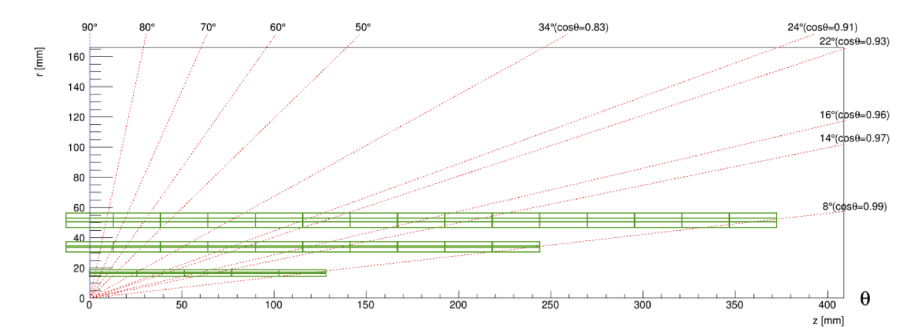
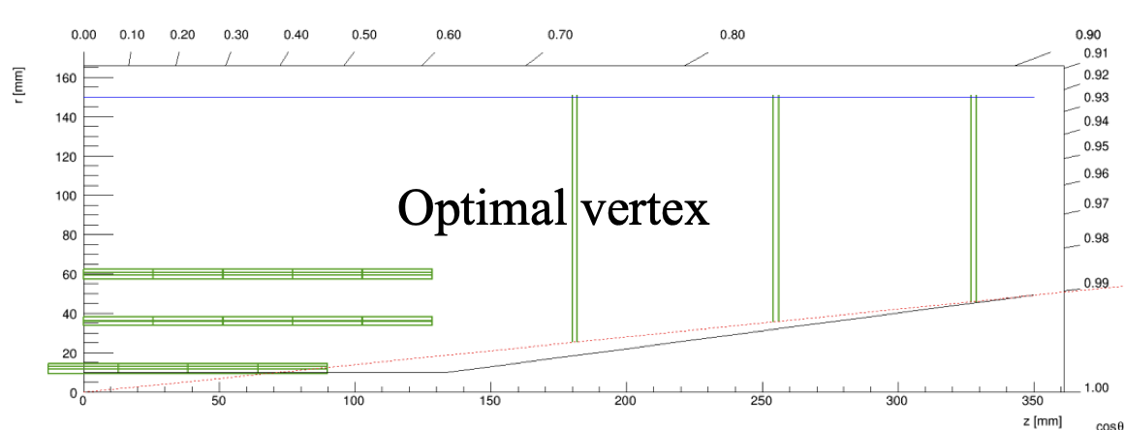
Plan : geometry and layout optimzation
End of March: finalize 1st draft of the detector geometry and mechnical design
Physics Layout optimization (mainly focus on layout for endcap )
Feasibility study of 2 layout ( mechanics support, cooling, cable ….)
Vertex detector MOST2 prototype layout has been implement in CEPCSW
Try to perform further optimization with full simulation
Long barrel
Short barrel + endcap

Slide 4
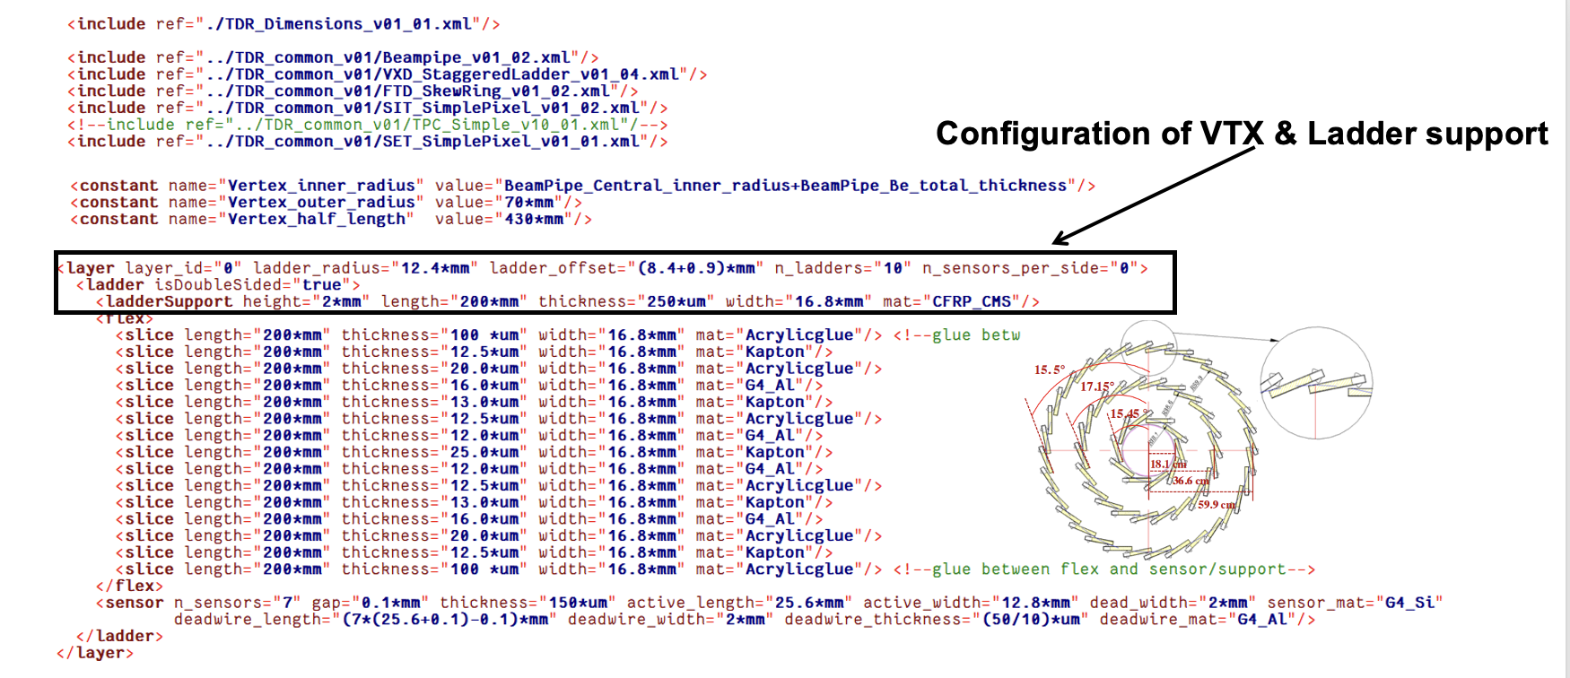
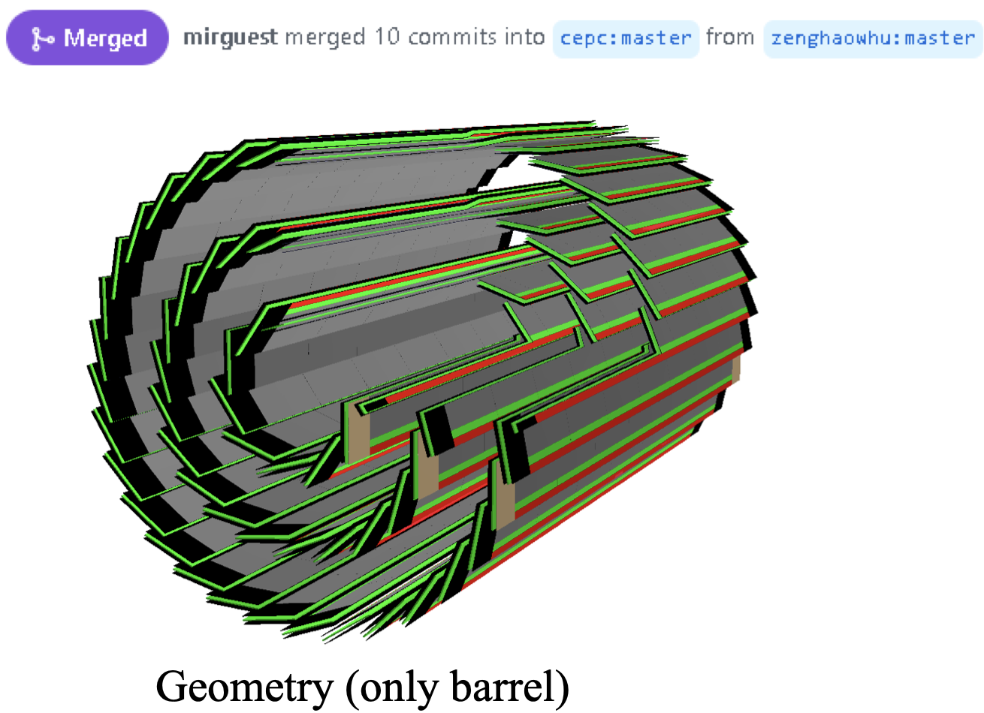
Layout optimization: CEPCSW full simulation
MOST2 prototype layout has been implemented in CEPCSW
Long barrel： can be optimized using CEPCSW
Short barrel+ endcap: Need to implement Endcap disk geometry into CEPCSW
Need to work with software group

Slide 5
Need to converge soon
Sensor chip dimension
Ladder dimension
Flexible PCB ( number of metal layer )
Carbon fiber support (height and material budget)
Support design for short barrel

Slide 6
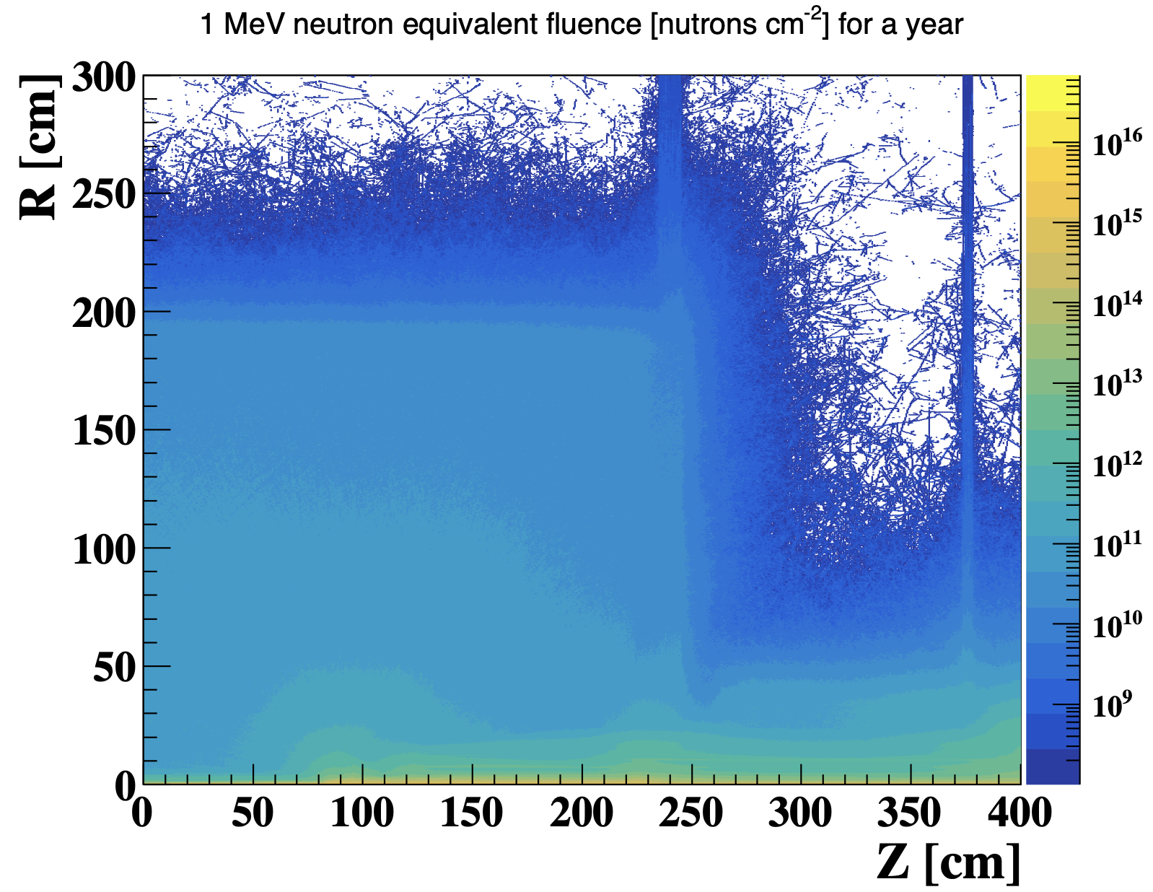
Plan: MDI background input
End of March: Plan to work with electronics group to finalize the readout design
Need final input from MDI group for background estimation
Got 1st offical background input from MDI group last week
Request MDI group to provide the background distribution and raw data
Get background hit density distribution in vertex detector in software

Slide 7
backup

Slide 8
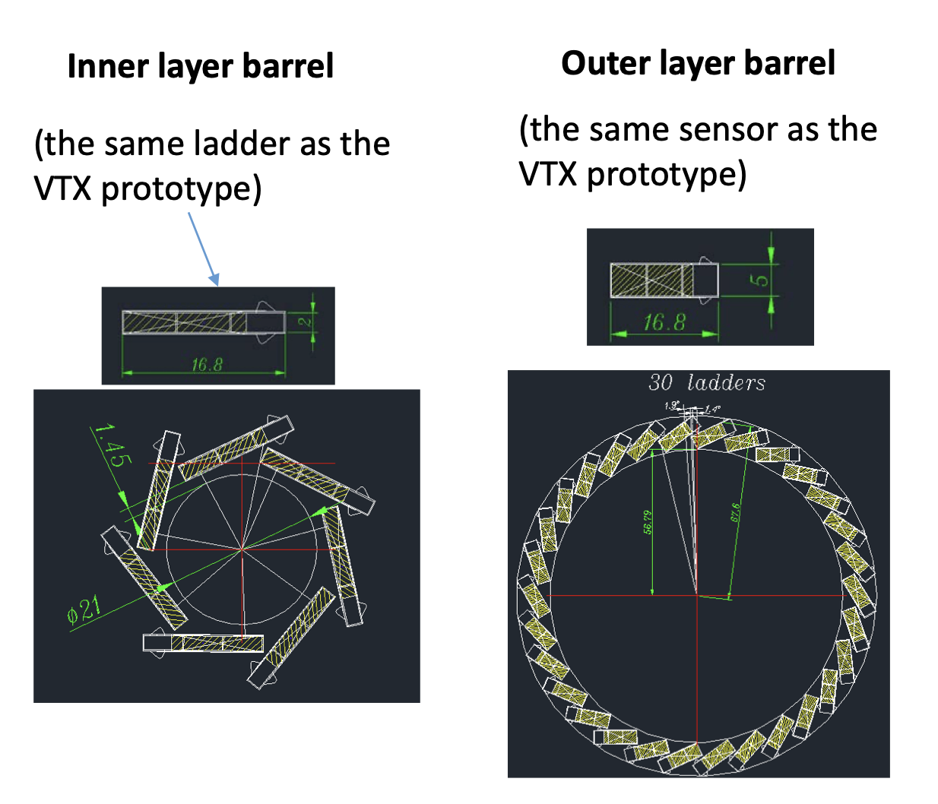
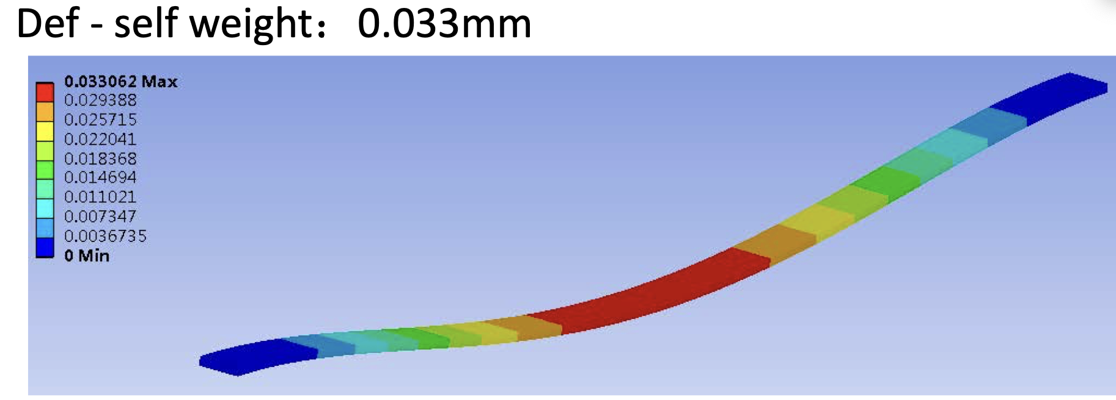
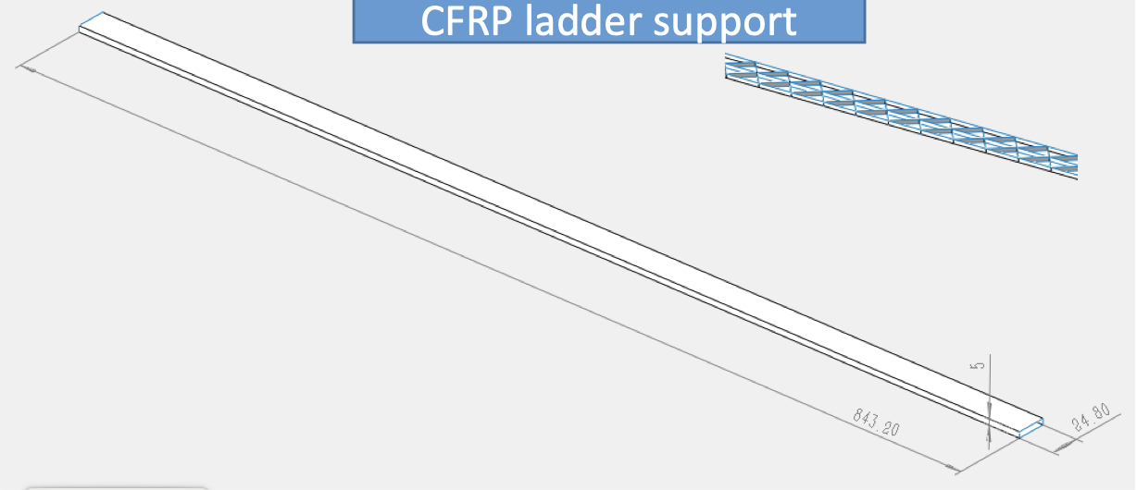
Feasibility study of long barrel (by Jinyu)

Slide 9
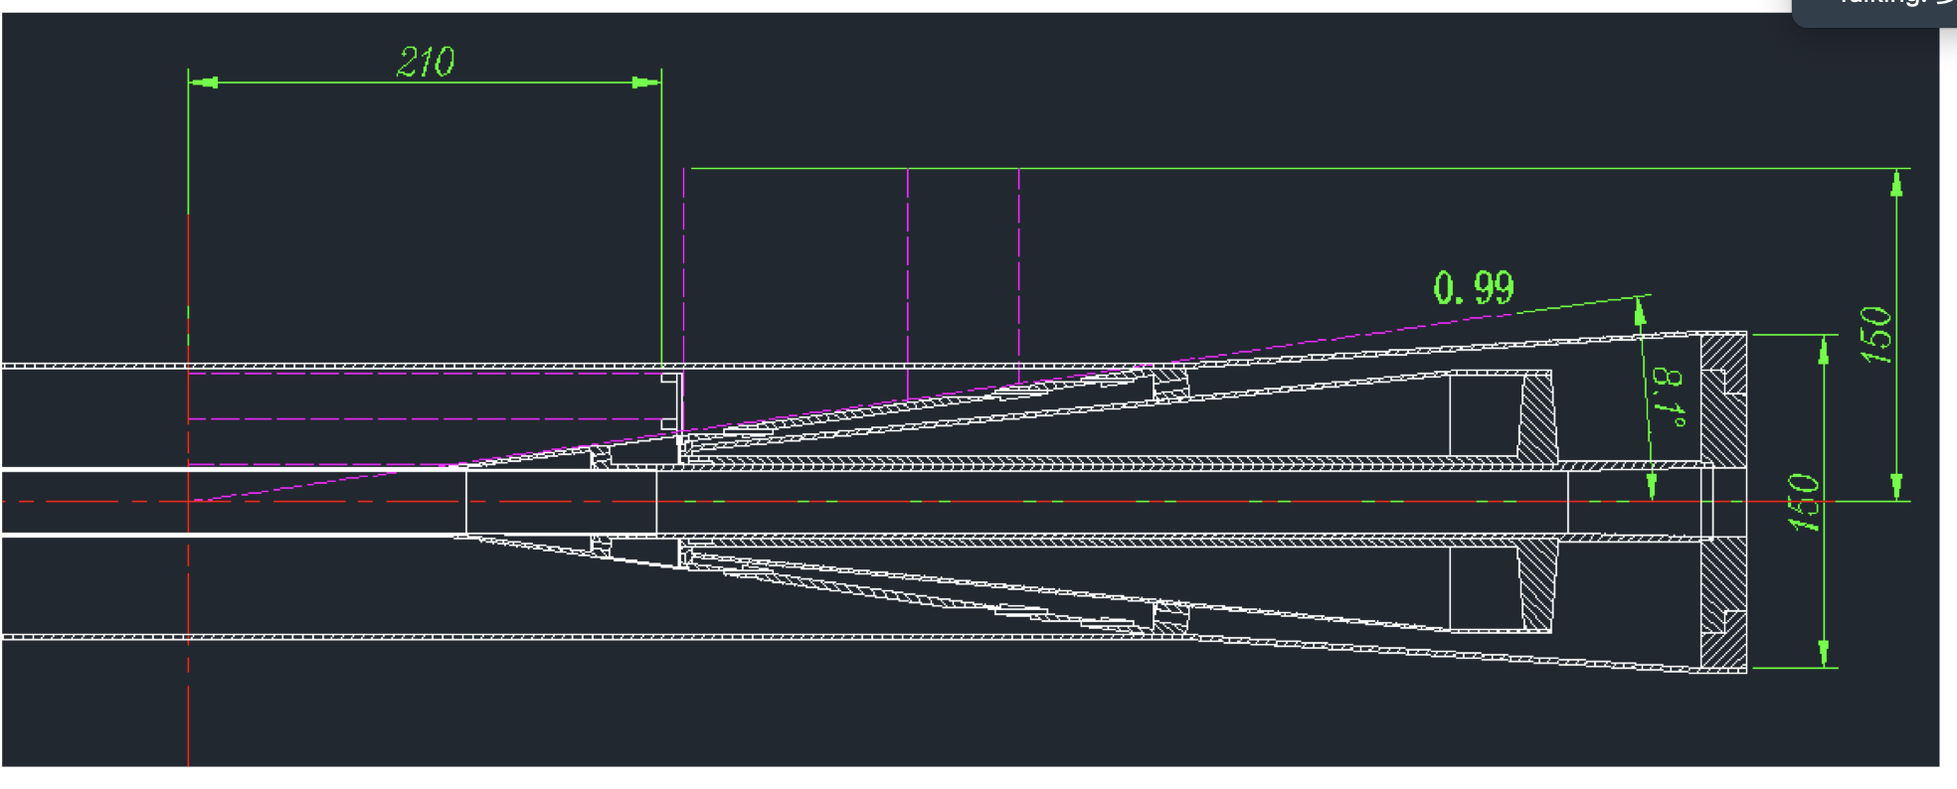
Cable and cooling for vertex detector
Cable
Air Cooling

Slide 10
Weekly meeting
Group Meeting every Thursday afternoon (2nd meeting last Thursday)
https://indico.ihep.ac.cn/event/21543/
From last meeting, Discussion about the choice of technology
Discussion with L3 Stitching (Mingyi) and SOI (Yunpeng)
Agree to focus CMOS pixel for reference TDR baseline

Slide 11
Key parameters
Single-point spatial resolution (now and in the next 5 years)
Time stamp precision requirement (to be discussed with Shengsun Sun)
Material budget
Cost estimation
Occupancy
Max data rate that can be handled by this technology (now, and in the next 5 years)
Radiation hardness (now, and in the next 5 years)
Power dissipation (now, and in the next 5 years)
Expected Technology availability in the future
Technology Readiness

