Slide 1
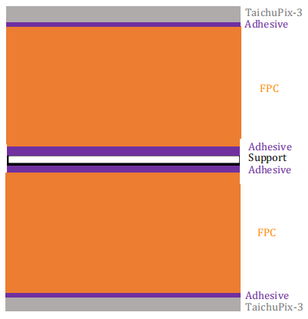
Old Ladder material
150um Si
100um Acrylicglue
12.5um Kapton
20um Acrylicglue
16um G4_Al
13um Kapton
12.5um Acrylicglue
12um G4_Al
25um Kapton
12um G4_Al
12.5um Acrylicglue
13um Kapton
16um G4_Al
20um Acrylicglue
12.5um Kapton
100um Acrylicglue
250um CFPR
100um Acrylicglue
12.5um Kapton
20um Acrylicglue
16um G4_Al
13um Kapton
12.5um Acrylicglue
12um G4_Al
25um Kapton
12um G4_Al
12.5um Acrylicglue
13um Kapton
16um G4_Al
20um Acrylicglue
12.5um Kapton
100um Acrylicglue
150um Si

Slide 2
New Ladder material
50um Si
12.5um Acrylicglue
12.5um Kapton
12.5um Acrylicglue
16um G4_Al (50%)
13um Kapton
12.5um Acrylicglue
12um G4_Al (100%)
25um Kapton
12um G4_Al (100%)
12.5um Acrylicglue
13um Kapton
16um G4_Al (50%)
12.5um Acrylicglue
12.5um Kapton
12.5um Acrylicglue
250um CFPR
12.5um Acrylicglue
12.5um Kapton
12.5um Acrylicglue
16um G4_Al (50%)
13um Kapton
12.5um Acrylicglue
12um G4_Al (100%)
25um Kapton
12um G4_Al (100%)
12.5um Acrylicglue
13um Kapton
16um G4_Al (50%)
12.5um Acrylicglue
12.5um Kapton
12.5um Acrylicglue
50um Si

