Slide 1
CEPCSW ------ VXT section
Tianyuan Zhang
2024.03.014

Slide 2
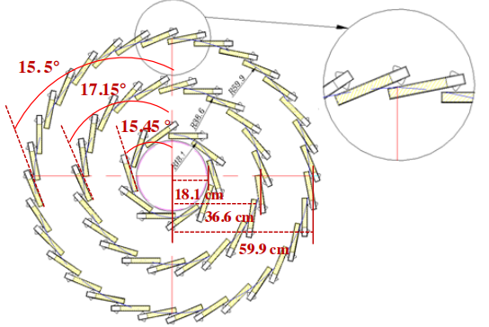
Configuration of VTX & Ladder support

Slide 3
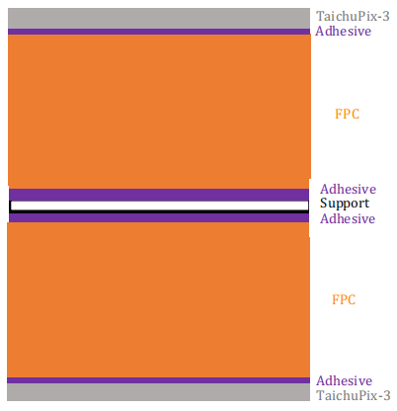
50um Si
12.5um Acrylicglue
12.5um Kapton
12.5um Acrylicglue
8um G4_Al
13um Kapton
12.5um Acrylicglue
8um G4_Al
13um Kapton
12.5um Acrylicglue
12um G4_Al
25um Kapton
12um G4_Al
12.5um Acrylicglue
13um Kapton
8um G4_Al
12.5um Acrylicglue
13um Kapton
8um G4_Al
12.5um Acrylicglue
12.5um Kapton
12.5um Acrylicglue
250um CFPR
12.5um Acrylicglue
12.5um Kapton
12.5um Acrylicglue
8um G4_Al
13um Kapton
12.5um Acrylicglue
8um G4_Al
13um Kapton
12.5um Acrylicglue
12um G4_Al
25um Kapton
12um G4_Al
12.5um Acrylicglue
13um Kapton
8um G4_Al
12.5um Acrylicglue
13um Kapton
8um G4_Al
12.5um Acrylicglue
12.5um Kapton
12.5um Acrylicglue
50um Si
50um Si
12.5um Acrylicglue
12.5um Kapton
12.5um Acrylicglue
8um G4_Al
13um Kapton
12.5um Acrylicglue
12um G4_Al
25um Kapton
12um G4_Al
12.5um Acrylicglue
13um Kapton
8um G4_Al
12.5um Acrylicglue
12.5um Kapton
12.5um Acrylicglue
250um CFPR
12.5um Acrylicglue
12.5um Kapton
12.5um Acrylicglue
8um G4_Al
13um Kapton
12.5um Acrylicglue
12um G4_Al
25um Kapton
12um G4_Al
12.5um Acrylicglue
13um Kapton
8um G4_Al
12.5um Acrylicglue
12.5um Kapton
12.5um Acrylicglue
50um Si
layer1
layer2、3 (for each ladder with more than 10 sensors)

Slide 4
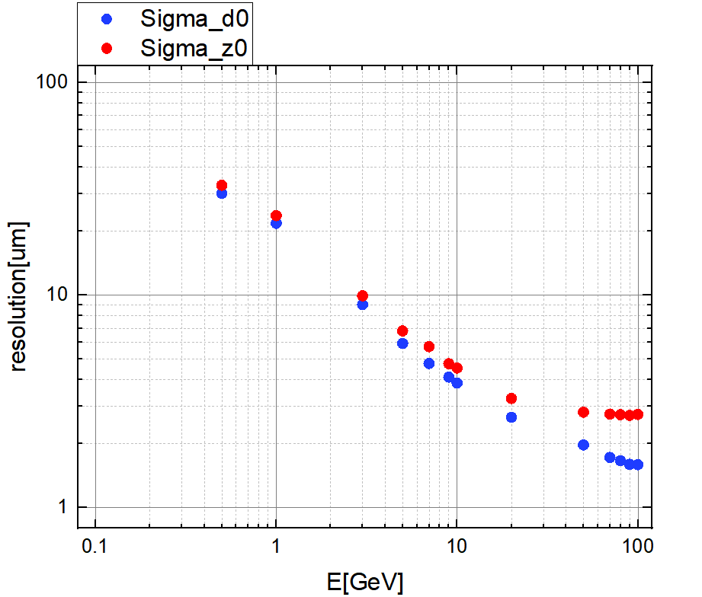
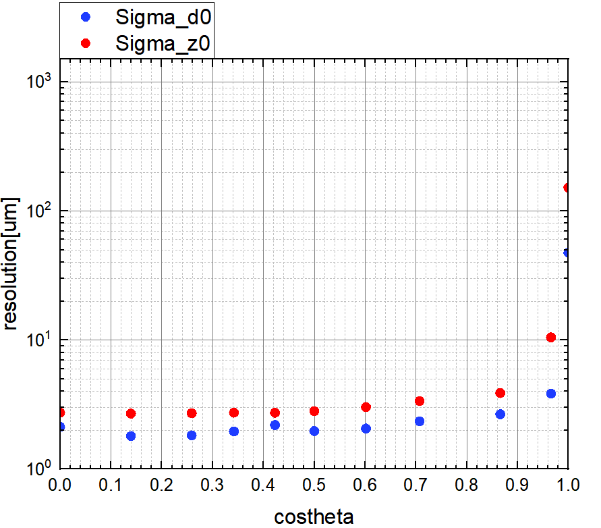
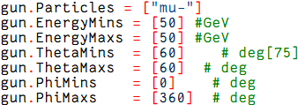
When costheta = 0.5, particles_energy are 0.5, 1, 3, 5, 7, 9, 10, 20, 50, 70, 80, 90 and 100, respectively.
Costheta values correspond sequentially
theta = 90°, 82°, 75°, 65°, 60°, 53°, 45°, 30°, 15°, 8.11°, when particles energy = 50GeV;
When the muon energy is greater than 5GeV, the resolution is less than 5 um.

Slide 5
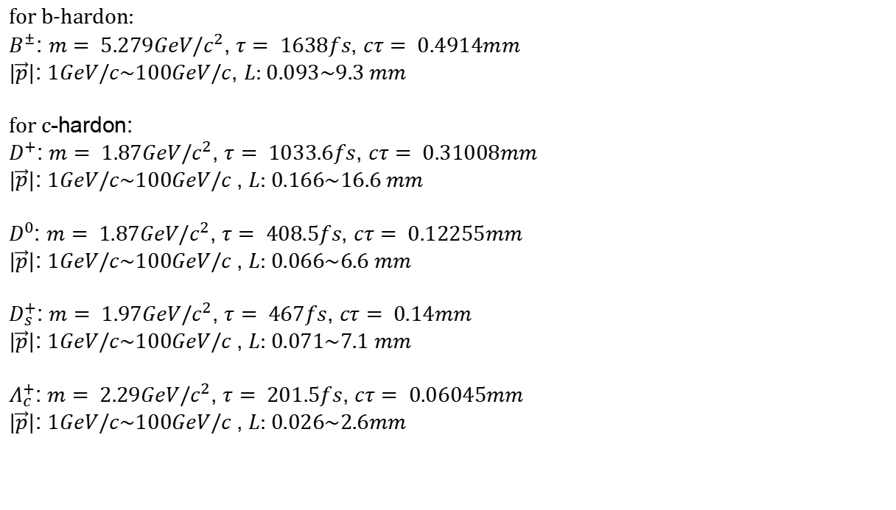
$$L= γτβc=cτ \frac{|\vec{p}|}{mc}$$
for b-hardon:
$B^{±}$: $m= 5.279GeV/c^{2}$, $τ= 1638fs$, $cτ= 0.4914mm$
$|\vec{p}|$: $1GeV/c\sim 100GeV/c$, $L$: $0.093\sim 9.3 mm$
for c-hardon:
$D^{+}$: $m= 1.87GeV/c^{2}$, $τ= 1033.6fs$, $cτ= 0.31008mm$
$|\vec{p}|$: $1GeV/c\sim 100GeV/c$ , $L$: $0.166\sim 16.6 mm$
$D^{0}$: $m= 1.87GeV/c^{2}$, $τ= 408.5fs$, $cτ= 0.12255mm$
$|\vec{p}|$: $1GeV/c\sim 100GeV/c$ , $L$: $0.066\sim 6.6 mm$
$D_{s}^{+}$: $m= 1.97GeV/c^{2}$, $τ= 467fs$, $cτ= 0.14mm$
$|\vec{p}|$: $1GeV/c\sim 100GeV/c$ , $L$: $0.071\sim 7.1 mm$
$Λ_{c}^{+}$: $m= 2.29GeV/c^{2}$, $τ= 201.5fs$, $cτ= 0.06045mm$
$|\vec{p}|$: $1GeV/c\sim 100GeV/c$ , $L$: $0.026\sim 2.6mm$

