Slide 1
2401.05911
Dian-Wei Wang
2024.03.14

Slide 2
References
2402.15408
2303.18216
2401.05911

Slide 3
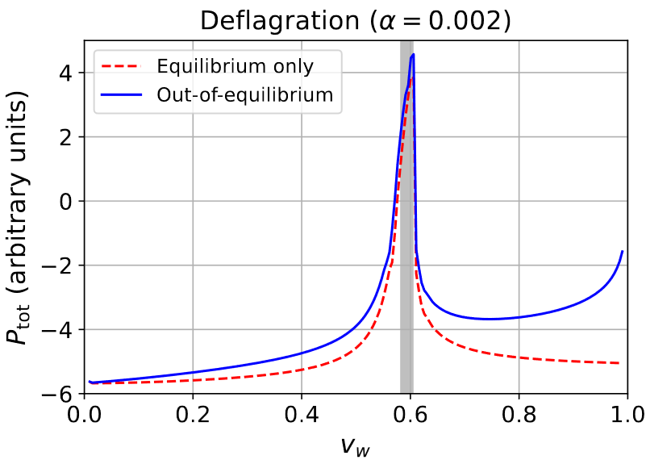
Matching method
Basic idea
driving force
friction force
2204.13120
Cline, et al.
Runaway criterion:
$⇒$ runaway
Jouguet velocity
LTE: Local Thermal Equilibrium

Slide 4
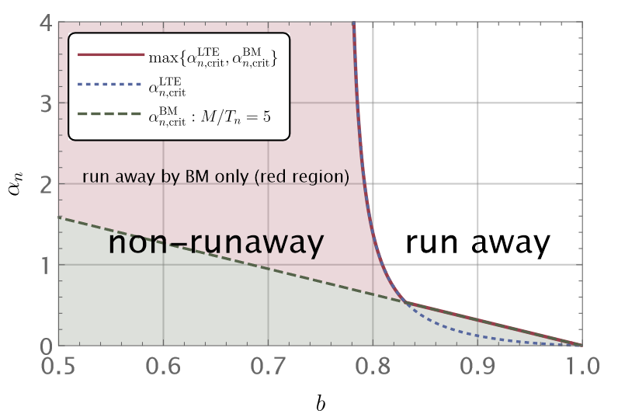
Matching method
Hydrodynamics – matching condition
BM: Bodeker and Moore
[1703.08215]
$b$ is the ratio of effective dof
between two phases

Slide 5
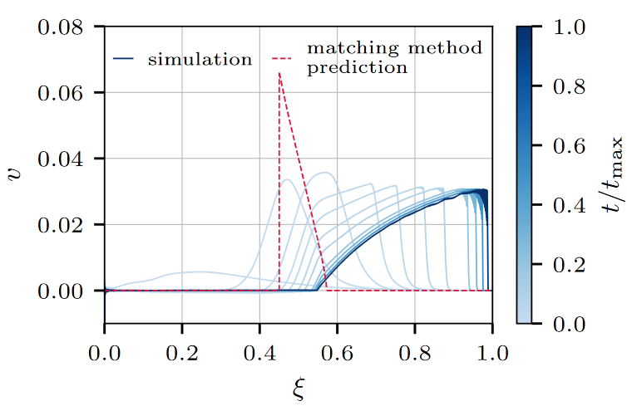
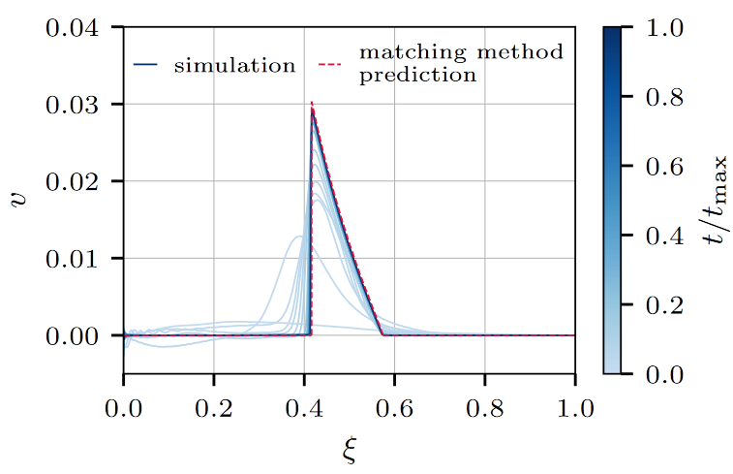
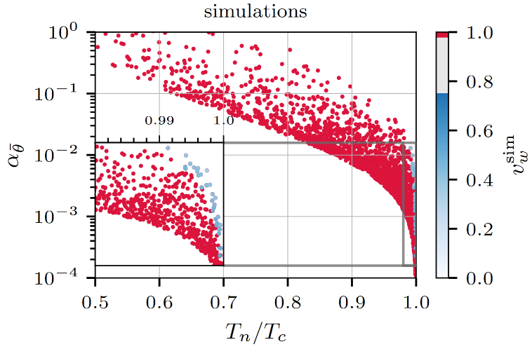
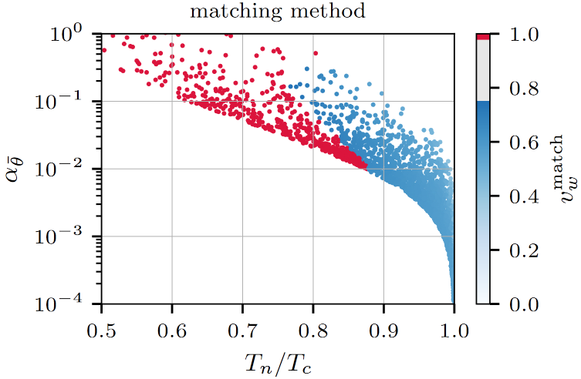
Numerical result
2402.15408

Slide 6
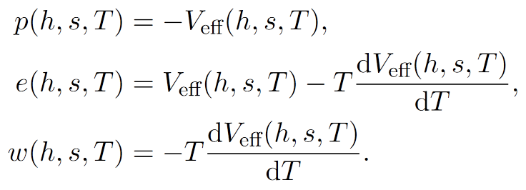
Numerical result
2402.15408
SM + singlet
equations
Something is missing!
2303.18216

Slide 7
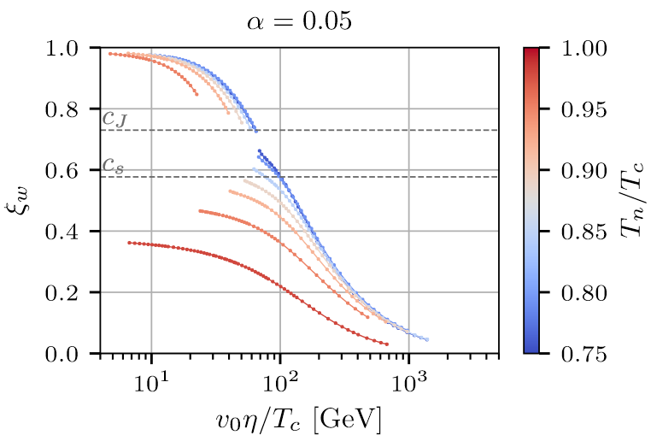
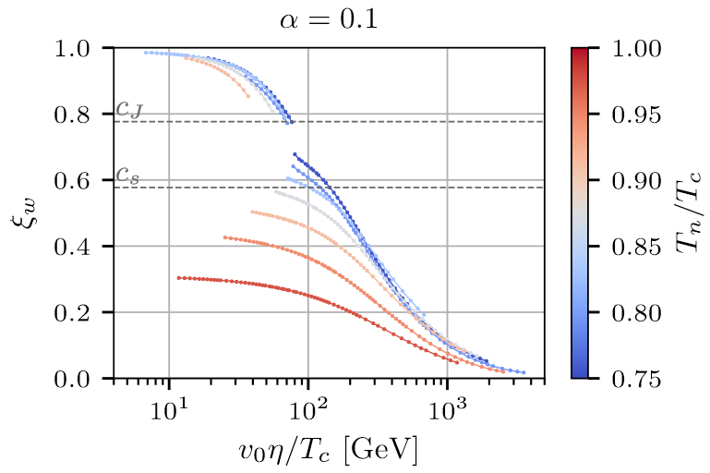
Out-of-equilibrium effect
2303.18216

Slide 8
Numerical result
2402.15408

Slide 9
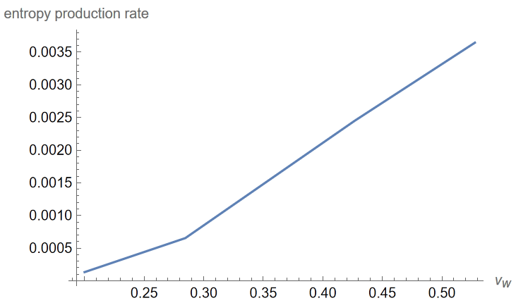
Comparison with my result
Entropy production rate
Calculating $v_{w}$ using W-Y Ai’s method
I will check it later
$$su≡sγv \\ s_{+}u_{+}−s_{−}u_{−}≥0 \\ rate≡\frac{s_{−}u_{−}−s_{+}u_{+}}{s_{+}u_{+}}≃{10}^{−3}$$
Is it small enough to say $Δsu≃0$?
But $α$ is also small, $0.03\sim 0.08$.

Slide 10
Thanks for your listening!
Dian-Wei Wang
2024.03.14

