Slide 1
Progress in last week of Elec-TDAQ
Thursday link：https://indico.ihep.ac.cn/event/21884/
Discussed with LGAD-TOF & Si Strip, preliminarily defined the readout strategy of the SET
A general clocking fanout architecture also defined
Preliminary background R&D of powering discussed
Discussions with sub-dets
With Si Pixel Tracker
Data rate from the physics event calculated, yet the background rate needs to be considered especially for the innermost layer
With ECAL
Requirement on energy measurement accuracy needs to be further discussed
A preliminary module level readout scheme proposed, will be further discussed in Elec-TDAQ meeting
Constraint from mechanical needs to be further discussed

Slide 2
Preliminary readout strategy of TOF & Si Strip
TOF & Si Strip
Similar in Elec readout architecture
Different in module size & quantity

Slide 3
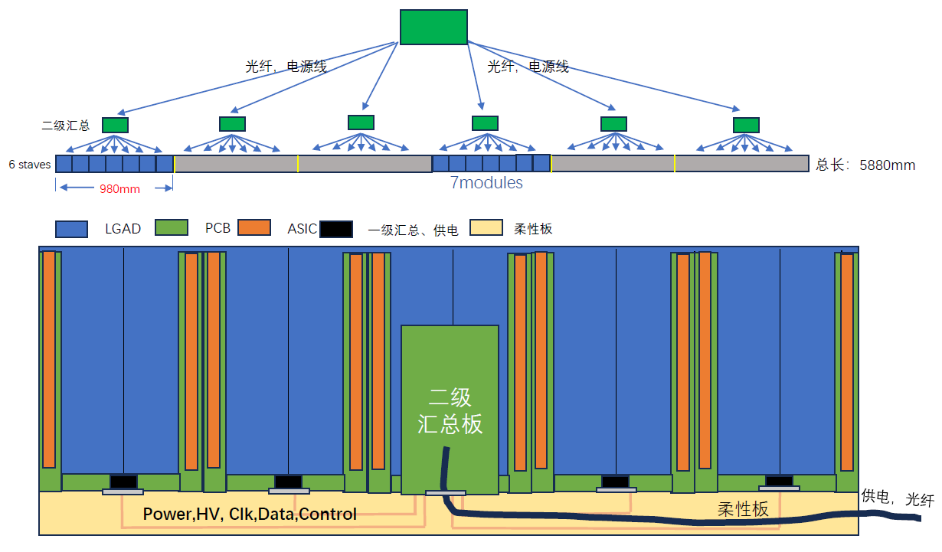
Preliminary readout strategy of TOF & Si Strip
A readout scheme by two level of data concentration
Module level
Stave level

Slide 4
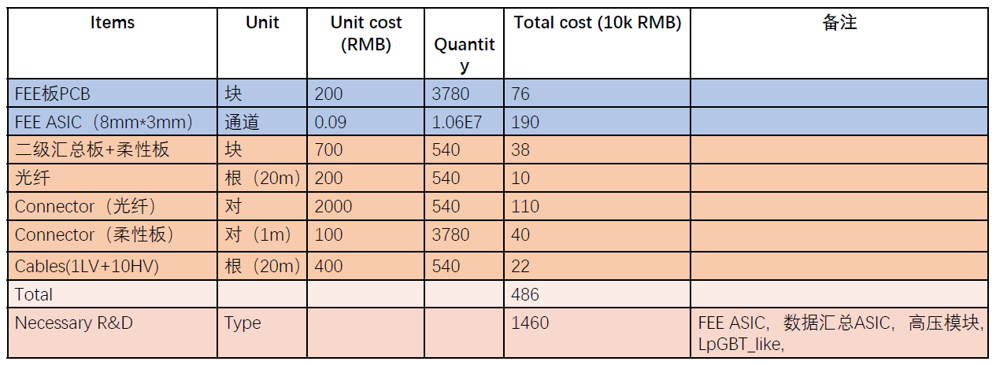
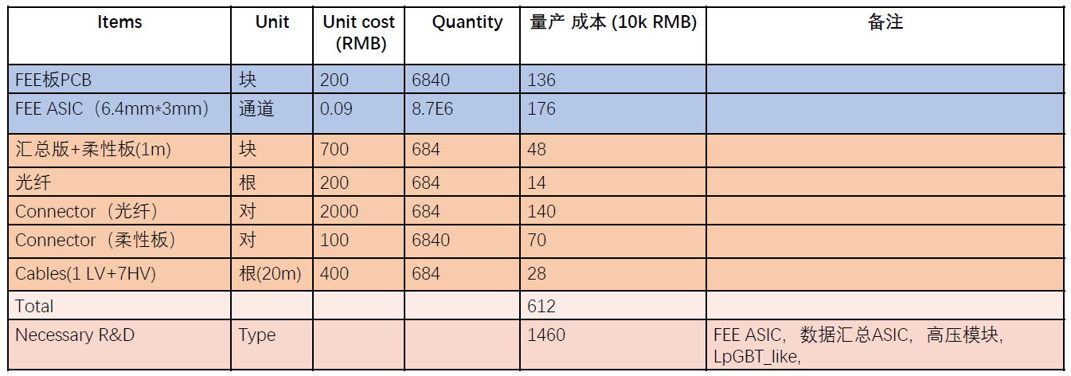
Rough cost estimation (only FEE，barrel)
TOF
Si Strip
The Si Strip module quantity is higher than TOF by the current layout, can be optimized if necessary

Slide 5
Recent plan
To determine the preliminary readout scheme of CAL
Summarize of the readout scheme of all sub-det
conclude the requirement for the common data link design
conclude the requirement for the common powering design
Determine the Elec-TDAQ strategy

Slide 6
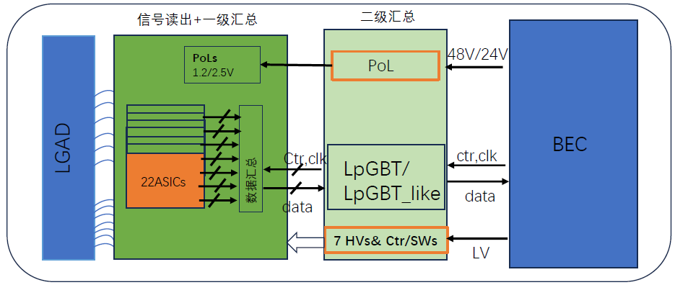
Diagram of each level of Elec

Slide 7
