Slide 1

中国科学院高能物理研究所
Institute of High Energy Physics, CAS
CEPC Detector Magnet Ref TDR
Physical Design Magnet_RT V1.1
Feipeng NING
2024.03

Slide 2
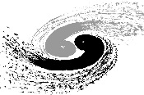
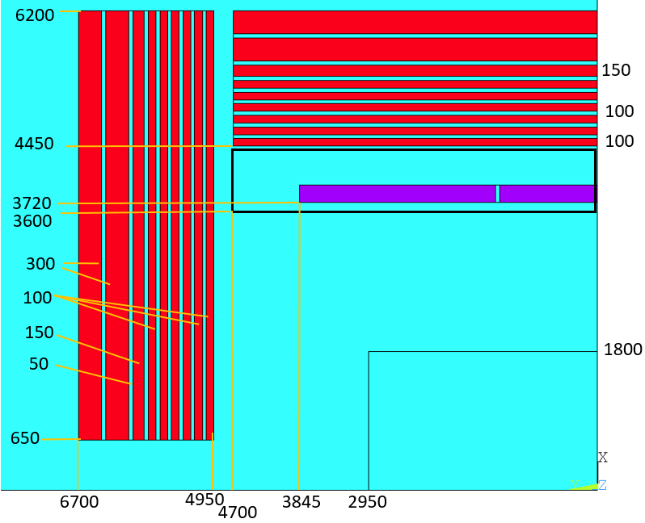
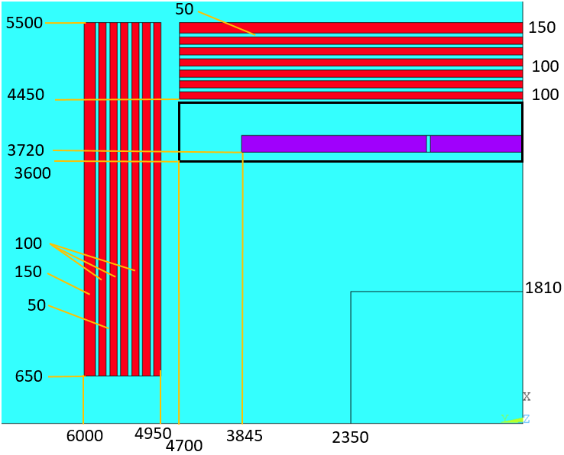
1. Magnet parameters
Magnet Interface：
Several parameters have changed:
Yoke mass (ton) | 3000 | 5000
Tracking Volume (Diameter*length) | 3.62*4.7 | 3.6*5.9
Size (Diameter*length) | 11*12 | 12.4*13.4

Slide 3
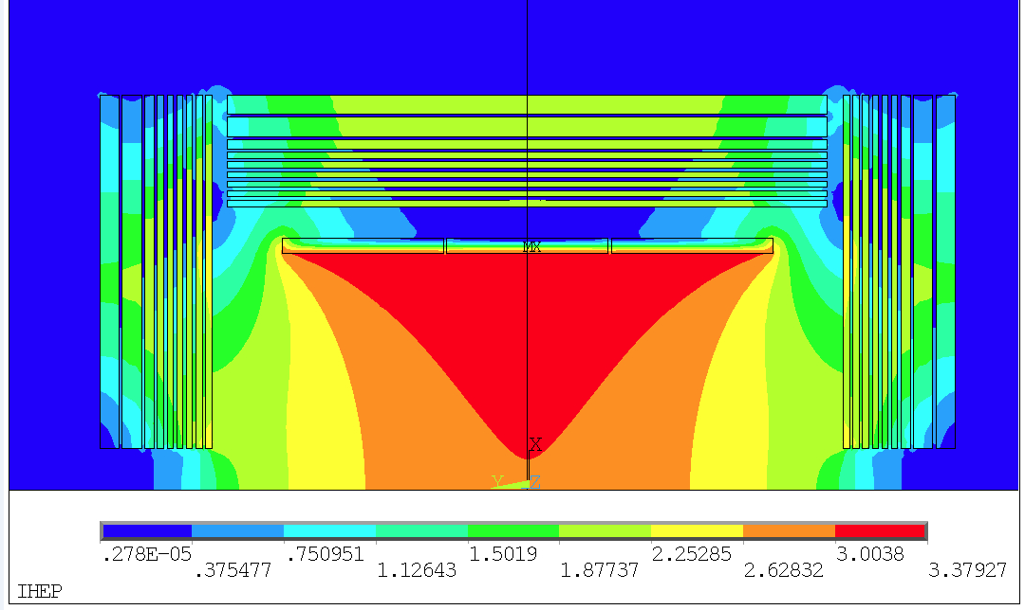
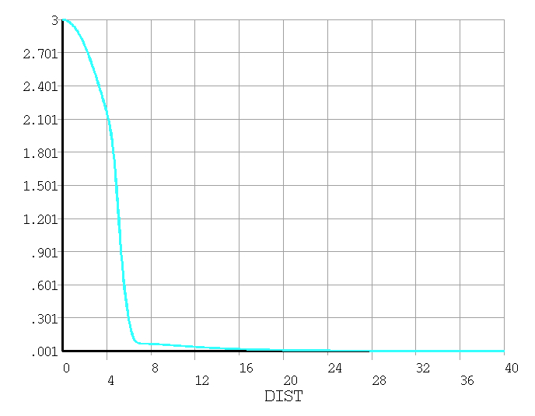
1. Magnet parameters
Magnetic field distribution:

Slide 4
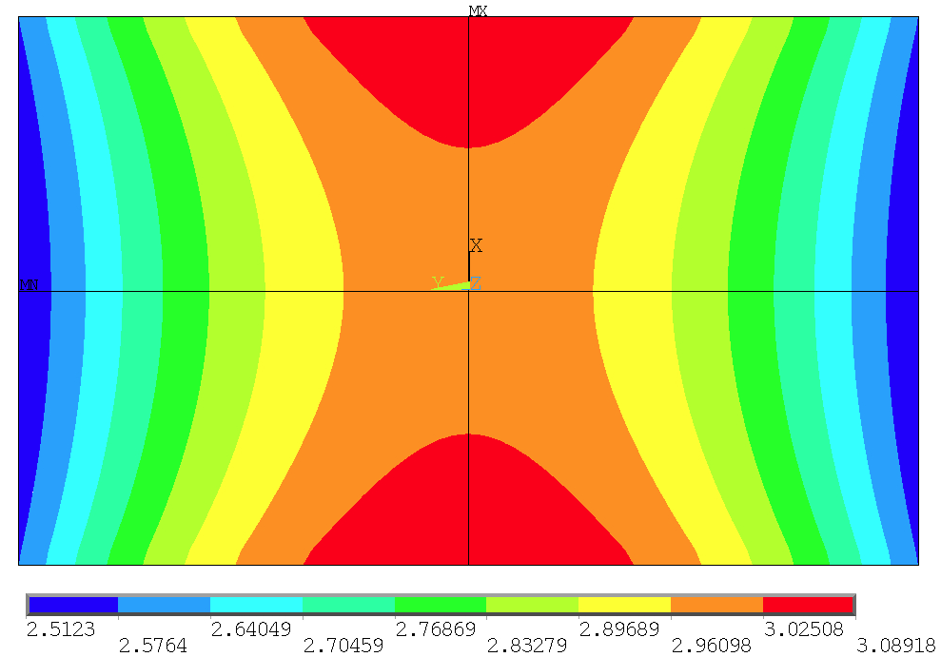

2. Physical design of the detector magnet
Magnetic field distribution of the Track Volume:
Tracking Volume
(diameter 3.62m, length 4.7m)
(diameter 3.6m, length 5.9m)
Bmax= 3.08918081
Bmin = 2.51229834
Bmax-Bmin= 0.5768824786
Peak-Peak non-uniformity:
$B_{p}=\frac{B_{max}−B_{min}}{B_{center}}$ = 19.2%
 | Peak-peak non uniformity
Ref TDR V1 | 14.6%
Ref TDR V1.1 | 19.2%

Slide 5
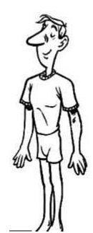
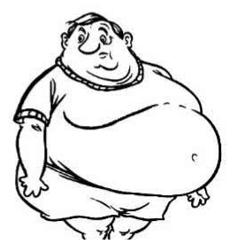
Physical design of the detector magnet
It’s very hard to optimize the uniformity of the Tracking volume.
Now
Ideal
Optimized target

Slide 6
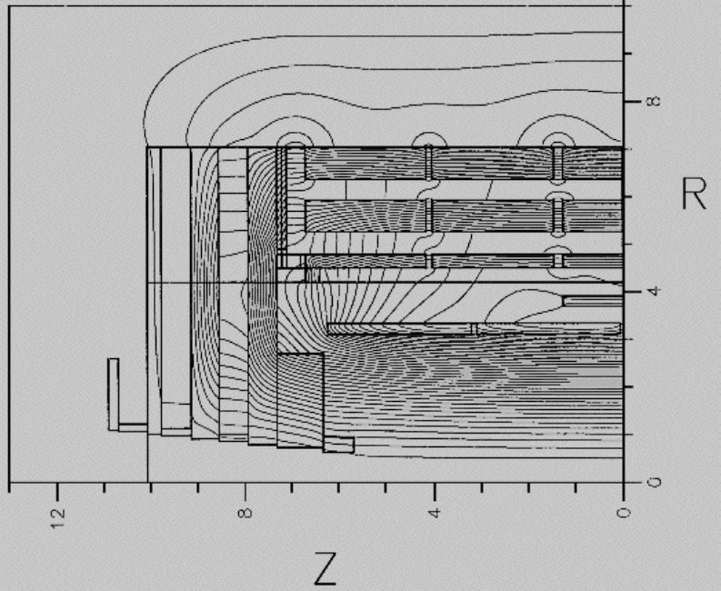
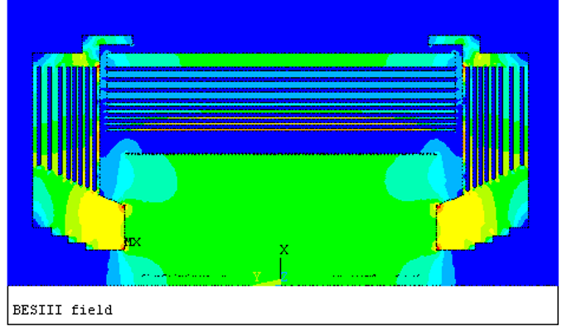

2. Physical design of the detector magnet
1. Add pole head:
CMS
BES III
2. Extend the coil and add compensation coils:
Compensation coil

Slide 7
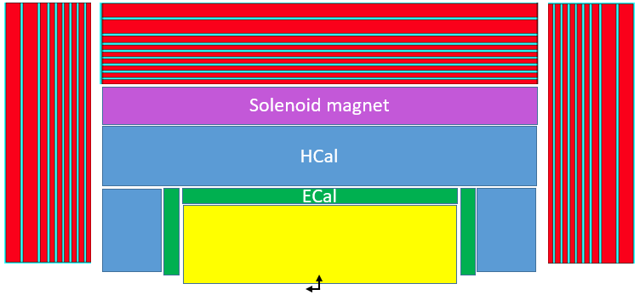
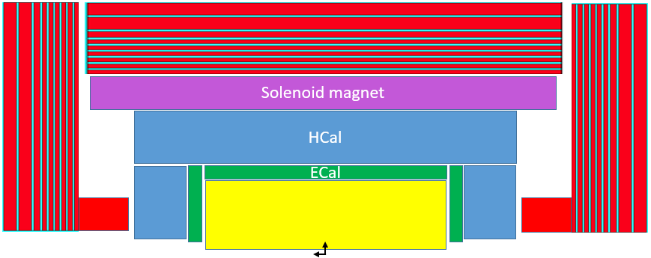
Optimization plan:
3. Yoke and stray field
Add pole head；
Extend the coil and add compensation coils:
The optimization objective:
  Peak-peak Non-uniformity less than 10% (Maybe 5%).
问题：
1，哪些区域需要均匀的磁场？
2，均匀度多少能满足要求？
Questions:
1, Which areas require a uniform magnetic field?
2, How much uniformity can meet the requirements?

Slide 8
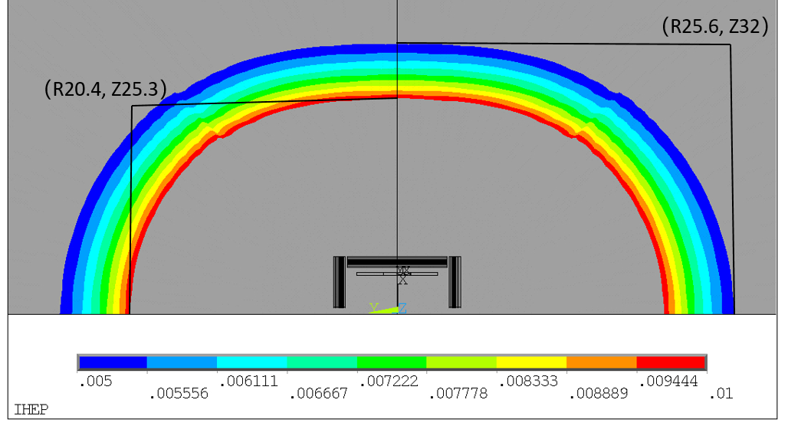
stray field:
3. Yoke and stray field
Stray field |  | Ref TDR V1 | Ref TDR V1.1
50 Gs | R direction | 25.6 m | 21.5 m
 | Z direction | 32 m | 26.6 m
100 Gs | R direction | 20.4 m | 17.1 m
 | Z direction | 25.3 m | 20.9 m
50 Gauss and 100 Gauss distribution

Slide 9
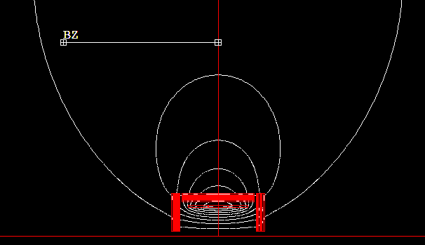
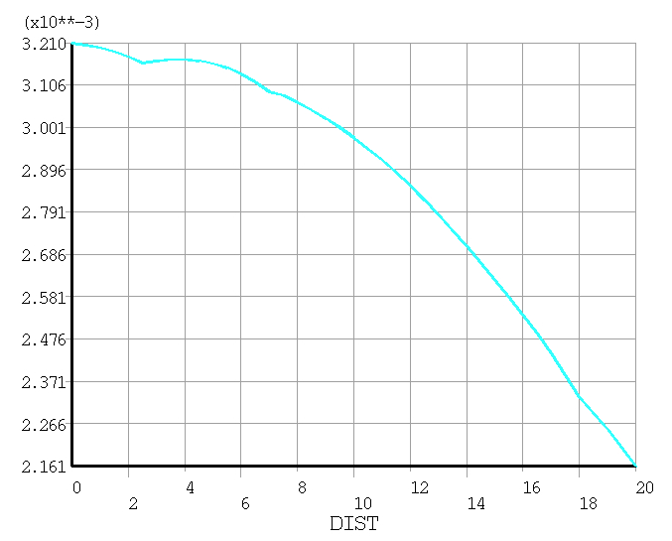
Magnetic field at the booster ring
Less than 50 Gauss
25m
From 32Gs to 21Gs
The detector stray field can reach the booster and influences the beam dynamics of booster.
The current study shows that the correction to the detector stray field seems possible at low field (less than 50 gauss) level by orbit correction.
Add correctors
Dou Wang, Yuan Zhang, Daheng Ji, Feipeng Ning, Impacts of Detector Stray Field on Booster, AP NOTE, ACC-AP-NOTE-2020-001, Receive Date (October 15, 2020)

Slide 10
Questions?
问题：
1，哪些区域需要均匀的磁场？
2，均匀度多少能满足要求？
3，磁场测量的精度是否会影响对均匀度的要求？
Questions:
1, Which areas require a uniform magnetic field?
2, How much uniformity can meet the requirements?
3，Will the accuracy of magnetic field mapping affect the requirement for uniformity?

