Slide 1
Tracker for reference detector TDR
WANG Meng 王萌
2024.3.19

Slide 2
status
working on layout optimization of Si inner tracker with fast simulation (LG)
TPC
readout module optimization, dN/dx simulation, hit density at inner radius, etc.
➔ Huirong’s talk
silicon pixel tracker
estimated data: < 1 Mbps/chip w/o including beam background
timing requirements (necessity, precision, and where) to be clarified
silicon microstrip tracker
beam background simulation
layout study
LGAD and TOF
number of modules, channels, etc
YXB: readout scheme and cost estimation for LGAD and Si strip.
Last meeting’s minutes at https://indico.ihep.ac.cn/event/21891

Slide 3
TPC vs DC: performance
 | unit | TPC, Higgs | TPC, Z | DC, Higgs | DC, Z
B-field | T | 3 | 2 | 3 | 2
Performance
material budget barrel | X0 | 1.20% |  | 1.14%
material budget endcap | X0 | 17% |  | 28%
Npoint of measurement/full-trk |  | 2300 | 2300 | 66 | 66
point resolution in rφ, max | μm | 100 | 400 | 100 | 100
point resolution in rz | μm | 100 -- 500 | 200 -- 800 | 2000 | 2000
momentum resolution: σ(pT)/pT = a·pT ⨁ b
a | 1/GeV | 1.8 → 1.2E-05 | 3.3 → 2.7E-05 | 2.1E-05 | 3.2E-05
b |  | 6.0E-04 | 9.0E-04 | 7.7E-04 | 1.2E-03
K/π separation power @ 20GeV |  | ≤ 3σ | ≤ 3σ | 3.1 σ | 3.1 σ
dE/dx or dN/dx resolution |  | ≤ 3.2% | ≤ 3.2% |  | 2.5--2.6%
hit rate, max |  |  |  |  | 70 kHz/cell
occupancy, max |  |  |  |  | 11%
note |  | pad 0.5x0.5 mm2, ch 2x3e7 |  | cell size 18x18mm2, 27.6 kCells

Slide 4
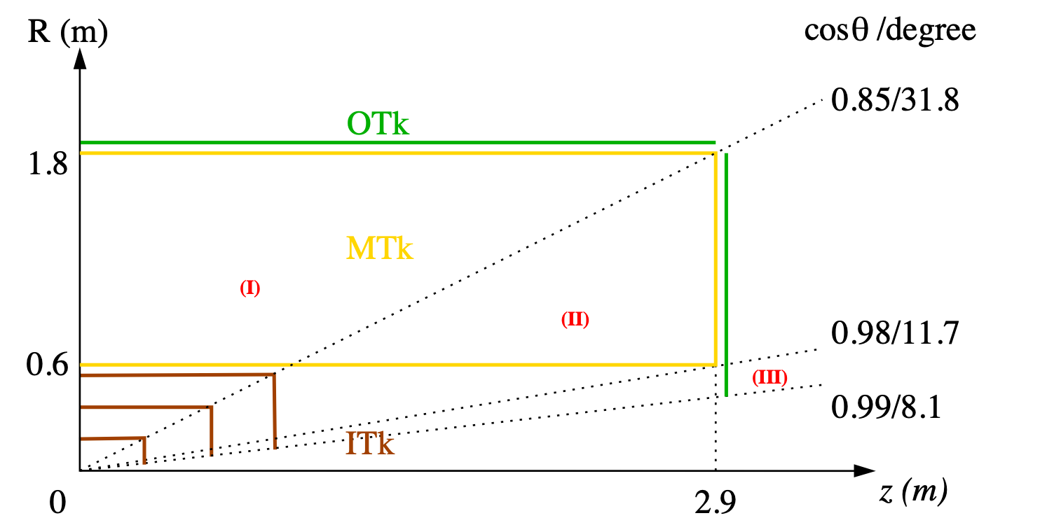
CEPC tracking system, draft
Three tracking regions
barrel, full Main + Si trackers
endcap, partial Main tracker
forward, Si tracker only

