Slide 1
The progress in theoretical and simulation work on the BBI
付泓瑾

Slide 2
一. 理论部分
1. 上次提到导出共振强度时把最外层的积分区间变成了
$〈…〉=\frac{1}{2π}\int_{0}^{2π}{dθ}→\frac{1}{Φ}\int_{−\frac{Φ}{2}}^{\frac{Φ}{2}}{dθ}$, 其中$Φ→+∞$
Kondratenko在计算整数共振时，也是
$\vec{w}∙{\vec{e}}^{∗}≅ν_{0}\frac{z_{s}^{′′}}{R}e^{iν_{0}(\tilde{Κ}−θ)}=\sum_{k}{w_{k}e^{−ikθ}}$
$⇒w_{k}=\frac{ν_{0}}{2πR}\int_{0}^{2π}{z^{′′}e^{iν_{0}\left(\tilde{K}−θ\right)}e^{ikθ}dθ}=\frac{ν_{0}}{2π}\int_{0}^{2π}{Κ_{x}(θ)F_{k}(θ)e^{ikθ}dθ}$

Slide 3
但实际上只有周期性函数，那样的三角级数才会严格收敛，对于准周期函数,系数需要在无穷大积分
对于从周期函数，展开系数$w_{k}$在有限区间或者无穷区间上积分都是一样的

Slide 4
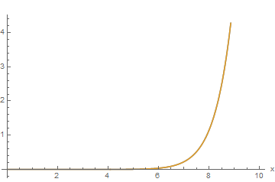
2.$|w_{k}|$的近似表达形式
Kondratenko在1974年文章中给出：
$w_{k}=\frac{Nr_{e}f_{z0}}{πγz_{0}}A\int_{0}^{\frac{a_{z}^{2}}{2z_{0}^{2}}}{dt}\frac{2z_{0}e^{−t}}{\sqrt{a_{z}^{2}+2(x_{0}^{2}−z_{0}^{2})t}}[I_{\frac{k_{z}−1}{2}}\left(t\right)−I_{\frac{k_{z}+1}{2}}\left(t\right)]$
并且当$m≫1$时，近似有$I_{m}≈\frac{\exp\left(\sqrt{m^{2}+t^{2}}\right)}{\sqrt{2π}{\left(m^{2}+t^{2}\right)}^{\frac{1}{4}}}{[{\left(1+\frac{m^{2}}{t^{2}}\right)}^{\frac{1}{2}}−\frac{m}{t}]}^{m}$
对于m=10， 修正贝塞尔函数和近似的比较如下：

Slide 5
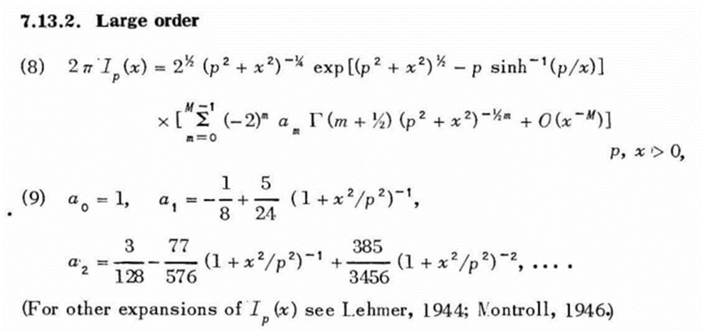
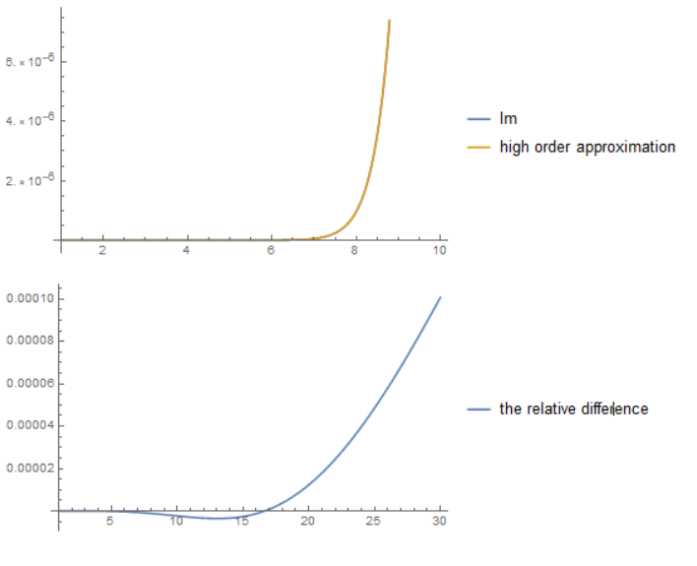
为导出Kondratenko的形式，后面级数项直接取零阶, 利用$Γ\left(\frac{1}{2}\right)=\sqrt{π}$,
$I_{P}\left(x\right)=\frac{1}{\sqrt{2π}}{(p^{2}+x^{2})}^{−\frac{1}{4}}e^{\sqrt{p^{2}+x^{2}}}e^{−p∗sinh^{−1}(\frac{p}{x})}$
再取近似$e^{−p∗sinh^{−1}(\frac{p}{x})}≈{(\sqrt{1+\frac{p^{2}}{x^{2}}}−\frac{p}{x})}^{p}$,则有
$I_{P}\left(x\right)=\frac{1}{\sqrt{2π}}{(p^{2}+x^{2})}^{−\frac{1}{4}}e^{\sqrt{p^{2}+x^{2}}}{(\sqrt{1+\frac{p^{2}}{x^{2}}}−\frac{p}{x})}^{p}$

Slide 6
为方便讨论记$P\left(m,t\right)=\frac{\exp\left(\sqrt{m^{2}+t^{2}}\right)}{\sqrt{2π}{\left(m^{2}+t^{2}\right)}^{\frac{1}{4}}}$, $B\left(m,t\right)={[{\left(1+\frac{m^{2}}{t^{2}}\right)}^{\frac{1}{2}}−\frac{m}{t}]}^{m}$
$I_{\frac{k_{z}−1}{2}}\left(t\right)−I_{\frac{k_{z}+1}{2}}\left(t\right)≈−\frac{∂I(m,t)}{∂m}|_{m=\frac{k_{z}}{2}}$
$≈−P\left(\frac{k_{z}}{2},t\right)∙∂_{m}B|_{m=\frac{k_{z}}{2}}−B(\frac{k_{z}}{2},t)∙∂_{m}P|_{m=\frac{k_{z}}{2}}$
$I_{\frac{k_{z}−1}{2}}\left(t\right)−I_{\frac{k_{z}+1}{2}}\left(t\right)≈\frac{\exp\left(\sqrt{{\left(\frac{k_{z}}{2}\right)}^{2}+t^{2}}\right)}{\sqrt{2π}{\left({\left(\frac{k_{z}}{2}\right)}^{2}+t^{2}\right)}^{\frac{1}{4}}}{\left[{\left(1+\frac{{\left(\frac{k_{z}}{2}\right)}^{2}}{t^{2}}\right)}^{\frac{1}{2}}−\frac{\frac{k_{z}}{2}}{t}\right]}^{\frac{k_{z}}{2}}\left[−{\left(1+\frac{{\left(\frac{k_{z}}{2}\right)}^{2}}{t^{2}}\right)}^{\frac{1}{2}}+\frac{\frac{k_{z}}{2}}{t}+\frac{k_{z}}{2}\right]−$
$\frac{\exp\left(\sqrt{{\left(\frac{k_{z}}{2}\right)}^{2}+t^{2}}\right)}{\sqrt{2π}{\left({\left(\frac{k_{z}}{2}\right)}^{2}+t^{2}\right)}^{\frac{1}{4}}}{\left[{\left(1+\frac{{\left(\frac{k_{z}}{2}\right)}^{2}}{t^{2}}\right)}^{\frac{1}{2}}−\frac{\frac{k_{z}}{2}}{t}\right]}^{\frac{k_{z}}{2}}$ $≈\frac{\exp\left(\sqrt{{\left(\frac{k_{z}}{2}\right)}^{2}+t^{2}}\right)}{\sqrt{2π}{\left({\left(\frac{k_{z}}{2}\right)}^{2}+t^{2}\right)}^{\frac{1}{4}}}{\left[{\left(1+\frac{{(\frac{k_{z}}{2})}^{2}}{t^{2}}\right)}^{\frac{1}{2}}−\frac{\frac{k_{z}}{2}}{t}\right]}^{\frac{k_{z}}{2}}\frac{k_{z}}{2}$

Slide 7
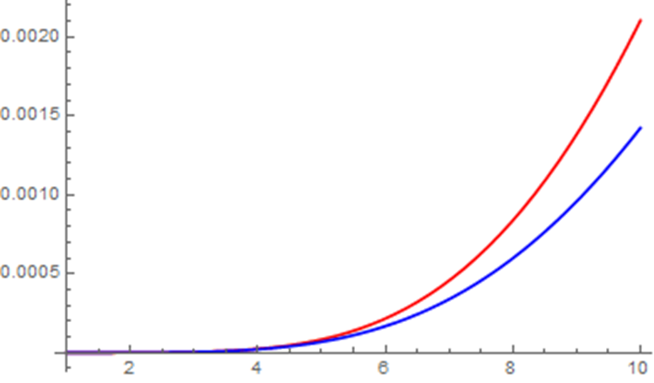
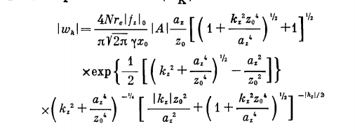
易知$t→0$时，$I_{m}→0$，那么作为积分的估计，取
$w_{k}≈\frac{Nr_{e}f_{z0}}{πγz_{0}}A\frac{a_{z}^{2}}{2z_{0}^{2}}\frac{2z_{0}e^{−\frac{a_{z}^{2}}{2z_{0}^{2}}}}{\sqrt{a_{z}^{2}+2(x_{0}^{2}−z_{0}^{2})\frac{a_{z}^{2}}{2z_{0}^{2}}}}\frac{\exp\left(\sqrt{{\left(\frac{k_{z}}{2}\right)}^{2}+t^{2}}\right)}{\sqrt{2π}{\left({\left(\frac{k_{z}}{2}\right)}^{2}+t^{2}\right)}^{\frac{1}{4}}}{\left[{\left(1+\frac{{(\frac{k_{z}}{2})}^{2}}{t^{2}}\right)}^{\frac{1}{2}}−\frac{\frac{k_{z}}{2}}{t}\right]}^{\frac{k_{z}}{2}}\frac{k_{z}}{2}$
$=\frac{Nr_{e}f_{z0}}{2π\sqrt{π}γz_{0}}A\frac{a_{z}}{x_{0}}k_{z}exp⁡[\frac{1}{2}(\sqrt{k_{z}^{2}+\frac{a_{z}^{4}}{z_{0}^{4}}}−\frac{a_{z}^{2}}{z_{0}^{2}})]{\left(k_{z}^{2}+\frac{a_{z}^{4}}{z_{0}^{4}}\right)}^{−\frac{1}{4}}{\left[{\left(1+\frac{k_{z}^{2}z_{0}^{4}}{a_{z}^{4}}\right)}^{\frac{1}{2}}−\frac{k_{z}z_{0}^{2}}{a_{z}^{2}}\right]}^{\frac{k_{z}}{2}}$
Kondratenko给出的结果

Slide 8
二.模拟计算
1. 发射度跟踪
目前发现Bmad ltt结果中, 强束粒子数没有改变垂直发射度，只改变了水平发射度。SAD脚本中两个发射度都有变化

Slide 9
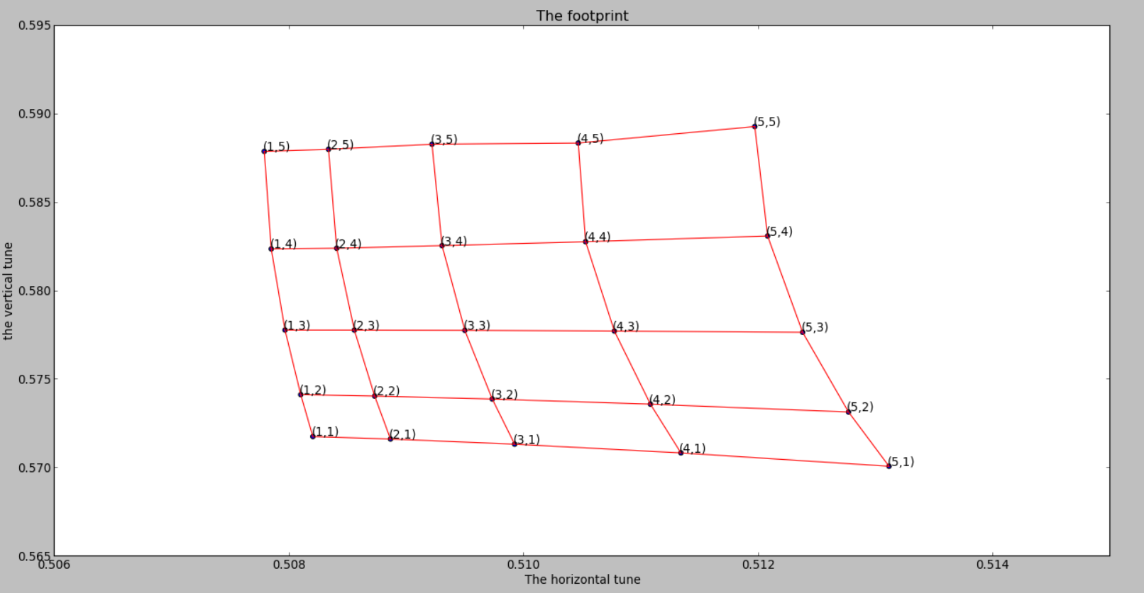
2. 不同幅值的粒子的footprint绘制
lattice 设置:无垂直二极铁的lattice增加vbend生成的SAD文件，再转成Bmad文件，关闭同步辐射
跟踪不同初始x，y坐标（以基值倍数表示）的粒子1000圈，FMA方法计算tune, 初始坐标基值：x0=0.001, y0=0.0001
2.1 无BB元件的情况
$$ν_{x}$$
$$ν_{y}$$
SAD脚本的结果

Slide 10
$$ν_{x}$$
$$ν_{y}$$

Slide 11
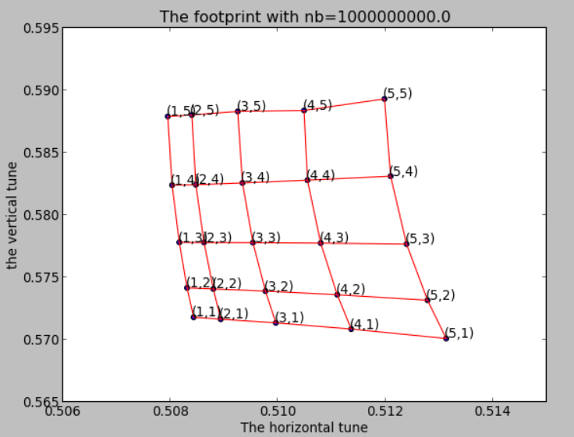
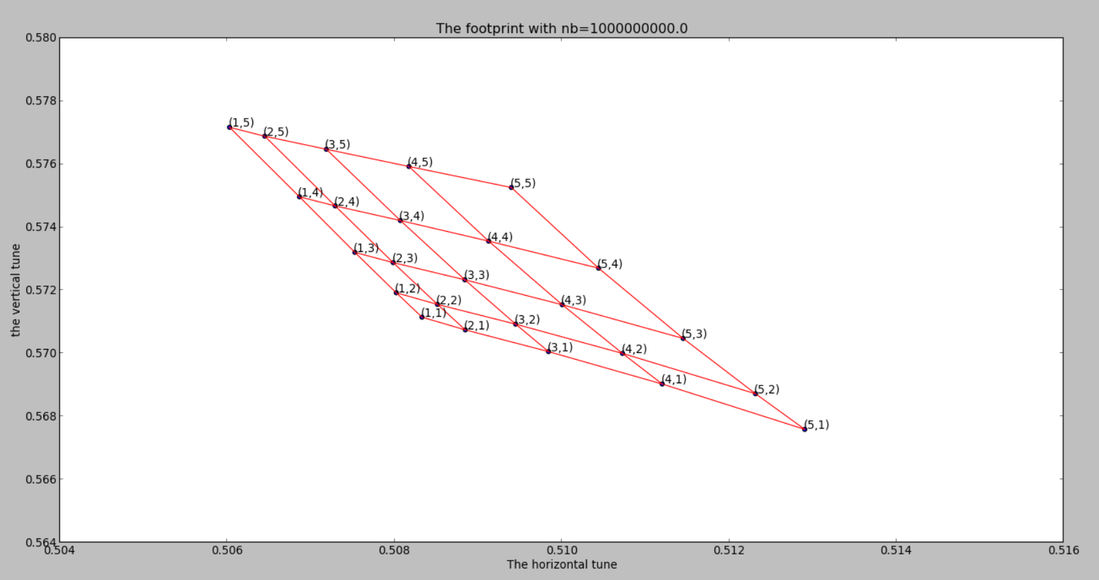
2.2 加入BB元件
（1）nb=1.0e9
Bmad ltt跟踪结果
SAD脚本跟踪结果

Slide 12
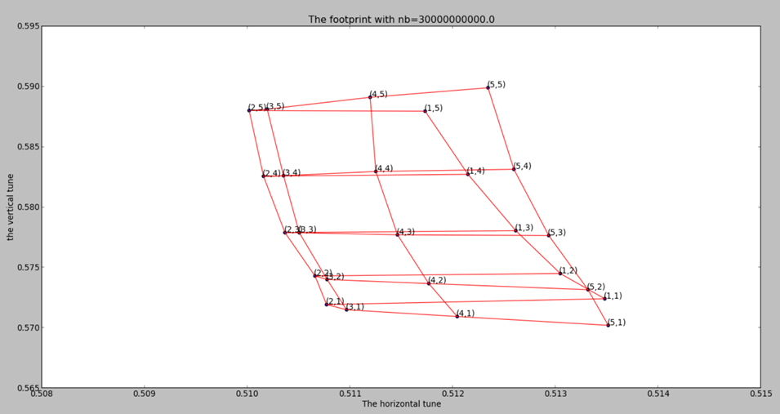
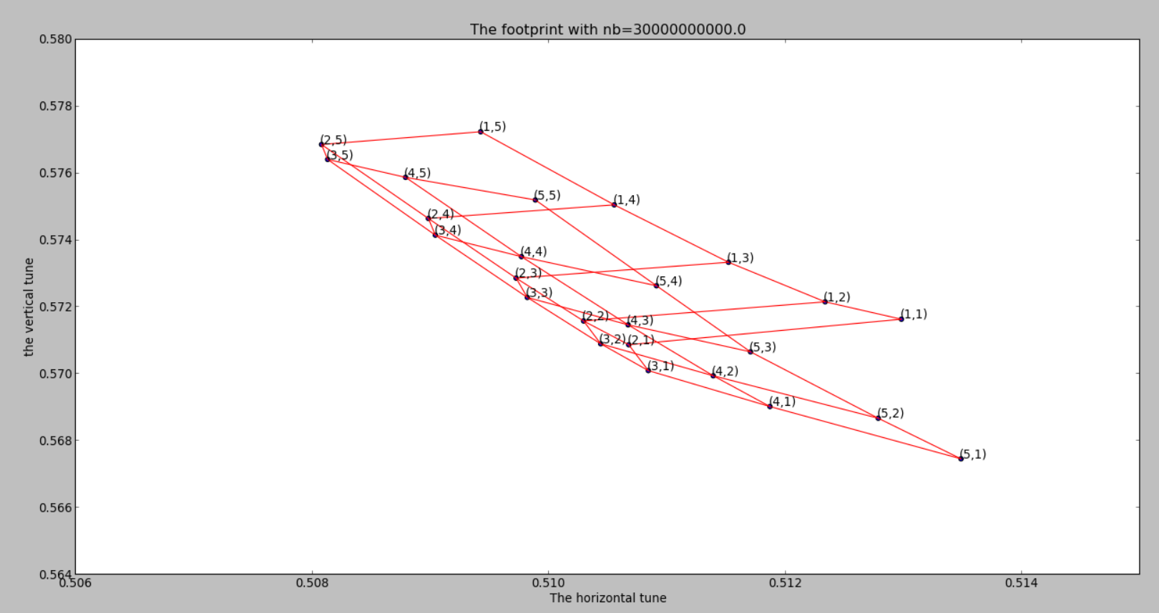
(2) 增加强束粒子数
SAD脚本跟踪结果
Bmad ltt跟踪结果

