Slide 1
Plastic scintillator ECAL and HCAL
Yunlong Zhang
University of Science and Technology of China

Slide 2
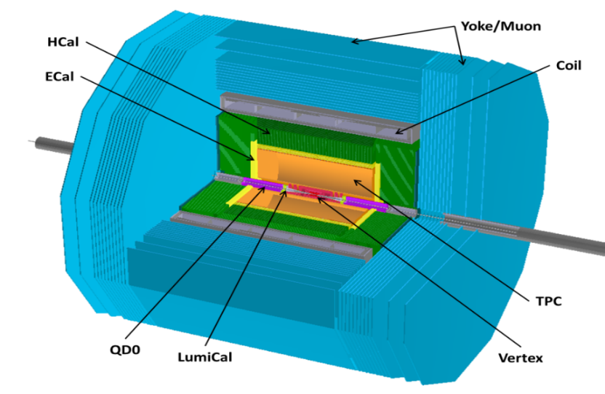
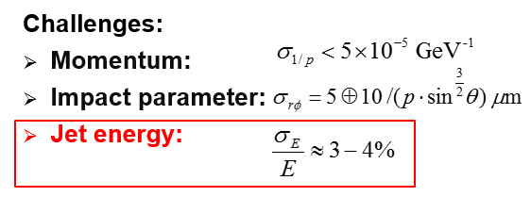
Requirements of CEPC Calorimeter
ILD-like detector with additional considerations.
The Particle Flow Algorithm (PFA) calorimeter concept was proposed
  High granularity
  Good track finding
  Good energy resolution

Slide 3
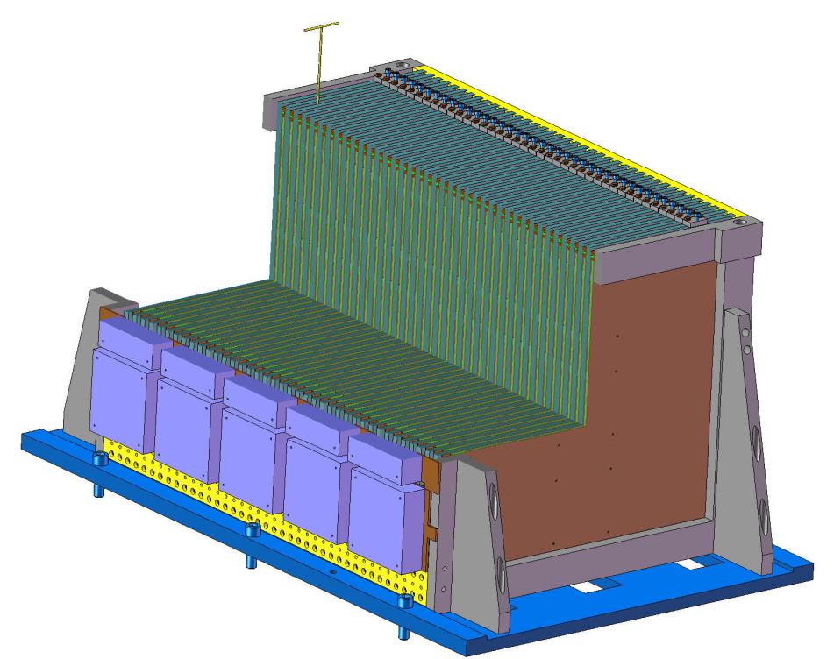
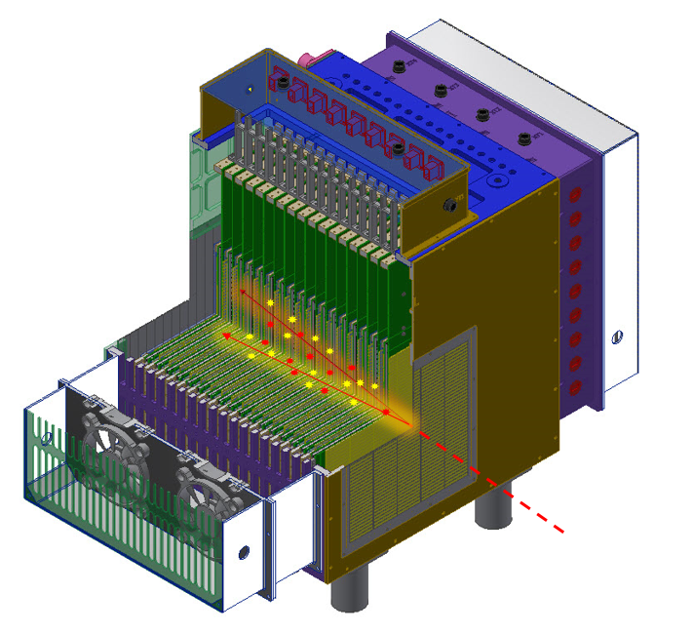
PFA Calorimeter
Sampling Calorimeter
Calo | Sampling No. | Sensitive detector | Absorber | Granularity | Electronics | Absorb length | Energy Resolution | weight
Sci-W ECAL | 32 | PSD+SiPM | W-Cu | 5mm×5mm | SP-2E | 22 X₀ | 16%@ 1 GeV | 0.3 T
AHCAL | 40 | PSD+SiPM | Fe | 40mm×40mm | SP-2E | 4.6 NIL | 60%@ 1 GeV | 5.0 T
hadron
AHCAL
Sci-W ECAL

Slide 4
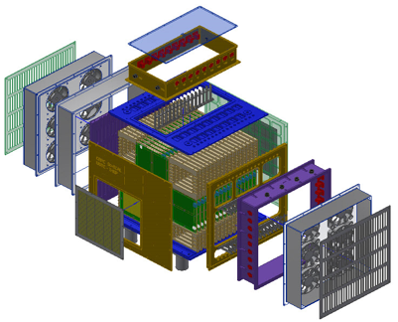
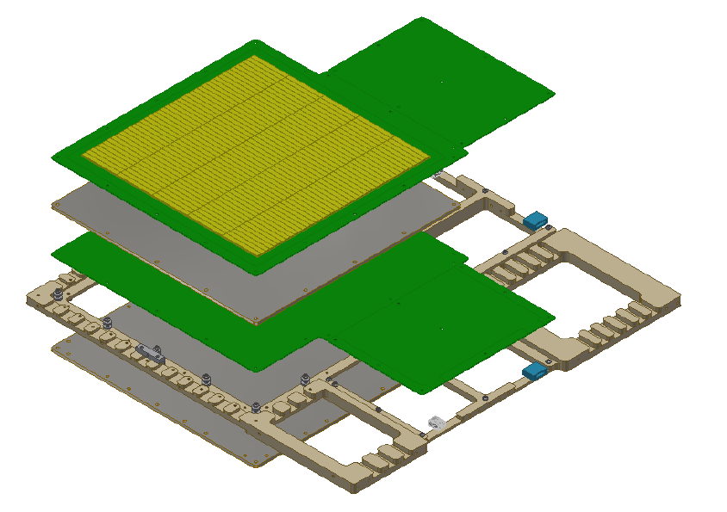
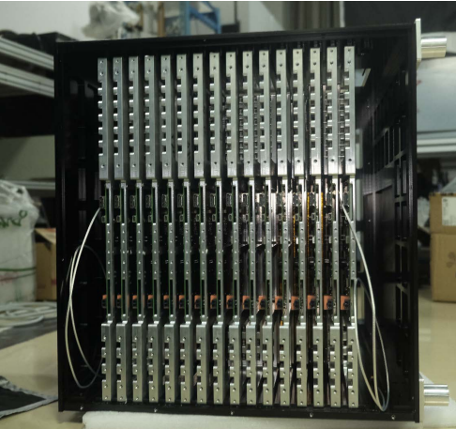
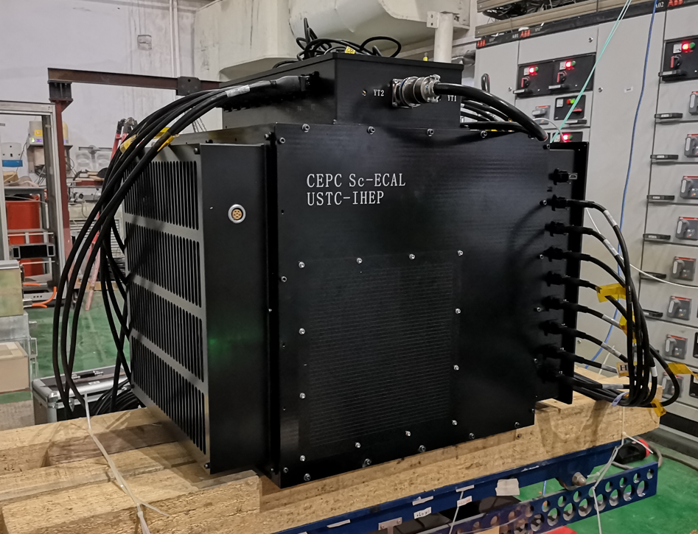
Sci-W ECAL
Sci-W ECAL
  32 layers，16 super-layes
  210 channels of each layer，total channels:6720
  Sensitive area：22cm×22cm

Slide 5
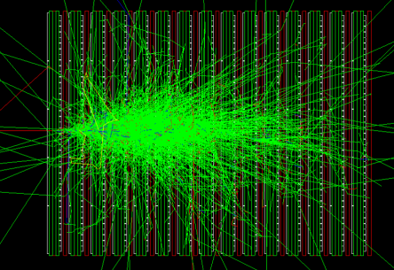
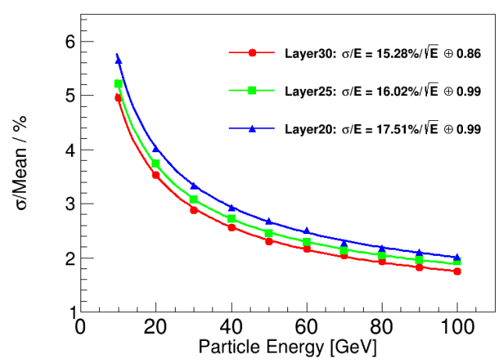
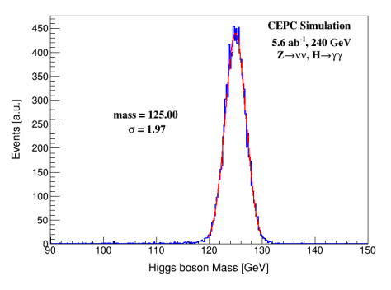
ECAL
能量分辨率16%@1GeV
BMR：1.97% （H->γγ）
BMR

Slide 6
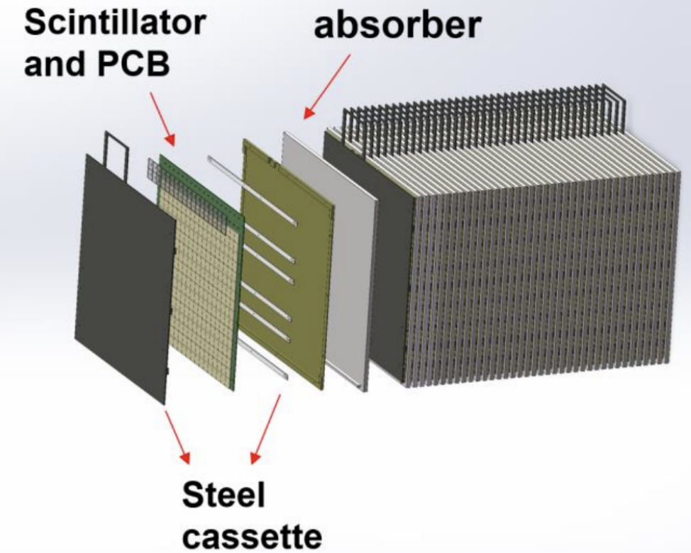
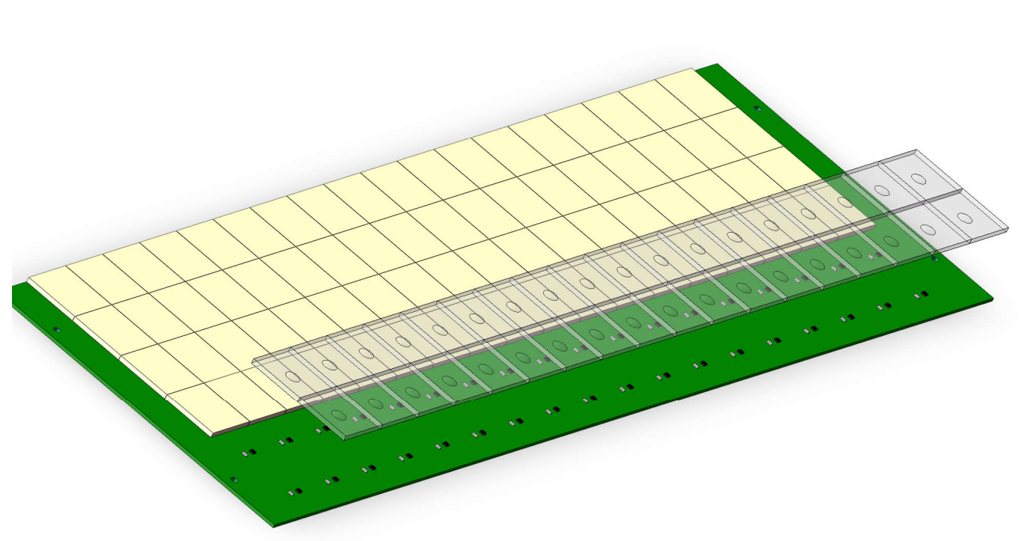
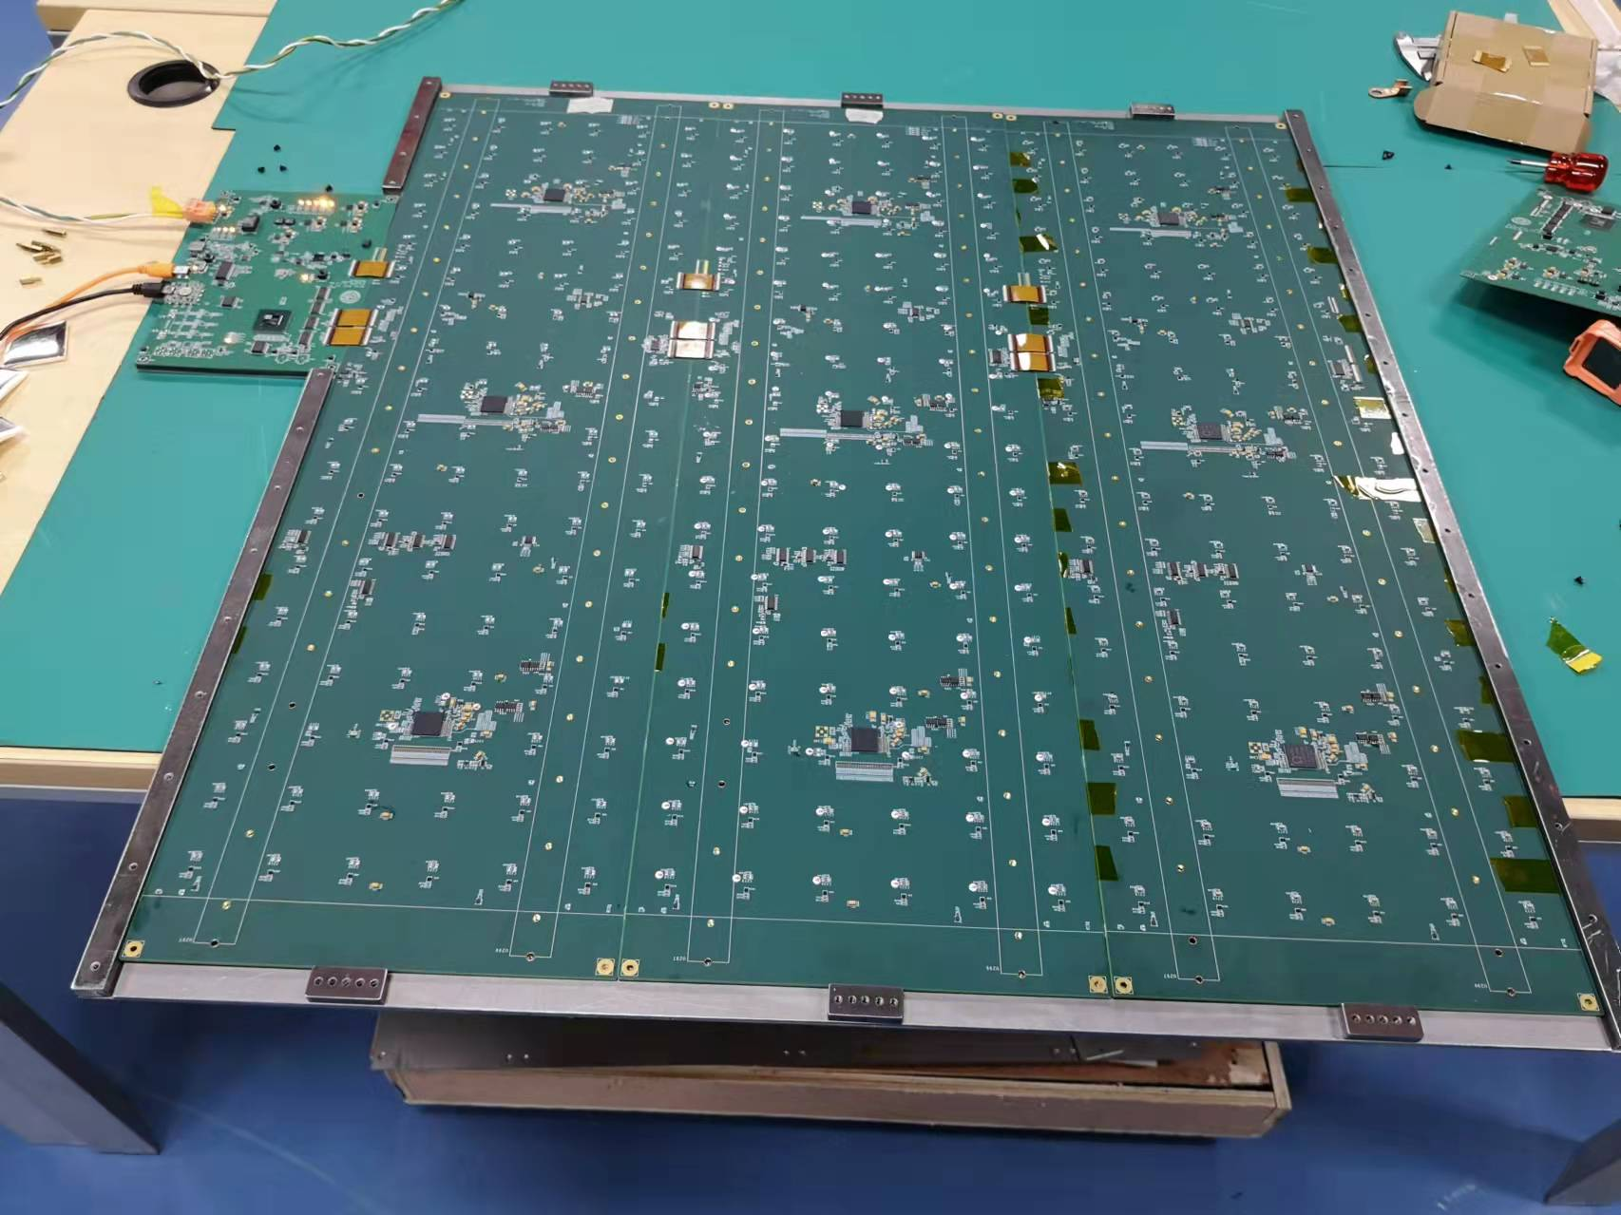
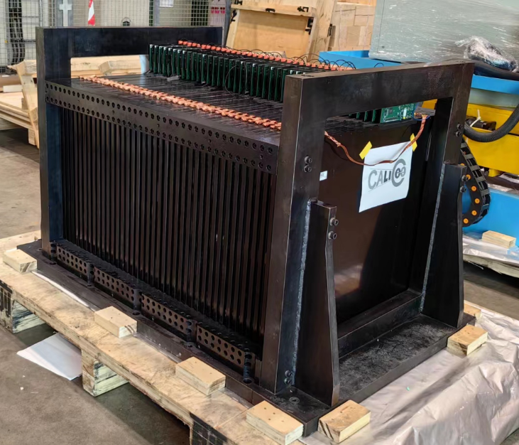
AHCAL
The AHCAL was assembled this summer
  40 sensitive layers, and sensitive area is ~ 72 cm x 72 cm
    Each layer has 324 sensitive cells
    Total number is 12960

Slide 7
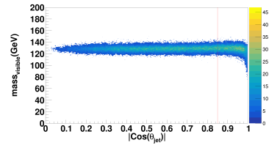
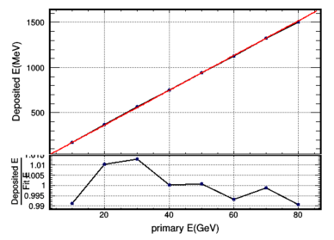
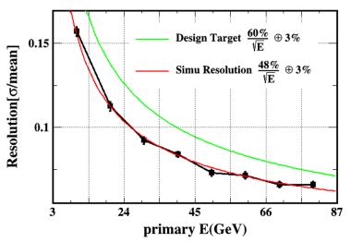
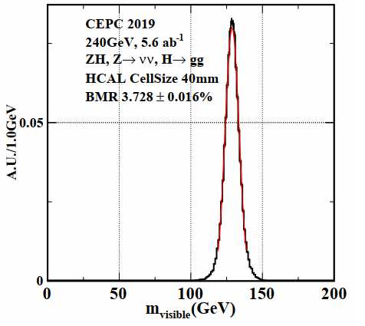
AHCAL
能量线性优于1%
能量分辨率~48%@1 GeV
BMR ~3.7% （H->gg）

Slide 8
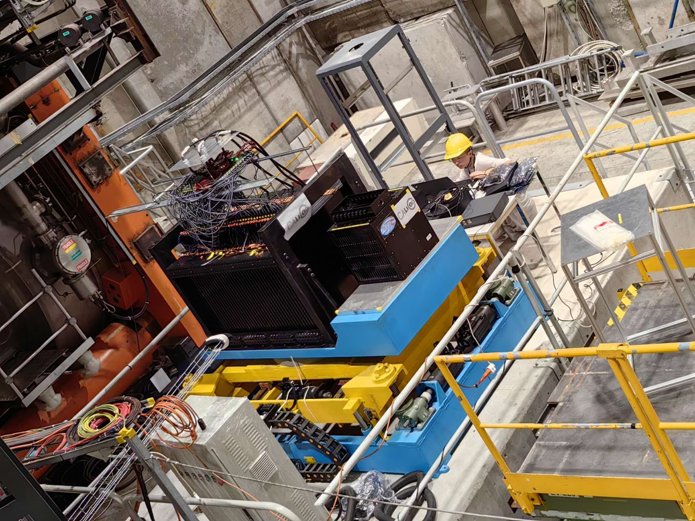
ECAL & AHCAL Beam Test
ECAL
AHCAL

Slide 9
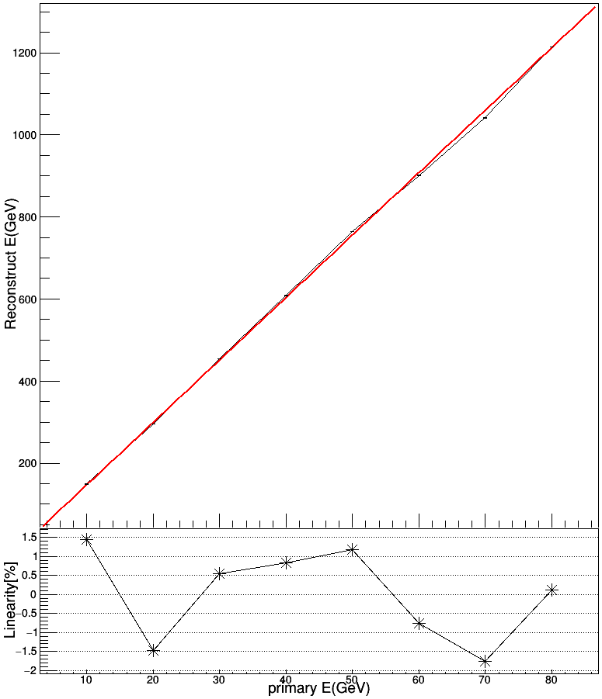
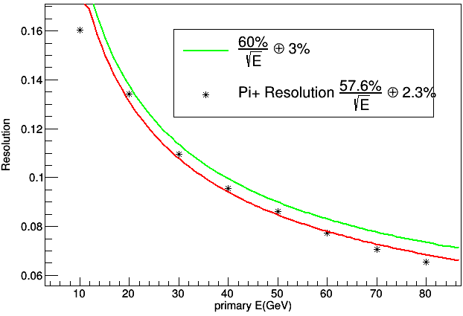
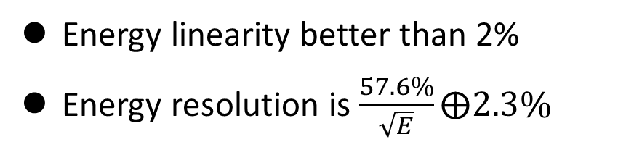
ECAL & AHCAL Beam Test
Energy linearity better than 2%
Energy resolution is $\frac{57.6\%}{\sqrt{E}}⨁2.3\%$
10 – 80 GeV

Slide 10
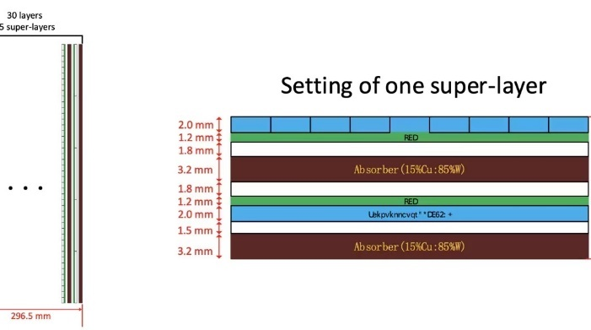
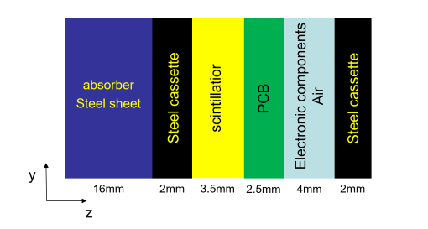
计算依据
ECAL Barrel Inner radius R1 = 1.90m, Outer radius R2 = 2.14m, length L= 6.0m, Nlayers=30 Area of Barrel = 2*PI*[(R1+R2)/2]*L * NLayer = 2284.6 m2
ECAL Endcap Inner radius r1 = 0.35m, Outer radius r2 =2.14m, Nlayers=30 Area of Endcap = 2*PI*(r2*r2 – r1*r1) * NLayer = 840.2 m2
HCAL Barrel Inner radius R1=2.25 m, Outer radius R2=3.69m, length L= 6.7m, Nlayers=48, Area of Barrel = 2*PI*[(R1+R2)/2]*L * NLayer = 6001.4 m2
HCAL Endcap Inner radius r1 = 0.4m, Outer radius r2 =3.69m, Nlayers=48, Area of Endcap = 2*PI*(r2*r2 – r1*r1) * NLayer = 4058.3 m2

Slide 11
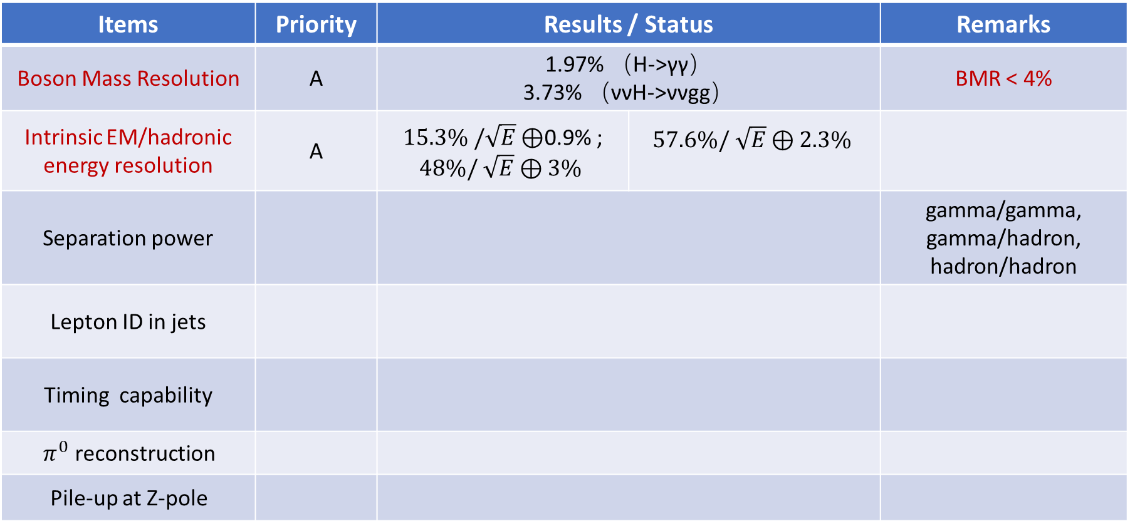
Performance Summary
Items | Priority | Results / Status |  | Remarks
Boson Mass Resolution | A | 1.97% （H->γγ） 3.73% （ννH->ννgg） |  | BMR < 4%
Intrinsic EM/hadronic energy resolution | A | $15.3\% /\sqrt{E}⊕$0.9% ; $48\%/ \sqrt{E}⊕3\%$ | $$57.6\%/ \sqrt{E}⊕2.3\%$$
Separation power |  |  |  | gamma/gamma, gamma/hadron, hadron/hadron
Lepton ID in jets
Timing capability
$π^{0}$ reconstruction
Pile-up at Z-pole
Priority/importance for performance requirements: (A) must-have; (B) plus; (C) not essential

Slide 12
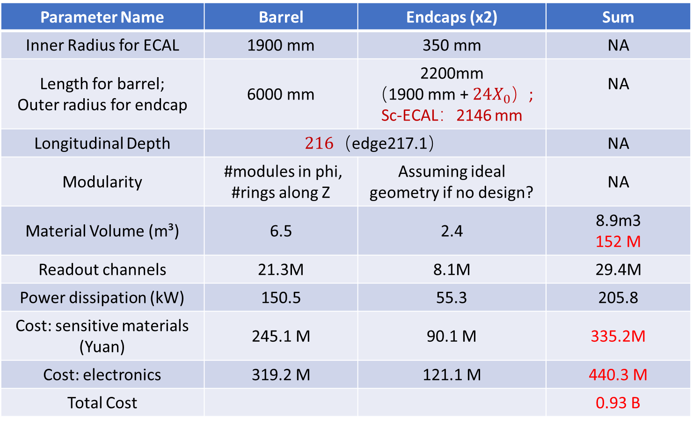
ECAL Cost Summary
Parameter Name | Barrel | Endcaps (x2) | Sum
Inner Radius for ECAL | 1900 mm | 350 mm | NA
Length for barrel; Outer radius for endcap | 6000 mm | 2200mm （1900 mm + $24X_{0}$）; Sc-ECAL：2146 mm | NA
Longitudinal Depth | $216$（edge217.1） |  | NA
Modularity | #modules in phi, #rings along Z | Assuming ideal geometry if no design? | NA
Material Volume (m³) | 6.5 | 2.4 | 8.9m3 152 M
Readout channels | 21.3M | 8.1M | 29.4M
Power dissipation (kW) | 150.5 | 55.3 | 205.8
Cost: sensitive materials (Yuan) | 245.1 M | 90.1 M | 335.2M
Cost: electronics | 319.2 M | 121.1 M | 440.3 M
Total Cost |  |  | 0.93 B
Please also consider to indicate in extra or supporting materials
Unit cost for key components and materials
References for unit cost or estimates
Uncertainty or risks if applicable
闪烁体：3.5元/channel
SiPM: 10 元/片
电子学：15 元/channel
W：123$, 886 元/kg

Slide 13
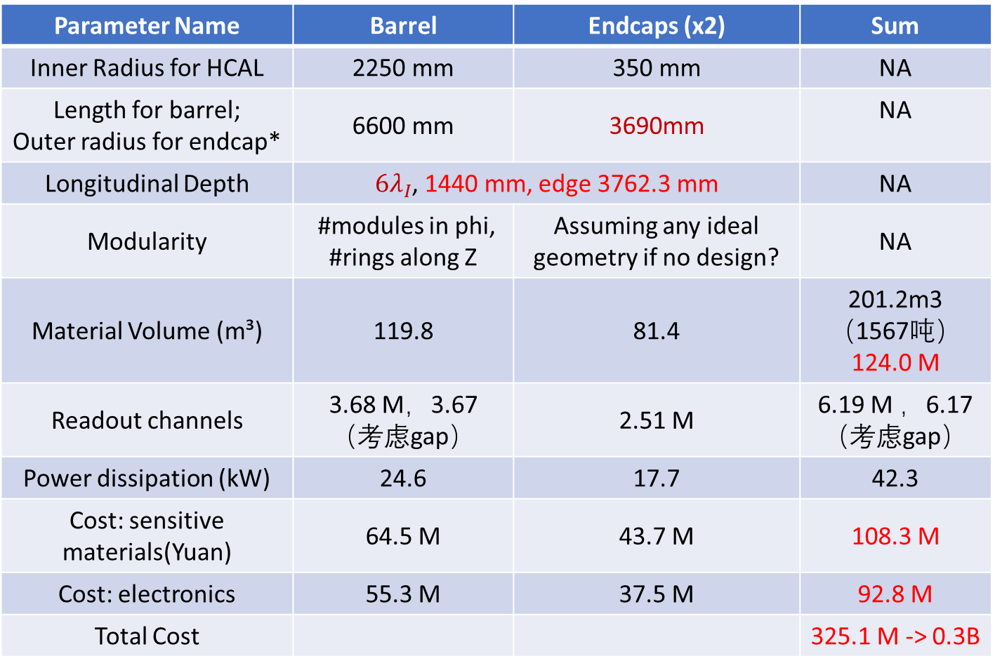
AHCAL Cost Summary
Parameter Name | Barrel | Endcaps (x2) | Sum
Inner Radius for HCAL | 2250 mm | 350 mm | NA
Length for barrel; Outer radius for endcap* | 6600 mm | 3690mm | NA
Longitudinal Depth | $6λ_{I}$, 1440 mm, edge 3762.3 mm |  | NA
Modularity | #modules in phi, #rings along Z | Assuming any ideal geometry if no design? | NA
Material Volume (m³) | 119.8 | 81.4 | 201.2m3 （1567吨） 124.0 M
Readout channels | 3.68 M，3.67（考虑gap） | 2.51 M | 6.19 M ，6.17（考虑gap）
Power dissipation (kW) | 24.6 | 17.7 | 42.3
Cost: sensitive materials(Yuan) | 64.5 M | 43.7 M | 108.3 M
Cost: electronics | 55.3 M | 37.5 M | 92.8 M
Total Cost |  |  | 325.1 M -> 0.3B
* Endcaps encompass barrel
Please also consider to indicate in extra or supporting materials
Unit cost for key components and materials
References for unit cost or estimates
Uncertainty or risks if applicable
闪烁体：7.5元/channel
SiPM: 10元/片
Ele：15元/channel
Fe：7.9万元/吨

Slide 14
Technical readiness level
Status and plans of simulation studies and R&D (a table template)
Person power
Category | Status | Design 1 | Other Alternative Design (if any)
Technical Readiness Level | Full Simulation (system level)
 | Full Simulation (module level)
 | Prototyping R&D (common)
 | Prototyping R&D (modules, units)

Slide 15
ECAL and AHCAL
ECAL (Scintillator + SiPM, Barrel 2323 + Endcap 840 = 3163 m2)
P(inside layer) ~ 3.163^7 (channels) * 7mW/ch(SPIROC) = 221.4 kW (full load)
P(interface) ~ 9W /DIF/m2 * 3163m2 = 28.5 kW
P(total) ~ 250 kW
AHCAL (Scintillator + SiPM, Barrel 5609.2 + Endcap 4045.3 = 9654.5m2)
P(inside layer) ~ 6.0341e6 (channels) * 7mW/ch (SPIROC) = 42.24 kW
P(interface) ~ 9W /DIF/m2 * 9654.5m2 = 86.9 kW
P(total) ~ 129.14 kW

